Slide 1
Measuring Efficiency
HSCRC
Performance Measurement
Workgroup
March 17, 2014
Tom Valuck, MD, JD

Slide 2

Framework for Measuring Efficiency
Definition
Perspectives
Levels of accountability
Types of efficiency measurement
Methodological issues
Phasing

Slide 3
What Is Efficiency?
Patient-centered definition
  Relationship between inputs and outputs
  Efficiency = quality / costs
  Can increase efficiency by increasing quality, decreasing costs, or both; but cheaper is not necessarily more efficient
  To measure efficiency, need both the quality and cost components

Slide 4
Efficiency: The Relationship Between
Cost and Quality
We Need to Be Here
Quality of Care
We Are Here
Cost of Care
Notes:
Maximize; IOM dimensions of quality

Slide 5
What Is Efficiency?
Value and affordability are subjective assessments of efficiency
  Depends on perspective – cost to whom and the quality they receive
    Consumer – sensitive to out-of-pocket costs; otherwise, want the best quality outcome
    Policymaker, serving as purchaser and payer – want to maximize outcome per unit cost
    Hospital – operational efficiency, but need to consider appropriateness
  Example: assessing the value and affordability of a CT scan after head trauma

Slide 6
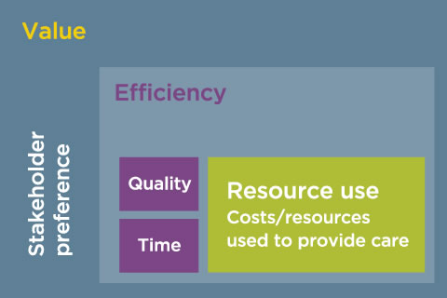


Slide 7
Measuring Efficiency
Levels of accountability – cost and quality
  Service
    unit of service
    for a single patient
    provided by one entity
  Episode
    bundle of services
    for a single or multiple patients
    provided by one or more entities
  Population
    wide range of services
    for multiple individuals
    provided by one or more entities
More population-based

Slide 8
Measuring Efficiency
Cost/resource use component
  Types of measures
    Utilization – counts of services
    Condition- or procedure-specific cost/resource use
    Total cost/resource use – by individual or population
  Price implications – standardized vs. actual costs
  Time period – acute vs. chronic conditions
Quality component
  Multiple dimensions

Slide 9
Measuring Efficiency
Linking measures of cost and quality
  Side-by-side display – aggregate or condition-specific
  Indexing
  Roll-up score with weighting
  Composite measure
More precise relationship

Slide 10
Measuring Efficiency
Measuring inefficiency
  Waste – appropriateness, overuse
  Safety – harm, complications
  Care coordination – readmissions, duplicate tests
  Patient engagement – misalignment with preferences
  Population health – missed prevention or patient education opportunities
  Operational – throughput, staffing, workforce injuries

Slide 11
Measures Related to Efficiency
Cost/resource use examples
  Utilization – counts of services
    Casemix-Adjusted Inpatient Hospital Average Length of Stay, for medical and surgical admissions (United Health Group)
    Intensive Care Unit Length of Stay, observed and risk-adjusted (Lee Institute)
  Condition- or procedure-specific cost/resource use
    Episode Treatment Groups, e.g., hip/knee, pneumonia (Optum)
    CMS draft resource use measures
  Total cost/resource use – individual or population
    Payment-Standardized Medicare Spending per Beneficiary (CMS)
    Total Cost of Care/Resource Use Population-Based PMPM Index (HealthPartners)

Slide 12
Measures Related to Efficiency
Appropriateness/Overuse Examples
  Appropriate Head CT Imaging in Adults with Mild Traumatic Brain Injury (Partners HealthCare)
  Back Pain series, e.g., surgical timing, imaging (NCQA)
  Cardiac Imaging for Preoperative Risk Assessment for Non-Cardiac Low-Risk Surgery (CMS)
  Cardiac Stress Imaging: Routine Testing After Percutaneous Coronary Intervention (ACC)
  Cesarean Section, nulliparous women with term, singleton baby in a vertex position (TJC)
  Prostate Cancer: Avoidance of Overuse of Bone Scan for Staging Low Risk Prostate Cancer Patients (AMA-PCPI)

Slide 13
Measures Related to Efficiency
Index
  NCQA Relative Resource Use (RRU)
    Total annual resource use for diabetes, asthma, COPD, cardiovascular conditions, hypertension, low back pain
    Indexed observed/expected ratio (plan population)
    RRU index and quality index reported together

Slide 14
Measures Related to Efficiency
Roll-up with weighting
  CMS (FY 2015)
    Clinical process of care – 20%
    Patient experience of care – 30%
    Outcome – 30%
    + Efficiency – 20%
    Total Performance Score
  Leapfrog Hospital Recognition Program
    Quality score – 65%
    + Resource use score – 35%
    Value score

Slide 15
Methodological Issues Related to Efficiency Measurement
Similar to issues for other types of measures
  Levels of analysis
  Measurement period
  Exclusions and outliers
  Risk adjustment
  Comparison groups; stratification
  Benchmarking
  Attribution
  Data sources and aggregation
  Meaningfulness and actionability
  Alignment
  Administrative complexity and cost

Slide 16
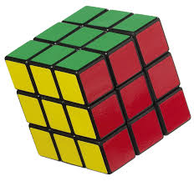
Phasing Options
Begin by:
  Measuring:
    Cost – resources
    Appropriateness
  Reporting measures of cost and clinical quality outcomes side-by-side
Progress to measures of efficiency that roll-up cost and clinical quality or actually measure efficiency as a valid and reliable composite measure
Increasing sophistication

Slide 17
Monitor Other Activities Related to
Efficiency Measurement
CMS program implementation
  Hospital Value-Based Purchasing
  Physician Value-Based Payment Modifier
NQF initiatives
  Endorsement
    Cost and resource use
    Episode grouper evaluation criteria
  Linking cost and clinical quality
  MAP Affordability Family of Measures
Choosing Wisely

Slide 18
Thank You

