Slide 1
PMWG Readmissions Sub-group
04/30/2019

Slide 2
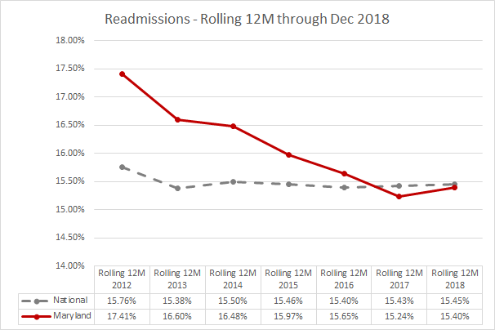
Medicare Waiver Test: At or below National Medicare Readmission Rate by CY 2018
YOU DID IT! CONGRATULATIONS, MARYLAND HOSPITALS!
Data are currently available through December 2018

Slide 3
Agenda
Lit Review (MedPAC, MPR, HQI)
Existing Measure edits
Incl. of Oncology Patients due to Planned Admission logic
Inclusion/Exclusion of AMA Patients
Shrinking Denominator of Eligible Discharges
Status Update:
Benchmarking
Social Determinants of Health (SDOH)
Descriptive analyses of SDOH
Regression Model to quantify additional risk
Non-traditional Measure(s)
Excess Days in Acute Care (EDAC)
Population-based readmission measure

Slide 4
Literature Review and Descriptive Statistics
Notes:
Andi

Slide 5
MPR Literature Review Topic Areas
Readmission correlation with other Quality measures (?)
Per capita or population-based readmission measures: a per capita readmission rate is related to both admission and readmission rates within a geographical area; often used in combination with other types of avoidable admissions.
The relation of readmissions to emergency department (ED) use or observation stays: Most studies found the reduction in readmission rates has been accompanied by decreases in admissions and increases in ED and observation stays (not resulting in admission); other factors besides avoiding readmissions may be driving general increases in use of ED and observation stays.
The significance of different follow-up periods for readmission:
Shorter interval more in hospital control, and longer interval more population focused
High performers on readmits are consistent regardless of interval

Slide 6
MPR Literature Review Topic Areas
Alternative measures of post-discharge health care use:
Measure of ED visits following discharge analogous to readmission rates, reflects the need for post-acute care but is not sensitive to the admitting decision of the ED.
CMS measure- Excess Days in Acute Care (EDAC)
“Home Time” measure challenge- hospitalizations and SNF stays can be beneficial for a patient to subsequently maintain independence
Identifying a target readmission rate: The proportion of readmissions classified as avoidable ranged from 5 to 79 percent; “avoidable” readmissions however can be defined differently depending on whether you want to count those that could have been avoided through better ambulatory care.
Another approach to identify target readmission rate is to consider effectiveness of interventions to reduce readmissions
Notes:
; using this approach it is estimated 20-30 percent of readmissions are preventable.

Slide 7
MedPAC Review of HRRP
1. Trends in HRRP
Raw-After HRRP enacted rate of decline for HF,PN, and AMI fast and statistically significant
Risk Adjusted-Fastest decline rate for HF, not statistically significant for PN and AMI
2. Observation Stays
Increased observation stays from 2011-2013
Readmission rates declined substantially after controlling for growth in observation stays.
Changes in observation stays were similar for post discharge readmissions and those without prior admission
Notes:
1b. Readmission rates for PN and AMI also dropped quickly between 2010-2016 , but difference is not statistically significant across different testing methods.
2a. Only 20-25% of readmissions decline could be accounted for by increase in outpatient observation stays (Medpac report 2016). Repllicate 04/16
2a. Growth in observation stays within 30 days of discharge 22.2%; Growth in observation stays for those w/o prior admission 22.1%
Note: Not aware of literature that has examined the growth in ED visits after introduction of the HRRP. However, other issues have contributed to the increase in ED and observation stays, unclear as to what extent.
RAC-challenged the medical necessity of hospital short stays, which we would expect to increase SOI in IPPS hospitals which is due to MS-DRG coding system
b. higher coding of soi based on msdrg
c. coding incentives of prospective payment system

Slide 8
MedPAC Review of HRRP Cont.
3. Mortality - concern that incentivizing lower readmission rates may correspond with adverse quality impacts
Time trend analysis and correlation analysis revealed raw rates of mortality increased for HF but declined for PN and AMI
Risk adjusted mortality rates declined for all conditions
Notes:
3a. Increase may be due to decline in initial admissions and increase in SOI (combination of in patient and post 30 day)
3b. Evidence suggest that patients admitted in 2016 had higher ROM than 2010

Slide 9
MedPAC Review of HRRP Cont.
4. Social Risk Factors and Readmissions
Hospitals with larger shares of low income medicare patients had higher readmission rates
Hospitals serving lower income patients had worse outcomes after controlling for patient mix
Hospitals with larger levels of low-income patients tended to improve readmission rates faster than other hospitals.
Notes:
3. Individual effects, neighborhood effect, or both. (medicare payment advisory committee 2013).
explain what mix that actually was
give examples of some of the work done that may have contributed to the improved readmission rates faster (i.e, upstream focus, social health investments,...)

Slide 10
Literature Review - Suggested Next Steps
Consider which national trends and studies to replicate with internal (All-Payer) Case-mix data or Medicare data
Data limitations preclude immediate replication of mortality correlation study
Currently working on reviewing trends in ED Visits and Observation stays, acknowledging that both may be appropriate settings of care for re-visits under TCOC model.
Notes:
1.
1. Replicate study using internal inpatient mortality data
2. Replicate time trend analysis comparing 2010-2016 readmission rates as opposed to 2010-2014.
Write out steps for replicating Readmission Rates versus ED/OBS and build plan for how to replicate within Maryland (2012-2016)
3. Model hospital performance against a similar peer group of low income patients using an alternative threshold.
2.
3.

Slide 11
Maryland Statewide Medicare FFS Data
Timeframe: Q4-2015 to Q3-2018

Slide 12
About HQI Data
Medicare Fee-For-Service (FFS) Data
Receive Parts A, B, and D claims on a quarterly basis in three-year timeframes on a 3-6 month delay
Most recent quarters tend to vary from dataset to dataset due to the lag in claims processing
Maryland comparisons to other states and national rates come from the National Coordinating Center (NCC), which are cut from a much larger dataset
Hospital utilization rates are based on our CMS evaluation measures

Slide 13
About HQI Data
Group/Measure | Description
National/US | All Medicare fee-for-service (FFS) beneficiaries residing in any valid ZIP code in the 50 States, District of Columbia, Puerto Rico, the United States (US) Virgin Islands, and outer Pacific islands.
State | All Medicare FFS beneficiaries residing in any valid ZIP code in the state/territory.
Eligible Beneficiaries | Number of Medicare FFS beneficiaries who reside in the ZIP codes associated with the designated grouping.
Admissions | Number of hospitalizations from short-term hospitals, critical access hospitals (CAHs), psychiatric hospitals, and psychiatric units among eligible Medicare FFS beneficiaries who reside in the ZIP codes associated with the designated grouping.
Readmissions | Number of readmissions within 30 days of a hospital discharge among eligible Medicare FFS beneficiaries residing in the ZIP codes associated with the designated grouping. Readmissions and hospital discharges are from short-term hospitals, CAHs, psychiatric hospitals, and psychiatric units.
Emergency Department Visits | Number of ED visits only from short-term hospitals, CAHs, psychiatric hospitals, and psychiatric units among eligible FFS beneficiaries residing in the ZIP codes associated with the designated grouping.
Observation Stays | Number of observation stays only from short-term hospitals, CAHs, psychiatric hospitals, and psychiatric units among eligible FFS beneficiaries residing in the ZIP codes associated with the designated grouping.

Slide 14
YEARLONG SUMMARY
VOLUMES | Maryland | Nation
# Eligible Beneficiaries | 881,565 | 38,095,369
# Admissions | 216,160 | 10,004,195
# Readmissions | 37,899 | 1,794,983
# Discharges | 208,982 | 9,694,493
# ED Visits | 296,003 | 14,635,153
# Observations Stays | 62,021 | 2,075,218
RATES | Maryland | Nation
# Admissions per 1,000 Beneficiaries | 244.53 | 261.89
# Readmissions per 1,000 Beneficiaries | 42.87 | 46.99
# ED Visits per 1,000 Beneficiaries | 334.85 | 383.12
# Observation Stays per 1,000 Beneficiaries | 70.16 | 54.33
% of Live Discharges Readmitted Within 30 Days | 18.14% | 18.52%

Slide 15
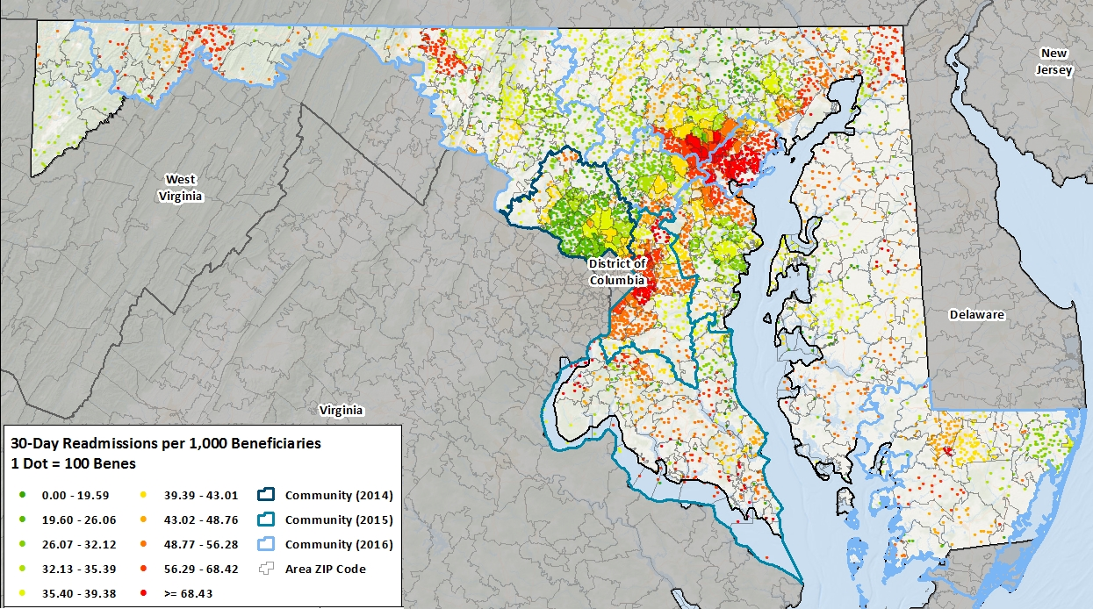
Heat Map of Readmissions per 1,000 Beneficiaries

Slide 16
YEARLONG SUMMARY
% of Medicare Institutional Days Spent by Setting
% of Eligible Medicare Beneficiaries Receiving Vaccinations and Home Health Services

Slide 17
Readmission Rates by Demographics
Beneficiary Sex and Race/Ethnicity
Beneficiary Age Group
 | Discharges | Readmissions | Readm30%
Males | 93,589 | 17,877 | 19.10%
Females | 112,756 | 18,997 | 16.85%
White | 134,798 | 22,476 | 16.67%
Black | 61,238 | 12,657 | 20.67%
Asian | 3,172 | 548 | 17.28%
Hispanic | 1,853 | 336 | 18.13%
 | Discharges | Readmissions | Readm30%
Under 65 | 39,382 | 9,235 | 23.45%
65-69 | 32,218 | 5,405 | 16.78%
70-74 | 35,278 | 5,819 | 16.49%
75-79 | 32,153 | 5,697 | 17.72%
80-84 | 27,017 | 4,489 | 16.62%
85 and Older | 40,298 | 6,229 | 15.46%

Slide 18
Readmission Rates by LOS and DD
Length of Stay (LOS)
Discharge Destination
 | Discharges | Readmissions | Readm30%
1 - 3 days | 94,920 | 13,724 | 14.46%
4 - 7 days | 72,155 | 13,629 | 18.89%
8 - 14 days | 29,313 | 6,828 | 23.29%
15 - 21 days | 6,743 | 1,653 | 24.51%
> 21 days | 3,845 | 1,040 | 27.05%
 | Discharges | Readmissions | Readm30%
HHA | 39,494 | 7,616 | 19.28%
Home | 99,302 | 16,498 | 16.61%
SNF | 45,683 | 8,861 | 19.40%
Hospice | 7,147 | 171 | 2.39%

Slide 19
YEARLONG SUMMARY

Slide 20
Top Discharge DXs Leading to Readmission

Slide 21
QUARTERLY TRENDS

Slide 22
QUARTERLY TRENDS

Slide 23
Contact Information
Carla Thomas
Director of Care Transitions
cthomas@hqi.solutions
Jennifer Cheng
Data Analyst
jcheng@hqi.solutions

Slide 24
This material was prepared by Health Quality Innovators (HQI), the Medicare Quality Innovation Network - Quality Improvement Organization for Maryland and Virginia, under contract with the Centers for Medicare & Medicaid Services (CMS), an agency of the U.S. Department of Health and Human Services. The contents presented do not necessarily reflect CMS policy. HQI|11SOW|20190329-135829

Slide 25
Potential Edits to Existing Measure
Notes:
Andi

Slide 26
Oncology Cases
Currently excluded from RRIP due to historical concerns with planned admission logic
For many cancer patients, readmission following hospitalization may be preventable and should be addressed to potentially lower costs and improve patient outcomes and quality of life.
Measure: 30-Day Unplanned Readmissions for Cancer Patients (Seattle Cancer Care Alliance)
NQF endorsed, ID #3188
Used by CMS in Prospective Payment System-Exempt Cancer Hospital Quality Reporting Program beginning with CY 2019 performance period, FFY 2021 program year.
Considers patients with an admission type of emergency or urgent within 30 days of an index admission as an unplanned readmission.
Excludes patients readmitted for chemotherapy or radiation therapy treatment (defined as a principal diagnosis of chemotherapy or radiation therapy), or with disease progression (using a principal diagnosis of metastatic disease as a proxy)
Staff is considering to include oncology patients moving forward; will request clinical experts to review planned admission logic and if needed have a call to discuss.
Notes:
Read again with context of CMS Planned Admission logic vs. additional cancer-specific measure
Eligible Discharges that are deemed urgent/emergent (see Dianne’s email from Claudine) may include a lot of missing values

Slide 27
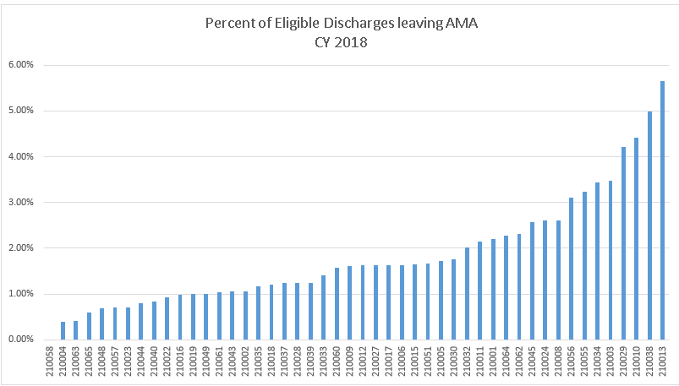
Inclusion of Index Admissions where Patient leaves AMA
Currently included in RRIP and Medicare waiver metric
Considerable variability across hospitals in percent of patients leaving AMA
Decreased readmission rates slightly for all but 5 hospitals; average decrease statewide was 0.15 percentage points with largest decrease being about 0.5 percentage points
Bon Secours
Notes:
in powerpoint mark that Bon Secors highest, and statewide average of 1.59%

Slide 28
Reasons for Leaving AMA
Based on focus group interviews of patients and providers at an academic medical center*, the following reasons for leaving AMA emerged:
drug seeking
pain management
other family or work obligations
wait time
doctor’s bedside manner
teaching-hospital status
communication
Discussion: Should hospitals be held accountable for readmissions when patient leaves AMA?
*Onukwugha. E., et. al. Reasons for discharges against medical advice: a qualitative study. Qual Saf Health Care. 2010 October

Slide 29
Reduction in Eligible Discharges over All-Payer Model
Notes:
Andi

Slide 30
Denominator of Eligible Discharges over time
Eligible Discharges decreased from 538,603 to 472,385 during the All-Payer Model, 2013-2018
By-Hospital Trends
Concurrent SOI trends
Eligible Discharges decreased -4.37%, 2016-2018. Concurrent Expected Readmissions only decreased slightly at -0.20%, suggesting Case-mix increase is acknowledged in the case-mix adjustment.

Slide 31
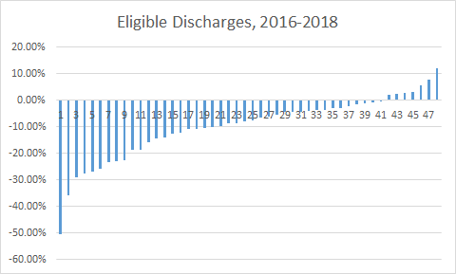
By-Hospital Eligible Discharges over time
Notes:
lead to small hospital discussion - show example hospitals? consider how to designate in future meetings
Note 50% decline is Chestertown
Removed HC-Germantown with extraordinary increase
Sample hospitals due show variation, but lead to questions in ‘sample’ selection

Slide 32
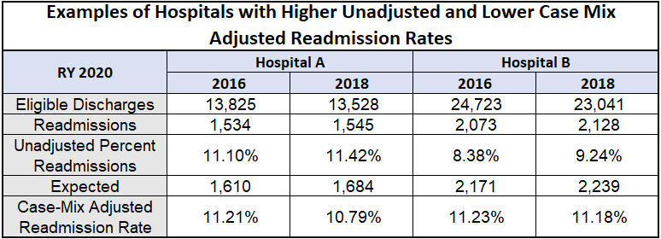
Impact of Case-Mix on Shrinking Denominator Concerns
Case-mix adjusted readmission rate = hospital observed to expected readmissions ratio multiplied by the statewide base readmission rate
Expected and observed readmissions are based on the same denominator, thus the changes in the total admissions are reflected in both the observed and expected numbers.

Slide 33
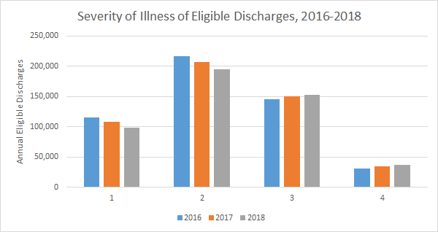
Severity of Illness over time
Notes:
add percentages

Slide 34
Status Update on Priority Issue Areas
Notes:
Andi

Slide 35
Benchmarking - Compare MD to Similar “Peer Groups”

Slide 36
Statewide Readmission Goal: Benchmarking Maryland Performance
Subgroup goal: Consider statewide goal for readmissions (currently National Unadjusted Medicare FFS Average)
1st Step: Compare Maryland performance to benchmark or comparison group
Status: Currently working on several options for benchmarking that we plan to bring to subgroup over next several months.

Slide 37
Potential Medicare Benchmarks
MD vs Nation:
Maryland vs National performance on unadjusted waiver test (Current)
Maryland vs. National performance on CMS Hospital-wide readmission (HWR) measure (risk-adjusted)
MD vs. Peer Group:
MD hospital vs peer groups on CMS HWR measure using MPR Peer Groups
MD and matched counties on per discharge and per capita readmissions
Notes:
Alyson
National Performance:
Existing Measure (Waiver Test)
Other available measure (HWR)
Peer Group Performance:
Peer Group Defined as:
MPR 2016 designation
William MEDA definition
Readmission defined as:
Measure

Slide 38
Potential Commercial/Medicaid Benchmarks
Commercial
Comparison of MD and matched counties on per discharge and per capita readmissions
Medicaid
Within MD comparisons? Differences across MCOs? Other options?
All payer: Should we evaluate performance against the National Inpatient Sample (data lag)?
Notes:
Alyson

Slide 39
Social Determinants of Health (SDOH) and Risk Adjustment

Slide 40
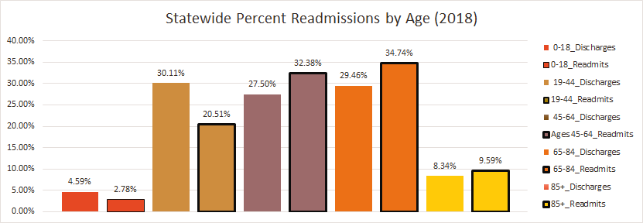
Readmissions by Age Group
Percent Readmissions | Ages 0-18 | Ages 19-44 | Ages 45-64 | Ages 65-84 | Ages 85+
2016 | 7.13% | 8.12% | 13.99% | 14.20% | 13.78%
2017 | 7.70% | 8.47% | 14.09% | 14.03% | 13.53%
2018 | 7.18% | 8.6% | 13.93% | 13.95% | 13.60%

Slide 41
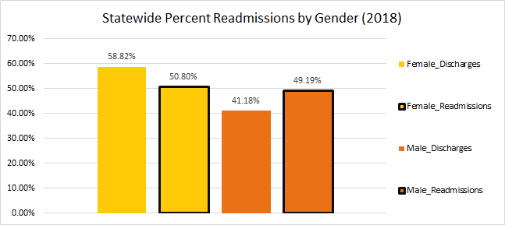
Readmissions by Gender
Percent Readmissions | Female | Male
2016 | 10.40% | 14.14%
2017 | 10.42% | 14.35%
2018 | 10.22% | 14.13%
Notes:
Make font bigger

Slide 42
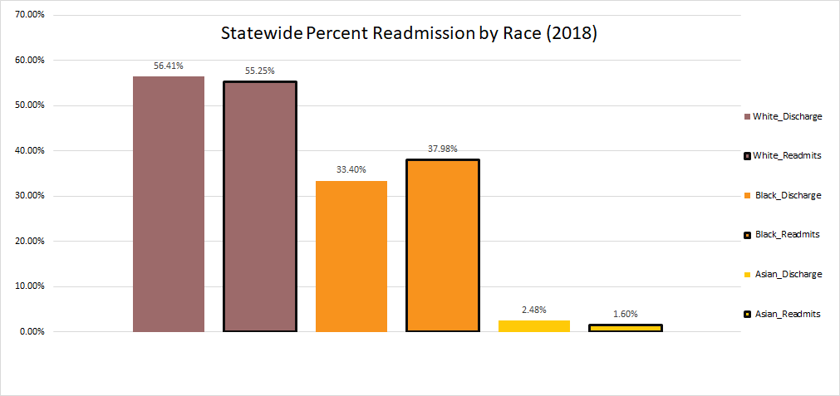
Readmissions by Race Category
Percent Readmissions | White | Black | Asian
2016 | 11.49% | 13.79% | 7.48%
2017 | 11.71% | 13.81% | 7.36%
2018 | 11.59% | 13.46% | 7.62%

Slide 43
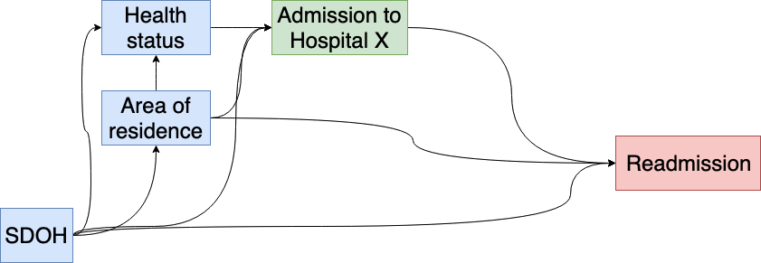
Conceptual model: Readmission and SDOH
Notes:
Social determinants affect the neighborhood you live in, your health status, where you obtain medical care, and your risk of readmission.

Slide 44
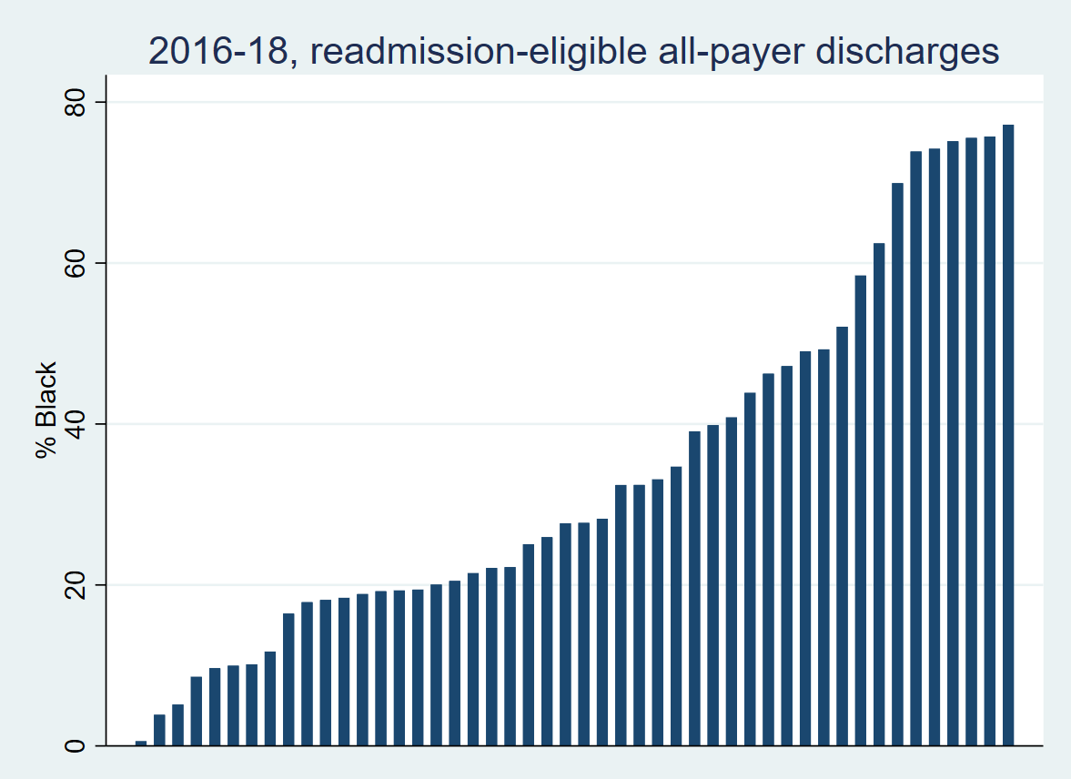
Percentage of black patients, by hospital
Notes:
Discharges with RACE = Black, year of data

Slide 45
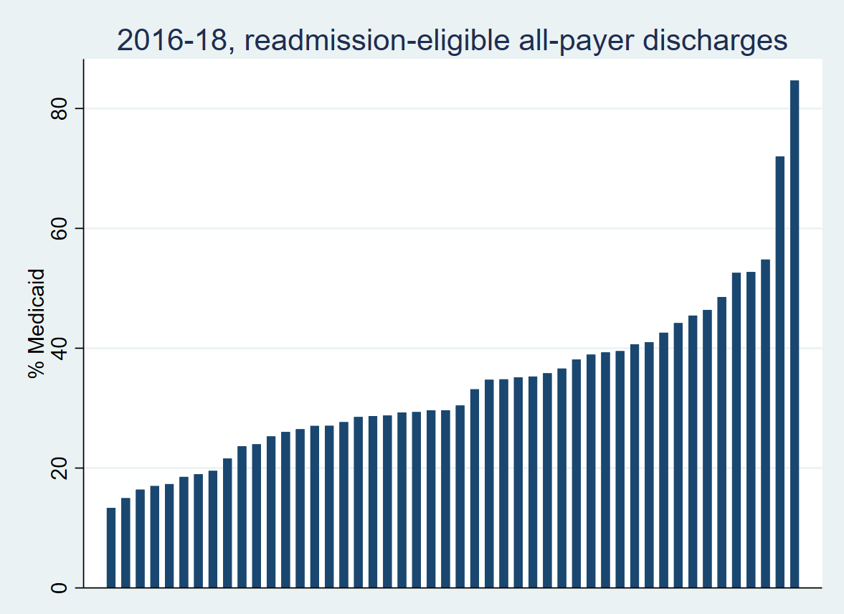
Variation in Medicaid status by hospital
Notes:
Discharges with Medicaid; year for data

Slide 46
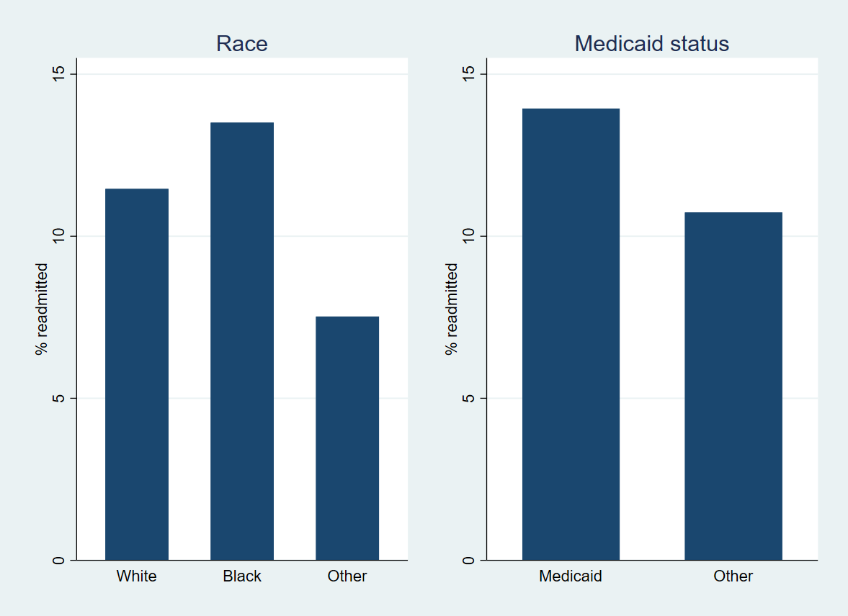
Race, Medicaid, and readmission

Slide 47
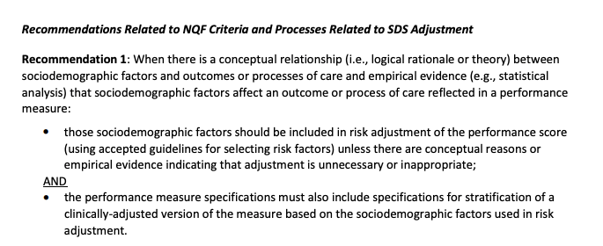
NQF panel recommendation
Notes:
Hospital choice and readmission share a common cause (SDOH). Without adjustment, the readmission O:E will be an inaccurate measure of the readmission risk patients face at a given hospital, and hospitals with SDOH-challenged populations will be inappropriately penalized, which may worsen disparities. Measuring improvement produces an accurate O:E, but leaves open the question of whether a hospital provides equal care to patients of all SDOH levels. We are interested in measuring and eliminating disparities.

Slide 48
Available SDOH metrics
SES/Duals/Medicaid
Race
Area Deprivation Index
Index combining individual/area measures
Z-code (future consideration)
Notes:
Individual SDOH metrics like Medicaid eligibility and race are useful. Measures that reflect the patient’s home environment, such as the Area Deprivation Index, provide information on different social determinants. However, producing hospital disparity measures for multiple social determinants may muddy performance. An index reflecting a number of SDOH components provides a single indicator of disparity.

Slide 49
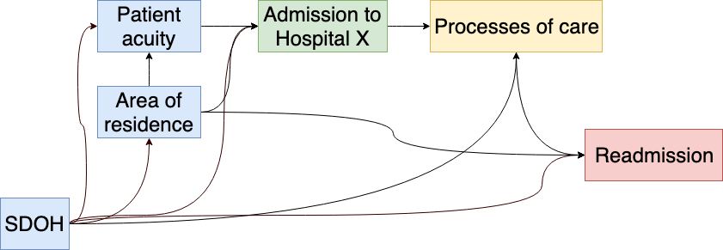
Conceptual model: Readmission and SDOH
Notes:
Blue items represent factors in readmission that are determined prior to admission and are often beyond a hospital’s control. These are dependent on SDOH. However, we also need to understand the effect of SDOH on processes of care, which are under a hospital’s control. When social determinants impact processes of care, this produces disparities. In order to measure the disparity, we need to separate the effect of SDOH into two components. The first accounts for the effect of social determinants on hospital selection and readmission across all hospitals. The second addresses the question of whether a low-SDOH patient at a given hospital faces increased readmission risk as compared to a high-SDOH patient at the same hospital. This is the disparity metric. In other words, this approach separates the effect of the type of patients received by hospital from the effect of the hospital’s treatment of those patients.

Slide 50
Key points
Unadjusted attainment will yield inaccurate comparison between hospitals
Improvement or adjustment by SDOH can conceal disparities
We are working on a modeling approach that provides a hospital-specific disparity measure.
Notes:
Define confounder
Define multi-level model

Slide 51
Non-traditional Readmission Measures

Slide 52
Readmissions: Alternative Measures
RRIP - Currently single measure - All-cause readmission within 30-days; National HRRP has 6 condition-specific measures
Examples of Alternative Readmission Measures (Suggested by Stakeholders)
Per capita readmissions
NOTE Some have suggested Per Capita Admissions as alternative utilization measure
ED or OBS Re-visits
National Condition-Specific Measures
Readmissions within Shorter Window (7 days) or Longer Window (60 days)
eCQM for Readmissions
April SPOTLIGHT: Excess Days in Acute Care

Slide 53
Weighing Alternative Measure Inclusion
Should subgroup consider alternate/additional measures of readmissions?
Pros:
May more holistically assess hospital performance;
May allow Maryland to assess observation stays and ED revisits;
May credit hospitals with better performance on population-based measures
Cons:
Additional measures will make the program more complex;
Similar measures may lead to duplication/overlap

Slide 54
Excess Days in Acute Care (EDAC)
Measure Description:
Captures excess days that a hospital’s patients spent in acute care within 30 days after discharge.
Measures incorporates the full range of post-discharge use of care (emergency department visits, observation stays, and unplanned readmissions).
“Utilization of these services, for any reason, is disruptive to patients and caregivers, costly to the healthcare system, and puts patients at additional risk of hospital-acquired infections and complications.”
Condition Specific 3-year Medicare measure: AMI, HF, Pneumonia (no all-cause available)
Hospital Compare began reporting July 2017 (AMI, HF) & July 2018 (pneumonia)
NQF endorsed; Risk adjusted using all Medicare claims for previous 12 months; non SES adjustment due to concerns on masking disparities
Various exclusions including AMA, planned readmissions

Slide 55
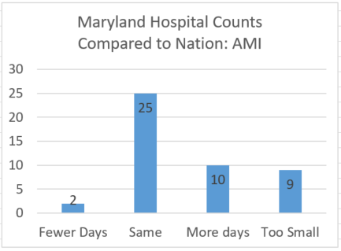
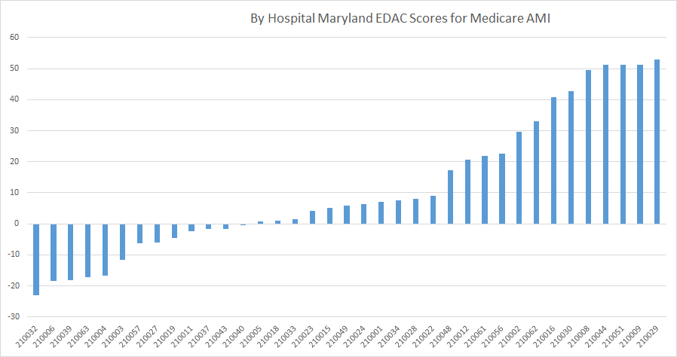
EDAC Results: Heart Attack (7/1/14-6/30/17)
National weighted average: 6.58 excess days per 100 discharges
Maryland weighted average: 8.68 excess days per 100 discharges

Slide 56
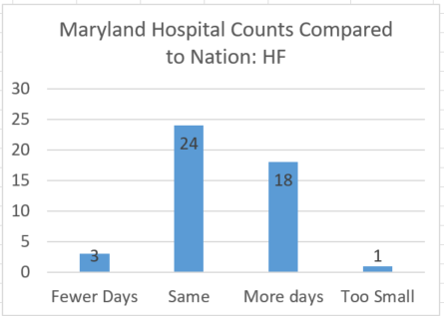
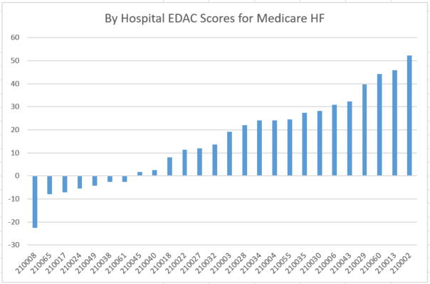
EDAC Results: Heart Failure (7/1/14-6/30/17)
National weighted average: 7.49 excess days per 100 discharges
Maryland weighted average: 17.36 excess days per 100 discharges

Slide 57
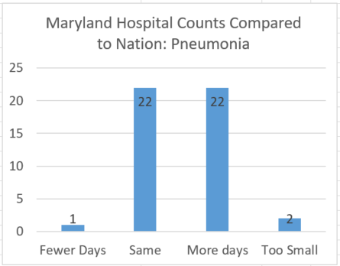
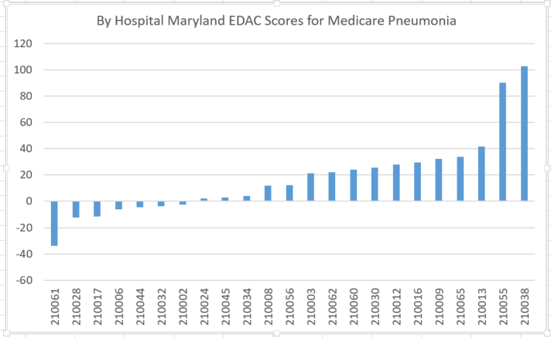
EDAC Results: Pneumonia (7/1/14-6/30/17)
National weighted average: 7.48 excess days per 100 discharges
Maryland weighted average: 12.64 excess days per 100 discharges

Slide 58
Next meeting and conclusion
Next meeting is Tuesday, May 28
Topics may include:
Benchmarking Update
Progress on Potential Risk Adjustment Model
Updates to Statewide Target Methodology/Forecasting
Additional Modeling of non-traditional measures?

