Slide 1
Performance Measurement Workgroup
12/16/2015

Slide 2
Update on CMMI Waiver Target Metric
HSCRC and CMMI have agreed to Version 5 of readmission measure, which includes the following change:
  Exclusion of stays where a psychiatric condition is listed as a primary diagnosis in claims for the index admission or readmission.
  Exclusion of stays where a rehabilitation condition is listed as a primary diagnosis in claims for the index admission or readmission.
  Refining the definition of stays and transfers in the readmissions measures to treat all same-day and next-day claims as continuous stays or transfers, except where:
    The second admission occurs at the same hospital but has a diagnosis code that differs from the index admission;
    The second admission occurs the next day at the same hospital, either with the same or a different diagnosis code.

Slide 3
Comparison V4 and V5
 | National |  |  |  | Maryland
 | Admissions | Readmissions | Readmission Rate | Percentage Point Difference from V4 | Admissions | Readmissions | Readmission Rate | Percentage Point Difference from V4 | Gap between MD and Nation
V4 | 9,184,776 | 1,449,745 | 15.78% |  | 207,550 | 35,449 | 17.08% |  | 1.30%
V5 Proposed (includes transfer adjustments as well) | 9,007,811 | 1,385,896 | 15.39% | -0.39% | 196,369 | 32,618 | 16.61% | -0.47% | 1.22%
V5 Psych Exclusion Only | 9,040,487 | 1,411,002 | 15.61% | -0.17% | 198,620 | 32,912 | 16.57% | -0.51% | 0.96%
V5 Rehab Exclusion Only | 9,176,271 | 1,448,983 | 15.79% | 0.01% | 202,902 | 34,954 | 17.23% | 0.15% | 1.44%

Slide 4
Readmission Reduction Incentive Policy Updated for RY2018

Slide 5
Readmission Measure Changes
Revise Transfer Logic:
  All same and next day admissions (determined by admit and discharge date) are considered a transfer
Modify Planned Admission logic for ICD-10

Slide 6
Projecting National FFS Rates
In support of RRIP Improvement Target Setting
December 16th, 2015
Matthew Sweeney

Slide 7
Overview
Project national Medicare FFS readmission rate
  Provides “goalposts” to assess state’s progress
  Develop FFS improvement targets for state (by year)
  Supports development of all-payer improvement targets
Downward trend in national FFS rate has slowed
  Cumulative reduction CY2011 – 2013: -5.6%
  Cumulative reduction CY2013 – 2015: -0.6%
Apply variety of methods to predict national readmission rate through CY2018
  Develop range of predicted values
  Account for uncertainty inherent in any one projection
Develop FFS improvement targets under various scenarios

Slide 8
Data and Methods
Data:
  Monthly Medicare FFS national rate
  January 2011 to June 2015
  Version V of the measure specifications
Projection models:
  ARIMA and LOESS
    Use historical data to project future readmission rates
    Decompose and model seasonality and trend separately
    Yields projected rate and 95 percent confidence intervals
  Two-year moving average
All methods make similar predictions for rates in CY2016, 2017, and 2018

Slide 9
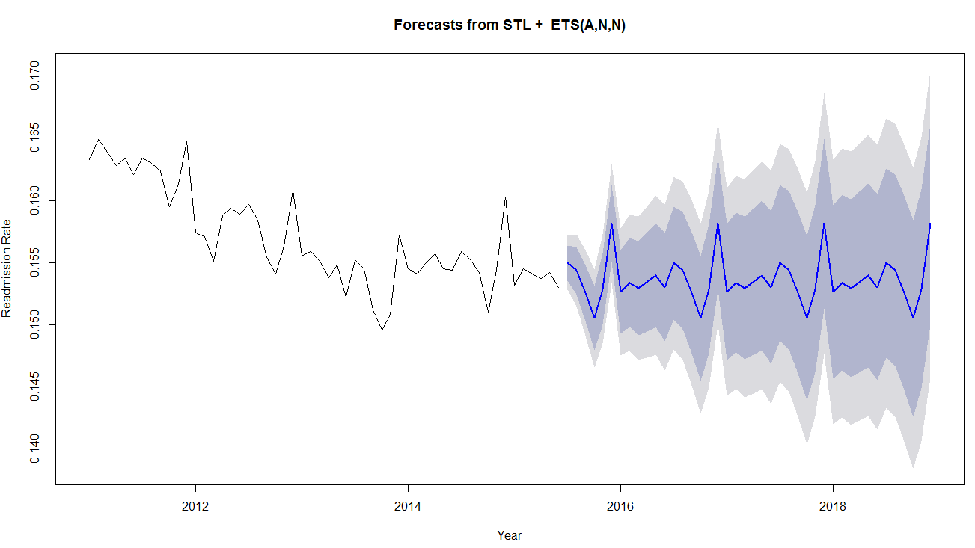
LOESS Projections

Slide 10
Moving Averages

Slide 11
Two-Year Moving Average Projection

Slide 12
Summary of National Projections
Moving average, ARIMA, LOESS all indicate no trend in national rate
  Projected rate is 15.4%
Should we believe it?
  Model projections based on recent lack of trend
  Could pre-2014 reduction re-occur?
Scenario 1: trend remains flat through 2018 (model predictions)
Scenario 2: assume average decrease observed since 2011 will occur in future years

Slide 13
Scenario 2: Assume Average Change Since 2011

Slide 14
Setting FFS Improvement Targets
Inherent uncertainty in projected national rate
Present FFS improvement targets based on three national projection estimates:
  Observed annual change (CY 15 over CY 14)
  Lower bound of statistical projections
    Incorporate uncertainty in projections
  “Scenario 2” (as a ”worst case” scenario)

Slide 15
RY2018 RRIP Rate Targets

Slide 16
FFS Reduction Targets Across Approaches
* Cumulative reductions are calculated over the CY2013 Maryland FFS rate of 16.61%.
** Observed Rate of Change refers to applying observed rate of change in CY2015 (over CY2014) for future years and setting Maryland targets accordingly. The LOESS-Lower Bound approach uses the lower bound of the 95th confidence interval around the predicted CY2018 national rate, and spreads the required cumulative reduction equally over the years. The “Scenario 2” approach assumes a CY2018 national rate that is based on projecting the average improvement observed from 2011 through June 2015 to future time periods.

