Slide 1
“By Report” Methodology Workshop
November 4, 2025
Sophie Okoma – Analyst 1, HDMI Audit & Integrity

Slide 2
AGENDA
Purpose
Standard Definitions
Process for RVU Calculation
Protocol For New or Unlisted Procedures
Reporting By-Report to HSCRC
By-Report Rationale
For Hospital
For the HSCRC
The Importance of By-Report
Q&A

Slide 3
Purpose
To establish a consistent, shared framework for developing Relative Value Unit (RVU) methodologies across all hospitals, ensuring uniformity and comparability. This is achieved by utilizing established, quantifiable weighting systems.
Commission-Approved Weighting Sources The Health Services Cost Review Commission (HSCRC) has approved the use of the following established weights for RVU calculation:
Medicare Physician Fee Schedule (MPFS): The relative value weights assigned to physician services by the Centers for Medicare & Medicaid Services (CMS).
Medicaid Fee Schedules: State-specific weights assigned to procedures under Medicaid programs.

Slide 4
Purpose, Cont.
Solventum: Weights derived from established 3M™ systems, such as All Patient Refined Diagnosis-Related Groups (APR-DRGs).
Adherence to these sources provides a standardized foundation for RVU development. Hospitals should also apply this systematic approach when establishing RVUs for similar or analogous procedures to maintain consistency.

Slide 5
Standard Definitions
A Relative Value Unit (RVU) is a standardized measure used by the HSCRC to quantify the resources consumed in providing a specific medical service. This system ensures a consistent method for valuing procedures across all Maryland hospitals.
Primary Source for RVU Values
The HSCRC mandates that RVUs be based on the Practice Expense (PE) component from the Medicare Physician Fee Schedule (MPFS).
Specifically, hospitals must use the PE value for a non-facility setting (like a doctor's office). This value is chosen because it comprehensively includes the costs of clinical staff, supplies, and equipment, which accurately reflects the hospital's resource use for that service.

Slide 6
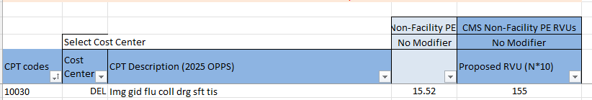
Process for Calculating RVU Values
RVU Assignment Protocol
The starting point is the Non-Facility PE weight proposed by CMS. To maintain whole numbers in Appendix D, multiplying the reported RVUs by 10 and rounded to the nearest integer. For this calculation, values of 0.5 or greater are rounded up

Slide 7
Process for Calculating RVU Values, Cont.
Additional Guidance:
For CPT codes with only a single RVU listed
CPT codes that are considered technical only (such as treatment codes), the single RVU reported will be used
CPT codes considered professional only are not listed in Appendix D
The rationale for RVUs derived using this standard methodology is documented as “MPFS”

Slide 8
Protocol For New or Unlisted Procedures
For new procedures that do not have a pre-assigned RVU (i.e., are not listed in Appendix D of the regulations), hospitals must assign a proxy value using the following "crosswalk" method:
Identify a Similar Procedure: The hospital must find a comparable, pre-existing CPT code that is already listed in Appendix D.
Justify the Match: The selection of the similar code must be based on a reasonable assessment of shared characteristics, including the time required, the supply costs incurred, and the clinical methodology used.
Assign the Value: The RVU of the established, similar procedure is then assigned to the new service. This ensures that new procedures are valued consistently and fairly within the HSCRC system.

Slide 9
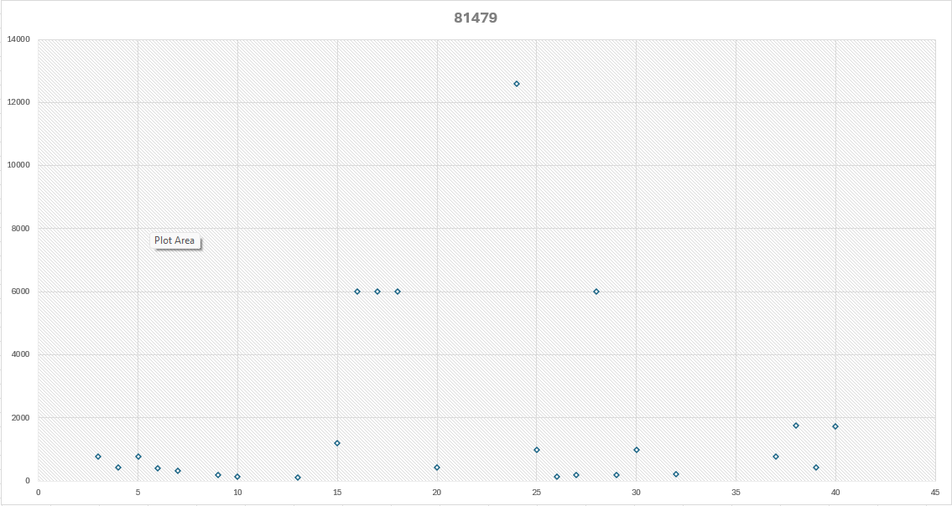
CPT CODE 81479
Displayed are the variances in RVU values across several hospitals
The minimum value of this CPT code is 100, with a max of 12,600.

Slide 10
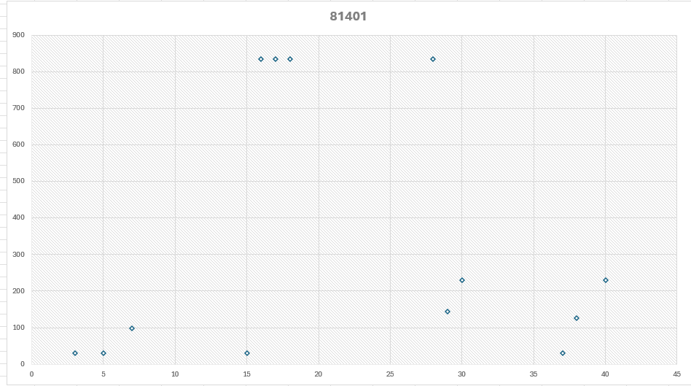
CPT Code 81401
The minimum value of this CPT code is 30, with a max of 835.

Slide 11
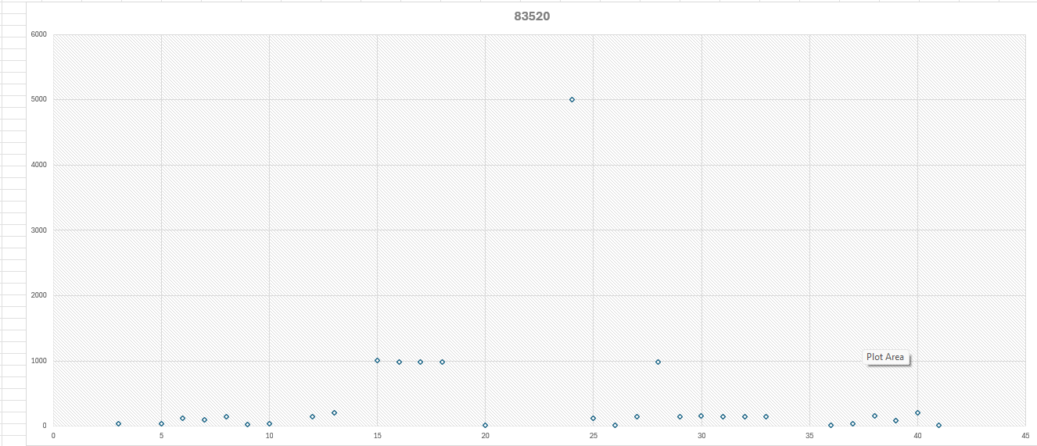
CPT Code 83520
The minimum value of this CPT code is 16, with a max of 5000.

Slide 12
Reporting By-Reports to HSCRC
For Maryland hospitals, reporting "By-Report" (BR) services to the HSCRC involves a specific process for procedures that don't have a pre-assigned Relative Value Unit (RVU). Here's a breakdown of the process:
1. Identifying "By-Report" Services
"By-Report" is used for unlisted, new, or rarely performed services where no specific CPT code or RVU exists in the HSCRC official schedules (like Appendix D of the Accounting and Budget Manual).

Slide 13
Reporting By-Reports to HSCRC
2. Assigning a Temporary RVU
Hospitals must assign a justifiable RVU to the "By-Report" service.
This is typically done by "mirroring" an existing CPT code that requires similar facility resources.
If the "By-Report" service is slightly more or less resource-intensive than the mirrored code, the RVU can be adjusted accordingly. The rationale for this decision should be documented.

Slide 14
Reporting By-Reports to HSCRC, Cont.
3. Submission to HSCRC
Hospitals submit patient-level administrative data (case mix data) on all discharges and outpatient visits to the HSCRC on a quarterly basis.
The assigned RVU for the "By-Report" service is included in this data submission.

Slide 15
Reporting By-Reports to HSCRC, Cont.
4. Audits and Documentation
The HSCRC conducts special audit procedures, which are performed by independent auditors.
During these audits, hospitals are required to submit a list of all procedures for which the units of service were assigned "By-Report."
This list should include the CPT code used, a description of the service, and the assigned RVUs.
It's crucial for hospitals to maintain clear documentation on how they determined the RVU for each "By-Report" service, as this may be reviewed during an audit.

Slide 16
By-Reports Rationale For Hospital
In essence, the "By-Report" mechanism allows for flexibility in billing for new and unusual services while maintaining a standardized reporting structure. The key is to ensure that the assigned RVU is reasonable and based on a comparison to established services with similar resource requirements.
Additionally, reporting "By-Report" is necessary for Maryland hospitals because it provides a crucial mechanism to account for new, rare, or unlisted medical procedures within Maryland's unique rate-setting system.

Slide 17
By-Reports Rationale For Hospital, Cont.
For Hospitals:
Ensures Reimbursement: It allows hospitals to get paid for legitimate services that are too new or uncommon to have a pre-assigned charge and Relative Value Unit (RVU). Without it, there would be no way to bill for innovative procedures.
2. Promotes Innovation: It gives hospitals the flexibility to adopt new medical technologies and procedures without waiting for a lengthy regulatory process to establish a formal rate.

Slide 18
By-Reports Rationale For HSCRC
For the HSCRC:
Maintains Data Integrity: It captures data on emerging procedures, allowing the HSCRC to understand the cost and resources involved. This data is vital for eventually establishing a permanent, standardized rate for the service.
Upholds Rate-Setting Principles: It ensures that all services provided have a justifiable, resource-based value (RVU) tied to them, even if temporary. This prevents arbitrary pricing and aligns with the HSCRC mission of ensuring costs are reasonable and equitable across the state.
Monitors New Technology: It gives the HSCRC visibility into the adoption and cost implications of new medical technology, which is essential for managing statewide healthcare costs effectively.

Slide 19
The Importance of “By-Report
"By-Report" is much more than just a billing category. It's the essential mechanism that allows Maryland's structured, rate-setting system to adapt to the constant evolution of medicine.
It's a Bridge to Innovation 🌉
Allowing hospitals to adopt new life-saving technologies and procedures while ensuring fair payment

Slide 20
The Importance of “By-Report
It Ensures System Integrity 📊
It provides the HSCRC with the critical data needed to analyze new services and eventually establish permanent, standardized rates
It's a Partnership for Progress 🤝
The By Report process requires a partnership between hospitals and the HSCRC, balancing fair reimbursement with regulatory consistency
Essentially, it's the process that keeps our healthcare payment system both stable and forward-thinking.

Slide 21

Additional Questions

