Slide 1
Performance Measurement Workgroup
September 17, 2025
HSCRC Quality Team

Slide 2
Meeting Agenda
Welcome and introductions, webinar housekeeping
IPPS FY 2026 Final Rule Summary
AHEAD Updates and Quality Program Transitions Options
Maryland Quality Performance and Comparison with National Programs
Inpatient Length of Stay Incentive
ED Wait Time Reduction Commission Updates

Slide 3
Workgroup Learning Agreements
Be Present – Make a conscious effort to know who is in the room, become an active listener. Refrain from multitasking and checking emails during meetings.
Call Each Other In As We Call Each Other Out – When challenging ideas or perspectives give feedback respectfully. When being challenged - listen, acknowledge the issue, and respond respectfully.
Recognize the Difference of Intent vs Impact – Be accountable for our words and actions.
Create Space for Multiple Truths – Seek understanding of differences in opinion and respect diverse perspectives.
Notice Power Dynamics – Be aware of how you may unconsciously be using your power and privilege.
Center Learning and Growth – At times, the work will be uncomfortable and challenging. Mistakes and misunderstanding will occur as we work towards a common solution. We are here to learn and grow from each other both individually and collectively.
REMINDER: These workgroup meetings are recorded.

Slide 4
PMWG Invited (i) and Confirmed (c) Members
Carrie | Adams | Meritus (i)
Kelly | Arthur | Qlarant QIO (c)
Ed | Beranek | Johns Hopkins Health System (c)
Zahid | Butt | Medisolv Inc.(c)
Tim | Chizmar | MIEMSS (c)
Linda | Costa | University of Maryland School of Nursing (c)
Ted | Delbridge | MIEMSS (c)
Shannon | Hall | Community Behavioral Health Assoc of Maryland (i)
Theressa | Lee | Maryland Health Care Commission (c)
Staci | Lofton | Families USA (i)
Angela | Maule | Garrett Regional Medical Center (c)
Patsy | Mcneil | Adventist Health (i)
Stephen | Michaels | MedStar Southern Maryland Hospital (c)
Lily | Mitchell | CareFirst (c)
Sharon | Neeley | Maryland Department of Health Medicaid (c)
Christine | Nguyen | Families USA (i)
Jonathan | Patrick | MedStar Health (c)
Nitza | Santiago | Lifebridge Health (c)
Dale | Schumacher | MedChi, Maryland State Medical Society (i)
Ed | Sefarian | Johns Hopkins Health System (c)
Madeleine "Maddy" | Shea | Health Management Associates (c)
Mike | Sokolow | University of Maryland Medical Systems(c)
Geetika "Geeta" | Sood | JHU SOM,Division of Infectious Diseases (c)
Bruce | VanDerver | Maryland Physicians Care (c)
Jamie | White | Frederick Health (i)
Amanda | Wright | Maryland Hospital Association (c)

Slide 5
Inpatient Prospective Payment System FY 2026
Final Rule

Slide 6
Hospital Value Based Purchasing Updates
Removed Health Equity Adjustment (HEA) starting FY 2026.
Modifications to the THA-TKA Complication and Stroke mortality measure:
  Add Medicare Advantage patients to the current cohort of patients and shorten the performance period from 3 years to 2 years, effective FY 2027.
  CMS is also making technical updates to the risk adjustment methodology to use International Classification of Diseases (ICD)-10 codes instead of Hierarchical Condition Categories (HCCs); modifications adopted, effective FY 2033.
Remove the COVID-19 exclusion and discontinue the covariate for prior COVID-19 history across all six Clinical Care measures (THA/TKA Complications and five condition-specific mortality measures), effective FY 2027.
Updated Performance standards published for FY 2027–FY 2031.
Extraordinary Circumstances Exception (ECE) policy codified/clarified.:
  Reduced filing deadline from 90 to 60-days
  Discretion to grant extensions as well as exceptions.

Slide 7
Hospital-Acquired Conditions and Hospital Readmissions Reduction Program Updates
Hospital-Acquired Condition Reduction Program (HACRP) final policy changes:
CDC NHSN HAI “rebaseline” adopted. CMS gives notice that CDC’s switch to 2022 standard population data for SIR calculations will flow into HACRP. Because HACRP uses a 2-year performance period, the new baseline first affects HACRP in FY 2028 (performance CY2025–CY2026).
ECE policy codified/clarified (shared approach across programs).
Hospital Readmissions Reduction Program (HRRP) final policy changes:
Medicare Advantage (MA) patients were added to all six HRRP measures’ cohorts.
The performance period was reduced from 3 years to 2 years.
COVID-19 exclusions removed from HRRP readmission measures.
MA payment amounts not included in the aggregate payments for excess readmissions calculation.
ECE policy codified/clarified (shared approach across programs).

Slide 8
Hospital Inpatient Quality Reporting and Digital Measures Updates
Hospital Inpatient Quality Reporting (IQR) Program
CMS removed the following four measures starting in FY 2026 (CY 2024 performance period):
Hospital Commitment to Health Equity
COVID-19 Vaccination Coverage Among Healthcare Personnel
Screening for Social Drivers of Health
Screen Positive Rate for Social Drivers of Health
Digital Measures
CMS is moving to FHIR-based eCQMs by converting current eCQMs (authored using the QDM) to eCQMs authored using the HL7 FHIR® Quality Improvement Core (QI-Core) IG and ensuring new eCQMs are also natively developed in FHIR.
CMS will add the following two new eCQMs focused on Hospital Harm for FY 2028 (CY 2026 performance):
Hospital Harm – Falls with Injury eCQM
Hospital Harm – Postoperative Respiratory Failure eCQM
CMS signaled these Hospital Harm eCQMs will likely replace conventional Patient Safety Indicators (PSI) in the future.

Slide 9
AHEAD Updates
Notes:
Good morning, Thank you Dianne for that overview. Now more than ever, we need to be following the IPPS proposed and final rules to understand and provide comment on the CMS quality programs given that under AHEAD, MD hospitals will be under the national quality programs for Medicare.
And that brings us to our next topic, which I know is on many hospital representatives minds, which is the upcoming transition from the TCOC model, which will end this year, and the start of the AHEAD model.
Over this next section, I will walk you through the updates we have on AHEAD. However, before we start, I just want to make clear that what we are presenting is based on discussions with CMMI and could change in the actual State agreement, and there are many questions and details that we know hospitals and ither stakeholders are anxuous to understand that are not able to be answered at this time and may not even be able to be answered definitely even once we have a revised State agreement. So I will walk through these slides, and take questions, but please know we are interested in understanding your questions but most likely will not have an answer for you. However, we are trying to be as transparent as we can with what we do know, and we are going to be needing this workgroup to help us over the coming months and years, as we navigate through this transition. And while right now there are a lot of questions, I just want to remind people that the HSCRC has been setting hospital rates since the last 1970s and has faced challenges and transitions before, and the way we have gotten through those challenges and transitions has been by collaborating with stakeholder and our federal partners. And so to make it through this next transition we are going to need your help and the help other stakeholders to provide input on how we can best use our unique hospital global budget system, even with the upcoming changes to how those global budgets will be administered, to ensure Marylanders have access to, affordability/high quality hospital care.
So I am going to dive right in, and because this is new, I am going to ask that I get through the first three slides before I pause for questions.

Slide 10
AHEAD Updates and Transition Timeline
CMS and Maryland have been renegotiating the AHEAD Model to reflect new federal priorities.
  The State and CMMI have already agreed to a terms sheet. The federal government would like the State Agreement and Participation Agreements to be signed in October for a January 2026 start.
CMS will set Medicare FFS global budgets starting in 2028.
  Performance Year 1 (2026) and PY2 (2027) will be a transition period where the State will continue to set all-payer Hospital Global Budgets.
  In order to smooth the transition, the State will be able to re-direct a portion of the total Medicare global budget amount between PY3 (2028) and PY5 (2030).
The State will continue to set non-Medicare FFS global budgets.
Savings target of $460M in additional Medicare FFS savings must be achieved in PY1 (2026) – PY7 (2032), with no additional savings expected in the final three PYs (through 2035).
Notes:
SO first, to unsure we are all on the same page, I just want to remind you that in November of last year MD signed a State agreement for the AHEAD model, however under the new administration, CMS and MD have been reneg…..
Currently, we have a terms sheet that we have agreed to, but we expect to get a new state agreement any day now, and our expectation is that the SA and hospital PA (something that will be new under ahead( will be signed in October….
Under the new SA, CMS will…..
However there will be a transition period, between 2026 and 2028 where the State will continue to set all-payer Hospital Global Budgets. After that, CMMI will administer the Medicare FFS HGB and the State will manage non-Medicare FFS globa budgets. However from 2028 through 2030, the State will be able to redistribute a portion of the HGB in a revenue neutral manner …..
The …..Savings target of $460M in additional Medicare FFS savings must be achieved in PY1 (2026) – PY7 (2032), with no additional savings expected in the final three PYs (through 2035).

Slide 11
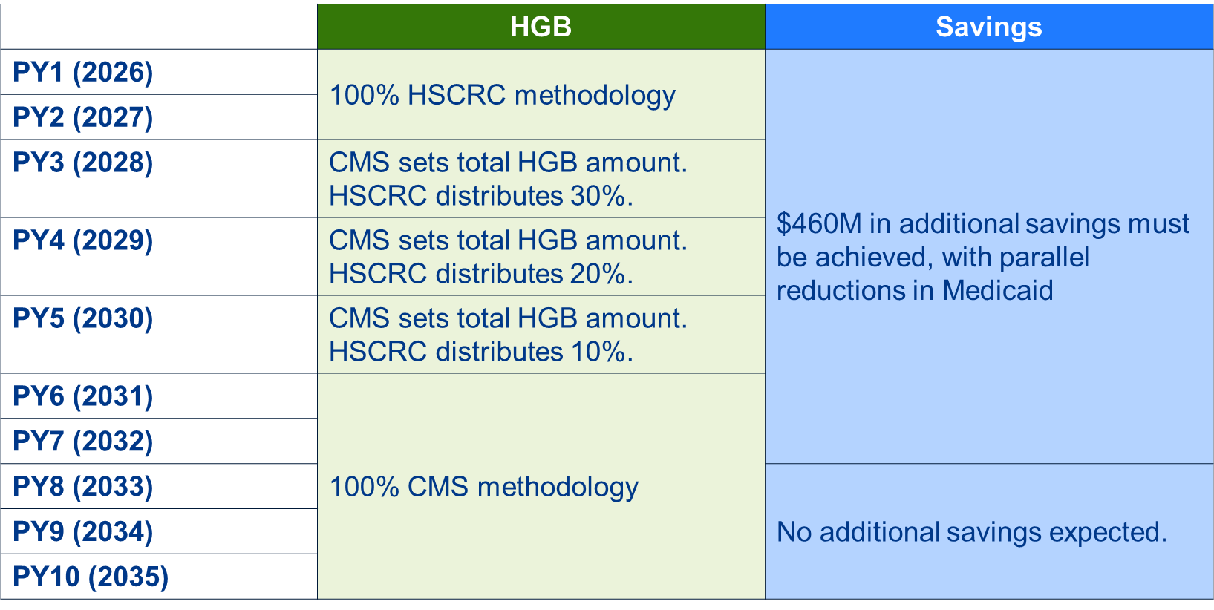
AHEAD Updates and Transition Timeline (continued)
Notes:
So here I am showing the timeline for transition of the MEdicare FFS…… So again you can see….

Slide 12
AHEAD Negotiation Updates: Further Details
Further global budget detail
Other terms
  The State and CMS will continue to discuss HGB methodology details throughout 2026. CMS has already indicated several areas where their approach may be different in MD (e.g., baseline revenue), considering MD’s unique experience/history.
  Quality program will largely follow the national approach for Medicare FFS in 2028.
  Non-Medicare payers will remain under HSCRC jurisdiction.
  Specific details on operational and policy transition will be developed in conjunction with stakeholders.
  EQIP will continue as-is through 2027. Beginning in 2028, EQIP will transition to operate under the CMS-designed HGB.
  MDPCP will continue as-is through 2028. In 2028, CMS and the state would evaluate the future of MDPCP. Any changes would be in effect for 2029-2034.
  The All-Payer TCOC and Primary Care Investment target requirements carry over into this Agreement.
  If savings accrue beyond Medicare FFS TCOC target, they would be returned to global budgets
Notes:
These are some of the other terms that we expect to be in the SA, such as EQIP ….and while I cannot answer questions on many of these, the major change for quality will be…..
So I will stop here now to ask questions on non-quality areas, before continuing to discuss what we know about quality….

Slide 13
AHEAD Population Health Accountability
The Statewide Population Health Accountability Plan (formerly Statewide Quality and Health Equity Targets) maintains the five required and one of two optional domains.
The goals of the Statewide PHAP are to:
  Clearly articulate the State or Sub-State Region's health needs and population health focus areas,
  Build a common agenda of initiatives with actionable, evidence-based strategies across specific domains,
  Specify metrics and data sources for measurement of progress toward defined Statewide Quality and Population Health Targets,
  Establish a strategy for continuous communication with model participants and community partners, and
  Memorialize these goals and document the state's commitments to improved health outcomes and population health strategies to ensure the maximum collective impact of the work of dedicated partners.
Submission is due by 10/15/2025.

Slide 14
Hospital Quality Programs
Terms sheet indicates MD hospitals will be under Medicare quality programs during transition period
Negotiating with CMMI and awaiting State Agreement for additional details
MHA and HSCRC have outlined two potential options for transition:
  Option 1: Later Transition
    Maintain All-Payer Quality Programs for CY 2026 performance and RY/FY2028 revenue adjustments
  Option 2: Earlier Transition
    Move to National programs for CY 2026 performance
    Develop non-Medicare programs for CY 2026 performance

Slide 15

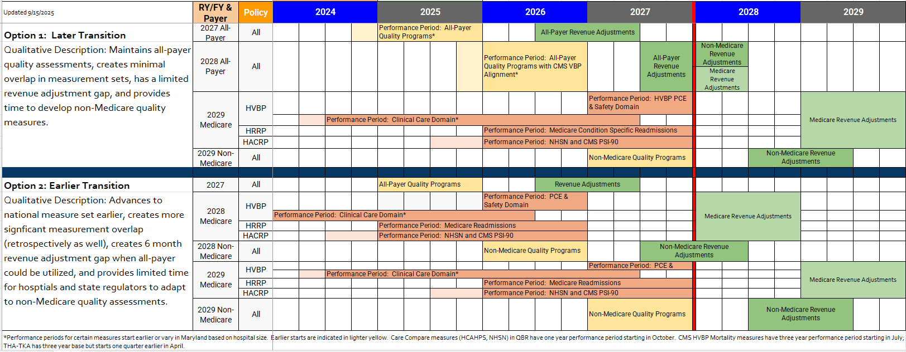
Option Timelines

Slide 16
Maryland Quality Performance and Comparison
with National Programs

Slide 17
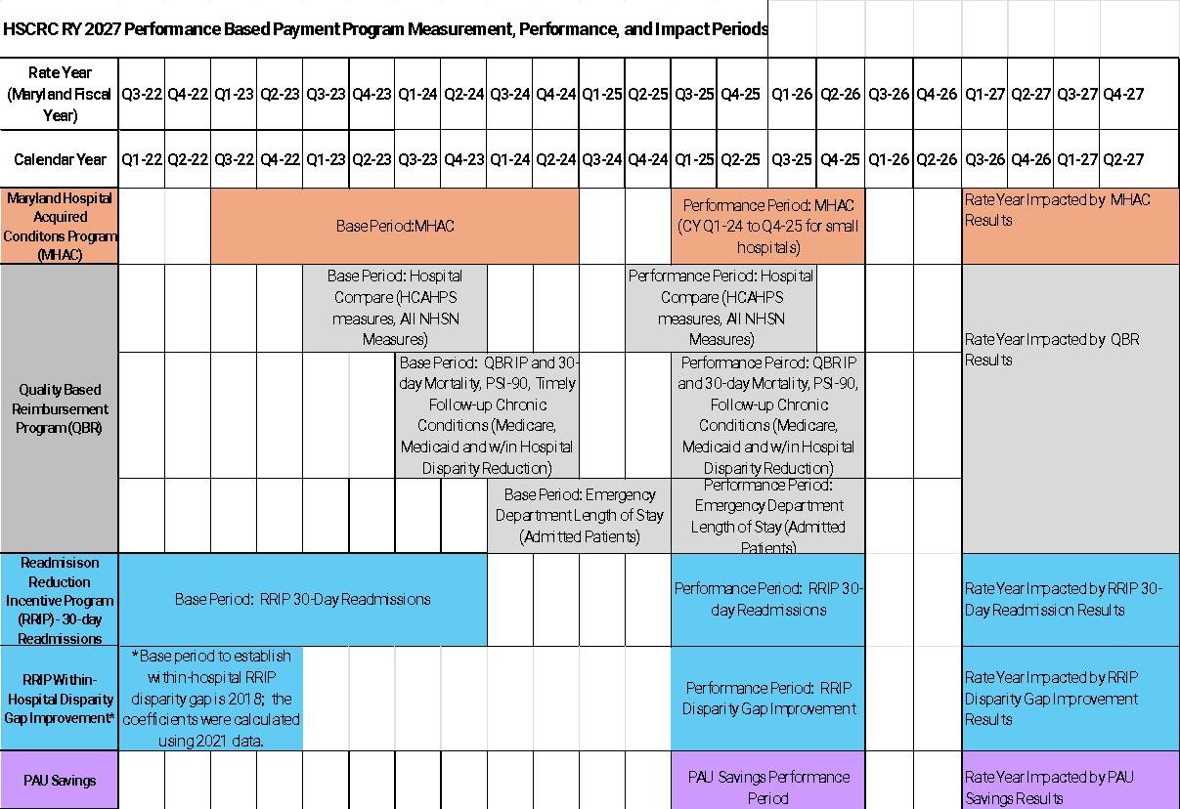
RY 2027 Quality Program Timelines

Slide 18
QBR & VBP

Slide 19
QBR-HVBP Program Comparison
Domain | Maryland QBR domain weights and measures, RY 2027 | CMS HVBP domain weights and measures, FFY 2027
Clinical Care | 10 percent Two measures: all-cause, all-condition inpatient mortality; all-cause, all-condition 30-day mortality | 25 percent Six measures: Five 30-day condition- specific mortality measures; THA/TKA complications
Person and Community Engagement | 60 percent Eight measures: Six HCAHPS categories top box score and consistency, and three categories linear score; TFU Medicare, Medicaid, equality gap improvement; ED LOS. | 25 percent Six HCAHPS measures top box score and consistency (2027)
Safety | 30 percent Six measures: Five CDC NHSN HAI measure categories; all-payer PSI 90 | 25 percent Six measures: Five CDC NHSN HAI measures; Sep-1 Sepsis Management bundle
Efficiency | N/A | 25 percent One measure: Medicare spending per beneficiary

Slide 20
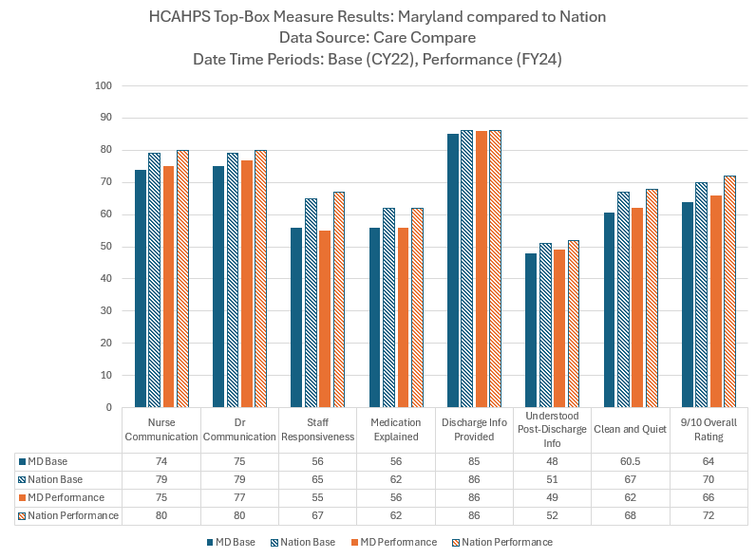
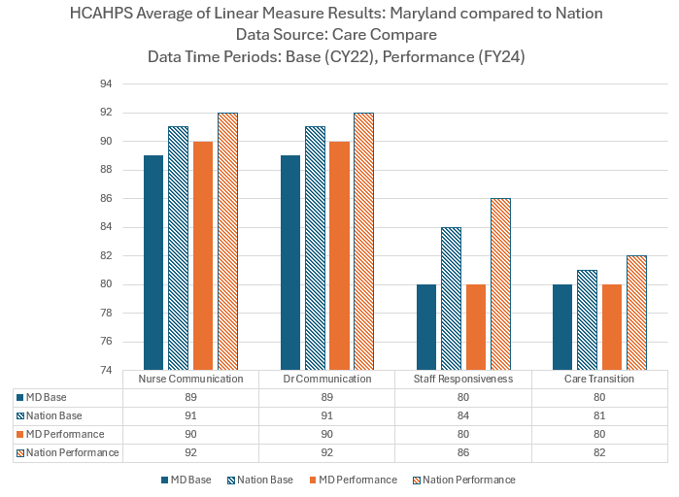
QBR HCAHPS
Both the nation and Maryland improved overall on top box scores, but Maryland continues to lag behind the nation for all categories except those related to discharge information.
Maryland improved on two of four linear measures and the nation improved on all four measures.

Slide 21
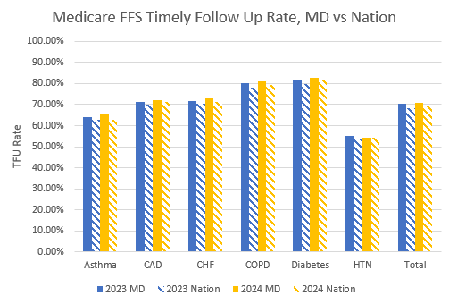
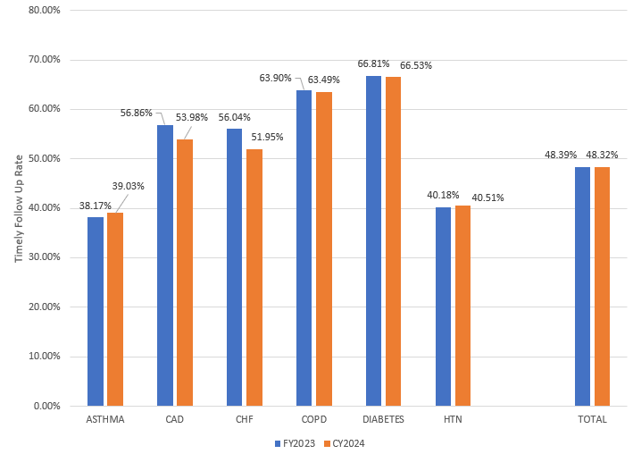
QBR Timely Follow Up
Maryland performs better than the nation on each of the six chronic conditions and overall, but is unchanged in 2023 and 2024.
Medicaid TFU in Maryland is Unchanged
Overall from FY 2023 to CY 2024

Slide 22
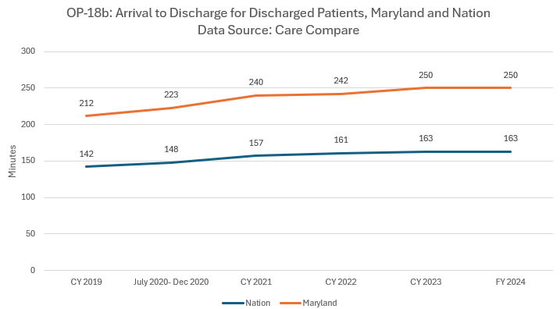
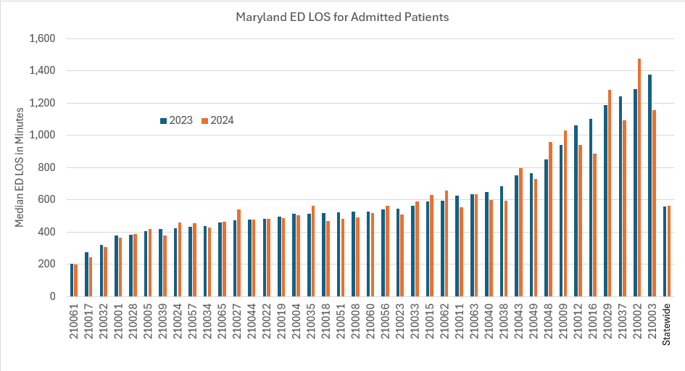
QBR ED Length of Stay
Maryland continues to have wait times ~90 minutes longer than the nation on average for discharged patients.
Based on RY2026 ED LOS measure developed by the Commission, statewide Maryland continues to have prolonged wait times of ~500+ minutes for admitted patients and is unchanged from 2023 to 2024.

Slide 23
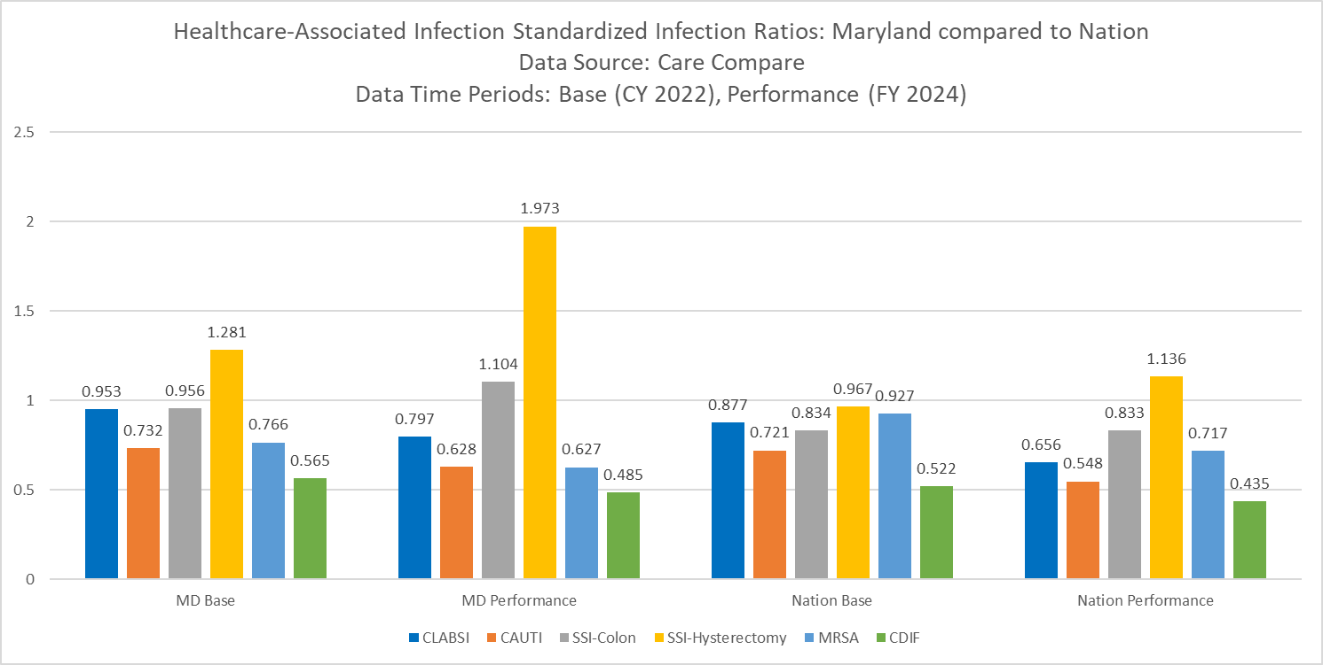
QBR CDC NHSN HAIs
Maryland’s SIRs for all HAIs are higher in the base and performance periods,
The differences from 2022-2023 are not statistically significant.
Maryland Changes in state-specific standardized infection ratios (SIRs) between 2022 and 2023 for NHSN Acute Care Hospitals
 | 2022 SIR | 2023 SIR | Percent Change | Direction of Change, Based on Statistical Significance | p-value
CLABSI | 0.946 | 0.848 | -10% | No statistically significant change | 0.1189
CAUTI | 0.753 | 0.763 | 1% | No statistically significant change | 0.8575
SSI Colon | 0.861 | 0.890 | 3% | No statistically Significant change | 0.8944
SSI Hysterectomy | 1.185 | 1.515 | 28% | No statistically significant change | 0.2771
MRSA | 0.767 | 0.571 | -26% | Statistically significant decrease | 0.0165
CDIF | 0.570 | 0.500 | -12% | Statistically significant decrease | 0.0060

Slide 24
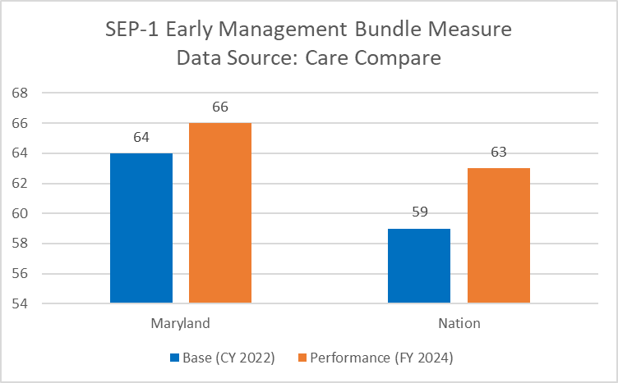
QBR Sepsis Bundle and All-Payer
AHRQ PSIs
Maryland performs better than the nation on the Sepsis bundle
On the all-payer PSI 90 Composite measure in the QBR program, Maryland continues to improve and perform better than the nation on the overall composite measure and the majority of the 10 component indicators.
PSI Name | Maryland 2024 Compared to the Nation 2024 | Maryland 2024 Compared to Maryland 2023
PSI 90 Composite | Better | Improved
PSI 3 Pressure Ulcer | Worse | Improved
PSI 6-Iatrogenic pneumothorax | Better | Improved
PSI 8 In Hospital Fall and Fracture | Better | Worse
PSI 9 Perioperative Hemorrhage or Hematoma | Better | Improved
PSI 10 Postoperative Acute Kidney Injury w/Dialysis | Better | Worse
PSI 11 Postoperative Respiratory Failure | Better | Improved
PSI 12 Postoperative Pulmonary Embolism or DVT | Better | Improved
PSI 13 Postoperative Sepsis Rate | Better | Improved
PSI 14 Postoperative Wound Dehiscence | Better | Worse
PSI 15 Abdominopelvic Accidental Puncture or Lac | Worse | Improved

Slide 25
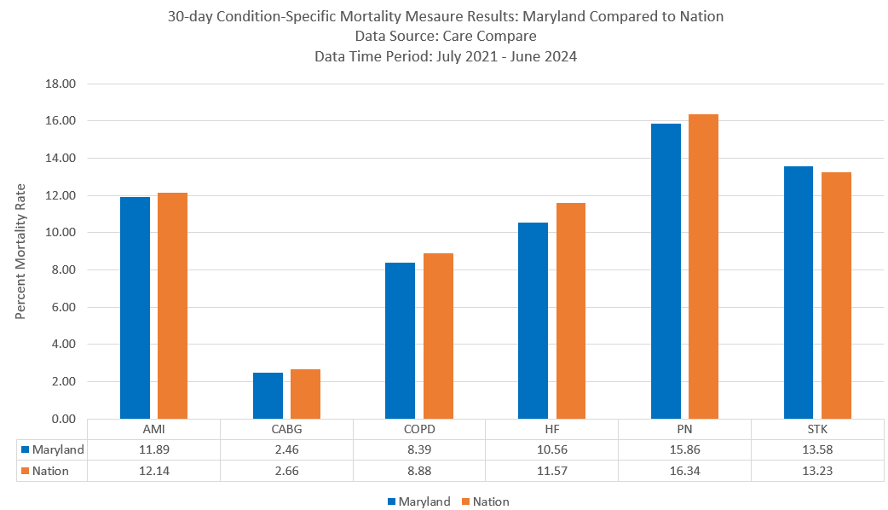
QBR IP and 30-Day and VBP Condition Specific Mortality
Inpatient Mortality: Statewide survival rate increased from 95.27 percent in the base period of SFY 2023 to 95.66 percent in the CY 2024 performance period.
30-Day Mortality: In CY 2024, survival rates range from ~96 percent to ~97 percent with 24 hospitals improving and six hospitals declining compared to SFY 2023; the statewide average survival rate improved by 0.10 percent.
Medicare 30-Day, Condition Specific Mortality: Maryland performed better than the nation on all condition specific measures.

Slide 26
Revenue Adjustments and Performance Recap
Final RY 2025 revenue adjustment results:
24 hospitals were penalized and 17 hospitals received a reward; statewide net penalties amount is ~$33 million across the 24 hospitals that were penalized while the 17 hospitals earning a reward will receive a total of ~$11M.
HCAHPS- Maryland continues to lag the nation.
Sepsis- Maryland continues to both improve over time and perform better than the nation on the SEP-1 bundle process measure and on other sepsis-related measures including PSI 13 Postoperative Sepsis.
Patient Safety Indicators- On the all-payer PSI 90 Composite measure in the QBR program, Maryland continues to improve and perform better than the nation on the overall composite measure and the majority of the 10 component indicators.
Timely Follow Up- Maryland continues to both improve over time and perform better than the nation in timely follow up after acute exacerbation of six chronic conditions for Medicare patients.
Mortality- Maryland continues to improve over time on the all-payer, all-conditions inpatient and 30-day QBR mortality measures used in the QBR program (applicable to broader patient populations than the CMS HVBP measure), and performs similarly to the nation on the Medicare 30-day condition specific HVBP mortality measures.
CDC NHSN HAI Measures- Between CY 2022 and CY 2023, Maryland improved on two measures and did not worsen on the remaining four measures based on the CDC’s annual analysis of statistically significant changes of performance on the measures.

Slide 27
MHAC & HACRP

Slide 28
Hospital Acquired Conditions Reduction Program
Maryland Hospital Acquired Conditions
Composite of 16 clinically significant potentially preventable complications
SIRs for six CDC NHSN HAIs
CMS PSI 90
Measures
Adjusts hospitals’ global budgets based on performance
The benchmark and threshold values set by APR DRG SOI at top and bottom 20th percentile values in the two year base period
Maximum reward and penalty is 2%
Revenue
Adjustment
Adjusts all Medicare FFS MS-DRG payments based on performance
Penalty-only program of 1% for the bottom quartile of performers
Provides hospitals with annual reports; rolling 12-month measure performance updated quarterly
            Allows hospitals to submit questions and request corrections during 30-day Review and Correction Period
Provides hospitals with monthly, quarterly and annual reports
Allows hospitals to submit questions and request corrections to measure logic prior to implementation of revenue adjustments
Reporting
Timelines

Slide 29
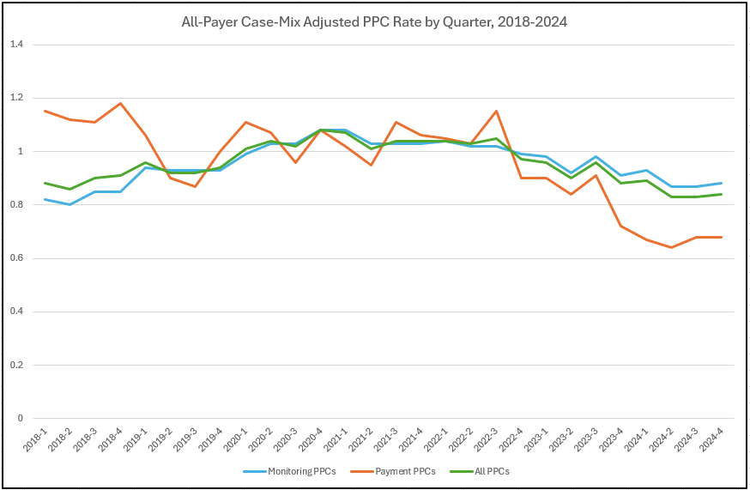
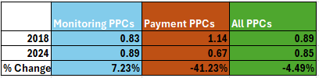
MHAC Potentially Preventable Complications
RY 2026 Results PPC Grouper Version 41 |  | CY 2018 | CY 2019 | CY 2020 | CY 2021 | CY 2022 | CY 2023 | CY 2024 | CY18-CY24 % Change
Total # of PPCs | Medicare FFS | 1863 | 1478 | 1390 | 1310 | 1229 | 994 | 806 | -57%
 | All-Payer | 3408 | 2799 | 2708 | 2807 | 2723 | 2350 | 1933 | -43%
Case-mix Adjusted Rate | Medicare FFS | 1.4220 | 1.1810 | 1.3224 | 1.2361 | 1.2005 | 0.9422 | 0.7598 | -46.57%
 | All-Payer | 1.2133 | 1.0176 | 1.1238 | 1.1008 | 1.0948 | 0.8959 | 0.7128 | -41.25%
The statewide O/E ratio went from 1.14 in 2018 to 0.67 in CY 2024, a 41 percent decrease.
In the RY 2026 MHAC program there were 33 percent fewer complications or approximately 950 fewer complications than would have been expected if the State had performed similarly to the RY 2026 base period.

Slide 30
RY 2026 Revenue Adjustments and Performance Recap
Revenue adjustments:
  RY 2026: 25 hospitals received scaled rewards for a total of about $47M, 5 hospitals received penalties for a total of about -$8M, resulting in the statewide net total of about $39M.
Comparing 2018 and 2024, hospitals have achieved a 41.25 percent and a 46.57 percent reduction in the all-payer and Medicare FFS case-mix adjusted complications rates, respectively.
In CY 2024, across the 15 clinically significant complications included in the RY 2026 MHAC program all PPCs had a decrease from the previous year, and there were 33 percent fewer complications or approximately 950 fewer complications than expected.
For PPC 35 Septicemia and Severe Infections Maryland has had a 42 percent reduction in for this PPC per 1000 in 2024 when compared with 2018, constituting a rate reduction of 1.25 to 0.68 per 1,000 admissions.

Slide 31
RRIP & HRRP

Slide 32
Hospital Readmissions Reduction Program (HRRP)
Readmission Reduction Incentive Program (RRIP)
Measures performance in all-payer, all-cause unplanned 30-day readmissions
Predetermined base and performance period to calculate improvement rates
Readmission rates are adjusted for severity of illness and out-of-state ratios
Measures readmissions across hospitals in Maryland
Excludes planned readmissions using Medicare logic & Maryland-specific adjustments¹
Measures performance on 6 condition or procedure-specific unplanned 30-day readmissions
Hospitals are assessed relative to the peer group median Excess Readmission Ratio
Rolling 2-year Performance Period that is updated annually (due to inclusion of MA data)
Excludes planned readmissions
Measures
Adjusts hospitals’ global budgets based on performance
Maximum reward and penalty is 2%
Reduces and rewards hospitals’ global budgets based on preset scale
Hospitals are assessed on the better of improvement or attainment
Adjusts all Medicare FFS MS-DRG payments based on performance
Penalty-only program; scaled penalty up to 3%
Revenue
Adjustment
Provides hospitals with monthly and annual reports
Allows hospitals to submit questions and request corrections to measure logic prior to implementation of revenue adjustments
Provides hospitals with annual reports
            Allows hospitals to submit questions and request corrections during 30-day Review and Correction Period
Reporting
Timelines
    1. Childbirth deliveries and rehabilitation are planned admissions. Bone marrow transplants and liquid tumor patients are not eligible to have an unplanned readmission or count as an unplanned readmission.

Slide 33
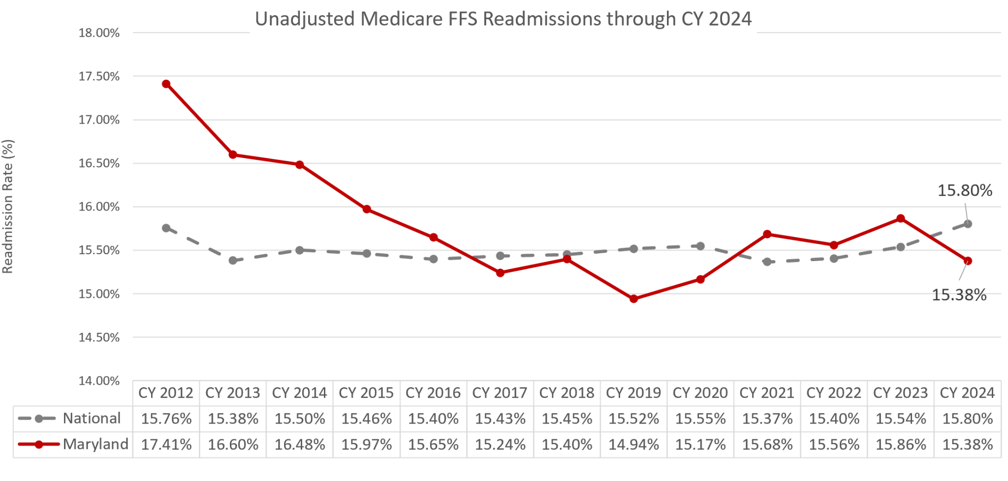
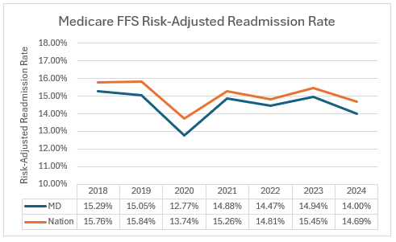
Readmissions
In CY 2024, Maryland met the model requirement of maintaining an unadjusted readmission rate lower than the Nation; MD’s rate was 15.38 percent while the nation saw a readmission rate of 15.80 percent.
Beginning with CY 2023 performance, CMMI has agreed to use a risk-adjusted hospital wide readmission (HWR) measure modified to Maryland Model. Using this measure, the State has met its contractual goal of performing better in CY 2024 than in CY 2018 and performing better than the nation in CY 2024. While the contractual test does not require Maryland to be statistically better than the nation, the analysis by CMMI found that Maryland was statistically better than the nation in CY 2024.
Data Source: Chronic Conditions Warehouse (CCW)- top right
Center for Medicare and Medicaid Innovation (CMMI)- bottom left

Slide 34
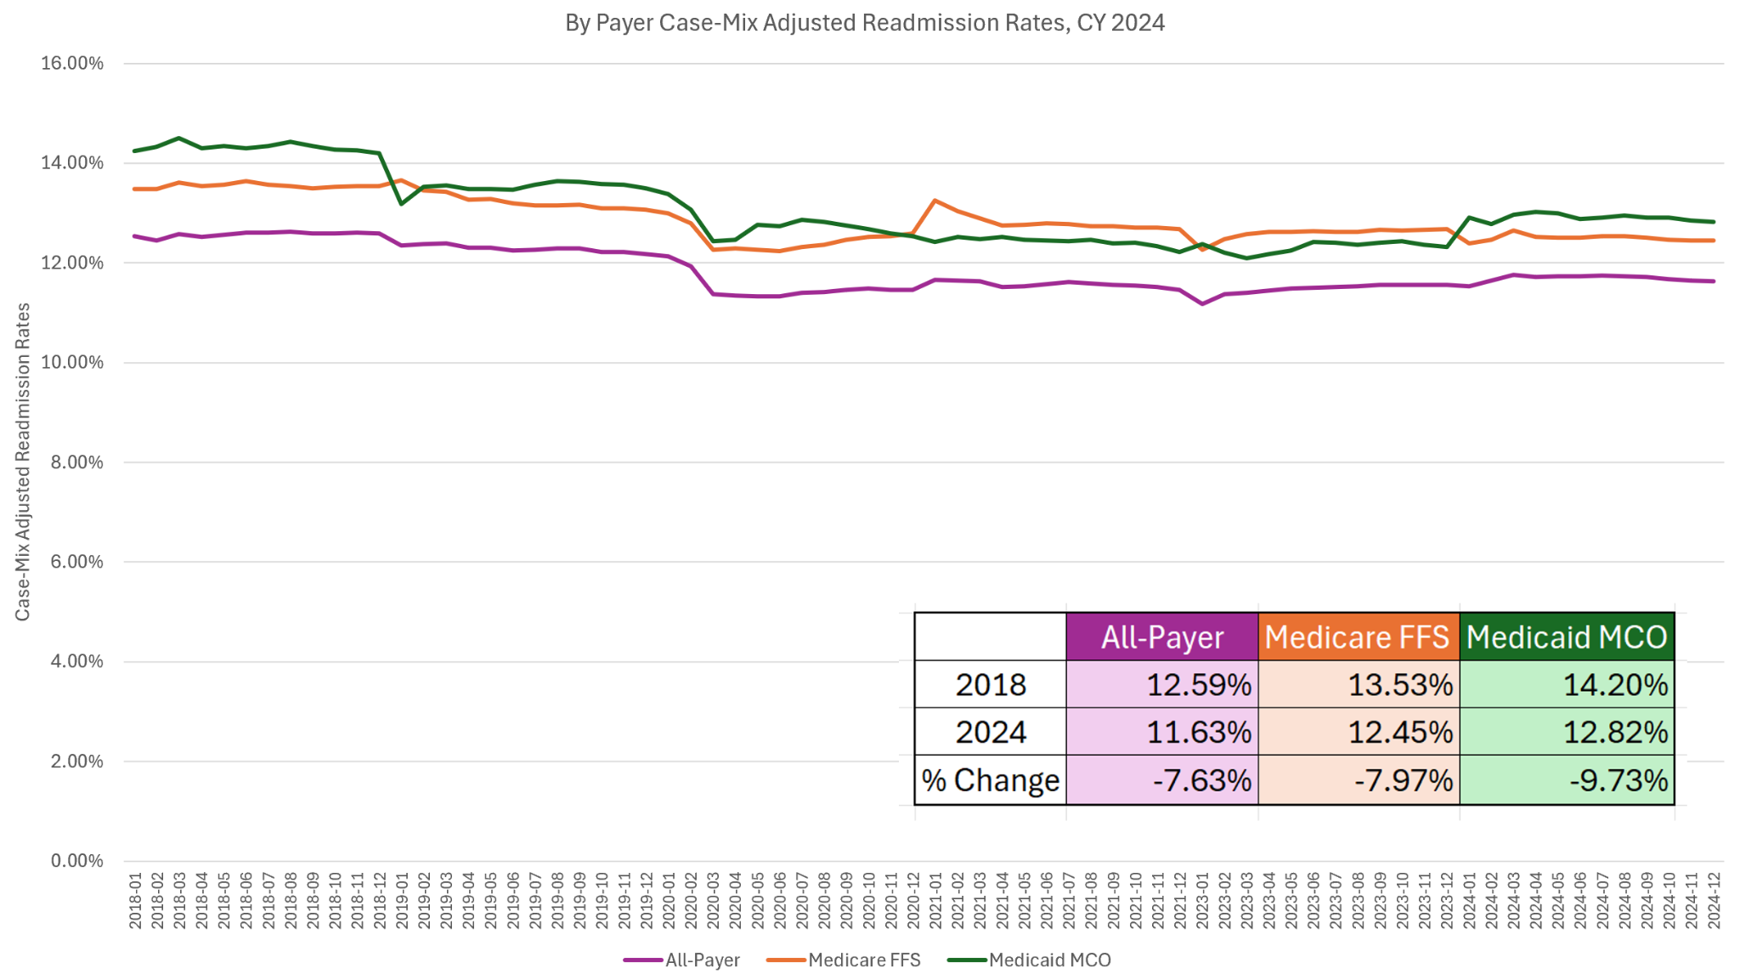
RRIP Performance, CY 2018- CY 2024
Since the beginning of the TCOC model in 2018, Maryland has made improvements in case-mix adjusted readmission rates with All-payer, Medicare FFS, and Medicaid MCO readmission reductions of 7.63 percent, 7.97 percent and 9.73 percent respectively as of 2024.

Slide 35
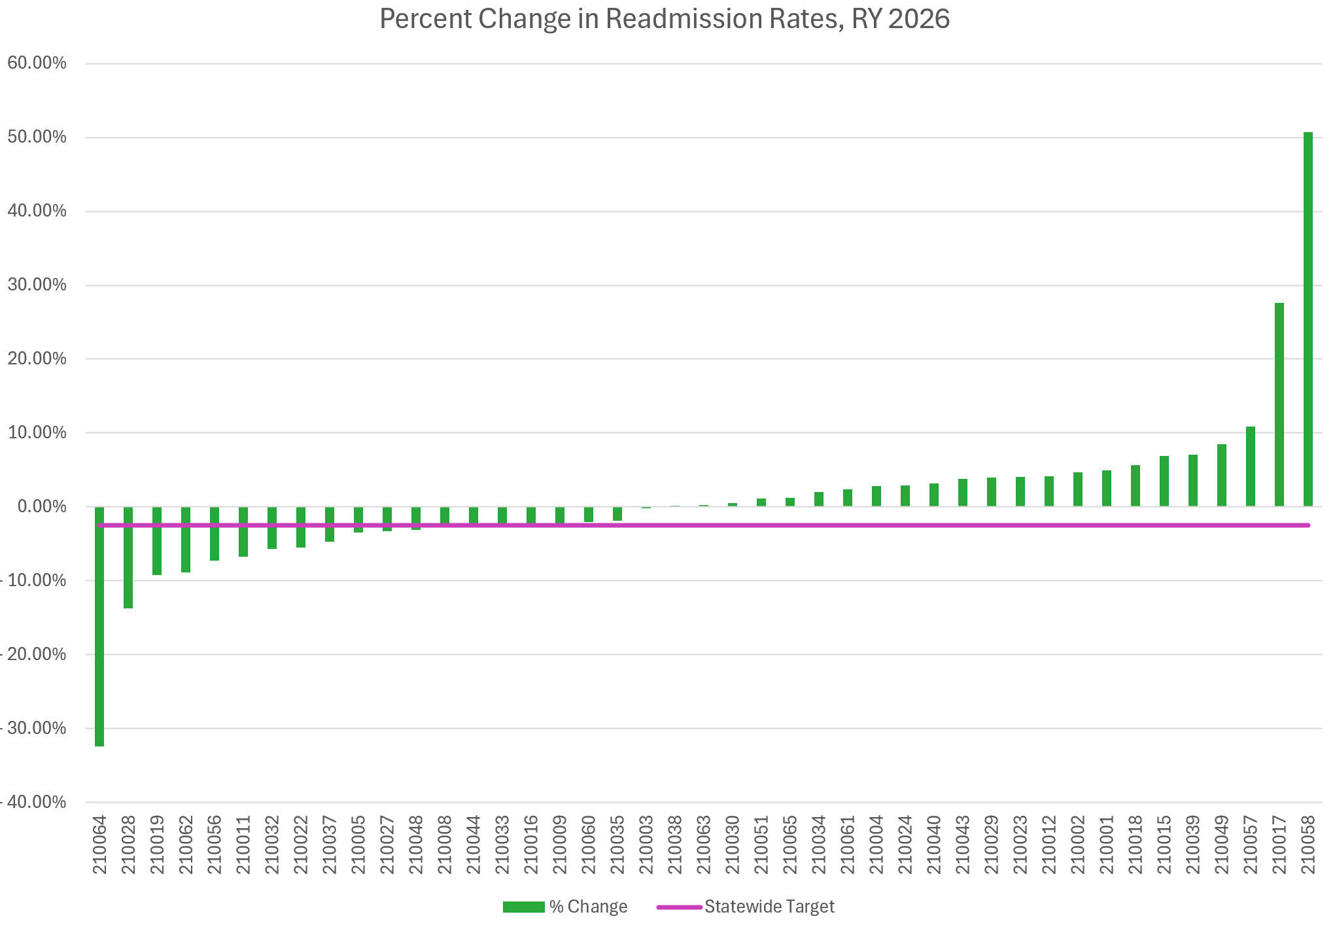
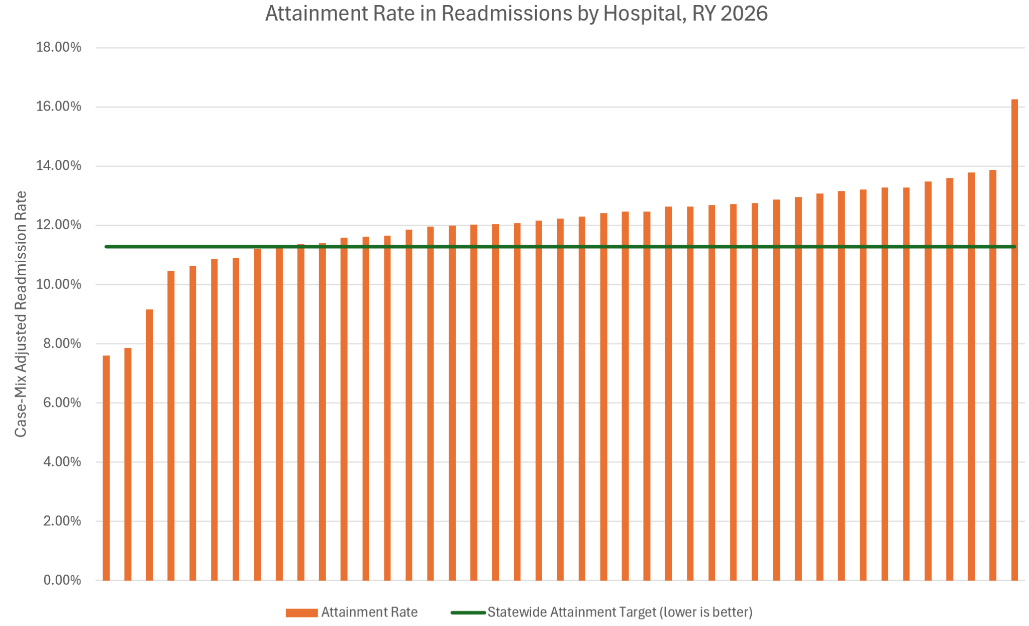
Hospital attainment rates, which are adjusted for out of state readmissions for fairness, ranged from 7.60 percent to 16.27 percent. There were 9 hospitals that performed better (below) than the attainment threshold of 11.28 percent. While the majority of the hospitals do not perform better than the attainment goal, this attainment goal was set at the 75th percentile using benchmarking data for Medicare and commercial payers thus, to be rewarded a hospital must perform significantly better than the average benchmarks.
In CY 2024, 19 hospitals had reductions in readmissions from the two-year base period of CY 2022/2023. Improvements ranged from -0.21 percent to -32.38 percent. 15 hospitals achieved the RY 2026 improvement target of reducing all-payer readmissions by 2.53 percent.
Data Source: Case-Mix

Slide 36
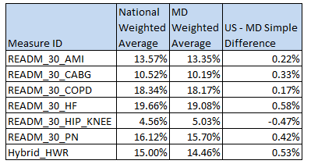
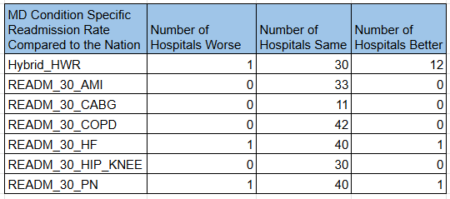
HWR and HRRP Condition-Specific Weighted Readmission Rates, Maryland-US
Maryland’s rate is lower (better) for all conditions except Hip/Knee. Maryland performed a half percentage point better than the Nation (0.53%) on the HHWR measure. The most recent data also indicates that 42 out of 43 Maryland hospitals perform the same (n=30) or better (n=12) than the nation on the HHWR.
Data Source: Care Compare
Condition Specific Measures: 7/1/2021-6/30/2024
Hybrid Hospital-Wide Readmissions: 7/1/2023-6/30/2024

Slide 37
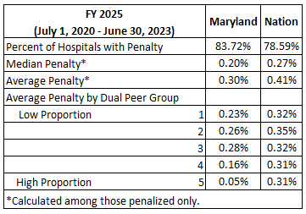
FFY 2025 HRRP Performance, MD vs Nation
Data from CMMI indicates that a higher proportion of hospitals in Maryland would be penalized for excess readmissions, but on average Maryland hospitals have lower penalties indicating they perform better than national hospitals on excess readmissions.
The lower average penalties are for all Duel Peer groups.
Data Source: CMMI

Slide 38
Revenue Adjustments and Performance Recap
Revenue adjustments:
  RY 2026: 19 hospitals received scaled rewards for a total of about $17M, 24 hospitals received penalties for a total of about $45M, resulting in the statewide net total of about -$28M.
  RY 2025: 20 hospitals received scaled rewards for a total of about $42M, 24 hospitals received penalties for a total of about -$28M, resulting in the statewide net total about $14M.
Between 2018 and 2024, Maryland hospitals reduced their all-payer case-mix adjusted readmissions by 7.63 percent, with even higher reductions of 7.97 percent for Medicare FFS beneficiaries and 9.73 percent Medicaid enrollees.
Maryland performs better than the national average on unadjusted and risk-adjusted readmissions in CY 2024.
From 2018 through 2024, Maryland has performed statistically significantly better than the nation on the risk-adjusted hospital-wide readmissions measure.
CMS Medicare Hospital Global Budget Methodology will include additional readmission adjustments in addition to HRRP. In addition, there will be a Statewide All-Payer readmission goal included in the Population Health Accountability Plan

Slide 39
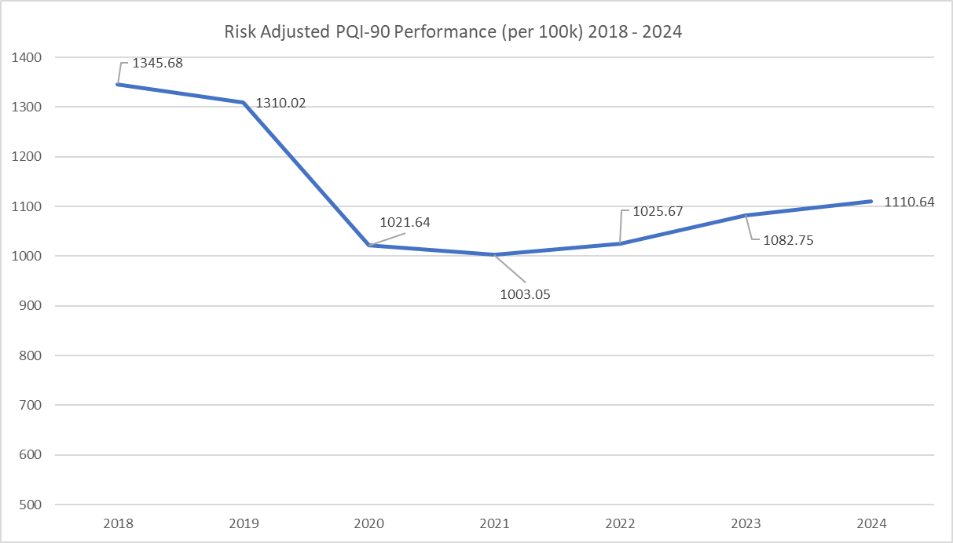
PAU PQIs
Maryland has experienced a 17.5 percent decrease across all PQIs in CY 2024 from 2018.
The CY 2024 statewide all-payer risk-adjusted avoidable admissions rate was 1110.64 avoidable admissions per 100,000 Marylanders. This is a slight increase from 2023, 2022, 2021, and 2020. It is not surprising to see increases in PQIs post-covid. However it is commendable that there is still sustained improvement relative to 2018.
With the amended PAU policy for SFY 2025, the statewide reduction for PAU is 0.03 percent. Individual hospital cuts are determined by performance on per capita PQIs, PDIs, and the percentage of revenue associated with readmissions.
CMS Medicare Hospital Global Budget Methodology will continue to assess avoidable admissions using AHRQ PQIs

Slide 40
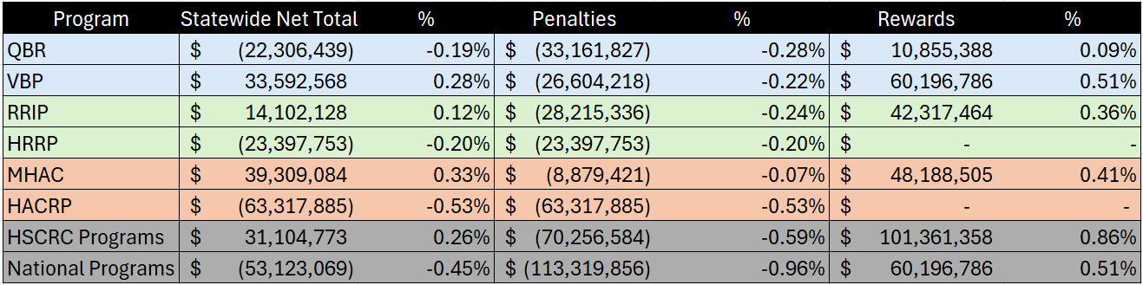
Comparison of RY2025 and FFY2025 Quality Adjustments
Estimates for MD hospitals performance in National programs is applied to All-Payer revenue for comparison purposes; CMS would apply adjustments to Medicare FFS revenue only.

Slide 41
Next Steps
Review State Agreement and determine with CMMI the basis of Quality Assessments for CY26-FY28 for Medicare FFS.
Review QBR-HVBP differences and move towards alignment with national program in terms of measures and weighting.
  Next month PMWG will review QBR-HVBP in detail and make decisions for RY2028
Compare RY26-FY26 MD-National Revenue Adjustments (based on data availability)

Slide 42
Inpatient Length of Stay

Slide 43
Background
Over the course of the TCOC Model, advances have been achieved on a broad range of quality and efficiency measures.
Inpatient volume has fallen markedly since 2018.
In contrast, the length of stay has progressively increased over the same period.
The Colmers report (July 2025) suggested the Commission develop a policy incentivizing Inpatient Length of Stay (IP LOS) reduction.

Slide 44
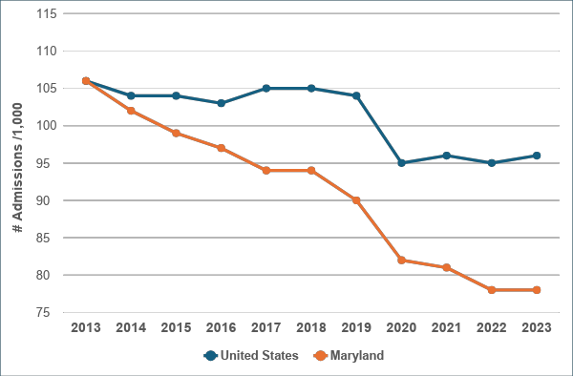
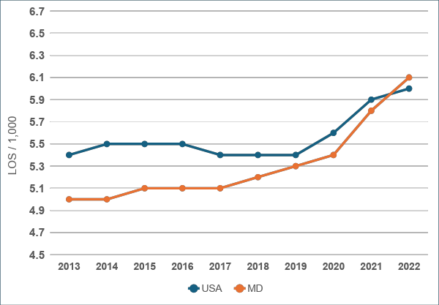
IP LOS Has Increased in Recent Years
Hospital Admissions per 1,000 Population, 2013-2023
Mean Inpatient IP LOS, 2013-2023
Source: https://www.kff.org/state-category/providers-service-use/hospital-utilization/

Slide 45
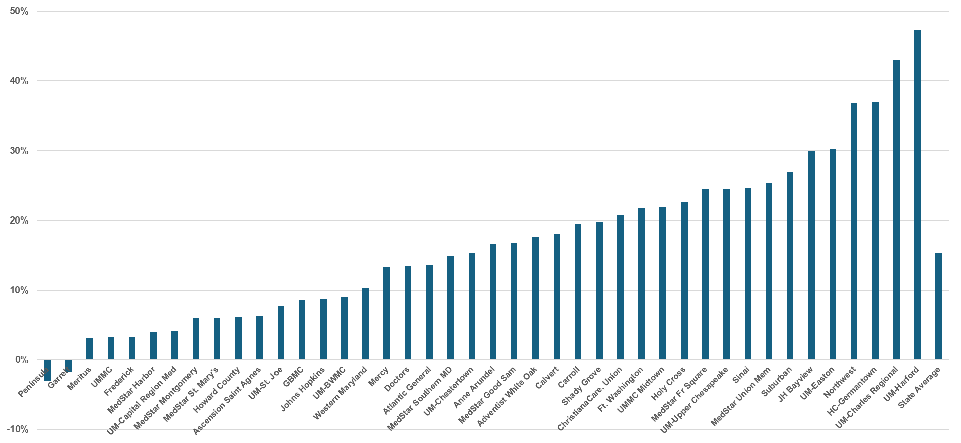
From 2018-2024, IP LOS Increased at Most Hospitals
Source: HSCRC Casemix. Chart reflects percentage change in crude IP LOS

Slide 46
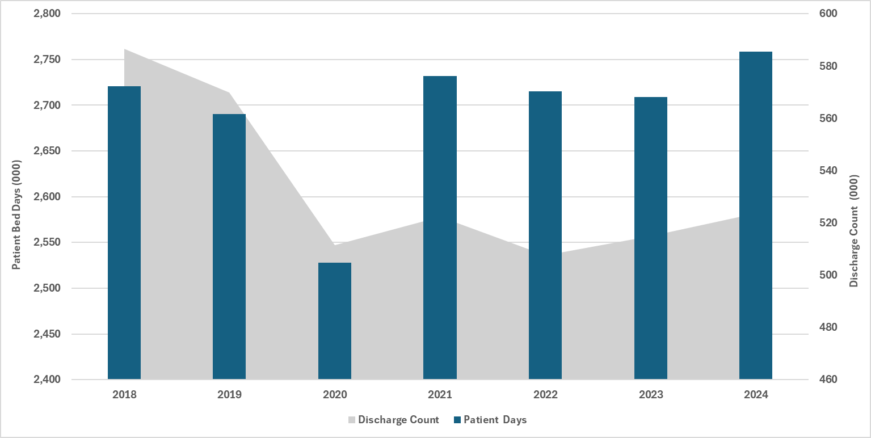
Patient Days and Number of Discharges by Year
Source: HSCRC Casemix All Payer Inpatient data

Slide 47
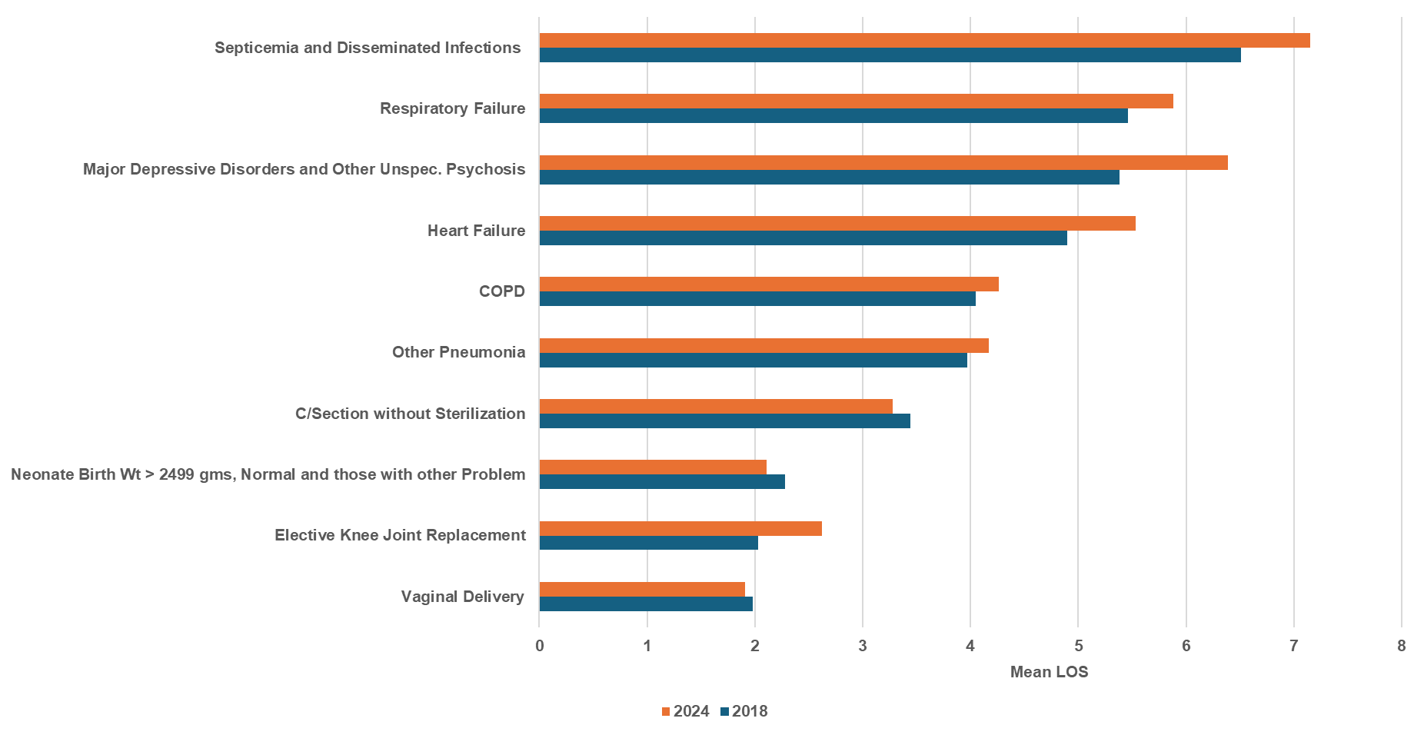
Increase is Consistent Across a Variety of Common DRGs
Source: HSCRC Casemix All Payer Inpatient data

Slide 48
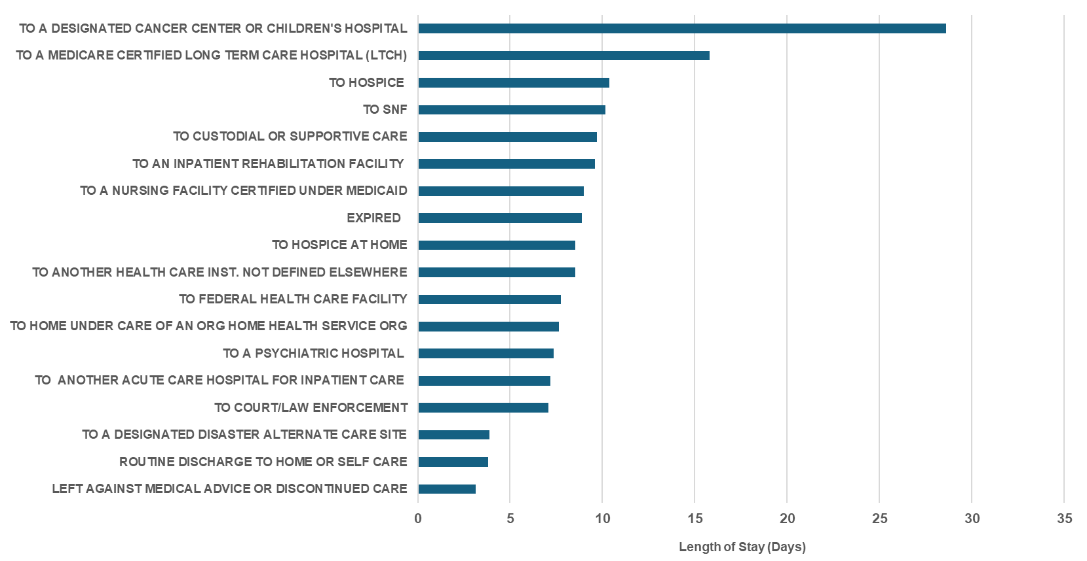
IP LOS is Elevated for Patients Discharged to Post-Acute Facilities

Slide 49
Discussion
Global budgets and TCOC accountability create incentives for hospitals to reduce IP LOS and preventable admission volume
While admission volume has fallen, longer IP LOS has resulted in an overall increase in IP utilization as measured by bed days, thus making global budgets less financially sustainable
A significant opportunity for efficiency and improved care remains around IP LOS
There is marked variation between hospitals in IP LOS changes since 2018 and marked variation in Medicare risk adjusted performance relative to national norms.
Significant number of hospitals are worse than nation on Medicare IP LOS
Focus on post-acute coordination may result in progress on IP LOS
Development of a policy incentivizing IP LOS reduction may benefit patients, ease emergency department boarding and ensure success under the AHEAD model

Slide 50
Topics for Further Discussion
Base & performance periods
Exclusions (mortality, transfer, etc)
Risk adjustment
Benchmark and threshold
Revenue at risk
Reward vs. penalty
Unintended consequences

Slide 51
Policy Development Timeline
PMWG Concept Discussion | 9/17/25
PMWG Policy/Methods Discussion | 10/15/25
Presentation of draft policy to Commission | 11/12/25
Final PMWG Discussion | 11/19/25
Presentation of final policy to Commission | 1/14/25

Slide 52
Emergency Department Updates:
ED Wait Time Reduction Commission
ED - Hospital Throughput Best Practices
ED LOS Observations Evaluation/Discussion

Slide 53
ED Initiatives Update

Slide 54
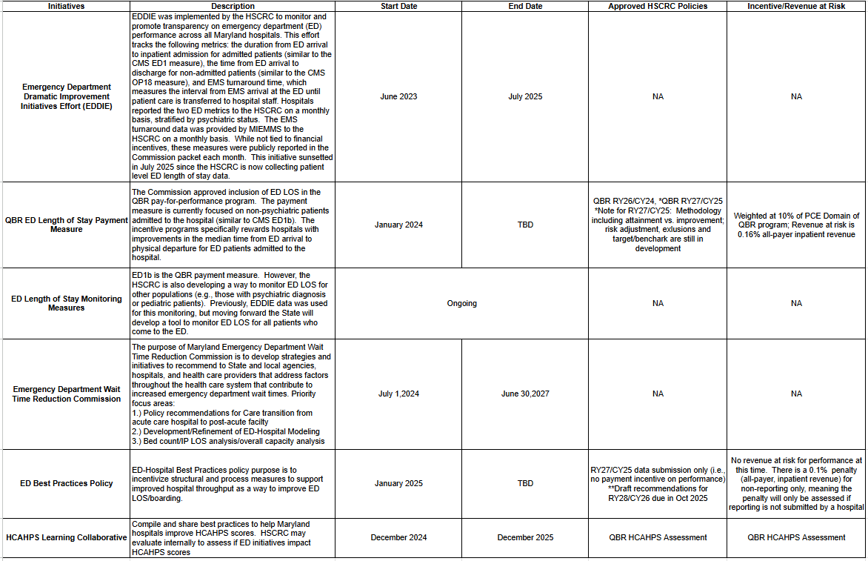
ED Initiatives

Slide 55
Establishment of Maryland ED Wait Time Reduction Commission
Bill went into effect July 1, 2024, and terminates June 30, 2027
Annual Legislative Reports due November 2025 and November 2026
Purpose: To address factors throughout the health care system that contribute to increased Emergency Department wait times
Specific focus: Develop strategies and initiatives to recommend to state and local agencies, hospitals, and health care providers to reduce ED wait times, including initiatives that:
Ensure patients are seen in most appropriate setting
Improve hospital efficiency by increasing ED and IP throughput
Improve postdischarge resources to facilitate timely ED and IP discharge
Identify and recommend improvements for the collection and submission of data
Facilitate sharing of best practices
Notes:
Members on the commission are listed in the blue box to the right. Appointments will be finalized on 8/26, all seats are filled and the first meeting is anticipated to be held in October 2024.
Read purpose
Read focus
Bullet 2: Again, throughput is the process of a patient transitioning from the ED to an inpatient bed and then home or a post-acute facility.
Bullet 3; Post discharge resources include places such as a skilled nursing facility, rehab, home health agency, PT, outpatient providers, including primary care, behavioral health and other specialists.
Bullet 4: Access to data across the continuum of care including outpatient, hospital,post-acute facilities and community agencies will allow us to create a holistic view of a patient’s interaction with the entire healthcare system. We anticipate that this view will allow us to better identify barriers to throughput and opportunities to improve patient flow.

Slide 56
Commission Subcommittees
Access to Non-Hospital Care
Data Subcommittee
Priority Focus:
                Post-acute access, capacity, and function
                Palliative Care/Hospice Care
                Prior Auth Delays & Denials
                Action Items/Deliverables:
Proposal & Recommendations to Regulatory Agencies and Legislature
Expansion of Palliative Care & Hospice Care Training, Resources, and Monitoring
Priority Focus:
Identify existing and develop new data reports that can be used to identify and quantify opportunities across the continuum of care.
Action Items/Deliverables:
Develop a model that quantifies impact of interventions on capacity, throughput and operations that impact Inpatient and ED LOS
Support data analytical work of all subgroups
ED-Hospital Best Practices
Hospital Capacity, Operations & Staffing
Priority Focus:
Develop best practices that will improve hospital and ED throughput and decrease ED LOS
Provide input into the methodology for ED-related pay for performance metrics
Action Items/ Deliverables:
Minimum of Two Best Practices implemented at each hospital
Refine Quality Based Reimbursement (QBR) ED LOS methodology.
Priority Focus:
Provide recommendations for improvement opportunities related to capacity, operations and workforce across the continuum of care.
Action Items/Deliverables: (Pending finalization)
Baseline Capacity analysis
Capacity calculator with standard targets
Recommendations for alternate capacity types (ex. HAH)

Slide 57
Data Subgroup

Slide 58
Hospital System Policy Simulations
HSCRC staff are working with a small group of stakeholders and analysts to build a simulation platform that can be used to understand how various types of policies could change ED-1 and OP-18 performance
The model uses real-world data on ED volume, staffing, and acuity, as well as inpatient capacity and other hospital-specific variables, to simulate patient pathways through the ED and inpatient services.
Modeling can provide estimates that allow the Commision to compare the expected effects of different policies across several types of hospitals
We are working to identify a short list of interventions to test, and hope to provide draft results for the September meeting

Slide 59
ED LOS Dashboard
HSCRC and ED Wait Time Reduction Commission want to monitor ED LOS for all patients, separate from the QBR ED LOS payment measure.
Developing Maryland Hospital ED LOS Dashboard to display data visualizations that allow monitoring of Inpatient and Outpatient ED LOS and stratification by hospital or patient characteristics.
Development Partners and Roles:
  Mathematica: Measure specifications, ad-hoc analyses, dataset creation
  CRISP-hMetrix: Tableau development, CRS Portal dissemination, Maintenance/Updates
  ED Commission and Subgroups: Input on uses, data specifications, data visualizations, content expertise, identification of areas for improvement

Slide 60
Best Practice Subgroup

Slide 61
Deliverables from Best Practice Subgroup
Implement a minimum of two best practices at each hospital that are designed to improve the emergency department (ED) and hospital throughput and reduce ED length of stay (LOS), per HSCRC Best Practice Policy
Provide input for the Quality Based Reimbursement (QBR) ED LOS methodology, specifically:
  Targets
  Risk Adjustment
  Exclusions
Recommendations for CY2025 performance are still under development. Subgroup recommendations will be reviewed by PMWG.

Slide 62
ED Best Practices Policy Updates
Policy Recommendation for CY2026 to HSCRC Commission in October 2025
CY 2025 Reporting :
Reporting template will be reviewed with the Best Practice Subgroup during 9/30 subgroup meeting
Hospitals are required to submit the report in December 2025. Non-reporting will result in a 0.1% penalty assessed on all-payer inpatient revenue in January 2026.
CY 2026 Recommendation:
Recommendation will be presented to HSCRC Commissioners at the October meeting.
HSCRC Staff plan to recommend that we continue monitoring in CY 2026 to allow for thorough evaluation and measurement of the impact of the best practices. Staff will also recommend the continuation of the non-reporting penalty of 0.1% all payer inpatient revenue

Slide 63
Legislative Report

Slide 64
Legislative Report Requirements
By November 1, 2025 the Commission must report to the Governor and the General Assembly on:
  Year 1 Commission activities, findings, and recommendations
  Update on the development, timeline, and implementation of any recommended policies and programs developed by the commission to improve ED wait times.
HSCRC staff will present the final draft report at September 24th ED Wait Time Reduction Commission meeting for review.
Final draft is due to MDH and the Governor’s office on October 1, 2025 for review prior to November 1st submission to the General Assembly.

Slide 65
Legislative Report Outline
  Executive Summary
  Background on Maryland ED wait times and reasons for establishing the ED Wait Time Reduction Commission
  Prior initiatives–EDDIE/ED LOS incentives
  Commission Overview:
    Composition of the Commission
    Development of the subgroups
    Development of priorities
    Opportunities and Barriers
    Resource Limitations
  Top 3 Key Recommendations identified in the first year
  Highlight successes (e.g., development and implementation of the Best Practice Policy)
  Conclusions–anticipated benefits of implementing recommendations
See subsequent slide for draft key recommendations

Slide 66
Legislative Report: Draft Key Recommendations
Strengthen the State’s capacity data infrastructure by developing a reliable and user-friendly reporting mechanism to comprehensively assess capacity across all healthcare settings, both in real-time and in annual assessments.
    Will leverage and build upon existing MIEMSS and MHCC processes and reports
Conduct additional statistical modeling and simulations to guide decision-making around hospital emergency department priorities and performance measures
    Modeling will provide critical insight into prioritization of initiatives, value-based arrangements and investments
Develop a formal proposal on opportunities to improve post-acute care access and capacity with a focus on regional capacity and proposed infrastructure for complex patient populations.

Slide 67
ED LOS Measures–Observation Cases

Slide 68
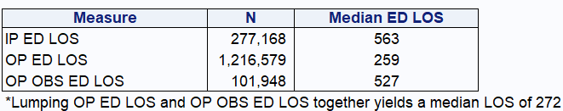
Initial Approach to ED LOS Measures
    The HSCRC is proposing to use separate ED LOS into three categories because patient severity and expected ED LOS differ when ED visit results in inpatient admission, observation stay, or neither.
    This approach deviates from CMS/Joint Commission ED LOS measures by separating out ED visits not resulting in admission into two categories (observation, non-observation).
    Three ED LOS Measures:
    IP ED LOS: ED visits resulting in inpatient admissions
    OP OBS ED LOS: ED visits resulting in observation stays outside of ED (but not inpatient admission)
    OP ED LOS: ED visits not resulting in inpatient admissions or observation stays outside of ED
    CY 2024 ED LOS by Measure:
Notes:
T

Slide 69
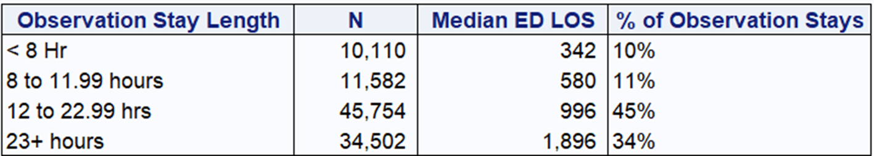

ED LOS Measures – Observation Stays
    CY 2024 Observation Stays by Length (among ED visits not resulting in admission)
    CY 2024 Observation Stays by Type (among ED visits not resulting in admission)
    Note: Considering observation stay to be outside of the ED if observation stay discharge precedes ED departure time by 30 minutes or more.
    Questions about observation stay inclusion:
    Should ED visits including observation stay be included in the OP ED LOS measure?
    Should ED visits resulting in an observation stay > 23 hours be included in the IP ED LOS measure?

Slide 70
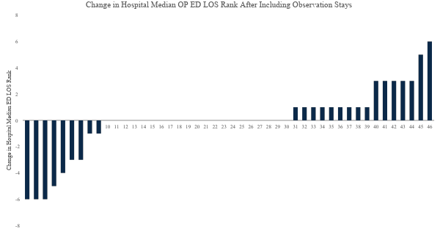
One OP ED LOS Measure w/Observation Stays
    Including ED visits w/observation stays in a single OP ED LOS measure results in:
    median ED LOS increasing by varying degrees across hospitals (0 to 66 minutes)
    change in hospital rank of 3 to 6 positions for 14 hospitals and 1 position for 11 hospitals.

Slide 71
THANK YOU!
Next Meeting: October 15, 2025

