Slide 1
Performance Measurement Workgroup
October 15, 2025
HSCRC Quality Team

Slide 2
Meeting Agenda
Welcome and introductions, webinar housekeeping
AHEAD Updates and Quality Program Transition Update
Quality Based Reimbursement (QBR) Policy RY 2028 Draft Discussion
Inpatient Length of Stay Incentive
ED Updates
ED Wait Time Reduction Commission Legislative Report Status
ED Best Practices Draft Policy
ED LOS Risk-Adjustment Measure for RY27 QBR

Slide 3
Workgroup Learning Agreements
Be Present – Make a conscious effort to know who is in the room, become an active listener. Refrain from multitasking and checking emails during meetings.
Call Each Other In As We Call Each Other Out – When challenging ideas or perspectives give feedback respectfully. When being challenged - listen, acknowledge the issue, and respond respectfully.
Recognize the Difference of Intent vs Impact – Be accountable for our words and actions.
Create Space for Multiple Truths – Seek understanding of differences in opinion and respect diverse perspectives.
Notice Power Dynamics – Be aware of how you may unconsciously be using your power and privilege.
Center Learning and Growth – At times, the work will be uncomfortable and challenging. Mistakes and misunderstanding will occur as we work towards a common solution. We are here to learn and grow from each other both individually and collectively.
REMINDER: These workgroup meetings are recorded.

Slide 4
PMWG Invited (i) and Confirmed (c) Members
Carrie | Adams | Meritus (i)
Kelly | Arthur | Qlarant QIO (c)
Ed | Beranek | Johns Hopkins Health System (c)
Zahid | Butt | Medisolv Inc.(c)
Tim | Chizmar | MIEMSS (c)
Linda | Costa | University of Maryland School of Nursing (c)
Ted | Delbridge | MIEMSS (c)
Shannon | Hall | Community Behavioral Health Assoc of Maryland (i)
Theressa | Lee | Maryland Health Care Commission (c)
Staci | Lofton | Families USA (i)
Angela | Maule | Garrett Regional Medical Center (c)
Patsy | Mcneil | Adventist Health (i)
Stephen | Michaels | MedStar Southern Maryland Hospital (c)
Lily | Mitchell | CareFirst (c)
Sharon | Neeley | Maryland Department of Health Medicaid (c)
Christine | Nguyen | Families USA (i)
Jonathan | Patrick | MedStar Health (c)
Nitza | Santiago | Lifebridge Health (c)
Dale | Schumacher | MedChi, Maryland State Medical Society (i)
Ed | Seferian | Johns Hopkins Health System (c)
Madeleine "Maddy" | Shea | Health Management Associates (c)
Mike | Sokolow | University of Maryland Medical Systems(c)
Geetika "Geeta" | Sood | JHU SOM,Division of Infectious Diseases (c)
Bruce | VanDerver | Maryland Physicians Care (c)
Jamie | White | Frederick Health (i)
Amanda | Wright | Maryland Hospital Association (c)

Slide 5
AHEAD Updates
Notes:
Good morning, Thank you Dianne for that overview. Now more than ever, we need to be following the IPPS proposed and final rules to understand and provide comment on the CMS quality programs given that under AHEAD, MD hospitals will be under the national quality programs for Medicare.
And that brings us to our next topic, which I know is on many hospital representatives minds, which is the upcoming transition from the TCOC model, which will end this year, and the start of the AHEAD model.
Over this next section, I will walk you through the updates we have on AHEAD. However, before we start, I just want to make clear that what we are presenting is based on discussions with CMMI and could change in the actual State agreement, and there are many questions and details that we know hospitals and ither stakeholders are anxuous to understand that are not able to be answered at this time and may not even be able to be answered definitely even once we have a revised State agreement. So I will walk through these slides, and take questions, but please know we are interested in understanding your questions but most likely will not have an answer for you. However, we are trying to be as transparent as we can with what we do know, and we are going to be needing this workgroup to help us over the coming months and years, as we navigate through this transition. And while right now there are a lot of questions, I just want to remind people that the HSCRC has been setting hospital rates since the last 1970s and has faced challenges and transitions before, and the way we have gotten through those challenges and transitions has been by collaborating with stakeholder and our federal partners. And so to make it through this next transition we are going to need your help and the help other stakeholders to provide input on how we can best use our unique hospital global budget system, even with the upcoming changes to how those global budgets will be administered, to ensure Marylanders have access to, affordability/high quality hospital care.
So I am going to dive right in, and because this is new, I am going to ask that I get through the first three slides before I pause for questions.

Slide 6
AHEAD Updates and Transition Timeline
CMS and Maryland have been renegotiating the AHEAD Model to reflect new federal priorities.
CMMI released the State Agreement on September 22nd. The federal government would like the State Agreement to be signed in October and hospital Participation Agreements to be signed in November for a January 2026 start.
CMS will set Medicare FFS global budgets starting in 2028.
Performance Year 1 (2026) and PY2 (2027) will be a transition period where the State will continue to set all-payer Hospital Global Budgets.
In order to smooth the transition, the State will be able to re-direct a portion of the total Medicare global budget amount between PY3 (2028) and PY5 (2030).
The State will continue to set non-Medicare FFS global budgets with quality adjustments.
Savings target of $460M in additional Medicare FFS savings must be achieved in PY1 (2026) – PY7 (2032), with no additional savings expected in the final three PYs (through 2035).
Notes:
SO first, to unsure we are all on the same page, I just want to remind you that in November of last year MD signed a State agreement for the AHEAD model, however under the new administration, CMS and MD have been reneg…..
Currently, we have a terms sheet that we have agreed to, but we expect to get a new state agreement any day now, and our expectation is that the SA and hospital PA (something that will be new under ahead( will be signed in October….
Under the new SA, CMS will…..
However there will be a transition period, between 2026 and 2028 where the State will continue to set all-payer Hospital Global Budgets. After that, CMMI will administer the Medicare FFS HGB and the State will manage non-Medicare FFS globa budgets. However from 2028 through 2030, the State will be able to redistribute a portion of the HGB in a revenue neutral manner …..
The …..Savings target of $460M in additional Medicare FFS savings must be achieved in PY1 (2026) – PY7 (2032), with no additional savings expected in the final three PYs (through 2035).

Slide 7
Hospital Quality Programs--Subject to Change
Based on our understanding of new State Agreement and CMMI discussions, quality team believes the following:
Maryland hospitals will move to CMS hospital quality programs for Medicare FFS either for FY 2029 or FY 2030.
State may continue non-Medicare FFS quality adjustments and will report annually to CMMI on the quality programs including measures, performance, revenue adjustments.
State will align non-Medicare FFS quality programs with the CMS programs to reduce hospital burden where feasible and appropriate.
Transition timelines:
PY1 (CY 2026) and PY2 (CY 2027) will have all-payer quality adjustments based on older RY programs.
PY3 (CY 2028) CMS will implement RY 2028 (CY 2026 performance) Maryland quality program adjustments.
Medicare quality program adjustments will start in PY4 (CY 2029) or PY5 (CY 2030) if more time is needed for transition.

Slide 8
Transition to CMS and Non-Medicare Quality Programs | Option #1 – Earliest Transition | Option #2 – Intermediate Transition | Option # 3 – Latest Transition
CMS Performance Period | Mid-year 2024 – End of 2026 | Mid-year 2025 – End of 2027 | Mid-year 2026 – End of 2028
HSCRC Performance Period | 2026 | 2027 | 2028 Non-Medicare Policies
Adjustment Period | 2028 | 2029 | 2030
Medicaid & Commercial Alignment with Medicare | Current Alignment | Partial Alignment focused on QBR-HVBP | Further Alignment as determined in collaboration with stakeholders
All-Payer Rev Adjustments implemented by CMS | 6 months | 1 year | 2 years
Option 2 was previously preferred over Option 1; Option 3 is new based on discussions with CMMI.

Slide 9

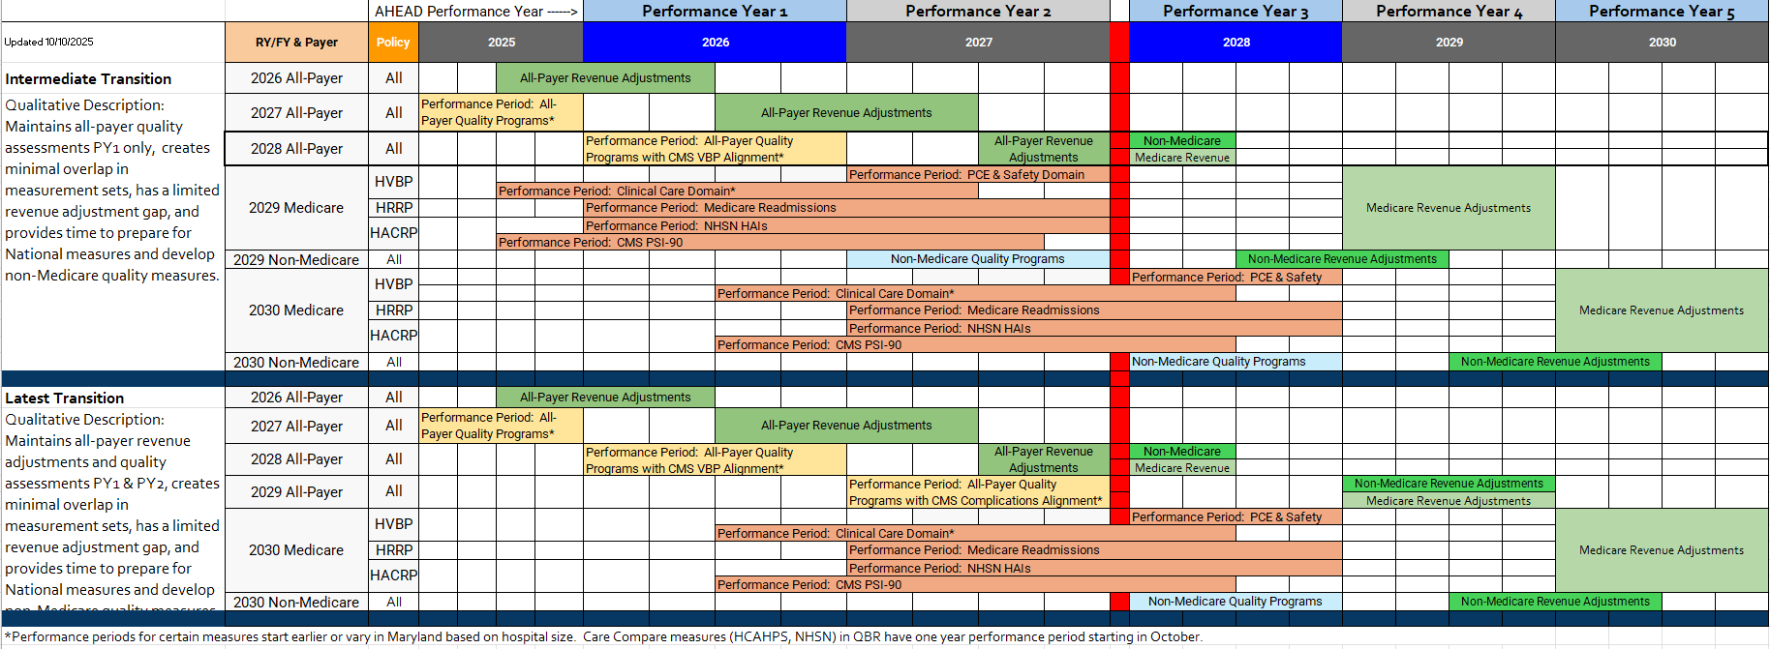
Option 2 & 3 Timelines
Intermediate option means hospital performance is already under some of the CMS quality measures (i.e., condition specific mortality, THA-TKA, CMS PSI). Other measures start CY2026 (i.e., condition specific readmissions and NHSN)

Slide 10
What is Alignment?
Alignment could be about measures, established standards, weighting, time periods, and/or revenue adjustments.
Alignment:
In a minute and targeted sense, arrangement of items in a straight line or a state of agreement
In a broader sense, alignment can mean being in harmony with priorities and intentions, or agreeing with a common cause.
For non-Medicare FFS alignment with CMS a combination of minute/targeted alignment of measures, domain weights, revenue adjustments as well as broader alignment with overall CMS priorities.
Examples: use of condition-specific mortality measures vs. all-cause mortality; inclusion of all-payer PSI in QBR vs. MHAC; scaled revenue adjustments with rewards vs. set penalty only.
As Maryland systematically aligns our quality programs with CMS over the next couple of years, incremental changes may be the best approach.

Slide 11
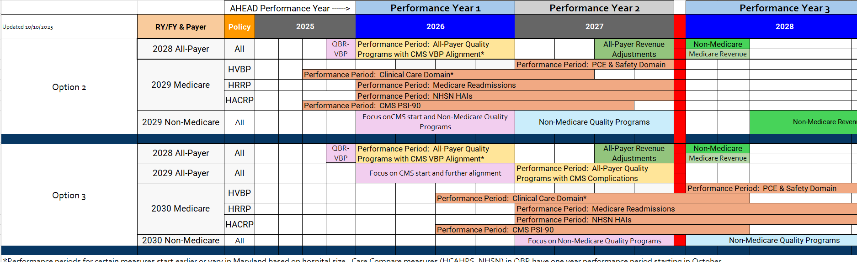
Alignment Discussion
Current focus is on QBR-VBP alignment (today’s discussion).
Alignment focus for next year depends on option chosen, decision on this is not needed for State Agreement.
PMWG and other stakeholder input will be needed for determining alignment priorities and timelines.

Slide 12
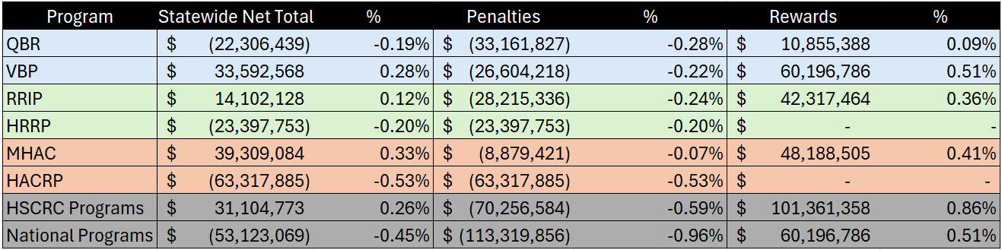
For Discussion: Alignment Prioritization and Phases
QBR-HVBP: HSCRC staff has prioritized CY2026 alignment given lack of evidence higher HCAHPS weight leads to improvement, program complexity, and number of MD-specific measures.
RRIP-HRRP: Staff propose future RRIP policy should align with statewide all-payer readmissions goals under AHEAD vs. HRRP direct alignment; current policy includes improvement goal through CY2026 that could be used for RY 2028 and during CY 2026 focus could be on development of new all-payer measure that aligns with statewide goal for RY 2029. Once developed, penalty only program and weighting of HRRP at 3 percent could be considered.
MHAC-HACRP: Given revenue adjustment methodology includes scaled adjustments with rewards, staff propose maintaining program in RY 2028 and prioritizing alignment with HACRP or non-Medicare FFS policy development for RY 2029. Use of PPCs instead of NHSN and PSI will need to be reconsidered, as well as opportunities to use eCQMs.
RY 2025
RY26 RRIP is -$28M; -0.22% net
Estimates for MD hospitals performance in National programs is applied to All-Payer revenue for comparison purposes; CMS would apply adjustments to Medicare FFS revenue only.

Slide 13
RY 2028 QBR Policy and HVBP Alignment

Slide 14
QBR RY 2028 Discussion Points
What incremental steps should the state take to align QBR with VBP?
What measures should be retained
What measures should be added
What measures should be removed and moved to monitoring
How should domains be re-weighted
Are there QBR elements not in VBP that are important to maintain for a Non-Medicare FFS program?
Changes to revenue adjustment methodology?
Should the current incentive (i.e., $150k per hospital) for complete and timely digital measures reporting be maintained?

Slide 15
MD Quality Based Reimbursement
2% Inpatient Revenue At-Risk
Hospital Value-Based Purchasing
2% Inpatient Revenue At-Risk
HCAHPS Top Box
0.40%
HCAHPS Top Box
0.40%
ED LOS
0.20%
HCAHPS Consistency
0.20%
PCE Domain
0.50%
Percents are IP revenue at-risk and not percent of QBR/VBP, i.e., VBP domains are each 25% of the 2% at-risk or 0.50% at-risk.
PCE Domain
1.2%
HCAHPS Consistency
0.10%
30-Day, Condition Specific, Medicare Mortality
0.40%
TFU Medicaid
0.07
HCAHPS Linear
0.20%
Clinical Care
0.50%
TFU Medicare + Disparity
0.13
THA-TKA Complications
0.10%
NHSN
0.40%
30-Day, All-Cause, All-Payer Mortality
0.10%
Safety
0.50%
NHSN
0.50%
Clinical Care
0.20%
Sepsis Bundle
0.10%
Safety
0.60%
Inpatient All-Cause, All-Payer Mortality
0.10%
Efficiency & Cost Reduction
0.50%
All-Payer PSI
0.10%

Slide 16
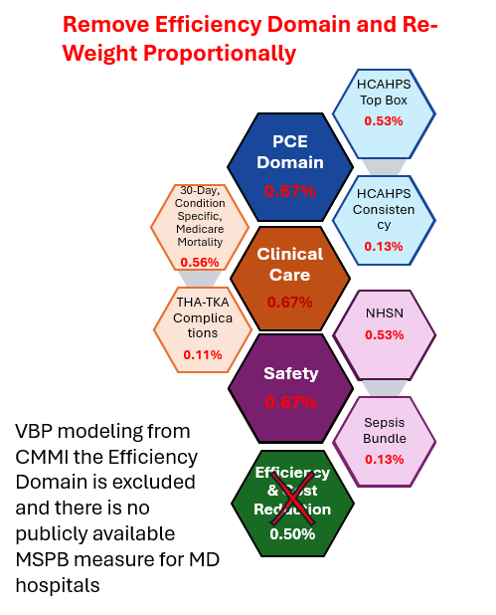
MD Quality Based Reimbursement
2% Inpatient Revenue At-Risk
HCAHPS Top Box
0.40%
ED LOS
0.20%
HCAHPS Consistency
0.20%
PCE Domain
1.2%
TFU Medicaid
0.07
HCAHPS Linear
0.20%
TFU Medicare + Disparity
0.13
30-Day, All-Cause, All-Payer Mortality
0.10%
NHSN
0.50%
Clinical Care
0.20%
Safety
0.60%
Inpatient All-Cause, All-Payer Mortality
0.10%
All-Payer PSI
0.10%

Slide 17
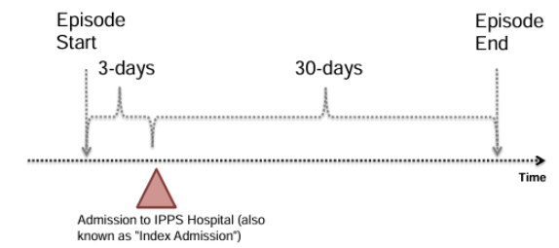
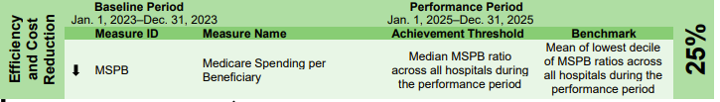
HVBP Efficiency Measure: Medicare Spending Per Beneficiary
Medicare Spending per Beneficiary (MSPB) is calculated by dividing a hospital's price-standardized, risk-adjusted spending for an episode of care by the national median spending for the same type of episode.
Exclusions:
Admissions within 30 days of discharge from another index admission
Acute-to-acute transfers
Episodes with $0 payment
Medicare advantage enrollment within 90 days prior or during the episode
Medicare secondary payer
Admissions w/discharge dates fewer than 30 days prior to the end of the performance period
Calculation Steps:
An episode=3 days before admit
to 30 days after discharge.
Services and payments determined using Parts A and B claims
Payments are standardized to remove variation from geographic differences in payment rates such as the geographic practice cost index.
Standardized payments are risk adjusted for patient characteristics, e.g., age and overall health status
The standardized, risk-adjusted payments= hospital spending for care episode.
Ratio of hospital episode spending used to compare hospital to the national median
HVBP Efficiency and Cost Reduction Domain, FFY 2027:
Interpreting the MSPB Score
Score of 1: The hospital's spending for the episode is about the same as the national median.
Score greater than 1: The hospital spends more per episode than the national median.
Score less than 1: The hospital spends less per episode than the national median.

Slide 18
Person and Community (PCE) Domain: HCAHPS
With additional QBR PCE measures, the QBR program weights the PCE domain more heavily at 60% compared to 25% (0.5% of IP revenue) for VBP:
The state performance on HCAHPS lags the nation so added additional domain weight overall.
Currently top-box weights are the same.
Linear HCAHPS measures for select domains were added to encourage improvement across continuum of scores and not just top box.
HCAHPS consistency points are weighted twice that of VBP.
HCAHPS Discussion questions:
Should we remove linear measures?
Correct HCAHPS consistency weighting to be proportional to VBP weighting of top box and consistency?
*Discuss overall PCE domain weight after discussion of other measures and domains.

Slide 19
Person and Community (PCE) Domain: Timely Follow Up Measures
Maryland added the Timely Follow-Up (TFU) for Medicare, Medicaid, and Medicare within hospital disparity gap measures to the PCE domain (10% of QBR) to encourage care coordination across settings for people with six chronic conditions:
Maryland has improved on Medicare TFU and out-performs the nation; Maryland has not improved on the TFU medicare disparity gap measure.
Medicaid TFU is largely unchanged, and much lower than Medicare TFU; AHEAD model includes new Medicaid Primary Care Model.
TFU discussion questions:
Should the Medicare TFU and disparity gap measures be maintained in payment program for RY 2028?
Should the Medicaid TFU be maintained in payment program for RY 2028?

Slide 20
Person and Community (PCE) Domain: ED LOS
Maryland added the ED Length of Stay measure (10% of QBR) to the PCE domain because:
Maryland has much longer wait times and compared to the nation
Area of public concern
Longstanding state legislature concerns
Longer ED LOS is a patient experience and patient safety concern
ED LOS question:
Should an ED LOS measure be maintained in FY 2028 QBR?
Notes:
RY2027 ED LOS risk-adjustment is under development.
CMS has developed a new eCQM on ED Access and Timeliness that can be voluntarily reported in CY2027 and will be mandatory for reporting in CY2028.

Slide 21
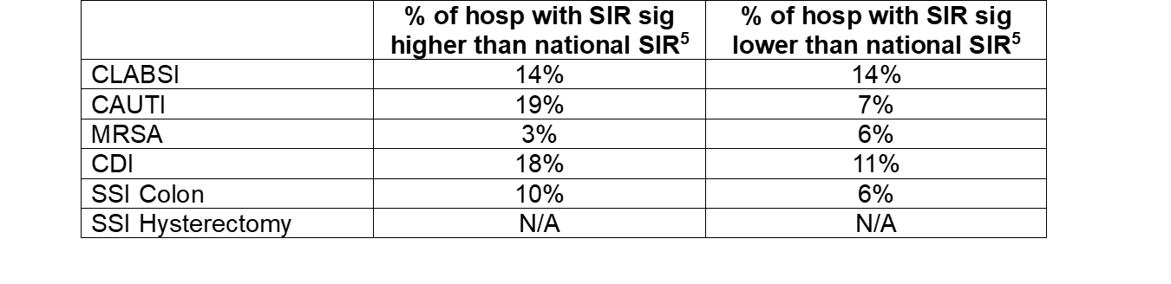
Safety Domain: CDC NHSN HAI Measures
Based on CDC’s most recent analysis (performance year CY 2023) of CDC NHSN measures:
The nation out-performs Maryland although the differences are not all statistically significant
Maryland’s changes from 2022 show no significant change on 4 measures and improvement on 2 measures
Additional previous concerns regarding NHSN measures are related to small case numbers and surveillance bias.
Measures also included in both HVBP and HACRP program.
Safety Domain and NHSN measure questions:
Should the domain weight be weighted evenly with the other QBR domains to align with CMS?
Increasing domain weights would add more weight to NHSN measures.
What are the alternative weighting options?

Slide 22
Safety Domain: AHRQ All-Payer Patient Safety Index
Maryland weights the Safety Domain higher at 30% compared to 25% (0.5% of IP revenue) for VBP
Unlike the HVBP program, QBR includes the all-payer PSI measure in the QBR program
Maryland continues to improve and perform better than the nation on the overall composite measure and the majority of the 10 component indicators.
PSI 90 is also included in the CMS HACRP program so removing it this year would mis-align with CMS measures portfolio without adjustments to MHAC policy.
Safety Domain and PSI 90 question:
Should the all-payer PSI 90 measure be retained in QBR or added to MHAC?

Slide 23
Safety Domain: Sepsis Bundle
Maryland weights the Safety Domain higher at 30% compared to 25% (0.5% of IP revenue) for VBP
Stakeholder SME concerns that measure definition is “one size fits all”, not appropriate for some sepsis patients.
Maryland performs better than the nation on the Sepsis bundle and does not include the measure in the QBR program.
Safety Domain Sepsis Bundle measure question:
Should the sepsis measure be adopted to align with CMS?

Slide 24
Clinical Care Domain: Mortality Measures
The QBR program weights this domain at 10% compared to 25% (0.5% of IP revenue) for HVBP:
Maryland continues to improve over time on the all-payer, all-conditions inpatient and 30-day mortality measures used in the QBR program (applicable to broader patient populations than the CMS HVBP measures)
Maryland performs similarly to the nation on the Medicare 30-day condition specific HVBP mortality measures.
Clinical Care Domain and Mortality measure questions:
What mortality measures should be used for RY 2028?
All-payer measurement (IP vs. 30-day?)
Medicare measurement
Should the domain weight be weighted evenly with the other QBR domains? This would be largest increase in domain weight.
What are the alternative weighting options?
For non-Medicare FFS policy should HSCRC explore options for CY 2027?

Slide 25
Clinical Care Domain: THA-TKA Complication Measure
The QBR program weights this domain at 10% compared to 25% (0.5% of IP revenue) for VBP
The QBR program discontinued the THA/TKA Complication Measure due to Maryland performing slightly better than the nation
Clinical Care Domain and THA/TKA questions:
Should the THA/TKA complications measure be adopted?
Should MD specific previous small cell size exclusion be included for this measure?

Slide 26
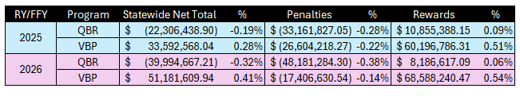
RY/FFY25 and RY/FFY2026 VBP and QBR Quality Adjustments
Estimates for MD hospitals performance in National programs is applied to All-Payer revenue for comparison; CMS would apply adjustments to Medicare FFS revenue only.
Notes:
RY2026 QBR results are based on a preliminary revised cut point of 35.73% (discussed in later slides).
VBP results are estimated based HSCRC analysis without adjustment of national cutpoint for rewards and penalties (staff working to calculate revised cut point for more accurate results)

Slide 27
QBR-HVBP Program Measures and Domain Weight Alignment
Domain | Maryland QBR domain weights and measures, RY 2027 | CMS HVBP domain weights and measures, FFY 2027 | Domain weight adjustment options to align QBR with VBP, RY 2028
Clinical Care | 10% (0.20% of total IP revenue) Two measures: all-cause, all-condition inpatient mortality; all-cause, all-condition 30-day mortality | 25% Six measures: Five 30-day condition- specific mortality measures; THA/TKA complications | 33% (0.67% of IP revenue) Measure Options: Increase domain weight Add THA TKA complications? Retain all-payer IP mortality and/or 30-day mortality? Adopt Medicare mortality measures? Consider alternative mortality measures?
Person and Community Engagement | 60% (1.2% of IP revenue) percent Eight measures: Six HCAHPS top box score and consistency, three categories linear score; TFU Medicare, Medicaid, equity gap improvement; ED LOS. | 25% Six HCAHPS measures top box score and consistency (2027) | 33% (0.67% of IP revenue) Measure Options: Decrease domain weight Retain six HCAHPS top box msrs Decrease consistency to VBP Retain Medicare TFU/disparity gap? Retain Medicaid TFU? Retain ED LOS?
Safety | 30% (0.60% of IP revenue) Six measures: Five CDC NHSN HAI measure categories; all-payer PSI 90 | 25% Six measures: Five CDC NHSN HAI measures; Sep-1 Sepsis Management bundle | 33% (0.67% of IP revenue) Measures Options: Increased domain weight Retain CDC NHSN Maintain All-Payer PSI 90 measure? Add Sepsis bundle?
Efficiency | N/A | 25% One measure: Medicare spending per beneficiary | 0% Maintain separate efficiency assessment

Slide 28

RY 2026 Revised Cut Point
Purpose: Revise cut point retrospectively to ensure that Maryland hospital revenue adjustments are relative to national performance (i.e., do not over or under penalize compared to nation).
Current Method: Assess national hospitals as if they were in the QBR program
Use QBR weighting and time periods for available national measures (HCAHPS, NHSN)
Use MD average performance for MD only measures (mortality, TFU, ED LOS)
Calculate average score for national hospitals as if in QBR
Outcome: 35.73% is the average score for National Hospitals in the QBR program.

Slide 29
Next Steps
Draft Policy November, Final Policy January.
Consider PMWG feedback and ask industry for alignment priorities
Model changes and impact on score differences between QBR-VBP
Finalize RY2026 revenue adjustment cut point
Draft policy for November based on initial input and staff recommendations for formal input from stakeholders

Slide 30
QBR Incentive Program approved in RY 2027 for Complete and Timely Digital Measures Reporting
The state contracts with CRISP/Medisolv for digital measure data reporting and recommends accelerated reporting compared to CMS requirements and all-payer hybrid data elements:
HSCRC eCQM reporting period is on a calendar year basis with reporting required after first six months and then quarterly
HSCRC Hybrid Hospital Wide Readmission and Mortality measures Core Clinical Data Elements (CCDE) reporting is all-payer (age 18 yrs+) for July-June annual period and reporting required after first six months and then quarterly
Majority of hospitals are on track to earn the reward

Slide 31
CMS Hospital eCQM Digital Measures Reporting Requirements CYs 2026-2028
CY 2028
Eight selected by CMS and three self-selected
CMS-mandated eCQMs:
Safe Use of Opioids—Concurrent Prescribing
Cesarean Birth (PC-02)
Severe Obstetric Complications (PC-07)
Hospital Harm—Severe Hyperglycemia
Hospital Harm—Severe Hypoglycemia
Hospital Harm—Opioid-Related Adverse Events
Hospital Harm—Pressure Injury: new measure
Hospital Harm—Acute Kidney Injury: new measure
Emergency Care Access and Timeliness (HOQR): newly required
CY 2027
Six selected by CMS and three self-selected
CMS-mandated eCQMs:
Safe Use of Opioids—Concurrent Prescribing
Cesarean Birth (PC-02)
Severe Obstetric Complications (PC-07)
Hospital Harm—Severe Hyperglycemia
Hospital Harm—Severe Hypoglycemia
Hospital Harm—Opioid-Related Adverse Events: newly required measure.
Emergency Care Access and Timeliness (HOQR): new voluntary
CY 2026
Five selected by CMS and three self-selected
CMS-mandated eCQMs:
Safe Use of Opioids—Concurrent Prescribing: (CMS506)
Cesarean Birth: (PC-02)
Severe Obstetric Complications: (PC-07)
Hospital Harm—Severe Hyperglycemia:newly required
Hospital Harm—Severe Hypoglycemia: newly required
Important considerations
Non-compliance penalty: Failure to meet these requirements puts hospitals at risk of a one-fourth
reduction in their annual payment update.
Zero-denominator reporting: Hospitals that do not provide obstetric services but participate in the Hospital IQR program must submit a zero-denominator declaration for the Cesarean Birth (ePC-02) and Severe Obstetric Complications (ePC-07) measures each quarter.
Validation scoring: Beginning with data from the 2025 reporting period (impacting the FY 2028 payment determination), CMS will score eCQM validation based on data accuracy.

Slide 32
HSCRC Digital Measures Reporting Requirements 2026: Electronic Clinical Quality Measures (eCQMs) and Digital Hybrid Measures
Title | Short Name | CMS eCQM ID | 2024 | 2025 | 2026 | HSCRC* | CMS
Anticoagulation Therapy for Atrial Fibrillation/Flutter | STK-3 | CMS71v13 | X | X | X (v15) | Self-Selected | Self-Selected
Antithrombotic Therapy By End of Hospital Day 2 | STK-5 | CMS72v12 | X | X | X (v14) | Self-Selected | Self-Selected
Cesarean Birth | PC-02 | CMS334v5 | X | X | X (v7) | Required | Required
Discharged on Antithrombotic Therapy | STK-2 | CMS104v12 | X | X | X (v14) | Self-Selected | Self-Selected
Excessive Radiation Dose or Inadequate Image Quality for Diagnostic CT in Adults (Facility IQR) | IP-ExRad | CMS1074v2 |  | X | X (v3) | Self-Selected | Self-Selected
Global Malnutrition Composite Score | GMCS | CMS986v2 | X | X | X (v5) | Self-Selected | Self-Selected
Hospital Harm - Acute Kidney Injury | HH-AKI | CMS832v2 |  | X | X (v3) | Self-Selected | Self-Selected
Hospital Harm - Opioid-Related Adverse Events | HH-ORAE | CMS819v2 | X | X | X (v4) | Self-Selected | Self-Selected
Hospital Harm - Pressure Injury | HH-PI | CMS826v2 |  | X | X (v3) | Self-Selected | Self-Selected
Hospital Harm - Severe Hyperglycemia | HH-Hyper | CMS871v3 | X | X | X (v5) | Required | New Required
Hospital Harm - Severe Hypoglycemia | HH-Hypo | CMS816v3 | X | X | X (v5) | Required | New Required
*For CY 2026 HSCRC will require 3 self-selected measures, consistent with CMS requirements

Slide 33
HSCRC Digital Measures Reporting Requirements 2026: eCQMs and Digital Hybrid Measures
Title | Short Name | CMS ID | 2024 | 2025 | 2026 | HSCRC* | CMS
ICU Venous Thromboembolism Prophylaxis | VTE-2 | CMS190v12 | X | X | X (v14) | Self-Selected | Self-Selected
Safe Use of Opioids - Concurrent Prescribing | Safe use of opioids | CMS506v6 | X | X | X (v8) | Required | Required
Severe Obstetric Complications | PC-07 | CMS1028v2 | X | X | X (v4) | Required | Required
Venous Thromboembolism Prophylaxis | VTE-1 | CMS108v12 | X | X | X (v14) | Self-Selected | Self-Selected
Hospital Harm - Postoperative Respiratory Failure | HH-RF | CMS1218v2 |  |  | X | Self-Selected | Self-Selected
Hospital Harm - Falls with Injury | HH-FI | CMS1017v2 |  |  | X | Self-Selected | Self-Selected
Core Clinical Data Elements for the Hybrid Hospital-Wide Readmission Measure with Claims and Electronic Health Record Data | Hybrid HWR | CMS529v6 | X | X | X | Required age 18+ | Required age 65+
Core Clinical Data Elements for the Hybrid Hospital-Wide All-Condition All-Procedure Risk-Standardized Mortality Measure | Hybrid HWM | CMS844v6 | X | X | X | Required age 18+ | Required age 65+
Emergency Care Access and Timeliness (HOQR) |  | CMS1244v1 |  |  |  | Require 2027? | Required 2028
*For CY 2026 HSCRC will require 3 self-selected measures, consistent with CMS requirements

Slide 34
Inpatient Length of Stay

Slide 35
Background
Global budgets and TCOC accountability create incentives for hospitals to reduce IP LOS and preventable admission volume
While admission volume has fallen, longer IP LOS has resulted in an overall increase in IP utilization as measured by bed days, thus making global budgets less financially sustainable
Significant number of hospitals are worse than nation on Medicare IP LOS
The Colmers report (July 2025) suggested the Commission develop a policy incentivizing Inpatient Length of Stay (IP LOS) reduction
Development of a policy incentivizing IP LOS reduction may benefit patients, encourage post-acute coordination, ease emergency department boarding and ensure success under the AHEAD model

Slide 36
Policy Development Timeline
PMWG Concept Discussion | 9/17/25
PMWG Policy/Methods Discussion | 10/15/25
Presentation of draft policy to Commission | 11/12/25
Final PMWG Discussion | 11/19/25
Presentation of final policy to Commission | 1/14/25

Slide 37
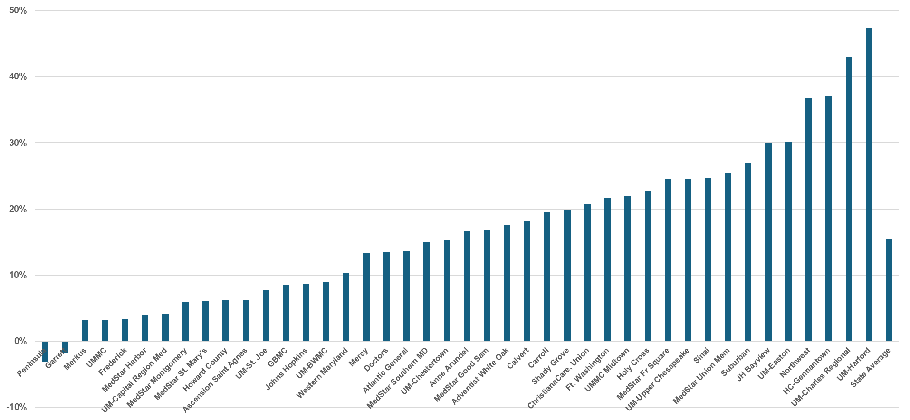
From 2018-2024, IP LOS Increased at Most Hospitals
Source: HSCRC Casemix. Chart reflects percentage change in crude IP LOS

Slide 38
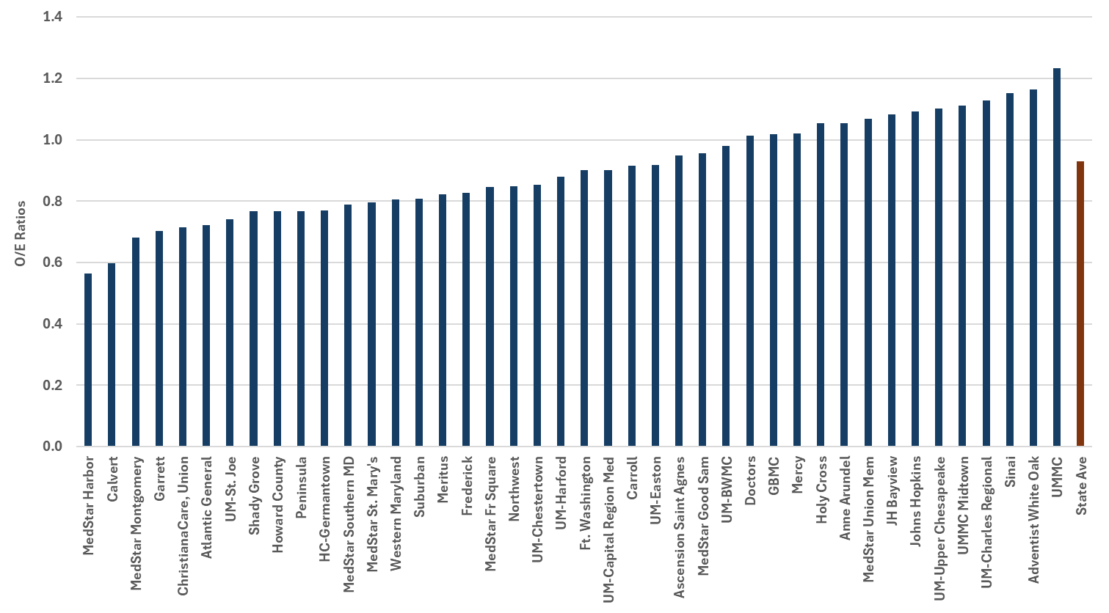
One Third of MD Hospitals Have LOS Higher Than US Average
Focus of future policy incentives
Medicare Part A 2024 claims, adjusted for age, gender, MS-DRG, comorbidities, using National Norms

Slide 39
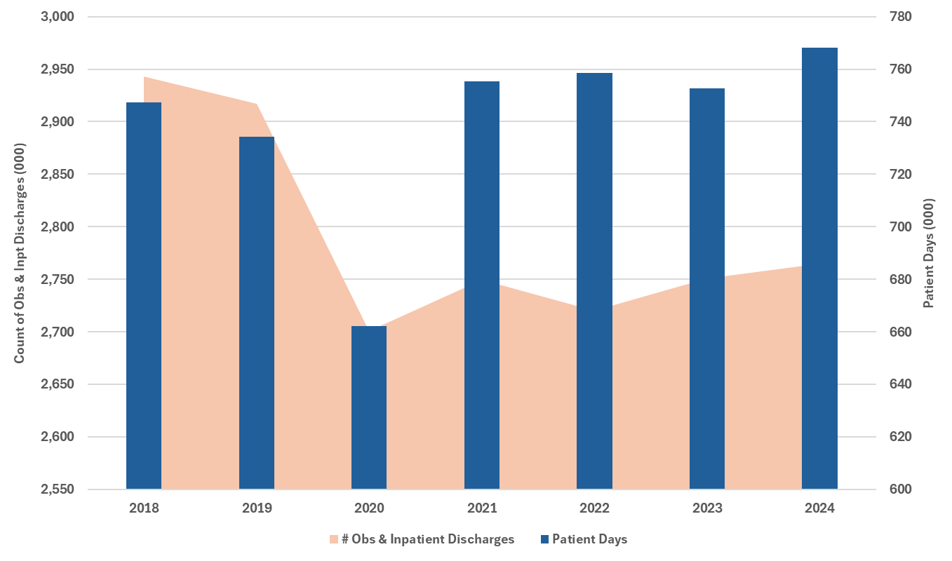
Accounting for OBS Stays Does Not Explain Rising Patient Days
Source: HSCRC Casemix

Slide 40
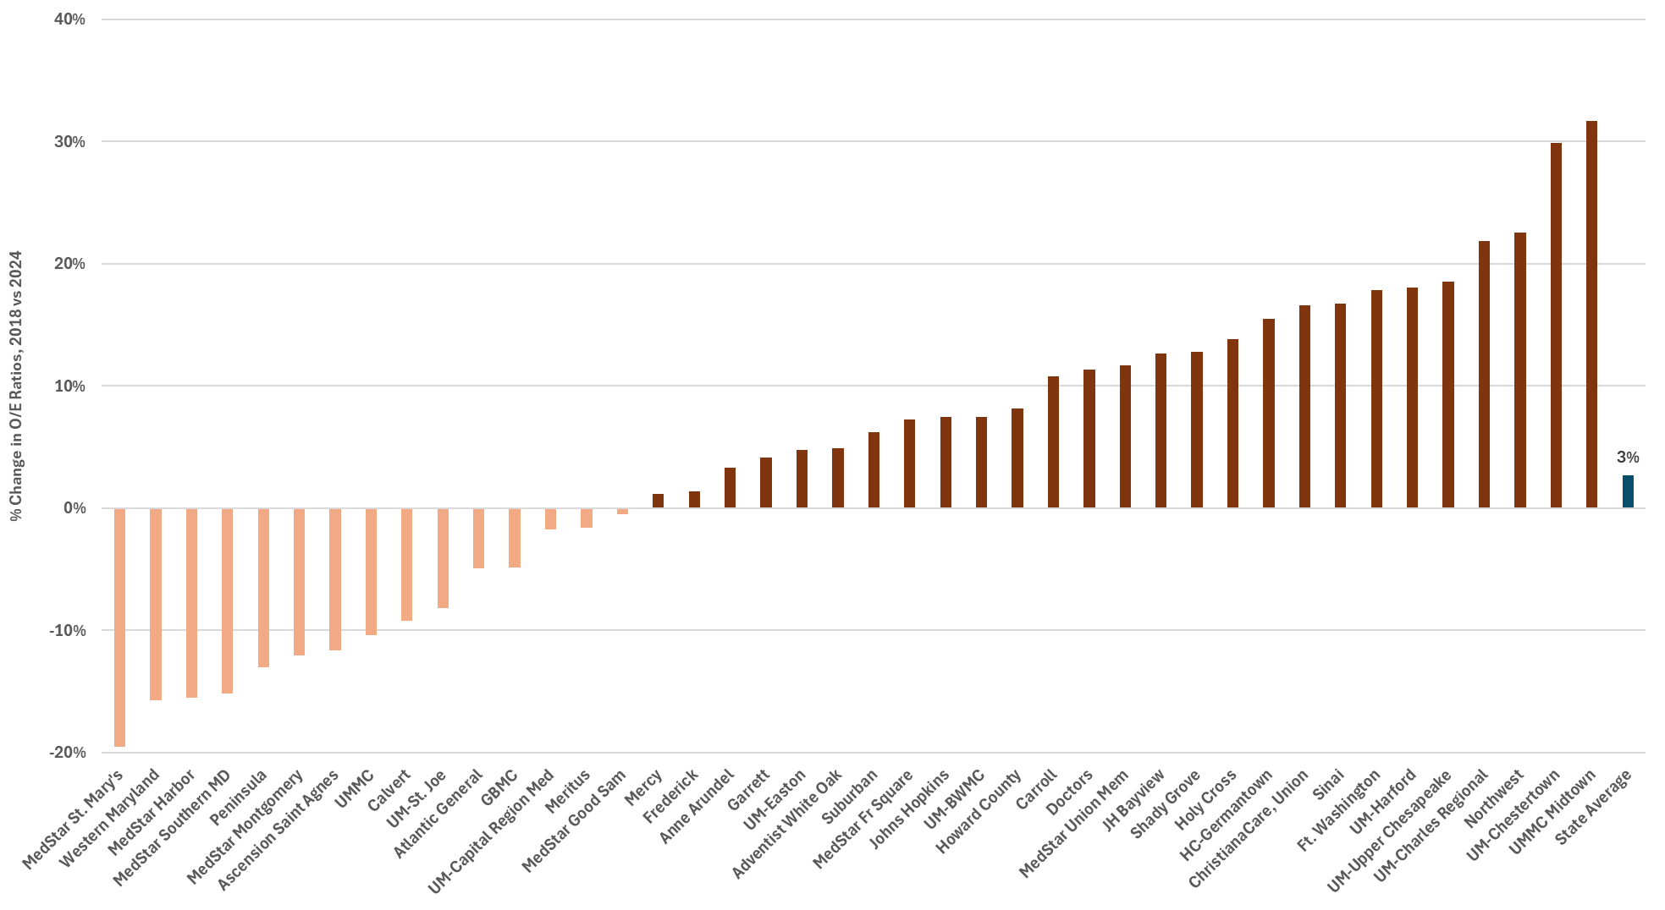
Change in LOS Over Time for IP-Only Procedures, 2018 vs 2024
Based on HSCRC Casemix Inpatient Data, adjusted for severity of illness and APR_DRG using
2018 norms

Slide 41
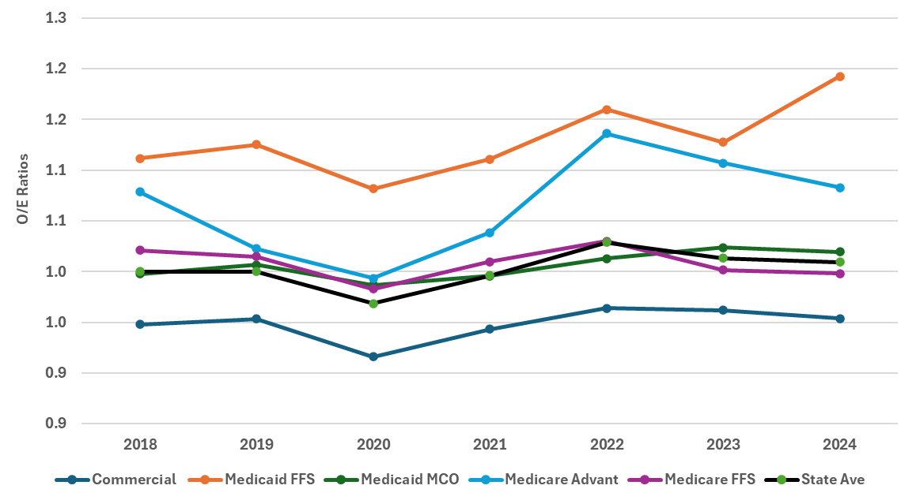
LOS Increase is Concentrated in Non-Commercial Benes
Note: Based on HSCRC Casemix Inpatient Data, adjusted for severity of illness and APR_DRG using
2018 norms

Slide 42
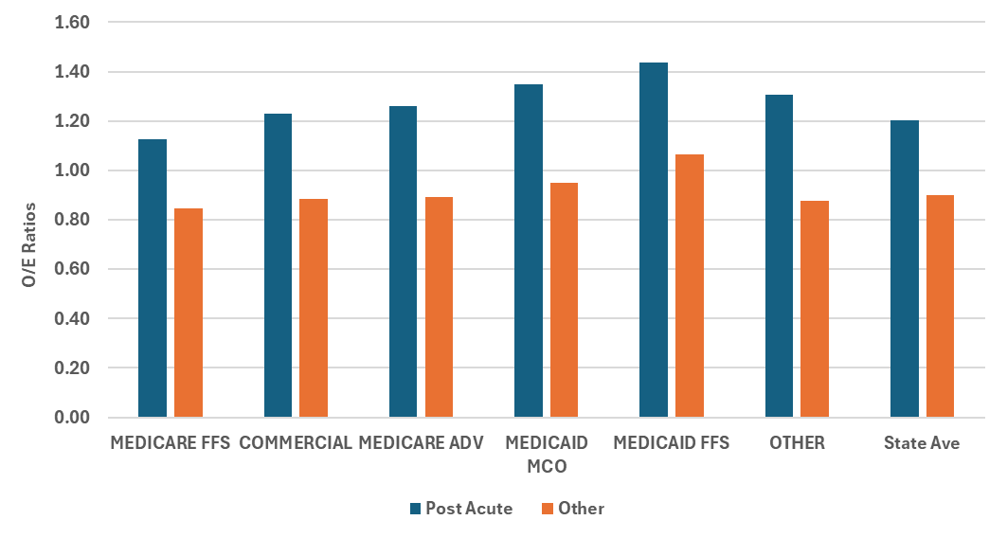
Post-Acute Discharges Are a Major Driver of LOS
Source: HSCRC Casemix All Payer Inpatient data

Slide 43
Measurement
Key points:
The policy will measure inpatient hospital LOS across all-payer, all-cause admissions for acute, chronic, inpatient psychiatry, and specialty hospitals.
Proposed exclusions:
Discharges leaving against medical advice
Same and next day transfers
Expired cases
Shock trauma

Slide 44
Proposed Risk Adjustment
Expected LOS for each patient will be estimated using the base-year mean for each severity of illness (SOI) category within APR-DRG categories from HSCRC casemix
Expected LOS for each hospital will be derived by summing the expected LOS for each patient discharged during the measurement period
Adjusted LOS is Observed LOS/ Expected LOS * Statewide LOS
CY 2018 will be used to calculate statewide averages (normative values), as well as attainment benchmark/threshold values.
Performance period: CY26 or upon policy approval

Slide 45
Incentive Considerations
Improvement-only policy would not necessarily reward hospitals that have invested in managing LOS in previous years
Attainment-only policy could discourage hospitals with longest LOS from investing in improvements
Better of improvement/attainment both recognizes prior investment and encourages future investment
Reward + penalty would likely provide appropriate incentives

Slide 46
Revenue at Risk
Key considerations
Relationship to other quality programs
Sensitivity to unanticipated consequences
Incentive large enough to spur improvement
If LOS incentive exceeds RRIP, it would potentially encourage early discharge from hospital and worsen patient outcomes
Therefore, revenue at risk < 2% is appropriate

Slide 47
Topics for Further Discussion
Connection to Medicare VBP efficiency domain
Reporting
Monitoring for unintended consequences

Slide 48
Emergency Department Updates:
ED Wait Time Reduction Commission Legislative Report Status
ED Best Practices Draft Policy
ED LOS Risk-Adjustment Measure for RY27 QBR

Slide 49
Legislative Report

Slide 50
Legislative Report Update
Draft report was reviewed by the ED WTR Commissioners on 10/3, feedback integrated and draft sent for final review on 10/10
Final draft will be submitted to the Governor’s office and MDH for review this week
Interim report will be submitted to the legislature by 11/1

Slide 51

Legislative Report: Draft Key Recommendations
Strengthen the State’s capacity data infrastructure by developing a reliable and user-friendly reporting mechanism to comprehensively assess capacity across all healthcare settings, both in real-time and in annual assessments.
Will leverage and build upon existing MIEMSS and MHCC processes and reports
Conduct additional statistical modeling and simulations to guide decision-making around hospital emergency department priorities and performance measures
Modeling will provide critical insight into prioritization of initiatives, value-based arrangements and investments
Develop a formal proposal on opportunities to improve post-acute care access and capacity with a focus on regional capacity and proposed infrastructure for complex patient populations.

Slide 52
Draft Recommendations for RY 2028
Building upon the ongoing work of staff and key stakeholders, refine the specifications developed by the Best Practice subgroup on a set of up to six Hospital Best Practices that are designed to improve emergency department (ED) and hospital throughput and reduce ED length of stay (LOS).
For each best practice identified, develop three weighted tiers with corresponding measures that reflect the fidelity and intensity of each best practice. Weighting of tiers will be determined in CY 2026 after CY 2025 data is collected and analyzed.
Require hospitals to select two Best Practices to implement and report data on for RY 2028.
Failure to implement and report data to the Commission by December 31st 2026 will result in a 0.1 percent penalty on all-payer, inpatient revenue to be assessed in January 2027.
We intend to evaluate the impact of the best practices and make a final recommendation for subsequent rate years after the CY 2025 and CY2026 Best Practice program impact is assessed.

Slide 53
Rationale
Data for CY 2025 will be submitted in December. A continuation of monitoring will ensure adequate time to analyze the data and understand the impact of each best practice at individual hospitals and across the state.
Continued monitoring with reporting accountability rather than a transition to pay for performance will provide time to consider how this program will be integrated into and align with the AHEAD model transition.
HSCRC believes that with the AHEAD transition in progress, hospitals should continue to hardwire existing practices to ensure consistency and improvement in RY 2028.
Preliminary results indicate that implementation of these best practices have yielded improvements in throughput

Slide 54
Example of ED Hospital Throughput Best Practice Successes
Bayview Hospital Best Practice: Patient Flow/Throughput PI Council
Focus is building capacity and enhancing patient throughput throughout the entire hospital
Application: Bayview created a Hospital Capacity Steering Committee focused on building on capacity and enhancing patient throughput across the entire hospital.
Current Focus #1: Reduced ED Boarding Times
Median ED Boarding Data:
There was a cultural shift enabled by the Hospital Capacity Steering Committee, but it took time to build the foundation, identify root causes, and launch targeted projects.
Where we used to be: Jul–Sep 2024: 12:07 hours median boarding per patient
Where we are currently: Jul–Sep 2025 (mature projects): 8:00 hours median boarding per patient
33% improvement
Current Focus #2: Lower Walkout Rate (combined LWBS, LBT, SAL) as this is an outcome measure that closely correlates with ED boarding and ED wait times.
Walkout Rate Data:
Where we used to be: Feb 2023 – Jan 2024: 26.4% total elopement/walkout rate
Where we are currently: Feb 2024 – Sep 2025: 19.7% total elopement/walkout rate
25% improvement, reflecting more patients staying to complete care rather than leaving due to long waits
These data points tie directly back to the Hospital Capacity Steering Committee and demonstrate how this best practice has helped improve key metrics, especially as we allow time for the projects to mature and for the culture to change around the importance of hospital capacity.

Slide 55
ED Hospital Throughput Best Practice Successes
Suburban Hospital Two Best Practice Submissions: Daily Huddles and Bed Capacity Alert System – impact on Throughput
Application: Suburban has created a Daily Huddle Process focused on a collaborative approach to patient throughput and safety.
All key stakeholders are on this daily huddle, including our Hospital President, VPMS, CNO, COO, Nursing leadership, ED Leadership, Hospitalist team, and every service line.
Focus on initiatives such as increasing early inpatient discharges (goal of 10 discharge orders by 10am) that positively impact patient flow.
During this huddle, review bed capacity and ED volume so we can respond with appropriate actions.
This approach builds situational awareness, capacity, and collaboration, while focusing on patient care and safety.

Slide 56
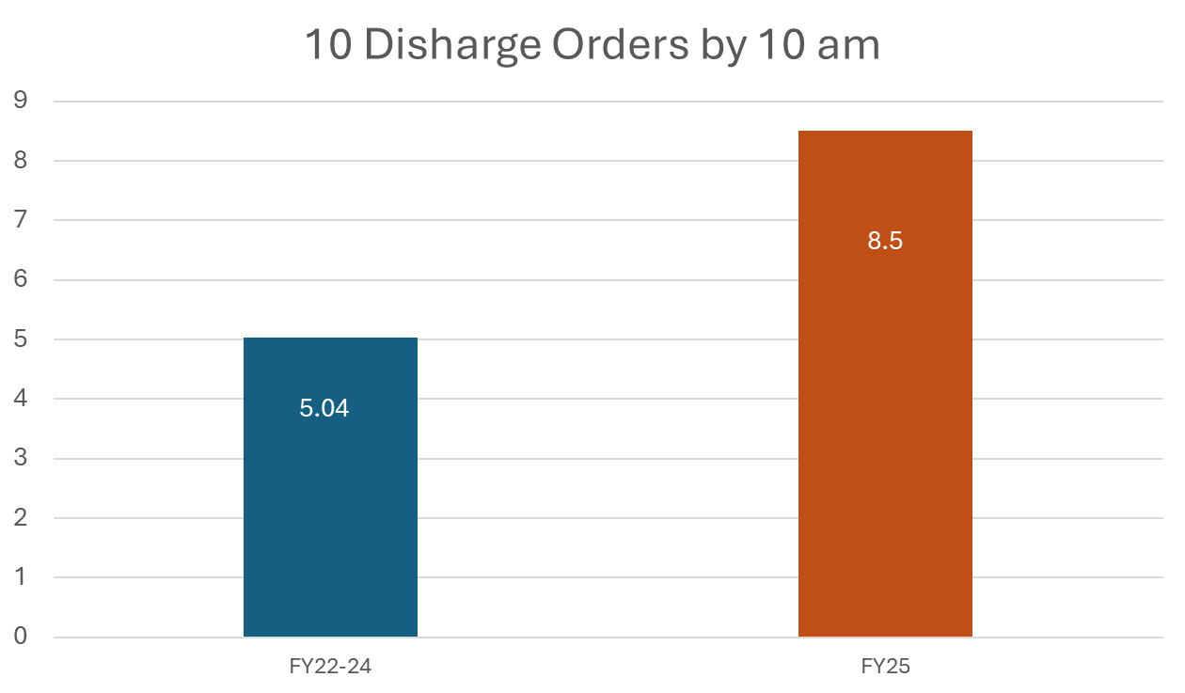
ED Hospital Throughput Best Practice Successes
Goal of entering 10 discharge Orders by 10am
This opens bed capacity on the medical units earlier in the day
Which allows us to move patients out of a busy ED and decreases boarding
The slide illustrates marked improvement in FY25

Slide 57
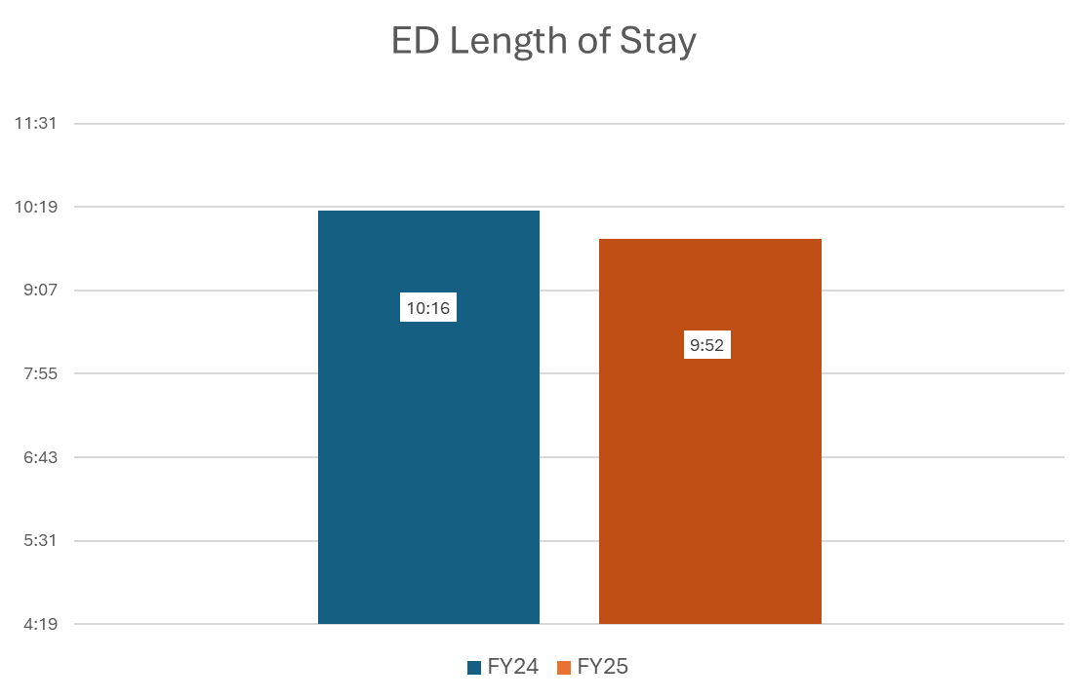
ED Hospital Throughput Best Practice Successes
Goal of decreasing our average Emergency Department length of stay
This allows us to see more patients in a faster and safer manner
This improves patient experience and medical care
The slide illustrates significant improvement in FY25

Slide 58
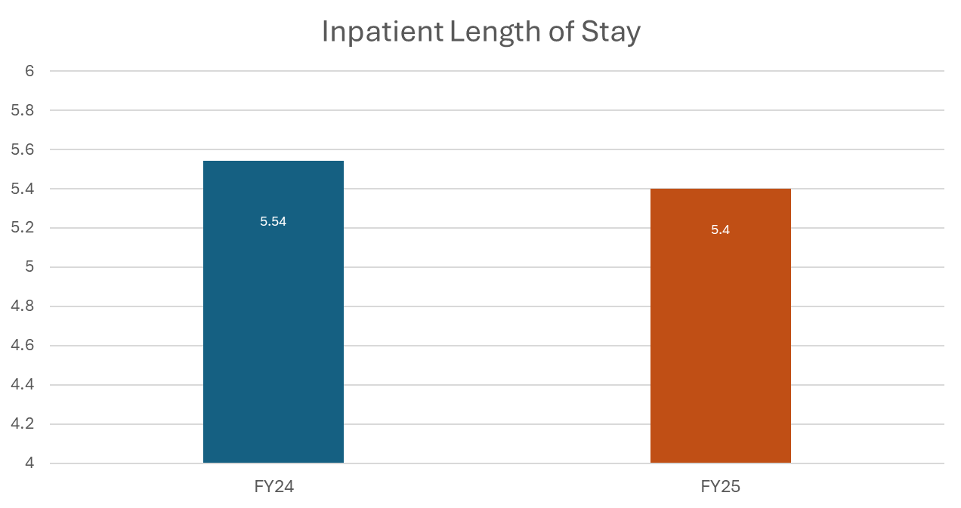
ED Hospital Throughput Best Practice Successes
Goal of decreasing our average inpatient length of stay
This increases bed availability for new patients that need admission
Which decreases the time a patient boards in the ED
The slide illustrates small improvement in FY25

Slide 59
Example of ED Hospital Throughput Best Practice Successes
Emergency Department wait times continue to be a focus for the University of Maryland Medical System and all of its Member Organizations.
A tremendous amount of work has gone into addressing ED wait times and the best practices instituted have begun to demonstrate positive results.
UMMS Member Organizations have implemented and shared best practices including:
Daily Huddles
Interdisciplinary Rounds
Patient Flow Councils
Expedited Care
The Expedited Care efforts in particular have demonstrated significant success as evidenced by:
Member Organizations have reduced the number of patients leaving without being seen by 26%
ED Arrival to Discharge times (OP-18) have improved by 6% CY to date (August) 2025 compared to CY 2024.
Much of this success can be attributed to Rapid Medical Evaluation/Rapid Assessment Zone programs that have emergency medicine physicians and APPs evaluating patients upon arrival.
The goal is to assess, initiate care, and potentially discharge patients earlier in their stay, thus saving invaluable bed capacity in the Main ED for those patients that require a bed

Slide 60
Draft Recommendations for RY 2028
Building upon the ongoing work of staff and key stakeholders, refine the specifications developed by the Best Practice subgroup on a set of up to six Hospital Best Practices that are designed to improve emergency department (ED) and hospital throughput and reduce ED length of stay (LOS).
For each best practice identified, develop three weighted tiers with corresponding measures that reflect the fidelity and intensity of each best practice. Weighting of tiers will be determined in CY 2026 after CY 2025 data is collected and analyzed.
Require hospitals to select two Best Practices to implement and report data on for RY 2028.
Failure to implement and report data to the Commission by December 31st 2026 will result in a 0.1 percent penalty on all-payer, inpatient revenue to be assessed in January 2027.
We intend to evaluate the impact of the best practices and make a final recommendation for subsequent rate years after the CY 2025 and CY 2026 Best Practice program impact is assessed.

Slide 61
ED LOS Measure-Development of Risk-Adjusted Measure

Slide 62
Development of Risk-Adjusted ED LOS Measure
RY 2027 QBR includes improvement on IP ED LOS measure
Hospital stakeholders have requested staff to explore risk-adjustment for this measure
Mathematica has begun work on ED LOS risk-adjustment with priority on the IP ED LOS payment measure using current specification (e.g., removal of pediatrics, primary psychiatric dx, etc.)

Slide 63
Risk-Adjustment Considerations
Appropriate for outcome measures when comparing across hospitals
Conceptual models are used to pick potential risk factors to include in risk-adjustment
Preferable to fit model with as few variables as possible to explain variance
The purpose of risk adjustment is to eliminate bias from confounding variables – those that are associated with both the outcome and with differences in patient population across hospitals
Adjusting for variables describing what happens after a patient arrives at the hospital (i.e., processes of care) can bias performance estimates

Slide 64
ED Length of Stay Risk Adjustment: Inpatient
Preliminary Results: 10/14

Slide 65
Objective
Develop a measure of hospitals’ ED length of stay that can identify opportunities for improvement by accounting for differences in their patient and visit characteristics
Test exclusions and risk factors that permit fair comparisons among hospitals

Slide 66
Methods
2 Models in development
ED visits resulting in inpatient admission
ED visits ending without inpatient admission*
Logged dependent variable
Avoids negative LOS prediction
Improves fit
Complicates interpretation
Identifying patient and hospital characteristics
Hospital characteristics associated with patient model residuals
Comparing patient-level models with and without hospital fixed effect
If a variable from the patient-level model is not related to outcome in the presence of hospital fixed effect, its correlation with the outcome is probably due to the hospital
* i.e., outpatient ED LOS; Not presented

Slide 67
Inpatient model
Calendar Year 2023, 2024 models fit
Results presented for 2023
Admission APR-DRG, APR-MDC and admission risk of mortality are clinical risk adjusters
Includes inpatient admissions with observation stays
ED stays with valid ED dates and times
Excludes maternity, trauma, burns, psychiatric, pediatric, homeless, chronic conditions, rehab
Excludes stays over 30 days long

Slide 68
Risk factors considered
Clinical characteristics
Risk of mortality: On admission to inpatient stay
APR_MDC: Admitting major diagnostic category from inpatient stay
APR-DRG: Admitting APR-DRG from inpatient stay, if at least 30 stays with this DRG (these are grouped into single dummy DRG)
Patient demographics
Sex: Male, female, unknown
Age group: 5-year groupings, with 18 – 20, 85+
Preferred language English: Y=no other language specified
Hospital choice
Observation stay: Observation start date not missing
Visit characteristics
Primary payer: Charity, Medicare, Medicaid, Commercial, Other, NA
Arrived by ambulance: Y/N
Admission source: Excludes newborns
Hour of arrival: From ED arrival time
Weekend arrival: From ED arrival date
Secondary psychiatric diagnosis: From code list

Slide 69
Initial patient model
Variable | DF | Type 1 SS | Mean square | F-stat | Probability
Ambulance arrival | 1 | 540.95 | 540.95 | 1117.53 | <.0001
MDC | 23 | 1347.59 | 58.59 | 121.04 | <.0001
English not preferred | 1 | 35.10 | 35.10 | 72.50 | <.0001
Observation stay | 1 | 3314.49 | 3314.49 | 6847.23 | <.0001
Risk of mortality | 4 | 933.46 | 233.36 | 482.09 | <.0001
APR DRG | 230 | 7329.17 | 31.87 | 65.83 | <.0001
Payer group | 4 | 239.25 | 59.81 | 123.56 | <.0001
Sex | 2 | 25.51 | 12.75 | 26.35 | <.0001
Admission source | 10 | 230.45 | 23.05 | 47.61 | <.0001
Age Group | 14 | 104.24 | 7.45 | 15.38 | <.0001
Arrival hour | 23 | 411.22 | 17.88 | 36.94 | <.0001
Weekend visit | 1 | 93.50 | 93.50 | 193.15 | <.0001
Secondary psych | 1 | 60.18 | 60.18 | 124.32 | <.0001
Preferred language not English: LOS 7 percent longer
With observation stay: 18 percent longer
Medicare and Medicaid LOS is longer
Shortest stays are in late morning hours (7 – 11)
ROM level 4 LOS is shorter than other ROM
Secondary psych LOS is 3 percent longer
Ambulance arrivals are 7 percent shorter

Slide 70
Hospital model
Variable | DF | Type 1 SS | Mean Square | F-stat | Probability
Trauma level | 3 | 6800.21 | 2266.74 | 4.27 | 0.01
Medicare share | 1 | 1568.59 | 1568.59 | 2.95 | 0.09
Charity share | 1 | 1382.52 | 1382.52 | 2.60 | 0.12
Medicaid share | 1 | 11.59 | 11.59 | 0.02 | 0.88
Trauma level 2 LOS significantly longer than level 3
Do not recommend adding level 2 adjustment – 42 hospitals too small a number to identify effect
R-square = .344

Slide 71
Patient model with hospital effect
Variable | DF | Type 1 SS | Mean square | F-stat | Probability
Hospital | 41 | 29271.28 | 713.93 | 1911.05 | <.0001
Ambulance arrival | 1 | 543.69 | 543.69 | 1455.34 | <.0001
MDC | 23 | 1568.12 | 68.18 | 182.50 | <.0001
English not preferred | 1 | 0.04 | 0.04 | 0.10 | 0.7545
Observation stay | 1 | 2477.56 | 2477.56 | 6631.89 | <.0001
Risk of mortality | 4 | 1201.77 | 300.44 | 804.22 | <.0001
APR DRG | 230 | 7892.97 | 34.32 | 91.86 | <.0001
Payer group | 4 | 172.52 | 43.13 | 115.45 | <.0001
Sex | 2 | 24.85 | 12.43 | 33.26 | <.0001
Admission source | 10 | 198.25 | 19.82 | 53.07 | <.0001
Age Group | 14 | 132.03 | 9.43 | 25.24 | <.0001
Arrival hour | 23 | 358.75 | 15.60 | 41.75 | <.0001
Weekend visit | 1 | 139.36 | 139.36 | 373.04 | <.0001
Secondary psych | 1 | 57.99 | 57.99 | 155.21 | <.0001
Preferred language not English not significant when controlling for hospital – suggests that non-English speakers are getting care at hospitals with longer LOS, not that it takes longer to care for them – variable dropped

Slide 72
Patient model
Variable | DF | Type 1 SS | Mean square | F-stat | Probability
Ambulance arrival | 1 | 540.95 | 540.95 | 1117.12 | <.0001
Observation stay | 1 | 3514.74 | 3514.74 | 7258.26 | <.0001
MDC | 23 | 1151.29 | 50.06 | 103.37 | <.0001
Risk of mortality | 4 | 928.74 | 232.19 | 479.48 | <.0001
APR DRG | 230 | 7317.93 | 31.82 | 65.71 | <.0001
Payer group | 4 | 248.98 | 62.25 | 128.54 | <.0001
Sex | 2 | 26.10 | 13.05 | 26.95 | <.0001
Admission source | 10 | 227.41 | 22.74 | 46.96 | <.0001
Age Group | 14 | 98.86 | 7.06 | 14.58 | <.0001
Arrival hour | 23 | 415.38 | 18.06 | 37.30 | <.0001
Weekend visit | 1 | 93.56 | 93.56 | 193.21 | <.0001
Secondary psych | 1 | 53.69 | 53.69 | 110.88 | <.0001
R-square = .102

Slide 73
Clinical model
Variable | DF | Type 1 SS | Mean square | F-stat | Probability
MDC | 23 | 1483.63 | 64.51 | 129.90 | <.0001
Risk of mortality | 4 | 1272.00 | 318.00 | 640.38 | <.0001
APR-DRG | 230 | 8553.86 | 37.19 | 74.89 | <.0001
Clinical model contains 3 of the 4 most powerful predictors from the full model (other is observation stay) and retains much of its explanatory power
R-square = .079

Slide 74
Discussion & Next steps
Consider what risk factors to include in final model?
Investigate observation stays
Consider alternative estimation methods
Refine exclusions, risk-factors, and share hospital level results

Slide 75
THANK YOU!
Next Meeting: November 19, 2025

Slide 76
APPENDIX

Slide 77
Inpatient Prospective Payment System FY 2026
Final Rule

Slide 78
Hospital Value Based Purchasing Updates
Removed Health Equity Adjustment (HEA) starting FY 2026.
Modifications to the THA-TKA Complication and Stroke mortality measure:
Add Medicare Advantage patients to the current cohort of patients and shorten the performance period from 3 years to 2 years, effective FY 2027.
CMS is also making technical updates to the risk adjustment methodology to use International Classification of Diseases (ICD)-10 codes instead of Hierarchical Condition Categories (HCCs); modifications adopted, effective FY 2033.
Remove the COVID-19 exclusion and discontinue the covariate for prior COVID-19 history across all six Clinical Care measures (THA/TKA Complications and five condition-specific mortality measures), effective FY 2027.
Updated Performance standards published for FY 2027–FY 2031.
Extraordinary Circumstances Exception (ECE) policy codified/clarified.:
Reduced filing deadline from 90 to 60-days
Discretion to grant extensions as well as exceptions.

Slide 79
Hospital-Acquired Conditions and Hospital Readmissions Reduction Program Updates
Hospital-Acquired Condition Reduction Program (HACRP) final policy changes:
CDC NHSN HAI “rebaseline” adopted. CMS gives notice that CDC’s switch to 2022 standard population data for SIR calculations will flow into HACRP. Because HACRP uses a 2-year performance period, the new baseline first affects HACRP in FY 2028 (performance CY2025–CY2026).
ECE policy codified/clarified (shared approach across programs).
Hospital Readmissions Reduction Program (HRRP) final policy changes:
Medicare Advantage (MA) patients were added to all six HRRP measures’ cohorts.
The performance period was reduced from 3 years to 2 years.
COVID-19 exclusions removed from HRRP readmission measures.
MA payment amounts not included in the aggregate payments for excess readmissions calculation.
ECE policy codified/clarified (shared approach across programs).

Slide 80
Hospital Inpatient Quality Reporting and Digital Measures Updates
Hospital Inpatient Quality Reporting (IQR) Program
CMS removed the following four measures starting in FY 2026 (CY 2024 performance period):
Hospital Commitment to Health Equity
COVID-19 Vaccination Coverage Among Healthcare Personnel
Screening for Social Drivers of Health
Screen Positive Rate for Social Drivers of Health
Digital Measures
CMS is moving to FHIR-based eCQMs by converting current eCQMs (authored using the QDM) to eCQMs authored using the HL7 FHIR® Quality Improvement Core (QI-Core) IG and ensuring new eCQMs are also natively developed in FHIR.
CMS will add the following two new eCQMs focused on Hospital Harm for FY 2028 (CY 2026 performance):
Hospital Harm – Falls with Injury eCQM
Hospital Harm – Postoperative Respiratory Failure eCQM
CMS signaled these Hospital Harm eCQMs will likely replace conventional Patient Safety Indicators (PSI) in the future.

Slide 81
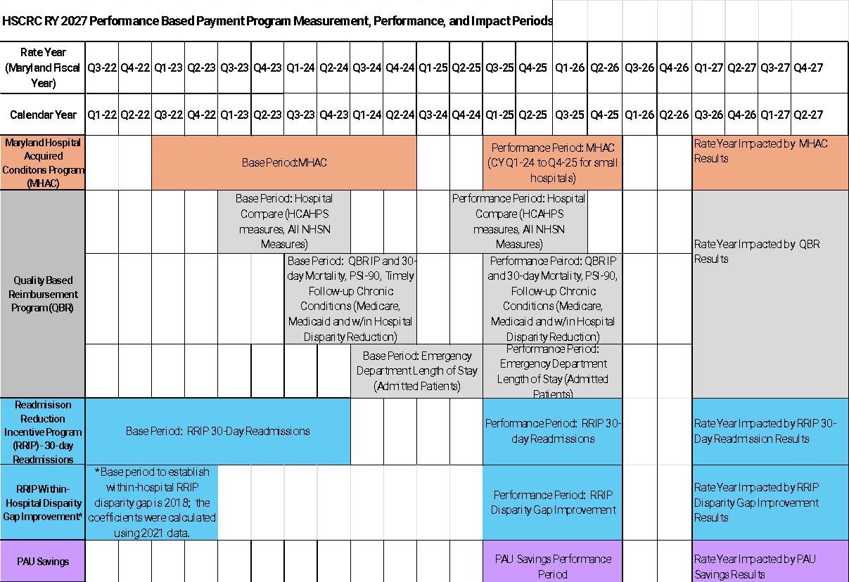
RY 2027 Quality Program Timelines

Slide 82
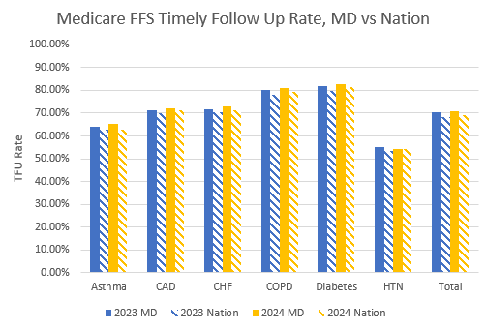
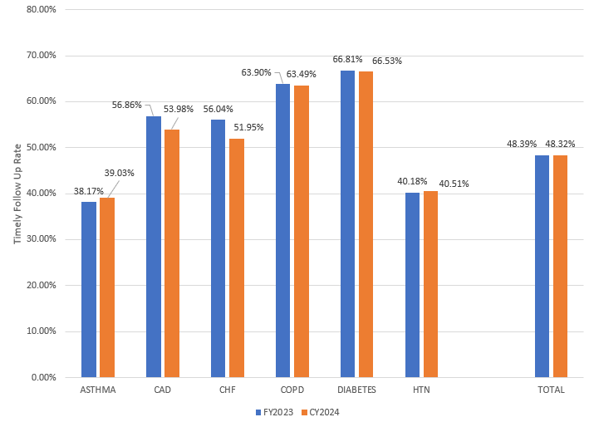
QBR Timely Follow Up
Maryland performs better than the nation on each of the six chronic conditions and overall, but is unchanged in 2023 and 2024.
Medicaid TFU in Maryland is Unchanged
Overall from FY 2023 to CY 2024

Slide 83
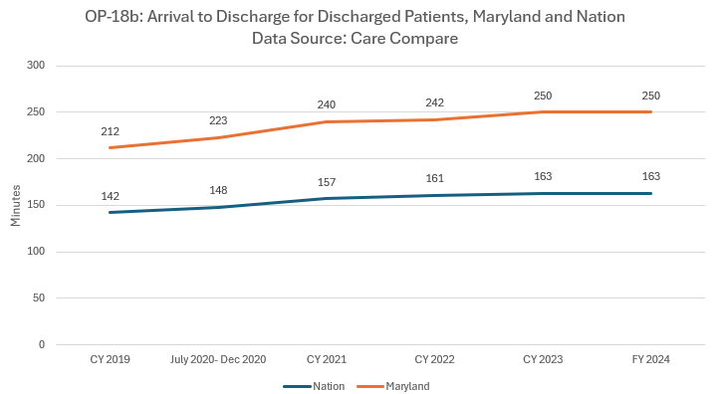
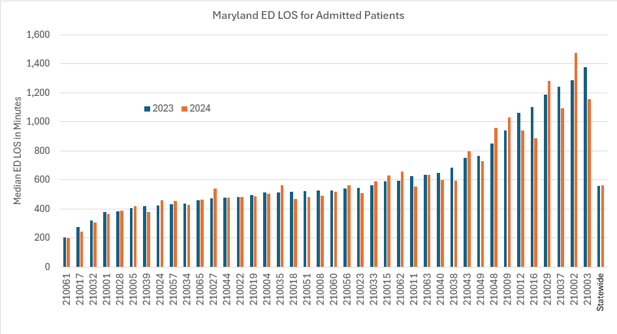
QBR ED Length of Stay
Maryland continues to have wait times ~90 minutes longer than the nation on average for discharged patients.
Based on RY2026 ED LOS measure developed by the Commission, statewide Maryland continues to have prolonged wait times of ~500+ minutes for admitted patients and is unchanged from 2023 to 2024.

Slide 84
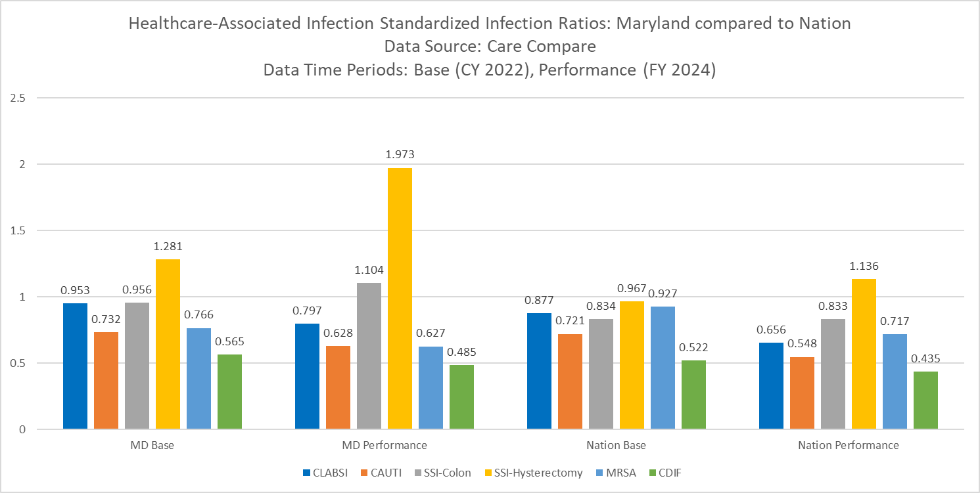
QBR CDC NHSN HAIs
Maryland’s SIRs for all HAIs are higher in the base and performance periods,
The differences from 2022-2023 are not statistically significant.
Maryland Changes in state-specific standardized infection ratios (SIRs) between 2022 and 2023 for NHSN Acute Care Hospitals
 | 2022 SIR | 2023 SIR | Percent Change | Direction of Change, Based on Statistical Significance | p-value
CLABSI | 0.946 | 0.848 | -10% | No statistically significant change | 0.1189
CAUTI | 0.753 | 0.763 | 1% | No statistically significant change | 0.8575
SSI Colon | 0.861 | 0.890 | 3% | No statistically Significant change | 0.8944
SSI Hysterectomy | 1.185 | 1.515 | 28% | No statistically significant change | 0.2771
MRSA | 0.767 | 0.571 | -26% | Statistically significant decrease | 0.0165
CDIF | 0.570 | 0.500 | -12% | Statistically significant decrease | 0.0060

Slide 85
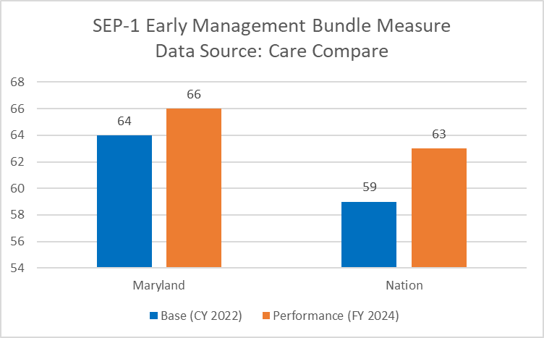
QBR Sepsis Bundle and All-Payer
AHRQ PSIs
Maryland performs better than the nation on the Sepsis bundle
On the all-payer PSI 90 Composite measure in the QBR program, Maryland continues to improve and perform better than the nation on the overall composite measure and the majority of the 10 component indicators.
PSI Name | Maryland 2024 Compared to the Nation 2024 | Maryland 2024 Compared to Maryland 2023
PSI 90 Composite | Better | Improved
PSI 3 Pressure Ulcer | Worse | Improved
PSI 6-Iatrogenic pneumothorax | Better | Improved
PSI 8 In Hospital Fall and Fracture | Better | Worse
PSI 9 Perioperative Hemorrhage or Hematoma | Better | Improved
PSI 10 Postoperative Acute Kidney Injury w/Dialysis | Better | Worse
PSI 11 Postoperative Respiratory Failure | Better | Improved
PSI 12 Postoperative Pulmonary Embolism or DVT | Better | Improved
PSI 13 Postoperative Sepsis Rate | Better | Improved
PSI 14 Postoperative Wound Dehiscence | Better | Worse
PSI 15 Abdominopelvic Accidental Puncture or Lac | Worse | Improved

Slide 86
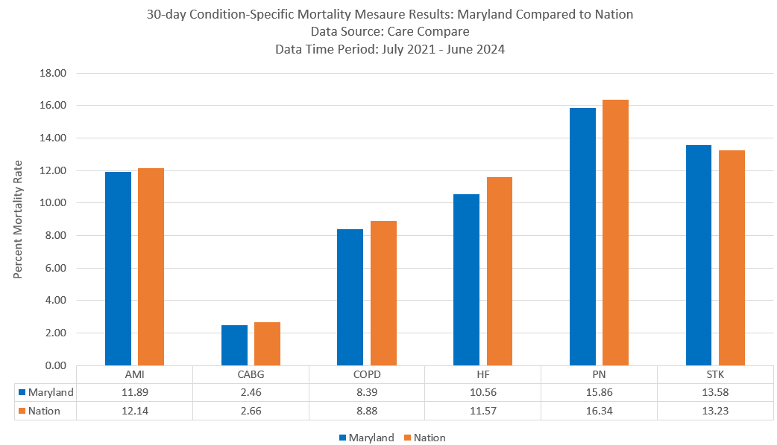
QBR IP and 30-Day and VBP Condition Specific Mortality
Inpatient Mortality: Statewide survival rate increased from 95.27 percent in the base period of SFY 2023 to 95.66 percent in the CY 2024 performance period.
30-Day Mortality: In CY 2024, survival rates range from ~96 percent to ~97 percent with 24 hospitals improving and six hospitals declining compared to SFY 2023; the statewide average survival rate improved by 0.10 percent.
Medicare 30-Day, Condition Specific Mortality: Maryland performed better than the nation on all condition specific measures.

Slide 87
Revenue Adjustments and Performance Recap
Final RY 2025 revenue adjustment results:
24 hospitals were penalized and 17 hospitals received a reward; statewide net penalties amount is ~$33 million across the 24 hospitals that were penalized while the 17 hospitals earning a reward will receive a total of ~$11M.
HCAHPS- Maryland continues to lag the nation.
Sepsis- Maryland continues to both improve over time and perform better than the nation on the SEP-1 bundle process measure and on other sepsis-related measures including PSI 13 Postoperative Sepsis.
Patient Safety Indicators- On the all-payer PSI 90 Composite measure in the QBR program, Maryland continues to improve and perform better than the nation on the overall composite measure and the majority of the 10 component indicators.
Timely Follow Up- Maryland continues to both improve over time and perform better than the nation in timely follow up after acute exacerbation of six chronic conditions for Medicare patients.
Mortality- Maryland continues to improve over time on the all-payer, all-conditions inpatient and 30-day QBR mortality measures used in the QBR program (applicable to broader patient populations than the CMS HVBP measure), and performs similarly to the nation on the Medicare 30-day condition specific HVBP mortality measures.
CDC NHSN HAI Measures- Between CY 2022 and CY 2023, Maryland improved on two measures and did not worsen on the remaining four measures based on the CDC’s annual analysis of statistically significant changes of performance on the measures.

