Slide 1
Second Volume Workgroup Meeting
April 25, 2024

Slide 2
Agenda
Workgroup Work Plan Update
Updated Timeline for Workgroup Engagement
Stakeholder Feedback on Out of State Analysis
Deregulation Review
Volume Scorecard Update

Slide 3
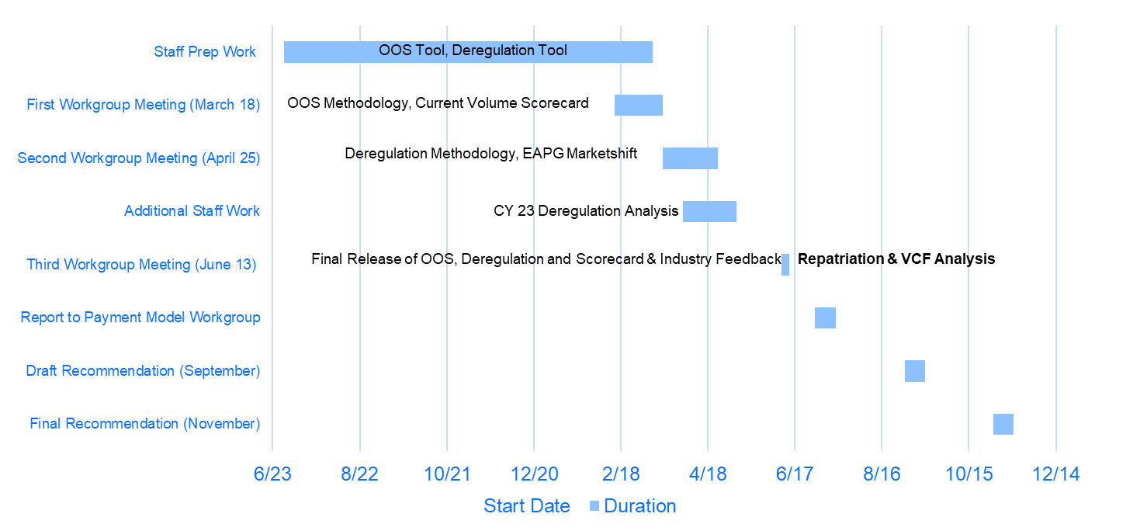
Revised Timeline for CY 2024 Volume Workgroup
Due to Requests for Repatriation and VCF Analyses staff is proposing extending the timeline
May engage workgroup in one additional meeting if necessary

Slide 4
Stakeholder Feedback on OOS Analysis

Slide 5
Stakeholder Feedback on OOS Analysis
One stakeholder asked if staff was concerned about the movement of services to OOS
Staff noted that this would be handled through the deregulation policy
Additionally, there has been notification to the HSCRC of hospital’s added oos services
A few stakeholders suggested that an asymmetrical approach should be considered for the proposed OOS methodology and/or there should be a holistic review of all volume funding policies before making adjustments
I.e., larger materiality thresholds for defunding than new funding & limiting defunding when volume is not funded “adequately” across all volume policies
There are limited data analytics staff can provide on these points, but stakeholder input would be appreciated
Most cited concerns stemmed around the omission of drugs and supplies and the decision to use experience data in lieu of ECMADS
See analysis on next slide with potential solution
Additional questions were raised concerning:
Variable cost factor analyses
Repatriation
Anything else?

Slide 6
Experience Data vs ECMADS Analysis and Proposal
As staff have noted, there are several drawbacks to using experience data in lieu of ECMADS, but for analyses that go back to 2014 experience data is absolutely necessary
Analyses of both data approaches for RY 2022 vs RY 2021 indicates there is a limited difference
ECMAD Approach applies 50% VCF and excludes Oncology Drug service line
Staff believe this analysis demonstrates that the use of experience data and the exclusion of drugs and supplies creates negligible YOY discrepancies relative to ECMADS but overtime could be problematic
Staff, thus, proposes using experience data to a more current time period and then updating thereafter with ECMADS
EX: RY14-RY23 Experience Data + RY23-RY24 ECMADS
Important to remember that %’s are based of off ~10% of statewide revenue

Slide 7
Deregulation

Slide 8
What is Deregulation?
Deregulation is the movement of a hospital service from a HSCRC regulated space to an unregulated space (most often outpatient services but also chronic and rehab).
A service is presumed to be regulated if the building is on the campus of a hospital
Criteria outlined in COMAR are considered for determination of unregulated services, which need to be approved by the Commission
Service movement can be initiated by 1) payers, 2) the hospital itself, 3) physician practices and in some cases the deregulation may simply be a function of 4) service discontinuation or 5) cross border movement to an unregulated hospital
1) Payer Initiative Ex: Remicade, Immunoglobulin, Endoscopies, and Ultrasounds
2) Hospital Ex: Oncology
3) Physician Practices Ex: Endoscopy
4) Service Discontinuation Ex: Sleep Services 5
5) Cross Border Movement Ex: Inpatient Surgery & Cardiology into D.C.

Slide 9
Deregulation Tool Sources
Market Shift data:
All-Payer data derived from hospital casemix data
EAPG/DRG specific, allowing for more granular look at potential shifts
Does not contain non-hospital activity, thus making it hard to use on it’s own as confirmation of deregulation vs. dissipated volumes that are supposed to be rewarded by the GBR methodology
Medicare CCW (chronic conditions warehouse):
Medicare only dataset and is not used in other hospital rate adjustments
Significant advantage of being able to observe if offsetting increases have occurred in other settings
Claims are assigned to one of three place of service (outpatient hospital, other outpatient and professional) and ECMADs are assigned using weights developed in casemix.

Slide 10
Current Review Process
1. Quantify declines in:
Unrecognized Market Shift data (UMS Decline) and
Shifts in place of service away from hospital in the Medicare CCW data (POS Shift) at a service line and hospital service area level - requires extrapolation to all-payer
2. Flag a service line-service area combination for further review if there is both a material (a) UMS Decline and (b) POS Shift.
3. Quantify an amount of potential deregulation, measured in ECMADs, as the lessor of the UMS Decline and the POS Shift.
4. The potential deregulation is then validated by reviewing the underlying data for that hospital service line area and converted to dollars using the hospital specific charges per ECMAD for that service line.
5. Assuming no data flags and other issues are identified the HSCRC will then share the data with the hospital for input on the circumstances before proposing a final adjustment.

Slide 11
Overarching concerns
Utilizing the methodology outlined in the previous slide, it is unsurprising that most of the shifts of service occurred in Major and Minor Surgery.
Most deregulation occurs in OP services
Surgical services are very susceptible to site of service change (e.g., knee replacements were previously all performed in an IP setting and now can be done in OP).
Major and Minor Surgery are amorphous service lines:
Major Surgery has 94 unique EAPG’s (4th highest); Minor Surgery has 64 (5th highest)
Service lines on average have 34 unique EAPG/DRG’s
Disparate procedures exist within these service lines
Major Surgery Example - Hysterectomies (8% of cases); Endoscopies (7% of cases)
Minor Surgery Example - Wound Repair (17% of cases); Biopsies (4% of cases)

Slide 12
Potential Solution
Prior methodology relied on service line evaluation because staff must:
Evaluate changes in all-payer hospital volumes AND
Ensure that the shifts have not already been accounted for in Marketshift
Staff created a new methodological tool (EAPG/DRG marketshift analysis)
Shifts are quantified at the same geography but are aggregated by EAPG/DRG’s in lieu of service lines
Analysis is normalized to regular marketshift adjustment values

Slide 13
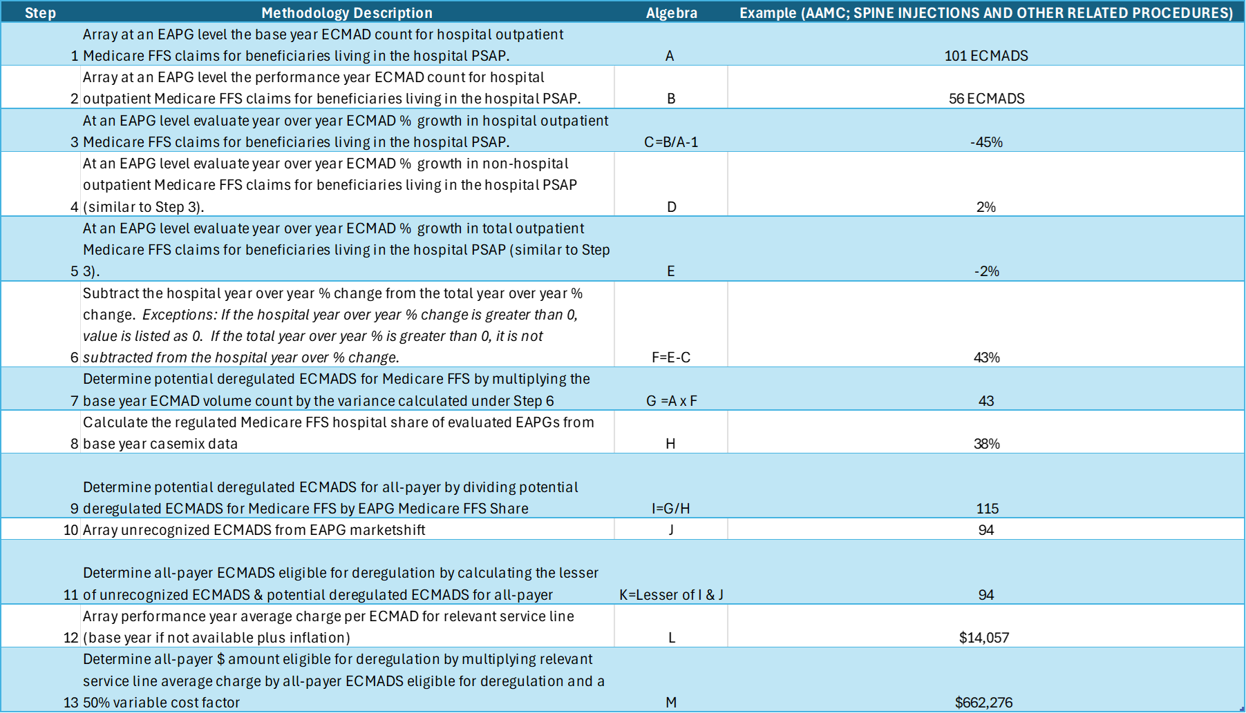
Proposed Methodology & Deregulation Model Walkthrough
Potential Considerations
Restricting hospital outpatient to regulated hospital delivery vs hospital service area
Using service line Medicare FFS Share in lieu of EAPGS to extrapolate to all-payer
Using EAPG Average Charge in lieu of service line
Discontinued materiality thresholds under EAPG approach

Slide 14
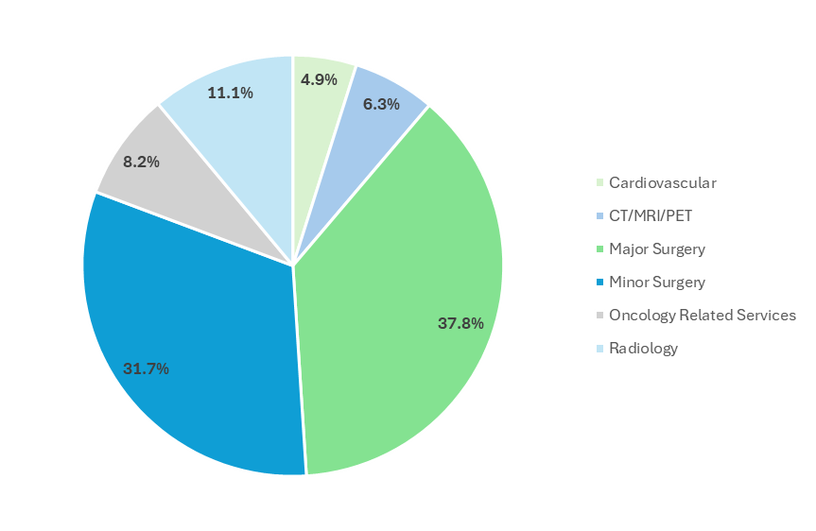
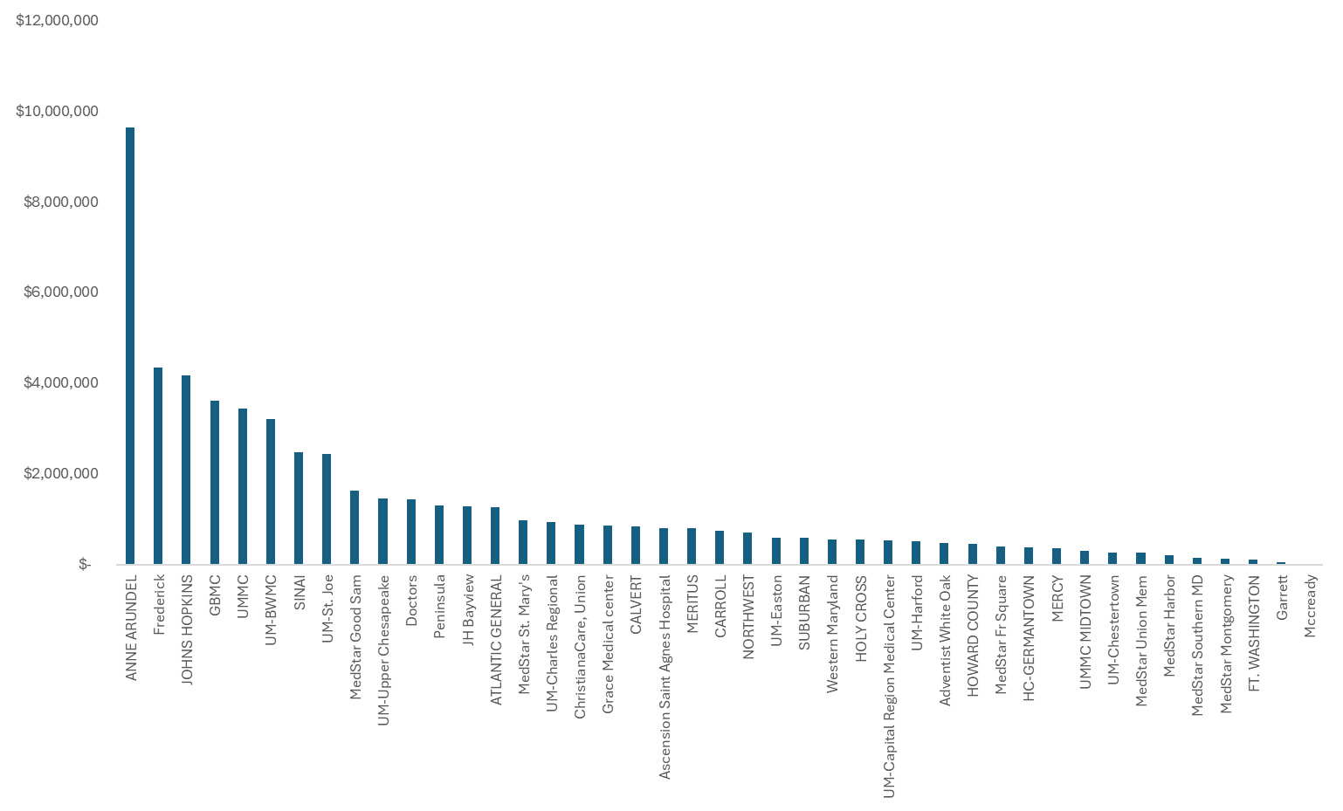
Preliminary Deregulation Results
As suspected, the majority of CY 2022 potential deregulation was in major and minor surgery (~70%)
Potential deregulation was similar to service line approach (R=.89) but $12M less statewide ($56M versus $68M)

Slide 15
Other Deregulation Considerations

Slide 16
Hospital Notification of Deregulation
To streamline the hospital notification process for deregulations, the HSCRC staff is finalizing a document detailing key submission requirements and the types of supporting documents expected to accompany a deregulation request.
This initiative aims to enhance the efficiency and security of the deregulation process, ensuring a smoother transition for services moving to unregulated settings and setting clear expectations between the HSCRC and hospitals.
More information on the process in the next few slides.

Slide 17
Hospital Notification of Deregulation
1. Hospitals initiate deregulation requests by submitting a formal request letter on system letterhead.
The letter should state what is being deregulated, the effective date of deregulation, and anticipated $ value of shift to unregulated setting.
2. Following the letter, hospitals are further required to provide supporting documentation along with their formal request.
Due to the sensitive nature of the data, hospitals must refrain from sending patient-level data via unencrypted email.
Secure channels such as an encrypted email or the Repository (RDS) should be utilized.
3. Hospital Rate Analysts at the HSCRC will review requests and ensure that all data requirements are met.
Upon review, this information will be forwarded to the Health Data Management and Integrity Team (HDMI) to run HSCRC casemix reports.
4. Rate Setting will recommend a final GBR permanent adjustment to the hospital.
The validation process adheres to the final values provided by the HSCRC casemix data, as it represents the most accurate and reliable reported data values available.
Depending on the date of notification, the HSCRC may be required to include a one-time adjustment to account for unreported time.

Slide 18
Hospital Notification of Deregulation
Calculating a Hospital Deregulation Adjustment:
1. The HSCRC casemix report will be compared against hospital-reported data to identify any significant discrepancies in RVUs and charges.
In cases of material differences, analysts will consult with the hospital to verify accuracy.
2. The HSCRC then uses the final, accurate casemix data to calculate final permanent adjustments, applying a 50% VCF to the latest 12-month actuals.
Deregulations that occur late in the rate year may lead to adjustments based on an annualized current year calculation for a full 12-month period.
3. For late-reported previous year deregulations, a one-time 50% VCF adjustment is calculated for the post-deregulation period.

Slide 19
Waiting Vs. Notifying
Why do hospitals need to notify and not wait until the deregulation tool identifies the deregulation?
Hospitals have a contractual obligation to notify the Commission.
Thus, staff believes there should an incentive to notify, rather than wait.
All permanent adjustments will be based on a 50% variable cost factor
On time notification will have a 50% variable cost factor for first year results
Strawman: deregulation found via the deregulation tool will have a one-time component with a 65% variable cost factor
What is the process to reconcile against the deregulation tool?
What happens if a $9.5m deregulation was calculated, but the deregulation tool identifies $10m for same service? Or same scenario, but opposite figures?
Should there be a true up?
Should there be a materiality threshold to determine if a reconciliation needs to occur?
Strawman: any variance between the prospective deregulation adjustment and the dereg tool that exceeds the lesser of 2% or $1M will require reconciliation

Slide 20
Grace Period/Backfill?
Do hospitals need to notify if they plan on backfilling the services?
Yes, hospitals still need to notify.
HSCRC and hospital will determine appropriate path forward based on circumstances. For example, if a hospital has a temporary physician vacancy, staff would likely be okay to wait until a new physician comes on board. (strawman: within 1 year)
Plan for backfill will need to be presented upon notification of deregulation.
Backfill should be governed by historical utilization levels, i.e. regulated backfill + new deregulated service may not exceed historical utilization level.

Slide 21
How will deregulation interact with other policies?
Policy | Consideration | Staff Preliminary Recommendation
Marketshift | How will the Commission ensure the deregulation adjustment is not already accounted for by marketshift? | Staff’s dereg tool purposefully limits the potential dereg to the lesser of place of service shifts or unrecognized marketshift declines. Thus, there should be no double counting
Demographic Adjustment | Will deregulation have an effect on population funding? | Deregulation will not affect estimates of population growth or statewide funding of demographic changes. May affect market share, which is used to allocate population funding, but same outcome would result if deregulation is scored or not scored.
EQIP | Should deregulation be removing funding from hospitals that follow the incentives of the EQIP policy? | EQIP policy indicated that deregulation would be scored regardless of EQIP incentives. EQIP rewards + 50% VCF should still be sufficient to spur participation in program
Efficiency | Should deregulation be removing funding from efficient hospitals? | Raises an interesting question since hospitals with relatively favorable TCOC and hospital charge per case should be further incented to move services appropriately to lower cost settings. Thoughts on potential rules for implementation?

Slide 22
How can the deregulation tool help assess Repatriation?
Repatriation is when Maryland residents left the State of Maryland to get treatment, but then come back to the State. These shifts are not picked up in Market Shift, because the cases are coming from a border State.
Due to limited availability of OOS data, OOS all-payer market shift analyses (repatriation) are unable to be completed.
Staff believe the deregulation tool could be a reliable source to quantify repatriation (through extrapolation), but additional additional analyses will take time:
Will be able to determine if Medicare FFS place of service shift, exclusive to hospital based care, came from out of state
Like deregulation, unrecognized marketshift will be the governor to ensure analysis and extrapolation are sound
Hospitals will need to work with staff on ad hoc basis if repatriation is not Medicare related

Slide 23
Updated Volume Scorecard

Slide 24
Additional Details on Volume Scorecard Background
FAQ’s | Staff Responses
What do you mean by expected versus observed? | Observed adjustments are changes in revenue recorded in hospitals’ rate file. Expected adjustments are what a hospital would have received at a 50% VCF if volumes were funded under a fee-for-service methodology
What are unrecognized ECMADS? | Unrecognized ECMADS are volume that grew or declined but were not shifted in the marketshift methodology
How are unrecognized dollars value calculated? | Unrecognized ECMADS X the base year average charge per case X 50% VCF X an inflation factor
Why don’t the CY 2022 Demographic Adjustments tie to the rate file? | Staff attempted to allocate the census catch up portion of the RY 2024 DA in the CY 2022 evaluation. Moving forward the entire RY 2024 DA will be in the CY 2023 evaluation.
What revenue adjustments are used in the volume scorecard? | Marketshift adjustments and Demographic Adjustments for the existing scorecard. The scorecard today will also layer in the PAU Shared Savings Adjustments and out-of-state adjustments as well as additional miscellaneous volume adjustments (e.g., Kaiser realignment) and adjustments related to efficiency
Notes about updated scorecard
Expected out-of-state revenue adjustments do not have any exclusions for PAU
Expected PAU adjustments include unrecognized marketshift values and marketshift values
RY 2025 PAU Adjustments are not yet reflected in CY23 assessment
Marketshift values are draft values
Most values are expressed in current year dollars

Slide 25
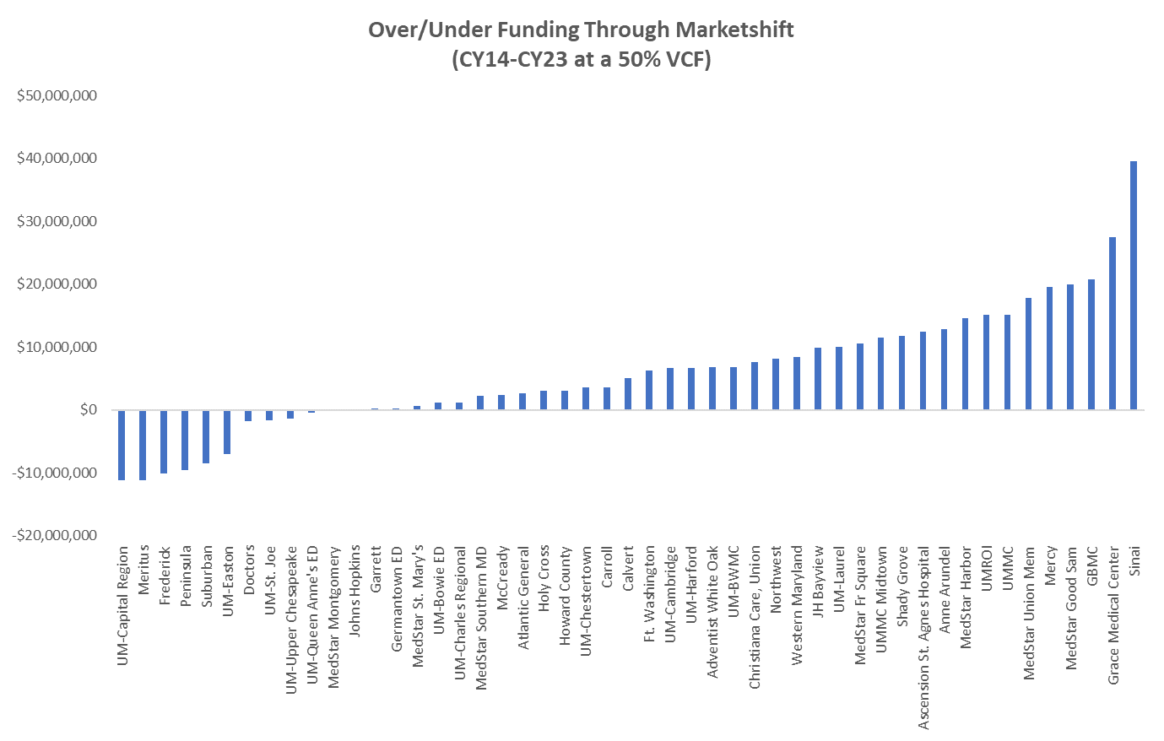
Volume Efficacy: Marketshift Funding Only
Updates through CY 2023 still demonstrate that through the Marketshift alone very few hospitals are not funded for volume at a 50% variable cost factor
CY22 overfunding -$478M
CY23 overfunding - $294M
Analysis that only uses Marketshift and/or excludes Demographic Adjustment funding is flawed
Underfunding is by design, as the Demographic Adjustment funds use rate growth
Marketshift is not intended to capture all volume growth
Statewide Over Funding = $294M

Slide 26
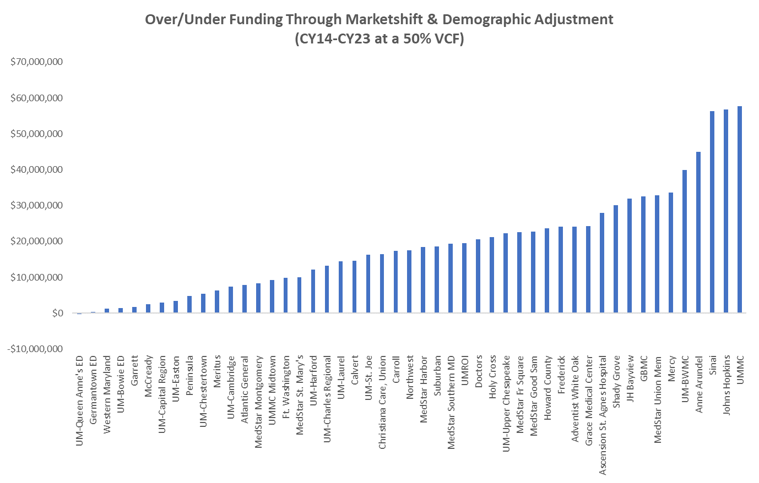
Volume Efficacy: Current Scorecard
Staff continue to demonstrate that most all hospitals are funded at a 50% VCF for in-state volume changes
CY22 Overfunding - $1.17B
CY23 Overfunding - $930M
Scorecards on next few slides will layer in
Out-of-state
PAU
Deregulation
Miscellaneous Volume Adjustments
Efficiency
Statewide Over Funding = $930M

Slide 27
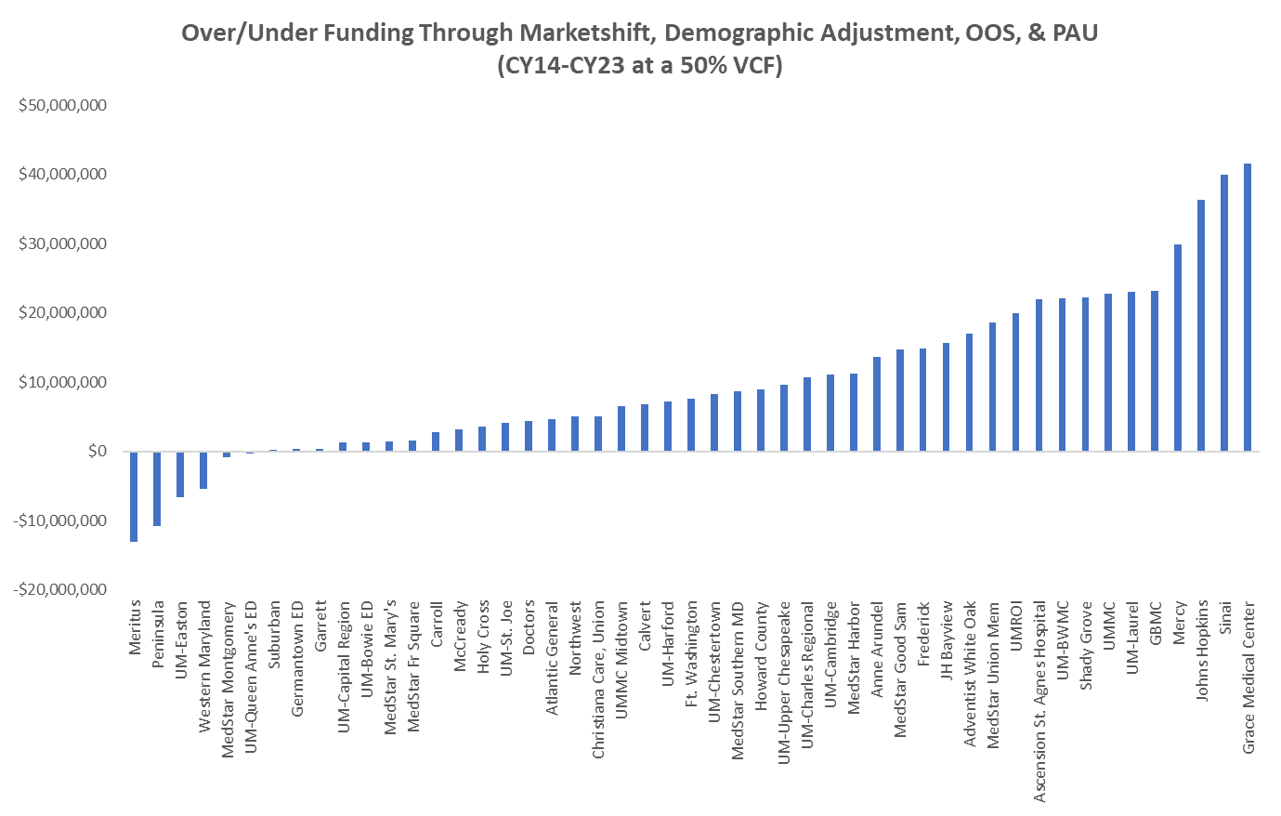
Volume Efficacy: Current Scorecard with OOS & PAU
Inclusion of OOS volumes and adjustments generally increases overfunding
Statewide increase of $139M
Inclusion of PAU generally decreases overfunding
CY22 - $49 decline in PAU versus shared savings of $550M
CY23 - $24M increase in PAU vs shared savings of $550M (RY25 value not yet reflected)
Statewide Over Funding = $497M

Slide 28
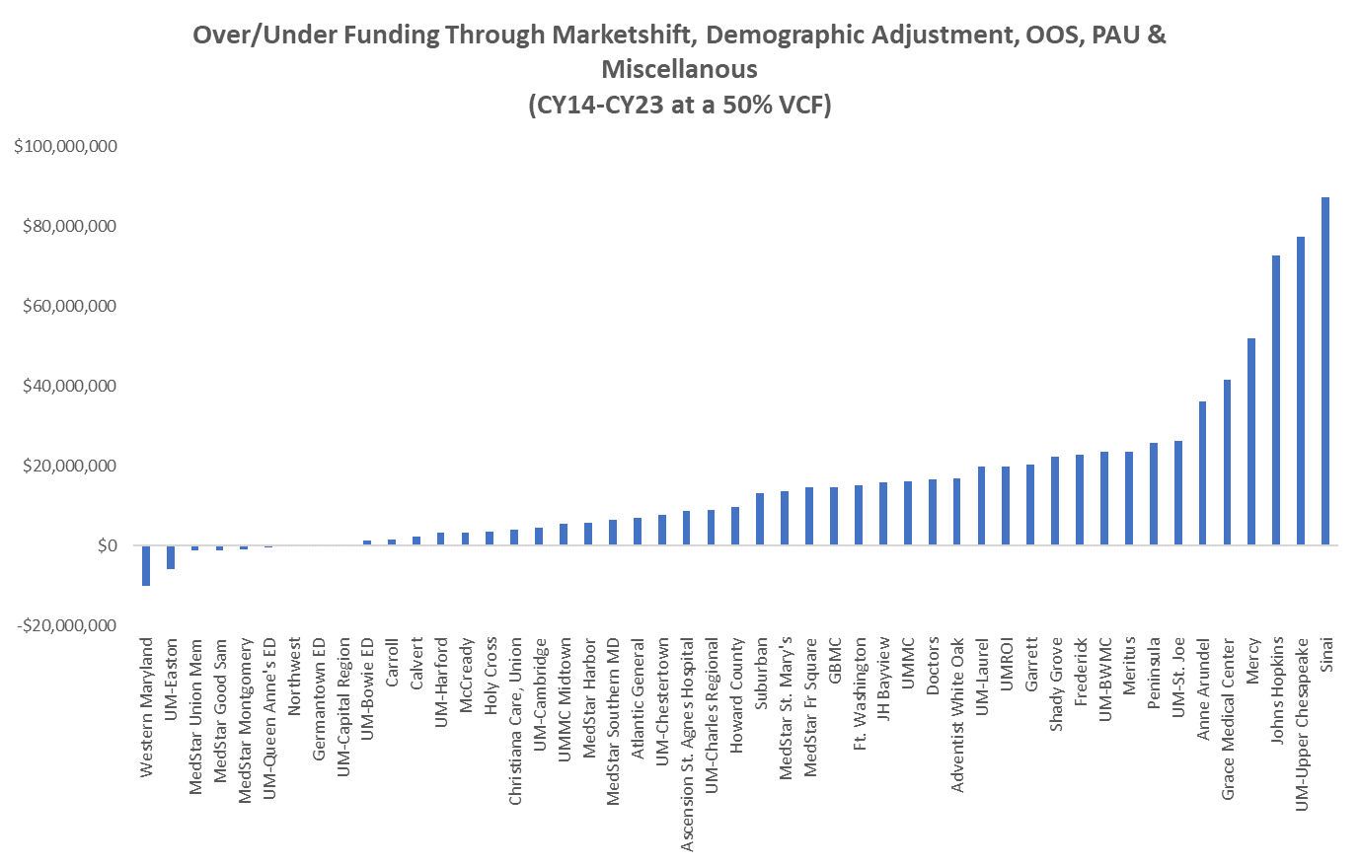
Volume Efficacy: Current Scorecard with OOS, PAU and Misc.
Miscellaneous adjustments fall into three categories
Deregulation
Other Volume (e.g., system realignments)
Efficiency
Inclusion of miscellaneous adjustments generally increases overfunding, due to newly regulated services and efficiency adjustments
Adjustments will require further review from industry, both for accuracy and categorization
Statewide Over Funding = $775M

Slide 29
Next Meeting (June 13th)
Final release of Out of State, Deregulation, & Volume Scorecard
OOS Results through FY23
CY 23 Deregulation Results
Fully Loaded Volume Scorecard
Review of Variable Cost Factor Analyses
Review of potential repatriation methodology
Industry Input & Feedback

Slide 30
Questions?

