Slide 1
Responding to Respiratory Surge in Maryland:
Proposal Under Consideration
March 2025

Slide 2
Agenda
Respiratory Surge in Maryland
Marketshift Assessment
Proposal for Consideration

Slide 3
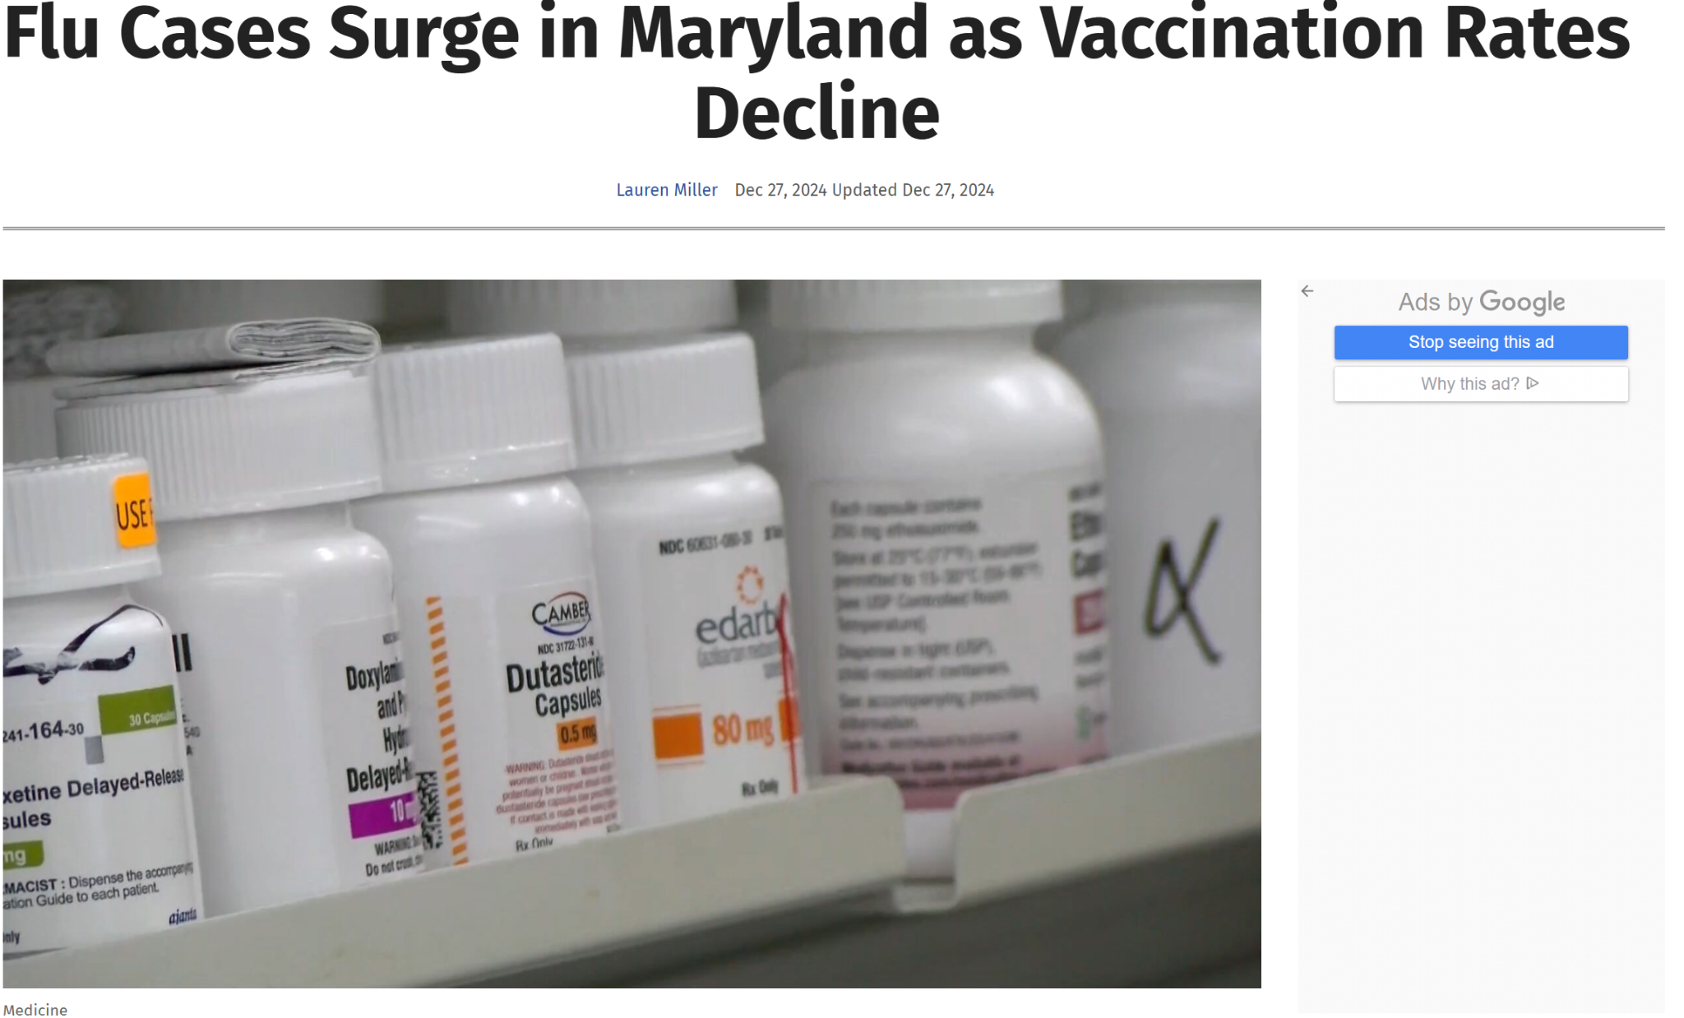
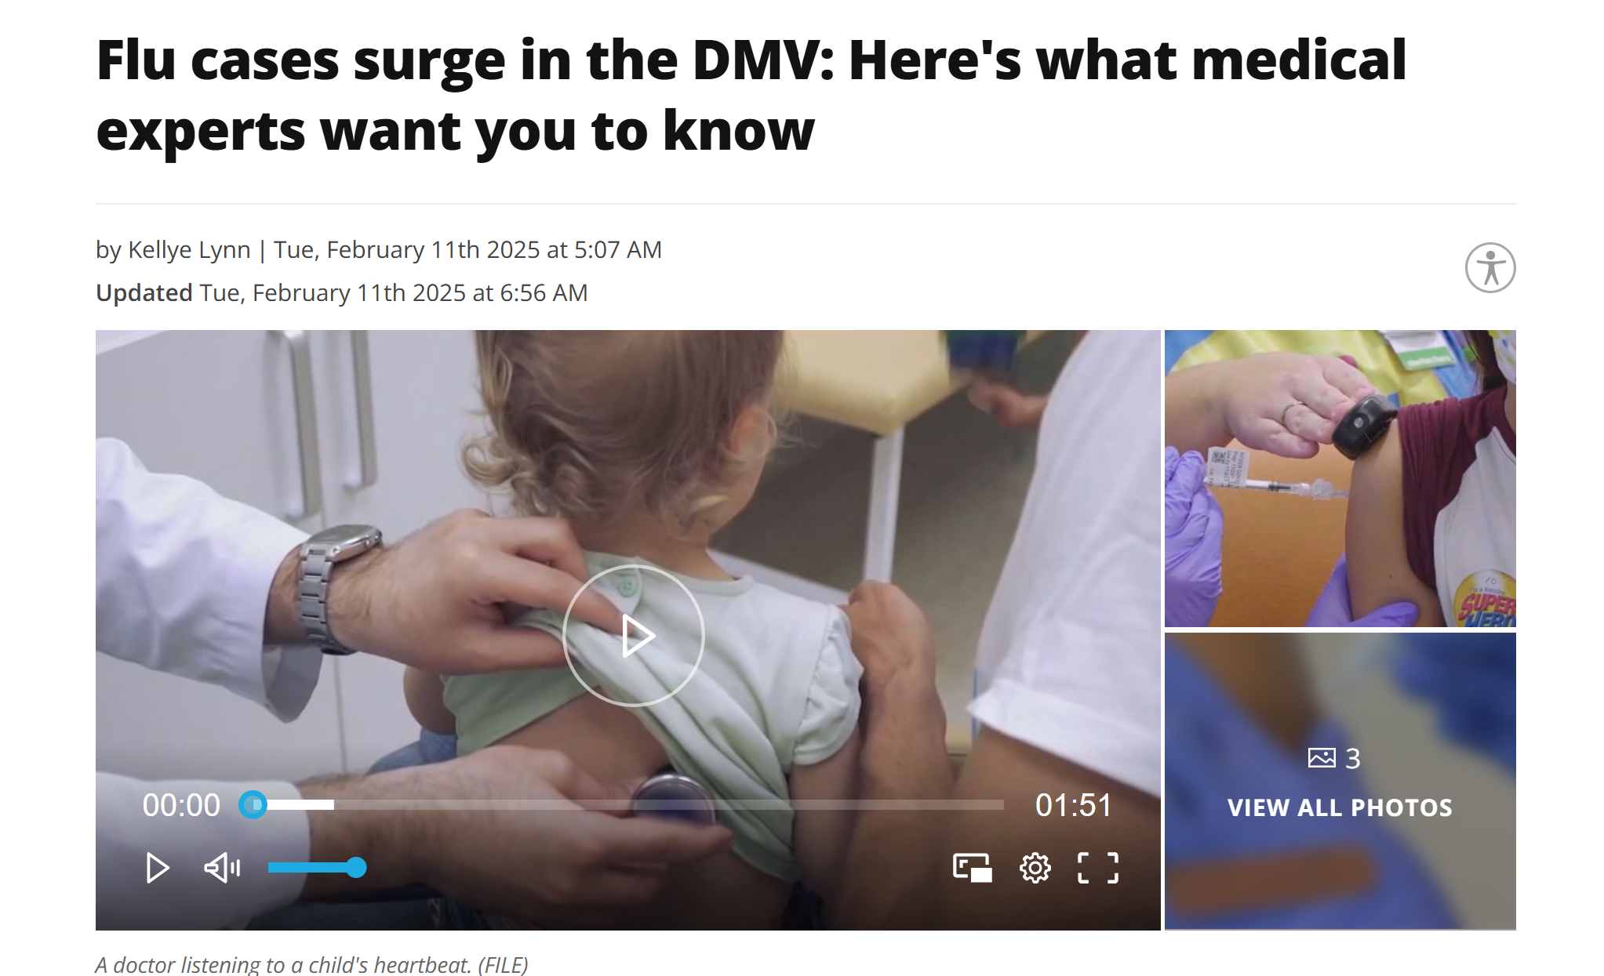
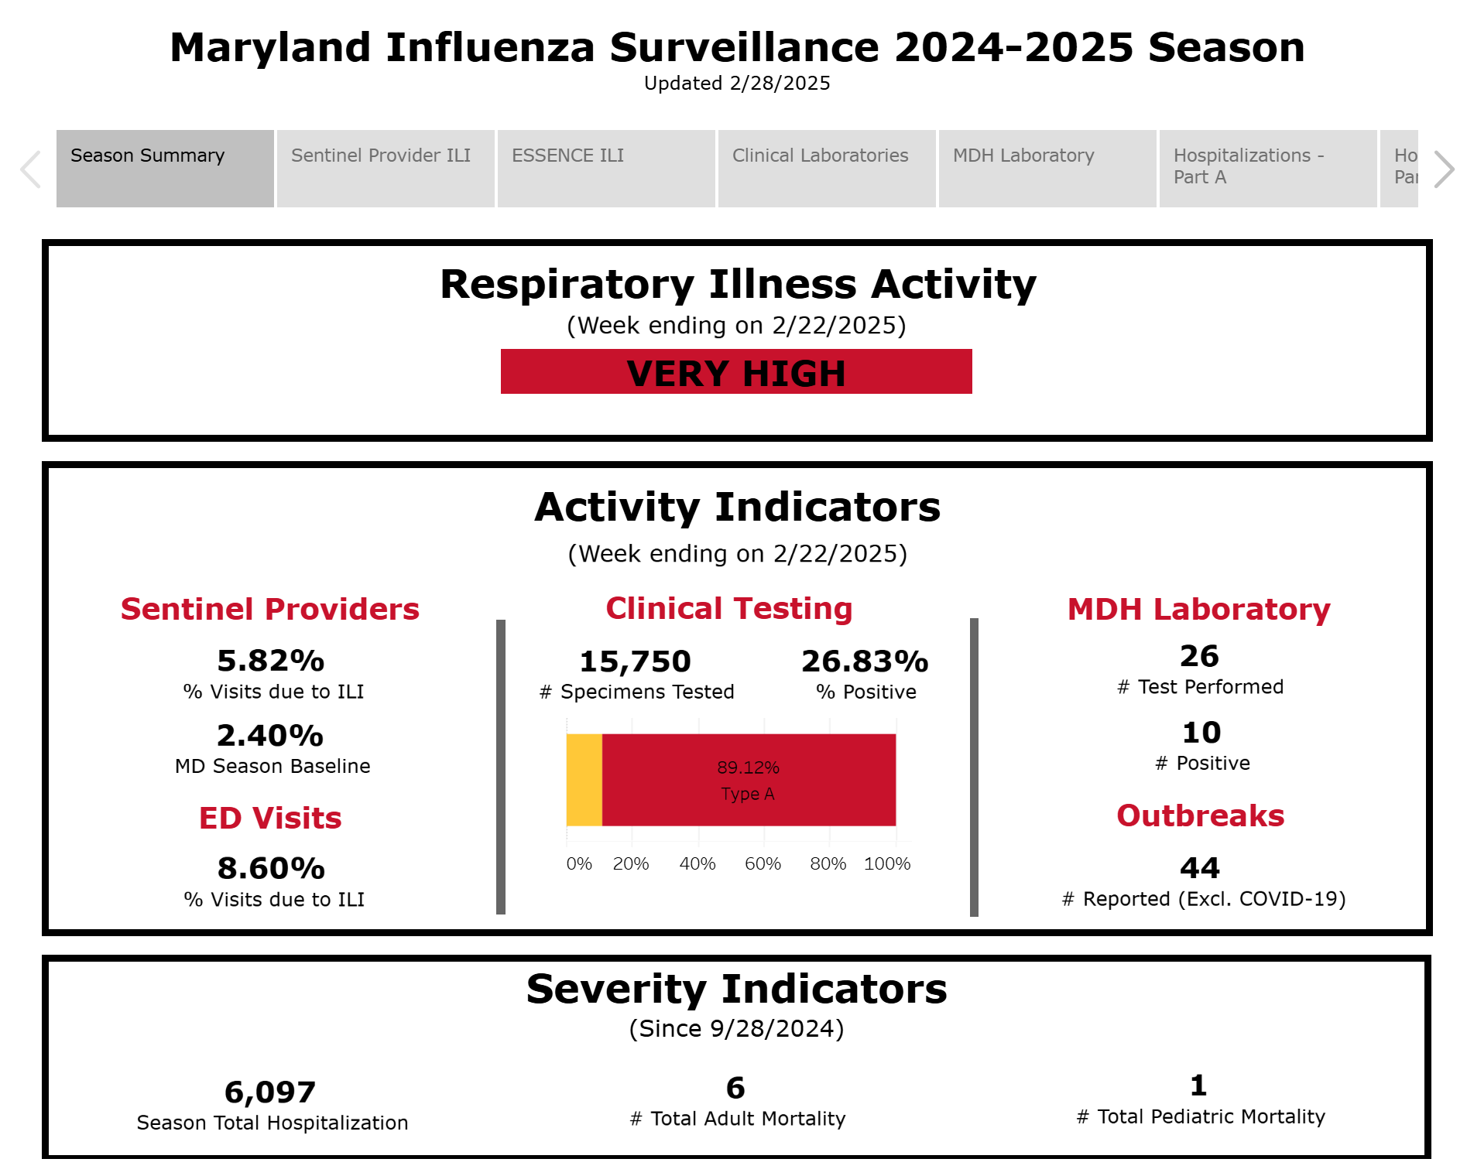
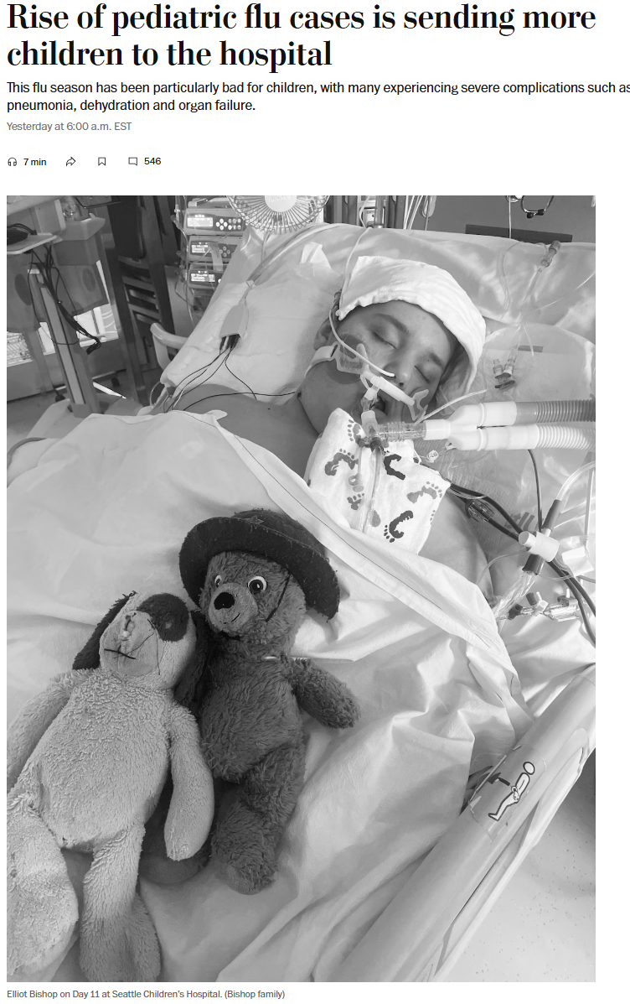

Volume Pressures
This year’s respiratory season is particularly intense, straining hospitals seeing large numbers of RSV, influenza, and COVID patients.
“Anita K. Patel, a pediatric critical-care doctor at Children’s National Hospital in D.C., said this is the worst flu season she has seen in more than a decade.”

Slide 4
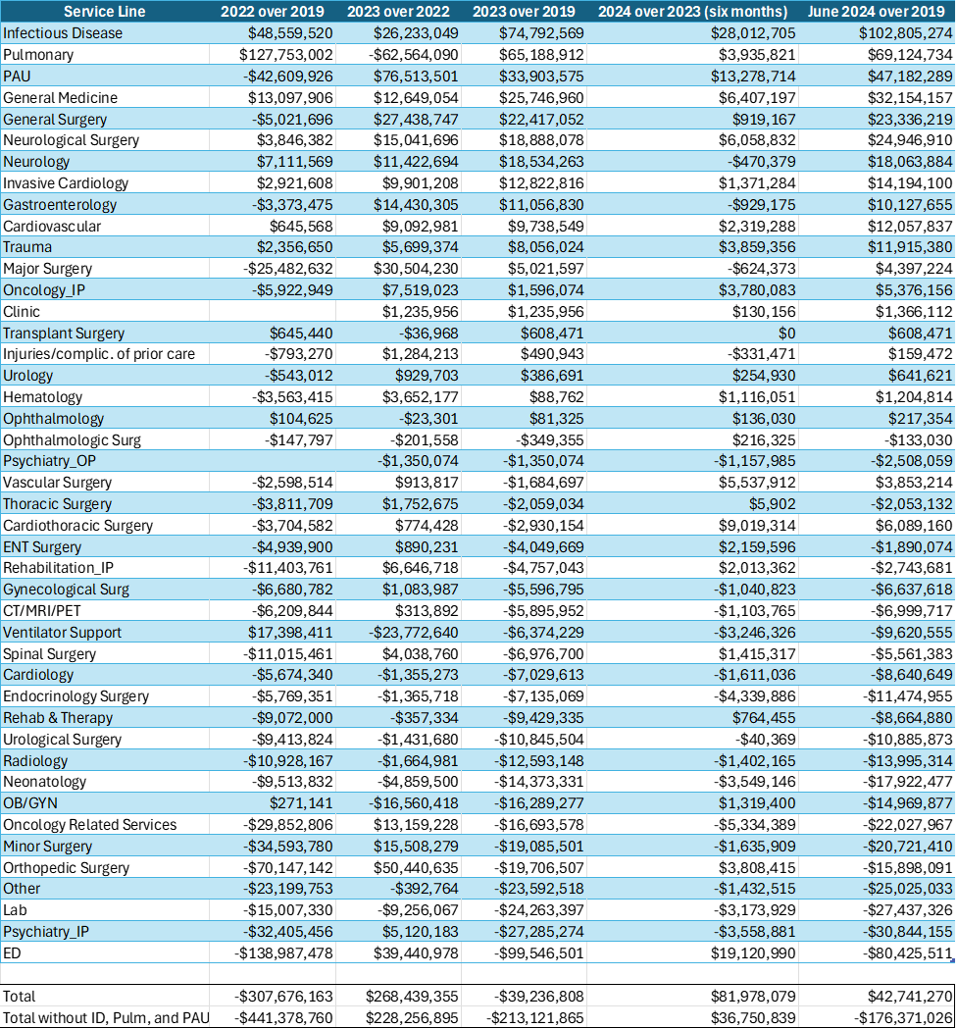
Review of Marketshift Volumes from 2019
A review of volume changes from 2019-2024 shows significant rise in respiratory volumes
2024 is the first year since the pandemic that case volumes have returned to a 2019 baseline such that there is use rate growth beyond marketshift
This is largely driven by three service lines:
  Infectious Disease
  Pulmonary
  PAU (largely with COVID diagnosis)

Slide 5
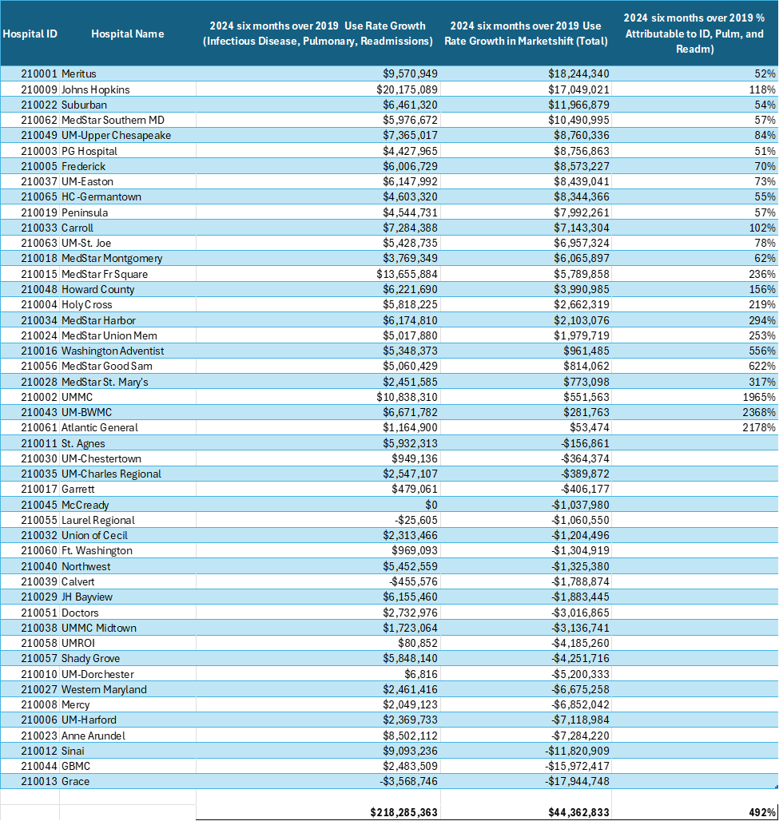
Review of Marketshift Volumes from 2019 by Hospital
Out of 50 facilities, 24 had net growth from 2019 through June 2024.
For 13 of them over 100% of the use rate growth was due to infectious disease, pulmonary, and PAU cases
For 11 of them, 50-84% of use rate growth was due to infectious disease, pulmonary, and PAU cases.

Slide 6
Respiratory Surge Considerations
Staff suspended the surge policy because COVID had become endemic after the Omicron surge in 2022
However, COVID continues to create periodic strains on GBR volumes, particularly with the confluence of other respiratory illnesses:
  RSV
  Pneumonia
  Influenza
In light of sustained cost increases in respiratory cases, a possible approach is reinstating the surge policy with the following parameters:
  GBR should be exceeded at standard rates X volumes
    Ensures other volume dissipation is not offsetting respiratory increases
  Hospital should receive in RY 2025 the lesser of:
    GBR at standard rates X volumes MINUS GBR for RY 2024 OR
    Growth in RY 2019-2024 Volumes with a Respiratory Major Diagnosis Code PLUS Sepsis Cases with a co-occuring COVID diagnosis X Standard Rates
  Surge allowance should be discounted by funding provided in RY 2025 to account for volume growth, such as full rate application enhancements or other applicable revenue adjustments

Slide 7
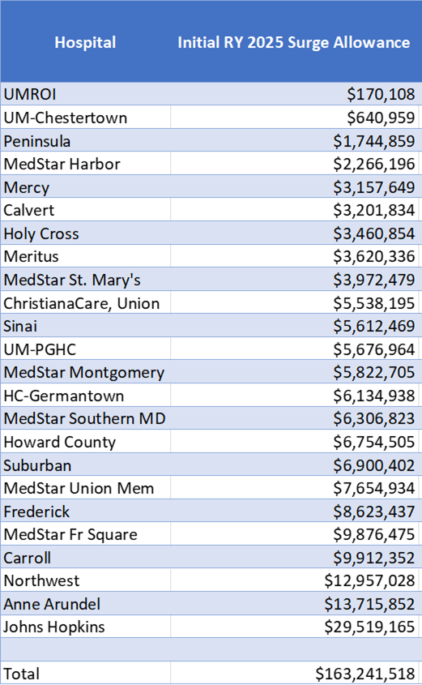
Surge Policy Modeling
Surge Policy modeling identifies $163.2M growth in respiratory cases
Discounting this total by funding already provided through the full rate application and other applicable revenue adjustments will reduce the final allowance to ~$140-$145M

Slide 8
Other Considerations
Staff recommends increasing hospital rates in RY 2026, with consideration by staff for earlier charges based on financial condition
Hospitals accepting the funding should maintain or increase their staffing capacity to meet the needs of patients in Maryland.
Hospitals should coordinate with respiratory virus prevention activities with Maryland Department of Health.
As additional support Staff will make a supplemental addition to the CDS-A drug list for RSV immunization for infants.

