Slide 1
Payment Models Workgroup
September 23, 2026

Slide 2
Agenda
Assessment Changes Under Split Global Budgets
Market Shift Discussion
Bridge Policy for CMS Global Budgets follow up Discussion
  Workgroup Feedback on Weighting & Other Items
Adjournment

Slide 3
Assessment Changes Under Split Global Budgets
FY 2028 & Beyond

Slide 4
Assessments Included in Base Year HGBs under FFS
Medicaid Deficit Assessment
Healthcare Coverage Fund
CRISP Assessment
Nurse Support Program I
Nurse Support Program II
HSCRC User Fees
MHCC User Fees
These assessments are updated every year as part of each hospital’s rate structure. This list is HSCRC staff’s understanding of assessments that will be included in the base year of each hospitals Medicare Global Budget.
Source: Appendix A Maryland specifications

Slide 5



Future Assessment Calculation Under Split Payment Systems
FUTURE STATE
Split Payment System
Base Year
Assessment A: $100 million for Fiscal Year
Medicare FFS % = 35%
Multi Payer % = 65%
Base Year HGBs
$35 million
All Other Payers
2
Assessment A: $125 million for Fiscal Year
Base Year + 1
$35 million X 3% (Medicare FFS inflation)
$36 million FFS
28% FFS Share
$125 million - $36 million
$89 million multi payer
Assessed on multi-payer GBRs
72% Multi-Payer Share
Total Assessed Value for Fiscal Year $125m

Slide 6
Other Assessments Items
Ongoing Assessments
Calculation shown on previous slide would be done for each assessment
Continue review of Medicare proportion to understand Medicare share Significant shift to the multi-payer share may require Commission discussion.
  Healthcare Coverage Fund & Medicaid Deficit Assessment are tied to Legislation
Future share split is determined by HGB inflation AND share of Medicare recipients
Future New Assessments
Assessments not included in Base Year HGBs will need to be assessed on the multi-payer GBRs
Funding levels for future assessments will be decided at creation of assessment
Assessments in FY 2028
Staff will determine appropriate split of assessments in FY 2028 as part of operationalizing strategy work

Slide 7
Market Shift Policy – Potential Adjustments for AHEAD

Slide 8
Summary
Need to update HSCRC Market Shift algorithm as Medicare Fee for Service* patients are no longer paid for under the multi-payer GBR
Conceptual options:
  1 – remove Medicare patients before running market shift algorithm
  2 – run market shift algorithm and then remove Medicare patients
    This option not feasible to mixing Medicare and non-Medicare patients in measuring volume changes
How does removing Medicare patients affect market shift volumes and stability?
*For this presentation Medicare refers to Medicare Fee for Service (FFS)

Slide 9
Market Shift Adjustment Summary
Changes approved in December 2025
45 services (32 inpatient, 13 outpatient)
264 geographies (zip codes, county-level for 15 counties)
Excludes out of state, high cost drugs, quarternary, PAU
Variable cost factor for inpatient/outpatient, medical/surgical grouping
  inpatient medical: 57 percent / inpatient surgical: 66 percent
  outpatient medical: 54 percent / outpatient surgical: 63 percent
Market Shift calculations implemented twice per year
  January – 6-month temporary adjustment
  July – 12-month permanent adjustment

Slide 10
Summary of Market Shift Differences
Policy Area | Maryland approach | CMMI approach
Qualifying Volume | Focuses on shifts, taking the lesser of approach to prevent overall volume growth incentives | Includes all volume changes but with gains limited to revenue in the hospital-specific market area plus overlapping zip codes; revenue updates based on proportion of services within service area
Service Line Distinction | Attempts to identify volume changes at a granular level, allowing insights into shifts | Volume considered at the overall level, no service line granularity
PAU | Preserves global budget financial incentives for hospitals to reduce unnecessary care by excluding PAU volumes | PAU volume is not excluded
Overlap with Demographic Adjustment | Focus on true offsetting shifts localizes the adjustment to true changes in market competitive position | Scoring of all volume changes means demographic impacts are included in market shift calculation
Funding Factor | Uses data-derived estimate of service-specific costs to assign variable costs, balancing resource reimbursement with incentives for volume growth | Uses 80% funding factor
Small Hospitals | Market shift applied consistently to all hospitals | Small hospitals with less than 2% of state Medicare payments protected from negative market shift adjustment
Shift Calculation | Shift calculated based on ECMADs | Shift calculated based on average of weights and payments

Slide 11
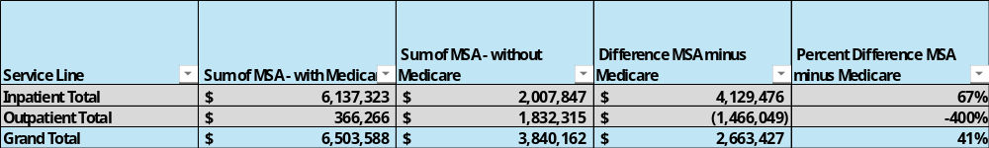
Impact of Removing Medicare from Market Shift
Market Shift Algorithm comparing CY25 and CY24 with Medicare patients excluded
  Total MSA with Medicare - $6.5M
  Total MSA without Medicare - $3.8M
Differential impact across service lines
Note market shift associated with Medicare FFS patients will be accounted for by CMMI HGB market shift adjustment
 | With Medicare | Without Medicare
Average Hospital MSA (absolute value) | $ 2,969,389 | $ 2,307,890
Median Hospital MSA (absolute value) | $ 2,261,460 | $ 1,466,731

Slide 12
Hospital MSA Comparing CY25 and CY24, with and without Medicare

Slide 13
Service Line MSA Comparing CY25 and CY24, with and without Medicare

Slide 14
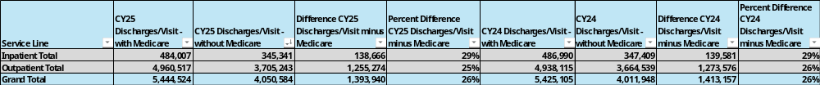
Service Line Volume Changes

Slide 15
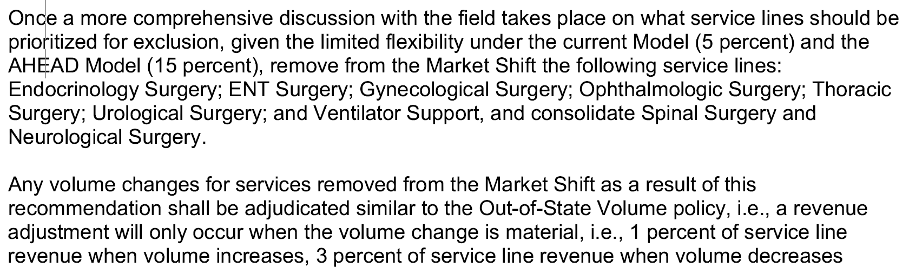
Low Volume Service Lines
December 2025 Market Shift Recommendation:
After removing Medicare patients 17 service lines have 20% or more of geographies with fewer than 10 patients
  Psychiatry IP, Pulmonary, Cardiology, Urology, Ophthalmology, Unassigned_IP at zip code level
  Rehabilitation_IP, Vascular Surgery, Spinal Surgery, Injuries/Complications, Urological Surgery, ENT Surgery, Gynecological Surgery, Ventilator Support, Ophthalmologic Surgery, Transplant Surgery at county level

Slide 16
Low Volume Service Lines (cont.)
Carve-out will further reduce volumes included in GBR and market shift
Options
  Geographic Aggregation – use county instead of zip code
  Service Line Aggregation – combine with other service lines or add to General Surgery / General Medicine
  Exclude from Market Shift and use Out of State methodology*
    *volume would also be excluded from % revenue under GBR
  Leave unchanged

Slide 17
Timing for Market Shift
 | RY 2028 Full Year Market Shift (Jan – Dec) | RY 2029 Temporary Market Shift (Jan – Jun)** | RY 2029 Full Year Market Shift (Jan – Dec)**
APR/EAPG Version | APR: 43 EAPG: 4.0 | APR: 44 EAPG: 4.1 | APR: 44 EAPG: 4.1
Data Period Used: Base Period Performance Period | January – December 2025 January – December 2026 | January – June 2026 January – June 2027 | January – December 2026 January – December 2027
Implementation Date | July 2027 | January 2028 | July 2028
AHEAD Implications | **Split hospital global budgets take effect January 1, 2028, which could influence the application of market shift for these periods

Slide 18
Categorical Exclusions
The categorical exclusion flag created at the on-set of the All-Payer Model, flagged certain cases deemed as highly specialized and innovative for removal from market shift calculations
  Certain tertiary and quaternary services mainly occurring at the State’s Academic Medical Centers (AMCs)
Growth associated with these cases have been funded in various ways:
  Categorical cost growth (Prior to RY 2017)
  Intensity adjustments (RY 2017 – RY 2020)
  Complexity and Innovation Policy (RY 2021 – RY 2026)
  Global budget carveouts (As of RY 2027)
About 57% of revenue flagged as categorical exclusions in CY 2025 is now being carved out of hospital global budgets (as shown on the next slide)
  The remainder mainly include certain research and hematological cases

Slide 19
Categorical Exclusions Cont….
Categorical Exclusion Service Line
 | Revenue |  |  | Percent Revenue
Exclusion Type | Non-Carve-out | Carve-out | Total | Percent Non-Carve-out
Bone Marrow Transplant |  | $ 254,399 | $ 254,399 | 0%
Burn | $ 1,447,008 | $ 24,855,411 | $ 26,302,419 | 2%
Hematological Cases | $ 19,834,111 | $ 21,041,799 | $ 40,875,910 | 22%
Myelodysplastic | $ 3,325,495 | $ 1,298,021 | $ 4,623,516 | 4%
Research Cases | $ 14,636,013 | $ 3,950,015 | $ 18,586,028 | 16%
Total | $ 39,242,627 | $ 51,399,644 | $ 90,642,272 | 43%
Original Product Lines for Categorical Exclusions
HEMOTOLOGICAL CASES
Oncology | $ 7,957,190
Hematology | $ 4,100,224
Infectious Disease | $ 2,471,737
General Surgery | $ 1,436,802
General Medicine | $ 1,188,495
Pulmonary | $ 1,161,391
Gastroenterology | $ 553,336
Cardiology | $ 380,037
Neurology | $ 332,021
Orthopedic Surgery | $ 172,727
Spinal Surgery | $ 49,137
Vascular Surgery | $ 12,634
Urology | $ 11,348
Ophthalmology | $ 7,031
Total | $ 19,834,111
RESEARCH CASES
Hematology | $ 3,826,134
Oncology | $ 3,103,981
Infectious Disease | $ 3,065,531
General Surgery | $ 1,111,914
Gastroenterology | $ 810,966
General Medicine | $ 702,389
Neurology | $ 494,142
Pulmonary | $ 445,071
Urological Surgery | $ 417,180
Cardiology | $ 237,889
Thoracic Surgery | $ 139,488
Neurological Surgery | $ 90,428
Orthopedic Surgery | $ 50,260
Invasive Cardiology | $ 42,584
Injuries/complic. of prior care | $ 38,485
Ophthalmology | $ 35,924
Urology | $ 23,649
Total | $ 14,636,013
Medicare FFS accounts for about 13 percent of non-Carve-out revenues in the Categorical Exclusions service
Is there a strong industry preference on how to handle the non-carve out categorical exclusion cases?
    One alternative is to roll them back into the originally assigned product lines

Slide 20
Next Steps
Further analysis on impact of removing carve-out services and Medicare patients on Market Shift
Service Line Adjustment / Exclusions
Revisit at Next Payment Models Workgroup on October 7
Draft Recommendation – November Commission meeting

Slide 21
Bridge Policy Follow Up Discussion

Slide 22
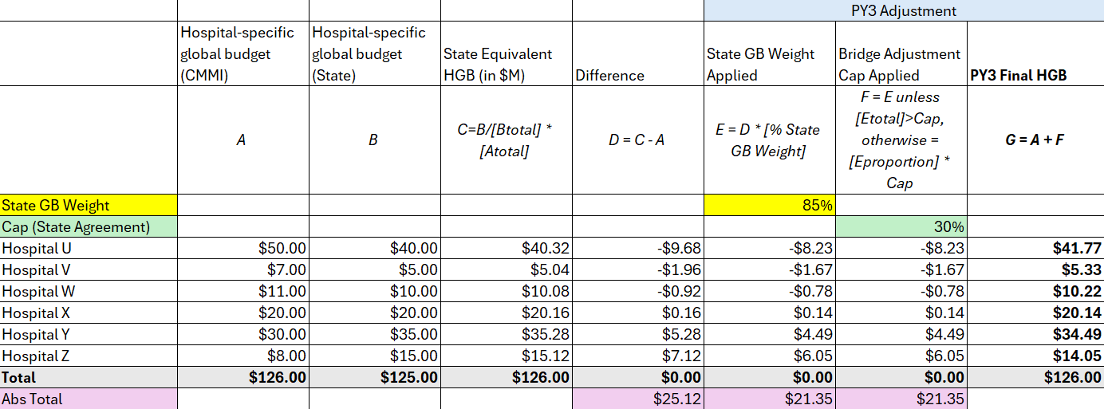
Modeling Review

Slide 23
Feedback Received To-Date
Scope
  Distribution of statewide/net impact
  Limit impact at a hospital level
    Bridge adjustment is applied to only a certain threshold at an individual hospital level?
    Adjustments get collapsed to smaller range
  Adjustment-specific consideration?
    Limiting to the bottom and top performing repricing quartiles
    Any other adjustments?
State weight
  No 100% state weight
  Gradual glide path
Notes:
$25 UCC fund was approved to provide access to UCC funding earlier than hospitals would otherwise have access to (September 2028). We are working on a policy proposal for how to distribute this amount.

Slide 24
Alternative Approach(es)
“Split-the-difference” approach
Weighted average of CMMI and state budgets
Redistribution “pool” limited to net negative adjustment to ensure revenue neutrality
Adjustment-specific approach
Just repricing?
Would need to quantify the impact of each adjustment

Slide 25
Summary and Next Steps
Bridge adjustment to provide a ‘glide path’ between HSCRC and CMMI MFFS global budgets
  Not planning adjustment to undo all changes
Options for focus of adjustment:
  Overall GBR/HGB difference
  Repricing
  Specific adjustments
Draft Recommendation - October Commission meeting
Final Recommendation - February Commission meeting

