Slide 1
Payment Models Workgroup
October 7, 2026

Slide 2
Agenda
Continued Market Shift Discussion
Demographic Adjustment
Bridge Adjustment Updates
Upcoming CMMI Office Hours
Adjournment

Slide 3
Market Shift Policy – Continued Discussion Potential Adjustments for AHEAD

Slide 4
Summary of Prior Discussion and Feedback
Prior meeting reviewed current State and proposed CMMI market shift policies
Review analysis removing Medicare FFS beneficiaries from market shift
  Creates 17 “low volume” services lines
  Options for geographic or service line aggregation
Discuss market shift policy timing - updated policy to be implemented in January 2028 for 6 month 2027/2026 comparison
Discussed Categorical Exclusions - with carve-out policy, should these be rolled back into assigned service lines?
Stakeholders see value in aligned market shift policies
  Interest in reducing administrative complexity

Slide 5
Modeled Differential Impact of Market Shift Policies
4 hospitals (Hospital A, Hospital B, Hospital C, Hospital D)
4 services (IP Surgical, IP Medical, OP Surgical, OP Medical)
Changes in volume (Y1, Y2) across service lines
  Volume changes not associated with service line adjustment
Medicare and non-Medicare patients
  Assumed equal volumes
Assumes shared service area
  Single geography for HSCRC policy
  Overlapping hospital service area for CMS policy
Assumes same payment rates across hospitals, 3% inflation
Scenarios model potential outcomes under policy
Scenarios are not predictions of behavior or expected outcomes

Slide 6
Market Shift Policy Modeling
Market shift policy dynamics
  Maryland: lesser of volume growth and decline
    State MSA = Volume change * Average cost per unit * VCF
    Volume increases limited by volume decreases within a service line and geography
  CMMI: proportional change within service area
    CMMI MSA = Average of proportional change in weights and prices * MSA Allowance
    MSA Allowance = Sum of Y2 payments within service area * State Growth Benchmark (1.05) * Funding Factor (80%)
    Proportional change in weights = (Y2 hospital weights / Y2 service area weights) - (Y1 hospital weights / Y1 service area weights)
    Proportional change in prices = (Y2 hospital prices / Y2 service area prices ) - (Y1 hospital prices / Y1 service area prices )

Slide 7
Balanced Growth Scenario
Balanced Growth: In a scenario in which hospitals gain and lose value equivalently, CMMI and HSCRC market shift policies yield similar outcomes except for small hospitals not receiving a negative MSA.
Hospital | Volume Change Medicare | Volume Change Non-Medicare | Medicare MSA (CMMI methodology) | Multi-payer MSA (State methodology)
Hospital A | 30 | 30 | $ 457,152 | $ 356,401
Hospital B | -30 | -30 | $ (457,152) | $ (356,401)
Hospital C | 8 | 8 | $ 91,549 | $ 69,834
Hospital D (small hospital) | -8 | -8 | $ - | $ (69,834)

Slide 8
Unbalanced Growth
Unbalanced Growth: In a scenario in which the gaining hospitals grow more than the losing hospitals, the gaining hospitals receive a higher MSA and the losing hospitals receive a lower MSA under CMMI policy.
Hospital | Volume Change Medicare | Volume Change Non-Medicare | Medicare MSA (CMMI methodology) | Multi-payer MSA (State methodology)
Hospital A | 40 | 40 | $ 525,118 | $ 333,099
Hospital B | -30 | -30 | $ (569,666) | $ (356,401)
Hospital C | 13 | 13 | $ 153,195 | $ 93,135
Hospital D (small hospital) | -8 | -8 | $ - | $ (69,834)

Slide 9
One Hospital Grows
One Hospital Grows: In a scenario in which a single hospital grows while volume at other hospitals remains unchanged, the growing hospital receiving a positive MSA, two hospitals receive a negative MSA, and the small hospital does not receive a MSA under CMMI policy. There are no adjustments under the HSCRC market shift policy, however adjustment under demographic or repatriation may apply.
Hospital | Volume Change Medicare | Volume Change Non-Medicare | Medicare MSA (CMMI methodology) | Multi-payer MSA (State methodology)
Hospital A | 30 | 30 | $ 266,814 | $ -
Hospital B | 0 | 0 | $ (190,444) | $ -
Hospital C | 0 | 0 | $ (47,293) | $ -
Hospital D (small hospital) | 0 | 0 | $ - | $ -

Slide 10
Medicare and Multi-payer Variation
Medicare and Multi-payer Variation: In a scenario in which some hospitals grow in volume for Medicare patients while other hospital grow in volume for non-Medicare patients, market shift policies attribute growth to the hospital with volume increases. However, a small hospital that decreases volume for Medicare patients does not receive a negative adjustment while receiving a positive adjustment for increasing volume to multi-payer patients.
Hospital | Volume Change Medicare | Volume Change Non-Medicare | Medicare MSA (CMMI methodology) | Multi-payer MSA (State methodology)
Hospital A | 30 | -30 | $ 457,152 | $ (356,401)
Hospital B | -30 | 30 | $ (457,152) | $ 356,401
Hospital C | 8 | -8 | $ 91,549 | $ (69,834)
Hospital D (small hospital) | -8 | 8 | $ - | $ 69,834

Slide 11
Service Line Variation
Service Line Variation: In a scenario in which volume changes are offsetting across different service lines such that overall volume is unchanged, but some hospitals increase volume in higher cost cases while reducing volume in lower cost cases and other hospitals move in the opposite direction, the hospitals with increased volume in lower cost services receive a negative MSA.
Hospital | Inpatient Surgical Volume Change Medicare | Inpatient Surgical Volume Change Non-Medicare | Inpatient Medical Volume Change Medicare | Inpatient Medical Volume Change Non-Medicare | Medicare MSA (CMMI methodology) | Multi-payer MSA (State methodology)
Hospital A | 5 | 5 | -5 | -5 | $ 173,040 | $ 276,555
Hospital B | -5 | -5 | 5 | 5 | $ (173,040) | $ (276,555)
Hospital C | 1 | 1 | -1 | -1 | $ 34,608 | $ 55,311
Hospital D (small hospital) | -1 | -1 | 1 | 1 | $ - | $ (55,311)

Slide 12
Path to Alignment?
Elements that concern HSCRC staff about aligning with CMS market shift policy based on proportional volume within a service area:
Potential incentives for growth
Negative impact on hospitals that maintain volume
Inclusion of PAU volume
No service line granularity

Slide 13
Service Line Adjustment Requests
Current HSCRC Market Shift Policy describes 5 categories for service line adjustment requests:
Facility Conversions
Intersystem Shifts
Payer-Driven Volume Shifts
Materiality Exclusions
CON-Approved Service Expansions
Staff recommendation included future evaluation of Latent Demand as an additional category
Proposed CMMI specifications include service line adjustment process with specific eligibility criteria
Prospective revenue for new capacity or capacity shifts
Excluded from market shift temporarily
Also includes process for service line reductions

Slide 14
Potential Service Line Adjustment Recommendation
Potential recommendation to:
Further define process for service line adjustments/exclusions
Clarify category definitions and requirements
Build in coordination with CMMI for service line adjustment requests

Slide 15
Demographic Adjustment – Potential Adjustments for AHEAD
Notes:
This presentation is about the potential changes to be made to the Maryland Demographic Adjustment Methodology.

Slide 16
Scope
Maryland Current Methodology
CMMI Methodology
Utilization changes
Revenue Shifts
Age-Adjusted population to distribute funding
VS
Traditional Medicare
Excludes PAU
HCC Scores
Notes:
The Maryland Demographic adjustment is designed to adjust the hospital’s global budget to reflect changes in utilizations within their respective service area based upon projected age-adjusted population changes at the zip code level, while disallowing increases in utilizations due to potentially avoidable utilization (PAU). It includes utilzation…
2.On the otherhand, The CMMI Demographic Adjustment (DA) is designed to adjust HGBs to reflect changes in both the size and medical risk of the Medicare population served by the Participant Hospital.
2. The CMMI Demographic Adjustment (DA) is designed to adjust HGBs to reflect changes in both the size and medical risk of the population served by the Participant Hospital.

Slide 17
Summary of Demographic Adjustment Differences
Maryland approach | CMMI approach
Annual adjustment calculations based on: Age-adjusted growth in hospital service area Reduced by PAU revenue percentage Normalized to state-level population growth (not age-adjusted) Added a National Demand Modifier (0.1%) Excluded revenue attributable to other distinct volume policies Applied to percent of revenue under MD GBR | “The DA is the average percentage change in total HCC scores across all counties served by each Participant Hospital weighted by the percentage of revenue its Medicare residents accounted for at the Participant Hospital.” Applied to percent of revenue under CMMI HGB
•Staff isn’t contemplating using the HCC risk scores to adjust the current MD Demographic Adjustment. HCC risk scores are calibrated on Medicare FFS beneficiaries.
•Six months ago, Staff determined that estimations built on clinical risk and other demand drivers would introduce unnecessary complexity to the demographic adjustment. In addition, they were deemed unjustified given data limitations and the inherent subjectivity.
Notes:
On a granular level, the Maryland and CMMI Demographic adjustments are based on the following…..
Although CMMI uses

Slide 18
Maryland Demographic Adjustment Update Required
PRIMARY POLICY CHANGE
Medicare FFS patients are no longer paid for under the Maryland multi-payer Global Budget Revenue (GBR) model.
Conceptual Options
01
Claritas Population Adjustment
02
Demand Modifier Adjustment
03
Department of Planning Population Adjustment
Remove the Medicare FFS enrollment population from Claritas annual population estimates
Prorate the .1% National Demand Modifier based upon age-adjusted population growth
Remove the Medicare FFS enrollment population from the Department of Planning Population estimates
Notes:
Since Medicare FFS patients will no longer exist in the MD GBR model, staff will remove this revenue, utilization and population from the current MD Demo. Adjustment. In addition, we are modifying the demand modifier. First, we will remove…

Slide 19
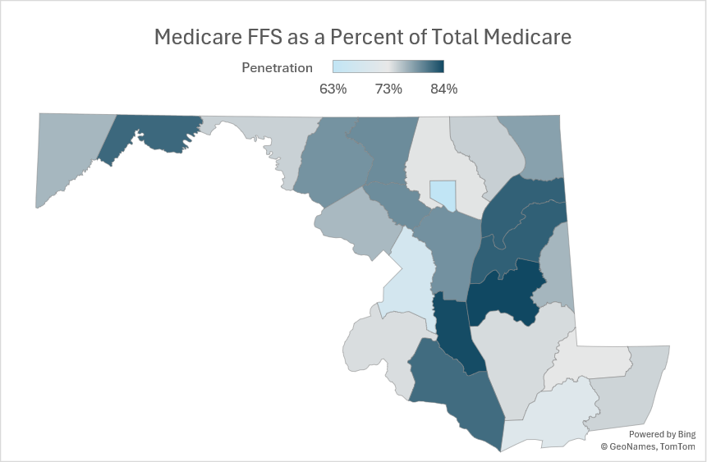
Medicare FFS Population Adjustment
DATA SOURCE
Using Medicare FFS Part-A & B Enrollment numbers from the CMS Monthly Enrollment dataset. 12-month or rolling 12-month data will be used based on data availability.
TARGET DEMOGRAPHIC
Only the dominant 65+ age groups will be adjusted, 91% Medicare enrollees
ADJUSTMENT METHODOLOGY
County-level Medicare enrollment numbers will be proportionally adjusted based on the Claritas Age/ county/zip code specific Population estimates. Next, these enrollment numbers are deducted from the Claritas population.
State-level Medicare enrollment numbers will be deducted from the Department of Planning population estimates
CY2025 enrollee penetration by county ranges 68% to 84%.
Notes:
This is how we proposed to remove the Medicare populations from the DA . Box 1 shows the data source which are the Medicare FFS part-A enrollment numbers from CMS. Box 2 shows that we will adjust the 65+ age group. They represent 91% of enrollees. Box 3 show how staff will actually remove the records.

Slide 20
Demographic Engagement Next Steps
Revisit on 10/15 Payment Model Workgroup
Run FY27 Demographic adjustment with proposed changes to estimate impact
Add impact of carve-out reduction as % of revenue under the GBR
Draft Recommendation - November Commission Meeting

Slide 21
Bridge Adjustment Updates

Slide 22
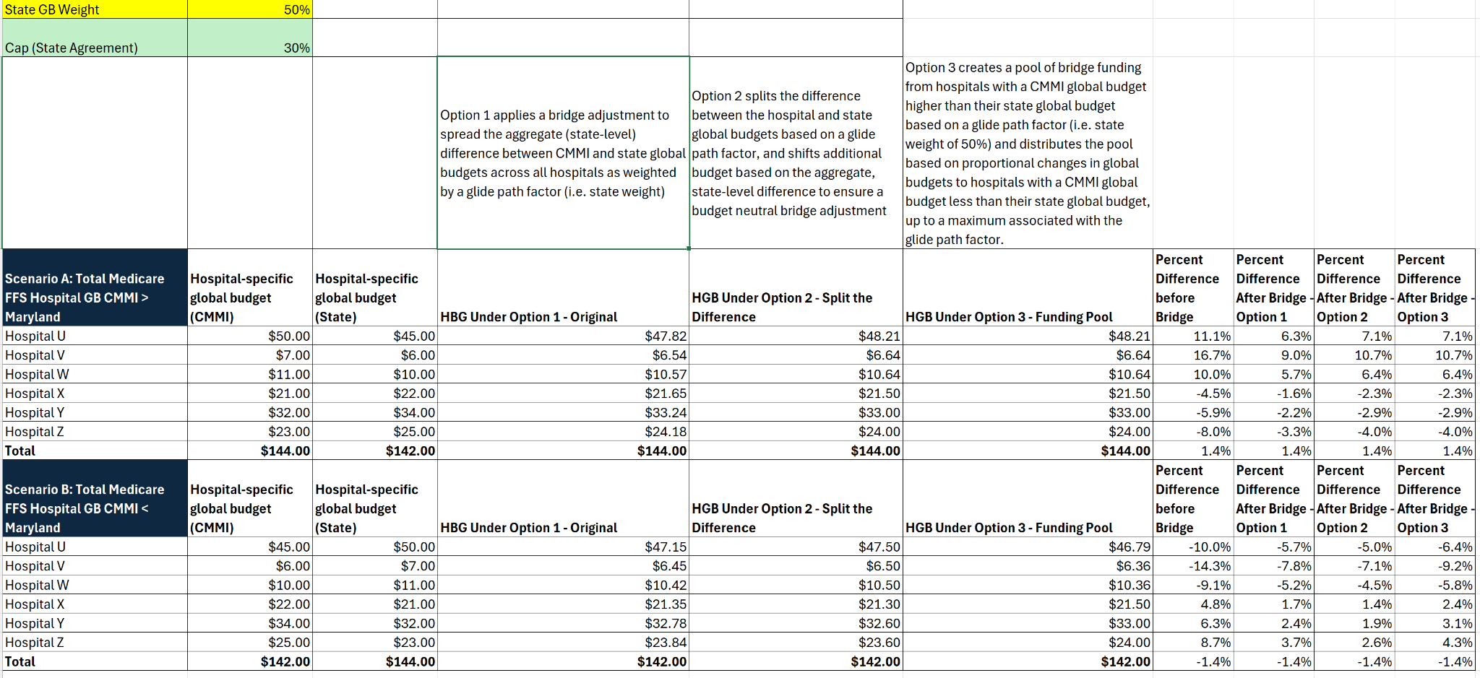
Additional Bridge Adjustment Modeling Provided

Slide 23
Draft Recommendation for Bridge Adjustment
Recommend one of the options described The options differ in the extent to which they spread differences in aggregate state-level funding across hospitals and the hospital- level impacts of the transition between State- and CMMI- set global budgets.
The bridge adjustment be applied to State-defined and CMMI-defined global budgets as a whole rather than identify specific adjustments to which the bridge adjustment will be applied.
  Received feedback suggesting that the adjustment should be applied to individual CMMI decisions/drivers of variance and then decide whether each should or should not be subject to a phase-in. Staff are concerned with the complexity of that approach.
The state weight for each be set as a range and the specific weight be determined when finalized HGBs are available. Recommended ranges are:
  PY3 (2028) 50% - 85%
  PY4 (2029) 25%- 65%
  PY5 (2030) 0% - 35%.
Staff recommend the Commission approve a bridge adjustment policy that staff can implement without seeking additional Commission approval in late 2027

Slide 24
CMMI Engagement Updates
October 15 3:30pm - Maryland HGB Appendices office hours
October 20 4pm - DPU office hours
Comments on HGB specifications due to CMMI October 31
Reach out to Cait to be added to CMMI AHEAD Newsletter
  cait.cooksey@maryland.gov
  Please respond by COB 10/9/2026

Slide 25
Next Meeting: Thursday, October 15, 2026

