Slide 1
Payment Model Workgroup
April 3,2024

Slide 2

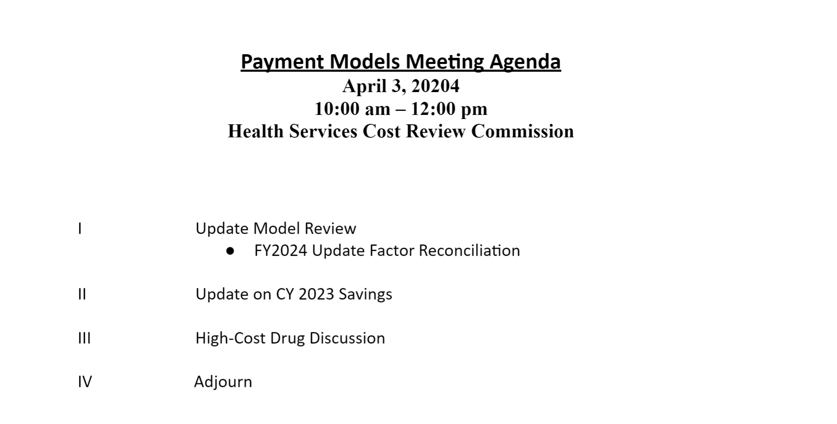

Slide 3
Update Factor Review

Slide 4
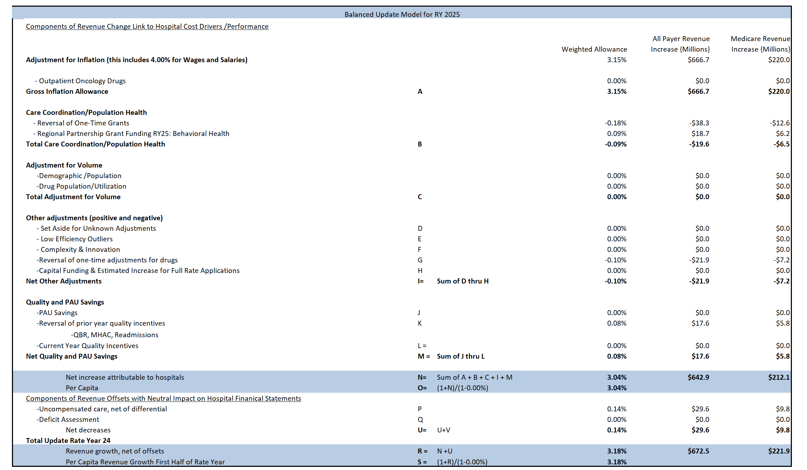

Slide 5
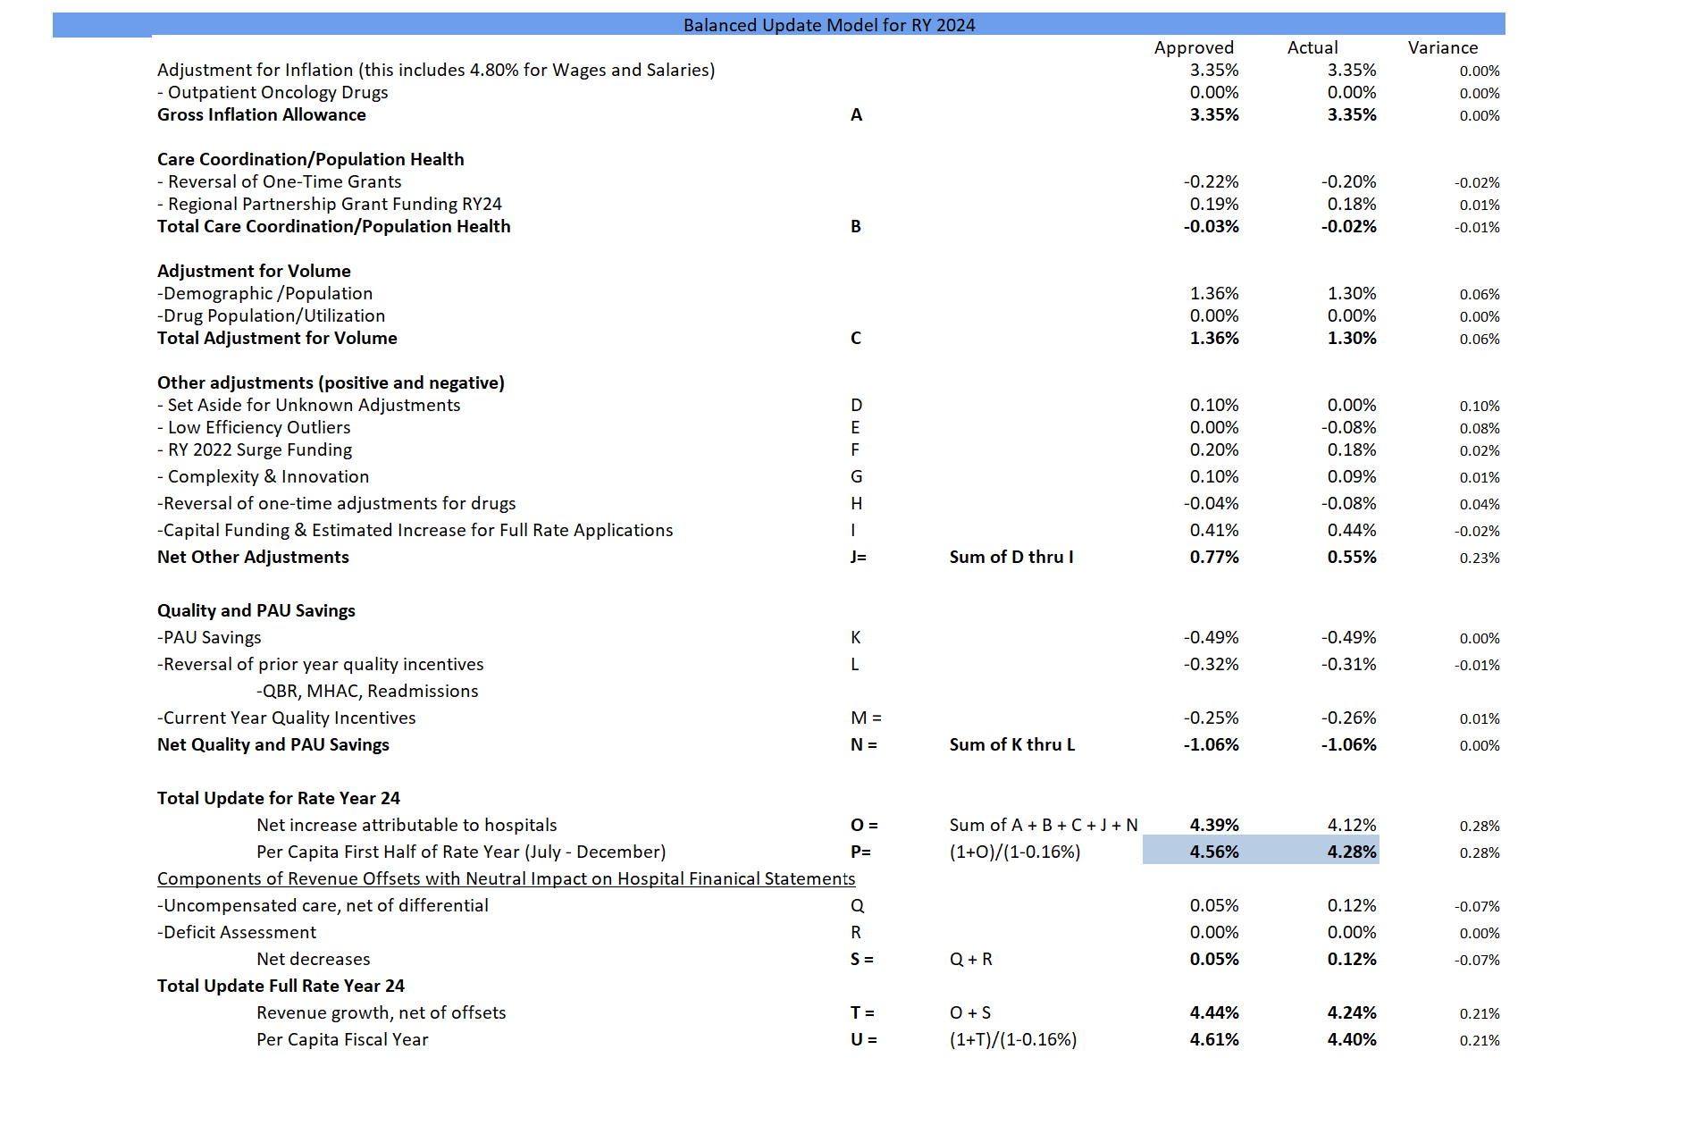
FY 2024 Update Factor Reconciliation

Slide 6
Update on CY 2023 Savings

Slide 7
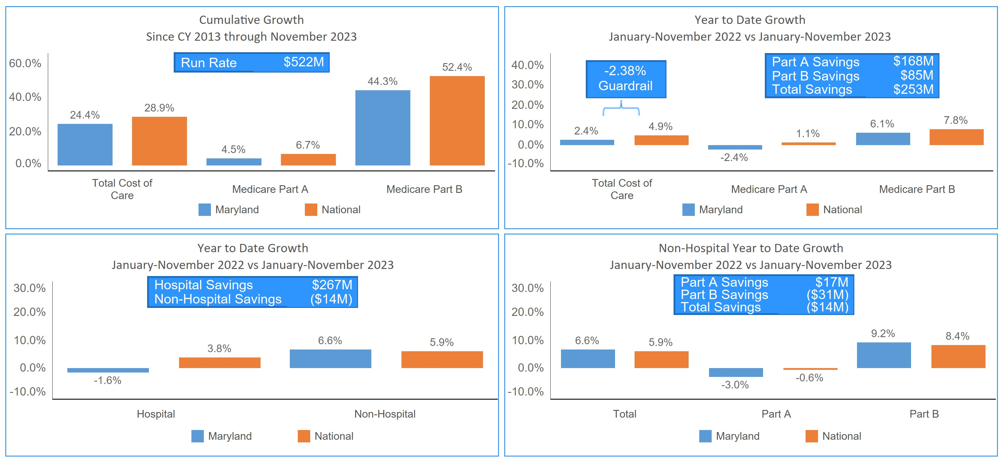
Medicare Total Cost of Care Payments per Capita
A negative number in parentheses represents dissavings

Slide 8
Projected CY24 Starting Point
In millions | Through 2022 (A) | CY2023 Through November (B) | Projected 2023 before MPA Savings Component Reversal (C=A+B) | Adjustments for 2024 (D) | Projected 2024 (E=C+D)
Claims Based Savings (including MDPCP and equivalent programs) | $162 | $253 | $415 | ($100) | $315
Other Non-Claims Based Savings | 95 | 0 | 95 | 0 | 95
Part C Savings (1) | 12 | 1 | 13 | (4) | 9
Total | $269 | $254 | $524 | ($104) | $419
2023 shown through November to avoid double counting MPA reversal that will occur in December and is reflected 2024 adjustments. Potential variances:
Non-claims-based payments (NCBP) – see separate slide
Clawbacks on MDPCP higher than estimated ~$20 M upside
December 2023 results (aside from MPA reversal), may be slightly weaker than average bringing down 2023 results overall ($0 to $20 Million risk)
Part C savings are scored based on year over year MA growth. Adjustments are estimated based on MA enrollment for 2023 and January and February of 2024.

Slide 9
Other Non-Claims Based Payments
MDPCP and equivalent national programs are scored with the claims-based payments, as reporting is available on a monthly basis.
Other non-claims-based programs have been scored only annually but CMS is beginning to provide quarterly updates covering some programs.
Quarterly update for Q1 of 2024 showed the following for 2023 (in $M):
Programs (1) | 2022 Savings | 2023 Savings | Difference | Comment
Have 2023 Data BPCI-A, OCM, VT APM, DC/Reach | $37 M | $40 M | +$3M | Drops in National BPCI-A and OCM offset by increase in Direct Contracting and Reach.
No 2023 Data CJR, SSP, DC/Reach Shared Savings | $58 M | ?
Only major programs are listed, all programs are scored.

Slide 10
Recap of Projection Scenarios used in FY24 Update Factors
Varying projections are used for National hospital and non-hospital and Maryland non-hospital. Maryland hospital is based on all-payer update factor (same for all projection scenarios).
Actual results considerably exceed all scenarios
Scenarios were developed based on those used in prior year
Assuming they have similar drivers Maryland and National non-hospital use parallel assumptions applied to their specific history (which will include Maryland shifting dynamics).

Slide 11
Drivers of Variation in Scenarios
Largest driver of variance is that MD hospital results exceed expectation.
National and Maryland non-hospital trends were within the projection corridor.
While estimate of Maryland non-hospital trends was low this was offset by an equivalent error in national non-hospital.
Compares to $524 on Projected CY24 Starting Point slide, amount is slightly different due to different method of estimating December 2023 results.

Slide 12
Implications for 2025 Update Factor
Projections operated effectively for National and Maryland non-hospital; Staff intends to retain a similar set of scenarios for FY25.
Staff continue to analyze the variance in the Maryland Hospital bucket:
That general assumption that Medicare experience would follow the all-payer update factor did not hold.
Actual all-payer GBR change matches that anticipated in the update factor projections (within 0.2%).
Calculating a Medicare specific update based on Medicare revenue share at each hospital yields a 0.1% higher Medicare specific update factor, and therefore does not explain the gap.
If the total GBR change equals that which was anticipated, then the unexpected decrease in Medicare hospital spending must reflect a shift between payers.

Slide 13
High-Cost Drug Spending

Slide 14
High-Cost Drug (CDS-A) Policy Background
Instituted in 2016 to provide funding for high cost drugs outside of the normal GBR mechanisms
Uses the exemption in the TCOC contract that allows some funding on other than a population-based approach
2019 HSCRC moved to a fixed statewide drug list that is updated annually on specified criteria (previously it was on hospital specific criteria)
Two major funding arms for designated high-cost drugs:
50% funding on all changes in volume at a drug level, either at ASP or 340-B depending on the hospital
Differential inflation in update factor for drug price inflation (backed out of total inflation funding at a statewide level)
Net neutral to the state, will move funding between hospitals
Inflation amount set annually based on evaluation of historic data
Both price increases and mix shifts are considered

Slide 15
Policy Impact
Policy with 50% volume funding and differential inflation was intended to compensate for drug costs without removing the incentives for hospitals to negotiate drug prices and effectively manage utilization in terms of drug selection and site of service selection.
“Winners and Losers” under the policy will vary based on an interplay of factors
Hospitals will benefit when they can negotiate favorable ASP prices but while prices are lower under 340-B hospitals have less flexibility to negotiate.
Hospitals will benefit by aggressively adopting lower cost alternatives and shifting site of service wherever clinically appropriate.
Hospitals will suffer when exposed to volume increases in expensive new drugs relative to their opportunity to offset in mature drugs.
Analysis of Medicare claims shows Maryland has a significant savings from Part B drugs.

Slide 16
Proposed FY2025 Inflation Factors
Proposing a 2.5% drug inflation factor for FY25 with 7.5% for academics
Recognize more recent trends but increase inflation slowly, waiting on actuals to emerge, as was done when the inflation came down
Academic differential based on much higher trends in recent years.
Trend To-- | FY21 | FY22 | FY23 | FY24 | FY25
Actual State Price Trend | 0.4% | 1.7% | 3.4%
Actual Academic Price Trend | -0.4% | 4.9% | 9.3%
Funded in Inflation Factor | 6.0% | 6.0% | 1.0% | 0.0% | 2.5%
Academic Funding in Inflation Factor | 6.0% | 6.0% | 1.0% | 0.0% | 7.5%

Slide 17
Proposed CDS-A Policy Revisions
Accelerate funding of CDS-A by applying estimated CDS-A funding on July 1 of each year versus mid year.
July 1 update would be based on current casemix reporting for the prior December 31st year end and most recent ASP and 340b pricing available. No manual adjustment will be permitted.
True up on January 1st under normal audit process
Audit amounts will be final regardless of impact/accuracy of interim funding
A report will be added to CRS to support the interim funding amount
Identify “super” tier of CDS-A drugs that will be funded on a 100% cost basis (ASP or 340-B as appropriate)
Funding will be trued up every January 1st. Drugs will not receive any inflation.
If drugs drop out of the super tier they would be defunded at 100% and refunded under normal CDS-A policies.
A more comprehensive redesign of the policy may be merited.

