Slide 1
Payment Model Workgroup Meeting
September 23, 2024

Slide 2
Agenda
GBR Contract Updates
Volume Subgroup Update
Deregulation Methodology
Repatriation Methodology
OOS Methodology
Implementation Discussion
Volume Scorecard
Requirements for PAU Methodology Change
Point of Contact
Contractor Assessment
Potential Revisions to CDS-A

Slide 3
GBR Agreements Update

Slide 4
GBR Agreement Modernization
Staff intend to modernize the GBR Agreements prior to AHEAD implementation
New Agreements effective July 1, 2025
Updates include:
Inclusion of Addendum language into main agreement
Updated Compliance terms to incorporate drug and supply compliance as hospitals are currently monitored
Remove outdated model references
Language enhancements or exclusions as necessary
Mergers and acquisitions for new systems
Timeline will be communicated via the Payment Model distribution list

Slide 5
Volume Subgroup Update

Slide 6
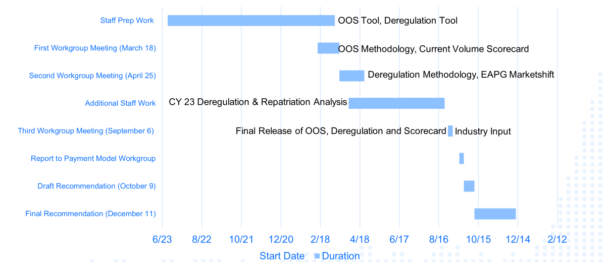
Revised Timeline for CY 2024 Volume Workgroup
Due to data delays as well as requests for Repatriation and VCF Analyses, staff extended the timeline

Slide 7
Global Budget Volume Policy Background
The HSCRC adjusts global budgets for anticipated changes in demographics/volume patterns and observed shifts in the market
To that end, the Commission implements the following volume adjustments:
Volume Adjustment | Approved Policy | Stand Alone | Purpose | Comment
Demographic Adjustment | X |  | Annual age adjusted population funding for in-state use rate growth
Marketshift | X |  | Semi-annual adjustments for regulated market shifts (zero sum)
Out-of-State |  | X | Annual adjustments for material changes to out-of-state volumes | Due to WG will use ECMADS
Deregulation |  |  | As needed reductions for observed shifts to unregulated settings | Delayed due to WG concerns
Repatriation |  |  | As needed adjustments for cross state border hospital shifts | New methodology requested by WG
Complexity and Innovation | X | X | Prospective funding to Academic Medical Centers for growth in unique quaternary services
CDS-A | X | X | Funding for changes in volume for select drugs (only volume variable methodology)
Once the last remaining policies are established (with the Volume Scorecard), staff will reconsider with Commissioners any necessary modifications to volume policies.
Ex: New service lines independent of population growth

Slide 8
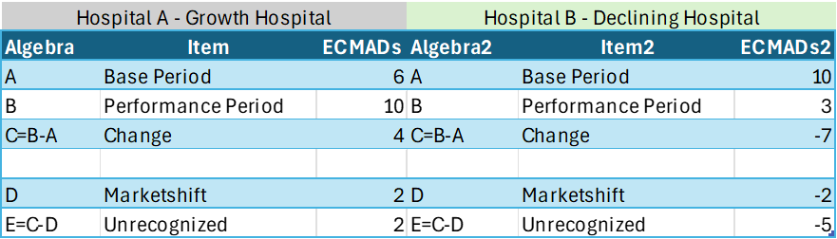
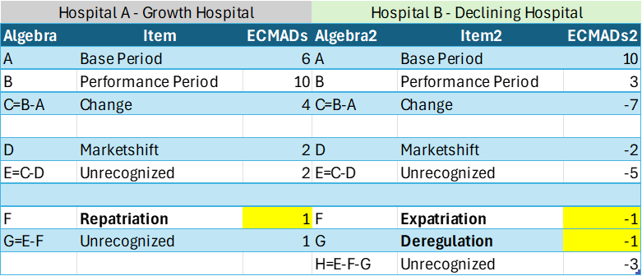
New Volume Policies Overview Example
Status Quo
Retained Revenue
Handled by Demographic Adjustment
New Policies
Out-of-State Volumes are handled in a stand alone methodology

Slide 9
Deregulation Methodology

Slide 10
What is Deregulation?
Deregulation is the movement of a hospital service from a HSCRC regulated space to an unregulated space (most often outpatient services but also chronic and rehab).
A service is presumed to be regulated if the building is on the campus of a hospital
Criteria outlined in COMAR are considered for determination of unregulated services, which need to be approved by the Commission
Service movement can be initiated by 1) payers, 2) the hospital itself, 3) physician practices and in some cases the deregulation may simply be a function of 4) service discontinuation or 5) cross border movement to an unregulated hospital
1) Payer Initiative Ex: Remicade, Immunoglobulin, Endoscopies, and Ultrasounds
2) Hospital Ex: Oncology
3) Physician Practices Ex: Endoscopy
4) Service Discontinuation Ex: Sleep Services 5
5) Cross Border Movement Ex: Inpatient Surgery & Cardiology into D.C.

Slide 11
Deregulation Tool Sources
Market Shift data:
All-Payer data derived from hospital casemix data
EAPG/DRG specific, allowing for more granular look at potential shifts
Does not contain non-hospital activity, thus making it hard to use on it’s own as confirmation of deregulation vs. dissipated volumes that are supposed to be rewarded by the GBR methodology
Medicare CCW (chronic conditions warehouse):
Medicare only dataset and is not used in other hospital rate adjustments
Significant advantage of being able to observe if offsetting increases have occurred in other settings
Claims are assigned to one of three place of service (outpatient hospital, other outpatient and professional) and ECMADs are assigned using weights developed in casemix.

Slide 12
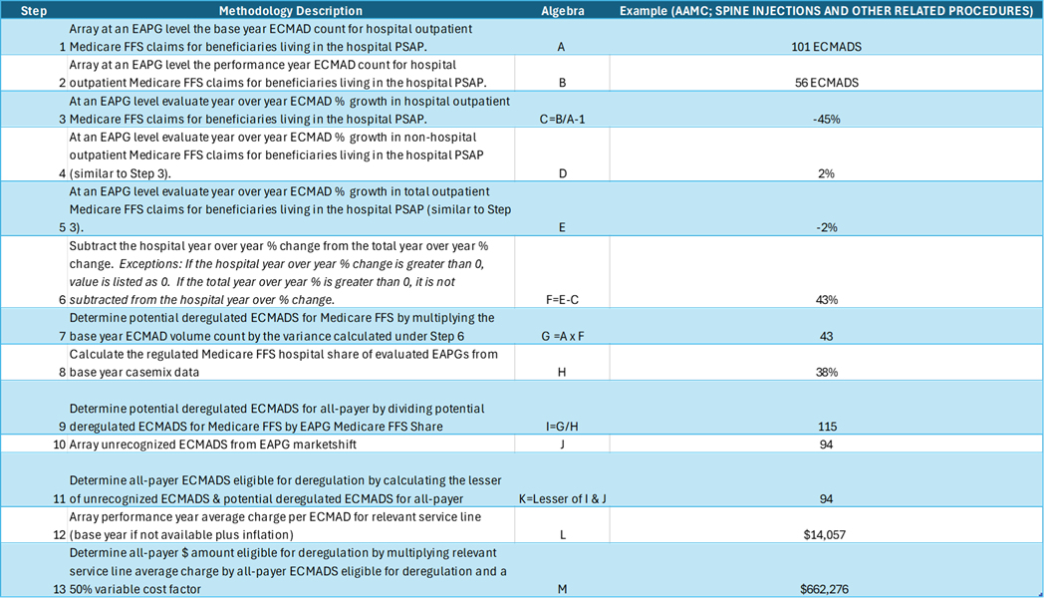
Proposed Methodology & Deregulation Model
Does not include:
1) ASC exclusion
2) Materiality Thresholds

Slide 13
Repatriation Methodology

Slide 14
What is Repatriation?
Repatriation is the cross border movement of Maryland residents from out-of-state hospital facilities to Maryland regulated facilities
Only accounts for hospital services; no evaluation along the continuum of care
The TCOC Model savings improve under repatriation because funding is reduced at a 100% variable cost factor outside of the State and in Maryland is increased at most at a 50% variable cost factor
Ex: Outpatient surgery from Wilmington, DE into Cecil county
Expatriation is cross border movement of Maryland residents from Maryland regulated hospital facilities to out-of-state hospital facilities
Only accounts for hospital services; no evaluation along the continuum of care
The TCOC Model savings degrade under expatriation because funding is increased at a 100% variable cost factor outside of the State and in Maryland is decreased at a 50% variable cost factor
Ex: Inpatient Surgery & Cardiology into D.C.

Slide 15
Repatriation Methodology
Data
Medicare TCOC Claims Data for non-Maryland facilities (only includes border states and DC)
2019 Baseline, 2023 Performance Period
Unlike Deregulation, will include inpatient and outpatient services
Grouped all non-Maryland facilities into regions (e.g., Pennsylvania vs. D.C.) for ease of analysis and to remove potential scoring of marketshifts outside of Maryland
Medicare TCOC Claims Data for Maryland facilities
Requires extrapolation to yield all-payer Unit of Analysis
ECMADs at the Service Line level
Geography is based on patient’s county due to availability of data
Average charge is based on hospital specific service line from regular marketshift
Evaluation
Marketshift Assessment, but assessment is always Maryland facilities compared to non-Maryland facilities
Will reconcile to unrecognized growth in Regular Marketshift (ECMADS, not charges)
Unlike Deregulation, it will be a two-sided assessment to potentially capture “expatriation” that cannot be identified in a facility to non-facility assessment

Slide 16
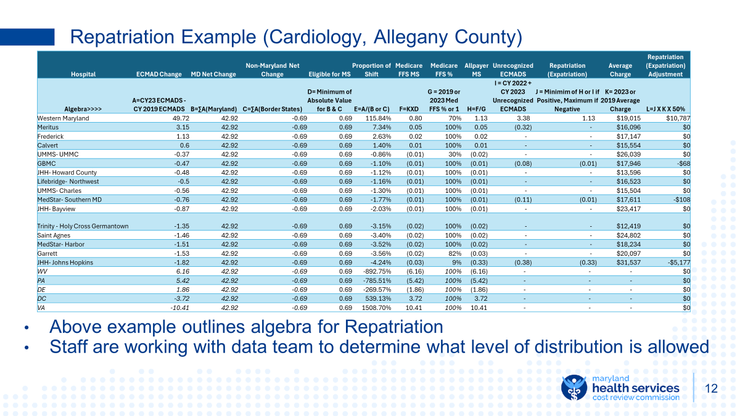
Repatriation Methodology
Data
Medicare TCOC Claims Data for non-Maryland facilities (only includes border states and DC)
Unlike Deregulation, will include inpatient and outpatient services
Grouped all non-Maryland facilities into regions (e.g., Pennsylvania vs. D.C.) for ease of analysis and to remove potential scoring of marketshifts outside of Maryland
Medicare TCOC Claims Data for Maryland facilities
Will require extrapolation based on regular marketshift service line shares
Unit of Analysis
ECMADs at the Service Line level
Geography is based on patient’s county due to availability of data
Average charge is based on hospital specific service line from regular marketshift
Evaluation
Marketshift Assessment, but assessment is always Maryland facilities compared to non-Maryland facilities
Will reconcile to unrecognized growth in Regular Marketshift (ECMADS, not charges)
Unlike Deregulation, it will be a two-sided assessment to potentially capture “expatriation” that cannot be identified in a facility to non-facility assessment

Slide 17
Out-of-State Methodology

Slide 18
Out-of-State Volume Background
Per the GBR contract, the Commission can adjust a hospital’s global budget revenue “If this percentage [out-of-state volume] changes materially during the term of this Agreement…” - Section X, Global Budget Revenue Agreement
To date, staff have adjudicated a few out-of-state adjustments because a) the volume change has been material and b) the volume change represented a material share of the hospital’s global budget
Unlike typical volume methodologies, staff have elected to use reported experience data in lieu of ECMADS from abstract data because the longitudinal assessments have base years under:
Different Groupers
Different Casemix Methodologies
Different Diagnosis and Procedure Code Versions (e.g., ICD-9 to ICD-10)
Most hospitals have a base year of 2014

Slide 19
Out-of-State Volume Methodology Specifics
Volume growth must meet aforementioned materiality thresholds
Baseline for hospital evaluation is:
2014 if hospital has not had an adjustment for out-of-state
Rate year subsequent to 2014 that was used to adjudicate out-of-state adjustment
Rate year subsequent to 2014 that was used to adjudicate full rate application
Performance year for evaluation is last completed fiscal year
All volume changes are measured at a 50% variable cost factor
OOS Revenue Increase @ 50% VCF = Current Rate X (Performance Year Volume - Base Year Volume)
Conversion factors are accounted for in volume assessment, e.g. clinic RVU conversion
Notable Exclusions
CDS rate center
MSS rate center
Material volume declines
Concern about volume unit of cost and overlap with CDS-A

Slide 20
Implementation Considerations

Slide 21
Existing Subgroup Recommendations
Based on the workgroup discussion thus far, staff will make the following recommendations when it advances a formal policy to the Commission
Deregulation and Repatriation will be based on CY 2023 and will be implemented in January 2025 rate orders
Staff will exclude from deregulation, cases that are identified on the non-ASC list (“unlisted” descriptions omitted from this exclusion)
Hospitals can provide additional information to contest deregulation finding, but will have burden of proof
Deregulation adjustments will be implemented on a one-time basis in the first year and if backfilling does not occur, e.g., a departing physician practice is not replaced, then the adjustments will be made permanent in the following year
OOS adjustments will be based on RY 2023 experience data and will be implemented in January 2025 orders
Future evaluations of OOS will utilize ECMADS for RY 2024 and each year thereafter in concert with prior year experience data

Slide 22
Recommendation for Consideration
Staff believe strongly that not all negative adjustments from these new volume policies should be implemented
Some volume changes are potentially small and temporal
Various policies incentivize deregulation (GBR’s, MPA, EQIP)
Future maturity of the model depends on moving to greater capitation risk
Not all hospitals have the same level retained revenue and/or efficiency performance
For these reasons, staff are considering recommending that negative adjustments through deregulation, OOS, and repatriation policies should only occur if:
The hospital is in the worst quartile of the Integrated Efficiency policy OR
The adjustment exceeds 3% of the hospital’s GBR OR
The adjustment exceeds 3% of the associated service line revenue
ALL PLANNED DEREGULATIONS SHOULD STILL BE REPORTED TO THE COMMISSION AND ADJUSTED FOR ACCORDINGLY
If deregulation tool indicates a potential deregulation that varies from planned deregulation by more than 10%, staff may consider revising the deregulation adjustment

Slide 23
Recommendation for Consideration cont.
While staff believe a ~3% materiality threshold should be triggered before a negative adjustment is made, staff do believe an asymmetrical approach for positive adjustments may be warranted
Growth in out-of-state volumes is good for the model because Maryland is effectively exporting services, which when reimbursed at a 50% variable cost factor lowers price per case and Maryland TCOC
Repatriation is good for the Model because reimbursement at a 50% variable cost factor and divestment at a 100% variable cost factor lowers price per case and Maryland TCOC
Thus, applying a higher materiality threshold may disincentive hospitals from growing “good volumes.”
In light of these considerations, staff would recommend a 1% materiality threshold for repatriation and out-of-state growth and a 3% materiality threshold for expatriation and out-of-state decline.

Slide 24
Volume Scorecard

Slide 25

Scorecard Background
The HSCRC is no longer a price regulator and thus the market no longer allocates funding in an unimpeded fashion
With Global Budgets, the Commission must interpret the invisible hand of the market through several volume policies
To ensure that the volume policies are working well, it is incumbent on the HSCRC to verify that the policies in aggregate are adequately covering the costs of new volumes
We have demonstrated for several years that the combination of our Demographic Adjustment and Marketshift policies are adequately funding total in-state volume changes (See Current Scorecard)
Is that sufficient given various omissions?
Out-of-State
Deregulation
PAU Shared Savings

Slide 26
Additional Details on Volume Scorecard Background
FAQ’s | Staff Responses
What do you mean by expected versus observed? | Observed adjustments are changes in revenue recorded in hospitals’ rate file. Expected adjustments are what a hospital would have received at a 50% VCF if volumes were funded under a fee-for-service methodology
What are unrecognized ECMADS? | Unrecognized ECMADS are volume that grew or declined but were not shifted in the marketshift methodology
How are unrecognized dollars value calculated? | Unrecognized ECMADS X the base year average charge per case X 50% VCF X an inflation factor
Why don’t the CY 2022 Demographic Adjustments tie to the rate file? | Staff attempted to allocate the census catch up portion of the RY 2024 DA in the CY 2022 evaluation. Moving forward the entire RY 2024 DA will be in the CY 2023 evaluation.
What revenue adjustments are used in the volume scorecard? | Marketshift adjustments and Demographic Adjustments for the existing scorecard. The scorecard today will also layer in the PAU Shared Savings Adjustments and out-of-state adjustments as well as additional miscellaneous volume adjustments (e.g., Kaiser realignment) and adjustments related to efficiency
Notes about updated scorecard
Expected out-of-state revenue adjustments do not have any exclusions for PAU
Expected PAU adjustments include unrecognized marketshift values and marketshift values
New PAU Shared Savings Approach is reflected in CY23 assessment
Marketshift values are final values
Hospital specific adjustments have been reviewed by external consultants and only exclude the following:
Capital Adjustments
Oncology Drug Adjustments
Quaternary Care Adjustments
Capital Adjustments

Slide 27
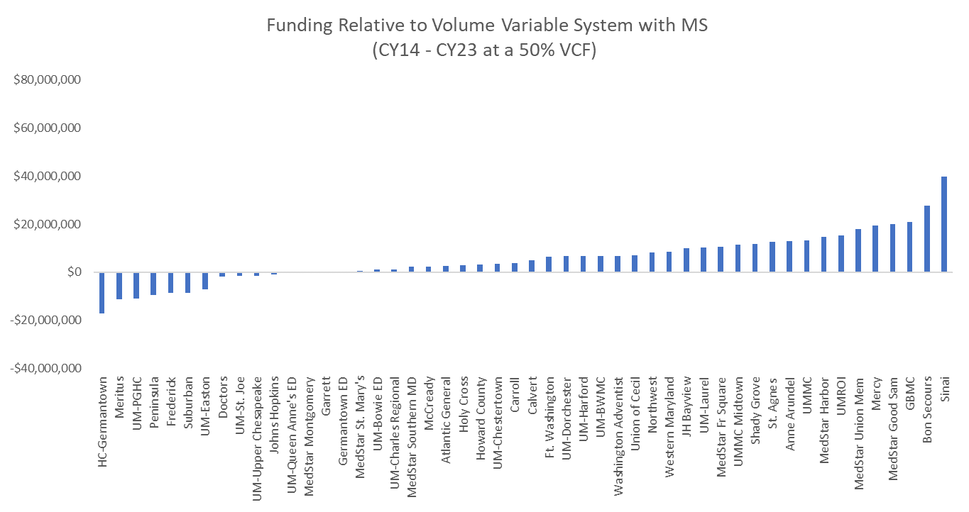
Volume Efficacy: Marketshift Funding Only
Updates through CY 2023 still demonstrate that through the Marketshift alone very few hospitals are not funded for volume at at least a 50% variable cost factor
CY22 overfunding -$467M
CY23 overfunding - $275M
Analysis that only uses Marketshift and/or excludes Demographic Adjustment funding is flawed
Underfunding is by design, as the Demographic Adjustment funds use rate growth
Marketshift is not intended to capture all volume growth

Slide 28
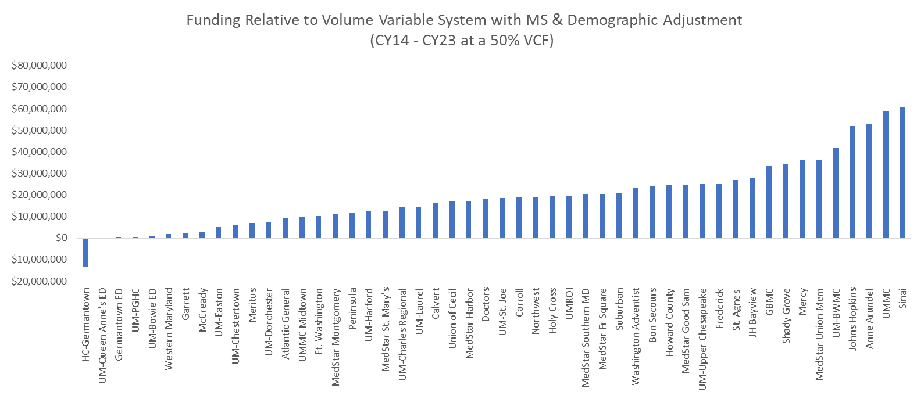
Volume Efficacy: Current Scorecard
Staff continue to demonstrate that most hospitals are funded at at least a 50% VCF for in-state volume changes
CY22 Overfunding - $1.10B
CY23 Overfunding - $958M
Scorecards on next few slides will layer in
Out-of-state
PAU
Deregulation
Miscellaneous Volume Adjustments
Efficiency

Slide 29
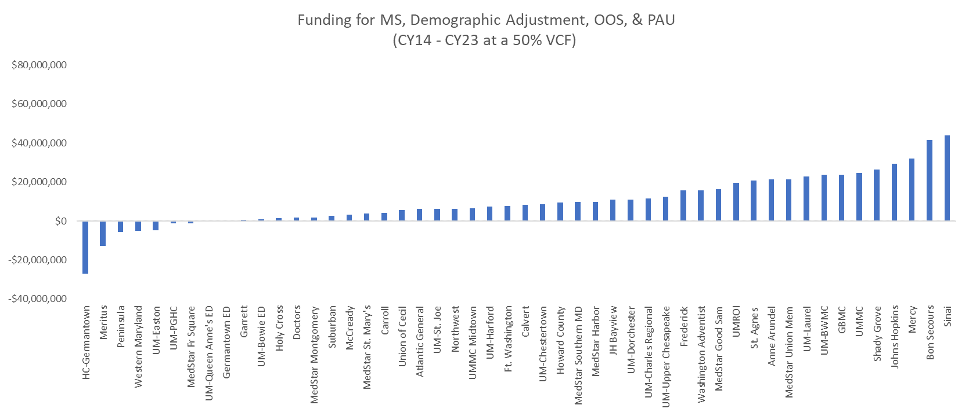
Volume Efficacy: Current Scorecard with OOS & PAU
Inclusion of OOS volume adjustments generally increases overfunding
Statewide Increase $139M
Inclusion of PAU generally decreases overfunding
Statewide Decrease $597M
Statewide Overfunding: $499M

Slide 30
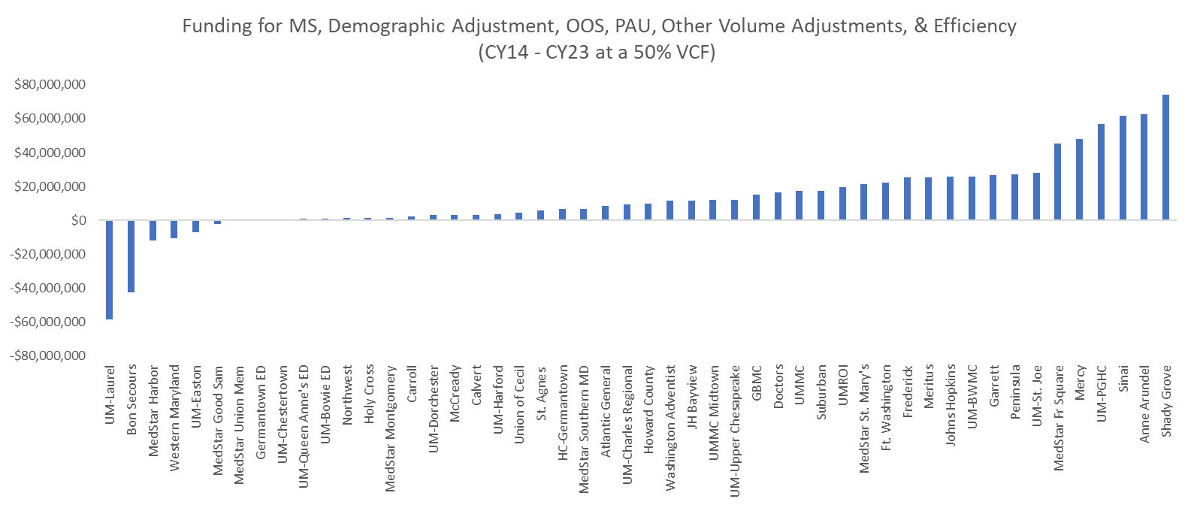
Volume Efficacy: Current Scorecard with OOS, PAU and Misc.
Miscellaneous adjustments fall into three categories
Deregulation
Other Volume (e.g., system realignments, payer initiated shifts)
Efficiency
Inclusion of miscellaneous adjustments generally increases overfunding, due to newly regulated services and efficiency adjustments
Adjustments will require further review from industry, both for accuracy and categorization
Statewide Overfunding: $652M

Slide 31
PAU Update Factor Discussion

Slide 32
PAU Requirements Due to Updated Policy
RY 2025 Update Factor amended the PAU Shared Savings to no longer operate as a Model savings policy. To ensure that focus on avoidable admissions is not compromised by this modification, Commissioners voted on the following requirements:
1) An analysis to be funded out of hospital rates of activities of current interventions to reduce PAU
2) Establishment of a single point of executive accountability for the PAU reduction strategy
3) Agreement to engage in future analyses of PAU performance
Staff would like feedback on implementation of these requirements

Slide 33
PAU Requirements Due to Updated Policy
1) An analysis to be funded out of hospital rates of activities of current interventions to reduce PAU
Staff will earmark $500k from the annual set aside to implement this requirement
What particular elements of current PAU interventions should be investigated?
When and how should the Commission report back its findings?
2) Establishment of a single point of executive accountability for the PAU reduction strategy
Should this be established for each hospital and/or system?
How should the Commission implement and record this requirement, e.g., annual letter from CEO’s/CFO’s establishing executive accountability?
3) Agreement to engage in future analyses of PAU performance
How should the Commission implement and record this requirement, e.g., one letter from CEO’s/CFO’s agreeing to participate in further program evaluation if analyses warrant further investigation?

Slide 34
Next Steps
Draft Recommendation in October
Final Recommendation in December
Implement adjustments from new volume policies in January 2025 rate orders

Slide 35
Potential Revisions to CDS-A

Slide 36
Upcoming Review of CDS-A Policy
HSCRC will be scheduling a Payment Model Workgroup for October to review proposed changes to the CDS-A policy
Replacing current policy, that blends cost-based reimbursement with an inflation factor, with a pure cost-based reimbursement policy. Current policy has provided appropriate funding to date, but:
the reimbursement implementation is complex
as drug growth concentrates at the high end of the clinical spectrum, funding and spending are becoming misaligned between hospitals.
Also proposing to provide a July 1 estimated funding and then use the January 1 adjustment to settle to the final post-audit amount. Will not change the total funding but will smooth out the adjustment during the year.
Policy changes will relate entirely to the way the CDS-A adjustments are implemented in rates, it will not change the audit process, which will continue as is.
Changes will be the focus of the next Payment Model Workgroup, ahead of a planned November Commission recommendation.

Slide 37

Questions?

