Slide 1
Performance Measurement Workgroup
May 21, 2025
HSCRC Quality Team

Slide 2
Meeting Agenda
AHEAD Update
CY 2024 Statewide Quality Performance
Contractual outcomes for CY24
SIHIS Quality Outcomes (Timely follow up, PQIs, readmission disparities)
Quality Financial Impact Dashboard Overview
RY 2027 MHAC Updates
Complications Discussion
Maryland Vs US performance on National complication measures
PPC Measures
QBR ED LOS Incentives

Slide 3
Workgroup Learning Agreements
Be Present – Make a conscious effort to know who is in the room, become an active listener. Refrain from multitasking and checking emails during meetings.
Call Each Other In As We Call Each Other Out – When challenging ideas or perspectives give feedback respectfully. When being challenged - listen, acknowledge the issue, and respond respectfully.
Recognize the Difference of Intent vs Impact – Be accountable for our words and actions.
Create Space for Multiple Truths – Seek understanding of differences in opinion and respect diverse perspectives.
Notice Power Dynamics – Be aware of how you may unconsciously be using your power and privilege.
Center Learning and Growth – At times, the work will be uncomfortable and challenging. Mistakes and misunderstanding will occur as we work towards a common solution. We are here to learn and grow from each other both individually and collectively.
REMINDER: These workgroup meetings are recorded.

Slide 4
PMWG Members
Carrie | Adams | Meritus
Andrew | Anderson | Johns Hopkins Bloomberg
Ryan | Anderson | MedStar - MD Primary Care Program
Kelly | Arthur | Qlarant QIO
Ed | Beranek | Johns Hopkins Health System
Barbara | Brocato | Barbara Marx Brocato & Associates
Zahid | Butt | Medisolv Inc.
Tim | Chizmar | MIEMSS
Linda | Costa | University of Maryland School of Nursing
Ted | Delbridge | MIEMSS (c)
Toby | Gordon | Johns Hopkins Carey Business School
Shannon | Hall | Community Behavioral Health Association of MD
Theressa | Lee | Maryland Health Care Commission
Stacy | Lofton | Families USA
Angela | Maule | Garrett Regional Medical Center
Patsy | Mcneil | Adventist Health
Stephen | Michaels | MedStar Southern Maryland Hospital
Lily | Mitchell | CareFirst
Sharon | Neeley | Maryland Department of Health Medicaid
Christine | Nguyen | Families USA
Jonathan | Patrick | MedStar Health
Elinor | Petrocelli | Mercy Medical Center
Mindy | Pierce | Primary Care Coalition of Montgomery County
Nitza | Santiago | Lifebridge Health
Dale | Schumacher | MedChi, Maryland State Medical Society
Madeleine "Maddy" | Shea | Health Management Associates
Mike | Sokolow | University of Maryland Medical Systems
Geetika "Geeta" | Sood | JHU SOM,Division of Infectious Diseases.
April | Taylor | Johns Hopkins Health System
Bruce | VanDerver | Maryland Physicians Care
Jamie | White | Frederick Health
Amanda | Wright | Maryland Hospital Association

Slide 5
CY 2024 Statewide Quality Performance

Slide 6
CY 2024 Statewide Quality Performance
Today’s presentation provides statewide results for the following TCOC model targets and SIHIS measures:
TCOC Medicare Readmissions Target & All-Payer Readmissions
TCOC Complications Target (Potentially Preventable Complications)
SIHIS Timely Follow Up after Acute Exacerbation of a Chronic Condition
SIHIS Avoidable Admissions
SIHIS Readmission Disparities
Notes:
There are two ways that we evaluate readmissions in Maryland. The first is is the Medicare FFS readmission contractual target. The TCOC model historically required MD to peform better than the nation on unadjusted all-cause 30-day medicare ffs readmissions but in CY 2023, CMMI agreed to switch to a risk-adjusted readmission which is an adapted version of the CMS hospital wide readmission measure. The 2nd way we evaluate readmissions in MD is through the readmissions reduction incentive program also known as RRIP. This program was established to ensure readmission improvement not only for Medicare beneficiaries but for all-payers. The measure evaluates 30-day all-payer, all-cause, all-condition readmissions and is risk-adjusted.

Slide 7
Maryland Readmission Performance

Slide 8
Readmissions Performance
Medicare FFS: Readmission Contractual Target
The TCOC model historically required MD to perform better than the Nation on unadjusted all-cause Medicare FFS 30-day readmissions
Starting in CY23, CMMI agreed to switch to a risk-adjusted readmission measure (i.e., adapted CMS Hospital-Wide Readmission measure) to compare Medicare performance in MD compared to the Nation
Readmissions Reduction Incentive Program (RRIP)
Program was established to ensure readmissions improvements for Medicare and All-Payers
Evaluates 30-day All-Payer, All-Cause, All-Condition Readmissions

Slide 9
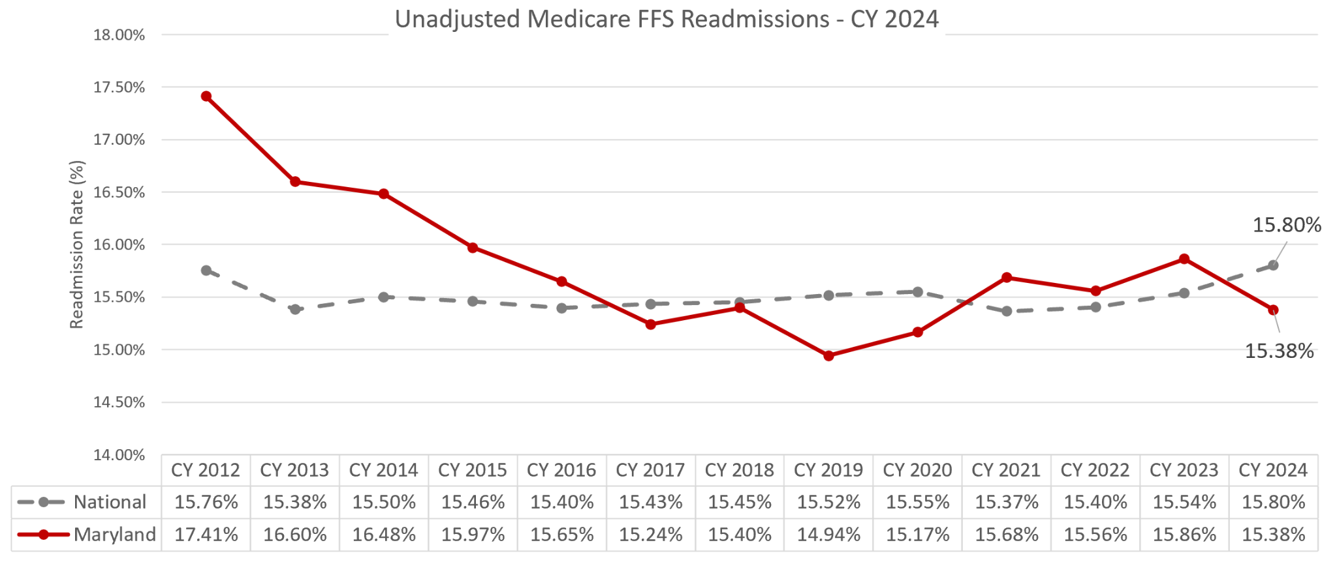
Unadjusted Medicare FFS Readmission Rates, MD vs Nation
Notes:
We perform better than the nation on an unadjusted basis

Slide 10
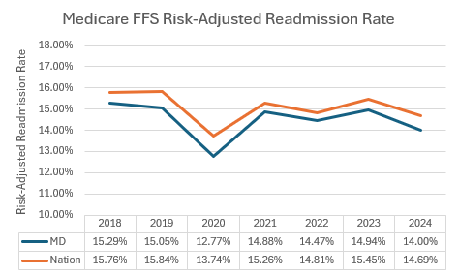
Current Test: MD TCOC Hospital-Wide All-Cause Readmissions
Notes:
We perform better than the nation on a risk-adjusted basis

Slide 11
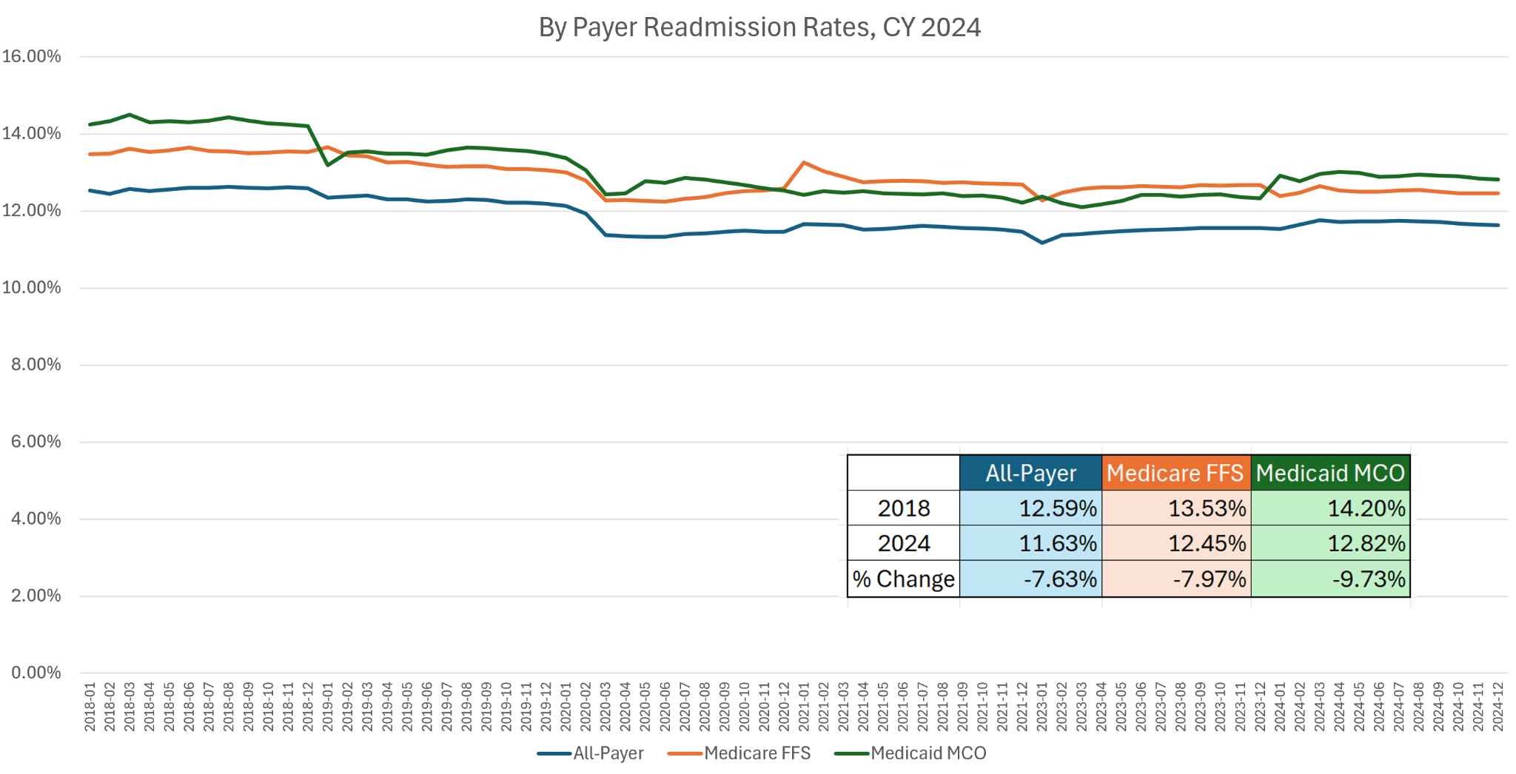
RRIP Case-Mix Adjusted Readmission Rates
Notes:
We are not backsliding on improvements gained during the all-payer model on a case-mix adjusted basis

Slide 12
Potentially Preventable Complications

Slide 13
Potentially Preventable Complications (PPCs)
PPCs are complications that are acquired during a hospital stay that were not present on admission
Based on a classification system developed by Solventum, previously Solventum Health Information System (Solventum)
Under the TCOC Model, Maryland cannot exceed the CY 2018 PPC rates for complications included in the MHAC payment program to maintain improvements made under the All-Payer Model.

Slide 14
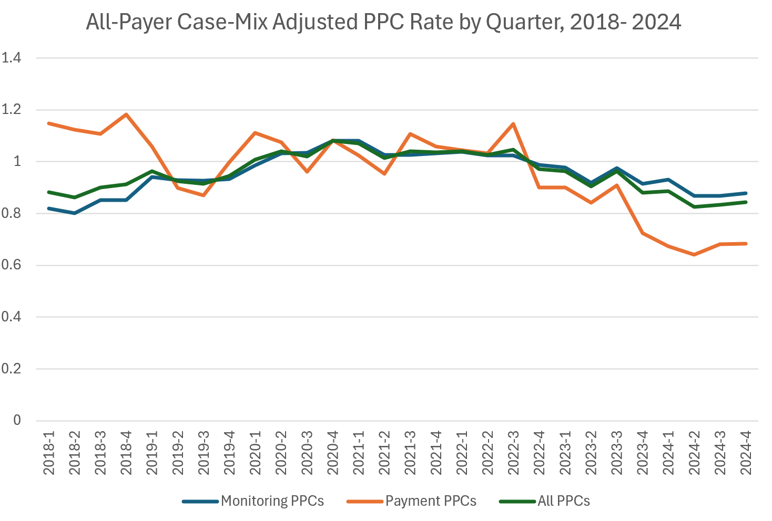
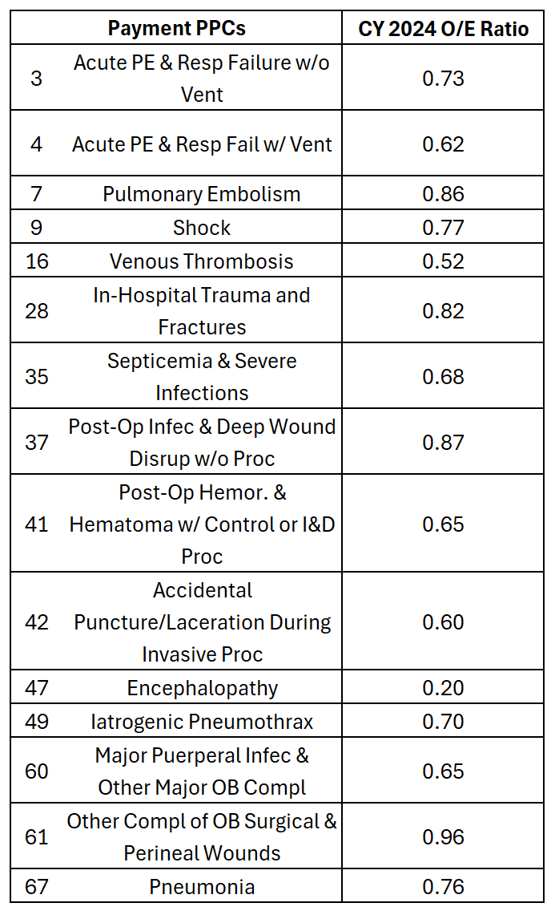
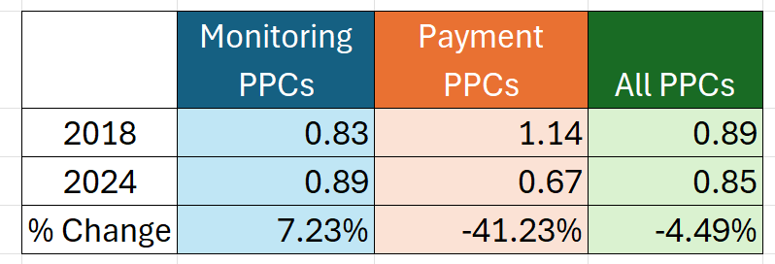
TCOC Complication Target Achieved for CY2024
Notes:
Maryland is far surpassing the performance in 2018 by reducing potentially preventable complications in the payment program by over 40%.

Slide 15
SIHIS Measure: TFU

Slide 16
Medicare FFS Timely Follow Up (TFU)
The TFU measure assesses the percentage of ED visits, observation stays, and inpatient admissions for one of six chronic conditions in which a follow-up was received within the time frame recommended by clinical practice:
Hypertension (follow-up within 7 days)
Asthma (follow-up within 14 days)
Congestive Heart failure (CHF)(follow-up within 14 days)
Coronary artery disease (CAD)(follow-up within 14 days)
Chronic obstructive pulmonary disease (COPD) (follow-up within 30 days)
Diabetes (follow-up within 30 days)
 | SIHIS Target
2018 Baseline | 70.85%
2021 Year 3 Milestone | 72.38% 2.16 percent improvement
2023 Year 5 Milestone | 73.42% 3.62 percent improvement
2026 Year 8 Final Target | 75% or 0.50% better than national rate 5.86 percent improvement
Note: Beginning with CY 2025, logic updates will be implemented which changes the follow-up time frames and stratifies by acuity for some patients
Notes:
The current TFU measure assesses the percentage of ED visits, observation stays, and IP admissions for one of the following 6 chronic conditions in which a follow-up visit was received within the specific timeframe recommended by clinical practice. For hypertension the followup timeframe is 7 days, 14 days for asthma, CHF,CAD and 30 dyas for COPD and diabetes.

Slide 17
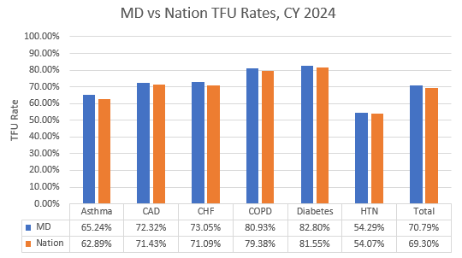
MD vs Nation CCW TFU Performance
Through CY 2024, Maryland’s performance is better in total and for all 6 of the chronic conditions compared to the nation. While not achieving the SIHIS improvement target, Maryland is achieving the goal of performing better than the nation.

Slide 18
SIHIS Measure: PQIs

Slide 19
AHRQ Prevention Quality Indicators (PQIs)
The AHRQ PQIs are population based indicators that identify hospitalizations that might have been avoided through access to high-quality outpatient care, thus providing insights into the quality of health services in a community.
There are ten individual PQI measures that are included in the overall PQI composite measure (PQI-90), which is risk-adjusted based on age and sex.
These ten measures are also grouped into three other specific composites
Acute composite(PQI 91)
Chronic composite (PQI 92)
Diabetic-related admissions composite (PQI 93) - can also be included in the chronic composite
SIHIS Goal: Reduce avoidable admissions from CY 2018 through CY 2026 by 25 percent, as measured by the AHRQ PQI-90

Slide 20
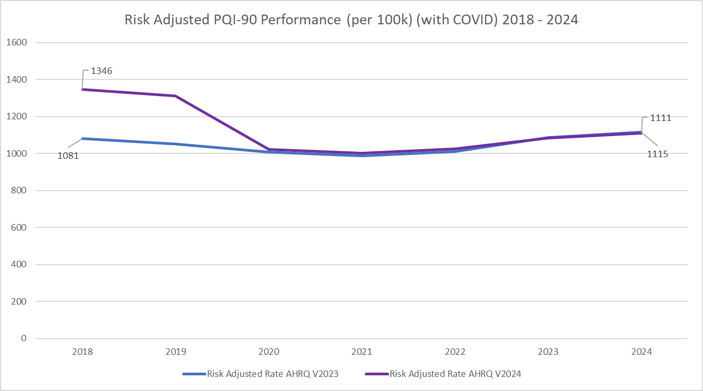
AHRQ PQI-90 Performance: Grouper Concerns
The AHRQ grouper is updated annually and all assessment years, including the baseline rates are re-calculated using the new grouper norms
During CY 2024, AHRQ Version 2023, which uses CY2019 and CY2020 for norms, was used to assess performance
The AHRQ version 2023 grouper shows that Maryland has experienced a 3.2 percent increase across all PQIs in CY 2024 from the 2018 baseline
The AHRQ version 2023 grouper baseline rates are suppressed making current performance appear higher than the baseline rate
The AHRQ version 2024 grouper shows that Maryland has experienced a 17.5 percent decrease across all PQIs in CY 2024 from the 2018 baseline
The AHRQ 2024 grouper, which uses CY 2021 for norms, more closely aligns with previous grouper versions and unadjusted trends

Slide 21
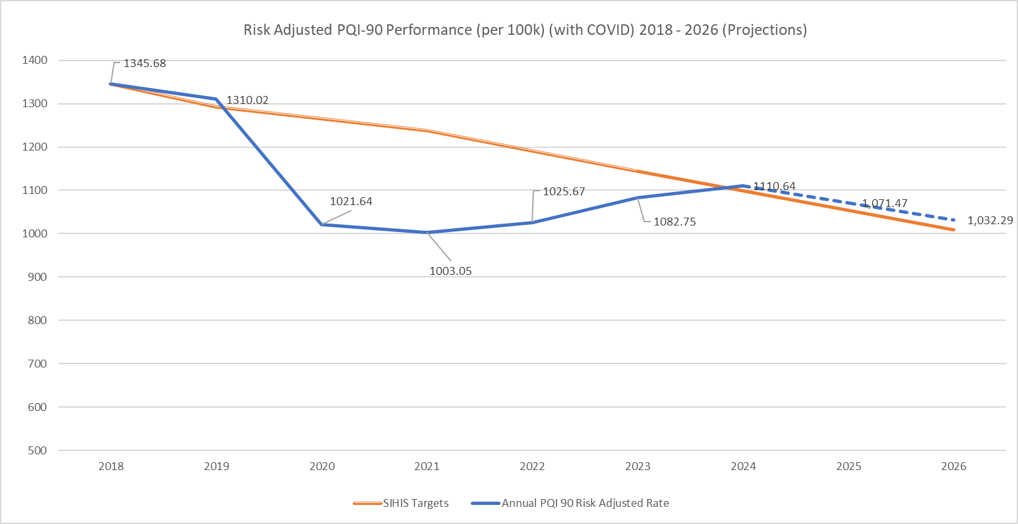
AHRQ PQI-90 Performance under SIHIS
To support Maryland’s success under SIHIS, Maryland hospitals are held financially accountable under the TCOC Model for all-payer PQI admissions through the PAU Policy
Using the AHRQ version 24 grouper, Maryland has experienced a 17.5 percent decrease across all PQIs in CY 2024 from the 2018 baseline.
However, PQI rates have trended slightly upwards since the drastic decrease seen in CY 2020 and CY 2021. Between CY 2023 and CY 2024 there was about a 3% increase
It is not surprising to see increases in PQIs post-covid. However it is commendable that there is still sustained improvement relative to a 2018 base
While trends over the past six years (2018-2024) indicate the State may slightly miss the 2026 Year 8 final target, the anticipated miss is slight (assuming the 6 year annual trend continues)
Improvement could increase if some of the recent growth is due to delayed care due to the pandemic as hospital utilization slowly reverts to pre-pandemic levels
Goal: Reduce Avoidable Admissions
Measure | AHRQ Risk-Adjusted PQIs Goal | Goal Status (AHRQ Grouper v2024)
2018 Baseline | 1,346 admits per 100,000 | 1,346 admits per 100,000
2021 Year 3 Target | 8 percent improvement | 25 percent improvement
2023 Year 5 Target | 15 percent improvement | 20 percent improvement
2026 Year 8 Final Target | 25 percent improvement | TBD

Slide 22
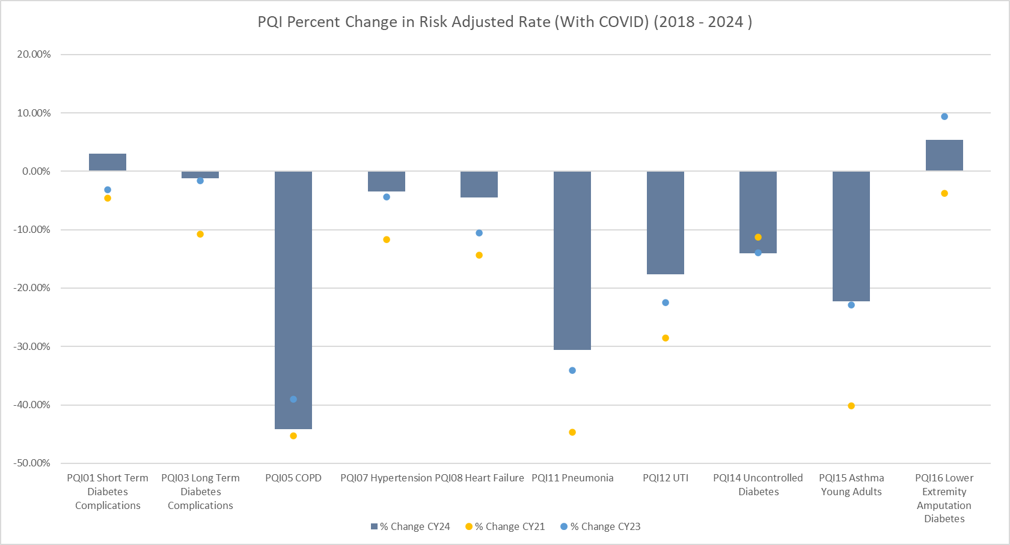
Prevention Quality Indicator (PQI) Performance
**AHRQ v2024 Software

Slide 23
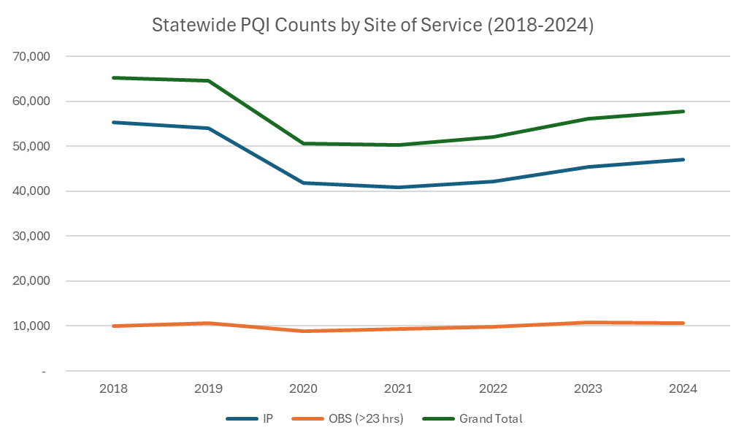
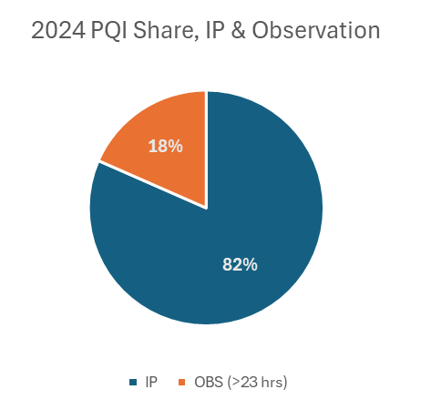
Statewide Unadjusted PQI Trends by Site of Service
Site of Service | % change | Variance between 2024 and 2018
IP | -15% | (8,189)
OBS (>23 hrs only) | 7% | 674
Total | -12% | (7,515)

Slide 24
Readmissions Disparity Gap

Slide 25
Concerns
Results raise concerns that an increasing number of hospitals are not able to meet improvement targets and receive disparity gap rewards
Potential Hypotheses
Hospitals not improving
Possibly due to lack of resources needed to address issues, early progress resulting in harder subsequent improvements, limitations in addressing non-hospital based social needs, among other factors
Methodology Concerns
Shrinkage effects of model are limiting improvement
Inherent issues with statistical modeling

Slide 26
Disparity Gap Revenue Adjustments Results Over Time
 | CY 2021 Performance | CY 2022 Performance | CY 2023 Performance | CY 2024 Performance
# of Hospitals with Improvement | 17 | 32 | 22 | 19
# of Hospitals Rewarded | 9 | 11 | 2 | 0
Statewide Total Reward ($) | ~$10M | ~$7.8M | ~$1.8M | $0
Average Improvement* | -16.40% | -19.05% | -11.96% | -13.83%
Max Improvement* | -39.73% | -61.54% | -34.87% | -30.12%
Min Improvement* | -1.10% | -0.18% | -0.55% | -0.28%
*Of the hospitals that saw an improvement in their disparity gap when compared to CY2018
Notes:
For CY2024, 19 hospitals demonstrated improvement in their disparity gap compared to the CY2018 baseline. The average improvement was 13.83%, with a maximum improvement value of 30.12% and a minimum improvement value of -0.28%. No hospitals achieved the disparity gap target and received any rewards for CY2024.

Slide 27
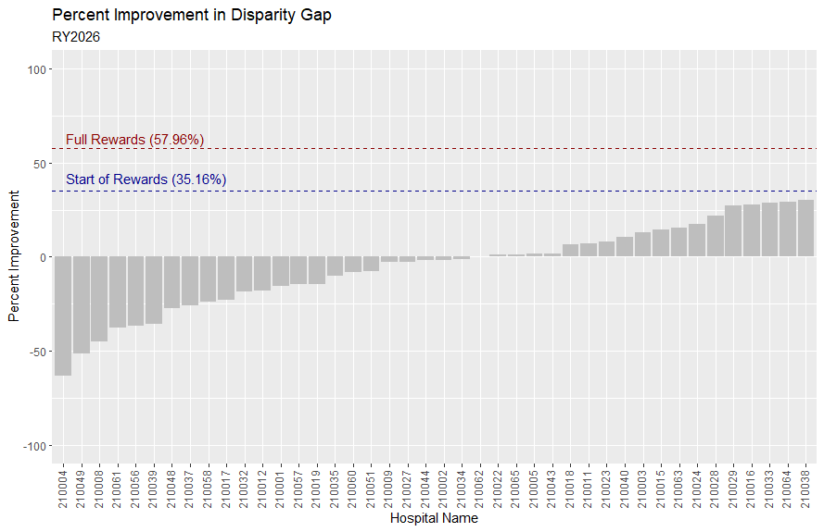
Notes:
When plotting performance for all hospitals, more than half of MD hospitals who reported data demonstrated an improvement in their disparity gap. Again, despite this improvement, no hospitals achieved the start of the disparity gap rewards at 35.16% or the full reward at 57.96%. Please note that the values on this graph and the following graphs are inverted so that percent improvement is positive.

Slide 28
Continued Initial Analyses
What are the annual changes among the risk-adjusted readmissions rates for individual PAI components for Maryland hospitals? Are hospitals, on average, demonstrating outsized improvements or declines in one particular PAI component compared to another?
Measurement: Comparing % Change in Risk-Adjusted Readmissions Rate for the three disparity gap components (Medicaid, Black, High ADI) between CY2024 and CY2018. First, results were plotted as a boxplot to demonstrate median and spread for changes between performance and baseline years. Then, results were plotted longitudinally year-over-year between performances years and baseline. Non-PAI risk-adjusted readmissions rates were similarly plotted on the same scale for comparison.

Slide 29
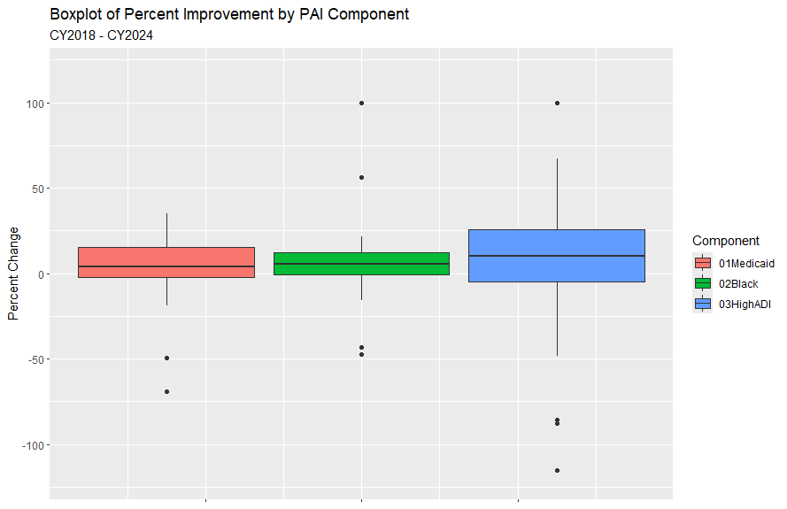
Notes:
Results for changes in the risk-adjusted readmissions rates for the three PAI components between CY2024 and CY2018 demonstrate modest improvement across all hospitals. The median percent change for Medicaid was reported to be 3.93% (IQR: 17.64), for Black to be 5.69% (12.64), and for high ADI to be 9.94% (30.40).

Slide 30
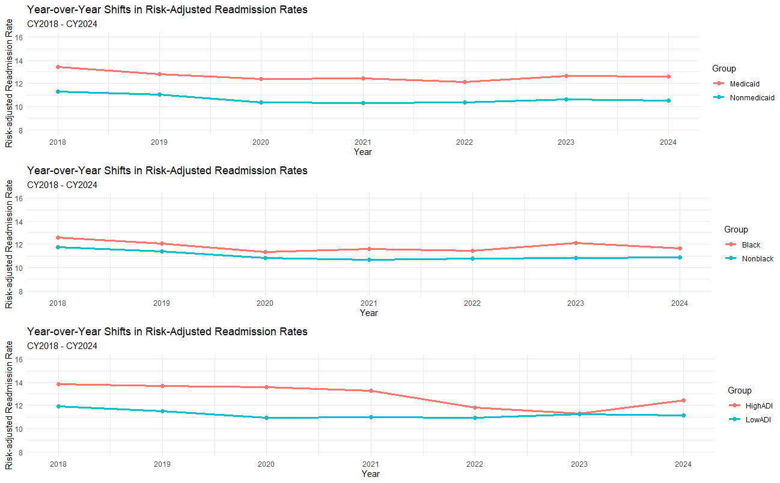
Notes:
When comparing performance longitudinally, the RARR for Medicaid and Black have remained primarily constant year-over-year between CY2018 and CY2024. This is roughly mirrored by their non-PAI counterparts. However, the RARR for High ADI patients slightly dipped in 2023 before rebounding in 2024. Alongside our prior findings, these conclusions lead Staff to believe that comparatively better improvement in non-PAI components is not primarily responsible for washing out progress among PAI components.

Slide 31
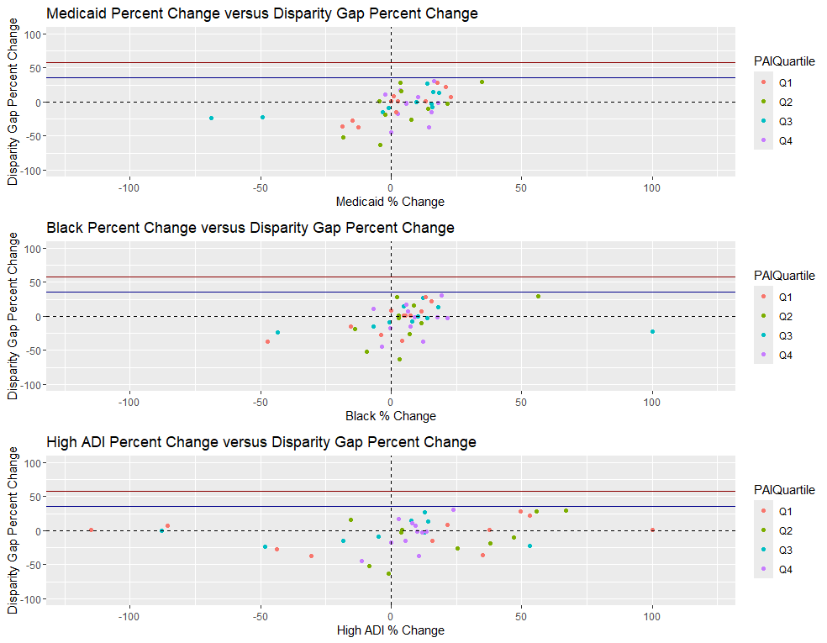
Notes:
Lastly, Staff examined whether there was a correlation between improvement in one particular PAI component (e.g., Black patients) and percentage improvement in the disparity gap between CY2024 and CY2018. Staff also examined whether disparity gap improvement may have been confounded by average PAI by hospital, as measured in quartiles. We found no major conclusive evidence that directed improvement in one particular PAI component or average hospital PAI is correlated with percentage improvement in the disparity gap.

Slide 32
RY2028 Readmission Disparity Gap and Beyond: Priorities List
Assess PAI and Disparity Gap methodology to understand performance results
Investigate whether hospitals that are showing relatively greater improvements in certain targeted populations (e.g., Medicaid) compared to different targeted populations (e.g., Black) are seeing imbalanced improvements in the disparity gap
Impact of risk-adjustment model and reliability adjustments
Applies to Timely Follow-up for Medicare as well
Staff continues to explore simulation modeling that more clearly shows the impact of changes in readmissions on the disparity gap
Re-evaluate the base period and time period for coefficients
Re-assess the improvement targets and scaling
Improve disparity gap report to be more user-friendly
Align with AHEAD priorities

Slide 33
Quality Financial Impact Dashboard (QFID)

Slide 34
What is the QFID?
The Quality Financial Impact Dashboard (QFID) is a tableau dashboard on the CRS portal that provides hospitals with estimates of their quality revenue adjustment which are based on their current performance.
The QFID is updated monthly on the CRS portal during the mid-cycle release and reflects the performance within the most recent reports.

Slide 35
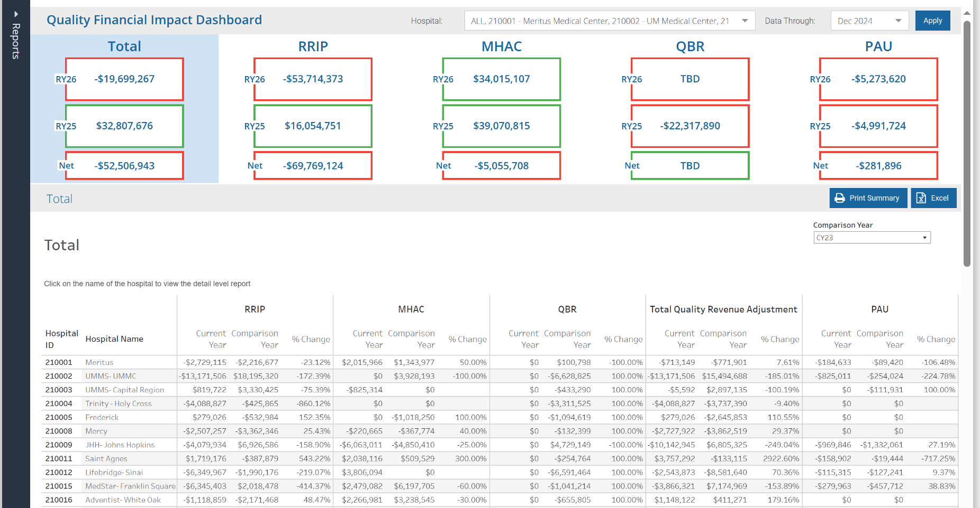
Landing Page
This displays the financial impact for the quality programs in total and for each program for the selected hospital(s). The current and previous RY and the net amount between the RYs is shown. Clicking a program’s tab launches the respective program summaries.
Notes:
Here we have the statewide total revenue adjustment for RY 26, RY25 and the net change between the two rate years. Below the squares is a list of the selected hospital(s)’ performance in the quality programs. Please note that due to the differences in financial implications of PAU, it is not included in the “total” calculation.

Slide 36
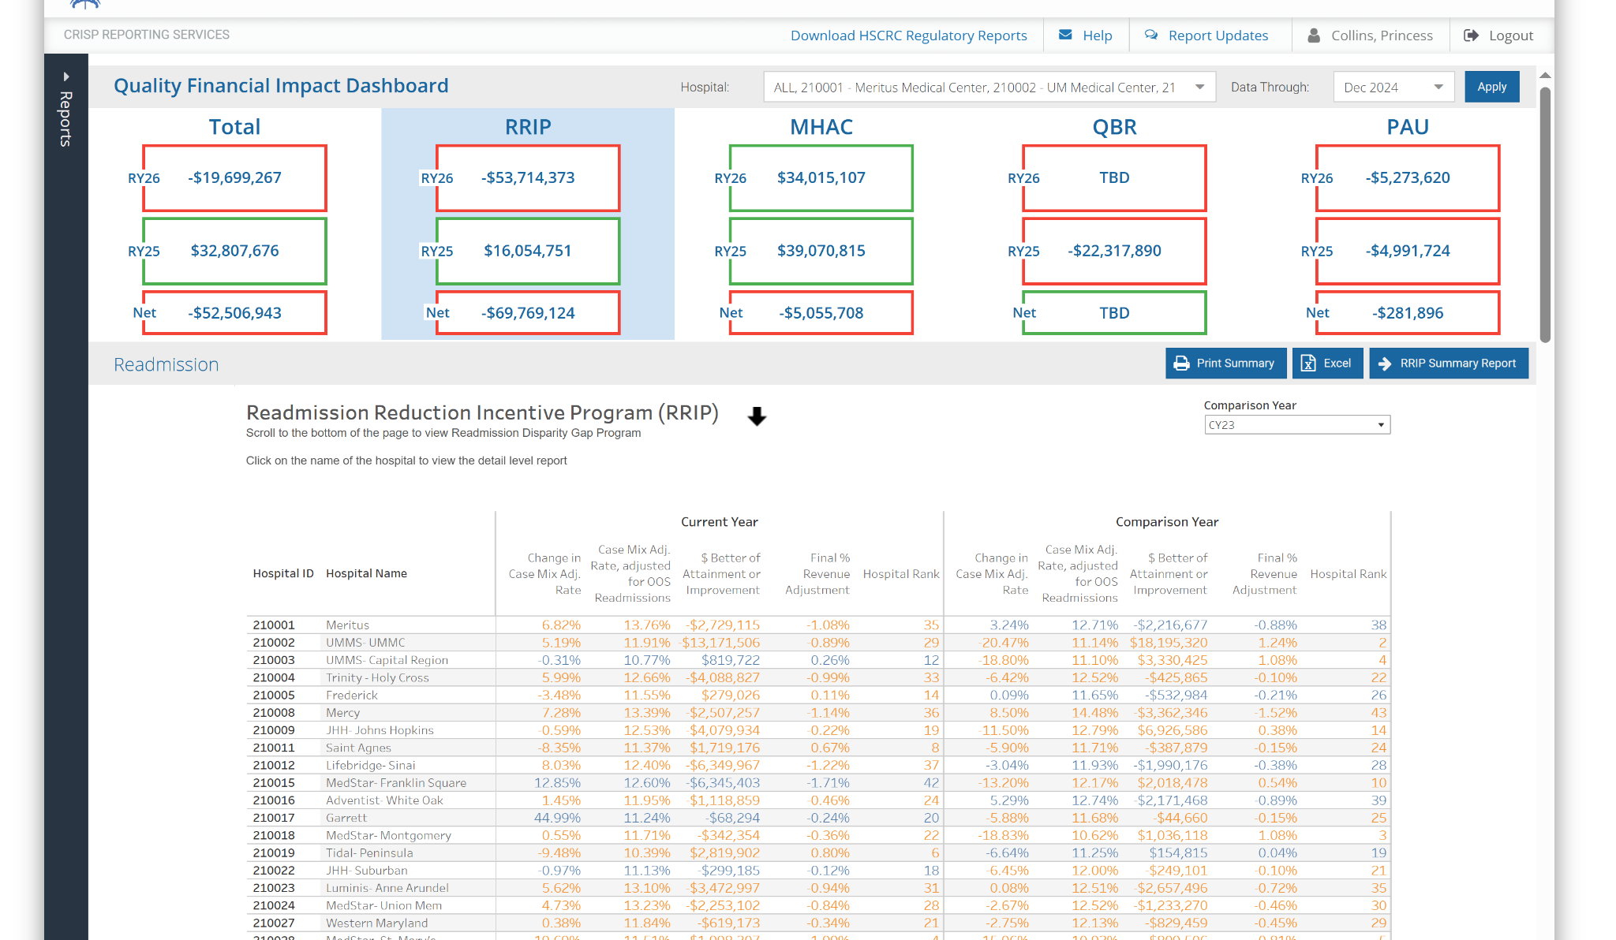
Summary View
This allows users to see a summary of the selected hospital(s) performance within the current year vs a selected comparison year. Clicking a hospital’s row launches the respective program’s details.
Notes:
The example here is RRIP. The RRIP summary allows users to their their change in the case mix adjusted rate from the base, the attainment rate, the $ and % revenue adjustment and the relative hospital rank.

Slide 37
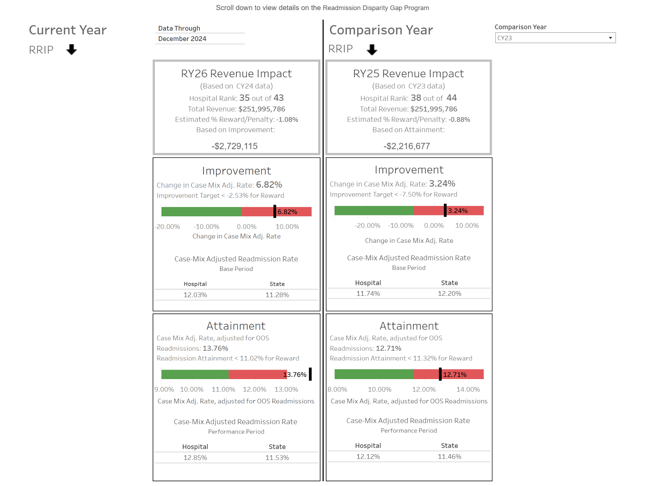
Hospital/Detail Level View
On the detail level view, hospitals can see how their current performance compares to the threshold to begin receiving rewards. The same is done for the selected comparison year on the right.

Slide 38
QFID Features
Arrows for whether lower or higher is better (ex: up arrow for MHAC program, down arrow for O/E ratio for PPCs)
Color coding to denote differences specific to the program (ex: blue for eligible for RRIP-disparity gap, orange for ineligible)
The ability to download the summary reports from within the dashboard
We welcome feedback to improve the user’s experience.

Slide 39
Maryland Hospital Acquired Conditions
(MHAC) Updates RY 2027 and Beyond

Slide 40
RY 2027 MHAC Policy Updates

Slide 41
RY 2027 MHAC Program Implementation Updates and Status
Reporting Updates
PPC Combo - pneumonia
AMC Concerns

Slide 42
RY2027 MHAC Reporting
Hospitals have cost weights and expected PPCs for CY24 under Version 42
Program/Policy- Measure | Resource | Estimated Date via CRS Portal | Estimated Date via HSCRC Quality Team Email | Additional Information
MHAC | Memo | N/A | 5/30/25 | Prelim, unvalidated Threshold: 1.3524 Prelim, unvalidated Benchmark: 0.4836
MHAC | Summary Report | TBD | N/A | Will include finalized base period norms and composite threshold and benchmark and CY2025 YTD scores. In the meantime hospitals should use CY2024 modelled data for prioritization.
MHAC | Base Detail Level Reports | TBD | N/A
MHAC | Performance Detail Level Reports | 5/23/25 | N/A | Preliminary unvalidated data
MHAC | Preliminary Norms from MPR | 5/23/25 | N/A | Preliminary unvalidated data

Slide 43
PPC 67 (combo of PPC 5 and PPC 6) Concerns and Options
Historically, PPC 5: Pneumonia & Other Lung Infections and PPC 6: Aspiration Pneumonia have been combined into PPC 67:
Clinical cause of pneumonia are not always clear
Coding concerns
The current PPC composite method uses single PPC 67 Solventum cost (harm) weight that imprecisely estimates each hospital’s observed harm (numerator) and expected harm (denominator) because the proportion of expected and observed of PPC 5 and PPC 6 varies drastically across hospitals
Solventum harm weights are very different for PPC 5 (1.8707) and PPC 6 (0.7765)
Options to adjust the PPC 5 and PPC 6 calculation:
Use PPC 5 and PPC 6 separately instead of PPC 67
Use hospital-specific PPC 67 numerator weights and PPC 67 denominator weights that result in observed harm and expected harm that is equivalent to observed harm (numerator of composite) and expected harm (denominator of composite) of using PPC 5 and PPC 6 separately.
Use statewide proportion of expected PPCs for PPC 5 and expected PPCs for PPC 6 (instead of statewide proportion of at-risk discharges) to calculate a single PPC 67 cost weight.
Notes:
PPC 67 (combination of PPC 5 and PPC 6) has a higher measure reliability than PPC 5 and PPC 6 separately, so was advantageous under the previous methodology

Slide 44
PPC 67 vs. PPC 5 and PPC 6
Illustration of differences in observed harm and expected harm
Comparing the 3rd row [PPC measure(s) = 5+6] to the 4th row [PPC measure(s) = 67] identifies the degree to which the single Solventum cost weight for PPC 67 underestimates or overestimates observed harm and expected harm for the given hospital
For this hospital, PPC 67 underestimates observed harm by 9.2 and expected harm by 6.4
Each hospital has a different proportion of expected and observed PPCs for PPC 5 and PPC 6, such that PPC 67 overestimates or underestimates observed and expected harm by varying degrees across hospitals
PPC Measure(s) | Solventum Cost Weight | Observed PPCs | Expected PPCs | Observed Harm (Observed PPCs * Solventum Cost Weight) | Expected Harm (Expected PPCs*Solventum Cost Weight)
5 | 1.8707 | 15 | 12.5 | 28.1 | 23.4
6 | 0.7765 | 4 | 6.8 | 3.1 | 5.3
5 + 6 | -- | 19 | 19.3 | 31.2 | 28.7
67 | 1.1553 | 19 | 19.3 | 22.0 | 22.3
Notes:
Comparing the 3rd row (PPC measure = 5+6) to the 4th row (PPC measure = 67) identifies the degree to which the single Solventum cost weight for PPC 67 underestimates or overestimates observed harm and expected harm

Slide 45
AMC MHAC Concerns
Academic Medical Center (AMC) Concerns:
To assess specific concerns related to the unique procedures and higher severity patients served by AMCs and how performance is benchmarked, including:
Evaluation of AMC contribution to normative values and adequacy of risk-adjustment
Assessment of setting of benchmark and thresholds
Identification of procedures unique to AMCs and occurrence of complications
Consideration of national benchmarks for AMCs
Plan to meet with AMCs in June to review workplan and then meet in late August to review results and recommendations that will be presented at September-October PMWG meeting.

Slide 46
Maryland Vs.National Performance on Complication Measures

Slide 47
Maryland Performance on Complications Measures Used Nationally
Maryland hospitals are measured on a number of complication measures that are also used nationally
Understanding Maryland’s relative performance should inform how we measure complications in our programs
Emerging measures such as eCQMs provide an opportunity for potential new measures that are all-payer and are consistent nationally

Slide 48
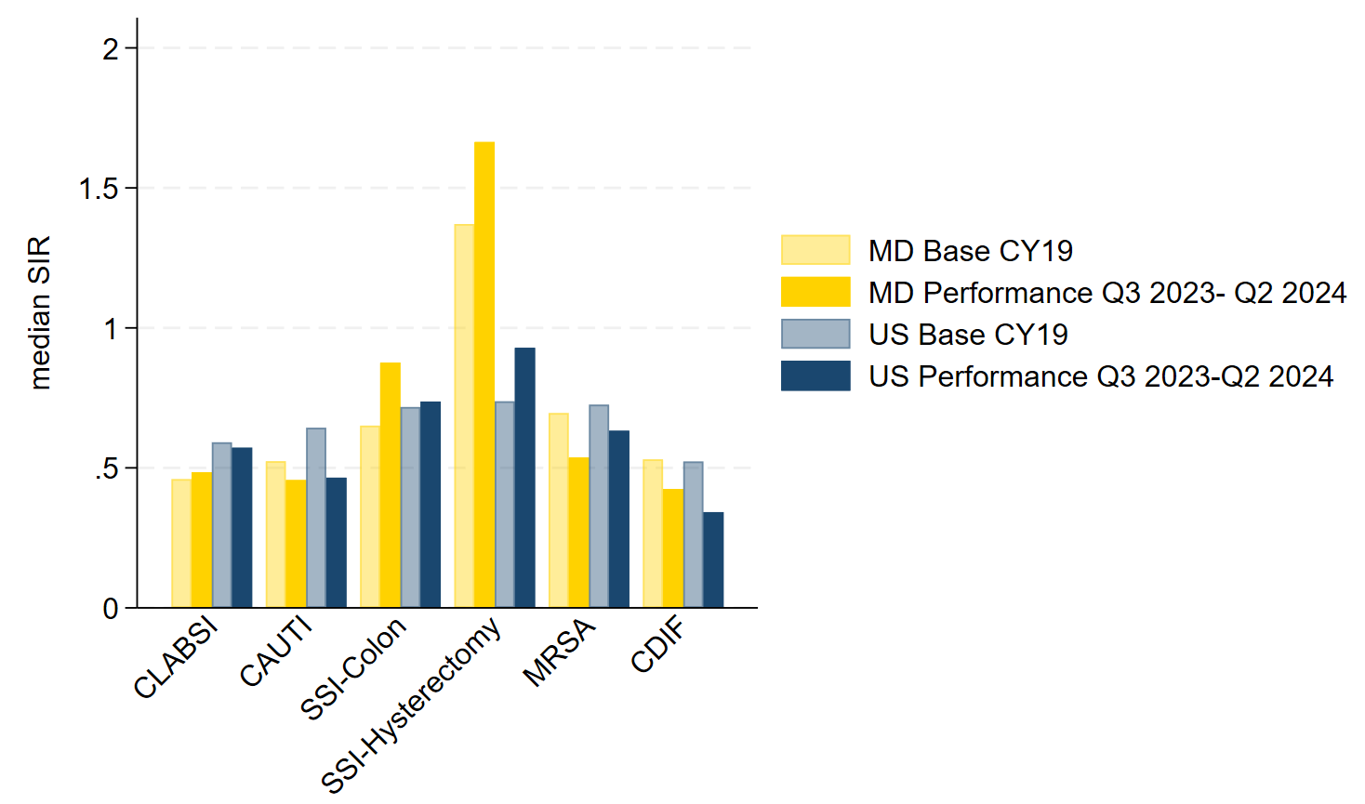
NHSN HAIs Maryland Vs. National Performance

Slide 49
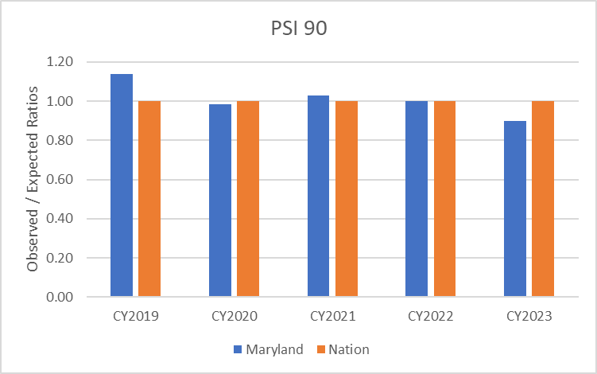
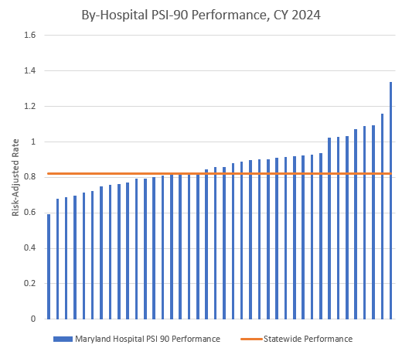
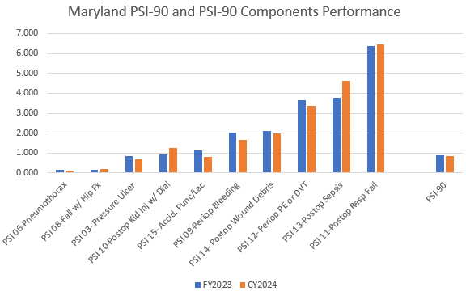
PSI 90- All-Payer Performance

Slide 50
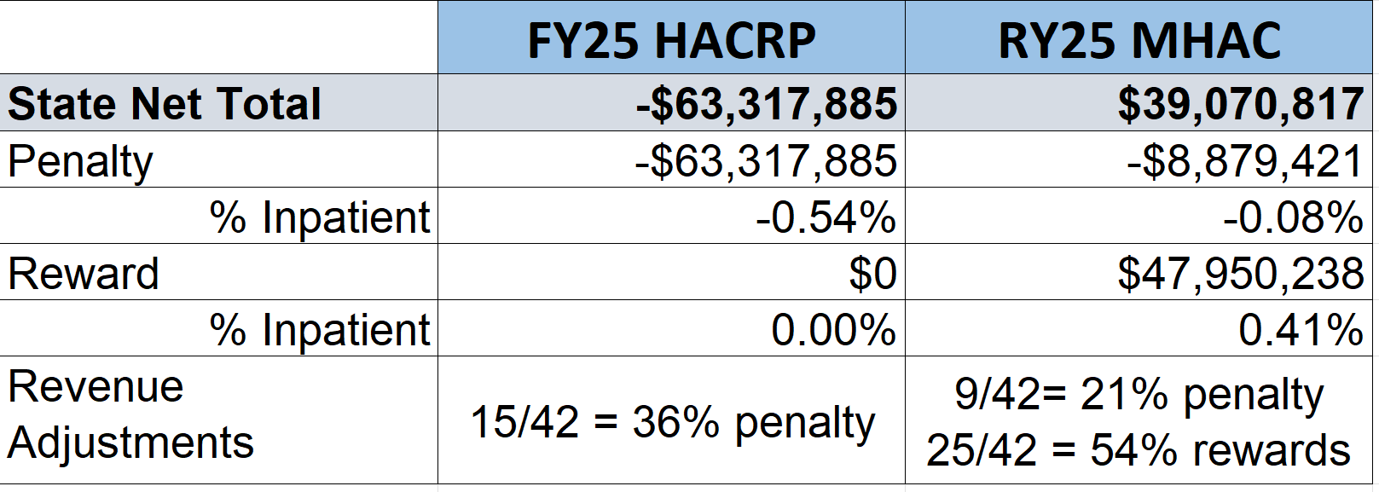
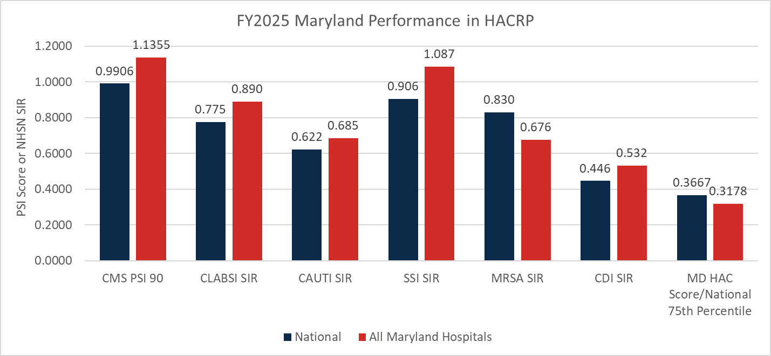
FY 2025 HACRP MD Performance
MD performs worse on all measures except MRSA; State as a whole performs better than national 75th percentile.
Note: Staff estimated all-payer revenue adjustments using HACRP results from CMMI (apples to apples comparison). CMS would apply adjustments to Medicare FFS revenue only, so this is higher than what it would be if in the HACRP program.
While staff still believes the MHAC program is superior to the HACRP program because of its comprehensiveness (e.g, inclusion of major obstetric complications ), prospective standards, and upside risk, staff believes it is important to understand how Maryland would fare in the national program.
Higher is better
For the FY 2025 HAC Reduction Program, the CMS PSI 90 measure uses a performance period of July 1, 2021, through June 30, 2023. The CDC NHSN HAI measures (CLABSI, CAUTI, SSI, MRSA, and CDI) have a performance period of January 1, 2022, through December 31, 2023.
RY2025 MHAC is based on CY 2023 performance using Solventum Potentially Preventable Complications.
Notes:
Percent Hospitals Penalized
15/42 = 36%
9/42 = 21%

Slide 51
HSCRC Digital Measures Reporting Requirements 2025: Electronic Clinical Quality Measures (eCQMs)
Title | Short Name | CMS eCQM ID | CBE* # | 2024 | 2025 | HSCRC
Anticoagulation Therapy for Atrial Fibrillation/Flutter | STK-3 | CMS71v13 | N/A | X | X | Self-Selected
Antithrombotic Therapy By End of Hospital Day 2 | STK-5 | CMS72v12 | N/A | X | X | Self-Selected
Cesarean Birth | PC-02 | CMS334v5 | 0471e | X | X | Required
Discharged on Antithrombotic Therapy | STK-2 | CMS104v12 | N/A | X | X | Self-Selected
Excessive Radiation Dose or Inadequate Image Quality for Diagnostic CT in Adults (Facility IQR) | IP-ExRad | CMS1074v2 | 3663e |  | X | Self-Selected
Global Malnutrition Composite Score | GMCS | CMS986v2 | 3592e | X | X | Self-Selected
Hospital Harm - Acute Kidney Injury | HH-AKI | CMS832v2 | 3713e |  | X | Self-Selected
Hospital Harm - Opioid-Related Adverse Events | HH-ORAE | CMS819v2 | 3501e | X | X | Self-Selected
Hospital Harm - Pressure Injury | HH-PI | CMS826v2 | 3498e |  | X | Self-Selected
Hospital Harm - Severe Hyperglycemia | HH-Hyper | CMS871v3 | 3533e | X | X | Required
Hospital Harm - Severe Hypoglycemia | HH-Hypo | CMS816v3 | 3503e | X | X | Required
ICU Venous Thromboembolism Prophylaxis | VTE-2 | CMS190v12 | N/A | X | X | Self-Selected
Safe Use of Opioids - Concurrent Prescribing | Safe use of opioids | CMS506v6 | 3316e | X | X | Required
Severe Obstetric Complications | PC-07 | CMS1028v2 | N/A | X | X | Required
Venous Thromboembolism Prophylaxis | VTE-1 | CMS108v12 | N/A | X | X | Self-Selected

Slide 52
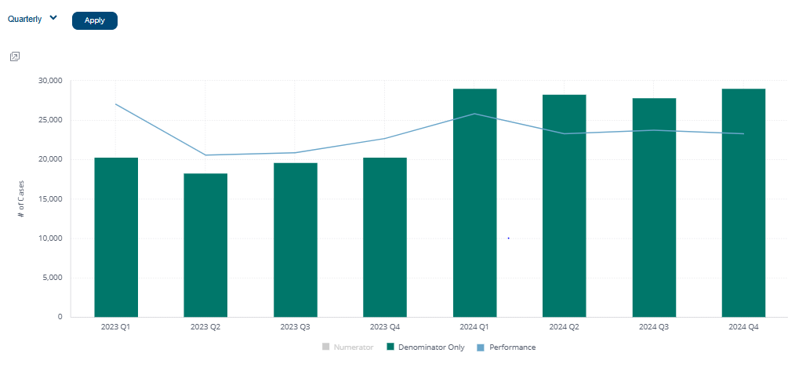
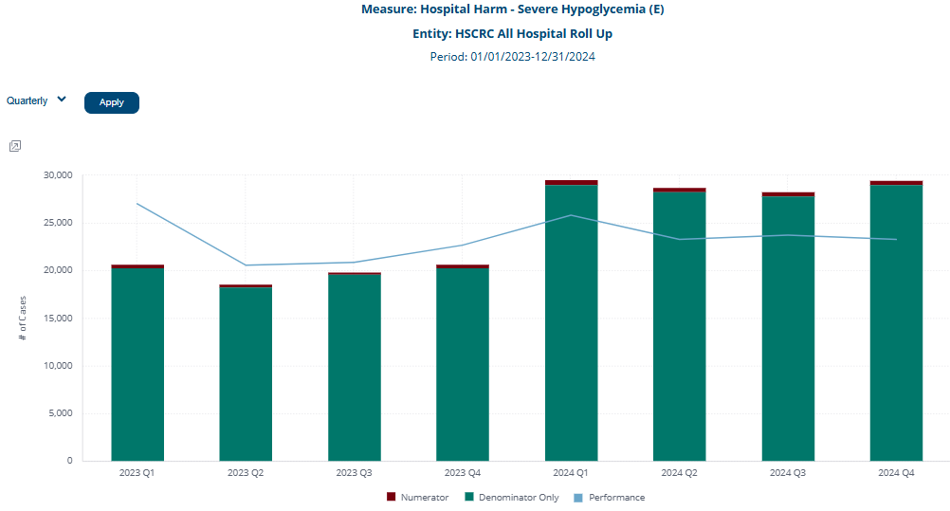
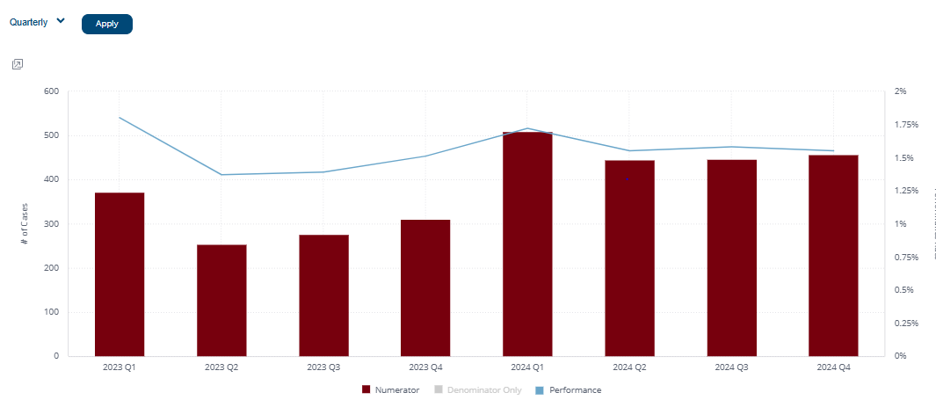
Hypoglycemia Measure Example 2023-2024 Quarterly Trends

Slide 53
Complication Measure Discussion

Slide 54
What Complication Measures we Use and How we Calculate Them are Impacted by Several Issues
Criteria for maintaining current measures/selecting new measures for inclusion in the payment program have been previously established but should be reconsidered.
Methodology update from individual measures to composite:
Has allowed reconsideration of the pneumo combo measure
Has allowed for reliable calculation of results for hospitals with smaller numbers of particular PPCs (expected > zero)
May allow selection of monitored PPC measures with increasing rates
How do we consider Maryland performance on (existing and emerging) measures used nationally for use in our payment program.

Slide 55
Payment PPC Selection Criteria
PPC Data Analysis/Statistics
High rates: Rate per 1,000 generally 0.5 or above
High Volume: Volume of observed events 100 or above (over two years)
Increasing rates
Significant variation across hospitals
At least half of the hospitals are eligible for the PPC
Additional Considerations
All-payer
Clinical significance
Potential influence of coding practices/changes
Opportunity for improvement/actionability
Overlap with other measures in QBR
Alignment with national programs
If using composite methodology, staff plans to revisit monitoring PPCs with lower rates and volumes.
Notes:
State overall goal of the program

Slide 56
Criteria for Evaluating PPCs for MHAC
The HSCRC is re-evaluating the criteria to determine which PPCs should be included in the PPC composite for the MHAC Program
The HSCRC will recalibrate the PPC assessment criteria now that the MHAC Program uses a PPC composite instead of individual PPC measures
Measure reliability and predictive validity are no longer important because the PPC measure data are rolled into a composite. However, the HSCRC would like to pick a set of PPC measures that results in a PPC composite with high reliability and acceptable predictive validity.
Assessment Criteria | RY28 Importance? | RY21 Importance
Number of hospitals with 2 expected PPCs | N/A | Very High
Distribution of observed rates across hospitals | Moderate | Moderate
Changes in hospital rates over time | Moderate/High | Moderate
Distribution of norms across APR-DRG-SOIs | Moderate | Moderate
Clinical significance | Very High | Very High
Clinical actionability | High | High
Measure Coding Concerns | High | High
Measure Content Validity | High | High
Measure Predictive Validity | Low | Moderate
Measure Reliability (signal-to-noise) | Low | High
Composite Reliability | Very High | N/A

Slide 57
Monitored PPC Handout

Slide 58
QBR Measure Review

Slide 59
RY 2025 ED LOS Measure Update
Hospital Review and Validation Process
CY2023 Median ED LOS by hospital report and corresponding patient level files was sent out to hospitals on 4/25
Hospitals had a three week review period (extension granted); May 1st Best Practices Meeting reviewed results and discussed measure specifications
RY2026 Decisions
Measure changes
Improvement goal

Slide 60
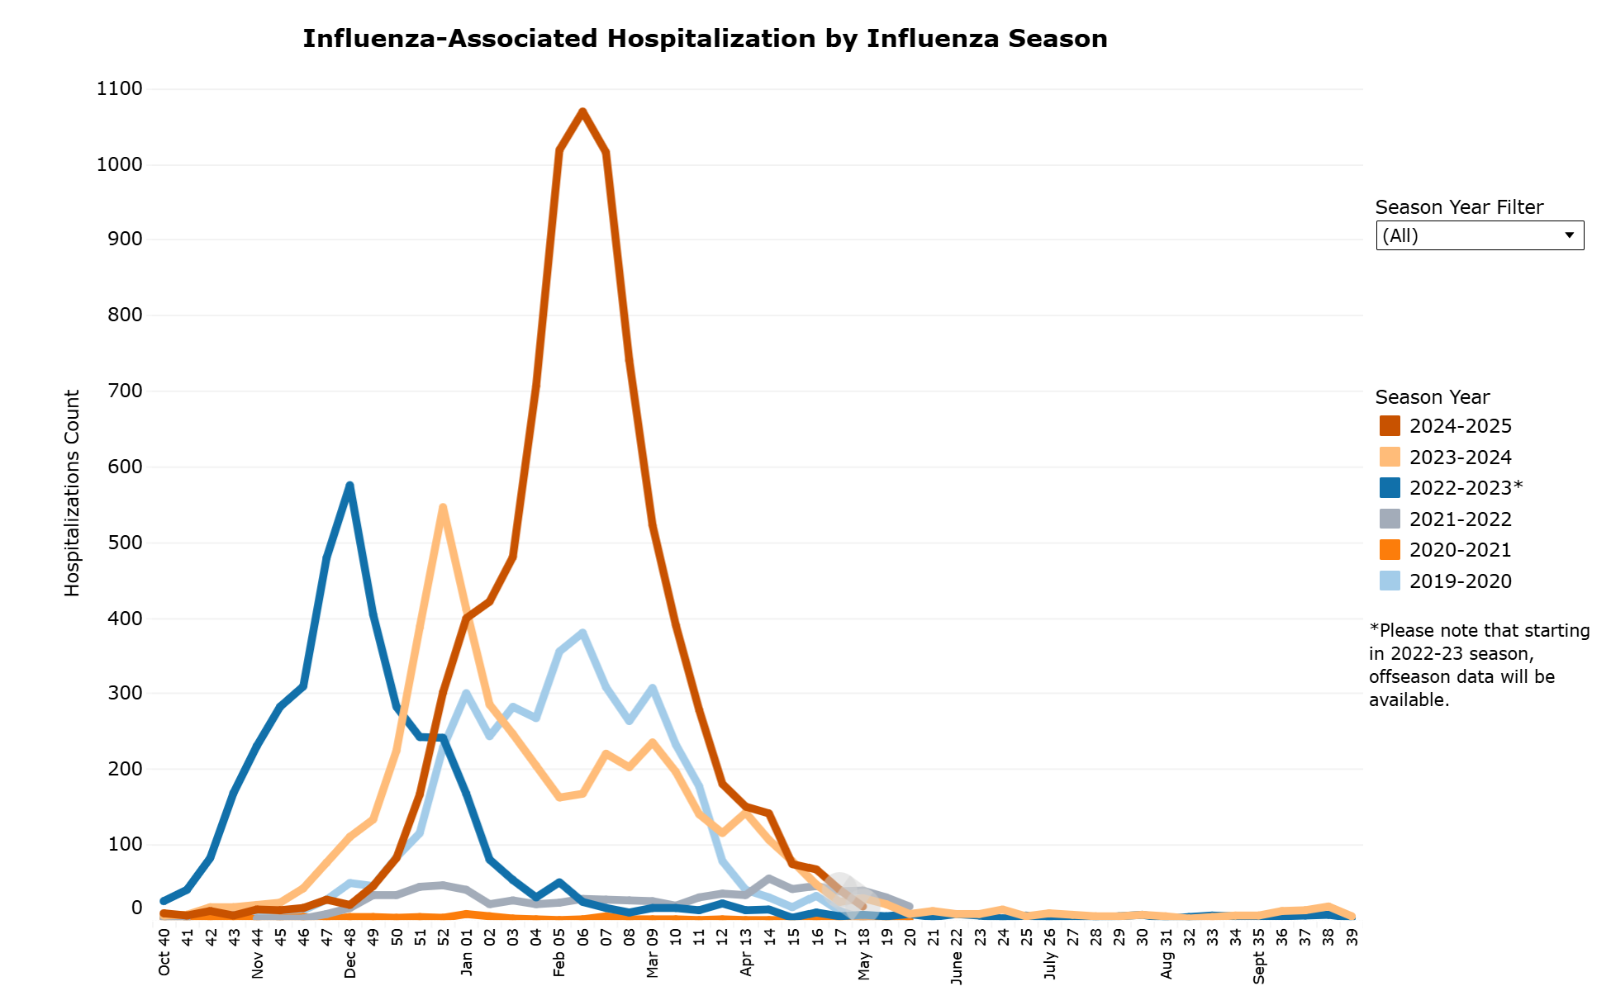
2024 QBR Performance Summary
2024 results on ED1b were mixed
23 hospitals reduced the median ED LOS from CY23 - CY24 (range 0.3% to 19%), resulting in 106k fewer hours spent waiting in emergency rooms.
17 hospitals experienced increases in the median ED LOS (range from 0.4% to 14%), resulting in an additional 127k hours spent waiting in emergency rooms.
1 hospital saw no change and 1 hospital was excluded because it converted to a FMF.
Mixed results are likely due to performance improvements and influence of 2024 respiratory season.
If hospitals with performance that was more heavily influenced by case growth are removed (n=9), the remaining hospitals (n=31) improved median wait times on average by 3%, resulting in 33k fewer hours spent waiting in emergency rooms
Excluded - Hospitals with worse performance and less than 3% growth in cases (n=7) AND
Excluded - Hospitals with better performance and less than a 3% decline in cases (n=2)
See next slide for hospital by hospital comparison

Slide 61
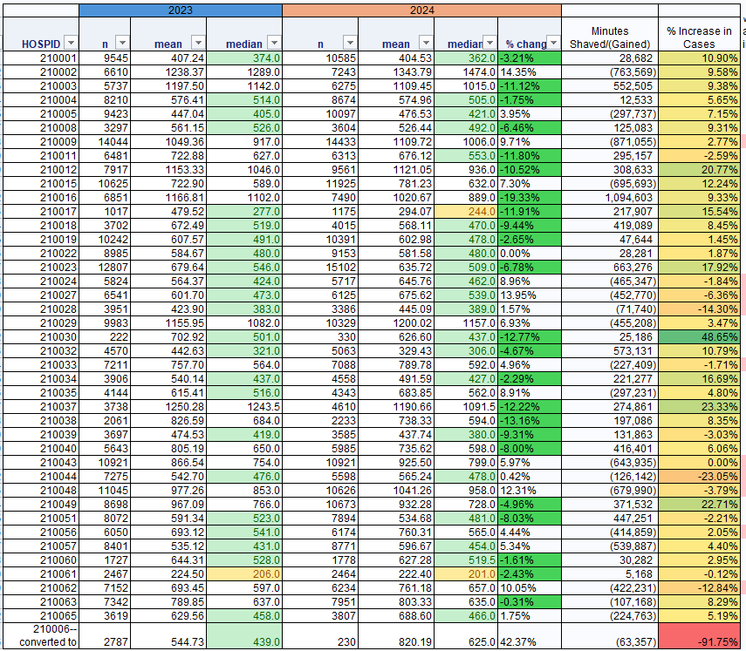
By Hospital
Arrayed by hospital ID Lists
Number of cases
Median ED LOS
Average ED LOS
% change in Median ED LOS
Change in Minutes Waiting = Change in Average ED LOS X 2024 cases

Slide 62
Current Exclusions for ED LOS Measure
Current exclusions were sent to hospitals for review on 4/25 along with a request for any additional proposed exclusions.
Current Exclusions:
Exclude pediatric cases
Remove discharges age <18
Exclude/do not merge in discharges from Shock Trauma (Hospid: 218992) to UMMS as is done for some quality measures.
Exclude psychiatric discharges for QBR payment measure using The Joint Commission list of primary diagnoses and APR-DRGs:
Primary diagnosis codes from TJC were used for the applicable calendar year. These are the specific tables:
Table Number 10.01: Mental Disorders-HBIPS/ED
Table Number 10.02: Mental Disorders-ED
Discharges with a psychiatric or substance abuse related APR-DRG
APR-DRGs 740, 750, 751, 752, 753, 754, 755, 756, 757, 758, 759, 760, 770, 772, 773, 774, 775, 776
Exclude discharges related to deliveries
Discharges with a maternal delivery related APR-DRG (Note: not all obstetrical patients are excluded)
APR-DRGs 539, 540, 541, 542, 543, 547, 548, 560, 561, 564, 566
Exclude rehabilitation discharges
dailyser=’08’
Exclude Chronic discharges
Major service line = CHRONIC

Slide 63
Additional Exclusions Proposed By Hospitals
Trauma and Burn cases in line with exclusion of shock trauma patients
Homeless patients as defined by zipcode=88888
Rationale: placement issues or housing limitations can cause course of action we have limited control.
From an equity standpoint, recommend tracking these cases and including needs in the ED recommendations to the state; proposal is to exclude these cases from the P4P program.
Secondary diagnosis of psychiatric diagnosis using the same list of Joint Commission diagnoses included for the primary exclusion criteria
Longer ED LOS cases may require treatment for psychiatric reasons but were hospitalized for medical reasons.
HSCRC has requested case examples as well as a refined list of specific codes
Clarification of Daily Service (Data element 47) vs. Major Service (46) for chronic care
Major service was used in initial run, but no cases were with Daily Service of Chronic were included (meaning they either were all removed because major service = chronic or other reason).
Will include both Daily Service and Major Service in future runs to ensure all chronic care cases are excluded.

Slide 64
ED Wait Time Reduction Commission & Subcommittees Update
ED Wait Time Reduction Commission
Meetings Ongoing (Next Meeting - June 3)
Coordinating Site Visit to JHH in June/July
Access to Non-Hospital Care
Meetings Ongoing (Next Meeting - June 5)
Priority Focus: Post acute capacity and care transition opportunities
Data Subcommittee
Meetings Ongoing (Next Meeting - June 23)
Priority Focus: Capacity, LOS and complexity data
ED Hospital Throughput Best Practices
Meetings Ongoing (Next Meeting - June 17)
Priority Focus: Implementation Plans and Development of Reporting Template
Hospital Capacity, Operations & Staffing
First Meeting May 16
Priority Focus: TBD by subgroup

Slide 65
THANK YOU!
Next Meeting: June 18, 2025

