Slide 1
FY 2027 Quarter 1 Data Forum
September 11, 2026 @10:00 AM
Join Zoom Meeting:
https://us06web.zoom.us/j/4107642605?pwd=MmVwREVMbFFYUzlCeWpJcFFZYWF5UT09&omn=85973965350
For Meeting ID and Passcode please contact Curtis Wills: curtis.wills@maryland.gov
1

Slide 2
Why, When, Where
WHY?
  Open and ongoing communication between HSCRC & industry
  Forum to ask questions about submitted hospital data (case mix, financial, and supplemental)
  Sharing of best practices
WHEN?
  10:00 am
WHERE?
  via Webinar (link is posted on our website 2 months before the next meeting)
FY 2027 Dates
December 11, 2026
March 12, 2027
June 11, 2027

Slide 3
Agenda
Reminders (Curtis)
Financial Data Update (Karen)
Data Processing Update (Shivani Bhatt, hMetrix/Burton Policy)
Case Mix Audit Update (Brenda Watson, Commence)
Upcoming Workgroups and Next Meeting (Curtis)

Slide 4
Reminders

Slide 5
HSCRC Points of Contact for Data
Nancy Chiles Shaffer Phone: (410) 764-2566 Email: nancy.shaffer@maryland.gov | Andrea Strong Phone: (410) 764-2571 Email: andrea.strong@maryland.gov
Curtis Wills Phone: (410) 764-2594 Email: curtis.wills@maryland.gov | Hannah Thurner Phone: (410) 764-3371 Email: hannah.thurner@maryland.gov

Slide 6
Please Complete the Data Forum Survey!
Opportunity to provide feedback on
  Meeting logistics (meeting notice, registration, ease of participation)
  Topics covered during the prior meeting
  Topics for discussion for future meetings
After this Data Forum, participants will receive a link to a survey via Survey Monkey
Questions about the survey: contact hscrcteam@hmetrix.com

Slide 7
Timeline for Historical and Ongoing Data Submissions
Due Date | 7/30/2026 | 10/30/2026 |  | 1/29/2027
Denial File | Summary | Summary | Patient-Level | Summary | Patient-Level | Patient-Level
Reporting Period | FY 26 Q4 | FY27 Q1 | FY26 Q4 | FY27 Q2 | FY27 Q1 | FY27 Q2
Location | HSCRC Email | DAVE | DAVE | DAVE | DAVE | DAVE
Naming Convention | N/A | HOSPID_FY27Q1_SUMDENIAL.xlsx | HOSPID_FY26Q4_DENIAL.xlsx | HOSPID_FY27Q2_SUMDENIAL.xlsx | HOSPID_FY27Q1_DENIAL.xlsx | HOSPID_FY27Q2_DENIAL.xlsx
Final Denial Date | During FY26 Q4 | During FY27 Q1 | During FY25 and FY26 | During FY27 Q2 | During FY27 Q1 | During FY27 Q2
  From FY 2027 onwards, all denial files will be submitted through DAVE
  Adherence to the mandatory naming conventions below is required
    Summary data: HOSPID_FYyyQq_SUMDENIAL.xlsx
    Patient-level data: HOSPID_FYyyQq_DENIAL.xlsx
  Patient-level reporting will be done in parallel with the existing quarterly Denial Reporting.
  Hospitals may submit a summary file along with FY 2026 Q4 patient-level data covering all denial dates in FY 2025 and FY 2026 with file name- HOSPID_FY26Q4_SUMDENIAL.xls

Slide 8
Submission Process
Delivery & File Naming
  Location: Upload files directly to the designated DAVE submission folder.
  Frequency: Submit one file per hospital, per quarter.
  Standard Naming Convention: HOSPID_FYyyQq_DENIAL.xlsx.
    Example: 210001_FY25Q1_DENIAL.xlsx.
Data Reconciliation Logic
  To ensure data integrity, denial records will be reconciled with Case Mix data using the following keys:
    Hospital ID
    Patient Account Number
    Service Date
  Note: The reported Service Date must fall between the Admission/From Date and ±1 day of the Discharge/Thru Date.
Error Reporting
  While HSCRC plans to implement automated error reports in the future, there is currently no error threshold for these submissions.

Slide 9
Financial Data Update

Slide 10
FY 2026 Annual Filing Submission (eF2) Update
FY 2026 Annual Filing
All FY 2026 Annual Filings must be submitted via eF2. Hospital submission templates are available for download in DAVE.
The June 30 memo outlines the changes made to the FY 2026 annual filing template
Medicare Advantage - Qualifying Plans
Report all revenue information for these plans for FY 2026 (as noted in the August 31, 2026 memo)
Medicare Advantage - Qualifying Plans
  H1225 - Johns Hopkins Healthcare LLC - HOPKINS HEALTH ADVANTAGE, INC
  H2108 - Health Care Service Corporation - BRAVO HEALTH MID-ATLANTIC, INC
  H2172 - Kaiser Foundation Health Plan Inc - KAISER FDTN PLAN OF THE MID-ATLANTIC STATES
  H3890 - Johns Hopkins Healthcare LLC - HOPKINS HEALTH ADVANTAGE., INC
  H7379 - CareFirst, Inc - CAREFIRST ADVANTAGE PPO, INC
  H7464 - UnitedHealthGroup, Inc - UNITEDHEALTHCARE OF THE MID-ATLANTIC, INC
  H8854 - CareFirst, Inc - CAREFIRST ADVANTAGE DSNP, INC
  H9306 - Lifebridge Health, Inc - ALTERWOOD ADVANTAGE, INC

Slide 11
FY 2026 Annual Filing Submission (eF2) Update Continued
Clinician Cost Schedule (Schedule CCS)
For FY 2026, Schedule CCS will be submitted via excel template. The excel template was sent to hospitals on September 9, 2026. Data will be due December 14 (for hospitals with a June 30 year end).
  Email completed schedules to: hscrc.annual@maryland.gov
Annual Filing Office Hours
          Monday - Friday, 8:30a - 3:00p
  September 21, 2026 - December 18, 2026
  To schedule: https://calendar.app.google/mK9z6MV1UStqVUYZ8
Contact Information
For any questions related to the Annual Filing or Schedule CCS: hscrc.annual@maryland.gov

Slide 12
Data Processing Update

Slide 13
Points of Contact- hMetrix / Burton Policy
Shivani Bhatt
Primary PoC
Email
shivani@hmetrix.com
Phone
(484) 228-1453
Iris Xu
Annual Filing PoC
Email
iris@hmetrix.com
Mary Pohl
Hospital Support
Email
marypohl@burtonpolicy.com
Phone
(410) 274-3926
Team Email: hscrcteam@hmetrix.com

Slide 14
Submission Instructions
Submitting Test Files (Case Mix & UCC)
  For testing, select "Test/Sandbox File Submission".
  Submit Case Mix, Financial, and UCC test data to the test directory.
  Test environment error reports are available under “Review Test Error Reports” Tab.
Submitting Production Files
  Submit data files to the appropriate subfolder after selecting "Production File Submission."
Production Subfolder Guide
Submit this File… | To this Production Submission Folder | Comments
Files intended for direct submission to HSCRC, does not require hMetrix processing. | Ad-Hoc | File will be sent to HSCRC everyday at 11 AM. Notify the HSCRC staff after uploading the file
Files requiring hMetrix processing: Case Mix, UCC, supplemental, and other hMetrix-processed ad hoc submissions (e.g., audit files, ED LOS Ad-hoc data) | Submission | Production error reports for these submissions can be found under Tasks tab in DAVE ( https://hscrcdave1.hmetrix.com) All files other than the Case Mix files require a naming convention

Slide 15
FY 2027 Updates
NDC Lookup
Current Issue & Solution
To validate reported NDCs, hMetrix previously used Cerner's database. Due to incompleteness, it created many false positive errors. To resolve this, we are combining Cerner's NDC database with the RxNorm database to expand coverage and reduce false positives.
Database Maintenance & Gaps
Since NDCs are nuanced and gaps (like third-party repackaging) still exist, we will review the data quarterly and continue working with Cerner.
💡 Hospitals no longer need to send NDC lists.
EHR Survey
Frequency Timeline Update
Currently, hospitals submit surveys every 6 months. From FY 2027 onwards, all EHR survey tasks will transition to an every 12 months update cycle.
Interim Updates
If a hospital has a planned EHR update between the official cycles, they should still proceed and update the survey accordingly.
12-Digit NDC Transition Support: As per FDA’s July updates, the 12-digit NDC will be available after 2033 and the industry is in preparation phase right now. Please feel free to reach out to hMetrix if your hospital is planning a update to accomodate 12 digit NDCs.

Slide 16
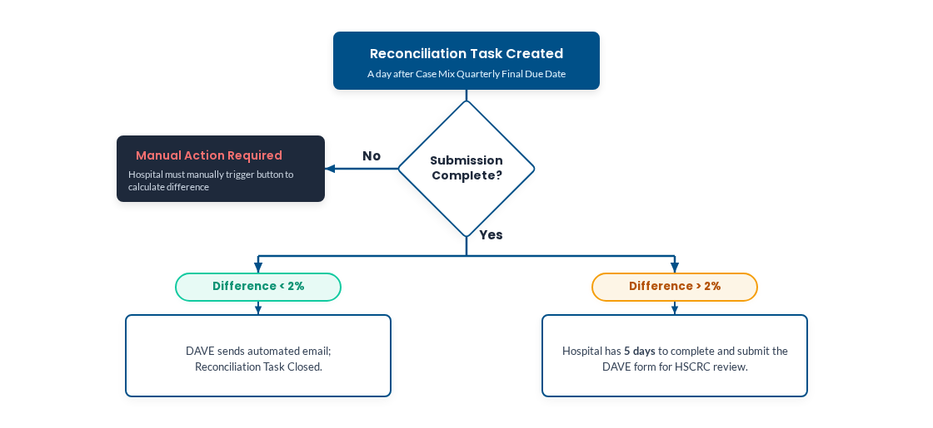
FY 2027 Case Mix-Financial Data Reconciliation Workflow
Current Process: hMetrix sends Excel reconciliation reports after preliminary data and again 2 days after final Case Mix final data. Hospitals must download, complete, and submit the report to HSCRC within 5 business days.
FY 2027 Onwards (Task-Based): hMetrix stops Excel reports. The real-time "Case Mix vs. Financial report" under the hospital report tab allows review within minutes of submission. Reconciliation will be tracked as a task.
Due dates for Reconciliation Reports will be automatically extended when extensions for case mix data is approved.

Slide 17
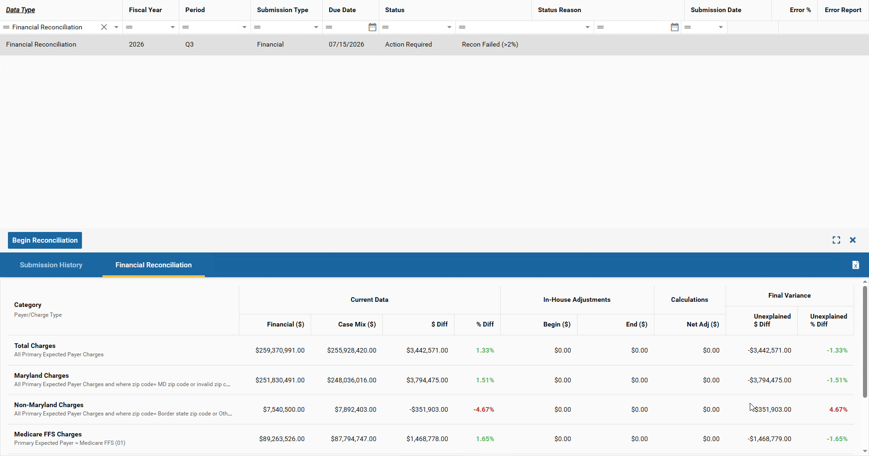
FY 2027 Case Mix-Financial Data Reconciliation Workflow (Contd.)

Slide 18
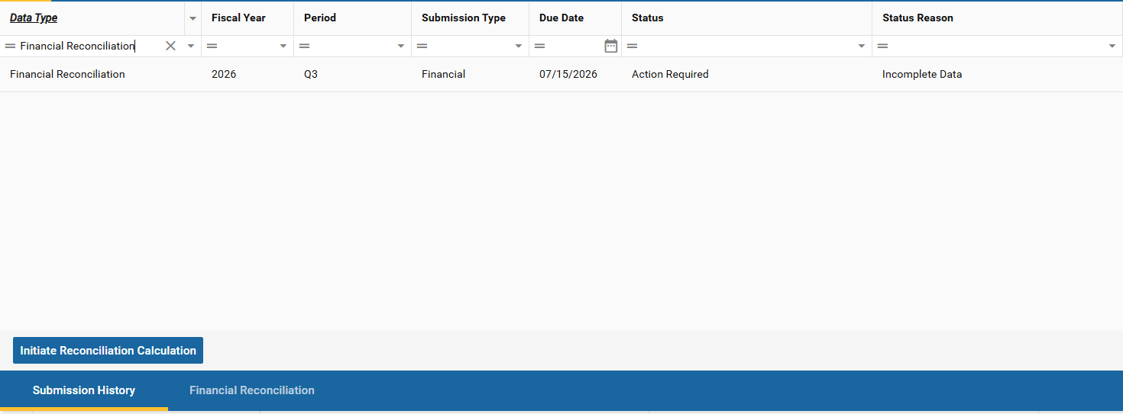
FY 2027 Case Mix-Financial Data Reconciliation Workflow (Contd.)
Manual Action Required
If Case Mix or Experience data is incomplete on the due date and the tasks are in Overdue status, the hospital must initiate reconciliation manually by clicking the task and starting the calculation.

Slide 19
FY 2027 Case Mix-Financial Data Reconciliation Workflow (Contd.)
Data Resubmission
Case Mix Vs Financial
No Excel Updates
Reconciliation is not expected to be done when hospitals re-submit their data. However, the task can be reopened if needed.
For primary submission reconciliation, hospitals can use the Case Mix Vs Financial tab. The quarterly summary is available after each submission and can be exported.
No excel files will be updated for the reconciliation process. All adjustments are integrated directly into the system workflow.
User Guide & Slides
User Roles & Alerts
Extensions & Exports
The comprehensive user guide will be shared with the industry along with these presentation slides to support the reconciliation workflow.
All users who has Financial user role will receive dave notification and can complete this task successfully within the portal.
If Case Mix submission has an extension, the reconciliation task due date will be after the Case Mix submission due date automatically.
Reconciled data can be exported if Hospital likes to have a copy, but the form needs to be completed first.

Slide 20
Reminders
Rate Center Trend Monitoring Report
  hMetrix added Rate Center Trend Monitoring Report to case Mix error report to help hospitals identify unusual Rate Center Charges and enable timely resolution of potential issues during submission from FY25 Q1 report
DAVE User Management
  Reach out to the hMetrix Team to add new users or modify access
  A worksheet for each hospital/hospital system is maintained by hMetrix
  Update and return the user workbook to modify access
Change in Hospital Connection Option
  hMetrix can support both connection for hospital submission using SFTP and DAVE.
  Reach out to hMetrix Team to change the choice of Hospital Connection method

Slide 21
Case Mix Audit Update

Slide 22
Case Mix Reminders
CY24 Overall Results
 | Hospital |  |  |  |  |  |  |  |  |  |  |  | AT
Summary Category | #63 | #64 | #65 | #66 | #67 | #68 | #69 | #70 | #71 | #72 | #73 | #74 | 50th | 75th | 90th | SO | PB
Overall | 80 | 89 | 85 | 83 | 90 | 45 | 87 | 68 | 80 | 85 | 92 | 77 | 84 | 89 | 91 | 82 | 95
Inpatient | 72 | 92 | 95 | 81 | 94 | 77 | 95 | 59 | 89 | 87 | 90 | 79 | 88 | 94 | 95 | 84 | 95
Outpatient | 86 | 87 | 77 | 85 | 88 | 20 | 80 | 76 | 72 | 84 | 94 | 76 | 82 | 87 | 92 | 76 | 95

Slide 23
Case Mix
The CY 2024 reviews suggest that the principal data-quality risks are concentrated in identifiable clinical and coding processes rather than being uniformly distributed across Case Mix Data.
Overall outpatient reviews had a 23 percent essential-error rate, versus 16 percent inpatient, and performance varied dramatically by service category. Ambulatory surgery performed very well, whereas emergency department observation, infusion, clinic/other, excision of lesions, and wound care were substantially more problematic.
Areas showing strength/improvement | Areas needing further attention
Ambulatory surgery | ED observation
Outpatient observation | Infusion
Emergency department | CPT/HCPCS selection
Other charging | Units of service

Slide 24
Case Mix Reminders
CY 2025 Review:
  HSCRC notified facilities included in CY 2025
  AGS will be sending letters with the projected review date next week

Slide 25
Upcoming Standing Workgroup Meetings

Slide 26
Payment Models Workgroup
Objective: Develops recommendations for the HSCRC on the structure of payment models. This group focuses on balancing the approach to updates, addressing key topics such as Balanced Updates, Guardrails for Model Performance, Market Share, and Initial and Future Models.
Next Meeting: September 23, 2026, 1-3pm. Meeting Link
For more information: https://hscrc.maryland.gov/Pages/hscrc-workgroup-payment-models.aspx

Slide 27
Performance Measurement Workgroup
Objective: Responsible for evaluating measurement methodologies and recommending optimal approaches to the HSCRC. The goal is to identify measures that are reliable, informative, and practical for assessing hospital quality and safety.
Subgroups to the Performance Measurement Workgroups
  Readmissions Subgroup to the PMWG
  Quality Based Reimbursement (QBR) Program Redesign Subgroup to the PMWG
  Emergency Department Length of Stay Measure Subgroup to the PMWG
Next Meeting: For the meeting schedule and location, please contact: hscrc.performance@maryland.gov
For more information: https://hscrc.maryland.gov/Pages/hscrc-workgroup-performance-measurement.aspx

Slide 28
Total Cost of Care Workgroup
Objective: Provide technical feedback to HSCRC on the methodologies and calculations that underpin care transformation and total cost of care management activities.
Membership: The HSCRC has appointed a diverse group of experts to serve on the Total Cost of Care workgroup. A comprehensive list of members can be accessed [here].
Next Meeting: September 23, 2026 @ 8:00 am. Meeting Registration Link
For more information: https://hscrc.maryland.gov/Pages/hscrc-tcoc.aspx

Slide 29
ED Wait Time Reduction Commission
Objective: Provide analytical support to the Maryland Emergency Department Wait Time Reduction Commission by evaluating system-wide factors contributing to prolonged emergency department wait times and informing the development of recommended strategies.
Next Meeting: September 23, 2026; 11am 1 pm. Meeting Link
For more information: https://hscrc.maryland.gov/Pages/ED-WTR-Commission.aspx

Slide 30
Next Meeting

Slide 31
Notes and slides will be posted to the HSCRC website:
https://hscrc.maryland.gov/Pages/hsp_info1.aspx
Next Meeting FY 2027 Q2
December 11, 2026
Join Zoom Meeting
https://us06web.zoom.us/j/4107642605?pwd=MmVwREVMbFFYUzlCeWpJcFFZYWF5UT09&omn=85973965350
For Meeting ID and Passcode please contact Curtis Wills: curtis.wills@maryland.gov

Slide 32
Appendix 1: Supplemental Data Update

Slide 33
New Supplemental Data Collection for FY 2026
Temporary Staffing Contracts
Request from the MD Joint Committee to submit a report on hospital and other regulated health facility contracts with agencies that provide temporary staffing
  Aggregate number of contracts for temporary staffing
  Actual expenditures for these contracts
  Description of the position types most staffed through these contracts
Working with MHA and the Department of Labor to define labor categories and develop data collection template
Instructions and template to be circulated in the coming months
Primary Care Investment
Maryland Health Care Commission (MHCC) is requesting information on hospital health system investments in their primary care teams.
  Percentage of total payments (claims-based and non-claims based) allocated to primary care services
  The number of primary care sites included in hospital system
  Percentage of payments allocated for establishing, maintaining or expanding primary care services
  Participation in advanced payment models
Reporting will be at a system-level
Instructions and template to be circulated in the coming months

Slide 34
Appendix 2: Grouper for Case Mix Weights and Reports

Slide 35
Grouper for Case Mix Weights and Reports
Rate Year | RY 2028
Solventum APR/EAPG Version* | IP Weights: 43 OP Weights: 4.0
Data Period Used for Weight Development | IP: CY 2024 (12 Months) OP: CY 2024 and Q1 of CY 2025 (15 Months)
Weight Release Date | Second Quarter CY 2026
Policies Applicable To | CY 2026 6-Month Marketshift
For questions related to Case Mix Weights or Market Shift, please email:
Nduka Udom (nduka.udom@maryland.gov) (case mix weights)
Denise Johnson (denise.johnson@maryland.gov) (market shift reports)
*The SolventumTM All Patient Refined DRG (APR DRG) Software and SolventumTM Potentially Preventable Complications (PPC) Software are proprietary products of Solventum Health Information Systems.

Slide 36
Appendix 3: Audit and Integrity Update

Slide 37
Accounting & Budget Manual Update
The Audit and Integrity team is finalizing updates to the following sections of Accounting & Budget Manual:
  Section 200 - Chart of Accounts
  Sections 400 - Reporting Requirements
  Section 500 - Reporting Instructions
  Section 700 (Appendix D) - Standard Unit of Measure
  Appendix B - Hospital List
The draft revisions will be presented at the July 22, 2026, Public Commission Meeting
If you have any questions or concerns about these changes, please contact Wayne.Nelms2@maryland.gov

Slide 38
Appendix 4: Quality Update

Slide 39
AHEAD Updates and Transition Timelines
Maryland entered the AHEAD Model beginning 1/1/2026.
CMS will set Medicare FFS global budgets starting in 2028.
  Performance Year 1 (2026) and PY2 (2027) will be a transition period where the State will continue to set all-payer Hospital Global Budgets.
  To smooth the transition, the State will be able to re-direct a portion of the total Medicare global budget amount between PY3 (2028) and PY5 (2030).
The State will continue to set non-Medicare FFS state hospital global budgets (state HGB) with quality adjustments.
Savings target of $460M in additional Medicare FFS savings must be achieved in PY1 (2026) – PY7 (2032), with no additional savings expected in the final three PYs (through 2035).
Notes:
SO first, to ensure we are all on the same page, I just want to remind you that in November of last year MD signed a State agreement for the AHEAD model, however under the new administration, CMS and MD have been reneg…..
Currently, we have a terms sheet that we have agreed to, but we expect to get a new state agreement any day now, and our expectation is that the SA and hospital PA (something that will be new under ahead( will be signed in October….
Under the new SA, CMS will…..
However there will be a transition period, between 2026 and 2028 where the State will continue to set all-payer Hospital Global Budgets. After that, CMMI will administer the Medicare FFS HGB and the State will manage non-Medicare FFS globa budgets. However from 2028 through 2030, the State will be able to redistribute a portion of the HGB in a revenue neutral manner …..
The …..Savings target of $460M in additional Medicare FFS savings must be achieved in PY1 (2026) – PY7 (2032), with no additional savings expected in the final three PYs (through 2035).

Slide 40
AHEAD Maryland Hospital Quality Incentives
Medicare Fee-for-Service
CMS Quality Programs
Hospital Value Based Purchasing (HVBP)
Hospital Acquired Conditions Reduction
Hospital Readmission Reduction
AHEAD Specific Incentives
Effectiveness Adjustment: Revenue linked to unplanned readmissions, ED visits, and avoidable admissions
Community Improvement Bonus: Focus on hospital-wide readmissions and avoidable admissions
Other Payers
Medicaid, Commercial, & Medicare Advantage
HSCRC Quality Programs
Quality Based Reimbursement
Maryland Hospital Acquired Conditions Program
Readmission Reduction Incentive Program
Notes:
Medicare FFS incentives include CMS Quality Programs (HVBP, HAC Reduction, Readmission Reduction).1
AHEAD-specific Medicare incentives are the Effectiveness Adjustment and Community Improvement Bonus.1
For Other Payers, HSCRC runs Quality Based Reimbursement (QBR), MHAC, and RRIP.1

Slide 41
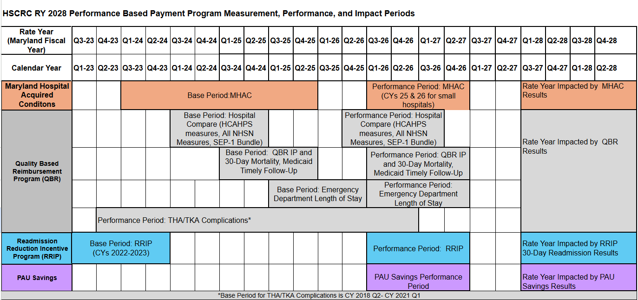
RY 2028 Quality Program Timelines

Slide 42
Grouper Transition: MHAC, RRIP, QBR for CY 2026
Rate Year | RY2028
*Solventum APR/PPC Version | 43 (Updated from version 42 to incorporate annual Solventum updates)
Timeline | Base Year: MHAC (including PSI90): FY 2024 & 2025 IP and 30-Day Mortality: FY 2025 RRIP: CYs 2022 and CY 2023 THA/TKA: Q2 CY 2018- Q1 CY 2021 NHSN, HCAHPS, SEP-1: CY 2024 Performance Year: HCAHPS, NHSN, SEP-1: Q4 CY 2025 - Q3 CY 2025 THA/TKA: Q2 CY 2023 – Q1 CY 2026 All Other Measures: CY 2026 (CY 2025-2026 for PPCs for small hospitals)**
Implementation Date | RY 2026 policies began Jan 1, 2026, in most cases. Look for base and performance period reports on the CRS Portal coming in April.
*The Solventum™ All Patient Refined DRG (APR DRG) Software and Solventum™ Potentially Preventable Complications (PPC) Software are proprietary products of Solventum Health Information Systems.
**Staff still analyzing use of two years in performance period data for small hospitals for PSI-90

Slide 43
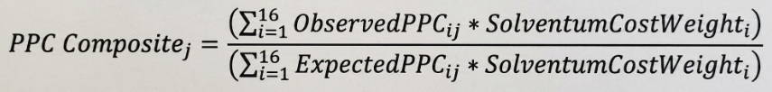
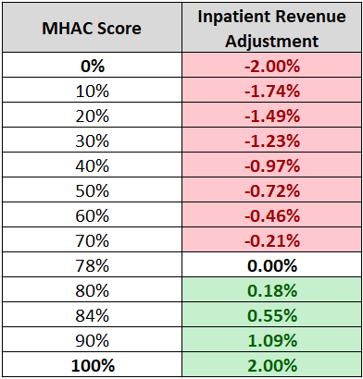
Complication Measures
Risk-Adjustment and Standardized Scores
MHAC Score and Revenue Adjustments
PPC Composite: 16 Potentially Preventable Complications
Hospitals are not evaluated on PPCs for which they have 0 at-risk during the performance period.
PSI-90 Composite: 10 Patient Safety Indicators
To be evaluated on PSI-90. hospitals must have at least one PSI-90 component with >= 25 eligible discharges AND at least seven PSI-90 components with >= 3 eligible discharges.
Formula to calculate PPC composite score:
Solventum cost weights used as proxy for patient harm. Expected PPCs calculated by applying statewide average PPC rate by APR-DRG SOI cell (norms) from base to hospitals’ patient mix in performance period. Only APR-DRG SOI cells with >31 at-risk discharges statewide are included. Catastrophic cases (>6 PPCs) are excluded.
Details on PSI-90 scoring: AHRQ All-Payer PSI 90 Scoring Methodology
The PSI-90 and PPC Composite Measures are converted to 0-100 percent score by comparing CY 2026* hospital performance to a statewide threshold and benchmark.
*Small hospitals will be assessed on CYs 25 & 26
July 2023- June 2025 data used to calculate statewide averages (norms) and threshold/benchmark for both composite measures.
MHAC Score is calculated by weighting the PPC percent score at 5/6th and the PSI-90 percent score at 1/6th.
Hospital’s MHAC Score is compared to a preset revenue adjustment scale.
Cut point for rewards/penalties is average statewide MHAC score based on modeling; cut point will be updated to the average MHAC score during performance period.
Max Penalty -2% & Reward +2%
3- Acute Pulmonary Edema & Respiratory Failure w/o Ventilation | 4- Acute Pulmonary Edema & Respiratory Failure w/ Ventilation | 5- Pneumonia & Other Lung Infections | 6- Aspiration Pneumonia
7- Pulmonary Embolism | 9- Shock | 16- Venous Thrombosis | 28- In-Hospital Trauma/ Fractures
35- Septicemia & Severe Infections | 37- Postoperative Infection w/o Procedure | 41- Postoperative Hemorrhage/Hematoma w/ Procedure or I&D | 42- Accidental Puncture/ Laceration w/ Invasive Procedure
47- Encephalopathy | 49- Iatrogenic Pneumothorax | 60- Major Puerperal Infection & Other Major OB Complications | 61- Other Complications of OB Wounds
03- Pressure Ulcer Rate | 06- Iatrogenic Pneumothorax Rate | 08- In-Hospital Fall-Associated Fracture Rate | 09- Perioperative Hemorrhage or Hematoma Rate
10- Postoperative Acute Kidney Injury Requiring Dialysis Rate | 11- Postoperative Respiratory Failure Rate | 12- Perioperative Pulmonary Embolism or DVT Rate | 13- Postoperative Sepsis Rate
14- Postoperative Wound Dehiscence Rate | 15- Abdominopelvic Accidental Puncture or Laceration Rate
Threshold Benchmark
Avg 0-20th percentile Avg 80th -100thpercentile
0% 20% 40% 60% 80% 100%

Slide 44
RY 2028 MHAC Changes
Assess hospital performance on AHRQ Patient Safety Index Composite (PSI-90) in addition to Solventum PPCs.
Move AHRQ PSI-90 measure from the Quality Based Reimbursement Program to MHAC to align better with CMS programs.
Weigh the AHRQ PSI-90 measure similarly to weight used in CMS complications program (i.e., 1/6th of MHAC score).

Slide 45
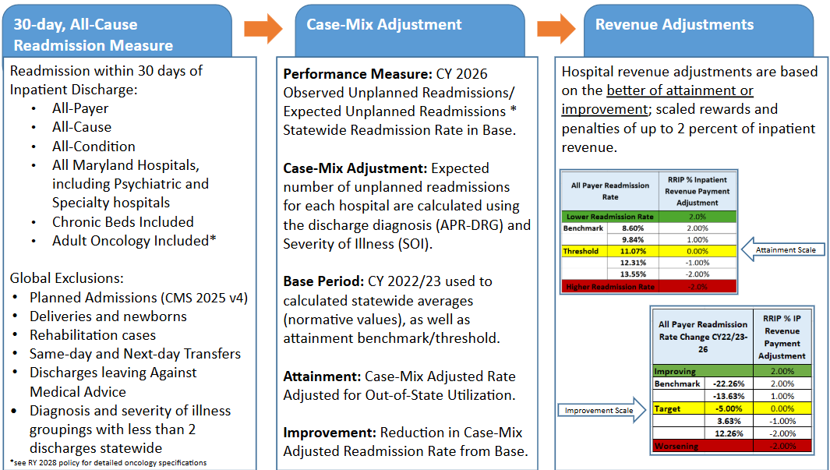
RRIP Methodology Overview
Notes:
Here is an overview of the RRIP methodology. The measure for this program is a 30-day all-cause, all-payer, all-condition readmission measure. Performance on this measure is assessed for the better of attainment which is adjusted for out of state readmissions or improvement from the base period which is a blended base period of CY 2022 and CY 2023. A hospital’s performance is then compared to predetermined threshold and benchmarks to determine a hospital’s revenue adjustment which has a max reward and penalty of 2% of IP revenue.

Slide 46
RY 2028 RRIP Changes
Modified methodology: Attainment rates are adjusted using the Out of State Utilization Adjustment (OOS UA) to fairly compare hospitals
  OOS UA = CCW Readmission Rate/ CCW Readmission Rate with MD Claims only
  New methodology better accounts for out of state readmissions and transfers that previous methodology. New methodology will also be applied to RY 2027.
Removal of disparity gap measure from payment program
Updated performance standards:
  Attainment Target = 11.07%
  Improvement Target = -5%

Slide 47
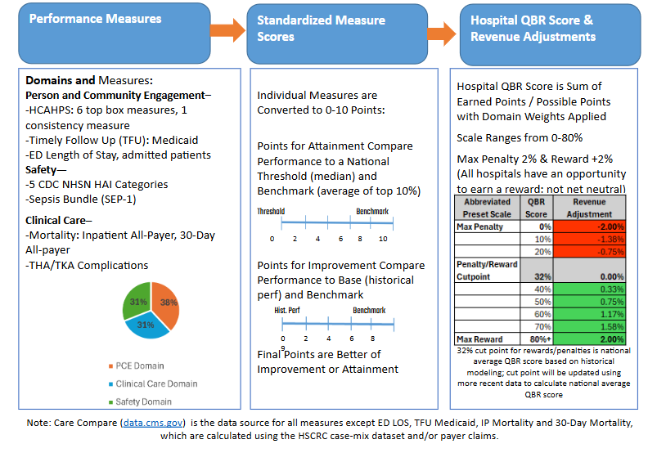
Overview of QBR

Slide 48
RY 2028 QBR Changes
Better align with CMS HVBP:
  Measure removals- Medicare timely follow up, PSI 90, HCAHPS linear measures from the Person and Community Engagement domain; PSI 90 from the Safety domain.
  Measure additions- Total Hip/Knee Arthroplasty complications to the Clinical Care domain; Sepsis Bundle to the Safety domain
  Domain weight adjustments- Decrease weight on the Person and Community Engagement domain (60% to 38%) and increase weights on Clinical Care (10% to 30%) and Safety Domains (30% to 31%)
Address State/ All-Payer Priorities:
  Maintain Medicaid timely follow up and ED Length of stay measures in the Person and Community Engagement domain; maintain all-payer inpatient and 30-day mortality measures in the Clinical Care domain.

Slide 49
For RY 2028, Commission Approved Continuing QBR Incentive Program for Complete and Timely Digital Measures Reporting
The state contracts with CRISP/Medisolv for digital measure data reporting and recommends accelerated reporting compared to CMS requirements and all-payer hybrid data elements:
  HSCRC eCQM reporting period is on a calendar year basis with reporting required after first six months and then quarterly
  HSCRC Hybrid Hospital Wide Readmission and Mortality measures Core Clinical Data Elements (CCDE) reporting is all-payer (age 18 yrs+) for July-June annual period and reporting required after first six months and then quarterly
Majority of hospitals are on track to earn the reward for RY 2027

Slide 50
CMS Hospital eCQM Digital Measures Reporting Requirements CYs 2026-2028
CY 2028:
8 selected by CMS and 3++ self-selected CMS-mandated eCQMs:
Safe Use of Opioids—Concurrent Prescribing
Cesarean Birth (PC-02)
Severe Obstetric Complications (PC-07)
Hospital Harm—Severe Hyperglycemia
Hospital Harm—Severe Hypoglycemia
Hospital Harm—Opioid-Related Adverse Events
Hospital Harm—Pressure Injury: new measure
Hospital Harm—Acute Kidney Injury: new measure
Emergency Care Access and Timeliness (HOQR): newly required
CY 2027:
6 selected by CMS and 3 self-selected CMS-mandated eCQMs:
Safe Use of Opioids—Concurrent Prescribing
Cesarean Birth (PC-02)
Severe Obstetric Complications (PC-07)
Hospital Harm—Severe Hyperglycemia
Hospital Harm—Severe Hypoglycemia
Hospital Harm—Opioid-Related Adverse Events: newly required measure.
Emergency Care Access and Timeliness (HOQR): new voluntary
CY 2026 (RY 2028):
Maryland is aligning with CMS
5 selected by CMS and 3 self-selected
CMS-mandated eCQMs:
Safe Use of Opioids—Concurrent Prescribing: (CMS506)
Cesarean Birth: (PC-02)
Severe Obstetric Complications: (PC-07)
Hospital Harm—Severe Hyperglycemia: newly required
Hospital Harm—Severe Hypoglycemia: newly required
Important considerations:
Non-compliance penalty: Failure to meet these requirements puts hospitals at risk of a one-fourth reduction in their annual payment update.
Zero-denominator reporting: Hospitals that do not provide obstetric services but participate in the Hospital IQR program must submit a zero-denominator declaration for the Cesarean Birth (ePC-02) and Severe Obstetric Complications (ePC-07) measures each quarter.
Validation scoring: Beginning with data from the 2025 reporting period (impacting the FY 2028 payment determination); CMS will score eCQM validation based on data accuracy.

Slide 51
HSCRC Digital Measures Reporting Requirements CY 2026:
eCQMs and Digital Hybrid Measures
Title | Short Name | CMS eCQM ID | 2024 | 2025 | 2026 | HSCRC* | CMS
Anticoagulation Therapy for Atrial Fibrillation/Flutter | STK-3 | CMS71v13 | X | X | X (v15) | Self-Selected | Self-Selected
Antithrombotic Therapy By End of Hospital Day 2 | STK-5 | CMS72v12 | X | X | X (v14) | Self-Selected | Self-Selected
Cesarean Birth | PC-02 | CMS334v5 | X | X | X (v7) | Required | Required
Discharged on Antithrombotic Therapy | STK-2 | CMS104v12 | X | X | X (v14) | Self-Selected | Self-Selected
Excessive Radiation Dose or Inadequate Image Quality for Diagnostic CT in Adults (Facility IQR) | IP-ExRad | CMS1074v2 |  | X | X (v3) | Self-Selected | Self-Selected
Global Malnutrition Composite Score | GMCS | CMS986v2 | X | X | X (v5) | Self-Selected | Self-Selected
Hospital Harm - Acute Kidney Injury | HH-AKI | CMS832v2 |  | X | X (v3) | Self-Selected | Self-Selected
Hospital Harm - Opioid-Related Adverse Events | HH-ORAE | CMS819v2 | X | X | X (v4) | Self-Selected | Self-Selected
Hospital Harm - Pressure Injury | HH-PI | CMS826v2 |  | X | X (v3) | Self-Selected | Self-Selected
Hospital Harm - Severe Hyperglycemia | HH-Hyper | CMS871v3 | X | X | X (v5) | Required | New Required
Hospital Harm - Severe Hypoglycemia | HH-Hypo | CMS816v3 | X | X | X (v5) | Required | New Required
*For CY 2026 HSCRC will require 3 self-selected measures, consistent with CMS requirements

Slide 52
HSCRC Digital Measures Reporting Requirements CY 2026:
eCQMs and Digital Hybrid Measures, cont.
Title | Short Name | CMS ID | 2024 | 2025 | 2026 | HSCRC* | CMS
ICU Venous Thromboembolism Prophylaxis | VTE-2 | CMS190v12 | X | X | X (v14) | Self-Selected | Self-Selected
Safe Use of Opioids - Concurrent Prescribing | Safe use of opioids | CMS506v6 | X | X | X (v8) | Required | Required
Severe Obstetric Complications | PC-07 | CMS1028v2 | X | X | X (v4) | Required | Required
Venous Thromboembolism Prophylaxis | VTE-1 | CMS108v12 | X | X | X (v14) | Self-Selected | Self-Selected
Hospital Harm - Postoperative Respiratory Failure | HH-RF | CMS1218v2 |  |  | X | Self-Selected | Self-Selected
Hospital Harm - Falls with Injury | HH-FI | CMS1017v2 |  |  | X | Self-Selected | Self-Selected
Core Clinical Data Elements for the Hybrid Hospital-Wide Readmission Measure with Claims and Electronic Health Record Data | Hybrid HWR | CMS529v6 | X | X | X | Required age 18+ | Required age 65+
Core Clinical Data Elements for the Hybrid Hospital-Wide All-Condition All-Procedure Risk-Standardized Mortality Measure | Hybrid HWM | CMS844v6 | X | X | X | Required age 18+ | Required age 65+
Emergency Care Access and Timeliness (HOQR) |  | CMS1244v1 |  |  |  | Require 2027? | Required 2028
*For CY 2026 HSCRC will require 3 self-selected measures, consistent with CMS requirements

Slide 53
Stakeholder Feedback Opportunities - Quality
Performance Measurement Workgroup (PMWG): Decisions regarding AHEAD transition and alignment, future of HSCRC quality programs, etc
  Meets 3rd Wednesdays from 9:30-12pm
Clinical Adverse Event Measures (CAEM) subgroup: Decisions regarding the complications and mortality measure in future MHAC and QBR programs
  Meets 4th Wednesdays of June, July and August 10:30-12pm
CRISP User Feedback Workgroup: Provide feedback on CRS portal’s HSCRC regulatory reports and dashboards
  Planning to kick-off in September
If interested, please email Quality Team at hscrc.quality@maryland.gov

Slide 54
Appendix 5: Collection of ED Triage Values

Slide 55
Background
In 2021, staff asked hospitals to begin collecting triage status for patients discharged from the ED
This resulted in addition of two data items to the OP Data Submission Requirements (DSR) for FY 2022
  Initial ED Triage Value (EDTRIAGE)
  Final ED Triage Value (EDTRIAGE2)
Valid codes range from 1-5 and reflect Emergency Severity Index (ESI) score
Many facilities are reporting data, but others are not doing so

Slide 56
Next Steps
Understanding ED dynamics is increasingly important given the interest in improving ED length of stay
Staff is undertaking several analyses that depend on complete triage information
To support that work, we are interested in understanding potential obstacles to including EDTRIAGE and EDTRIAGE2 in the data validation process
Additionally, we would like to understand potential obstacles to adding these variables to the IP DSR for admitted patients coming through the ED

Slide 57
Appendix 6: Case Mix Update

Slide 58
FY 2027 Case Mix Data Submission Requirements Updates
Reserve Flag (Inpatient)
Only AMC hospitals (210002 and 210009) should submit Reserve Flag = 1 for Transplant cases.
All other hospitals will trigger an error if a transplant is reported.
ED Length of Stay (LOS)
Edit errors will now exclude non-ED hospitals for both inpatient and outpatient data.
Based on the HSCRC lookup, an error will only trigger for ED hospitals if ED charges are reported without the corresponding ED LOS variables.
SOGI Variables
Missing SOGI values for patients aged 18+ (inpatient and outpatient) will now trigger a warning instead of an error.
MedChi Variables - Feedback Required
HSCRC no longer requires Operating Physician MEDCHI Number and Attending Physician MEDCHI Number. The associated warning will be removed.
Hospital Survey: How should we implement this layout change?
  Option A: Remove both variables and shift subsequent variables two places forward.
  Option B: Remove the data but keep the empty variable slots as placeholders.

Slide 59
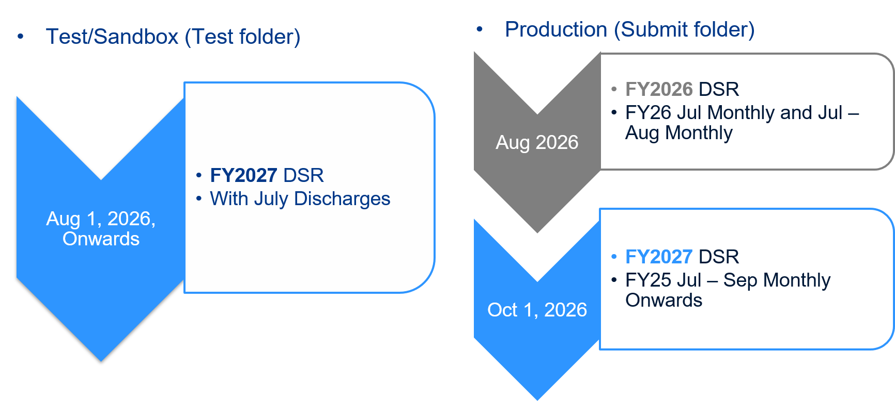
FY 2027 Case Mix DSR Implementation Timeline

Slide 60
Appendix 7: ED LOS Update

Slide 61
Important Updates related to QBR ED LOS
CY 2025 Pre Preliminary data through December was released in February, CY 2025 Final data will be available in April.
For RY 2027 & RY 2028 QBR ED LOS measure, staff will maintain improvement goal that focuses on not declining in performance (i.e., 0 to -5% and 0 to -10% based on median in base) and provide those with rates below national average the full points.
After in-depth review and discussion with numerous stakeholder groups, staff recommend that we do not implement a risk-adjustment methodology for RY 2027 and RY2028.
Staff and stakeholders will evaluate potential transition to ECAT digital measures to replace the current ED LOS measure in subsequent years.
ED LOS Dashboard is in development; the draft is currently being reviewed internally. The goal is to release V1 in April/May.

Slide 62
Appendix 8: Data Submission Reminders

Slide 63
Reminder: Datasets Submitted to DAVE for hMetrix Processing
Type of File | Frequency | Naming Convention
Financial Experience Data | Monthly | HospID_EXP_MMDDYYYY
Financial FSA Data | Monthly | HospID_FSA_MMDDYYYY
Case Mix IP, OP, PS | Monthly & Quarterly | N/A
UCC | Quarterly | HospID_FYyyQy_UCC
Financial FSB Data | Quarterly | HospID_FSB_MMDDYYYY
Hospice | Quarterly | HospID_HOSPICE_FYyyQx
Outpatient Cosmetic Surgery | Quarterly | HospID_OPCOSM_FYyyQx
Reconciliation Reports* | Quarterly | N/A
(Aggregated) Denials Report | Quarterly | HospID_FYyyQq_SUMDENIAL
Patient-level Denials Report | Quarterly | HospID_FYyyQq_DENIAL
6/12-month Financial Projection* | Biannual | N/A
9/12-month Financial Attestation * | Biannual | N/A
Audited Financial Statement PDF Report | Annual | FYyy_Audited_Financial_HospitalSystemName
Intern Resident Survey | Annual | HospID_GME_FYyy
Audit and Integrity files* | As Required | HospID_INTEGRITY_
* Indicates that they are forms to be completed in DAVE

Slide 64
Reminder: Reports Submitted to Delegated Mailboxes or HSCRC Website
Report Name | Frequency | Designated Mailbox / Website Portal
Debt Collection / Financial Assistance (DCFA) | Annually | hscrc.dcfa@maryland.gov
Credit and Collections Policy | Annually | hscrc.creditcollection@maryland.gov
Outpatient Service Survey | Annually | hscrc.opsurvey@maryland.gov
Special Audit Reports | Annually | hscrc.specialaudits@maryland.gov
Special Audit Report - By Report | Annually | hscrc.specialaudits@maryland.gov
IRS Form 990s | Annually | hscrc.form990@maryland.gov
Trustee Disclosure List of Trustees | Annually | List of Trustees Electronic Form
Trustee Disclosure of Interest Statement | Annually | Interest Statement Electronic Form

Slide 65
Updates to FY 2026 Monthly Experience Data
Reminder: Kaiser Permanente (Kaiser) reporting suspended for:
  Monthly Experience Data
  Quarterly Reconciliation Report
Hospitals will report volume and revenue data by rate center for patients where Medicaid (FFS or MCO) is the primary payer in preparation for the AHEAD model.
Hospitals will also reconcile Medicaid charges separately in the Reconciliation Reports

Slide 66
Updates to FY 2026 Monthly Experience Data
Medicaid variables still required!
Variable Name | Description | Variable Name | Description
Mcaid_Vol_In | Total Medicaid IP Volume | Mcaid_Out_Vol_In | Total Medicaid Out-of-state IP Volume
Mcaid_Vol_Out | Total Medicaid OP Volume | Mcaid_Out_Vol_Out | Total Medicaid Out-of-state OP Volume
Mcaid_Rev_In | Total Medicaid IP Revenue | Mcaid_In_Rev_In | Total Medicaid In-state IP Revenue
Mcaid_Rev_Out | Total Medicaid OP Revenue | Mcaid_In_Rev_Out | Total Medicaid In-state OP Revenue
Mcaid_In_Vol_In | Total Medicaid In-state IP Volume | Mcaid_Out_Rev_In | Total Medicaid Out-of-state IP Revenue
Mcaid_In_Vol_Out | Total Medicaid In-state OP Volume | Mcaid_Out_Rev_Out | Total Medicaid Out-of-state OP Revenue

Slide 67
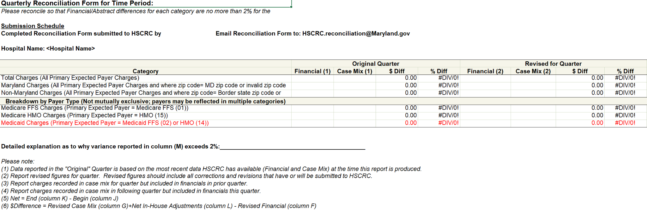
Updates to FY 2026 Quarterly Reconciliation Reporting

Slide 68
FY 2027 Experience Data Submission Requirements Updates
New Edit: Bed count reporting is limited to 20 authorized cost centers.
Rate Center for Medical Surgical Acute (MSG)
Rate Center for Pediatrics Acute (PED)
Rate Center for Psychiatric Acute (PSY)
Rate Center for Obstetrics Acute (OBS)
Rate Center for Definitive Observation (DEF)
Rate Center for Medical Surgical ICU (MIS)
Rate Center for Coronary Care (CCU)
Rate Center for Pediatric ICU (PIC)
Rate Center for Neonatal ICU (NEO)
Rate Center for Burn Care (BUR)
Rate Center for Shock Trauma (TRM)
Rate Center for Oncology (ONC)
Rate Center for Newborn Nursery (NUR)
Rate Center for Premature Nursery (PRE)
Rate Center for Rehabilitation (RHB)
Rate Center for Chronic Care (CRH)
Rate Center for Adult Psych (PAD)
Rate Center for Child Psych (PCD)
Rate Center for Respiratory Dependent (RDS)
Rate Center for Pediatric Step Down (PSD)
⚠️ Reporting bed counts for any rate center not on the approved list will trigger an error.

Slide 69
Appendix 9: Financial, Supplemental and Case Mix
Data Production Schedule

Slide 70
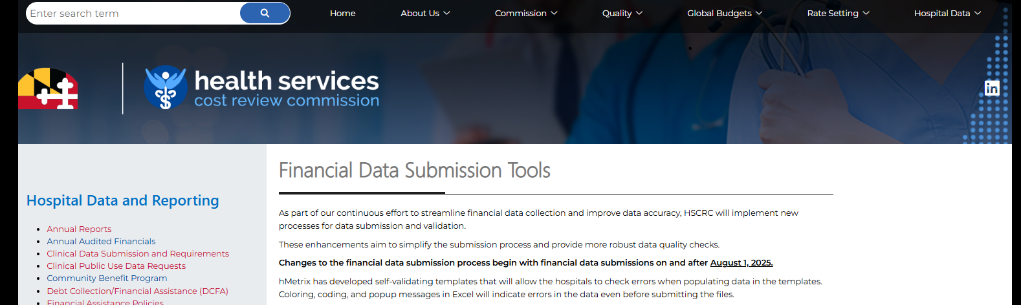
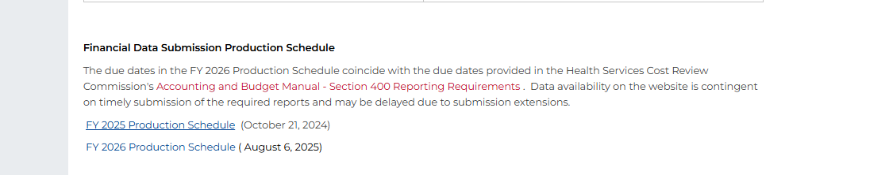
Production Schedule for Financial and Supplemental Data Submissions
Posted to the website on the Financial Data Submission Tools page: https://hscrc.maryland.gov/Pages/hsp_info2.aspx
Financial Data availability on the website is contingent on timely submission of the required reports and are subject to change.

Slide 71
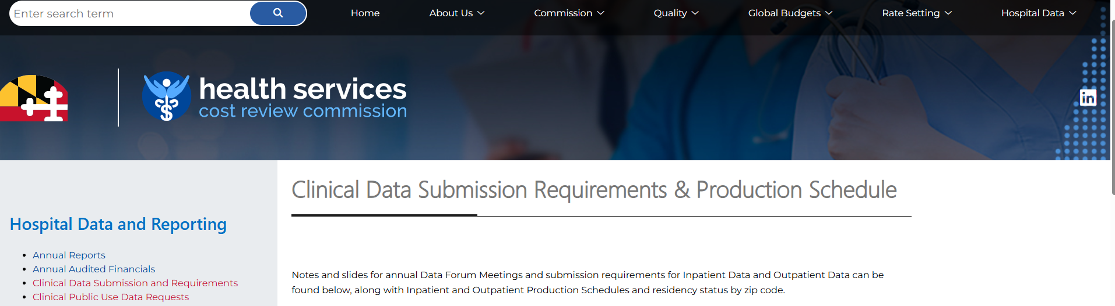

Production Schedule for Case Mix Data Submissions
Posted to the website on the Clinical Data Submission Requirements & Production Schedule page: https://hscrc.maryland.gov/Pages/hsp_info1.aspx
Clinical Data availability on the website is contingent on timely submission of the required reports and are subject to change.

Slide 72
Appendix 10: Process for Requesting Financial and Supplemental Data Extensions for Data
Not Submitted via DAVE

Slide 73
Reminder: Submitting Extensions for Financial and Supplemental Data
Process for submitted extensions for Financial and Supplemental Data that is not submitted via DAVE:
Submitted in writing on hospital letterhead with explanation for extension and noting each hospital and report that will be delayed
Addressed to the HSCRC Executive Director with copies to staff to ensure timely processing
Made within a reasonable time, before the due date
Email Extension Requests to:
Jon Kromm, Executive Director (jon.kromm@maryland.gov)
Andrea Strong (andrea.strong@maryland.gov)
Marcella Guccione (marcella.guccione@maryand.gov)
Wayne Nelms (wayne.nelms2@maryland.gov)

Slide 74
Submitting Extensions for Financial Data and Supplemental Data
Staff will review the extension request and respond (in writing) to the hospital indicating whether the request has been approved, and if the request is approved, the new due date (typically 1 week).
Submissions of late or significantly erroneous data is subject to a fine and/or GBR adjustment of up to $1,000 per day.

Slide 75
Appendix 11: Rate Center Trend
Monitoring Report

Slide 76
Rate Center Trend Monitoring Report
Objective
  Help hospitals identify unusual Rate Center Charges
  Enable timely resolution of potential issues during submission
Reason
  Several instances of delayed identification of incorrect Rate Center Charges
  Resulted in an expensive and undesired reopening of a closed quarter for resubmission
Timeline for implementation
  FY25 Q1 Final (October 1, 2024) onward a monitoring tab has been added to the error report
  Collect feedback via email in April 2025
  FY25 Q4 refine identification of unusual Rate Center Charges
  FY26 potential impact on error percentage

Slide 77
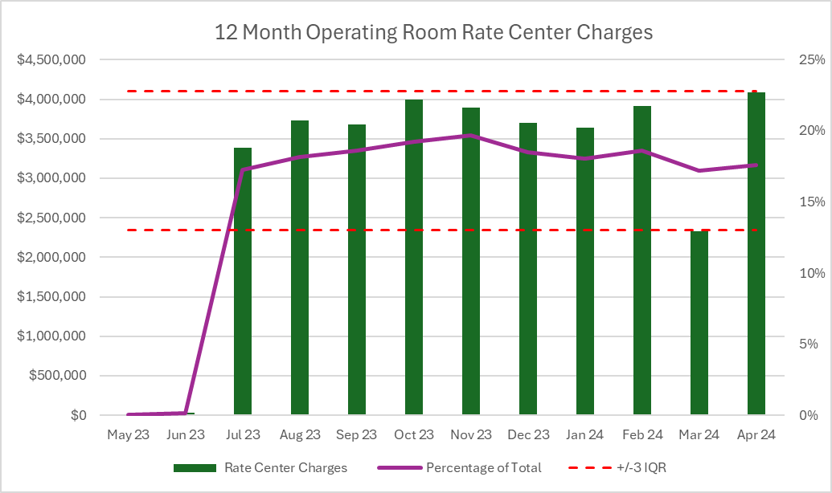
Total Charges & Rate Center Charges Outlier Identification
Identify Significant Rate Center
  The lookback period is 24 months
  > 5% utilization for more than half of lookback period
Outlier Identification
  Total Visit and Charges
    Current submission is outside +/- difference between 90th and 10th percentile
  Rate Center Charges
    Current submission is outside +/- 3 IQR
Hospitals to review Outliers in
  Current reported month

Slide 78
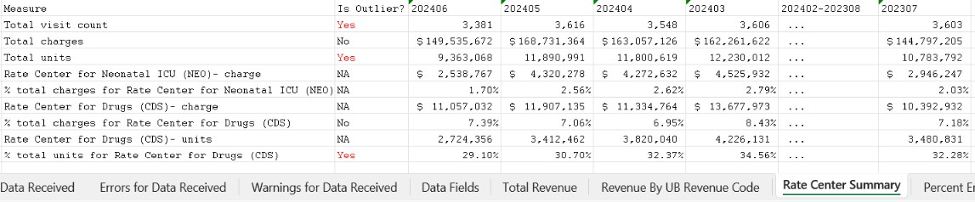
Monitoring Report Samples
A new tab “Rate Center Summary” is added to the error report
  Total visit count, total charges, total units, and all reported Rate center charges and units from the current and past 24 months are available for review
  Outliers are flagged for the months reported in the file only
  The outlier is determined by using the percent of charges or unit. The exception to this rule is if the hospital has at least one rate center that is >65% of total charges, the outlier is determined by using the value of reported charges or units.

Slide 79
Appendix 12: UCC Reporting

Slide 80
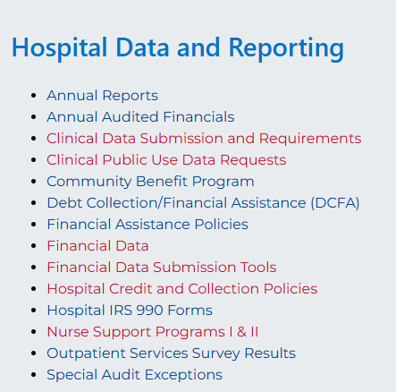
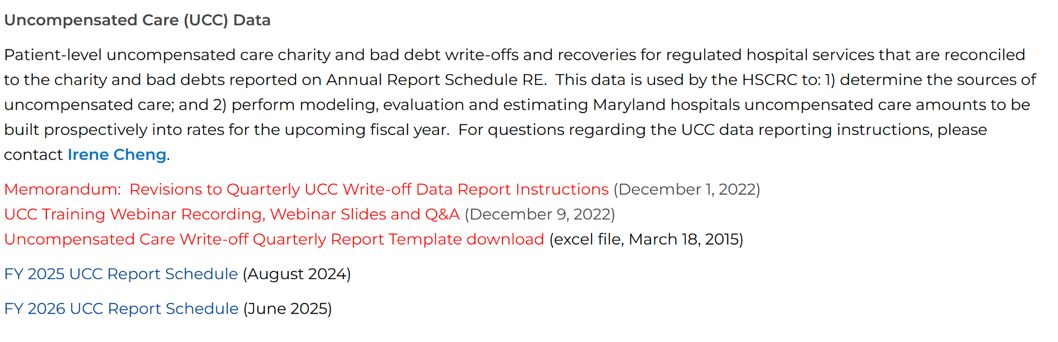
UCC Data Collection and Processing
FY26Q4 Data Submission: 55 reports received, 1 pending
FY27Q1 Data Submission: Oct 15 – Nov 30, 2026
FY26 UCC report submission schedule is posted on the HSCRC Financial Data Submission Tools web page.

Slide 81
UCC DSR and Edit Report Updates for FY 2026 Q4
UCC Data Edit Summary:
  47 reports have < 1% error
  3 reports have 1 - 1.99% error
  5 reports have 2 - 2.99% error
  0 report with > 3% error rate had data validated and was manually passed
  1 reports to be submitted

Slide 82
UCC Data: Notable Errors Observed in FY26Q4 Data Submission
Error | Notes | Percent of Records with Errors
Invalid or missing billed amount | This information might be unavailable for accounts that are old or transferred from another system | 0.027% of write-off records from 15 report files
Missing service date | Date should not be left blank | < 0.01% of write-off records
Missing expected payer | Text (e.g., n/a, unknown) is not valid; use code 99 if unknown | < 0.01% of write-off records
UCC account with service date within the past 8 quarters not found in Case Mix tapes | This may happen if UCC write-off reported before discharge (not an error but report timing differences), old account reported with incorrect service date, non-regulated patient account that are not required to be reported, etc. | 0.16% of write-off records (excluding psych hospitals)
Mismatched UCC service date outside of the range of one day prior to Case Mix admission/from date and discharge/through date by 1 day, 2 - 30 days or > 30 days | This may happen if either the service date reported for UCC record or the service date reported in case mix is incorrect | 0.4% of write-off records.

Slide 83
Points of Contact: UCC Data
HSCRC | hMetrix
Irene Cheng Email: Irene.Cheng@maryland.gov | DAVE Technical Support Email: hscrcteam@hmetrix.com
For questions regarding: Revised UCC reporting instructions UCC data edit rules UCC data quality Request report submission extension before due date (via DAVE) Request report data pass if error rate > 3% (via DAVE) Request report submission window be reopened to submit past due report (via DAVE) | For questions regarding: Access to edit reports and notification e-mail Filling the requests via DAVE

Slide 84
Appendix 13: 42 CFR Suppression Policy for Public Use Files

Slide 85
Reminder: New 42 CFR Suppression Policy for Public Use Files
Date Effective: Beginning September 2, 2025
Platform: CRS Portal and PUF Data requests
Data Impacted: Inpatient and Outpatient, CY 2016 and onwards
Key Policy Changes
Method | Diagnosis Code-Based Flagging: | Procedure Code-Based Flagging:
Old | Visit flagged as 42 CFR only if Primary Diagnosis was 42 CFR | Visit flagged as 42 CFR if any one procedure code was 42 CFR.
New | Visit flagged as 42 CFR if ANY diagnosis is 42 CFR. | Visit flagged as 42 CFR only if ALL procedure codes are 42 CFR.
% of Total Records Identified as 42 CFR (January 2016- May 2025)
Data Type | Old Method | New Method
IP | 2.17% | 12.72%
OP | 0.69% | 1.32%
Notes:
Change to remind that we will only suppress confidential data

Slide 86
Appendix 14: CDS-A Reports

Slide 87
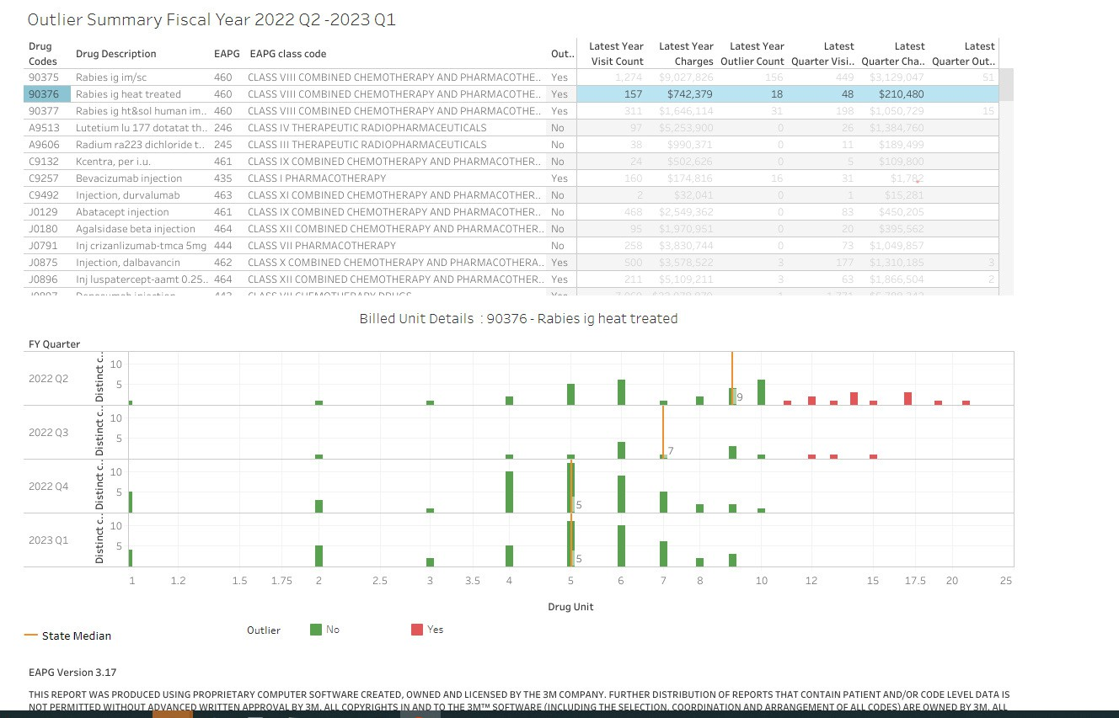
CDS-A Reports on CRISP Portal
Provides hospitals with high-cost drug utilization for outlier dosage units based on 3rd Monthly case mix data
Information should used to correct errors prior to submission of Quarterly case mix data.
Hospitals can see which drugs’ units are outliers compared to the State average

Slide 88
CDS-A Reports on CRISP Portal
CDS-A Audits starts with what is reported in the case mix data. If the case mix data has errors, the CDS-A data for the following year will have errors.
Hospitals are subject to fines if the case mix data used for CDS-A audits the following year contains errors.
For access to the CRISP portal, contact your CRS Portal Point of Contact or support@crisphealth.org

