Slide 1
Payment Model Workgroup
March 4, 2026

Slide 2
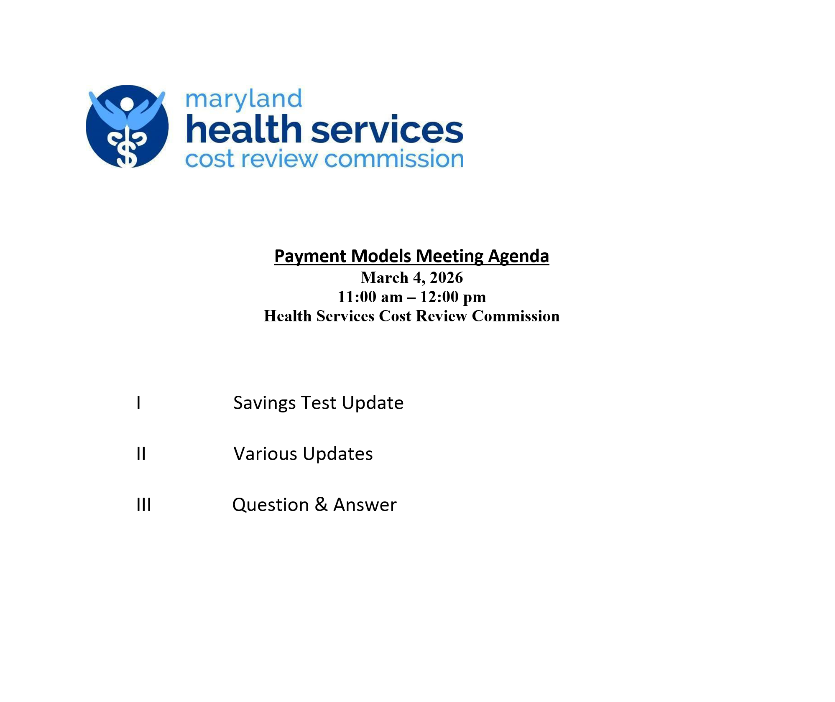

Slide 3
Key AHEAD Model Changes: Medicare FFS TCOC Target
Amended and Restated State Agreement (2025) | AHEAD State Agreement (2024) | ​TCOC Model
Incremental reduction versus national trend in Medicare FFS spending each year, additions each year: PY1: 0.13% PY2: 0.21% PY3: 0.30% PY4: 0.38% PY5: 0.46% PY6: 0.55% PY7: 0.63% PY8-10: 0% = ~2.66% savings over seven years against a 2023 base | 0.128% incremental reduction versus national trend in MC FFS spending each year, resulting in ~1.1% savings over the 10 years against a 2023 base | ~4% savings over prior 10 years
NEW: Any savings beyond these targets must be returned to the State (via hospital global budgets)

Slide 4
Medicare FFS TCOC Target: Current Understanding
Set to 2023, trended forward to 2025 at national trend
Estimated prospectively for initial target each year. Will be known value at the time of the Update Factor.
Other considerations
Trends are based on published USPCC values.
33% of trends is calculated against national $ and added to MD $ instead of applying trend to MD Base $.
Final answer is risk adjusted using HCC scores
National trends are derived from USPCC trend adjusted to ensure apples-to-apples between USPCC trend and State TCOC calculations.
Baseline x (1 + Interim Years Trend ¹) x (1 + National MC FFS Trend ² + True Up) - Savings Component
Final target is risk adjusted
Adjusts 50% of misses > .5% in projected trend in the current year.
Expressed as %, see prior slide
1. Actual National MC FFS Trend for 2024 and 2025.
2. The product of:
Estimated National MC FFS for the current year,
Average of Projected and Actual National MC FFS Trend for the prior performance year, and
Actual National MC FFS Trend for previous performance years.
Prior year actual experience is only weighted 50% versus expectation, allowing time to adjust

Slide 5
Medicare FFS TCOC Target: Estimated 2026 Target
Example Target Calculation
2023 Spend PBPY | A | $14,107
2023 Spend PBPY, Risk Adjusted | B | $14,433
Actual 2024 USPCC | C | 7.23%
Actual 2025 USPCC | D | 8.39%
2026 Projected USPCC Trend Less: Savings Component | E1 E2 | 4.29% (0.13%)
Cumulative Trend | F=(1+C)*(1+D)*(1+E1+E2) | 21.06%
Apply Trend 1/3 to US dollars 2/3 to MD Dollars | G | 20.18%
2026 Target | H=B*(1+G) | $17,347
From Maryland’s Amended and Restated AHEAD State Agreement
2023 Spend PBPY * Normalized State Average HCC Score (.9774)
This should be actual USPCC but that isn’t available for 2025 yet, 8.39% is TCOC actual 2025 trend (current USPCC = 4.97%). Gap is significant and USPCC may take more time to reflect actuals.
This represents the 2026 expected trend released in April 2025, once actuals are available it will be trued as noted on prior slide
The trend is applied using a 1/3 weight on dollar based and 2/3 weight on percentage impact on the base.
MD 2026 risk adjuster would be applied to this value to translate back to MD risk-adjusted equivalent.

Slide 6
Medicare FFS TCOC Target: Example of 2026 Target
Open Items:
Confirm actuals under AHEAD calculation methodology
Confirm HSCRC understanding of the calculation with CMMI
Confirm HCC methodology to be used
Confirm timeline for finalization of USPCC values and final savings amount (for how long do we update actuals).

Slide 7
Volume Workgroup - GBR Carve-Out Stakeholder Comments
March 2026

Slide 8
Agenda
Status update and Timeline
Stakeholder Comments on proposed GBR Carve-outs
Next Steps
Definitional Note:
Exclusion: service categories not considered subject to global budgets and therefore excluded from the denominator of relevant global budget calculations (e.g. Distinct Part Unit under CMMI methodologies, Psych hospitals under HSCRC methodologies)
Carve Out: service provided by an institution that is otherwise covered by the global budget methodology but reimbursed under a purely volume variable approach and are only excluded from the numerator of the relevant calculations (e.g. HIgh cost drugs under both CMMI and HSCRC methodologies)

Slide 9
Timeline and Status Update
Status Update
CMMI has not finalized their specifications under AHEAD
Potential June revisions to Financial Specifications draft 3.0
Final revisions are projected to be released this fall
Goal is to influence the CMMI decision on Carve-outs
Use our definitions versus what they will otherwise propose, to the greatest extent possible
Staff’s original thinking is to make this a prospective adjustment only but are interested in understanding industry needs for funding on a retrospective basis
Projected Timeline
February 2026
HSCRC Proposed GBR Carve-outs Memo sent out to industry with requests for comments
Stakeholder Comments due back to the HSCRC
March 2026
Volume Workgroup discussing stakeholder comments
April 2026
Volume Workgroup discussing Initial findings
Review HSCRC potential approach with CMMI
May 2026
Volume Workgroup discussion – Staff draft recommendations on GBR Carve-outs
Present Draft Recommendation at the Commission meeting
June 2026
Volume Workgroup discussion – Final Staff recommendations on GBR Carve-outs
Present Final Recommendations at the June Commission meeting

Slide 10
Summary of Public Comments
Key Topics | Adventist | GRMC | JHHS | LifeBridge Health | Luminis Health | MedStar Health | MHA | UMMS
High‑Cost Outpatient Drugs | x | x | x | x |  | x |  | x
Complex & Highly Specialized Care (Quaternary + Tertiary) | x | x | x | x | x | x | x | x
Low‑Volume Surgical Service | x |  |  |  |  | x | x
Cross‑Payer Alignment & Use of AHEAD Carve‑Out Flexibility (15%) | x | x | x | x | x | x | x | x
Staff received comment letters from eight stakeholders regarding on GBR carve-outs
The comments from stakeholders can be broadly categorized into four areas of concern

Slide 11
High‑Cost Outpatient Drugs
Overall Summary: Stakeholders generally support continuing a high‑cost outpatient drug carve‑out and emphasize the importance of a comprehensive, predictable list and a clear reconciliation process between CMMI/CMS exclusion lists and Maryland’s CDS‑A approach, noting risks of volatility and funding gaps if the federal list is narrower.
Staff Response: Staff position is to continue the comprehensive list of identifying and carving out high-cost outpatient oncology drugs from non-Medicare hospital GBRs under an approach that aligns with CMMI and the rest of the nation
Staff understands that a less comprehensive drug list could create budget volatility especially for small/rural hospitals that perform low-volume but high-cost variable therapies
Staff believes that is important to reconcile CMMI’s drug exclusion list to the drug list captured by the CDS-A policy to;
Understand what is captured by the CDS-A that is not included on CMMI’s list
Understand whether there are categories of drugs beyond CMMI’s list that merit carve-out
Ensure that Maryland hospitals are not disadvantaged (especially the small/rural hospitals)
Arrive at a consistent methodology to identify drugs to add to the carve-out list
Staff analyses will include:
Establishing a consistent drug identifier between the Maryland CDS-A and the CMMI drugs list
CPT/HCPCS codes have been used as the drug identifier in the CDS-A, however, CMMI identifies drugs using National Drug Codes (NDCs)
Staff began collecting NDC data from hospitals in July 2025 and FY26 Q1 data is currently available at the commission however, Staff is unsure about the completeness of the data as several hospitals have reported having issues with reporting on the NDCs
Impact modeling to illustrate how changes to the federal list may affect hospitals including those in small and rural areas of the state
Statewide and hospital-specific studies on the drug variations between the CDS-A and the CMMI list using case-mix data
Per JHHS FY 2025 modeling, there exist significant declines in drug charges reported between the CDS-A and the CMMI drug list (~21 percent at JHH and ~99 percent at Howard Medical Center)
Only 75 percent of JHH drug charges on the CDS-A are also picked up in the CMMI Drug list (less than 1% for Howard Medical Center)
Drug categories on the CDS-A but not on CMMI’s list which we can advocate for inclusion based on their variable and unpredictable nature
Continued discussions with CMMI and industry to arrive at a drug list that is comprehensive and consistent between Medicare and non-Medicare HGBs
Comments were received from: | Adventist | GRMC | JHHS | LifeBridge | MedStar | UMMS
See appendix for comment details.

Slide 12
Complex & Highly Specialized Care (Quaternary + Tertiary)
Overall Summary: Stakeholders support strengthening carve‑outs for complex/highly specialized care and emphasize that these services are costly, variable, innovation‑driven, and not well‑suited to fixed global budgets. Several recommend using stable claims‑based definitions (e.g., DRG/EAPG or SG2/Vizient frameworks) and discuss whether carve‑outs should apply beyond academic medical centers (e.g., open‑heart hospitals, trauma centers, specialized community providers). AMC’s request that transplant services and organ acquisition costs continue to be carved out, including when performed in outpatient settings
Staff Response: With expanded maximum GBR carve-outs from 5 percent under TCOC to 15 percent under AHEAD, Staff believe that there is some opportunity to revise the definitions of “highly specialized care” to capture more services previously defined as population-based care. However, Staff also note that carved-out services still count against overall savings tests and any approach should be careful not to cannibalize other services by carving out too broad a definition.
Staff agrees with industry and intends to:
Continue carving out of hospital GBRs all costs associated with inpatient transplant cases, including organ acquisition costs which have traditionally been carved-out of GBRs
Prioritize highly complex, innovative quaternary and tertiary care typically occurring at Academic Medical Centers(AMCs)
Recognize and expand the “highly specialized care” definition to include other complex care, non-academic hospitals that may provide unique and costly services that do not occur elsewhere in the State
However, Staff would like to express the following concerns:
Expanding highly specialized care definitions to include procedures done in outpatient. Staff believe that the vast majority of highly specialized tertiary and quaternary cases occur in the inpatient setting
The main driver of complexity and innovative care in outpatient is high-cost drugs which are already being carved out through the CDS-A policy
Using a DRG/EAPG based definition for qualifying tertiary and quaternary volumes as opposed to the ICD-10 Procedure codes currently in use (e.g., DRG/EAPG or SG2/Vizient frameworks approach) (See comparisons on the next slide)
CMMI has indicated a strong preference for using a transparent, non-proprietary approach to establishing the definition of highly specialized care
Staff would also prefer not to commit the State to a proprietary methodology
Comments were received from: | Adventist | GRMC | JHHS | LifeBridge | Luminis | MedStar | MHA | UMMS
See appendix for comment details.

Slide 13
Complex & Highly Specialized Care (Quaternary + Tertiary) Cont….
Comparisons between using ICD-10 procedure Codes and DRGS/EAPGs
Staff analyses will include:
Hospital-specific acuity level assessments in inpatient and outpatient (excluding high-cost drugs)
Growth assessments in tertiary and quaternary care services in the state
Magnitude of these volumes in inpatient versus outpatient (excluding high-cost drugs)
Establish a comprehensive definition for tertiary and quaternary care services
Re-evaluate the criteria by which we are defining hospital qualifications for Complexity and Innovation funding
Impact modeling to illustrate how much more highly specialized care we could capture by lowering the CPT cell dominance thresholds from 95 percent
Staff believe cell dominance remains an attractive way to identify complex services rather than an arbitrary cut off
Explore possible ways to use DRGs as opposed to procedure codes in the Complexity and Innovation Policy
Impact modeling on the use of DRGs as opposed to procedure codes in defining highly specialized complex and innovative care
Pros | Cons
ICD-10 Procedure Codes (CPT)
Identifying specific, highly intensive services or procedures | Does not account for overall acuity – high level CPT does not mean high risk, just that a complex procedure was performed
Represent concrete action so are generally objective – While coding rules apply, the procedure itself either occurred or did not | Fragmented view as it focuses only on the specific service whereas a patient might have a higher complexity due to a combination of services
Can readily be adapted to Medicare Hospital Global Budget methodologies
DRG/EAPG
Provides a more realistic picture on case severity ensuring that hospitals are reimbursed more for complex cases | Upcoding risks since DRGs are prone to subjectivity – assignment of a DRG often involves subjective judgment of clinical documentation, particularly in complex cases with multiple diagnoses
Aligns with other HSCRC volume methodologies which uses APR-DRGs in inpatient and EAPGs in outpatient. However, to align with Medicare HGBs we will have to use MS-DRGs in inpatient and APCs in outpatient the latter of which are currently not in use | EAPGs are a proprietary grouper which will not work for CMMI Medicare HGB methodologies. HSCRC does not have APC data thus aligning with CMS will require a new outpatient grouper and methodology
Comments were received from: | Adventist | GRMC | JHHS | LifeBridge | Luminis | MedStar | MHA | UMMS
See appendix for comment details.

Slide 14
Low‑Volume Surgical Service Lines
Overall Summary: Stakeholders generally acknowledge that excluding low‑volume surgical service lines can improve the reliability of market shift assessments, but several ask whether these exclusions should be treated as true carve‑outs (and thus count toward the 15% cap), urging HSCRC to clarify how CMMI would treat them and to prioritize carve‑out capacity accordingly.
Staff Response: Staff acknowledges that excluding low-volume surgeries from the market shift could improve reliability however, staff would like to engage in more comprehensive discussions with industry and CMMI to determine which service lines should be prioritized and whether this should be treated as true carve-outs under AHEAD
Last year, through various modeling of the market shift by Staff to test for reliability, Staff identified the following surgical service lines as not ideally suited for population-based methodologies due to them being high costs and low volume in nature
Endocrinology Surgery
ENT Surgery
Gynecological Surgery
Ophthalmologic Surgery
Thoracic Surgery
Urological Surgery
Ventilator Support
While Staff position is to have these service lines within global budgets, but volume variable adjusted i.e., adjust only when volume change is material, like the Out-of-State Policy
Staff analysis will:
Evaluate the impact of carving out these service lines on hospital reimbursement and the TCOC savings target
Assess geographic access implications in the state if these service lines are to be carve-out of the Market Shift Policy
Comments were received from: | Adventist | MHA | MedStar
See appendix for comment details.

Slide 15
Cross‑Payer Alignment & Use of AHEAD Carve‑Out Flexibility (15%)
Overall Summary: Stakeholders generally support aligning Medicare and non‑Medicare carve‑outs, so hospitals are not subject to different rules across payers and unnecessary administrative burden. They also note that the AHEAD model allows more flexibility to carve out certain services and believe this flexibility should be used to ensure hospitals are appropriately funded for services that are difficult to manage under fixed hospital budgets.
Staff Response: Staff agree that defining one set of services to be carved out of global budgets regardless of payer will reduce the administrative complexity of an already complicated payment structure and ensure alignment in hospital incentives across payers
Staff are still engaging in discussions with stakeholders and CMMI to;
Understand their position,
Influence any final CMMI decisions,
Better position to align services carved out from Medicare HGBs with those carved out for non-Medicare HGBs, to the greatest extent possible
While the AHEAD Model calls for a 15 percent carve-out which allows more flexibility to carve out more highly specialized variable services, staff believe that a portion of the 15 percent should be reserved to accommodate for;
Future refinements
Future additions of other new and emerging therapies or procedures
Anticipated higher growth in carved out services
Comments were received from: | Adventist | GRMC | JHHS | LifeBridge | Luminis | MedStar | MHA | UMMS
See appendix for comment details.

Slide 16
Next Steps
Staff will work on analyses outlined in this presentation and send out to the field prior to the April Volume Workgroup Meeting
The next Volume Workgroup discussion will occur in April, discussing Staff initial findings and models
Please be on the lookout for meeting invites which will be sent out next week
Staff will continue discussions with CMMI on the State's Carve-out approach

