Slide 1
FY 2025 Quarter 1 Data Forum
Sep. 13, 2024
@10:00 AM
Join Zoom Meeting
https://us06web.zoom.us/j/4107642605?pwd=MmVwREVMbFFYUzlCeWpJcFFZYWF5UT09&omn=87299189701
For Meeting ID and Passcode please contact Curtis Wills: curtis.wills@maryland.gov

Slide 2
Why, When, Where
WHY?
  Open and ongoing communication between HSCRC & industry
  Forum to ask questions about submitted hospital data (case mix and financial)
  Sharing of best practices
WHEN?
  10:00 am - 12:00 pm
WHERE?
  via Webinar (link is posted on our website 2 months before the next meeting)
FY 2025 Dates
December 13, 2024
March 14, 2025
June 13, 2025

Slide 3
Agenda
Announcements
  Case Mix Weights and Grouper Versions (Nduka)
  Quality Update (Dianne)
    SOGI Update (Princess)
    Z-Code Analysis (Princess)
    ED LOS Update (Damaria/Alyson)
    Inpatient Type 2 Diabetes Screening Pilot (Jason)
  Financial Assistance Update (Wayne)
  Financial Data Production Schedule and Extension Reminder (Andrea)
  Reminders (Oscar)
    Points of Contact
    CDS-A Report
    Data Forum Survey
Data Processing Vendor Update (Mary Pohl, hMetrix/Burton Policy)
  Rate Center DQ plan
Data Repository Vendor Update (Jen Vogel, SPG)
Case Mix Audit Vendor Update (Oscar)
FY 2025 DSR Updates (Curtis)
Upcoming Workgroups and Next Meeting (Curtis)

Slide 4
Case Mix Weights and Grouper Versions

Slide 5
Grouper Transition: Case Mix Weights and Reports
Rate Year | RY 2025
3M APR/EAPG Version* | IP Weights: 39 OP Weights: 3.17
Data Period Used for Weight Development | IP: CY 2022 (12 Months) OP: CY 2022 and Q1 of CY 2023 (15 Months)
Weight Release Date | First Quarter CY 2025
Policies Applicable To | CY 2024 6-Months Marketshift
*The 3M ™ All Patient Refined DRG (APR DRG) Software and 3M™ Enhanced APG (EAPG) Software are proprietary products of 3M Health Information Systems.

Slide 6
Reminder: Expansion of Denied Admissions Template
HSCRC will be revising the Denied Admissions template for FY 2026.
  The template will include more detailed fields
  Aimed at improving data collection.
We will be reaching out to all hospitals soon with more updates on these changes.
Please stay tuned for further communications.

Slide 7
Quality Update

Slide 8
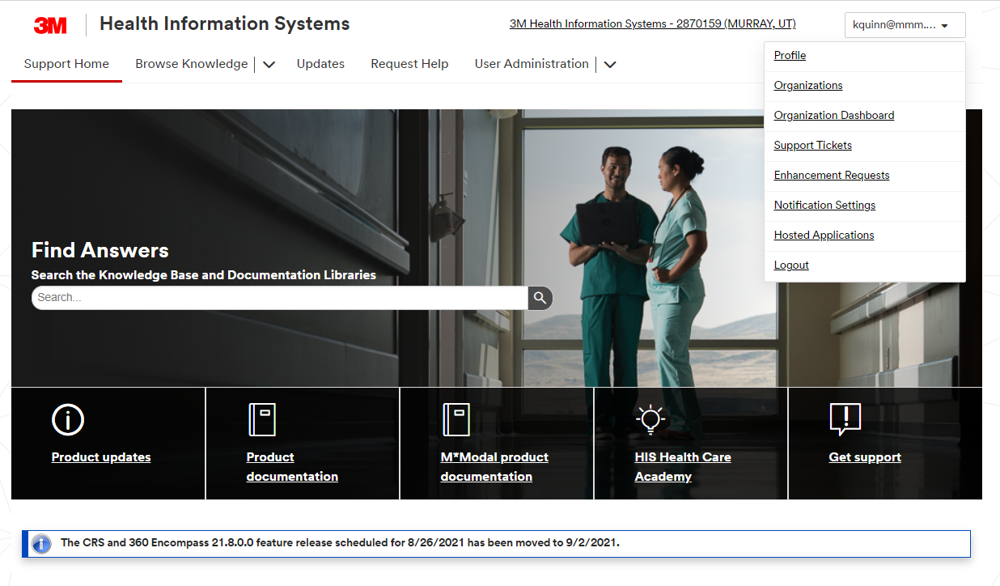
PPC Updates and Feedback
Login procedure for PPC documentation:
3M™ Web Portal - Login
For first use, at registration page, use the old username of "MDHosp" as your authorization code, complete the fields with your personal information to register
New PPC feedback submission procedure on 3M HIS support site:
https://support.3mhis.com/
Establish an account; after logging in, click on your login id in the upper right corner and click on “enhancement request”

Slide 9
Quality Update: Additional Topics
Updated RY 2026 MHAC program recommendations approved in the February 2024 Commission meeting.
  Transitioned to v41 of the 3M PPC grouper.
  No changes to the measures or fundamental methodology components
    Updated the methodology for setting threshold and benchmark standards to make the performance standards less sensitive to potential outliers by using the average performance of the top and bottom 20% of performance by averaging the worst and best performing hospitals
Quality is pursuing the following additional areas of quality of care
  Electronic Clinical Quality Measures (eCQMs) or other digital measures CY 2024
  See the CRISP eCQM website for more information and HSCRC memos on the main HSCRC Quality page
    Potentially add measure(s) to RY 2027 payment programs
  Sexual Orientation Gender Identity (SOGI) hospital data collection training project underway with asynchronous training availability anticipated by mid October 2024
  Continuing to exploring options for Outpatient Quality measures, in light of shifts from IP to OP care

Slide 10
Quality Update: New and Planned Monitoring Reports
New on CRS Portal
  TFU Disparity Gap Report
Planned for Future Release
  Maternal Morbidity-eCQM (estimated year end 2024)
  Sepsis Dashboard
  TFU behavioral health (TBD)

Slide 11
CY 2025 Digital Measure Submission to HSCRC
Title | Short Name | CMS eCQM ID | CBE* # | 2024 | 2025 | HSCRC
Anticoagulation Therapy for Atrial Fibrillation/Flutter | STK-3 | CMS71v13 | N/A | X | X | Optional
Antithrombotic Therapy By End of Hospital Day 2 | STK-5 | CMS72v12 | N/A | X | X | Optional
Cesarean Birth | PC-02 | CMS334v5 | 0471e | X | X | Required
Discharged on Antithrombotic Therapy | STK-2 | CMS104v12 | N/A | X | X | Optional
Excessive Radiation Dose or Inadequate Image Quality for Diagnostic CT in Adults (Facility IQR) | IP-ExRad | CMS1074v2 | 3663e |  | X | Optional
Global Malnutrition Composite Score | GMCS | CMS986v2 | 3592e | X | X | Optional
*Verify active CBE endorsement on the CMS certified consensus-based entity’s PQM website Source: https://ecqi.healthit.gov/eh-cah?qt-tabs_eh=1&globalyearfilter=2024&global_measure_group=3716

Slide 12
CY 2025 Digital Measure Submission to HSCRC
Title | Short Name | CMS eCQM ID | CBE* # | 2024 | 2025 | HSCRC
Hospital Harm - Acute Kidney Injury | HH-AKI | CMS832v2 | 3713e |  | X | Optional
Hospital Harm - Opioid-Related Adverse Events | HH-ORAE | CMS819v2 | 3501e | X | X | Optional
Hospital Harm - Pressure Injury | HH-PI | CMS826v2 | 3498e |  | X | Optional
Hospital Harm - Severe Hyperglycemia | HH-Hyper | CMS871v3 | 3533e | X | X | Required
Hospital Harm - Severe Hypoglycemia | HH-Hypo | CMS816v3 | 3503e | X | X | Required
ICU Venous Thromboembolism Prophylaxis | VTE-2 | CMS190v12 | N/A | X | X | Optional
Safe Use of Opioids - Concurrent Prescribing | Safe use of opioids | CMS506v6 | 3316e | X | X | Required
Severe Obstetric Complications | PC-07 | CMS1028v2 | N/A | X | X | Required
Venous Thromboembolism Prophylaxis | VTE-1 | CMS108v12 | N/A | X | X | Optional

Slide 13
Quality Update: eCQM Reporting Timeline
eCQM CY 2025 Performance Period Submission Windows
Q1 2025 data Open: 7/15/2025 Close: 9/30/2025
Q2 2025 data Open: 7/15/2025 Close: 9/30/2025
Q3 2025 data Open: 10/15/2025 Close: 12/30/2025
Q4 2025 data Open: 1/15/2026 Close: 3/31/2026
Hospitals may apply for an extraordinary circumstances exemption if warranted, including an extension if more time is needed. (See Quality page on HSCRC website)

Slide 14
HSCRC Hospital Wide Readmission and Hospital Wide Mortality CY 2024- 2025 Reporting Requirements
HSCRC requires hospitals to submit Core Clinical Data Elements (CCDE) for the HWR and HWM hybrid measures on patients from all payers using HSCRC specifications starting with July 1, 2024 performance; for the first 6 months of the performance period (July-December 2024) HSCRC expects reporting to begin in January 2025, and then quarterly thereafter for the January-June 2025 time period.
July 1, 2024 -June 30, 2025 Performance Period Submission Windows for Hybrid Measures CCDE
Q3 2024 data Open: 1/15/2025 Close: 3/31/2025
Q4 2024 data Open: 1/15/2025 Close: 3/31/2025
Q1 2025 data Open: 4/15/2025 Close: 6/30/2025
Q2 2025 data Open: 7/15/2025 Close: 9/30/2025
*HSCRC may consider an alternate extended submission timeline for all-payer CCDE submissions that aligns with the CMS timeline which is a full year of data after the performance period.

Slide 15
SOGI Data Collection Update

Slide 16
SOGI Data Collection Implementation Timeline (2024-2025)
February 1
  SOGI Training Contract Begins
March-April
  Finalize SOGI Variables and Training Materials
August 1
(FY25 Q1)
  Begin Testing Period for SOGI Data Collection
October 1, 2025
(FY26 Q2)
  SOGI Variables in Production (Mandatory)
October 1, 2024
(FY25 Q2)
  SOGI Variables in Production (Optional)
March 8
  Present Proposed SOGI Variables at Data Forum
April-June
  Hospital Staff Training

Slide 17
SOGI Training Sessions
HSCRC Staff contracted the Johns Hopkins Medicine’s Office of Diversity, Inclusion and Health Equity (ODIHE) to provide hospital staff with 6 synchronous SOGI training sessions
  169 individuals participated
HSCRC Staff have contracted CourseNetworking to host the asynchronous training session on the HSCRC website
  Staff are working to have the session accessible by October 14, 2024
  21 individuals completed the asynchronous session that was available via the JHM ODIHE

Slide 18
Edits for SOGI Data Elements
Variable | Description | Warning
Gender Identity | Enter patient's gender identity. Gender identity is a person's deeply held knowledge of their gender. More than one values can be reported in comma separated format. Example: |1,5| 1 = Female/woman/girl 2 = Male/man/boy 3 = Nonbinary, genderqueer 4 = Transgender female/woman/girl 5 = Transgender male/man/boy 6 = Another gender (not listed here) 7 = Don’t know/Questioning 8 = Prefer not to answer | Warning: if reported and value is invalid (values other than what is in the description)
Sexual Orientation | Enter patient's sexual orientation. Sexual orientation is a person’s multidimensional attraction to other people. More than one values can be reported in comma separated format. Example: |1,5,8| 1 = Lesbian 2 = Gay 3 = Straight or heterosexual (that is, not gay or lesbian) 4 = Bisexual 5 = Queer 6 = Pansexual 7 = Asexual 8 = Something else (not listed here) 9 = Don’t know/Questioning 10 = Prefer not to answer | Warning: if reported and value is invalid (values other than what is in the description)
Sex Assigned at Birth | Enter patient's Sex assigned at birth. Report only one of the values below: 1 = Female 2 = Male 3 = X/Another sex 4 = Don’t know 5 = Prefer not to answer | Warning: if reported and value is invalid (values other than what is in the description)

Slide 19
SDoH Z-Code Analysis

Slide 20
SDOH Data with ICD-10-CM Z Codes
Social Determinants of Health (SDOH)-related Z-codes (Z55-Z65) are used to document non-medical factors that affect health outcomes (i.e., housing, food insecurity, or lack of transportation)
  The number of valid codes have changed over time
    12 added for 2022, 3 added for 2023, 17 added for 2024
Z-codes refer to factors influencing health status or reasons for contact with health services that are not classifiable elsewhere as diseases, injuries, or external causes
HSCRC Staff are interested to understand z-code uptick in MD hospitals and analyzed Maryland hospital reporting of Z-codes between 2022-2024.

Slide 21
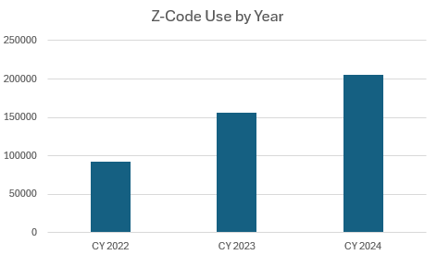
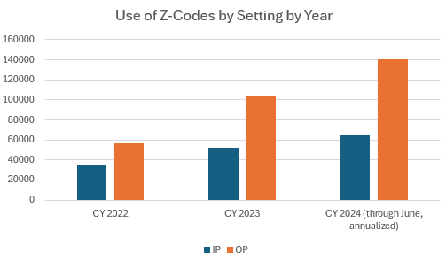
Z-Code Reporting (CY 2022-2024)
The use of z-codes is increasing over the years, for both the IP and OP settings
Z-codes are used more in the OP setting than in the IP setting

Slide 22
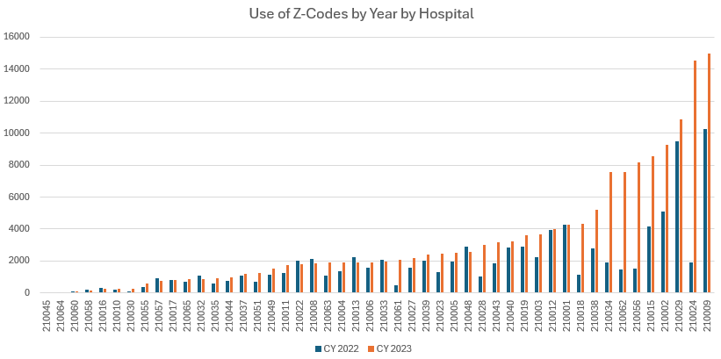
Z-Code Reporting By Hospital (CY 2022 vs 2023)
There is much variation in Z-code use among hospitals
37 out of 48 hospitals saw an increase in Z-codes in 2023 compared to 2022

Slide 23
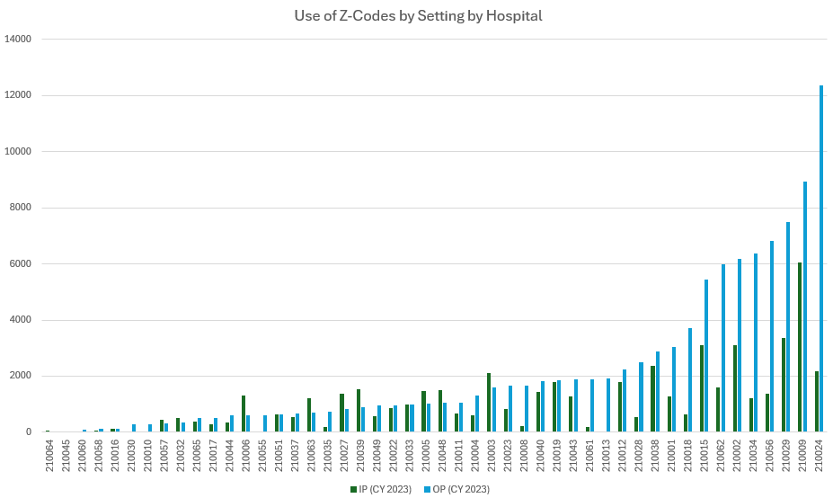
Z-Code Reporting By Hospital and Setting (IP/OP)
In CY 2023, 36 out of 48 hospitals used Z-codes more in the OP setting than the IP.

Slide 24
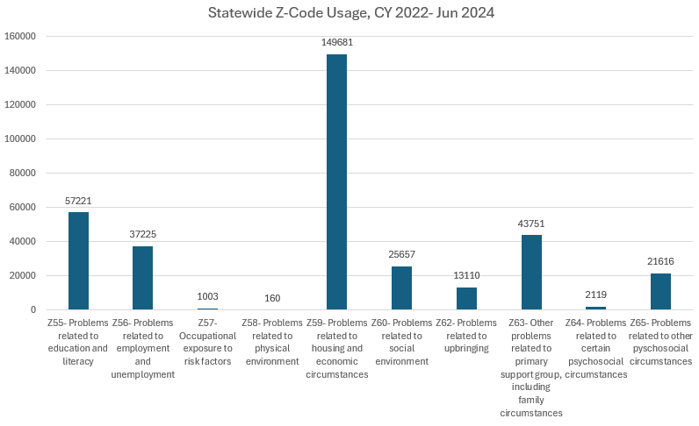
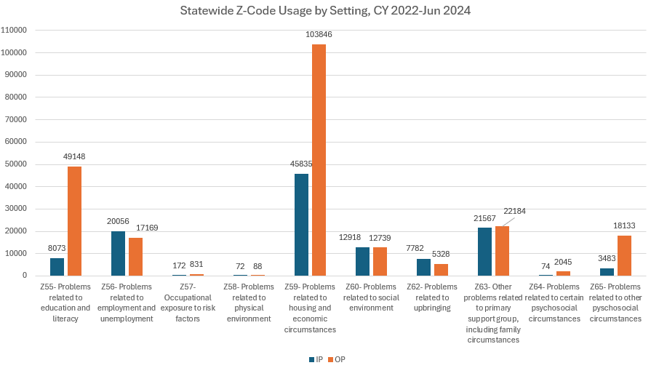
Z-Code Reporting by Code and Setting
In the last 2 ½ years, Z59 (problems related to housing and economic circumstances) was coded more than any other z-code overall; for both the IP and OP settings statewide.

Slide 25
Z-Code Analysis Next Steps
HSCRC staff will continue to monitor the use of SDOH Z-Codes and will report quarterly to this forum

Slide 26
ED LOS Update

Slide 27

ED LOS AD HOC Submission Extension
ED LOS ADHOC submission deadline has been extended to 9/13
            There are some hospitals with a significant number of ED visits being reported that we cannot match to the Inpatient or Outpatient case mix data and cases in the case mix data without an associated record in the ED LOS file
Reasons for mismatch include:
                Reported admission dates in Ad Hoc file being off by one or two days from the case mix reported dates;
                Hospitals may be reporting ED visits where patients left without being seen (LWBS), such that there is no record in the Case mix data
  HSCRC staff are reaching out to hospitals with poor match rates.
    HSCRC staff knows hospitals have handled LWBS cases differently; they will simply be excluded if they are not matched to the case mix data. However, for the 6-month submission period due in December, HSCRC may request hospitals to submit LWBS cases so that we can better understand the issue.

Slide 28

Subgroup 2: QBR Measure and Incentive Structure Update
Staff is evaluating a tiered target that would place hospitals into three groups based on their baseline performance (CY2023).
Those hospitals with ED LOS in the top 1/3 would have an improvement target of 0-5 percent; the middle third would have a target of 5-10 percent and the 1/3 with the longest ED LOS at baseline would have a target improvement of 10-15 percent
      Ensures that relatively better performers have a lower improvement target, while those with greater opportunity are expected to have larger improvements
Staff will combine the remainder of Subgroup 2 and ED Best Practices to finish the development of the ED LOS measure and begin the development of a “Best Practices Policy” to promote the adoption and expansion of processes aimed at reducing ED LOS.
Next Meeting of Subgroup 2:
September 27,2024

Slide 29
Establishment of Maryland ED Wait Time Reduction Commission
Bill went into effect July 1, 2024, and terminates June 30, 2027
Purpose: To address factors throughout the health care system that contribute to increased Emergency Department wait times
Chairs: Secretary of Health and Executive Director of HSCRC
Appointed Members:
Executive Director of MIEMSS
Executive Director of MHCC
2 Individuals with operation experience in an ED, including 1 physician
1 Individual with professional experience in an ED, who is not a physician or APP
1 representative from local EMS
1 representative from a Managed Care Plan with experience in Case Management
1 representative of Advanced Primary Care Practice
1 representative from MHA
1 representative from a patient advocacy organization
1 representative of a behavioral health provider
Specific focus: Develop strategies and initiatives to recommend to state and local agencies, hospitals, and health care providers to reduce ED wait times, including initiatives that:
Ensure patients are seen in most appropriate setting
Improve hospital efficiency by increasing ED and IP throughput
Improve postdischarge resources to facilitate timely ED and IP discharge
Identify and recommend improvements for the collection and submission of data
Facilitate sharing of best practices
29

Slide 30

ED Wait Time Reduction Commission:
Collaborate on behavioral health, post-acute, primary care, and other areas of opportunity.
Improve Access
Maryland Primary Care Program
Expand Behavioral Health Framework
SNF/Post-Acute
Hospital Payment Programs to Improve Clinical Care
MD Hospital Quality Policies
ED “Best Practices” incentive
Increase Transparency
MHCC Public Quality Reporting
ED Dramatic Improvement Effort
Reduction in Avoidable Utilization
Programs to optimize high value care and reduce avoidable utilization
Reducing the number of people who need the ED
Improving throughput within the hospital
Improving the hospital discharge process and post-ED community resources
30

Slide 31
Inpatient Type 2 Diabetes Screening Pilot

Slide 32
Diabetes Screening Background
CMMI directed the HSCRC to include one or more measures of hospital population health performance in the Medicare Performance Adjustment for CY24
After a series of stakeholder workgroups, staff proposed an inpatient diabetes screening program
Analysis suggested IP screening could reduce prevalence of undiagnosed diabetes by more than 30 percent, and assist in better glycemic control for those with a prior diagnosis
Commissioners asked staff to conduct a pilot of the screening program to better understand impact on hospital operations and effect on population health

Slide 33
Aims
To determine expected diagnostic yield and prevalence of undiagnosed/uncontrolled diabetes among inpatients
To understand how patients with abnormal HbA1c values are followed up either within or outside the inpatient clinical setting
To identify potential barriers, obstacles, and bottlenecks associated with screening for T2DM within the IP setting (e.g., Responsible data management, patient follow-up, actionable referral mechanisms, and financial incentivization)
To anticipate difficulties associated with scaling towards a statewide IP T2DM screening program

Slide 34
Patient Eligibility and Sampling Frame
Eligibility for T2DM Screening | Additional Exclusion Criteria
Patients 35 years of age or above, and without a prior HbA1c result within three years prior to admission (non-diagnosed) or without a prior HbA1c result within three months prior to admission (previously-diagnosed) as indicated by patient’s Electronic Medical Record (EMR) | Died in Hospital Left AMA Tested less than 3 months (diabetics) or less than 3 years (non-diabetics)

Slide 35
Intervention
The intervention for this pilot study includes a standing lab order for inpatient HbA1c testing that automates the process of screening eligibility.

Slide 36
Pilot Timeline
We are here
Pilot Development
Financial Reimbursement Mechanisms
Screening Tool Construction
Reporting Details and Program Protocol
Pilot Termination
July 1
Dec 1
Spring 2024
Oct 1
Pilot Initiation
Post-Pilot Analysis
Quantitative Analysis
Stakeholder Analysis (Questionnaire)
Presentation of Results to Commission
92 Days

Slide 37
Pilot Data Integration
EID
HSCRC Casemix Data
EMR
Responsible Entity: CRISP
EID
Patient Demographics, Admit Date, Discharge Date
Pilot Screening Tool
EID
Patient Eligibility
Lab Feeds
Pilot Analytic File
HbA1c Values
Responsible Entity: HMetrix
37

Slide 38
Financial Assistance Update

Slide 39
Financial Assistance Update
Effective October 1, 2024, House Bill 238 requires hospitals incorporate the following in their Financial Assistance Policy:
  Removed the requirement that the provision of reduced-cost medically necessary care and payment plans be in accordance with the mission and service area of the hospital;
  Authorized hospitals to consider only household monetary assets in excess of $100,000 when determining eligibility for free and reduced-cost care under the hospital's financial assistance policy; and
  Requires that certain retirement assets be excluded from consideration.
HSCRC is extending the deadline for the submission of Financial Assistance Policy (which should incorporate the above revisions) until January 31, 2025.
Submit this policy to hscrc.financialassistance@maryland.gov and included it with the Community Benefits Report that is submitted to The Hilltop Institute.
For questions, contact Wayne Nelms (wayne.nelms2@maryland.gov).

Slide 40
FY 2025 Production Schedule and
Process for Requesting
Financial Data Extensions

Slide 41
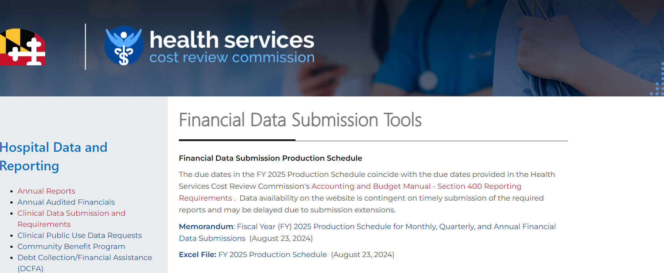
FY 2025 Production Schedule for Financial Data Submissions
Posted to the website on the Financial Data Submission Tools page: https://hscrc.maryland.gov/Pages/hsp_info2.aspx
Financial Data availability on the website is contingent on timely submission of the required reports and are subject to change.

Slide 42
Process for Submitting Extensions for Financial Data
Submitted in writing on hospital letterhead with explanation for extension and noting each hospital and report that will be delayed
Made within a reasonable time,
before the due date
Addressed to the HSCRC Executive Director with copies to staff to ensure timely processing
Email Extension Requests to:
    Jon Kromm, Executive Director (jon.kromm@maryland.gov)
    Andrea Strong (andrea.strong@maryland.gov)
    Marcella Guccione (marcella.guccione@maryand.gov)
    Wayne Nelms (wayne.nelms2@maryland.gov)

Slide 43
Process for Submitting Extensions for Financial Data
Staff will review the extension request and respond (in writing) to the hospital indicating whether the request has been approved, and if the request is approved, the new due date (typically 1 week).
Please note: Hospitals are granted a blanket 30-day extensions for the filing of Audited Annual Report Submissions, therefore, extensions beyond this timeframe will be granted only in emergency situations (an event over which the Hospital has no control).
  Any revisions to the Annual Report must be submitted in its entirety with a letter on Hospital letterhead specifying the Schedules revised and an explanation for the revisions.
Submissions of late or significantly erroneous data is subject to a fine and/or GBR adjustment of up to $1,000 per day.​​​

Slide 44
Reminders

Slide 45
HSCRC Points of Contact for Case Mix and Financial Data
Case Mix Data | Financial Data
Oscar Ibarra Phone: (410) 764-2566 Email: oscar.ibarra@maryland.gov | Andrea Strong Phone: (410) 764-2571 Email: andrea.strong@maryland.gov
Curtis Wills Phone: (410) 764-2594 Email: curtis.wills@maryland.gov | Marcella Guccione Phone: (410) 764-5594 Email: marcella.guccione@maryland.gov
Claudine Williams Phone: (410) 764-2561 Email: claudine.williams@maryland.gov Mailbox for Financial Data Submissions: hscrc.financial-data@maryland.gov

Slide 46
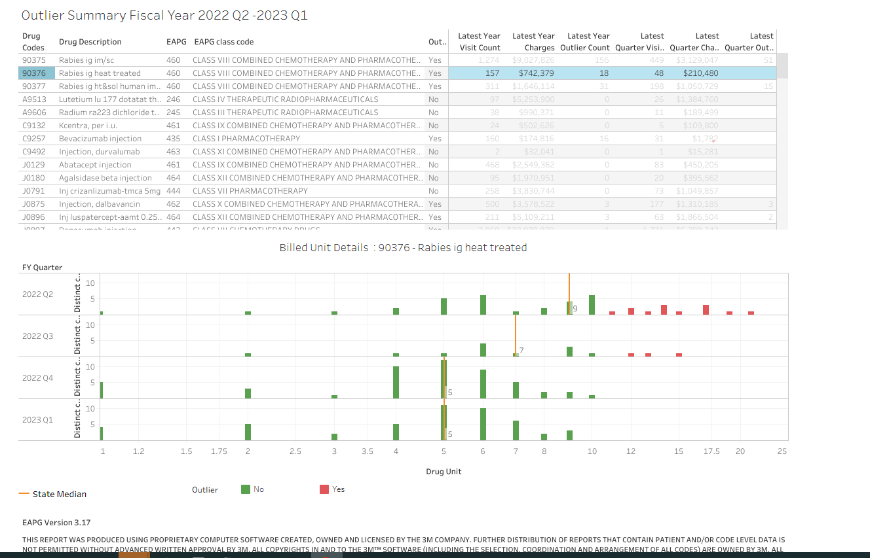
Reminder: CDS-A Reports on CRISP Portal
Provides hospitals with high-cost drug utilization for outlier dosage units based on 3rd Monthly case mix data
Information should used to correct errors prior to submission of Quarterly case mix data.
Hospitals can see which drugs’ units are outliers compared to the State average

Slide 47
Reminder: CDS-A Reports on CRISP Portal
CDS-A Audits starts with what is reported in the case mix data. If the case mix data has errors, the CDS-A data for the following year will have errors.
Hospitals are subject to fines if the case mix data used for CDS-A audits the following year contains errors.
For access to the CRISP portal, contact your CRS Portal Point of Contact or support@crisphealth.org

Slide 48
Reminder: Please Complete the Data Forum Survey!
Opportunity to provide feedback on
  Meeting logistics (meeting notice, registration, ease of participation)
  Topics covered during the prior meeting
  Topics for discussion for future meetings
After this Data Forum, participants will receive a link to a survey via Survey Monkey
Questions about the survey: contact hscrcteam@hmetrix.com

Slide 49
Data Processing Vendor Update

Slide 50
Points of Contact
HSCRC | hMetrix / Burton Policy
Oscar Ibarra Phone: (410) 764-2566 Email: oscar.ibarra@maryland.gov | Shivani Bhatt (Primary PoC) Phone: (484) 228-1453 Email: shivani@hmetrix.com
Curtis Wills Phone: (410) 764-2594 Email: curtis.wills@maryland.gov | Mary Pohl (Hospital Support) Phone: (410) 274-3926 Email: marypohl@burtonpolicy.com
Claudine Williams Phone: (410) 764-2561 Email: claudine.williams@maryland.gov | Team Email: hscrcteam@hmetrix.com
Notes:
Maria Manavalan will continue to be part of the project

Slide 51
Reminders
Production data
  Upload Case Mix (Inpatient, Outpatient and Psychiatric) files to the RDS server ‘submit’ folder
    These files are used for grouping and other downstream processes
  Upload UnCompensated Care (UCC) files to the RDS server ‘UCC’ folder
  Download error reports from https://hscrcdave1.hmetrix.com/
Test data
  Upload files to the RDS server ‘test’ folder - both Case Mix data as well as UCC files
  Available all the time for hospitals to test submissions
  Data is not used for downstream processes
  Download error reports from https://hdavetest.hmetrix.com/

Slide 52
Reminders
Financial Reconciliation Form
  Download from DAVE 2 days after the Quarterly case-mix submission deadline
EHR Survey Overdue Reminder
  Use the DAVE “EHR Survey” tab to update EHR system information every 6 months
DAVE User Management
  Reach out to the hMetrix Team to add new users or modify access
  A worksheet for each hospital/hospital system is maintained by hMetrix
  Update and return the user workbook to modify access

Slide 53
Rate Center Trend Monitoring Report

Slide 54
Rate Center Trend Monitoring Report
Objective
  Help hospitals identify unusual Rate Center Charges
  Enable timely resolution of potential issues during submission
Reason
  Several instances of delayed identification of incorrect Rate Center Charges
  Resulted in an expensive and undesired reopening of a closed quarter for resubmission
Timeline for implementation
  FY25 Q1 Final (October 1, 2024) onward a monitoring tab will be added to the error report
  Collect feedback via email in April 2025
  FY25 Q4 refine identification of unusual Rate Center Charges
  FY26 potential impact on error percentage

Slide 55
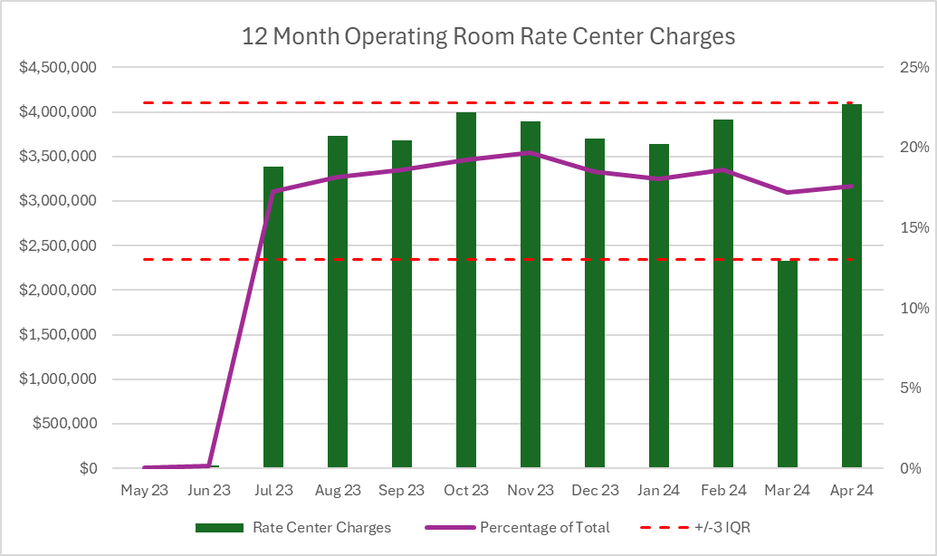
Total Charges & Rate Center Charges Outlier Identification
Identify Significant Rate Center
  The lookback period is 12 months
  > 5% utilization for more than half of lookback period
Outlier Identification
  Total Visit and Charges
    Current submission is outside +/- 1.5 IQR
  Rate Center Charges
    Current submission is outside +/- 3 IQR
Hospitals to review Outliers in
  Current reported month

Slide 56
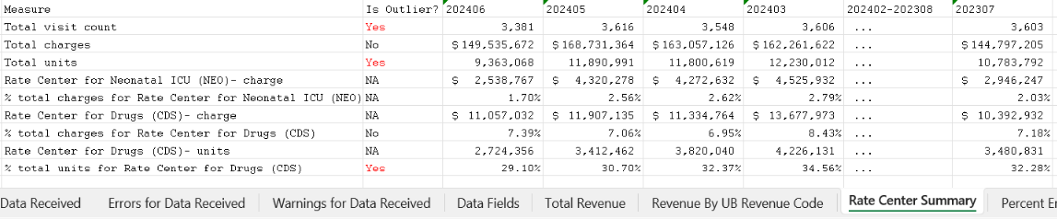
Monitoring Report Samples
A new tab “Rate Center Summary” will be added to the error report
  Total visit count, total charges, total units and all reported Rate center charges and units from the current and past 12 months will be available for review
  Outliers will be flagged based on the month reported in the file only
  The outlier is determined by using the percent of charges or unit. The exception to this rule is if the hospital has at least one rate center that is >65% of total charges, the outlier is determined by using the value of reported charges or units.

Slide 57
Data Repository Vendor Update

Slide 58
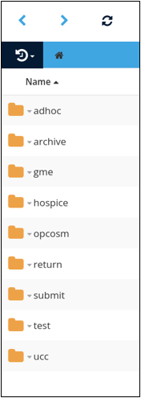
RDS Folder Structure
ADHOC
Submit files as requested by HSCRC or data processing vendor​
ARCHIVE
Record of files submitted
SPECIALITY FOLDERS
UCC, GME, Hospice, OPCOSM
RETURN
Files sent to end user​
SUBMIT
Submit FINAL data​
TEST
Submit TEST data​

Slide 59
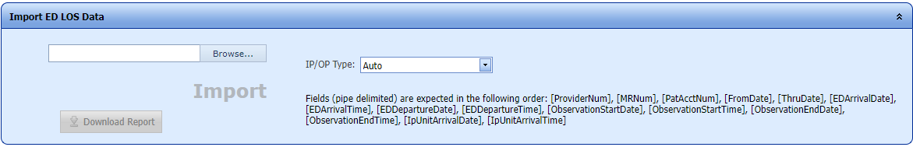
The St. Paul Group iSS ED LOS Update
St. Paul iSS ED LOS Ad-Hoc error report provides:
  Get instant error reports for ED LOS files to be submitted to HSCRC (IP/OP)
  Updates existing iSS IP/OP data to include ED LOS variables
  File should be in exactly the same format expected by HSCRC
  Should be used for updating/testing with existing data or "Patient key not found" error will occur

Slide 60
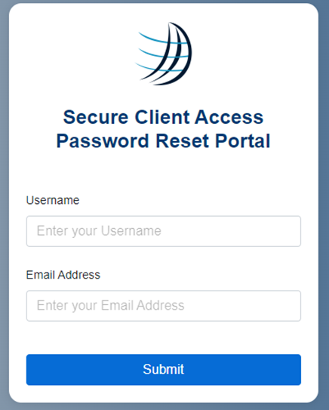
SCA Password Reset Portal and Contact Information
Password Reset Portal
HTTPS://PASSWORD.THESTPAULGROUP.COM
Enter USERNAME and EMAIL associated with account.
A secure email will be sent with a new password.
CONTACT INFORMATION:
St. Paul Operations
ops@thestpaulgroup.com

Slide 61
Case Mix Audit Update

Slide 62
Case Mix Audit Update
Advanta Government Services, LLC (AGS) has been awarded the contract for 2024-2029. AGS will review CY 2023 data from 12 inpatient or outpatient facilities and 6 target facilities (beginning in September 30).
Purpose: To evaluate the accuracy of the case mix data submitted to the Commission, which impacts hospital payment rates and performance-based payments.
Notification: Hospitals selected for audit will receive notification letters during the month of September.

Slide 63
Case Mix Audit Update, cont.
Review Types:
  General Review: A comprehensive audit covering a variety of inpatient, outpatient, and psychiatric cases submitted to the HSCRC.
  Targeted Review: Focused on specific inpatient, outpatient, or psychiatric cases of particular interest to the HSCRC, such as cases involving erroneous data or those with policy implications.
Audit Focus: Audits will primarily target data from acute care hospitals (inpatient & outpatient), psychiatric units, freestanding medical facilities (FMFs), emergency departments (ED), observation units, and labs.

Slide 64
Case Mix Audit Update, cont.
New
  ED times
  Reporting of SDOH diagnosis or missed SDOH diagnosis
  Psychiatric event reporting
Questions or concerns: Curtis Wills (curtis.wills@maryland.gov) or Brenda Watson (brendawatson@advantagovernmentservices.com).

Slide 65
FY 2025 DSR Updates

Slide 66
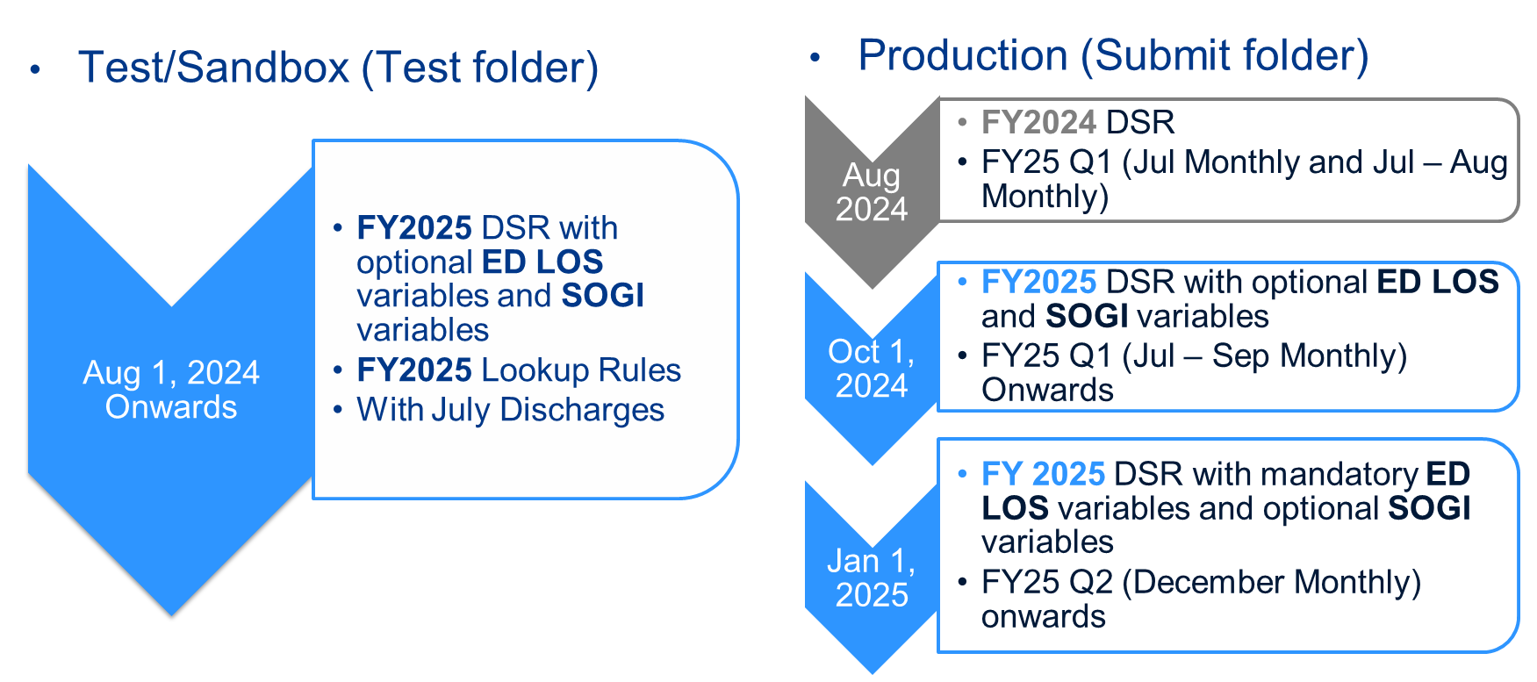
FY 2025 DSR Implementation Timeline

Slide 67
Upcoming Workgroup Meetings

Slide 68
Payment Models Workgroup
Objective: The Payment Models Workgroup develops recommendations for the HSCRC on the structure of payment models. This group focuses on balancing the approach to updates, addressing key topics such as Balanced Updates, Guardrails for Model Performance, Market Share, and Initial and Future Models.
Membership: The HSCRC has appointed a diverse group of experts to serve on the Payment Models Workgroup. A full list of members is available here: Payment Models Workgroup Appointments
Next Meeting: September 23, 2024 @ 1pm
For more information please visit the following website: https://hscrc.maryland.gov/Pages/hscrc-workgroup-payment-models.aspx

Slide 69
Performance Measurement Workgroup
Objective: The Performance Measurement Workgroup (PMWG) is responsible for evaluating measurement methodologies and recommending optimal approaches to the HSCRC. The goal is to identify measures that are reliable, informative, and practical for assessing hospital quality and safety. Membership: The HSCRC has appointed a diverse group of experts to serve on the PMWG. A comprehensive list of members can be accessed [here].
Next Meeting: For inquiries regarding the meeting schedule and location, please contact: hscrc.performance@maryland.gov
For more details, visit the HSCRC Performance Measurement Workgroup website at: https://hscrc.maryland.gov/Pages/hscrc-workgroup-performance-measurement.aspx

Slide 70
ED Measure and Incentive Methodology - Subgroup 2
Objective: To develop ED length of stay measure and incentive methodology for Rate Year 2026 Quality Based Reimbursement.
Membership: Those who are familiar with quality measurement, risk-adjustment, emergency department/hospital operations, and pay-for-performance/value-based payments.
Next Meeting: September 27, 2024 @ 10 am
For more information:
  https://hscrc.maryland.gov/Pages/ED-length-of-stay-workgroup.aspx

Slide 71
Next Meeting

Slide 72
Notes and slides will be posted to the
HSCRC website: https://hscrc.maryland.gov/Pages/hsp_info1.aspx
Next Meeting
FY 2025 Q2
December 13, 2025
Join Zoom Meeting
https://us06web.zoom.us/j/4107642605?pwd=MmVwREVMbFFYUzlCeWpJcFFZYWF5UT09&omn=85973965350
For Meeting ID and Passcode please contact Curtis Wills: curtis.wills@maryland.gov

Slide 73
Appendix 1: Quality Programs
Grouper Versions

Slide 74
Grouper Transition: MHAC, RRIP, QBR for CY 2023
Rate Year | RY2025
*3M APR/PPC Version | 40 (Updated from version 39 to incorporate annual 3M updates)
Timeline | Base Year: MHAC: CY 2020 Q3 – CY 2022 Q2 QBR-Mortality, All-payer PSI: CY 2021 Q3 – CY 2022 Q2 (FY 2022) RRIP: 2018; norms based on CY 2021 Performance Year: QBR HCAHPS, CDC NHSN measures: CY 2022 Q4- CY 2023 Q3, THA/TKA CMS defined 3-year period All Other Measures: CY 2023 (CY 2022-2023 for MHAC for small hospitals)
Implementation Date | RY 2025 policies begin Jan 1, 2023 in most cases. Look for base and performance period reports on the CRS Portal.
*The 3M ™ All Patient Refined DRG (APR DRG) Software and 3M ™ Potentially Preventable Complications (PPC) Software are proprietary products of 3M Health Information Systems.

Slide 75
Appendix 2: UCC Data
Collection Update

Slide 76
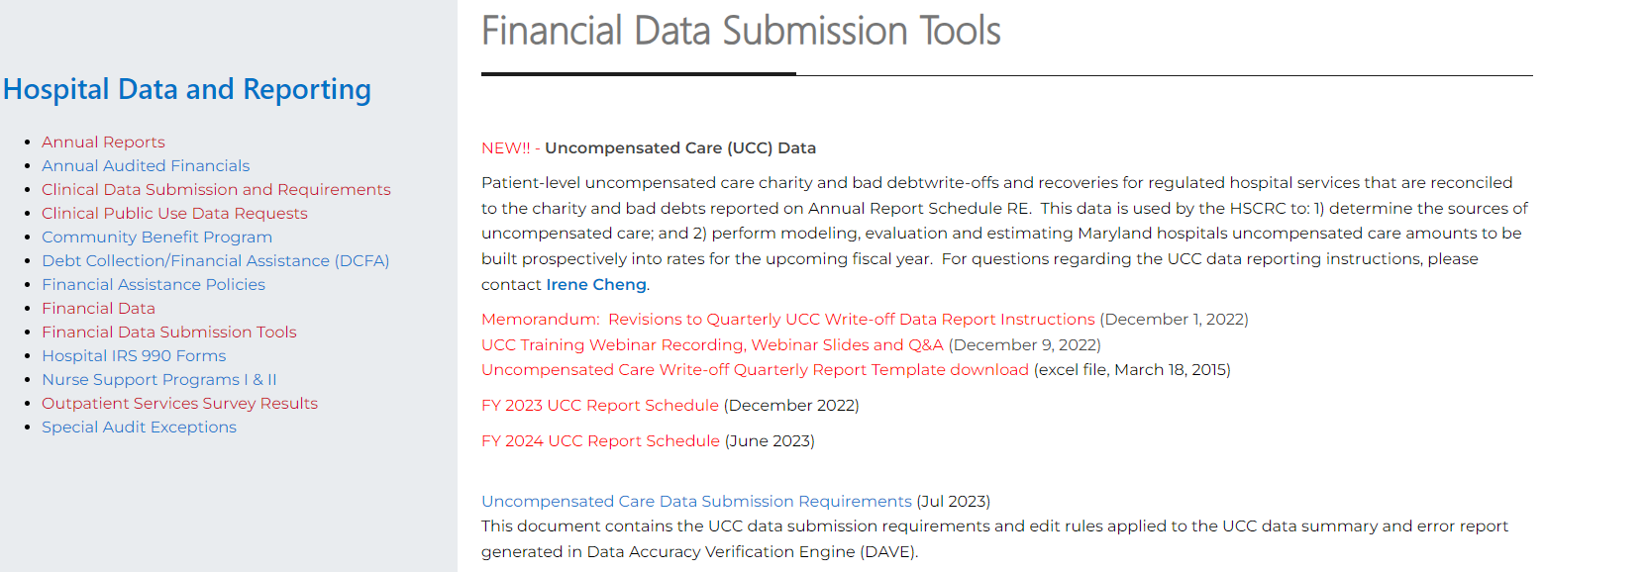
UCC Data Collection and Processing
FY23Q4 Data Submission: 55 reports received, 1 pending
FY24Q4 Data Submission: Jul 31 – Aug 29, 2024
FY25 UCC report submission schedule to be posted on the HSCRC Financial Data Submission Tools web page.
Notes:
The HSCRC is working with hMetrix to update the UCC file processing pipeline

Slide 77
UCC DSR and Edit Report Updates for FY 2024 Q3
Added new psychiatric hospital UM Upper Chesapeake Behavioral Health Pavilion
FY24Q3 UCC Data Edit Summary:
33 reports have < 1% error
15 reports have 1 - 1.99% error
6 reports have 2 - 2.99% error
1 reports with > 3% error rate had data validated and were manually passed
1 report to be submitted
Notes:
The HSCRC is working with hMetrix to update the UCC file processing pipeline

Slide 78
UCC Data: Notable Errors Observed in FY24Q3 Data Submission
Error | Notes | Percent of Records with Errors
Invalid or missing billed amount | This information might be unavailable for accounts that are old or transferred from another system | 0.02% of write-off records from 26 report files
Missing service date | Date should not be left blank | < 0.01% of write-off records
Missing expected payer | Text (e.g., n/a, unknown) is not valid; use code 99 if unknown | 0.01% of write-off records
UCC account with service date within the past 8 quarters not found in Case Mix tapes | This may happen if UCC write-off reported before discharge (not an error but report timing differences), old account reported with incorrect service date, non-regulated patient account that are not required to be reported, etc. | 0.32% of write-off records (excluding non-psych hospitals)
Mismatched UCC service date outside of the range of one day prior to Case Mix admission/from date and discharge/through date by 1 day, 2 - 30 days or > 30 days | This may happen if either the service date reported for UCC record or the service date reported in case mix is incorrect | 0.41% of write-off records. Error rate increased by 0.06% compared to 0.35% from FY24Q2.
Notes:
The HSCRC is working with hMetrix to update the UCC file processing pipeline

Slide 79
Points of Contact: UCC Data
HSCRC | hMetrix
Irene Cheng Email: Irene.Cheng@maryland.gov | DAVE Technical Support Email: hscrcteam@hmetrix.com
For questions regarding: Revised UCC reporting instructions UCC data edit rules UCC data quality Request report submission extension before due date (via DAVE) Request report data pass if error rate > 3% (via DAVE) Request report submission window be reopened to submit past due report (via DAVE) | For questions regarding: Access to edit reports and notification e-mail Filling the requests via DAVE

Slide 80
Appendix 3: FY2025 DSR Updates

Slide 81
FY 2025 DSR Updates
Add an error check for valid rate centers
  Error check to flag terminated or invalid rate centers (e.g.: Psychiatric ICU (PSI) and Free Standing ER Services (FSE)) - currently applied only to the Inpatient Psychiatric Data
  From FY 2025 onwards, this edit will be applied to all datasets (Inpatient, Outpatient and Psychiatric)
  The list of valid rate centers is available in the DSR
Add a new health plan payer for Out of State (non Maryland) Medicaid payers
  Code 129 (“OUT OF STATE (NON MARYLAND) MEDICAID PAYER”)
  A new error check: If the new payer code 129 is not reported with payer 06 ("OTHER GOVERNMENT PROGRAMS”)
Add a new error check for Type of Daily Service - Burn care (07)
  Type of Daily Service to used to identify burn cases that are excluded from financial methodologies.
  From FY 2025 onwards, Burn care will only be allowed to be reported by Johns Hopkins Bayview Medical Center (210029) for Burn trauma cases

Slide 82
FY 2025 DSR Updates (contd.)
Add an error check when terminated HCPCS code is reported
  HSCRC currently check if terminated CPT code is reported.
  From FY 25 onwards, an error check will be added if a terminated HCPCS code is reported.
  We will use the HCPCS/CPT termination date and compare it against the procedure date to flag the error.
New SOGI variables will be added
  The new variables will be added for testing from Aug 1, 2024. They will be included as optional variables in production run from FY 25 and will be mandatory from FY 26.
New ED LOS variables will be added
  Add date and timestamps and other needed variables to the monthly case-mix data. Hospital will be able to test it from Aug 1, 2024, and will be mandatory from Jan 1, 2025.
Updates to Accounting and Budgeting Manual Appendix D will be published
Rate Center Charge trend monitoring report
  New tab to be added to the Case Mix error report to help hospital identify variation in Rate Center Charges
  Details covered in later slides
Notes:
Ambulance run number warning is turned off

