Slide 1
FY 2023 Quarter 1 Data Forum
Please register for FY2023 Quarter 1 Data Forum Meeting at:
https://attendee.gotowebinar.com/register/4353433151100808204
After registering, you will receive a confirmation email containing information about joining the webinar.
September 9, 2022
@10:00 AM

Slide 2
Why, When, Where
WHY?
Open and ongoing communication between HSCRC & industry
Forum to ask questions about data (case mix and financial)
Sharing of best practices
WHEN?
10:00 am - 12:00 pm
FY 2023 Dates:
September 9, 2022
December 16, 2022
March 10, 2023
June 9, 2023
WHERE?
via Webinar (link is sent the day before the meeting)

Slide 3
Agenda
Announcements
Case Mix Weights and Grouper Transition Update (Denise/Dianne)
Quality Update (Dianne)
New ED Triage Edit (Claudine)
Reminders (Oscar)
Data Requests Moratorium
Expected Payer Codes for UCC
CDS-A Report and Timeline for 2021/2022 Audits
FY 2023 DSR Implementation Timeline
Data Forum Survey
UCC Data Collection Update (Irene)
Discussion on Gender-related Data (Claudine)
Data Processing Vendor Update (Mary Pohl, hMetrix/Burton Policy)
Case Mix Review Vendor Update (Brenda Watson, AGS, LLC)
Data Repository Vendor Update (Jen Vogel, SPG)
Next Meeting (Kai)

Slide 4
Grouper Transition: Case Mix Weights
Rate Year | RY 2023 | RY 2024
APR/EAPG Version | IP Weights: 37.1 OP Weights: 3.15 | IP Weights: 38 OP Weights: 3.16
Data Period Used | IP: CY 2019 (12 Months) OP: CY 2019 and Q1 of CY 2020 (15 Months) | IP: CY 2019 (12 Months)*** OP: CY 2019 and Q1 of CY 2020 (15 Months) ***
Implementation Date | July 2022 | July 2023
Number of Diagnosis/Procedure Codes Used | IP: Up to 30 procedure and diagnosis codes (primary and 29 secondary) OP OBS > 23 hrs (with IP): Up to 50 diagnosis codes (primary and 49 secondary) all procedure codes reported in Type III record OP: Primary diagnosis code and all procedure codes reported in Type III record
*** Staff will continue to use CY 2019 as the base for setting weights until such a time when new CY data proves viable for weight calculations
FY 2022 weights are posted on the HSCRC website. 3M made a multitude of changes to its grouper which had unforeseen consequences on the weights. HSCRC will create and post a de-identified dataset (with programs) for parties interested in recreating the weight calculations. Please submit a request to hscrc.data-requests@maryland.gov.

Slide 5
Grouper Transition: Market Shift – Rate Year 2024
 | Temporary Market Shift (Jan – Jun) | Full Year Market Shift (Jan – Dec)
APR/EAPG Version | APR: 38 EAPG: 3.16 | APR: 38 EAPG: 3.16
Data Period Used: Base Period Performance Period | January – June 2021 January – June 2022 | January – December 2019 January – December 2022
Implementation Date | January 2023 | July 2023
Number of Diagnosis/Procedure Codes Used | IP: Up to 30 procedure and diagnosis codes (principal and 29 secondary) OP Observation cases >23 hrs (with IP): Up to 50 diagnosis codes (principal and 49 secondary) OP: Primary diagnosis code and all procedure codes reported in Type III record

Slide 6
Grouper Transition: MHAC, RRIP, QBR for CY 2022
Rate Year | RY2024
APR/PPC Version | 39 (Updated from version 38 to incorporate annual 3M updates)
Timeline | Base Year: MHAC: CY 2020 Q3–CY 2021 Q4 QBR-Mortality: CY 2020 Q3–CY 2021 Q2 (FY 2021) RRIP: CY 2020 Q3–CY 2021 Q2 (FY 2021) Performance Year: All Programs: CY 2022 (longer timeframe for MHAC for small hospitals TBD) RY 2023 and COVID: Current policies will include COVID patients with concurrent normative values, subject to 3M grouper logic (e.g. 3M’s v39 PPC grouper will not assign many PPCs to COVID positive patients); this decision will be evaluated retrospectively.
Implementation Date | RY 2024 policies begin Jan 1, 2022 in most cases. Look for base period and performance period reports on the CRS Portal.

Slide 7
Quality Update: Additional Topics
For RY 2023, CMS finalized putting VBP and HAC programs on hold
Maryland previously stated we will hold QBR and MHAC hospital adjustments until January 2023 but may request to suspend program adjustments in light of final determination of suspensions for national programs.
COVID impact will be evaluated retrospectively for RY 2024 (CY 2022 performance)
This evaluation will take place iteratively with the Performance Measurement Work Group
Quality is pursuing the following additional areas of quality of care (more to come)
Electronic Clinical Quality Measures (eCQMs) or other digital measures – please see HSCRC memo dated 09/27/2021
Planned Monitoring Reports – Timely Follow-up for Medicaid (implemented); Maternal Morbidity; 30-day Mortality; Excess Days in Acute Care (EDAC)
Health Equity Workgroup (HEW) convened this summer to establish framework for hospital equity measurement; Social determinants of Health (SDoH) data elements; additional reporting of aggregated trends in SDoH to address health disparities
Outpatient Quality measures, particularly shifts from IP to OP care

Slide 8
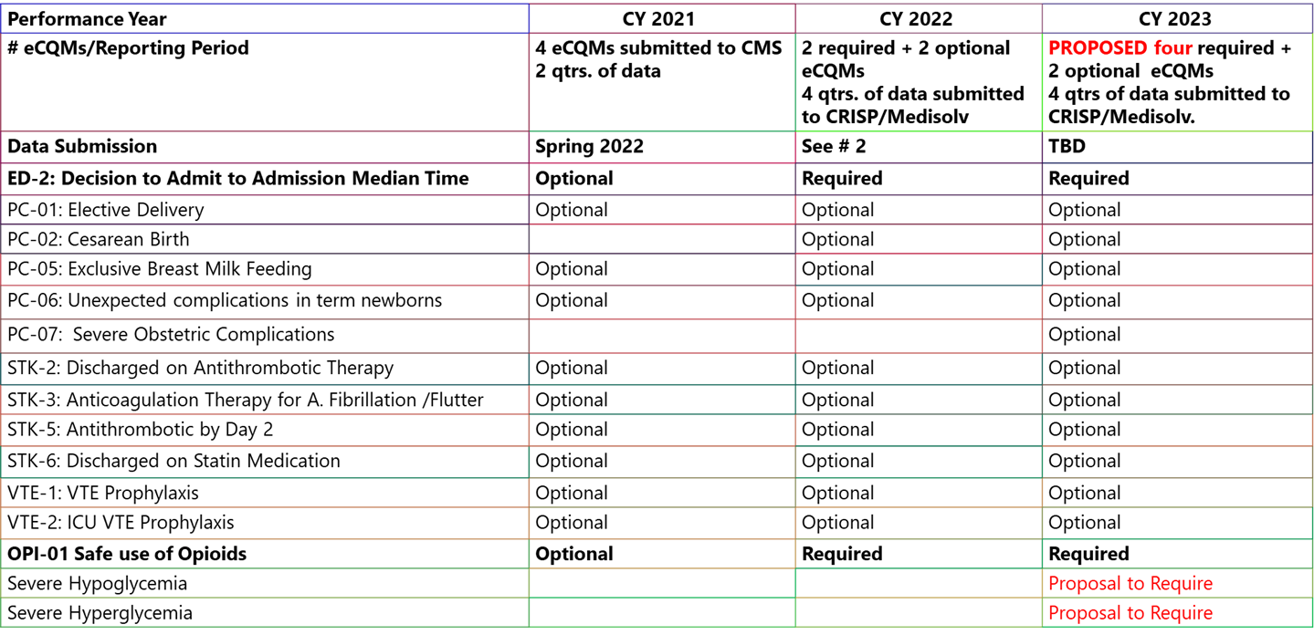
Quality Update: eCQM Measures by Year

Slide 9
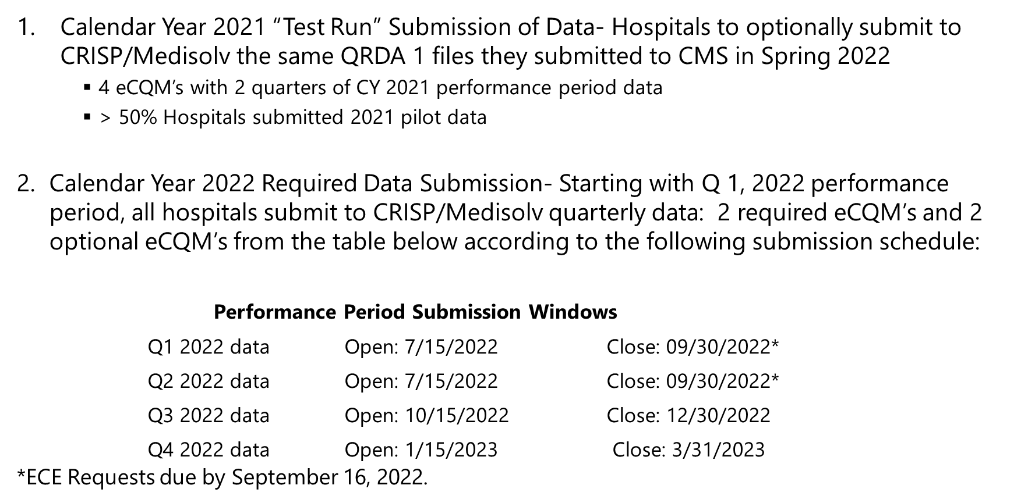
Quality Update: eCQM Reporting Timeline

Slide 10
NEW: ED Triage Data Validation
HSCRC added ED Triage variables to the outpatient data submission requirements effective CY 22
HSCRC will introduce data validation for these fields
Variable ED Triage 1 or ED Triage 2 must be populated for >= 99% of ED visits
ED visits are identified using the logic “EMG rate center charges > 0”
Warning for all submissions after Oct 1, 2022 (FY 23 Sept Preliminary data)
Converts to errors for all submissions on March 1, 2023 (FY 23 Feb Preliminary data)
Please send questions to hscrc.quality@maryland.gov

Slide 11
Reminder: Data Request Processing Delays and Abortion Cases
Data Request Delays
All new or revised DUAs must undergo additional review by MDH Strategic Data Initiative (SDI) Team and can take up to 60 days, in addition to the usual HSCRC and MDH IRB (if applicable) review
Best Advice: Submit requests early and be patient
Elective Abortion Records in Case Mix Data
Due to the heightened sensitivity around claims for elective abortions, particularly for out-of-state patients who receive care and the providers from whom they received abortion services, the HSCRC will be restricting disclosure of claims related to elective abortion cases beginning in FY 2023.
This policy will also be applied to new requests for data prior to FY 2023.

Slide 12
Reminder: Expected Payer Codes for UCC & Denials Quarterly Report
Use the New Primary Payer Codes for UCC and Denial data with service dates in FY22 and beyond
Combine
Blue Cross (04), HMO (12), Blue Cross National Capital Area (16),Blue Cross –Other State (17) with Commercial Insurance (05)
Title V (03) with Other Government Programs (06)
Donor (11) with Other (10)
Add
Behavioral Health Plans (19)
Valid Primary Payer Codes (since FY 2022)
Code Description
01 MEDICARE FFS
02 MD MEDICAID FFS AND PENDING MD MEDICAID
05 COMMERCIAL INSURANCE HMO/POS/PPO/PPN/TPA
06 OTHER GOVERNMENT PROGRAMS
Usage Notes: Report Out-of-State (non-MD)
Medicaid, Tri-Care, Champs and Title under this
category
07 WORKMEN'S COMPENSATION
08 SELF PAY
09 CHARITY (PATIENT WAS NOT CHARGES FOR CARE)
10 OTHER (INCLUDES GRANT FUNDED, DONOR)
14 MD MEDICAID MCO
15 MEDICARE ADVANTAGE
18 INTERNATIONAL INSURANCE
19 BEHAVIORAL HEALTH PLAN (NEW)
99 UNKNOWN

Slide 13
Reminder: CDS-A Reports Available on CRISP Portal
Purpose: to review hospital-level high-cost drug utilization for outlier dosage units based on 3rd Monthly case mix data
Information should used to correct errors prior to submission of Quarterly case mix data
CDS-A Audits starts with what is reported in the case mix data. If the case mix data has errors, the CDS-A data for the following year will have errors.
For access, contact your CRS Portal Point of Contact or support@crisphealth.org

Slide 14
Timeline: CDS-A Audit for FY 2022
September 23, 2022 | Hospitals receive final drug list and CDS-A Audit template for 2021/2022
October 21 2022 | Completed template due to HSCRC
October 21-December 23, 2022 | HSCRC staff completes audits and provides hospitals with results.
Hospitals will be subject to fines if any material error is found their FY 2022 CDS-A audit.

Slide 15
Reminder: FY 2023 DSR Implementation Timeline
Test/Sandbox
Production
FY2022 DSR
FY23 Q1 (Jul Monthly)
FY2023 DSR
FY2023 Lookup Rules
With July Discharges
Use test folder
Aug 2022
Aug 1, 2022 Onwards
FY2022 DSR
FY23 Q1 (Jul – Aug Monthly)
Sep 2022
FY2023 DSR
FY23 Q1 (Jul – Sep Monthly) Onwards
Oct 1, 2022

Slide 16
Reminder: Please Complete the Data Forum Survey!
Opportunity to provide feedback on
Meeting logistics (meeting notice, registration, ease of participation)
Topics covered during the prior meeting
Topics for discussion for future meetings
After this Data Forum, participants will receive a link to a survey via Survey Monkey
Questions about the survey: contact hscrcteam@hmetrix.com

Slide 17
UCC Data Collection Update

Slide 18
Improved UCC Data Collection and Processing
HSCRC is working with hMetrix to improve the UCC data processing
Improved features in DAVE
Manage and track tasks
Reminders and notifications
Automated error report generation
Advantages of the new system
Timely data processing
Offers an opportunity for hospitals to correct errors
Standardized data
Uses the same system as the Case Mix data
Details to be provided at the next quarterly data forum
Notes:
The HSCRC is working with hMetrix to update the UCC file processing pipeline

Slide 19
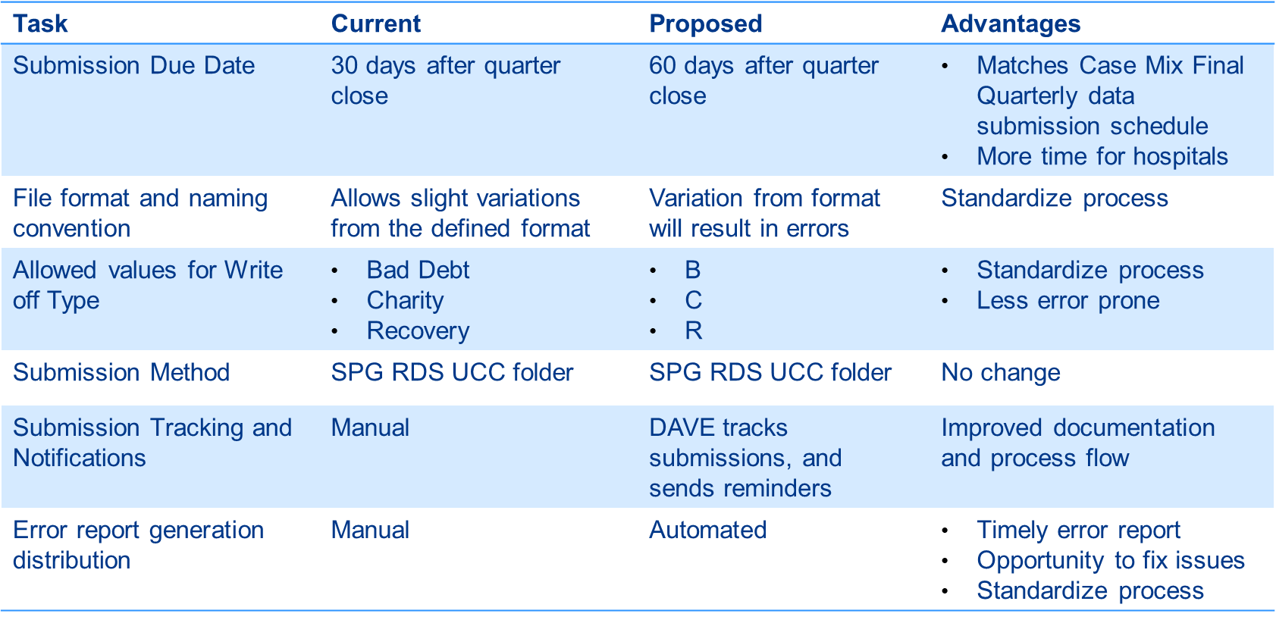
Proposed Changes to UCC Data Collection, Effective FY 2023 Q2

Slide 20
Discussion: Gender-related Data

Slide 21
Proposed Update to Collecting Sex and Gender-related Data
HSCRC proposes a review of the reporting of Gender in Case Mix data
The HL7 Gender Harmony Project is proposed as a potential best practice for the collection of Gender data
Update the definition of “Sex” Variable in DSR to “Sex for Clinical Use” as defined by the HL7 Gender Harmony Project
HSCRC seeks feedback from the Industry

Slide 22
HL7 Gender Harmony Project
A collective, collaborative, international effort to help fulfill health care’s responsibility to gender-marginalized people by specifying gender-inclusive standards that can be used by systems and clinicians in the provision of affirmative and quality person-centered care
Developed via an American National Standards Institute (ANSI)-certified collaborative balloted process based on work of the gender harmony project led by the HL7 Vocabulary Work Group.
The Model has five major elements independent of other components that may also be part of the information model for a person:
Gender Identity
Sex for Clinical Use
Recorded Sex
Name to Use
Patient Pronoun
Notes:
The GHP used a consensus-based, expert-driven approach to specify the data elements, value sets, element attributes, and use cases, which have been integrated into a harmonious logical model outlined in an HL7 informative ballot.

Slide 23
Sex for Clinical Use - Definition
Sex for Clinical Use (SFCU) is a categorization that
supports context specificity,
derived from observable information (e.g., Clinical observation, Radiology report, Lab report, Genetic testing)
directly linked to the information this element summarizes (such as a comment or a linked data observation) to clarify the context and resulting value
The SFCU value is not defined for use outside of a specific clinical context and should never be used as a label for the patient as a whole.
Because the SFCU is context-specific, on rare occasions there may be more than one concurrent SFCU for a patient
Notes:
This element is intended to characterize observations that align with or vary from female or male when the observation(s) are intended for use in a clinical activity. Examples of clinical observation that may be used to determine a value are karyotype, phenotype, sex from imaging, hormonal values, organ inventory, certain surgical procedures, genetic observations, external genital morphology and internal organ morphology.
For example, there could be multiple procedure results, each identifying a context specific SFCU determination used to set the normal range used. For example, an SFCU value and linked comment or specific observation could be summarized as “male, based on hormonal measurement.”
Values:Female: The “female” values apply to this patient, in the case of a given procedure or process in each context, for instance for a procedure, algorithm, hormone level, organ inventory, etc.
Male: The “male” values apply to this patient, in the case of a given procedure or process in each context, for instance for a procedure, algorithm, hormone level, organ inventory, etc.
Specified: This patient has specific documented characteristics that do not fully match either male or female in each context, for instance for a procedure, algorithm, hormone level, organ inventory, etc.
Unknown: The SFCU cannot be determined because there are no observations, or the observations are not sufficient to determine a value. For example, an emergency trauma case may require treatment before SFCU can be established.

Slide 24
Sex for Clinical Use - Proposed Codes
Current Codes in DSR | Proposed Codes and Definitions
Female | Female: The “female” values apply to this patient, in the case of a given procedure or process in each context, for instance for a procedure, algorithm, hormone level, organ inventory, etc.
Male | Male: The “male” values apply to this patient, in the case of a given procedure or process in each context, for instance for a procedure, algorithm, hormone level, organ inventory, etc.
 | Specified*: This patient has specific documented characteristics that do not fully match either male or female in each context, for instance for a procedure, algorithm, hormone level, organ inventory, etc.
Unknown | Unknown: The SFCU cannot be determined because there are no observations, or the observations are not sufficient to determine a value. For example, an emergency trauma case may require treatment before SFCU can be established.
*3M groupers do not support an option for “Specified” sex, hense these responses will be mapped to “Unknown”
Notes:
This element is intended to characterize observations that align with or vary from female or male when the observation(s) are intended for use in a clinical activity. Examples of clinical observation that may be used to determine a value are karyotype, phenotype, sex from imaging, hormonal values, organ inventory, certain surgical procedures, genetic observations, external genital morphology and internal organ morphology.
For example, there could be multiple procedure results, each identifying a context specific SFCU determination used to set the normal range used. For example, an SFCU value and linked comment or specific observation could be summarized as “male, based on hormonal measurement.”
Values:Female: The “female” values apply to this patient, in the case of a given procedure or process in each context, for instance for a procedure, algorithm, hormone level, organ inventory, etc.
Male: The “male” values apply to this patient, in the case of a given procedure or process in each context, for instance for a procedure, algorithm, hormone level, organ inventory, etc.
Specified: This patient has specific documented characteristics that do not fully match either male or female in each context, for instance for a procedure, algorithm, hormone level, organ inventory, etc.
Unknown: The SFCU cannot be determined because there are no observations, or the observations are not sufficient to determine a value. For example, an emergency trauma case may require treatment before SFCU can be established.

Slide 25
Next Steps
Convene a workgroup to discuss potential revision of Sex variable
Also consider other Sexual Orientation and Gender Identity variables
Reach consensus on definitions and timeline
Bring recommendations back to industry at a future Data Form
If you are interested in participating in the workgroup, contact Oscar Ibarra (Oscar.Ibarra@maryland.gov).
Notes:
This element is intended to characterize observations that align with or vary from female or male when the observation(s) are intended for use in a clinical activity. Examples of clinical observation that may be used to determine a value are karyotype, phenotype, sex from imaging, hormonal values, organ inventory, certain surgical procedures, genetic observations, external genital morphology and internal organ morphology.
For example, there could be multiple procedure results, each identifying a context specific SFCU determination used to set the normal range used. For example, an SFCU value and linked comment or specific observation could be summarized as “male, based on hormonal measurement.”
Values:Female: The “female” values apply to this patient, in the case of a given procedure or process in each context, for instance for a procedure, algorithm, hormone level, organ inventory, etc.
Male: The “male” values apply to this patient, in the case of a given procedure or process in each context, for instance for a procedure, algorithm, hormone level, organ inventory, etc.
Specified: This patient has specific documented characteristics that do not fully match either male or female in each context, for instance for a procedure, algorithm, hormone level, organ inventory, etc.
Unknown: The SFCU cannot be determined because there are no observations, or the observations are not sufficient to determine a value. For example, an emergency trauma case may require treatment before SFCU can be established.

Slide 26
Data Processing Vendor Update

Slide 27
Points of Contact
HSCRC | hMetrix / Burton Policy
Claudine Williams Phone: (410) 764-2561 Email: claudine.williams@maryland.gov | Shivani Bhatt (Primary PoC) Phone: (484) 228-1453 Email: shivani@hmetrix.com
Oscar Ibarra Phone: (410) 764-2566 Email: oscar.ibarra@maryland.gov | Mary Pohl (Hospital Support) Phone: (410) 274-3926 Email: marypohl@burtonpolicy.com
 | Team Email: hscrcteam@hmetrix.com
Notes:
Maria Manavalan will continue to be part of the project

Slide 28
Reminders
Production data
Upload files to the RDS server ‘submit’ folder
These files are used for grouping and other downstream processes
Download error reports from https://hscrcdave1.hmetrix.com/
Test data
Upload files to the RDS server ‘test’ folder
Available all the time for hospitals to test submissions
Data is not used for downstream processes
Download error reports from https://hdavetest.hmetrix.com/

Slide 29
Roadmap for Continuous Improvements to DAVE
CY22 Q3
Jul – Sep
Improvements to Data Processing and FY23 DSR deployment
UCC data processing development
Data request module deployment
CY22 Q4
Oct – Dec
Error report improvement to include trends
UCC data processing parallel run
HSCRC monthly and quarterly process review
CY23 Q1
Jan – Mar
Improvements to Data Processing
UCC data processing deployment
HSCRC monthly and quarterly process improvement

Slide 30
Case Mix Review Vendor Update

Slide 31
Point of Origin and Discharge Disposition Definitions
Point of Origin - defined as the patient’s immediate location before arriving at the hospital, hospital’s emergency department, or another point of entry
Discharge Disposition – discharge is when a patient leaves the hospital after receiving treatment or expires. Where the patient is going after the encounter is represented with a code to identify what type of facility or where the patient is discharged.

Slide 32
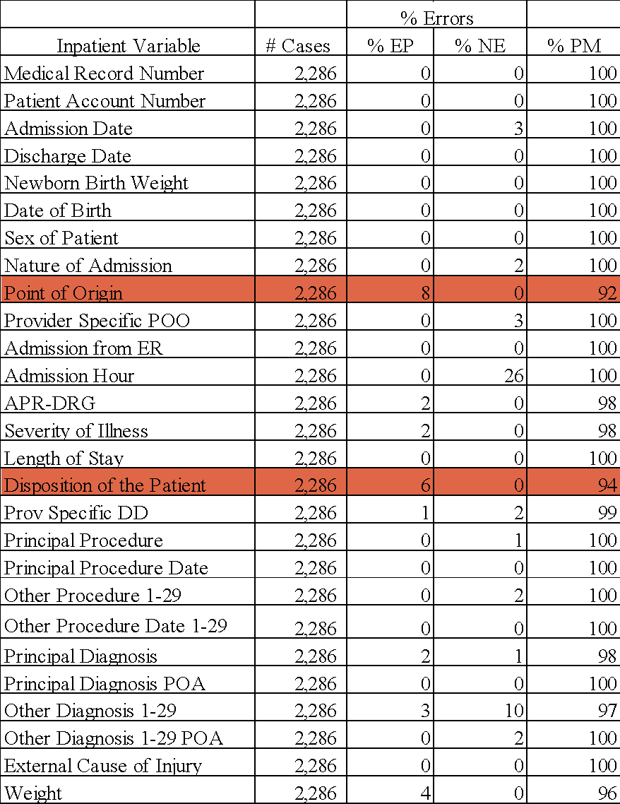
FY 2021 Overall Inpatient Variable Profile
EP = Essential Performance errors with the potential to impact payment.
NE = Non-Essential errors without impact on payment.
PM = Performance Measure representative of cases with no errors or non-essential errors.

Slide 33
FY 2021 Inpatient Variable-Specific Performance Among Hospitals
H
o
s
p
i
t
a
I
l
A
T
n
p
a
t
i
e
n
t
C
a
t
e
g
o
r
y
#
3
1
#
3
2
#
3
3
#
3
4
#
3
5
#
3
6
#
3
7
#
3
8
#
3
9
#
4
0
5
0
t
h
7
5
t
h
9
0
t
h
S
O
A
?
P
B
l
l
S
a
m
p
l
e
s
8
6
8
8
7
2
7
8
8
7
8
7
9
1
8
7
9
2
7
3
8
7
8
9
9
2
8
8
9
R
5
a
n
d
o
m
&
F
o
c
u
s
e
d
9
8
9
7
9
7
9
6
9
7
9
8
9
8
9
9
9
8
1
0
0
9
8
9
8
1
0
0
9
4
9
A
P
R
5
-
D
R
G
9
9
9
5
8
2
9
0
9
8
9
2
9
6
9
6
9
7
9
6
9
6
9
7
9
9
9
0
9
D
5
i
s
p
o
s
i
t
i
o
n
o
f
P
a
t
i
e
n
t
1
0
0
9
9
9
6
1
0
0
1
0
0
1
0
0
1
0
0
1
0
0
1
0
0
1
0
0
1
0
0
1
0
0
1
0
0
9
4
9
P
5
r
o
v
.
S
p
e
c
i
f
i
c
D
D
9
8
9
4
9
7
9
4
9
5
9
6
9
7
9
8
9
6
9
6
9
6
9
7
9
8
9
4
9
W
e
5
i
g
h
t
Red is >1, Yellow is <= 1 standard deviation from the PB, Green is at or above the PB.
AT = Achievement Threshold representing the 50th (median), 75th and 90th percentile of hospital performance.
SO↓ = Statistical Outlier representing one standard deviation from the PB.
EP = Essential Performance errors with potential to impact payment.
NE = Non-Essential errors without impact on payment.
PM = Performance Measure representative of cases with no errors or non-essential errors.
PB = Performance Benchmark frame of reference for expected case-level accuracy regarding payment impact.

Slide 34
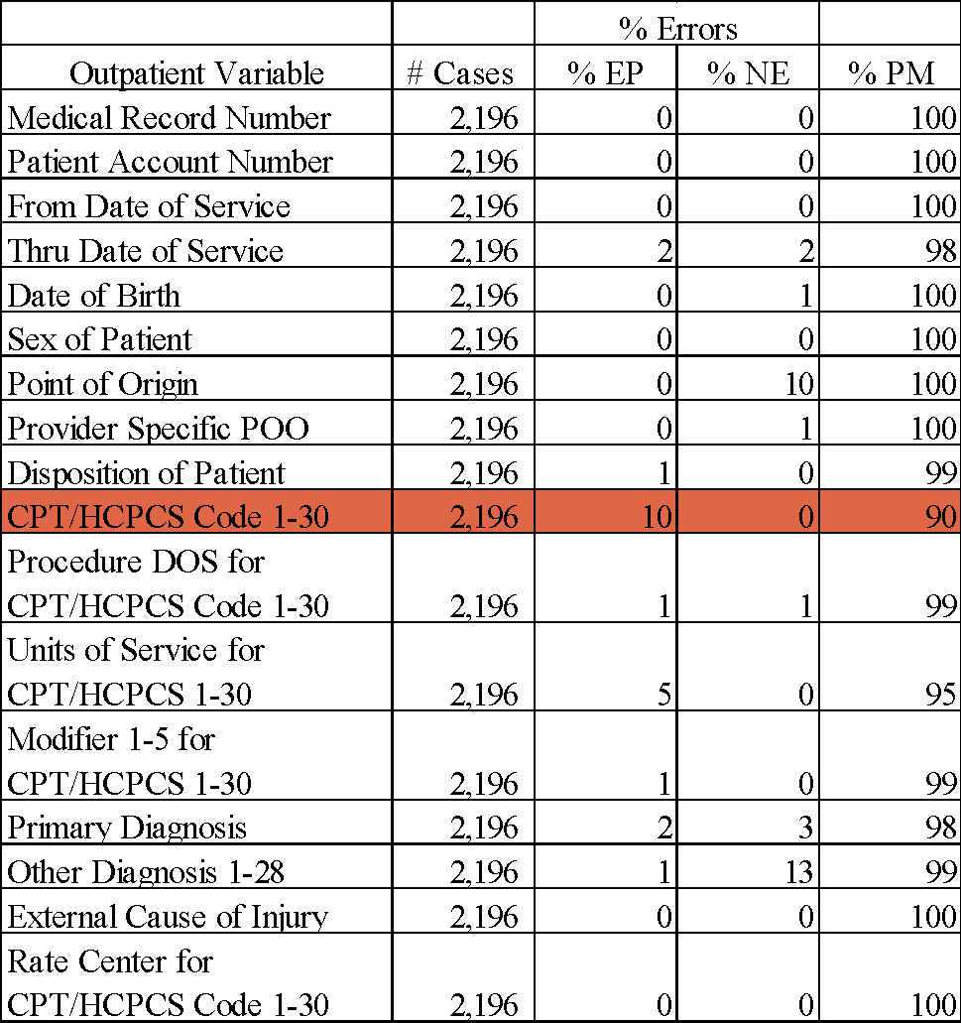
FY 2021 Overall Outpatient Variable Profile
EP = Essential Performance errors with the potential to impact payment.
NE = Non-Essential errors without impact on payment.
PM = Performance Measure representative of cases with no errors or non-essential errors.

Slide 35
FY 2021 Outpatient Variable-Specific Performance Among Hospitals
H
o
s
p
i
t
a
O
l
A
T
u
t
p
a
t
i
e
n
t
C
a
t
e
g
o
r
y
#
3
1
#
3
2
#
3
3
#
3
4
#
3
5
#
3
6
#
3
7
#
3
8
#
3
9
#
4
0
5
0
t
h
7
5
t
h
9
0
t
h
S
O
A
?
P
B
l
l
S
a
m
p
l
e
s
9
3
6
3
7
1
8
5
8
5
9
2
8
1
8
3
8
4
8
4
8
4
8
7
9
3
8
6
9
R
5
a
n
d
o
m
&
F
o
c
u
s
e
d
9
5
6
5
8
2
9
4
9
3
9
8
9
5
9
5
9
0
9
4
9
4
9
5
9
8
8
5
9
C
5
P
T
9
8
9
5
7
7
9
4
9
7
9
8
9
7
9
7
9
5
9
6
9
7
9
7
9
8
8
9
9
U
5
n
i
t
s
9
9
1
0
0
9
9
1
0
0
9
9
9
8
1
0
0
1
0
0
1
0
0
1
0
0
1
0
0
1
0
0
1
0
0
9
4
9
M
o
d
5
i
f
i
e
r
s
1
0
0
1
0
0
9
7
9
9
9
6
9
9
1
0
0
1
0
0
1
0
0
9
9
1
0
0
1
0
0
1
0
0
9
4
9
D
5
i
s
p
o
s
i
t
i
o
n
o
f
P
a
t
i
e
n
t
Red is >1, Yellow is <= 1 standard deviation from the PB, Green is at or above the PB.
AT = Achievement Threshold representing the 50th (median), 75th and 90th percentile of hospital performance.
SO↓ = Statistical Outlier representing one standard deviation from the PB.
EP = Essential Performance errors with potential to impact payment.
NE = Non-Essential errors without impact on payment.
PM = Performance Measure representative of cases with no errors or non-essential errors.
PB = Performance Benchmark frame of reference for expected case-level accuracy regarding payment impact.

Slide 36
Review of Residence Zip Code & Homeless
Residence Zip Code & Homeless
In each case where the patient was homeless, the zip code field was assessed on whether zip code 88888 or the hospital’s zip code and if the Z59.0 was used.
36 cases had documentation that the patient was homeless
6 cases (17%) reported 88888 zip code
32 cases (89%) reported Z59.0 homeless

Slide 37
COVID-19 Case Review
97% inpatient COVID-19 diagnosis accuracy
Discrepancies were due to re-sequencing COVID-19 to the principal diagnosis, and COVID-19 diagnosis was reported without supporting documentation
95% outpatient COVID-19 diagnosis accuracy
Discrepancies were due to re-sequencing COVID-19 as the primary diagnosis, and COVID-19 was reported as an acute condition when the patient had a history of COVID-19.

Slide 38
Proposed Future Changes to Case Mix Review
Inclusion on freestanding/specialty hospitals
Potential additional sources of information for review (i.e., lab results in CRISP)
Increasing the number of facilities reviewed b per year

Slide 39
Data Repository Vendor Update

Slide 40
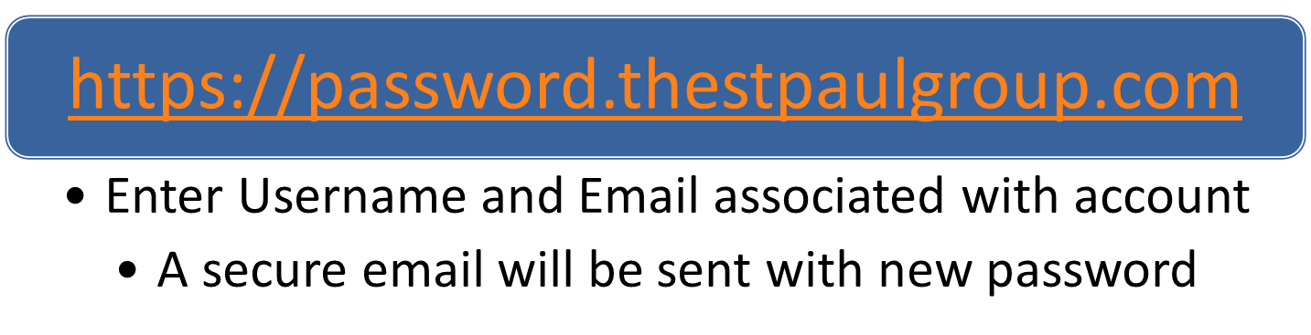
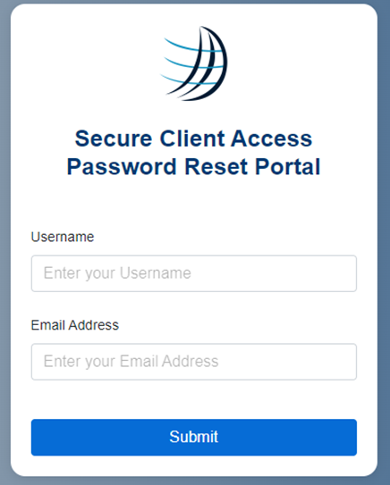
SCA Password Reset Portal

Slide 41

RDS Questions

Slide 42
Next Meeting

Slide 43
Notes and slides will be posted to the HSCRC website: https://hscrc.maryland.gov/Pages/hsp_info1.aspx Next Meeting FY 2023 Q2 December 16, 2022

Slide 44
Appendix: DSR Updates for FY 2023

Slide 45
Updates to the FY 2023 DSR Since Q3 Data Forum
Tertiary Payer Variable (NEW)
Previously proposed to remove tertiary payer variables
FY 2023 Change: Retain these variables to aid in identifying Kaiser patients
Kaiser Flag (NEW)
Intend to capture any Kaiser patient (Y/N)
FY 2023 Change: Add Kaiser Flag variable
New Cross Edit Error: if primary/secondary/tertiary plan payer is NOT 107 and Kaiser_flag = Y and vice versa
Type of Daily Service - Shock Trauma (02) (NEW)
Intended to capture admissions only to UM Shock Trauma
Admissions for the 8 MIEMSS-Designated Trauma Centers are already flagged using the IP Reserve Flag
FY 2023 Change: Remove code

Slide 46
Updates to the FY 2023 DSR Since Q3 Data Forum
Outpatient Date of service check for COVID testing (NEW)
CPT/HCPCS codes used to identify the COVID testing procedures are updated. The date of service for these codes can be +/- 5 days from the Thru date and From date.
A new tab added for the latest COVID testing codes. Please see next slide for the codes
Outpatient Date of Service (NEW)
Previously +/-2 days grace period was given for the outpatient services.
New Warning: If the date of service for procedure OTHER than COVID tests are NOT within the Thru date and from date
This warning will be converted to error on 1/1/2023
Hospitals with Licensed Hospice Beds Added to the DSR (NEW)
List used in data edits for Type of Daily Service variable
Existing Error: if value = 10 and Hospital does not have a HSCRC-approved Hospice contract for care

Slide 47
COVID Testing Codes
Updated on 5/10/2022
Immunology | Microbiology | Proprietary Laboratory Analyses | HCPCS codes
86317 | 87250 | 0202U | J0248
86318 | 87255 | 0223U | M0201
86328 | 87301 | 0224U | Q0220
86408 | 86328 | 0225U | Q0221
86409 | 87426 | 0226U | M0220
86413 | 87428 | 0240U | M0221
86602 | 87635 | 0241U | Q0222
86635 | 87636 |  | M0223
86769 | 87637 |  | Q0249
 | 87811 |  | M0249
 |  |  | M0250
 |  |  | U0001
 |  |  | U0002
 |  |  | U0003
 |  |  | U0004
 |  |  | U0005
 |  |  | C9803

Slide 48
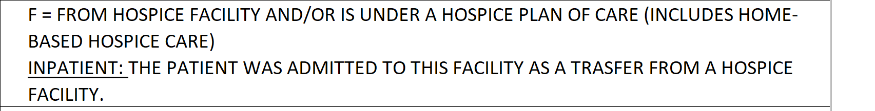
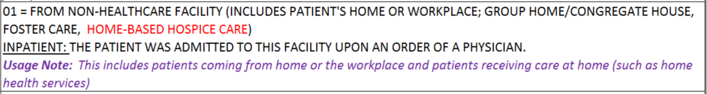
Updates to the FY 2023 DSR Since Q3 Data Forum
Point of Origin Code for Home Hospice
Currently coded as F (FROM HOSPICE FACILITY AND/OR IS UNDER A HOSPICE PLAN OF CARE (INCLUDES HOME-BASED HOSPICE CARE)
In FY 2019, HSCRC convened a workgroup to update and streamline the reporting of source of admission. The workgroup revised the code for Home Hospice to 01 (FROM NON-HEALTHCARE FACILITY (INCLUDES PATIENT'S HOME OR WORKPLACE; GROUP HOME/CONGREGATE HOUSE, FOSTER CARE). This code applies to patients receiving care at home.
FY 2023 Change: Home Hospice should be coded as 01

Slide 49
Remove/Revise Codes
IP Reserve Flag - Transfer Code (4)
Intended to capture transfers between hospitals
Most hospitals are not using it correctly or at all. Already have source of admission/discharge disposition codes to identify transfers.
FY 2023 Change: Remove Code
OP Reserve Flag - UM Shock Trauma (S)
Intended to capture visits to UM Shock Trauma
Visits to other MIEMSS-Designated Trauma Centers are not being flagged
FY 2023 Change: Revise code to apply to all MIEMSS-Designated Trauma Centers (similar to IP)

Slide 50
New Edits
Z-Codes for Homeless
Intent is to encourage hospitals to code the homeless z codes.
Eventually phase out homeless zip code
FY 2023 Warning: If Zip Code = “88888”, then Z59.X should also be reported as a secondary diagnosis code (See next slide for codes and definitions)
Trauma cases flagged at non-Trauma hospitals
Intent is to identify all trauma cases consistently across IP and OP.
Level I, II and III MIEMSS-Designated Trauma Centers: UM Shock Trauma, Johns Hopkins, PG Hospital Center, Sinai, Suburban, Peninsula, Western MD, Meritus
FY 2023 Cross Edit (IP): If not a MIEMSS-Designated trauma center, than Reserve Flag cannot eq R
FY 2023 Cross Edit (OP): If not a MIEMSS-Designated trauma center, then Reserve Flag cannot eq S

Slide 51
Homeless Z-Codes
Z59 Problems related to housing and economic circumstances
Z59.0 Homelessness
Z59.00 …… unspecified
Z59.01 Sheltered homelessness
Z59.02 Unsheltered homelessness
Z59.1 Inadequate housing
Z59.3 Problems related to living in residential institution
Z59.5 Extreme poverty
Z59.6 Low income
Z59.7 Insufficient social insurance and welfare support
Z59.8 Other problems related to housing and economic circumstances
Z59.81 Housing instability, housed
Z59.811 …… with risk of homelessness
Z59.812 …… homelessness in past 12 months
Z59.819 …… unspecified
Z59.89 Other problems related to housing and economic circumstances
Z59.9 Problem related to housing and economic circumstances, unspecified

Slide 52
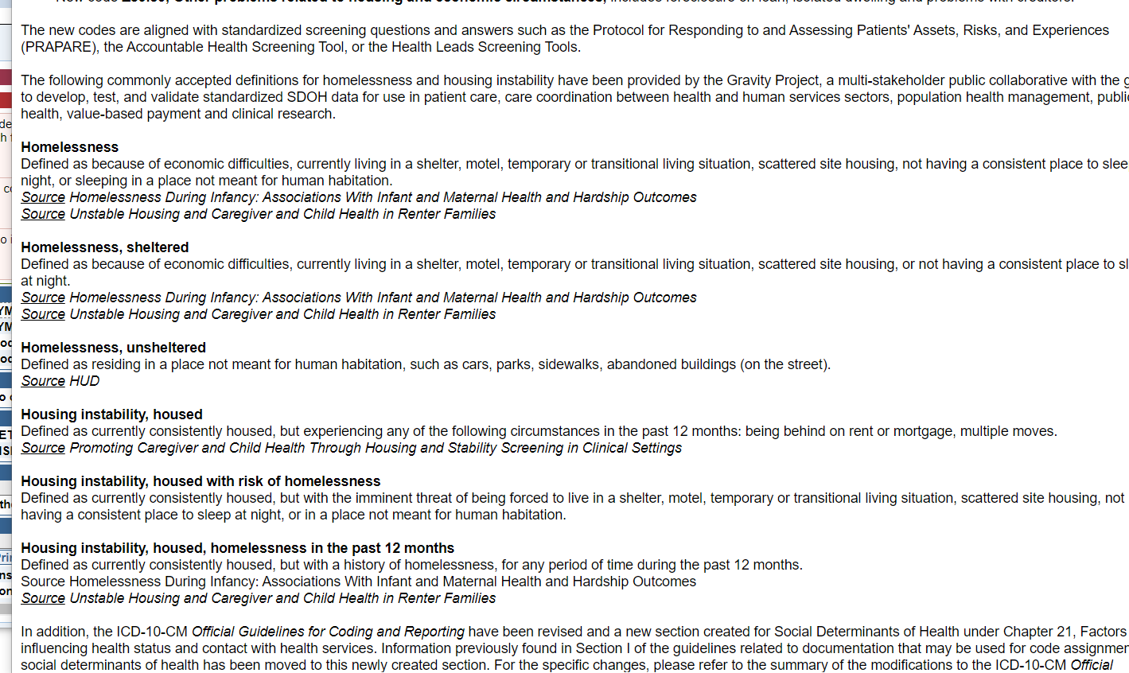
Homeless Definitions

Slide 53
New Edits for FY 2023
E & M codes with unit of 1
Some hospitals may still be reporting 1 unit for E & M.
According to Appendix D of Accounting and Budget Manual, effective 7/1/2019, the RVUs for E&M portion of a clinic visit are based on a 5-point visit level scale and valid values are 2-6 (See next slide for codes)
FY 2023 Warning: If CPT Code = (99202-99205, 99211-99215, and G0463) then unit value must be between 2-6
Medicaid ID = 77777777777 (Not Applicable)
Intent is to make rules consistent across all payer types.
FY 2023 Cross Edit: If Primary Expected Payer is eq (“06”, “07”, “10”, or “18”), then Medicaid ID must be 77777777777

Slide 54
RVU for E & M Visits
HCPCS CODES | APPENDIX D - STANDARD UNIT OF MEASURE REFERENCES DESCRIPTION / PROCEDURE | RVU Appendix D | HSCRC COST CTR
99211 | Level 1 0-10 minutes | 2 | CLINIC
99202/99212 | Level 2 11-25 minutes | 3 | CLINIC
99203/99213 | Level 3 26-45 minutes | 4 | CLINIC
99204/99214 | Level 4 46-90 minutes | 5 | CLINIC
99205/99215 | Level 5 >90 minutes | 6 | CLINIC

