Slide 1
FY 2025 Quarter 3 Data Forum
March 14, 2025
@10:00 AM
Join Zoom Meeting:
https://us06web.zoom.us/j/4107642605?pwd=MmVwREVMbFFYUzlCeWpJcFFZYWF5UT09&omn=85973965350
For Meeting ID and Passcode please contact Curtis Wills: curtis.wills@maryland.gov

Slide 2
Why, When, Where
WHY?
  Open and ongoing communication between HSCRC & industry
  Forum to ask questions about submitted hospital data (case mix and financial)
  Sharing of best practices
WHEN?
  10:00 am - 12:00 pm
WHERE?
  via Webinar (link is posted on our website 2 months before the next meeting)
FY 2025 Dates
June 13, 2025
September 12, 2025
December 12, 2025

Slide 3
Agenda
Quality Update (Dianne)
  SOGI Update (Princess)
  Z-Code Analysis (Princess)
Reminders (Curtis)
  Points of Contact
  New Reserve Flag and Optional Country of Birth
  New Health Plan Payer Code and Edits
  Discontinuing Release of ICD-9 Case Mix Data
  CDS-A Report
  Data Forum Survey
Patient-level Denial Template (Claudine)
FY 2025 DSR Updates (Claudine)
  National Drug Code
  RSV Vaccination Flag
  Revised Date of Admission/Discharge Definitions
Data Processing Update (Mary Pohl, hMetrix/Burton Policy)
Case Mix Review Update (Brenda Watson, AGS)
Upcoming Workgroups and Next Meeting (Curtis)

Slide 4
Quality Update

Slide 5
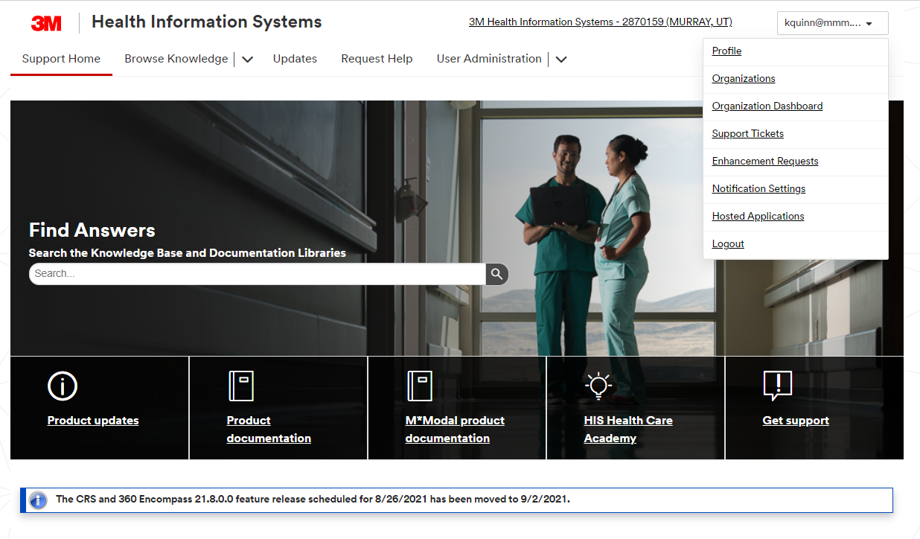
PPC Updates and Feedback
Login procedure for PPC documentation:
3M™ Web Portal - Login
For first use, at registration page, use the old username of "MDHosp" as your authorization code, complete the fields with your personal information to register
New PPC feedback submission procedure on 3M HIS support site:
https://support.3mhis.com/
Establish an account; after logging in, click on your login id in the upper right corner and click on “enhancement request”

Slide 6
RY Updates: MHAC, RRIP for CY 2025
Rate Year | RY2027
*3M APR/PPC Version | 42 (Updated from version 41 to incorporate annual 3M updates)
Timeline | Base Year: MHAC: CY 2024 Q3 – CY 2024 Q2 (FY 2024); Draft Policy in March RRIP: Staff Recommendation: Blended CY 2022/2023; Final Policy in April Performance Year: MHAC: CY 2025 RRIP: CY 2025
Implementation Date | RY 2027 policies begin Jan 1, 2025 in most cases. Look for base and performance period reports on the CRS Portal.
*The 3M ™ All Patient Refined DRG (APR DRG) Software and 3M ™ Potentially Preventable Complications (PPC) Software are proprietary products of 3M Health Information Systems.

Slide 7
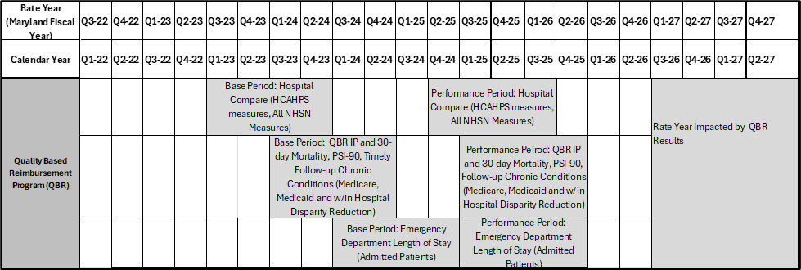
RY 2027 QBR Timeline; Policy Approved in December

Slide 8
Quality Staff Policy Proposal Updates, RY 2027
MHAC:
  Score hospital performance on a PPC composite that includes all payment PPCs explicitly weighted by Solventum (3M) cost weights as a proxy for patient harm and implicitly weighted by hospital-specific expected PPCs for each PPC measure
  Continuous linear scale that ranges from 0 to 100 percent without a hold harmless zone. The cut point for penalties and rewards is average hospital MHAC score as determined through prospective modeling.
    Retrospectively assess the average hospital MHAC scores and propose to the Commissioners that the cutpoint be modified if the actual average score is more than +/- 10 percent different from the prospectively modeled average MHAC score.
RRIP
  Blended base period of CY 2022/CY2023
  Apply blended base period retrospectively to RY 2026

Slide 9
Quality Update: Additional Topics
Quality is pursuing the following additional areas of quality of care
Electronic Clinical Quality Measures (eCQMs) or other digital measures CY 2025
See the CRISP eCQM website for more information and HSCRC memos on the main HSCRC Quality page
    While reporting requirements will remain consistent from CY 2024, Commissioners approved staff recommendation for hospital positive incentive if hospitals fully meet requirements for measure and expedited timeline reporting
Sexual Orientation Gender Identity (SOGI) hospital data collection training project underway with asynchronous training availability
Continuing to exploring options for Outpatient Quality measures, in light of shifts from IP to OP care

Slide 10
Quality Update: Planned Monitoring Reports
Planned for Future Release
  Maternal Morbidity-eCQM (estimated year end 2024)
  Sepsis Dashboard
  TFU behavioral health (TBD)

Slide 11
CY 2025 Digital Measure Submission to HSCRC
Title | Short Name | CMS eCQM ID | CBE* # | 2024 | 2025 | HSCRC
Anticoagulation Therapy for Atrial Fibrillation/Flutter | STK-3 | CMS71v13 | N/A | X | X | Optional
Antithrombotic Therapy By End of Hospital Day 2 | STK-5 | CMS72v12 | N/A | X | X | Optional
Cesarean Birth | PC-02 | CMS334v5 | 0471e | X | X | Required
Discharged on Antithrombotic Therapy | STK-2 | CMS104v12 | N/A | X | X | Optional
Excessive Radiation Dose or Inadequate Image Quality for Diagnostic CT in Adults (Facility IQR) | IP-ExRad | CMS1074v2 | 3663e |  | X | Optional
Global Malnutrition Composite Score | GMCS | CMS986v2 | 3592e | X | X | Optional
*Verify active CBE endorsement on the CMS certified consensus-based entity’s PQM website Source: https://ecqi.healthit.gov/eh-cah?qt-tabs_eh=1&globalyearfilter=2024&global_measure_group=3716

Slide 12
CY 2025 Digital Measure Submission to HSCRC
Title | Short Name | CMS eCQM ID | CBE* # | 2024 | 2025 | HSCRC
Hospital Harm - Acute Kidney Injury | HH-AKI | CMS832v2 | 3713e |  | X | Optional
Hospital Harm - Opioid-Related Adverse Events | HH-ORAE | CMS819v2 | 3501e | X | X | Optional
Hospital Harm - Pressure Injury | HH-PI | CMS826v2 | 3498e |  | X | Optional
Hospital Harm - Severe Hyperglycemia | HH-Hyper | CMS871v3 | 3533e | X | X | Required
Hospital Harm - Severe Hypoglycemia | HH-Hypo | CMS816v3 | 3503e | X | X | Required
ICU Venous Thromboembolism Prophylaxis | VTE-2 | CMS190v12 | N/A | X | X | Optional
Safe Use of Opioids - Concurrent Prescribing | Safe use of opioids | CMS506v6 | 3316e | X | X | Required
Severe Obstetric Complications | PC-07 | CMS1028v2 | N/A | X | X | Required
Venous Thromboembolism Prophylaxis | VTE-1 | CMS108v12 | N/A | X | X | Optional

Slide 13
Quality Update: eCQM Reporting Timeline
eCQM CY 2025 Performance Period Submission Windows
Q1 2025 data Open: 7/15/2025 Close: 9/30/2025
Q2 2025 data Open: 7/15/2025 Close: 9/30/2025
Q3 2025 data Open: 10/15/2025 Close: 12/30/2025
Q4 2025 data Open: 1/15/2026 Close: 3/31/2026
Hospitals may apply for an extraordinary circumstances exemption if warranted, including an extension if more time is needed. (See Quality page on HSCRC website)

Slide 14
HSCRC Hospital Wide Readmission and Hospital Wide Mortality CY 2024- 2025 Reporting Requirements
HSCRC requires hospitals to submit Core Clinical Data Elements (CCDE) for the HWR and HWM hybrid measures on patients from all payers using HSCRC specifications starting with July 1, 2024 performance; for the first 6 months of the performance period (July-December 2024) HSCRC expects reporting to begin in January 2025, and then quarterly thereafter for the January-June 2025 time period.
July 1, 2024 -June 30, 2025 Performance Period Submission Windows for Hybrid Measures CCDE
Q3 2024 data Open: 1/15/2025 Close: 3/31/2025
Q4 2024 data Open: 1/15/2025 Close: 3/31/2025
Q1 2025 data Open: 4/15/2025 Close: 6/30/2025
Q2 2025 data Open: 7/15/2025 Close: 9/30/2025
*HSCRC may consider an alternate extended submission timeline for all-payer CCDE submissions that aligns with the CMS timeline which is a full year of data after the performance period.

Slide 15
SOGI Data Collection Update

Slide 16
SOGI Data Collection Implementation Timeline (2024-2025)
February 1
  SOGI Training Contract Begins
March-April
  Finalize SOGI Variables and Training Materials
August 1
(FY25 Q1)
  Begin Testing Period for SOGI Data Collection
October 1, 2025
(FY26 Q2)
  SOGI Variables in Production (Mandatory)
March 8
  Present Proposed SOGI Variables at Data Forum
April-June
  Hospital Staff Training
October 1, 2024
(FY25 Q2)
  SOGI Variables in Production (Optional)

Slide 17
SOGI Data Collection Asynchronous Training Sessions
Registration is now available on the HSCRC website
Up to 2 business days after registering for the course on the HSCRC website, you will receive an email from CourseNetworking to “Set up your CN account”
After setting up your account, you will receive a notification to accept an invitation to the “HSCRC SOGI Data Collection Training”
If you have any issues or questions, please contact Princess Collins, princess.collins@maryland.gov

Slide 18
SOGI Data Collection Training FAQs
Who should attend these training sessions?
  Staff recommend that all employees that interact with patients attend this training including but not limited to clinicians, clinical staff, and registration/patient access staff.
Should the training videos be watched in order?
  It is recommended that participants watch all of the training videos in order to receive the full benefits of the training.
How are the recent federal government’s actions impacting this data collection?
  The federal government’s actions do not impact HSCRC commitment to collecting this data. These data variables are confidential to protect patient’s privacy and will NOT be available in our statewide public use files.

Slide 19
Reminders

Slide 20
HSCRC Points of Contact for Case Mix and Financial Data
Case Mix Data | Financial Data
Curtis Wills Phone: (410) 764-2594 Email: curtis.wills@maryland.gov | Andrea Strong Phone: (410) 764-2571 Email: andrea.strong@maryland.gov
Claudine Williams Phone: (410) 764-2561 Email: claudine.williams@maryland.gov | Marcella Guccione Phone: (410) 764-5594 Email: marcella.guccione@maryland.gov
Mailbox for Financial Data Submissions: hscrc.financial-data@maryland.gov

Slide 21
Reminder: New Health Plan Payer Code and Edits
Effective for discharges on or after January 1, 2025, New Health Plan Code for Carelon Behavioral Health (130)
  MD MEDICAID should be used for MD Medicaid Payer
OPTUM MARYLAND (MD MEDICAID) (118) will no longer be valid.
  If a hospital reports this code for services on or after this date, it should be flagged as an error.
Key Updates:
  Code 118 can remain in the edit to accommodate claims for services before January 1, 2025.
  Code 130 should be added to the edit for validation purposes.
  In the next fiscal year, code 118 will be removed entirely, as it will no longer be applicable for any claims.

Slide 22
Reminder: New reserve flag and Optional Country of Birth
Country of Birth Field is Optional (IP, OP, and PS)
  Effective Date: January 1, 2025
  Implementation Date (Production & Stage): March 1, 2025
  What’s Changing? The "Country of Birth" field will no longer be required for IP, OP, and PS discharges starting January 1, 2025.
New Reserve Flag for Adventist White Oak - 8th Floor (IP Only)
  Effective Date: February 1, 2025
  Implementation Date (Production & Stage): March 1, 2025
  What’s Changing?
    Y = Adventist White Oak for the 8th Floor
    Cross Edit Error: A system error will occur if the reserve flag is marked "Y" (ADVENTIST WHITE OAK 8TH FLOOR CASES) and:
      The hospital code is not 210016, and
      The discharge date is before February 1, 2025

Slide 23
Reminder: Discontinuing Release of ICD-9 Case Mix Data
Effective immediately, data prior to CY 2016 (ICD-9) will no longer be released in our public use files (including Revisit, and IP/OP PUF).
  Reason for Change:
    To streamline data management
    To focus on more recent trends and insights
  Impact:
    Reduced file size and improved performance
    More targeted analysis for current operations
Case Mix data prior to CY 2016 will not be available via CRISP (Databricks database) or hMetrix (Vertica database)
Any CRS reports that showed data pre-October 2015 will now only go back to October 2015
Please reach out to the HSCRC case mix data contacts if you have any questions

Slide 24
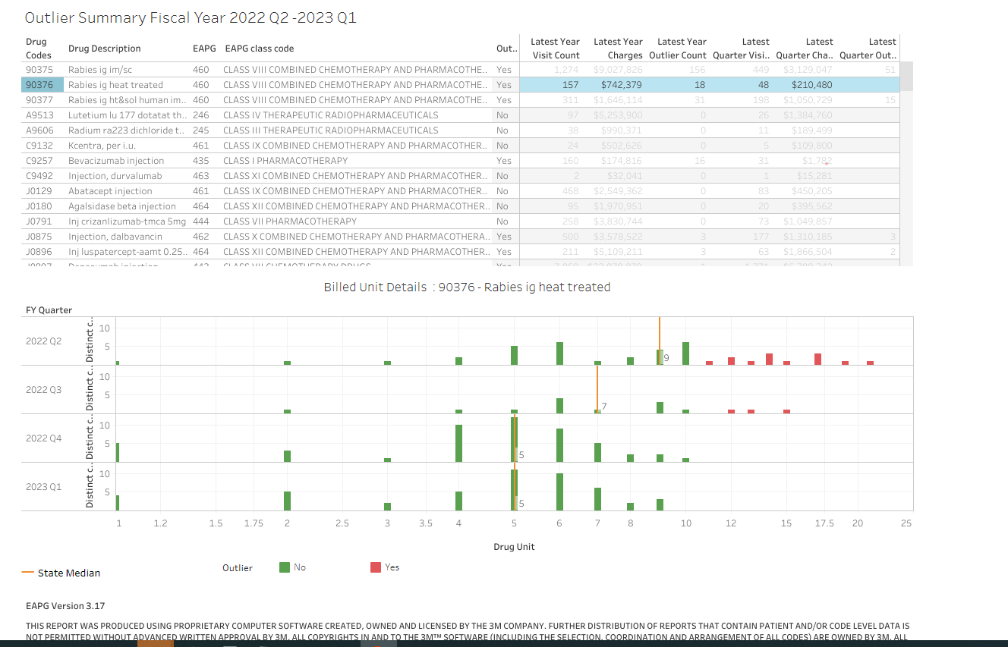
Reminder: CDS-A Reports on CRISP Portal
Provides hospitals with high-cost drug utilization for outlier dosage units based on 3rd Monthly case mix data
Information should used to correct errors prior to submission of Quarterly case mix data.
Hospitals can see which drugs’ units are outliers compared to the State average

Slide 25
Reminder: CDS-A Reports on CRISP Portal
CDS-A Audits starts with what is reported in the case mix data. If the case mix data has errors, the CDS-A data for the following year will have errors.
Hospitals are subject to fines if the case mix data used for CDS-A audits the following year contains errors.
For access to the CRISP portal, contact your CRS Portal Point of Contact or support@crisphealth.org

Slide 26
Reminder: Please Complete the Data Forum Survey!
Opportunity to provide feedback on
  Meeting logistics (meeting notice, registration, ease of participation)
  Topics covered during the prior meeting
  Topics for discussion for future meetings
After this Data Forum, participants will receive a link to a survey via Survey Monkey
Questions about the survey: contact hscrcteam@hmetrix.com

Slide 27
Patient Level Denial Template

Slide 28
Evolution of Hospital Denial Reporting
2009
HSCRC requires reporting of IP Admissions Denied for Medical Necessity to remove charges from hospital revenue capacity
2014
HSCRC mandates data collection for all denied patient accounts to better understand the reasons and magnitude of payer denials
2025
In response to concerns of increasing payor denial trends, HSCRC proposes patient level reporting of all denied patient accounts

Slide 29
What are we collecting?
Reporting Quarter | Primary or Secondary Insurance
Hospital ID | Amount of Paid by Insurance
Patient Medical Number | Amount Denied by Insurance
Service Date (Admit or Thru date as reported in case mix) | Payer Responsible for Denial
Total Initial Amount Billed to Insurance (net any patient responsibility amount) | Health Plan Payer Responsible for Denial
Bill Adjustments (Insurance Portion) | Insurance Reason for Denial
Type of Service (IP,OP,ED)

Slide 30
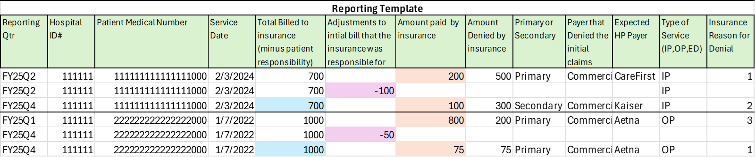
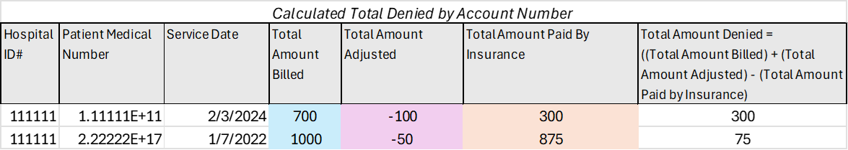
Template and Example

Slide 31
Requesting Hospital Feedback
Historical Data: Can hospitals provide FY 2019 (or another period) of data by December 2025? When can hospitals begin to submit quarterly FY 26 data in order for HSCRC to have sufficient data for FY 27 update (March - April 2026)?
For Bill Adjustments (Insurance Portion), is it possible to attribute the adjustment to a particular payer (i.e., primary or secondary)?
For Insurance Reason for Denial, should we use Claim Adjustment Reason codes or Remittance Advice Remark codes? Are there specific values associated with denials?

Slide 32
Proposed Timeline – CY 2025 - 2026
February
Socialize proposed template with industry
April
Present Final Template to MHA Technical Taskforce
March 2026
FY 2026 Q1-2 Patient Level and Denials Reports Due
March
Based on feedback, finalize template and present at Data Forum
December 2025
Ad-Hoc Patient Level Data Due

Slide 33
FY 2026 DSR Update

Slide 34
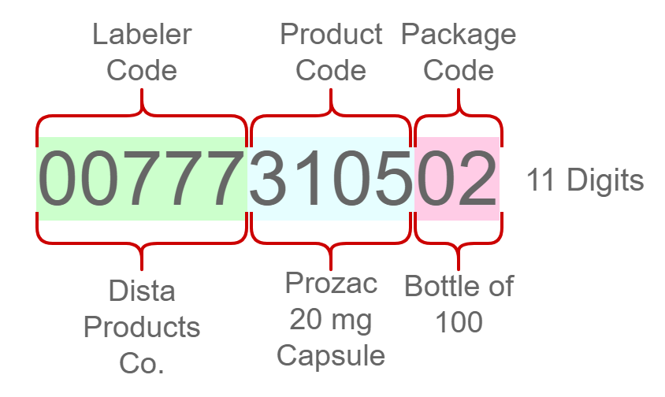
National Drug Code
As part of the Commission Approved staff recommendation to revise the CDS-A drug policy, staff is adding the National Drug Code (NDC) to case mix, effective July 1
New variable to be added to OP data only, Record Type 3
Reported for all drug codes
  Length: 11 digits (Labeler Code, Product Code, and Package Code)
  Format: XXXXXXXXXX, add leading zeros if necessary

Slide 35
RSV Vaccination Administration
As part of the Surge Funding proposal approved by the Commission at the March Public Meeting, staff is requiring reporting of RSV immunizations for infants in order to provide volume variable funding for hospitals.
  RSV and other respiratory virus cases are straining hospital resources
  Cannot identify IP RSV vaccinations through existing case mix reporting
New variable to IP case mix data
  Variable: RSVadmin
  Format: 1 digit
  Code:
    1 = Yes, the RSV vaccine was administered during the IP visit
    0 = No, the RSV vaccine was not administered during the IP visit
  Edit:
    Warning: If RSVadmin = 1 and Nature of Admission is not eq to Delivery (1) or Newborn (2)
    Error: If RSVadmin is blank and Nature of Admission is eq to Delivery (1) or Newborn (2)

Slide 36
Revised Definition of Admission and Discharge Dates
Admission Date:
Old Definition: Enter the month, day, and year of the patient’s admission to the hospital
New Definition: Enter the month, day, and year of when the patient was formally accepted at the hospital for bed occupancy and inpatient services (i.e., room, board, continuous nursing service, and other institutional services while lodged in the facility).
Discharge Date:
Old Definition: Enter the month, day, and year of the patient’s discharge from the hospital.
New Definition: Enter the month, day, and year of the patient’s discharge from the hospital (i.e., the termination of lodging and the formal release of an inpatient by the institution).

Slide 37
Data Processing Update

Slide 38
Points of Contact
HSCRC | hMetrix / Burton Policy
Curtis Wills Phone: (410) 764-2594 Email: curtis.wills@maryland.gov | Shivani Bhatt (Primary PoC) Phone: (484) 228-1453 Email: shivani@hmetrix.com
Claudine Williams Phone: (410) 764-2561 Email: claudine.williams@maryland.gov | Mary Pohl (Hospital Support) Phone: (410) 274-3926 Email: marypohl@burtonpolicy.com
 | Team Email: hscrcteam@hmetrix.com
Notes:
Maria Manavalan will continue to be part of the project

Slide 39
Upcoming Changes in Submission and Data Processing
Consolidating services under DAVE
  Data submission and distribution, to and from HSCRC
  Financial data processing
  Supplemental data processing
  Improved Reporting
  Data Requests
Phase 1 (Nov 24 - Dec 24) - Completed
  Facilitating data submission and distribution using DAVE
  Hosting the current financial and NSP1 website in the hMetrix data center
Phase 2 (Jan 25 - Sept 25) - In Progress
  Improvements in Financial data processing
  Supplemental data processing
  Improved Reporting
  Data Request application

Slide 40
Financial Data Submissions to DAVE – FY26
All data submissions to DAVE
Monthly submissions
  Experience Data
  Financial Income Statement (FSA)
  Financial Balance Sheet (FSB)
Biannual submissions
  Revenue Projection
  Experience Data Attestation
Notes:
Data collection in DAVE will start from August 1, 2025. The memo with details will be sent in April 2025.

Slide 41
Change in Submission Process
Current Process
Use Rates website for submission
Look for error in website
Fix errors and upload a corrected file
Data can be submitted only after all issues are addressed
New Process
Use DAVE for submission
Self-validating Excel templates
Fix issues before submitting data
Secondary checks by DAVE
Error reports will contain
  Issues with the submitted data
  Reconciliation with Case Mix data for quarterly submissions

Slide 42
Change in Revision Submitting Process
Current Process
Hospital Submits revisions
HSCRC
  Review and approve all revisions
  Including revisions submitted before the end of the submission deadline
New Process
Experience Data
  Submit revisions without HSCRC approval if attestation is not complete
FSA/FSB Data
  Submit revisions without approval before the end of fiscal year
  HSCRC approval required after the fiscal year submission period

Slide 43
Proposed Changes to Templates
Metadata tab for all Financial Data
  Provider ID
  Provider Name
  Reporting Period
Different files for FSA and FSB Data
Experience Data
  hMetrix proposes to streamline data submissions by removing the following total variables:
    vol_in, vol_out, rev_in, rev_out, med_in_vol_in, med_out_vol_in, med_in_vol_out, med_out_vol_out, med_in_rev_in, med_out_rev_in, med_in_rev_out, med_out_rev_out
    Totals will be computed automatically
      For example, vol_in (Total Inpatient Volume) will be removed and calculated using the following:
        Total Inpatient Volume = sum(In State Inpatient Volume, Out of State Inpatient Volume)
  Variable moved to Metadata
    Report Date
Requesting feedback by March 31, 2025
Notes:
Survey for feedback will be sent around 3/21/2025

Slide 44
Supplemental Data Submissions to DAVE
Annual Submission
  Intern Resident Survey
Quarterly submissions
  Hospice
  Outpatient Cosmetic Surgery
Changes
  Standardized file naming convention
  Receive notifications and reminders from DAVE
  Submission status updates in DAVE
Proposed File Naming Convention
HospID - Oscar ID of the hospitals
yy - Fiscal Year
x – Submission Quarter
File Type | Naming Convention
Intern Resident Survey | HospID_GME_FYyy
Hospice | HospID_HOSPICE_FYyyQx
Outpatient Cosmetic Surgery | HospID_OPCOSM_FYyyQx

Slide 45
Timeline – Financial & Supplemental Data
Feedback requested by end of March 2025
Memo with details of changes planned April 2025
Development in April and May 2025
Demonstration for HSCRC - May 2025
Hospital Training in June 2025
Hospital Testing in July 2025
DAVE-based system Go-Live in early August 2025

Slide 46
Reminders
Production Data Submission
  Data files must be submitted to the appropriate subfolder after clicking on the Production File Submission option. Submission to the parent prod directory will not be processed.
    adhoc: For files intended for direct submission to HSCRC, bypassing hMetrix processing.
    gme: For Graduate Medical Education program files for processing by hMetrix and HSCRC.
    hospice: For Hospice Report files for processing by hMetrix and HSCRC.
    opcosm: For Outpatient Cosmetic Surgery Report files for processing by hMetrix and HSCRC.
    submission: For Case Mix, UCC, and other hMetrix-processed ad hoc submissions (e.g., ED LOS Adhoc) for HSCRC. Error reports are available on the DAVE production site: https://hscrcdave1.hmetrix.com.
  For testing Case Mix and UCC submissions via hMetrix, data must be submitted to test directory, after clicking on the Test/Sandbox File Submission. Error reports are available at https://hdavetest.hmetrix.com.
Rate Center Trend Monitoring Report
  hMetrix added Rate Center Trend Monitoring Report to case Mix error report to help hospitals identify unusual Rate Center Charges and enable timely resolution of potential issues during submission from FY25 Q1 report
  hMetrix will share a survey link to collect feedback by April 4, 2025
Notes:
GME, Hospice, and OPCPSM will be consolidated in the future

Slide 47
Reminders (Contd.)
Financial Reconciliation Form
  Download from DAVE 2 days after the Quarterly case-mix submission deadline
EHR Survey Overdue Reminder
  Use the DAVE “EHR Survey” tab to update EHR system information every 6 months
DAVE User Management
  Reach out to the hMetrix Team to add new users or modify access
  A worksheet for each hospital/hospital system is maintained by hMetrix
  Update and return the user workbook to modify access
Change in Hospital Connection Option
  Reach out to hMetrix Team to change the choice of Hospital Connection method

Slide 48
Case Mix Review Update

Slide 49
Point of Origin
Definition:
The patient's immediate location before arriving at the hospital or the hospital’s emergency room. This data element focuses on patients’ place or point of origin before they come to the hospital rather than the doctor’s order or referral.
Example:
The patient resides at Oak Crest Assisted Living Center. The point of origin is 05- from a skilled nursing facility (SNF) intermediate care facility or assisted living facility (includes subacute, subacute rehab, and supervised congregate housing)
Note: 01- from a non-healthcare facility means home, workplace, foster care, or group home.

Slide 50
Point of Origin, cont.
Example:
An OB patient at 4:00 AM calls the provider and discusses their symptoms, and the provider confirms the patient is laboring and is instructed to head to the emergency room as a direct admission to labor/delivery.
The POO is reported as 01- from a non-healthcare facility means home, workplace, foster care, or group home. The patient was at home before arriving at the ED for direct admission.

Slide 51
Emergency Department Encounters
Maryland waiver hospitals are subject to the three-day payment window that affects outpatient diagnostic services and other pre-admission services that occur during the three days immediately preceding the date of a patient’s admission for inpatient services.
Multiple emergency visits on the same day are reported separately unless the patient is admitted. Then, the services three days preceding the admission are bundled.

Slide 52
Emergency Department Encounters, cont.
Example:
The patient is seen in the ED at 10 AM for chest pain and leaves against medical advice. The patient returns at 6 PM for continued chest pain and is seen in the ED and sent home at 10 PM. Reporting for the scenario would be two encounters
Encounter A) Chest pain diagnosis with procedures 99281 and 99283 disposition of 07 against medical advice
Encounter B) Chest pain diagnosis with procedures 99281 and 99284 and disposition of 01 home.
Note: in both scenarios, the patient was seen by providers

Slide 53
Observation
G0378- Hospital observation service, per hour
G0379- Direct Admission of patient for hospital observation care
Example: Patient arrives at the ED, is seen, and then admitted to observation.
Correct reporting includes the following codes:
99281-1
99283- 2
G0378- unit per hour for observation
* G0379 would not be appropriate since the patient was seen in the ED

Slide 54
Upcoming Workgroup Meetings

Slide 55
Payment Models Workgroup
Objective: The Payment Models Workgroup develops recommendations for the HSCRC on the structure of payment models. This group focuses on balancing the approach to updates, addressing key topics such as Balanced Updates, Guardrails for Model Performance, Market Share, and Initial and Future Models.
Subgroups to the Payment Models Workgroup
  Annual Filing Modernization Subgroup
  Volume Subgroup
  Population Health Innovations Subgroup
Next Meeting: April 2, 2025
For more information please visit the following website: https://hscrc.maryland.gov/Pages/hscrc-workgroup-payment-models.aspx

Slide 56
Performance Measurement Workgroup
Objective: The Performance Measurement Workgroup (PMWG) is responsible for evaluating measurement methodologies and recommending optimal approaches to the HSCRC. The goal is to identify measures that are reliable, informative, and practical for assessing hospital quality and safety.
Subgroups to the Performance Measurement Workgroups
  Readmissions Subgroup to the PMWG
  ​Quality Based Reimbursement (QBR) Program Redesign Subgroup to the PMWG
  ​Emergency Department Length of Stay Measure Subgroup to the PMWG
Next Meeting: For inquiries regarding the meeting schedule and location, please contact: hscrc.performance@maryland.gov
For more details, visit the HSCRC Performance Measurement Workgroup website at: https://hscrc.maryland.gov/Pages/hscrc-workgroup-performance-measurement.aspx

Slide 57
Total Cost of Care Workgroup
Objective: The Performance Measurement Workgroup (PMWG) is responsible for evaluating measurement methodologies and recommending optimal approaches to the HSCRC. The goal is to identify measures that are reliable, informative, and practical for assessing hospital quality and safety. Membership: The HSCRC has appointed a diverse group of experts to serve on the Total Cost of Care workgroup. A comprehensive list of members can be accessed [here].
Next Meeting: March 26, 2025
For more details, visit the Total Cost of Care Workgroup website at: https://hscrc.maryland.gov/Pages/hscrc-tcoc.aspx

Slide 58
Next Meeting

Slide 59
Notes and slides will be posted to the
HSCRC website: https://hscrc.maryland.gov/Pages/hsp_info1.aspx
Next Meeting
FY 2025 Q4
June 13, 2025
Join Zoom Meeting
https://us06web.zoom.us/j/4107642605?pwd=MmVwREVMbFFYUzlCeWpJcFFZYWF5UT09&omn=85973965350
For Meeting ID and Passcode please contact Curtis Wills: curtis.wills@maryland.gov

Slide 60
Appendix 1: Financial Methodology
Grouper Versions

Slide 61
Grouper Transition: Case Mix Weights and Reports
Rate Year | RY 2026
3M APR/EAPG Version* | IP Weights: 41 OP Weights: 3.18
Data Period Used for Weight Development | IP: CY 2023 (12 Months) OP: CY 2023 and Q1 of CY 2024 (15 Months)
Weight Release Date | First Quarter CY 2025
Policies Applicable To | CY 2024 12-Months Marketshift 2025 Demographic Report
*The 3M ™ All Patient Refined DRG (APR DRG) Software and 3M™ Enhanced APG (EAPG) Software are proprietary products of 3M Health Information Systems.

Slide 62
Appendix 2: UCC Reporting

Slide 63
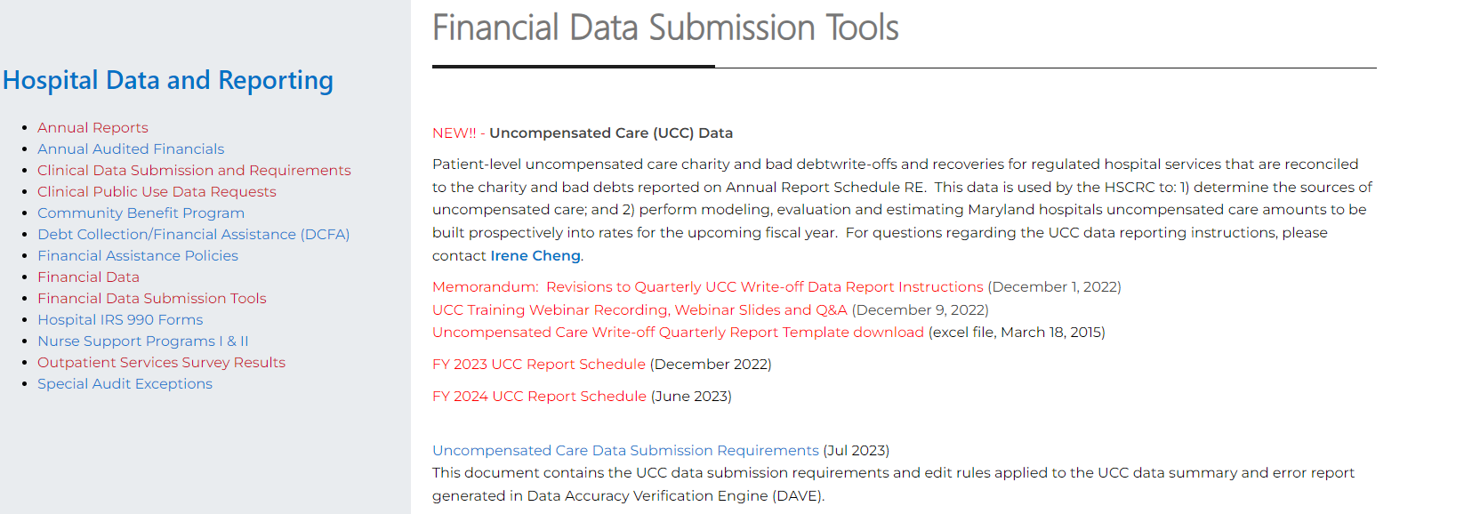
UCC Data Collection and Processing
FY25Q2 Data Submission: 56 reports received, 0 pending
FY25Q3 Data Submission: Apr 30 – May 31, 2025
FY25 UCC report submission schedule to be posted on the HSCRC Financial Data Submission Tools web page.
Notes:
The HSCRC is working with hMetrix to update the UCC file processing pipeline

Slide 64
UCC DSR and Edit Report Updates for FY 2025 Q2
UCC Data Edit Summary:
46 reports have < 1% error
7 reports have 1 - 1.99% error
2 reports have 2 - 2.99% error
1 reports with > 3% error rate had data validated and was manually passed
0 reports to be submitted
Notes:
The HSCRC is working with hMetrix to update the UCC file processing pipeline

Slide 65
UCC Data: Notable Errors Observed in FY24Q3 Data Submission
Error | Notes | Percent of Records with Errors
Invalid or missing billed amount | This information might be unavailable for accounts that are old or transferred from another system | 0.08% of write-off records from 15 report files
Missing service date | Date should not be left blank | < 0.01% of write-off records
Missing expected payer | Text (e.g., n/a, unknown) is not valid; use code 99 if unknown | < 0.01% of write-off records
UCC account with service date within the past 8 quarters not found in Case Mix tapes | This may happen if UCC write-off reported before discharge (not an error but report timing differences), old account reported with incorrect service date, non-regulated patient account that are not required to be reported, etc. | 0.25% of write-off records (excluding non-psych hospitals)
Mismatched UCC service date outside of the range of one day prior to Case Mix admission/from date and discharge/through date by 1 day, 2 - 30 days or > 30 days | This may happen if either the service date reported for UCC record or the service date reported in case mix is incorrect | 0.29% of write-off records.
Notes:
The HSCRC is working with hMetrix to update the UCC file processing pipeline

Slide 66
Points of Contact: UCC Data
HSCRC | hMetrix
Irene Cheng Email: Irene.Cheng@maryland.gov | DAVE Technical Support Email: hscrcteam@hmetrix.com
For questions regarding: Revised UCC reporting instructions UCC data edit rules UCC data quality Request report submission extension before due date (via DAVE) Request report data pass if error rate > 3% (via DAVE) Request report submission window be reopened to submit past due report (via DAVE) | For questions regarding: Access to edit reports and notification e-mail Filling the requests via DAVE

Slide 67
Appendix 3: Production Schedule and
Process for Requesting
Financial Data Extensions

Slide 68
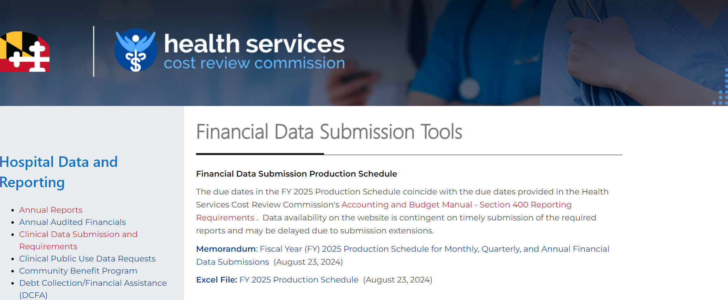
Production Schedule for Financial Data Submissions
Posted to the website on the Financial Data Submission Tools page: https://hscrc.maryland.gov/Pages/hsp_info2.aspx
Financial Data availability on the website is contingent on timely submission of the required reports and are subject to change.

Slide 69
Process for Submitting Extensions for Financial Data
Submitted in writing on hospital letterhead with explanation for extension and noting each hospital and report that will be delayed
Made within a reasonable time,
before the due date
Addressed to the HSCRC Executive Director with copies to staff to ensure timely processing
Email Extension Requests to:
    Jon Kromm, Executive Director (jon.kromm@maryland.gov)
    Andrea Strong (andrea.strong@maryland.gov)
    Marcella Guccione (marcella.guccione@maryand.gov)
    Wayne Nelms (wayne.nelms2@maryland.gov)

Slide 70
Process for Submitting Extensions for Financial Data
Staff will review the extension request and respond (in writing) to the hospital indicating whether the request has been approved, and if the request is approved, the new due date (typically 1 week).
Please note: Hospitals are granted a blanket 30-day extensions for the filing of Audited Annual Report Submissions, therefore, extensions beyond this timeframe will be granted only in emergency situations (an event over which the Hospital has no control).
  Any revisions to the Annual Report must be submitted in its entirety with a letter on Hospital letterhead specifying the Schedules revised and an explanation for the revisions.
Submissions of late or significantly erroneous data is subject to a fine and/or GBR adjustment of up to $1,000 per day.​​​

Slide 71
Appendix 4: Rate Center
Trend Monitoring Report

Slide 72
Rate Center Trend Monitoring Report
Objective
  Help hospitals identify unusual Rate Center Charges
  Enable timely resolution of potential issues during submission
Reason
  Several instances of delayed identification of incorrect Rate Center Charges
  Resulted in an expensive and undesired reopening of a closed quarter for resubmission
Timeline for implementation
  FY25 Q1 Final (October 1, 2024) onward a monitoring tab has been added to the error report
  Collect feedback via email in April 2025
  FY25 Q4 refine identification of unusual Rate Center Charges
  FY26 potential impact on error percentage

Slide 73
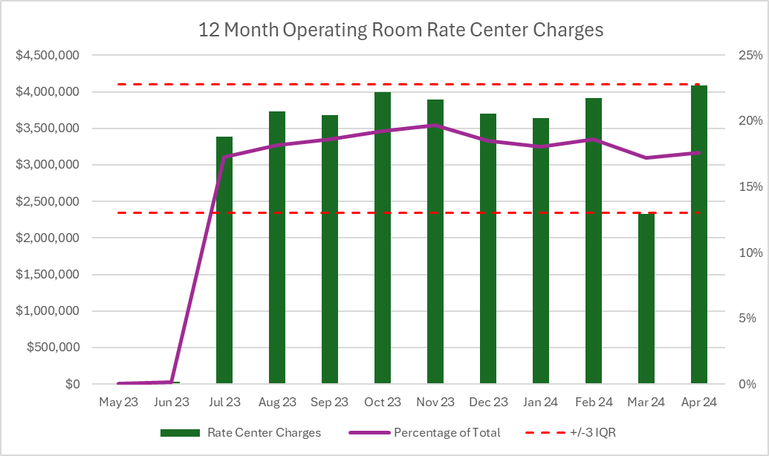
Total Charges & Rate Center Charges Outlier Identification
Identify Significant Rate Center
  The lookback period is 24 months
  > 5% utilization for more than half of lookback period
Outlier Identification
  Total Visit and Charges
    Current submission is outside +/- difference between 90th and 10th percentile
  Rate Center Charges
    Current submission is outside +/- 3 IQR
Hospitals to review Outliers in
  Current reported month
Notes:
The graph illustrates an example of how upper and lower bound using IQR is calculated. Here we show 12 month of data instead of 24 month for easy understanding

Slide 74
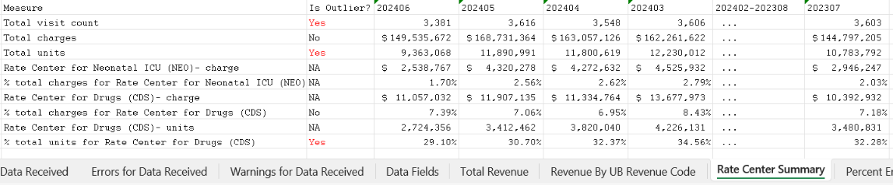
Monitoring Report Samples
A new tab “Rate Center Summary” is added to the error report
  Total visit count, total charges, total units, and all reported Rate center charges and units from the current and past 24 months are available for review
  Outliers are flagged for the months reported in the file only
  The outlier is determined by using the percent of charges or unit. The exception to this rule is if the hospital has at least one rate center that is >65% of total charges, the outlier is determined by using the value of reported charges or units.

