Slide 1
Hospital Clinical Adverse Events (CAEM) Subgroup
June 24, 2026
HSCRC Quality Team

Slide 2
Meeting Agenda
CAEM Goals and Work to Date
Digital measures overview
Mortality measures
  Sepsis mortality
PPC-PSI overlap updated analysis
Measures of interest Matrix: complications measures
CAEM next steps

Slide 3
CAEM Members
Kelly | Arthur | Qlarant
Sophia | Batallas | Adventist Health Care
Kaitlyn | Beeman | Western MD
Teresa | Brown | MHCC
Zahid | Butt | Digital Measures SME
Samantha | Crandall | GBMC
Jacqueline | Hartford | MD Pt Safety Center
Sofia | Liarakos | Lifebridge
Chris | Mccoy | UMS
Ashka | Mehta | Maryland MCH REP
Jonathan | Patrick | MedStar
Rebecca | Perlmutter | MPH, CIC MDH, HAI Infec Program Coordinator
Edward | Seferian | JHHS
Geeta | Sood | Infectious Disease SME
Michael | Staley | Meritus

Slide 4
Workgroup Learning Agreements
Be Present – Make a conscious effort to know who is in the room, become an active listener. Refrain from multitasking and checking emails during meetings.
Call Each Other In As We Call Each Other Out – When challenging ideas or perspectives give feedback respectfully. When being challenged - listen, acknowledge the issue, and respond respectfully.
Recognize the Difference of Intent vs Impact – Be accountable for our words and actions.
Create Space for Multiple Truths – Seek understanding of differences in opinion and respect diverse perspectives.
Notice Power Dynamics – Be aware of how you may unconsciously be using your power and privilege.
Center Learning and Growth – At times, the work will be uncomfortable and challenging. Mistakes and misunderstanding will occur as we work towards a common solution. We are here to learn and grow from each other both individually and collectively.
REMINDER: These workgroup meetings are recorded.

Slide 5
CAEM Goals and Recap

Slide 6
CAEM Goals
Recommend complications (MHAC), safety (QBR), and mortality (QBR) measures for:
  RY2029 (CY2027) Maryland Hospital Acquired Conditions program and Quality-Based Reimbursement, and
  Incubator that can be considered in future years, including:
    Measures that are not yet ready for payment that are either under consideration by CMS or measures that are important for MD under an all-payer quality program such as maternal health measures.
Recommend criteria for measure selection that can be used in future years and any payment considerations for PMWG
  For example: Maintain rewards in RY2029 if program includes measures beyond CMS portfolio.

Slide 7
Sources for Candidate Complication, Safety, and Mortality Measures
Maryland Hospital Acquired Conditions Measures (MHAC) Measures
CMS Hospital Acquired Complications Reduction Program Measures
Complications/Mortality Measures Under Maryland Quality Based Reimbursement
Complications/Mortality Measures Under CMS Hospital Value Based Purchasing
CMS Inpatient Quality Reporting measures
CMS Measures Under Consideration list for 2025
CMS Electronic Clinical Quality Measures (eCQMs)
Others?

Slide 8
Complications Recap
RY2028 MHAC
FY2028 HACRP
Subset of PPCs in composite, weighted at 5/6th of score
All-Payer AHRQ PSI, weighted 1/6th of score
State performance standards, 2% scaled rewards and penalties
NHSN Healthcare Associated Infections, weighted 5/6th of score
Medicare AHRQ PSI, weighted 1/6th
National performance standards, 1% penalty for worst quartile
CAEM Measure-Related Discussion to Date
Continue PPCs?
Discussed concern on proprietary costs and lack of alignment with CMS. Today we will discuss overlap with PSI and populations excluded if PPCs discontinued.
Add NHSN measures?
CAEM discussed concerns about these surveillance measures and duplication in multiple programs. Other concerns include small cell sizes, lack statistical differences over time and between hospitals, and ????.
Identify Incubator Measures for future rate years to justify program rewards
CAEM has discussed inclusion criteria for measure and developed matrix for input from CAEM members and stakeholders.
Today we will discuss specific areas/populations for non-Medicare HGBs as we discuss areas included with PPCs that are not as represented in the Medicare measures.

Slide 9
Safety Recap
FY2028 HVBP
FY2028 HVBP
Sep 1 bundle process measure
CDC NHSN HAI CLABSI, CAUTI, C Diff, MRSA and SSI (colon and hysterectomy)
National performance standards, 2% rewards or penalties, not revenue neutral, Safety domain weighted 31%
Sep 1 bundle process measure
CDC NHSN HAI CLABSI, CAUTI, C Diff, MRSA and SSI (colon and hysterectomy)
National performance standards, 2% rewards or penalties, revenue neutral, Safety domain weighted 25%
CAEM Measure-Related Discussion to Date
Continue Sep 1 bundle and CDC NHSN HAI measures in QBR
Discussed concerns about Sep 1 measure being one size fits all in QBR RY 2028 policy but CMS alignment was deemed important for the policy
Discussed concerns related to low numbers and reliability of NHSN measures
Identify Incubator measures for adoption and use when fully developed
CAEM discussed Hospital Onset Bacteremia HOB measure
Today we will identify options for adopting measures for Non-Medicare hospital GBRs

Slide 10
Mortality Measures Recap
FY2028 HVBP
RY2028 Maryland QBR
Clinical Outcomes Domain
All-Payer, all-condition, all-cause mortality measures, inpatient and 30-day
Total hip/knee arthroplasty complications
State performance standards, 2% scaled rewards and penalties, domain weighted at 31%
Clinical Outcomes Domain
All-cause 30-day condition specific mortality for AMI, CABG, COPD, CHF and Pneumonia.
Total hip/knee arthroplasty complications
National performance standards, 2% scaled rewards, revenue neutral with domain weighted at 25%
CAEM Measure-Related Discussion to Date
Align with CMS exactly on mortality measures
Discussed consensus to not adopt condition specific in QBR
Current options is to retain all payer 30-day and inpatient mortality measures
Today we will discuss the capture of sepsis in our current mortality measures and implications
Maintain alignment with CMS with use of THK complications measure
Discussed concerns related to majority of procedures having moved to out-patient
Today we will discuss whether to recommend retaining this measure after RY 2028
Identify Incubator measures for future adoption
CAEM has discussed Adult Community Onset Sepsis 30-day mortality measure and HWM hybrid measure
Today we will discuss options for timing of measure adoption for Non-Medicare hospital GBRs

Slide 11
Digital Measures Overview

Slide 12
Digital Quality Measures Overview
HSCRC: CAEM Workgroup
Zahid Butt
June 24, 2026

Slide 13
CMS Quality & Safety Reporting Programs
30
26
26
27
23
29
29
29
21
21
27
25
16
20
15
14
15
18
19
14
17
14
11
13
12
10
Measures
Submissions
2018
2019
2020
2021
2022
2023
2024
2025
2026
2027
2028
2029
2030
Current Public Reporting Reflects 2021 – 2024 Performance Yrs

Slide 14
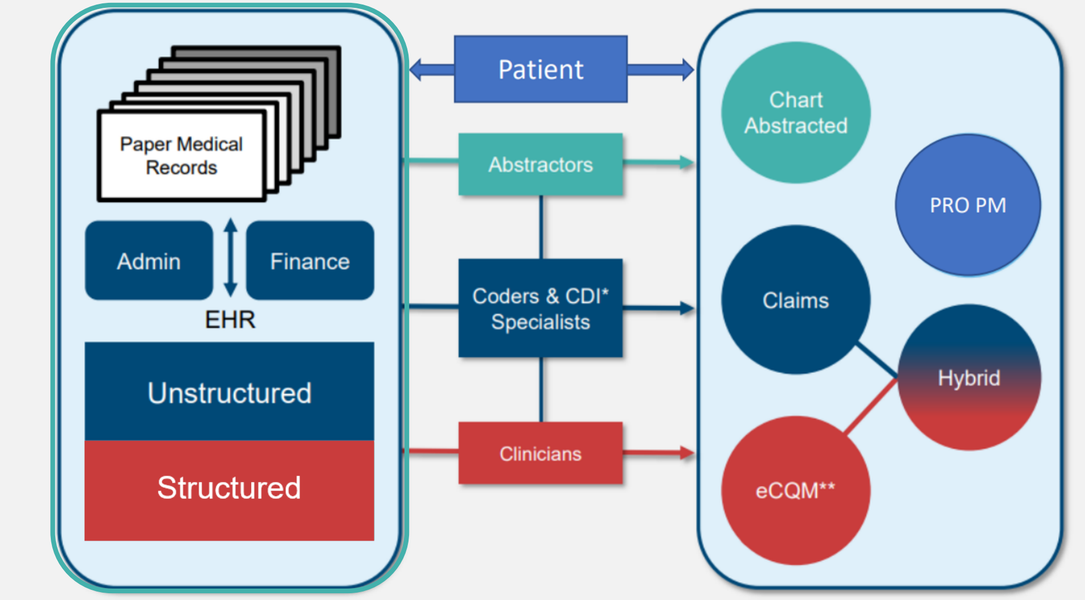
Types of Quality Measures in CMS Programs
Attestation
NLP
dQM

Slide 15
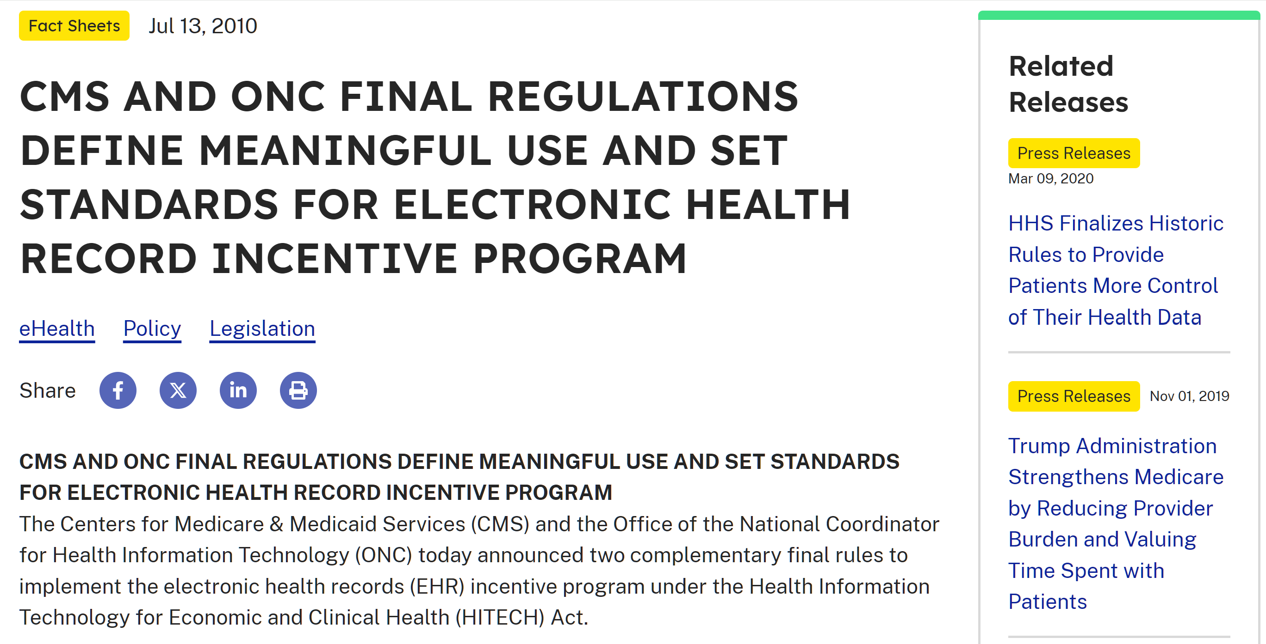

Slide 16
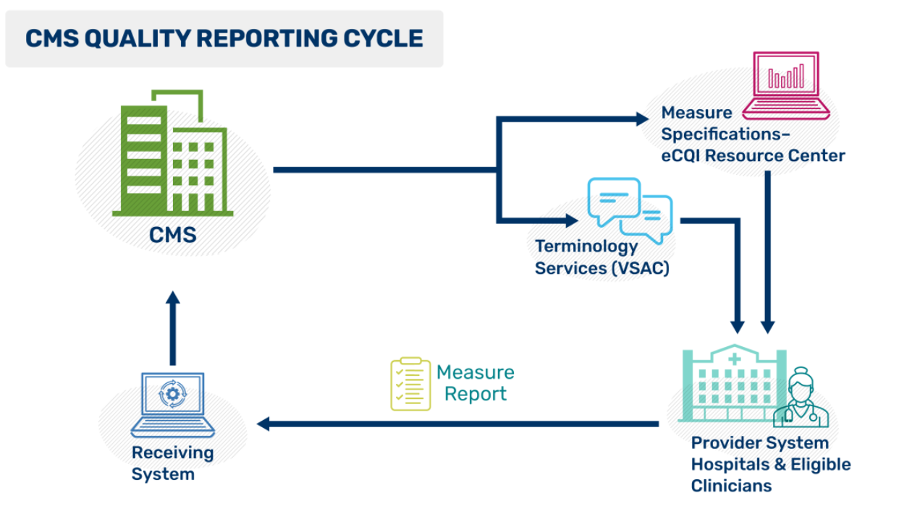
CMS eCQM Basic Reporting Cycle*
Program Specific eCQM Specs
Dev & Testing
EHR or 3rd Party Vendor
Products
* Detailed links in Appendix
Implement

Slide 17
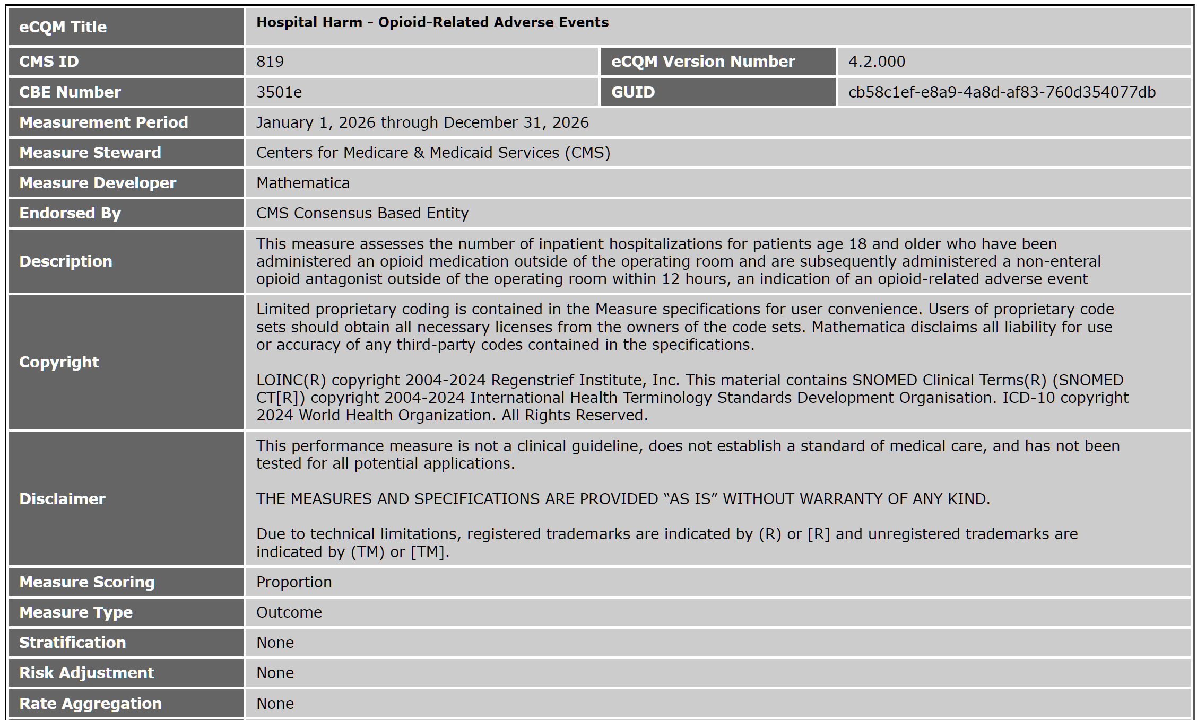

Slide 18
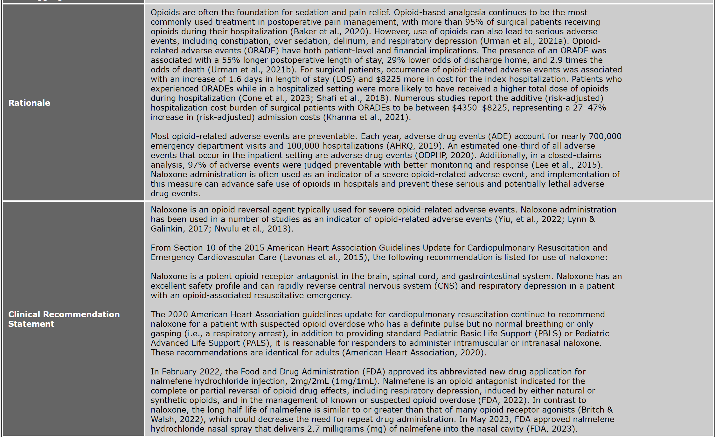

Slide 19
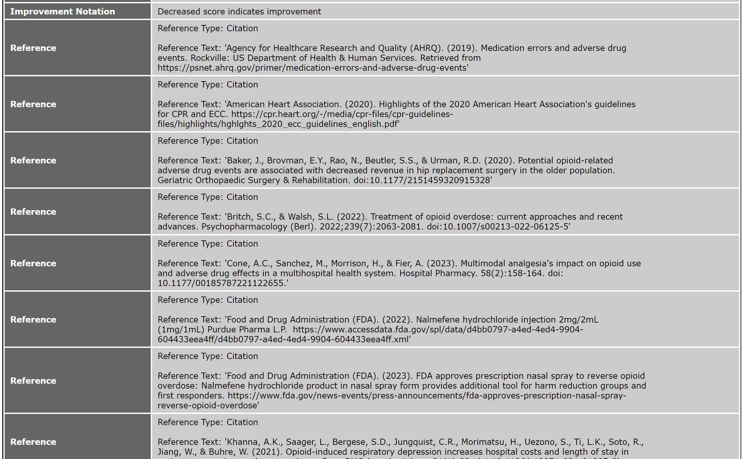

Slide 20
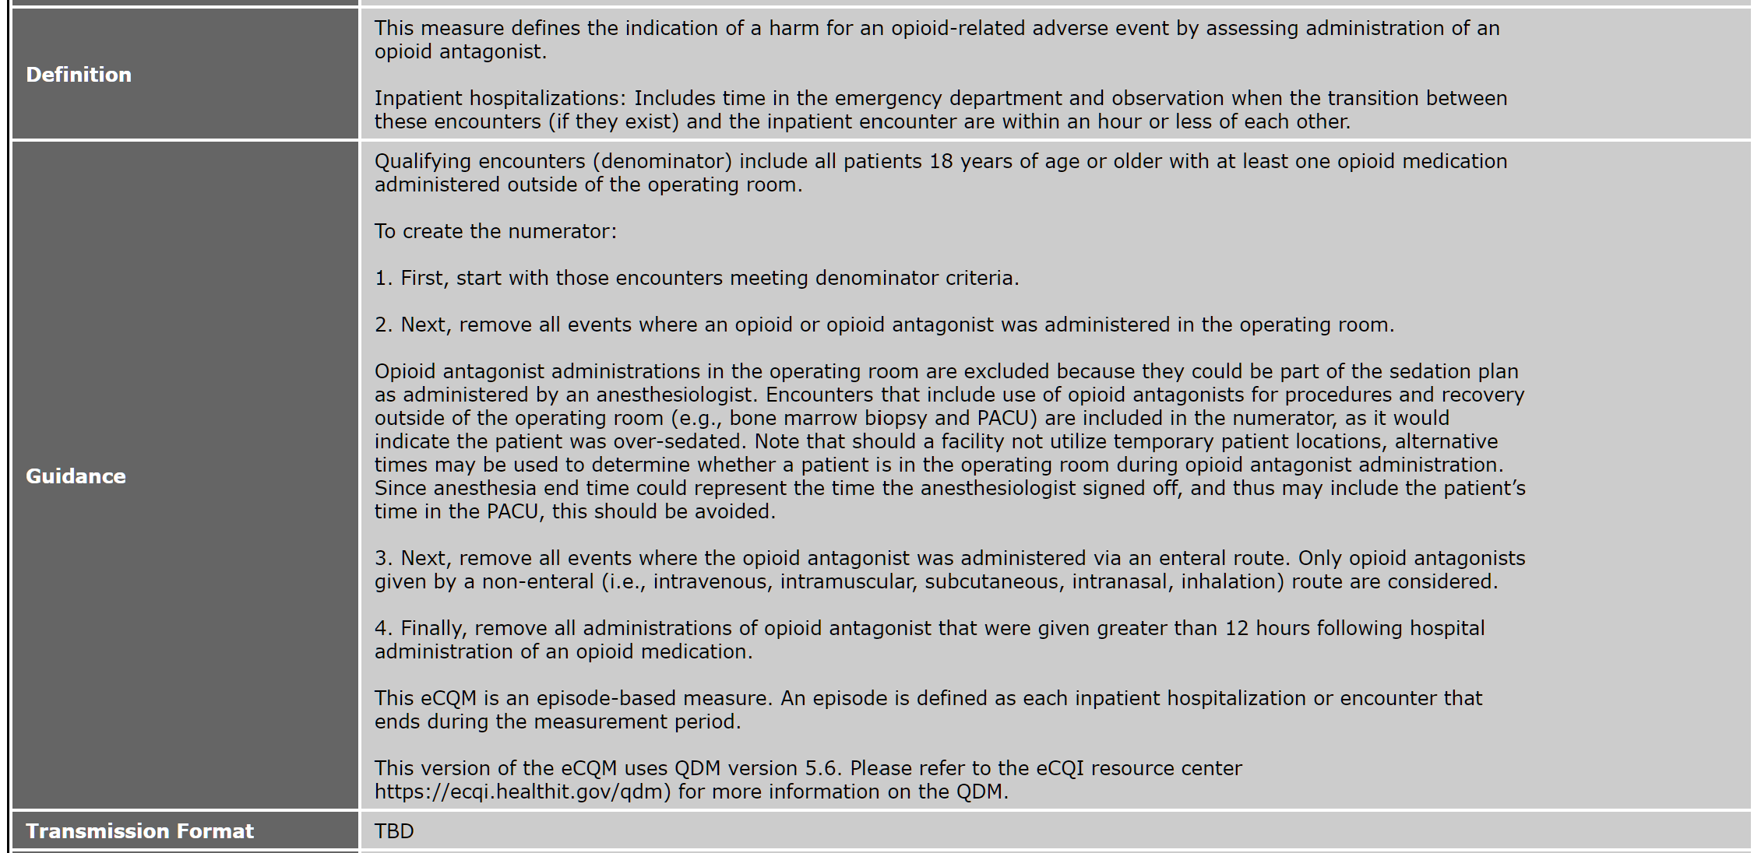

Slide 21
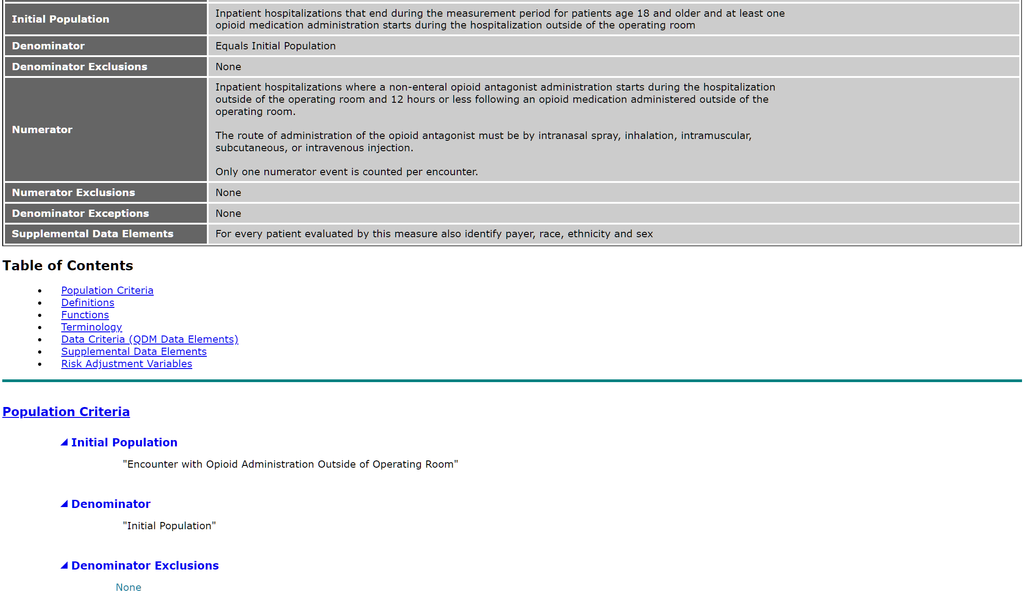

Slide 22
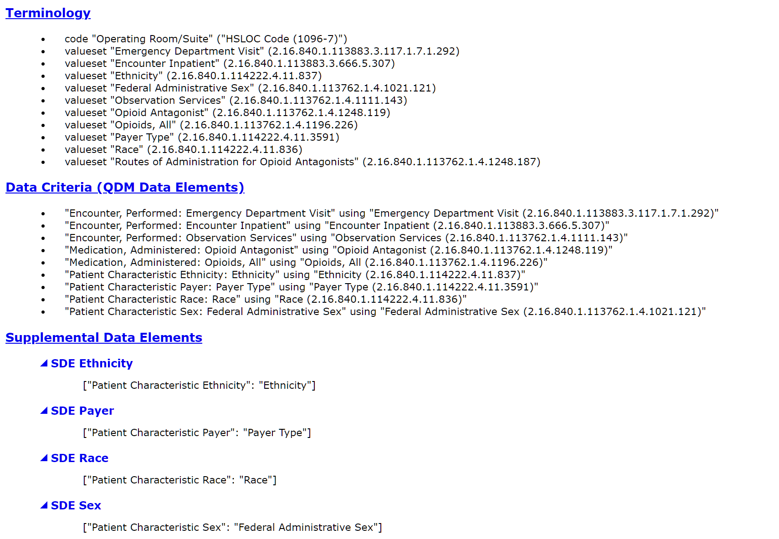

Slide 23
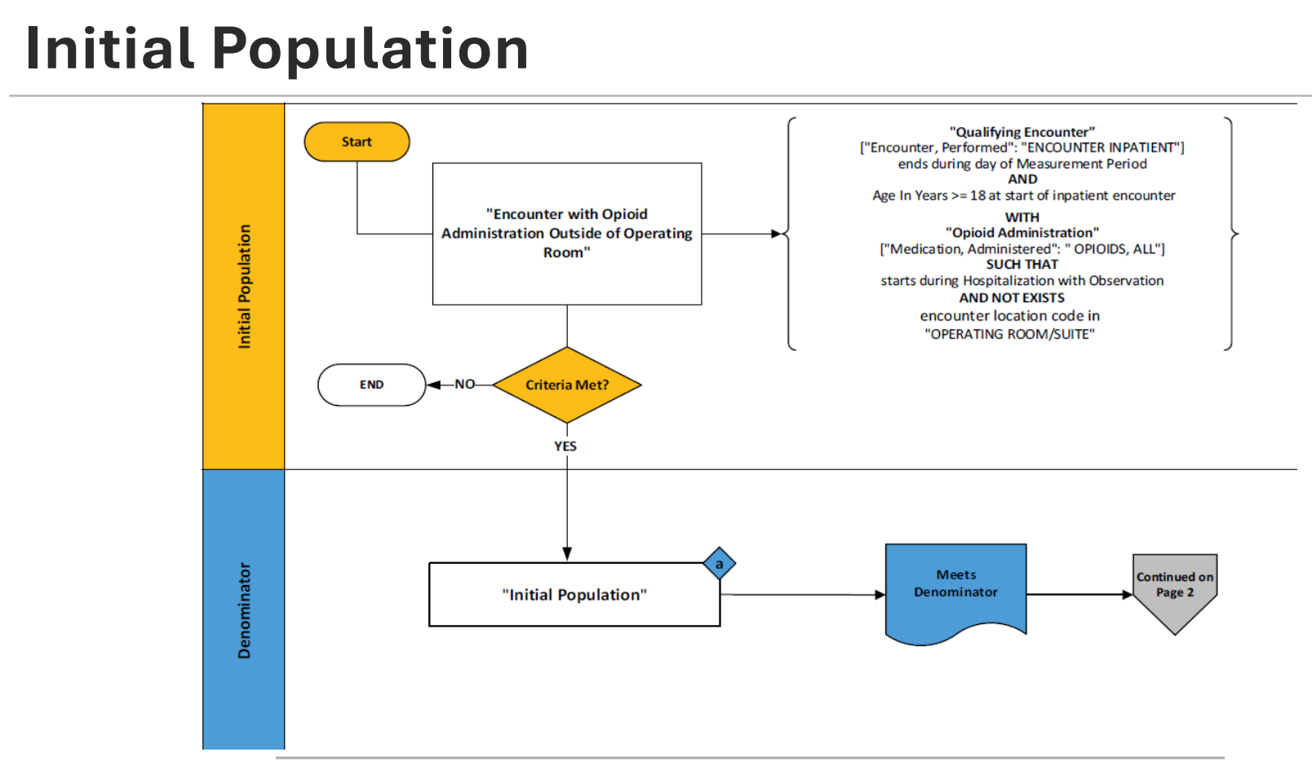

Slide 24
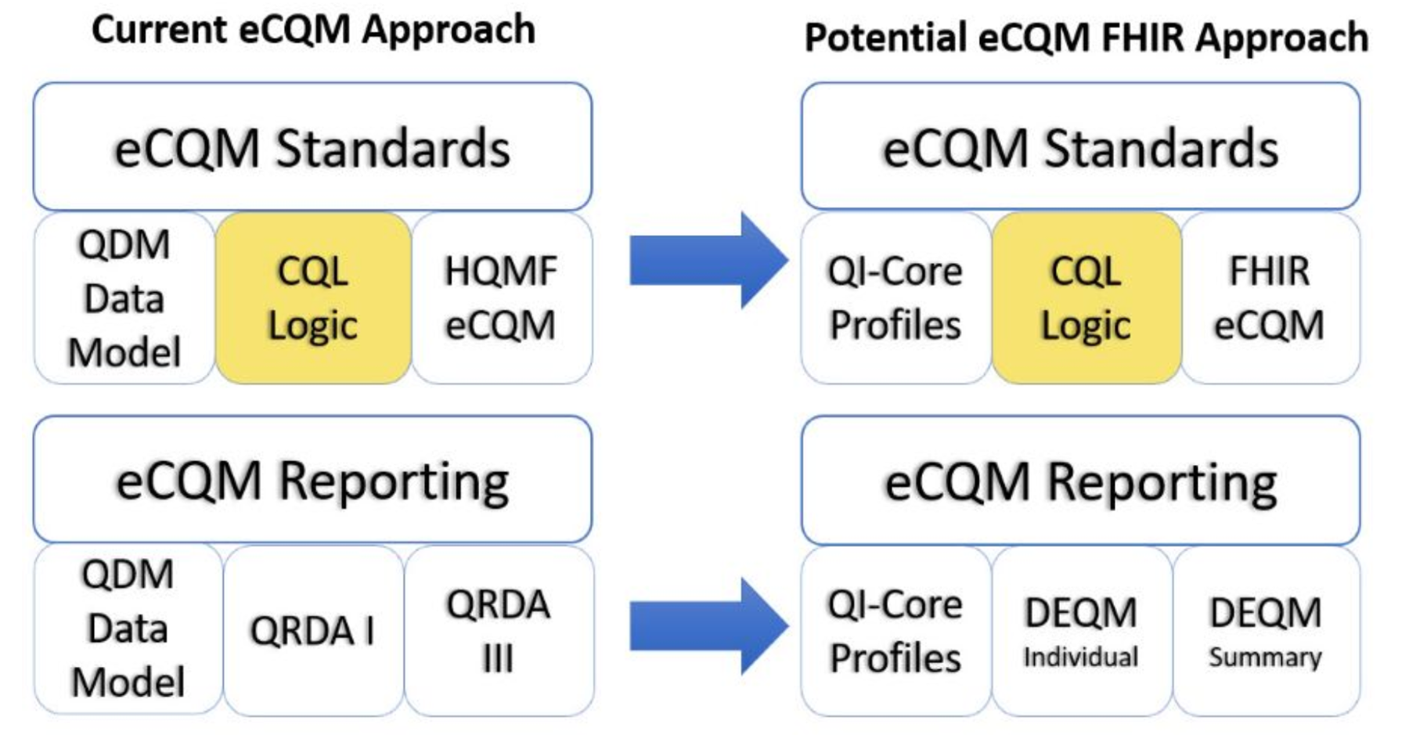
eCQM vs “FHIR eCQM” vs dQM
EHR
DATA

Slide 25
AT A GLANCE: DEFINITIONS (AI Generated)
eCQM
ESTABLISHED
dQM
CMS FUTURE DIRECTION
Electronic Clinical Quality Measures
Digital Quality Measures
Standardized tools that use data extracted from certified EHRs (CEHRT) to assess clinical quality. A mature, widely deployed subset of digital measures used across CMS reporting programs including MIPS, Hospital IQR, OQR, and Medicaid Core Sets.
A broader category that uses standardized digital data from multiple source types — including EHRs, administrative systems, HIEs, wearables, and patient-reported data. The CMS strategic direction for ALL future quality measures, leveraging FHIR APIs and real-time data pipelines.
VS
QDM V5.6
HQMF / QRDA
CEHRT
CQL
FHIR R4
QI-CORE
DEQM IG
CQL
REAL-TIME
RETROSPECTIVE
MULTI-SOURCE
eCQMs are a subset of dQMs — not a parallel category.

Slide 26
Standards & Interoperability
Technical Standards Overview (AI Generated)
EACH CARD:
eCQM
dQM
DATA MODEL
MEASURE FORMAT
ECQM
DQM
ECQM
DQM
QDM v5.6Quality Data Model — structured clinical data elements mapped from EHR fields
QI-Core FHIR-based profiles extending US Core — standardized, computable clinical resources
HQMF (XML)Health Quality Measure Format — HL7 v3 XML-based measure specification standard
FHIR Measure Resource (R4) Machine-readable measure definition using FHIR R4 Measure & Library resources
LOGIC LANGUAGE
SHARED STANDARD
DATA EXCHANGE
ECQM
DQM
ECQM
DQM
CQL: Clinical Quality Language — human-readable, machine-executable logic layer
FHIR APIs + DEQM IG Data Exchange for Quality Measures IG — REST API exchange in JSON/XML via MeasureReport
CQL: CQL logic language retained, enabling incremental eCQM → dQM migration
QRDA I / QRDA III XML-based reporting formats — patient-level (Cat I) and aggregate (Cat III)
TERMINOLOGY
INTEROPERABILITY
ECQM
DQM
ECQM
DQM
VSAC Value Sets SNOMED CT · LOINC · RxNorm · ICD-10-CM — managed via NLM VSAC repository
Same as ECQM + USCDI+ Quality All eCQM terminologies plus USCDI+ Quality Data Elements for expanded data coverage
HL7 v3 / C-CDA Document-centric exchange; limited cross-system integration — vendor mapping required
HL7 FHIR R4 REST APIs Broad cross-system interoperability — machine-to-machine, standardized, scalable
CQL is the key bridge — Clinical Quality Language is the only standard fully shared across both eCQM and dQM, making the transition evolutionary rather
than a wholesale replacement.

Slide 27
Data Sources
(AI Generated)
eCQM VS. dQM
eCQM
dQM
Certified EHRs (CEHRT) mandated source system
EHRs, HIEs, clinical registries, administrative systems
Multi-system, federated data landscape
PRIMARY SOURCE
Limited: Not typically included
Structured and Unstructured clinical data captured during clinical care plus Patient Generated: Wearables, home monitors, patient portals, PROs
PATIENT DATA
Limited administrative context
Full claims, enrollment, encounter & vital records
ADMIN DATA
Not captured Outside eCQM scope
SDOH
Social needs assessments included
Retrospective extraction At measurement period end
Measure results + reusing same CQL logic for real-time & near-real-time Clinical Decision Support via FHIR APIs
TIMING
dQMs expand data diversity across every dimension — from single-source EHR extraction to real-time, multi-system digital data pipelines

Slide 28
Quality Measurement Data Flows: eCQM vs. dQM (AI Generated)
eCQM Lane
dQM Lane
STEP 01
STEP 02
STEP 03
STEP 04
eCQM
Data Entry
Extraction
Calculation
Submission
Clinician enters structured data into certified EHR during clinical encounter
Manual / semi-automated EHR extract; vendor mapping required for each program
Measure logic runs within EHR or at facility level using CQL over QDM data
QRDA I (patient-level) or QRDA III (summary) XML files uploaded to CMS portal
STEP 01
STEP 02
STEP 03
STEP 04
dQM
Data Capture
Retrieval
Calculation
Submission
Automated ingestion across EHRs, wearables, patient portals & admin systems
Standardized FHIR API query — fully automated, no manual mapping needed
Distributed or centralized computable CQL measure logic over QI-Core FHIR data
FHIR MeasureReport via FHIR API — fully machine-to-machine, no portal upload
eCQM: Moderate-to-high burden — requires IT mapping effort and vendor coordination per reporting period
dQM: Lower clinician burden goal — automated pipelines may reduce some manual errors and potentially accelerate reporting cycles

Slide 29
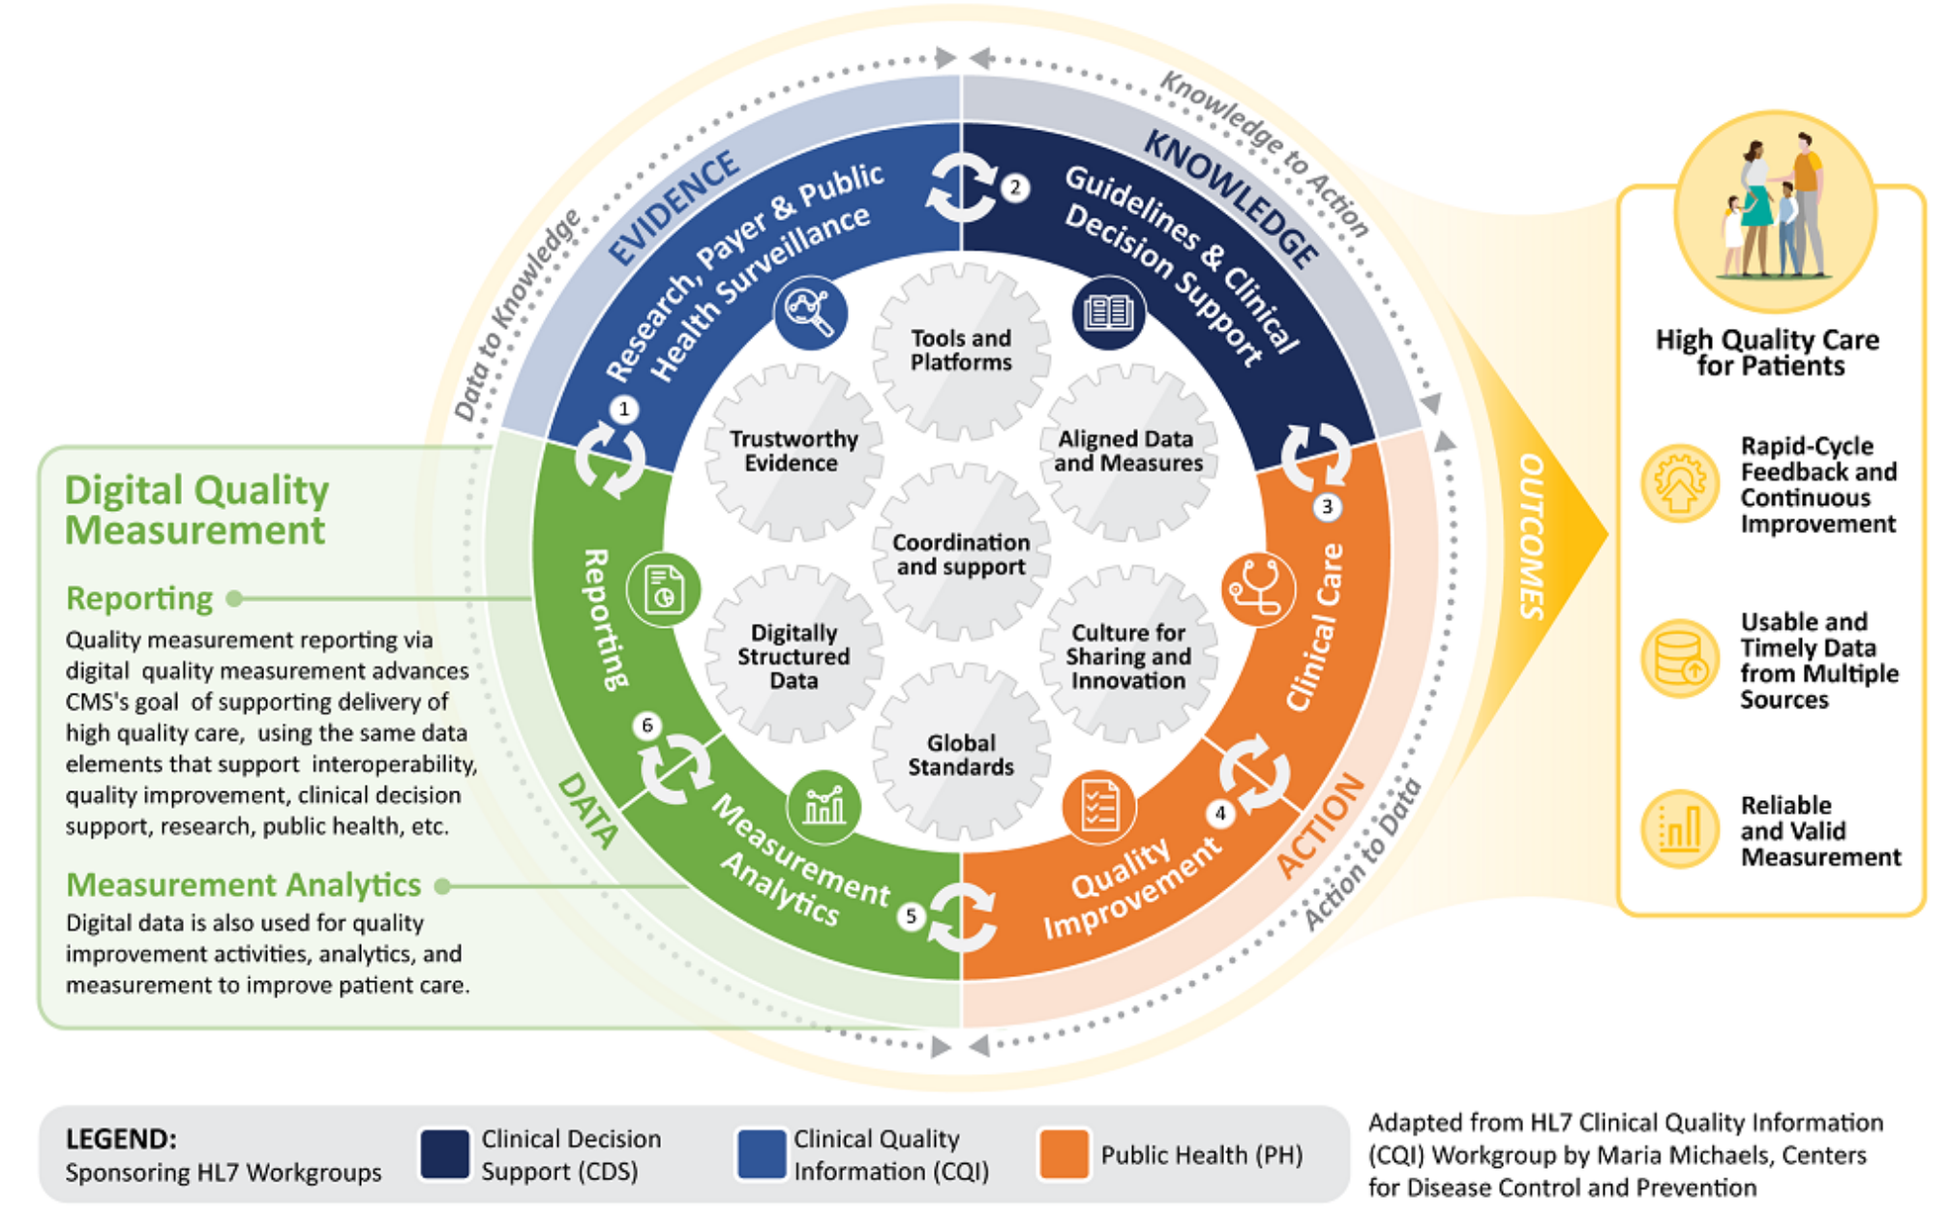
Quality Measurement & The Learning Health System
Internal Improvement
Regulatory Reporting
Value-Based Payments
Public Reporting

Slide 30

Supporting NCQA’s Vision for Digital HEDIS & FHIR dQM
Prof Societies, CDC, AHRQ
Research
Clinical Practice Guidelines
Treatment • Testing • Staging
Data Science
Evidence-Based Medicine
CPG, CDS, Rules
Measurement
Process
Outcomes
Case Reports
SHARED TOOLS,
INFRASTRUCTURE,
APPROACHES
Speed
Real-time
End-to-end
Efficient
TRUSTED
Data Collection
& Reporting
FHIR Services Integration
NLP Registries
EHR/CDR Term Mappings
Clinical Data Repositories, HIEs, EHRs
NCQA HEDIS
CMS Programs
dQMs, eCQMs, ECDS
QI Core, eCR, CCD

Slide 31
The Path from eCQM to dQM
CMS/NCQA TRANSITION ROADMAP · QUALITY MEASUREMENT EVOLUTION (Top Row AI Generated)
2010
2022
2024 – 2025
2026+
FUTURE
eCQM Era Begins
CMS dQM Strategic Roadmap Released
Pilot Programs & Connectathons
Active Transition
Full dQM Adoption
EHR incentive programs drive eCQM adoption across hospitals & clinicians. QDM, HQMF, and QRDA formats established.
CMS publishes vision for transitioning all quality measures to digital standards based on FHIR and QI-Core profiles.
FHIR-based measure testing underway. NCQA ECDS specs added to 2025 Medicaid Core Sets. MADiE updated for FHIR authoring.
eCQM programs begin parallel dQM reporting paths. New measures authored natively as dQMs using
QI-Core & FHIR Measure Report
All CMS quality programs operate under the dQM framework. Richer, multi-source, interoperable quality measurement at scale.
ESTABLISHED
COMPLETED
IN PROGRESS
UPCOMING
VISION
CMS IPPS
  - “Respecified” eCQMs
  - “De Novo” eCQM
CMS QPP/MIPS
  - 40+ eCQMs
CMS OPPS
- Few eCQM’s
Patient Safety eCQMs
  - New eCQMs
  - AHRQ PSI transition from claims to eCQM
eCQM Public Reporting
CMS FHIR eCQM Specs developed for IPPS/MIPS
  - Potential production testing
CDC NHSN dQM Pilot
- Sepsis Mortality Rate
- Severe Hypoglycemia
Source: CMS eCQI Resource Center · CMS Digital Quality Measurement Strategic Roadmap · HL7 FHIR R4

Slide 32
Thank You zwbutt@outlook.com

Slide 33
APPENDIX
CMS Patient Safety eCQM
- CMS eCQM ANNUAL CYCLE LINKS

Slide 34
2027 IPPS Proposed Rule: Electronic Clinical Quality Measures
Short Name | 2026 | 2027 | 2028 | 2029 | 2030
PC-02 | Required | Required | Required | Required | Required
PC-07 * | Required | Required | Required | Required | Required
CMS506 | Required | Required | Required | Required | Required
HH-Hyper | Required | Required | Required | Required | Required
HH-Hypo | Required | Required | Required | Required | Required
HH-ORAE | Available | Required | Required | Required | Required
HH-PI | Available | Available | Required | Required | Required
HH-AKI * | Available | Available | Required | Required | Required
HH-RF * | Available | Used for TEAM | Required | Required | Required
HH-FI | Available | Used for TEAM | Required | Required | Required
HH-VTE | - | - | Available | Available | Required
STK-02 | Available | Available | - | - | -
STK-03 | Available | Available | Available | Available | Available
STK-05 | Available | Available | Available | Available | Available
VTE-1 | Available | Available | - | - | -
VTE-2 | Available | Available | - | - | -
MCS | Available | Available | Required | Required | Required
IP-ExRad | Available | Available | Available | Available | Available
Advance Care Plan | - | - | Available | Available | Available

Slide 35
CMS eCQM Annual Cycle: 1st Quarter
eCQM
CMS Measures Inventory Tool Updated
CMS Quality Reporting Document Architecture I Implementation Guide Public Comments
Draft Electronic Clinical Quality Measure Specifications Posted in ONC Project Tracking System (Jira) for Public Testing and Comments
Reporting
Inpatient Quality Reporting Submission Closed*
MIPS Quality Measure Benchmarks
Quality Payment Program Reporting Submission Open and Closed*
Rule
Pre-Rulemaking: Measures Under Consideration Opens for New Measures
Pre-Rulemaking: Pre-Rulemaking Measure Review Publishes Final Report

Slide 36
CMS eCQM Annual Cycle: 2nd Quarter
CQM
CMS Measures Inventory Tool Updated
CMS Quality Reporting Document Architecture I Implementation Guide Updated
CMS Quality Reporting Document Architecture III Implementation Guide Public Comments
Electronic Clinical Quality Measure Annual Update Published
MADiE
Reporting
Not Applicable
Rule
Inpatient Prospective Payment System (Inpatient Quality Reporting and Promoting Interoperability) Proposed Rule
Pre-Rulemaking: Measures Under Consideration Closed

Slide 37
CMS eCQM Annual Cycle: 3rd Quarter
eCQM
CMS Measures Inventory Tool Updated
CMS Quality Reporting Document Architecture III Implementation Guide Updated
Cypress Updated
Eligible Clinician Electronic Clinical Quality Measure Flows
Hospital Electronic Clinical Quality Measure Flows
Reporting
Inpatient Quality Reporting Submission Open*
Rule
Inpatient Prospective Payment System (Inpatient Quality Reporting and Promoting Interoperability) Final Rule
Outpatient Prospective Payment System (Outpatient Quality Reporting) Proposed Rule
Physician Fee Schedule (Quality Payment Program) Proposed Rule

Slide 38
CMS eCQM Annual Cycle: 4th Quarter
eCQM
CMS Measures Inventory Tool Updated
Measures Under Consideration (MUC) List
Reporting
Inpatient Quality Reporting QRDA Testing*
Inpatient Quality Reporting Submission*
Quality Payment Program Reporting Tool Testing Open
Rule
Outpatient Prospective Payment System (Outpatient Quality Reporting) Final Rule
Physician Fee Schedule (Quality Payment Program) Final Rule
Pre-Rulemaking: Pre-Rulemaking Measure Review Meeting and Call for Public Comment

Slide 39
Periodic/Ad Hoc
eCQM
CMS Call for Measures
CMS Measures Management System Hub and Blueprint Content Updated
Electronic Clinical Quality Measure Technical Expert Panels
Individual Electronic Clinical Quality Measure Public Comment

Slide 40
PPC PSI-Overlap Analysis

Slide 41
PPCs and PSIs Have Differences in Numerators and Denominators
There is significant variability in the Numerator and Denominator populations and for each “overlapping” set of PSI/PPC combinations
Some of this variability is attributable to known differences in populations and specification logic.
  For example, both PSI 13 and PPC 38 measure Sepsis rates, however, PSI 13 is limited to postoperative Sepsis while PPC 38 covers all inpatient Sepsis cases.
  Other differences include Age and Major Diagnostic Category (MDC) variables.
  Data suggest the measure specifications are not sufficiently aligned for PSIs and PPCs to be considered comparable across most of the “overlapping” measure sets
    Measures within each measure set should be compared to their own historical performance rates in order to understand trends.
    This has implications if the PSIs were to replace PPCs
  While PPCs are more comprehensive in some of their constructs, they lack national comparative performance data and benchmarks.
Staff believes that inclusion of both PPCs and PSIs provides for comprehensive measurement of complications acquired in the hospital while making progress toward aligning with the HACRP program.

Slide 42
PSI-PPC Numerator and Denominator Overlap
Highlight Indicates Payment PPC
Measures Compared | Measure Inclusion | Numerator Cases |  | Denominator Cases
 |  | Frequency | Percent | Frequency | Percent
PSI 03: Pressure Ulcer PPC 31: Pressure Ulcers | PSI and PPC | 305 | 42.10% | 307,871 | 56.60%
 | PSI Only | 85 | 11.70% | 221,786 | 40.80%
 | PPC Only | 334 | 46.10% | 14,388 | 2.60%
PSI 06: Iatrogenic Pneumothorax Rate PPC 49: Iatrogenic Pneumothorax | PSI and PPC | 52 | 26.90% | 574,470 | 66.10%
 | PSI Only | 44 | 22.80% | 123,661 | 14.20%
 | PPC Only | 97 | 50.30% | 171,304 | 19.70%
PSI 08: In Hospital Fall with Hip Fracture Rate PPC 28: In-Hospital Trauma and Fractures | PSI and PPC | 135 | 57.00% | 727,412 | 81.90%
 | PSI Only | 4 | 1.70% | 113 | 0.00%
 | PPC Only | 98 | 41.40% | 160,956 | 18.10%
PSI 09: Perioperative Hemorrhage or Hematoma Rate PPC 41: Peri-Operative Hemorrhage & Hematoma with Hemorrhage Control Procedure or I&D Procedure | PSI and PPC | 45 | 16.50% | 97,744 | 46.10%
 | PSI Only | 182 | 66.90% | 24,721 | 11.70%
 | PPC Only | 45 | 16.50% | 89,447 | 42.20%

Slide 43
PSI-PPC Numerator and Denominator Overlap
Highlight Indicates Payment PPC
Measures Compared | Measure Inclusion | Numerator Cases |  | Denominator Cases
 |  | Frequency | Percent | Frequency | Percent
PSI 11: Postoperative Respiratory Failure Rate PPC 03: Acute Pulmonary Edema and Respiratory Failure without Ventilation | PSI and PPC | 23 | 2.20% | 52,099 | 10.00%
 | PSI Only | 392 | 37.20% | 13,759 | 2.60%
 | PPC Only | 639 | 60.60% | 454,842 | 87.40%
PSI 11: Postoperative Respiratory Failure Rate PPC 04: Acute Pulmonary Edema and Respiratory Failure with Ventilation | PSI and PPC | 59 | 10.20% | 55,750 | 10.70%
 | PSI Only | 356 | 61.40% | 10,108 | 1.90%
 | PPC Only | 165 | 28.40% | 454,682 | 87.30%
PSI 12: Perioperative Pulmonary Embolism or Deep Vein Thrombosis Rate PPC 07: Pulmonary Embolism | PSI and PPC | 144 | 21.20% | 118,992 | 17.10%
 | PSI Only | 405 | 59.60% | 40,983 | 5.90%
 | PPC Only | 130 | 19.10% | 536,775 | 77.00%
PSI 12: Perioperative Pulmonary Embolism or Deep Vein Thrombosis Rate PPC 16: Venous Thrombosis | PSI and PPC | 48 | 8.10% | 73,951 | 15.70%
 | PSI Only | 501 | 84.50% | 86,024 | 18.20%
 | PPC Only | 44 | 7.40% | 312,272 | 66.10%

Slide 44
PSI-PPC Numerator and Denominator Overlap
Highlight Indicates Payment PPC
Measures Compared | Measure Inclusion | Numerator Cases |  | Denominator Cases
 |  | Frequency | Percent | Frequency | Percent
PSI 13: Postoperative Sepsis Rate PPC 35: Septicemia & Severe Infections | PSI and PPC | 47 | 6.80% | 16,421 | 5.60%
 | PSI Only | 221 | 32.10% | 48,771 | 16.70%
 | PPC Only | 420 | 61.00% | 226,453 | 77.60%
PSI 14: Postoperative Wound Dehiscence Rate PPC 37: Post-Procedural Infection and Deep Wound Disruption without Procedure | PSI and PPC | 12 | 3.00% | 24,354 | 16.40%
 | PSI Only | 71 | 17.70% | 18,155 | 12.20%
 | PPC Only | 319 | 79.40% | 105,763 | 71.30%
PSI 14: Postoperative Wound Dehiscence Rate PPC 38: Post-Procedural Infection and Deep Wound Disruption with Procedure | PSI and PPC | 18 | 9.10% | 24,562 | 16.60%
 | PSI Only | 65 | 33.00% | 17,947 | 12.10%
 | PPC Only | 114 | 57.90% | 105,849 | 71.30%
PSI 15: Unrecognized Abdominopelvic Accidental Puncture or Laceration Rate PPC 42: Accidental Puncture/Laceration During Invasive Procedure | PSI and PPC | 109 | 61.90% | 131,525 | 14.40%
 | PSI Only | 21 | 11.90% | 1,331 | 0.10%
 | PPC Only | 46 | 26.10% | 782,256 | 85.50%

Slide 45
Service Line Analysis of PPC Cases Not Overlapping with “Paired” PSI
PPC | Paired PSI | PSI Filter Applied | CASE_TYPE | Analysis Population Cases | Obstetric N | Obstetric % | Surgical N | Surgical % | Medical N | Medical %
PPC3-Resp Failure, no vent | PSI11 | Y | DENOMINATOR | 454842 | 120714 | 26.54% | 21571 | 4.74% | 244251 | 53.70%
PPC3 | PSI11 | Y | NUMERATOR | 639 | 25 | 3.91% | 152 | 23.79% | 422 | 66.04%
PPC4-Resp failure, vent | PSI11 | Y | DENOMINATOR | 454682 | 120707 | 26.55% | 23372 | 5.14% | 242627 | 53.36%
PPC4 | PSI11 | Y | NUMERATOR | 165 | 1 | 0.61% | 43 | 26.06% | 110 | 66.67%
PPC7-- Pulm embolism | PSI12 | Y | DENOMINATOR | 536775 | 119033 | 22.18% | 10988 | 2.05% | 337675 | 62.91%
PPC7 | PSI12 | Y | NUMERATOR | 130 | 5 | 3.85% | 19 | 14.62% | 82 | 63.08%
PPC9-Shock | PSI13 | Y | DENOMINATOR | 568178 | 121439 | 21.37% | 26657 | 4.69% | 342214 | 60.23%
PPC9 | PSI13 | Y | NUMERATOR | 699 | 7 | 1.00% | 218 | 31.19% | 386 | 55.22%
PPC16-VTE | PSI12 | Y | DENOMINATOR | 312272 | 34472 | 11.04% | 6849 | 2.19% | 214632 | 68.73%
PPC16 | PSI12 | Y | NUMERATOR | 44 | 0 | 0.00% | 1 | 2.27% | 35 | 79.55%
PPC28-In hop trauma, fx | PSI08 | Y | DENOMINATOR | 160956 | 121509 | 75.49% | 5596 | 3.48% | 25758 | 16.00%
PPC28 | PSI08 | Y | NUMERATOR | 98 | 2 | 2.04% | 17 | 17.35% | 61 | 62.24%

Slide 46
Service Line Analysis of PPC Cases Not Overlapping with “Paired” PSI
PPC | Paired PSI | PSI Filter Applied | CASE_TYPE | Analysis Population Cases | Obstetric N | Obstetric % | Surgical N | Surgical % | Medical N | Medical %
PPC35-Sepsis | PSI13 | Y | DENOMINATOR | 226453 | 12836 | 5.67% | 15113 | 6.67% | 148811 | 65.71%
PPC35 | PSI13 | Y | NUMERATOR | 420 | 11 | 2.62% | 76 | 18.10% | 272 | 64.76%
PPC37-Postop infec w/o proc | PSI14 | Y | DENOMINATOR | 105763 | 26825 | 25.36% | 25572 | 24.18% | 43582 | 41.21%
PPC37 | PSI14 | Y | NUMERATOR | 319 | 0 | 0.00% | 174 | 54.55% | 104 | 32.60%
PPC41-Peri op Hem w/ control procedure | PSI09 | Y | DENOMINATOR | 89447 | 43578 | 48.72% | 13667 | 15.28% | 26320 | 29.43%
PPC41 | PSI09 | Y | NUMERATOR | 45 | 3 | 6.67% | 20 | 44.44% | 17 | 37.78%
PPC42- Acc punc and lac | PSI15 | Y | DENOMINATOR | 782256 | 123212 | 15.75% | 51048 | 6.53% | 482910 | 61.73%
PPC42 | PSI15 | Y | NUMERATOR | 46 | 3 | 6.52% | 22 | 47.83% | 11 | 23.91%
PPC47-Encephalopathy | UNMAPPED | N | DENOMINATOR | 430050 | 120207 | 27.95% | 56428 | 13.12% | 192249 | 44.70%
PPC47 | UNMAPPED | N | NUMERATOR | 187 | 1 | 0.53% | 46 | 24.60% | 128 | 68.45%
PPC49- Iatro pneumothorax | PSI06 | Y | DENOMINATOR | 171304 | 122436 | 71.47% | 2236 | 1.31% | 21793 | 12.72%
PPC49 | PSI06 | Y | NUMERATOR | 97 | 0 | 0.00% | 8 | 8.25% | 83 | 85.57%

Slide 47
Mortality Measures:
MD mortality measures sepsis cases capture analysis

Slide 48
Mortality Analysis
Sepsis Mortality- Approximately 1.7 million adults in the U.S. and 30,000 Marylanders develop sepsis each year accounting for 350,000 deaths in the U.S. and 1,100 in Maryland annually. *, ** ; It is the leading cause of hospitalization and mortality, with one in three people who die in the hospital having sepsis during their stay.
  Sepsis mortality using the AHRQ definition is included in the HSCRC Sepsis Dashboard on CRISP Reporting Services
  The CDC is developing and piloting a Adult Community Onset Sepsis digital hybrid mortality measure.
  HSCRC/MPR has begun analyzing to what extent the HSCRC Inpatient and 30-Day Mortality measures capture sepsis cases as defined by the AHRQ method in order to inform next steps on mortality measures/measurement.
* Found at: https://www.cdc.gov/sepsis/about/index.html. last accessed 8/6/2025.
**Found at: https://health.maryland.gov/newsroom/Pages/Sepsis-Awareness-Month-Highlights-Leading-Cause-Of-Deaths-In-US-Hospitals.aspx. last accessed 8/6/2025.

Slide 49
Sepsis and mortality measures: Service Line Breakdown

Slide 50
Sepsis and mortality measures: Methods
Relation of sepsis to 30-day and inpatient mortality measures measured as proportion by service line of discharges, inpatient and 30-day mortality with sepsis diagnoses
Service lines are those assigned to produce 30-day mortality measure
  Analyzed data from 2023 that was used to develop Sepsis Dashboard (which includes present on admission flags)
  Applied exclusions for 30-day mortality measure, including randomly excluded admissions for patients with multiple stays and patients with high probability of mortality
  Measured proportions of sepsis, sepsis with organ dysfunction, and healthcare associated sepsis infections compared to infection present on admission
Compared hospitals’ 30-day mortality excluding sepsis cases to their overall 30-day mortality for 2025
Compared results for discharges included in 30-day measure to overall results

Slide 51
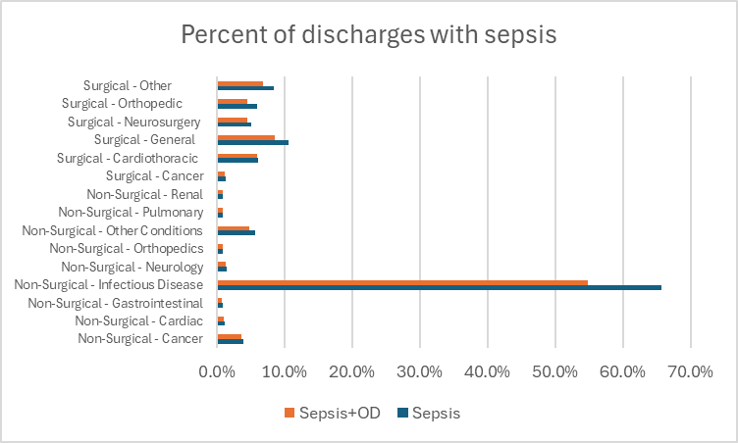
Patients with sepsis by service line: All sepsis and sepsis with organ dysfunction

Slide 52
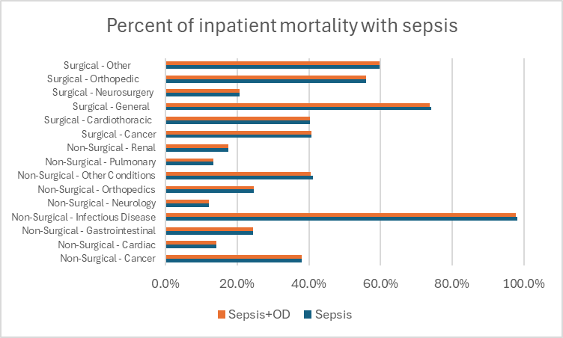
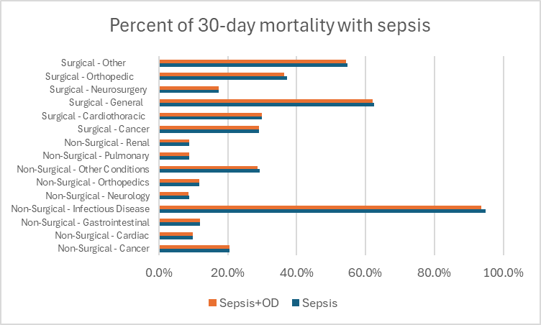
Sepsis share of mortality, by service line

Slide 53
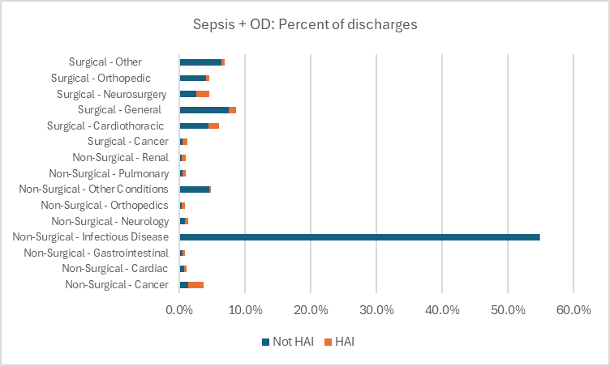
Sepsis (with organ dysfunction) as healthcare associated infection vs sepsis present on admission

Slide 54
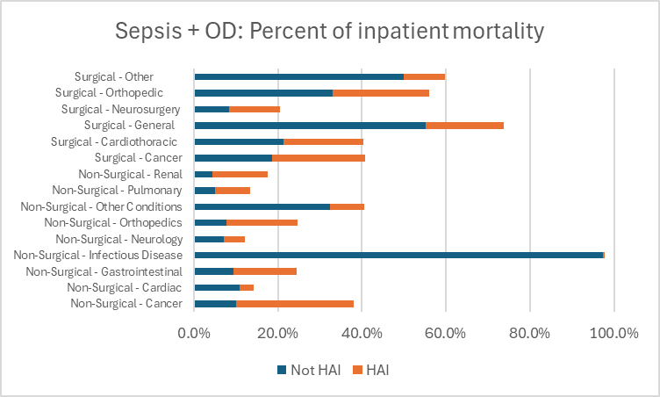
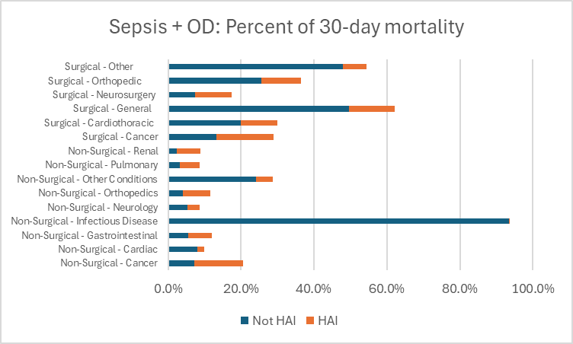
Role of healthcare associated sepsis infections in mortality, by service line

Slide 55
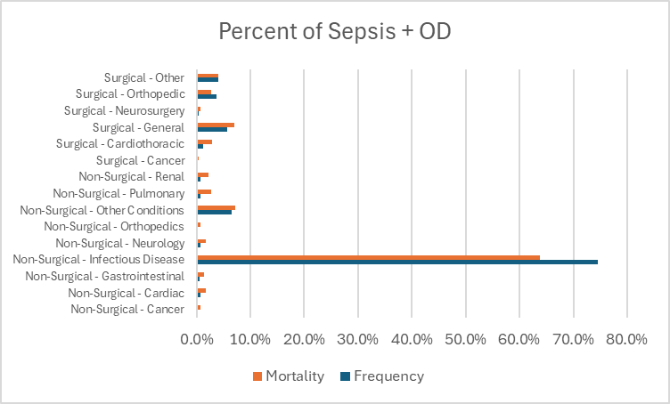
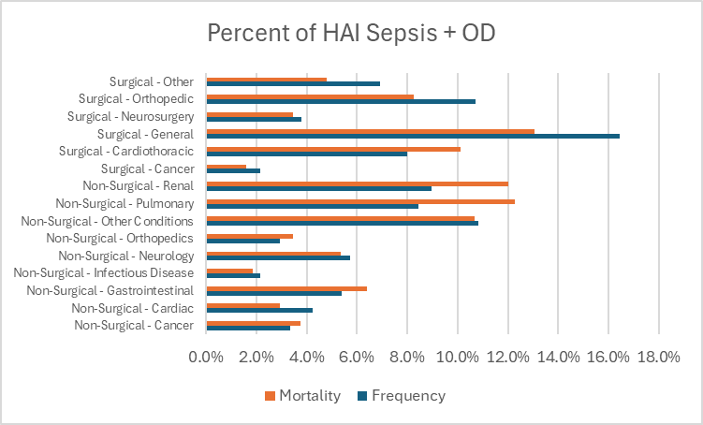
Service line share of sepsis (with organ dysfunction) and share of sepsis inpatient mortality

Slide 56
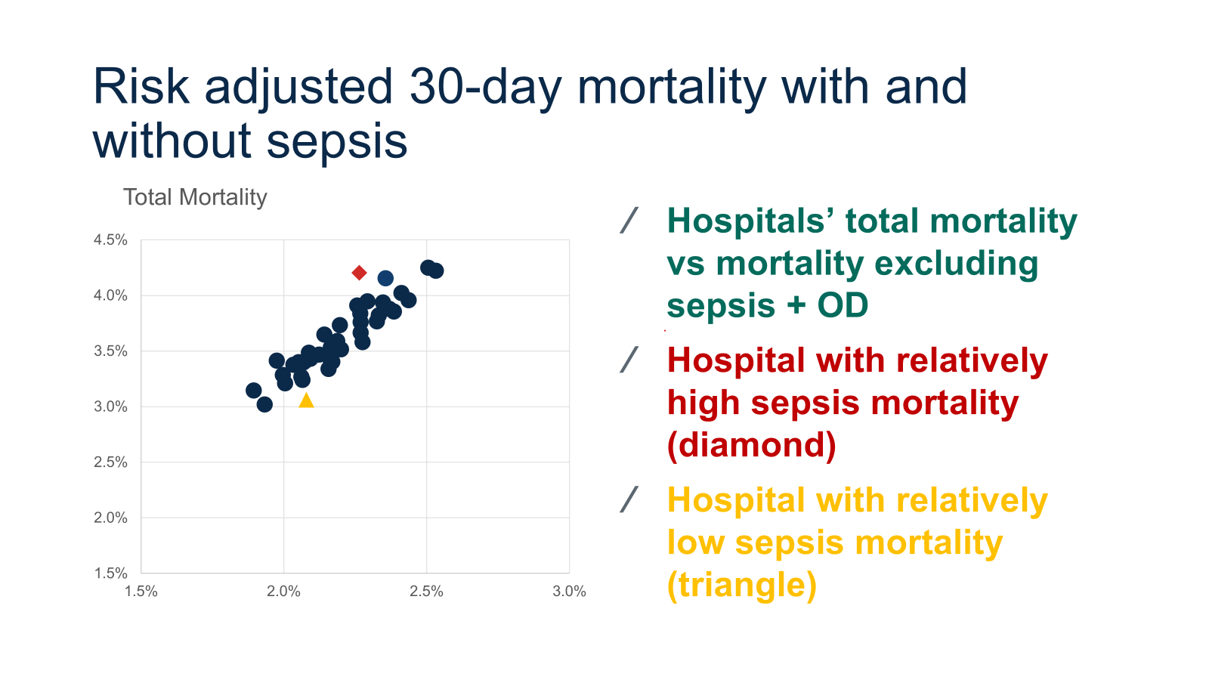
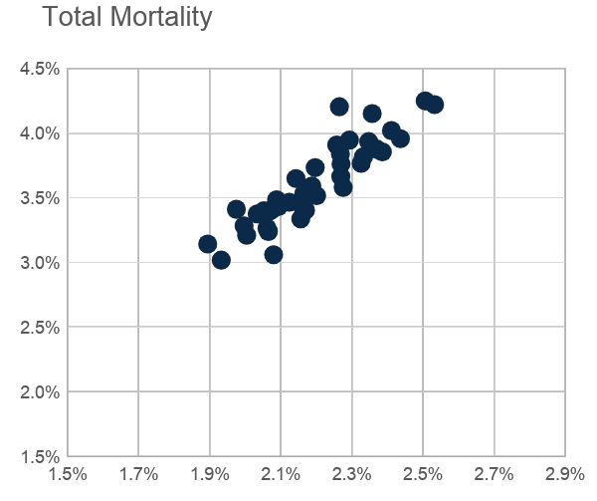
Risk adjusted 30-day mortality with and without sepsis
Hospitals’ total mortality vs mortality excluding sepsis + OD
Hospital with relatively high sepsis mortality (diamond)
Hospital with relatively low sepsis mortality (triangle)

Slide 57
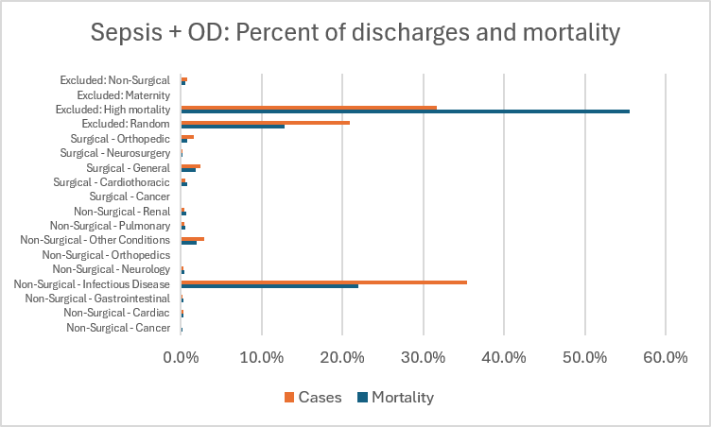
Share of Sepsis + OD Frequency and 30-Day Mortality by Service Line and Exclusion

Slide 58
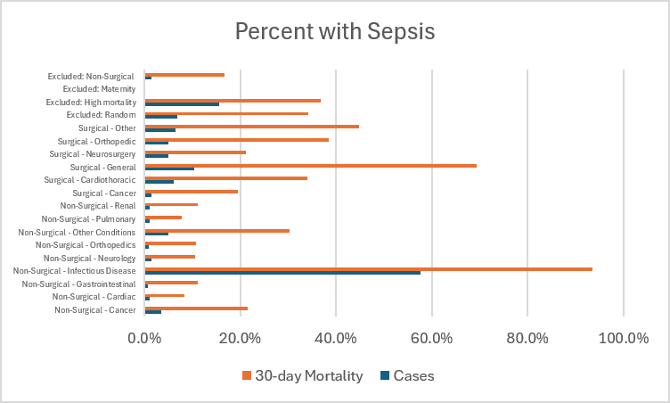
Share of Sepsis + OD in Discharges and 30-day Mortality

Slide 59
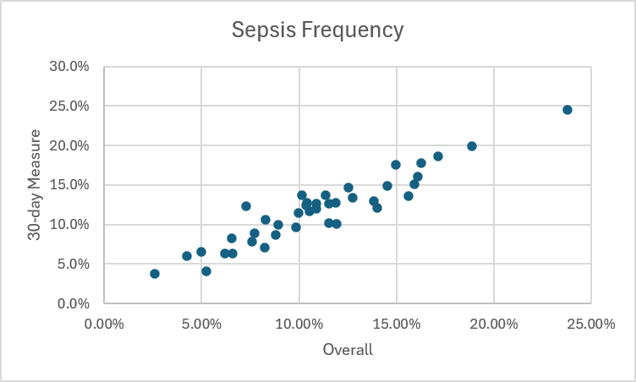
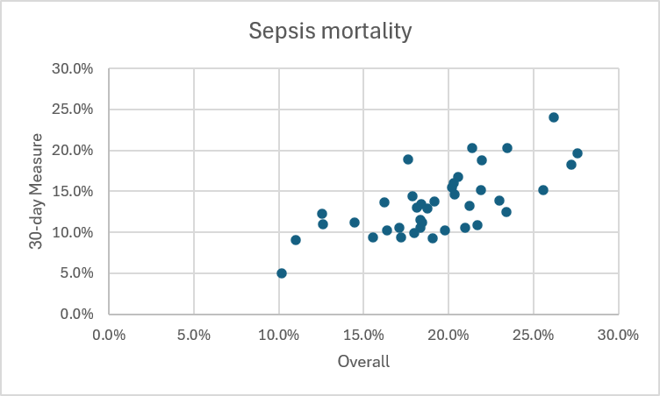
Sepsis + Organ Dysfunction by Hospital: Overall vs Dashboard 30-day Measure

Slide 60
Conclusions
Over 60% of discharges for the infectious disease service line in 2023 were patients with sepsis
  Over half were for sepsis + OD
Between 4% and 10% of discharges in surgical service lines involved sepsis + OD
Over 90% of infectious disease mortality was for patients with sepsis
  Almost all sepsis mortality includes organ dysfunction
For most surgical service lines, over 40% of inpatient mortality was incurred by sepsis patients
  The sepsis share of 30-day mortality is less than its share of inpatient mortality
Almost all infectious disease sepsis was present on admission; for other service lines, a substantial share was HAI

Slide 61
Conclusions (continued)
Among discharges included in the 30-day measure, over 70% of sepsis + OD discharges were in the infectious disease service line, accounting for over 60% of sepsis mortality
  Surgical discharges and the non-surgical – other service line accounted for most remaining sepsis discharges and mortality
General surgery accounted for the greatest share of HAI sepsis discharges and mortality
  HAI sepsis and sepsis mortality were spread across many service lines; the shares were least for infectious disease and cancer surgery
In 2025, 30-day mortality including sepsis cases was strongly correlated with 30-day mortality excluding them (r=0.90)
Over a third of sepsis cases and over half of sepsis mortality are excluded from the 30-day measure
Of high mortality cases excluded from the 30-day measure, under 20% were sepsis cases and under 40% of mortality was among sepsis cases
The frequency of sepsis in the overall hospital population is highly correlated with its frequency in the 30-day measure (r=0.94); mortality in the overall population is moderately correlated with mortality in the 30-day measure (r=0.70)

Slide 62
Mortality Measure Questions for Discussion
HSCRC is continuing work on risk adjusting our claims-based 30-day mortality measure using the Core Clinical Data Elements.
  Thoughts about migrating to a state hybrid 30-day Mortality?
  Are there additional considerations or analyses that should be done related to Hybrid CMS vs Maryland measure inclusions, exclusions?
How should we proceed to maximize our measurement of Sepsis mortality?
  What additional analysis should we do?
  Should we consider the option to use the AHRQ definition used in the HSCRC Sepsis Dashboard on CRISP Reporting Services
  Should we adjust the current HSCRC measures to better account for sepsis cases?
  Should we consider migrating to the CDC the Adult Community Onset Sepsis digital hybrid mortality measure when available?

Slide 63
Measures of Interest Matrix: Discussion

Slide 64
Candidate Measures of Interest
Endorsed by P4QM
CMS Pay for Performance Measures
  Total Hip Knee Arthroplasty
  Centers for Disease Control National Health Safety Network Healthcare Associated Infection (CDC NHSN HAI) Measure
Required Digital Measures (eCQMs)
  Cesarean Section (PC 02)
  Severe Obstetric Complications (PC 07)
  Severe Hyperglycemia (eCQM)
  Severe Hypoglycemia (eCQM)
  Safe Opioid Use Concurrent Prescribing (eCQM)
Measures under development or consideration
  Hospital Onset Bacteremia and Fungemia (CDC NHSN HAI)
SEE MEASURES EXCEL WORKBOOK FOR DETAILED SPECIFICATIONS AND TECHNICAL FINDINGS REGARDING THE MEASURES

Slide 65
Hospital Onset Bacteremia (HOB)
CBE ID 3686
Title CDC, National Healthcare Safety Network (NHSN) Hospital-Onset Bacteremia & Fungemia Outcome Measure
Endorsement Status: Endorsed , 7/24/2023 (no conditions)
Next Maintenance Cycle: Fall 2028
Measure Description: Risk-adjusted ratio of observed bacteremias and fungemias to predicted bacteremias and fungemias among patients previously admitted to acute care hospitals.
Numerator: Observed bacteremia and fungemia among patients previously admitted to acute care hospitals.
Denominator: The HOB measure denominator is the predicted number of HOB events in an acute care hospital based on predictive models using facility-level and patient-level factors.

Slide 66
Updated Measure Evaluation and Selection Criteria
Data Analysis/Statistics
  Variation across hospitals
  Reliable and Valid*
  Not topped off
  Improvement is needed
Additional Considerations
  Clinical significance^
  Coding: Supports coding practice improvements/not subject to known coding changes or concerns
  Opportunity for improvement/actionability*^
  Measure overlaps, e.g., PPC-PSI
  All-payer
  Feasible
New Proposed Criteria
National CMS alignment; consider CMS and MUC measures*
Addresses state priorities for quality and population health improvement
Cost of Proprietary systems*^
Adequate risk adjustment*
Digitally specified*
*Emphasized by subgroup
^Emphasized by PMWG
Notes:
State overall goal of the program

Slide 67
CAEM Next Steps

Slide 68
THANK YOU!
Next Meeting (Tentative): July 22, 2026
f

Slide 69
Appendix

Slide 70
CMS Measures

Slide 71
THK Arthroplasty P4QM Maintenance Review Fall 2024*
Following Committee review, P4QM staff assessment concluded:
The Feasibility criteria was met
The following criteria were not met but deemed addressable:
  Importance
  Closing the care gap
  Scientific Acceptability
  Use and Usability
Public comment stated endorsement should be removed because of the following concerns:
Exclusion of patients receiving outpatient surgery
Exclusion of Medicare patients during first year of Medicare eligibility
Failure to Adjust for Low Income Status
Inappropriate Adjustment for Type of Insurance
Inadequate Assessment of Model Fit
Poor Reliability of the Measure
Lack of Business Case for Using the Measure and Undesirable Effects of Doing So
*Refer to THK Arthroplasty Measure detailed endorsement information on the P4QM Website using the link in the title.
PUBLIC COMMENT Fall 2024
Center for Healthcare Quality and Payment Reform
The developer did not report how many hospitals would be classified as different from the national average using the proposed measure. However, the Measure Update Report for the current version of the measure (which uses data only for Original Medicare beneficiaries) indicates that the measure was only able to determine that 27 hospitals out of 3,257 hospitals performed “Better Than the National Rate,” and only 8 performed “Worse Than the National Rate.” 1,724 hospitals were classified as “No Different Than the National Rate,” and 1,498 had too few cases (less than 25) to make a determination of whether the hospital was better or worse than average.

Slide 72

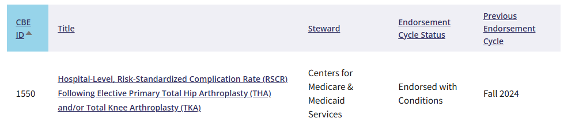
THK Arthroplasty P4QM Maintenance Review
E&M Committee Rationale/Justification
After the endorsement meeting, the developer of CBE #1550 submitted an appeal due to the following rationales:
Procedural error in the endorsement process; excessive focus on outpatient setting exclusion, outside scope of IP measure.
Misapplication of measure evaluation criteria, particularly risk adjustment.
The Appeals Committee voted to uphold the appeal based on both rationales above. Measure’ Endorsed with Conditions. When the measure returns for maintenance (5 years), the measure developer should have:
Explored the proportion of procedures done in the ASC/HOPD* setting and evaluate the need for adjustment (e.g., risk, stratification) based on impact to case mix.
Explored additional approaches to the reliability assessment to account for low-volume facilities (e.g., borrowing strength).

Slide 73
CDC NHSN HAI Measures: MRSA and CDiff Endorsement Status
CBE #1716 – Methicillin-resistant Staphylococcus Aureus (MRSA) Bacteremia LabID Event Standardized Infection Ration (SIR) [CDC NHSN] – Maintenance
Endorsed with Conditions: Fall 2025.
When the measure comes back for maintenance in 3 years, the developer will have: Explored the possibility of using other all-payer data sources to expand the use of patient- level factors in the risk adjustment model and reduce reliance on facility-level factors.
Vote Count: Endorse (2 votes; 10%), Endorse with Conditions (14 votes; 70%), Remove Endorsement (4 votes; 20%)
Summary of Public Comments: Battelle received one comment from the University of California Davis Health prior to the meeting. University of California Davis Health argued that the measure fails PQM Reliability criterion (>50% of facilities are below the threshold of 0.6), likely violates Poisson assumptions (overdispersion), and requires a longer performance period or higher minimum denominator for reliability.
CBE #1717 – Clostridium difficile (CDI) LabID Event Standardized Infection Ratio (SIR) [CDC NHSN] – Maintenance
Endorsed with Conditions: Fall 2025.
When the measure comes back for maintenance in 3 years, the developer will have: Explored the possibility of using other all-payer data sources to expand the use of patient- level factors in the risk adjustment model and reduce reliance on facility-level factors.
Vote Count: Endorse (1 vote; 6%), Endorse with Conditions (14 votes; 78%), Remove Endorsement (3 votes; 17%)

Slide 74
CDC NHSN HAI CLABSI and CAUTI Measures: Endorsement Status
Central Line-Associated Bloodstream Infection (CLABSI) Standardized Infection Ratio. CBE ID: 0139
1.5 Project: Management of Acute Events, Chronic Disease, Surgery, and Behavioral Health.
Endorsement Status: Endorsed with Conditions(Spring 2025) E&M Committee Rationale/Justification: When the measure returns for maintenance (3 years), the measure developer should have explored the possibility of using other all-payer data sources to expand the use of patient-level factors in the risk-adjustment model and reduce reliance on facility-level factors.
Catheter-Associated Urinary Tract Infection (CAUTI) Standardized Infection Ratio. CBE ID: 0138
1.5 Project: Management of Acute Events, Chronic Disease, Surgery, and Behavioral Health .
Endorsement Status: Endorsed with Conditions (Spring 2025) E&M Committee Rationale/Justification: When the measure returns for maintenance (3 years), the measure developer should have explored the possibility of using other all-payer data sources to expand the use of patient-level factors in the risk adjustment model and reduce reliance on facility-level factors.
Public comment: …”In the Inpatient Rehabilitation Facilities (IRF) space, 757 hospitals were designated on Care Compare as ‘Not Applicable,’ 54% are IRFs that had infections. Instead of being designated as the safest care providers related to catheter associated urinary tract infections on IRF Compare for consumer comparison, they are not displayed with a comparative category at all, effectively misrepresenting which IRF providers are, in fact, “better” with not only fewer infections – but zero, as “Not Applicable.”

Slide 75
CDC NHSN HAI SSI Measures: Endorsement Status
30-Day Post-Operative Colon Surgery (COLO) and Abdominal Hysterectomy (HYST) Surgical Site Infection (SSI) Standardized Infection Ratio (SIR). CBE ID: 0753
1.5 Project: Management of Acute Events, Chronic Disease, Surgery, and Behavioral Health
Endorsement Status: Endorsed with Conditions (Spring 2025)
E&M Committee Rationale/Justification
When the measure returns for maintenance (3 years), the measure developer should have:
Explored the possibility of using other all-payer data sources to expand the use of patient-level factors in the risk-adjustment model and reduce reliance on facility-level factors.
Explored the exclusion of the patient-level factors such as procedure duration and American Society of Anesthesiologists (ASA) score, while also considering the inclusion of procedure complexity and patient comorbidities.
Explored stratification of trauma cases rather than include as a risk-adjustment variable.

Slide 76
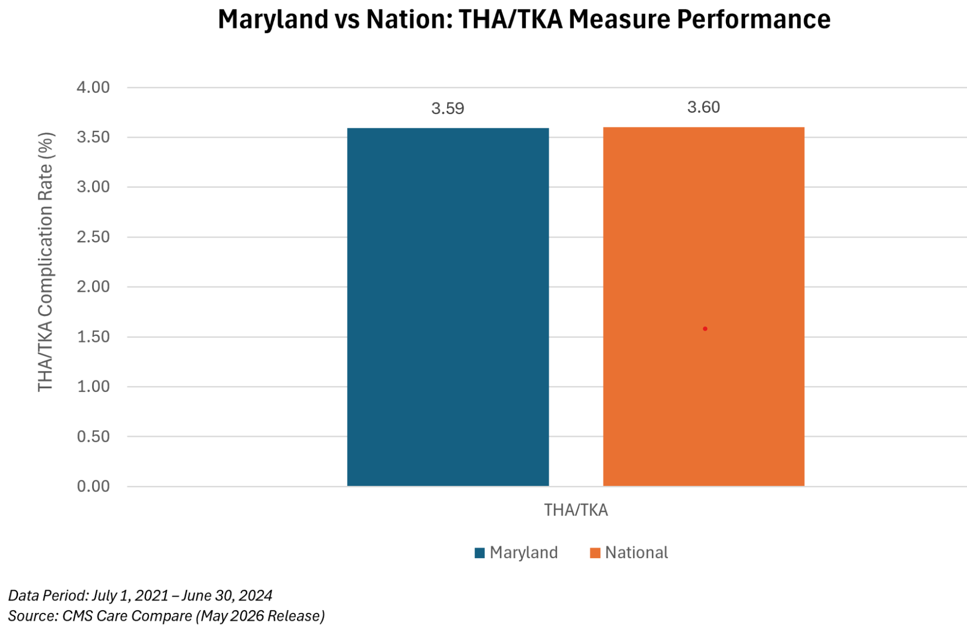
Maryland Performance is Comparable to the Nation THK Arthroplasty Complications

Slide 77
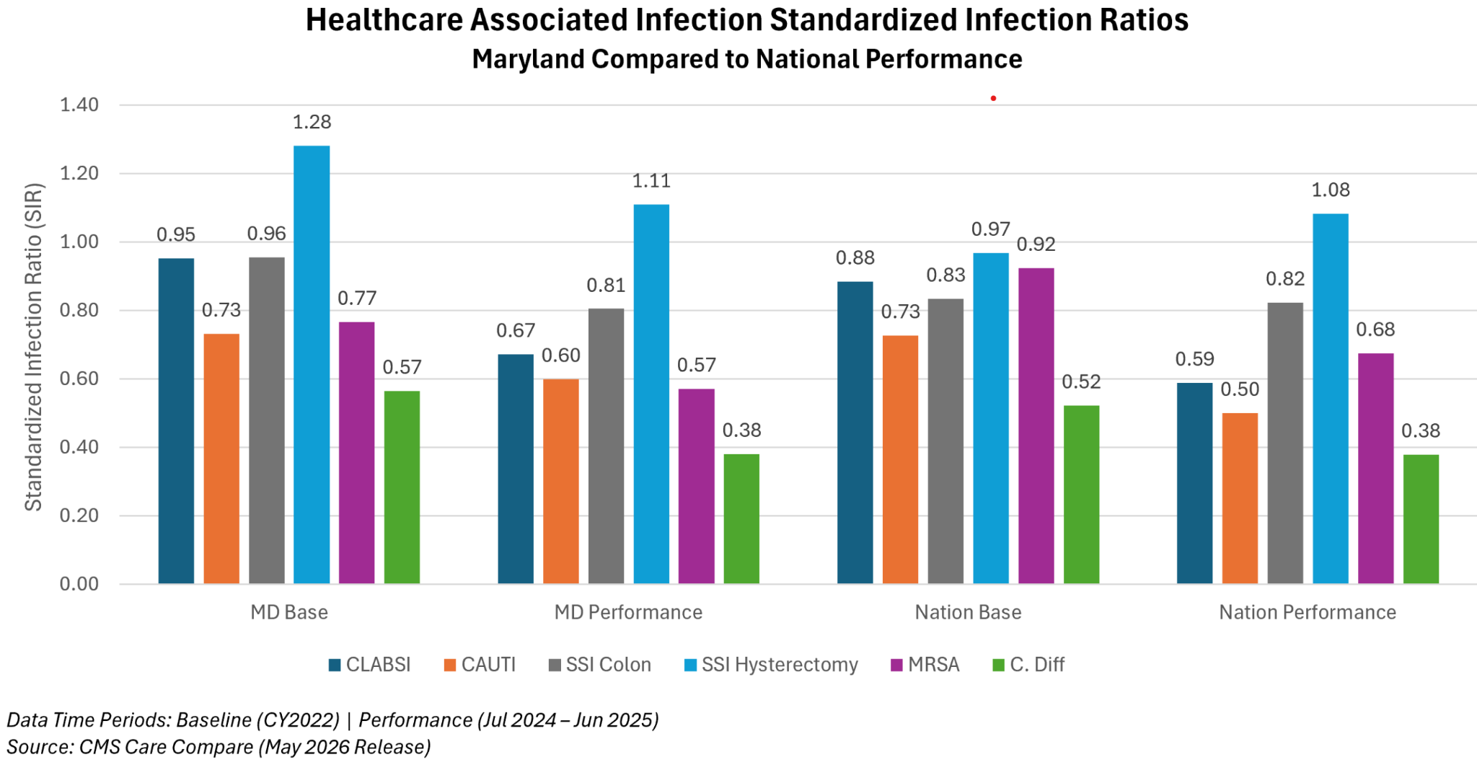
Maryland Performance is Comparable to the Nation on CDC NHSN HAI Pay for Performance Measures

Slide 78
Electronic Clinical Quality Measures (eCQMs)- Another potential source of Measures

Slide 79
eCQM Endorsement Status (See Workbook for Measure Specifications)
Rate of severe hypoglycemia among hospitalized patients. CBE ID:3503e
1.5 Project: Management of Acute Events, Chronic Disease, Surgery, and Behavioral Health
Endorsement Status: Endorsed with Conditions Spring 2025
E&M Committee Rationale/Justification: By measure maintenance (5 years), the developer will have considered the potential for risk adjustment through empirical analysis.
Hospital Harm - Severe Hyperglycemia. CBE ID: 3533e
1.5 Project: Management of Acute Events, Chronic Disease, Surgery, and Behavioral Health
Endorsement Status:Endorsed with Conditions Spring 2025
E&M Committee Rationale/Justification: When the measure returns for maintenance review in 5 years, the developer will have: Considered the potential for risk adjustment through empirical analysis.
Safe Use of Opioids – Concurrent Prescribing. CBE ID: 3316e. 1.5 Project: Primary Prevention. Endorsement Status: Endorsed with Conditions Fall 2023. E&M Committee Rationale/Justification:
Expand reliability and validity testing to ensure a more diverse population and explore regional diversity within testing.
Explore new versus current users of opioids and benzodiazepines on admission, and stratify by these populations.
ePC-07 Severe Obstetric Complications. CBE ID: 3687e. Endorsement Status: Approved for Trial Use ..1.0 New or Maintenance: New. Next Maintenance Cycle: Spring 2027. Known Issues with POA submission on secondary Dx codes.
ePC-02 Cesarean Birth. CBE ID: 0471e. 1.5 Project: Perinatal and Women's Health. Endorsement Status: Endorsed Spring 2022. Next Maintenance Cycle: Spring 202

Slide 80
ePC-02 Cesarean Birth Endorsed Measure
Planned Use
Measure Currently in Use
Public Reporting
6.1.2 Current or Planned Use(s)
Measure Currently in Use
Public Reporting
Quality Improvement (Internal to the specific organization)
Quality Improvement with Benchmarking (external benchmarking to multiple organizations)
Regulatory and Accreditation Programs
SEE ATTACHED PDF FILE WITH MEASURE TECHNICAL DETAILS SUBMITTED TO NQF IN 2022 FOR ENDORSEMENT CONSIDERATION.

Slide 81
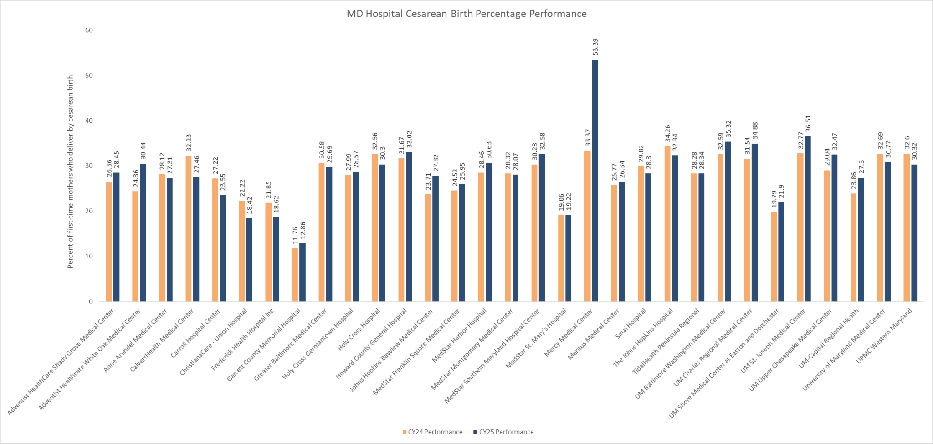
PC 02- Cesarean Section (CMS334)
Year | Measure | N | Mean | 10th Percentile | 25th Percentile | Median | 75th Percentile | 90th Percentile
CY 2024 | Cesarean Birth | 32 | 29.36 | 21.89 | 24.48 | 28.39 | 32.31 | 32.76
CY 2025 | Cesarean Birth | 32 | 30.70 | 19.49 | 27.06 | 28.51 | 32.37 | 35.28

Slide 82
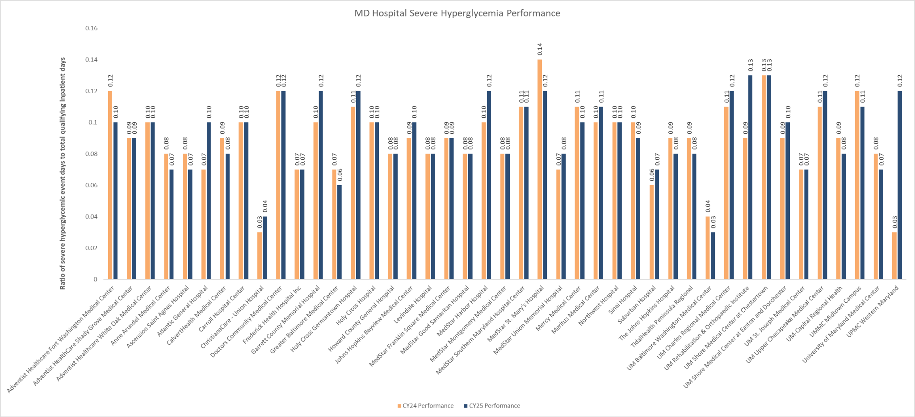
HH Hyper- Hospital Harm Severe Hyperglycemia (CMS871)
Year | Measure | N | Mean | 10th Percentile | 25th Percentile | Median | 75th Percentile | 90th Percentile
CY 2024 | Hospital Harm - Severe Hyperglycemia | 43 | 0.0898 | 0.070 | 0.080 | 0.090 | 0.100 | 0.118
CY 2025 | Hospital Harm - Severe Hyperglycemia | 43 | 0.0928 | 0.070 | 0.080 | 0.100 | 0.110 | 0.120

Slide 83
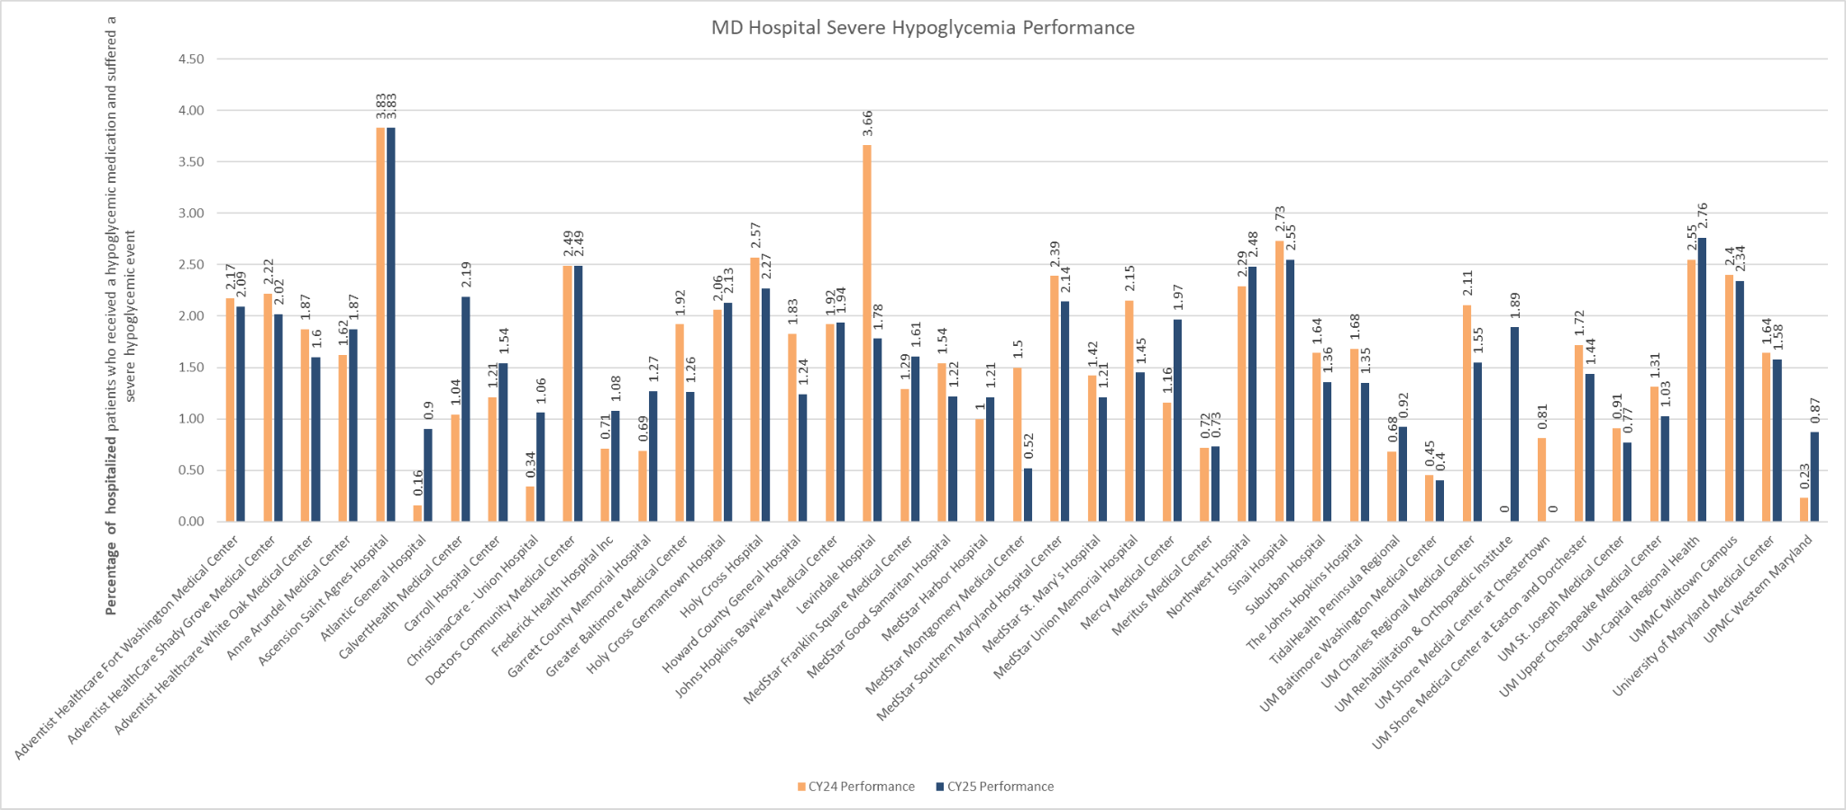
HH Hypo- Hospital Harm Severe Hypoglycemia (CMS816)
Year | Measure | N | Mean | 10th Percentile | 25th Percentile | Median | 75th Percentile | 90th Percentile
CY 2024 | Hospital Harm - Severe Hypoglycemia | 43 | 1.5960 | 0.496 | 0.955 | 1.640 | 2.160 | 2.538
CY 2025 | Hospital Harm - Severe Hypoglycemia | 43 | 1.5793 | 0.790 | 1.145 | 1.540 | 2.055 | 2.452

Slide 84
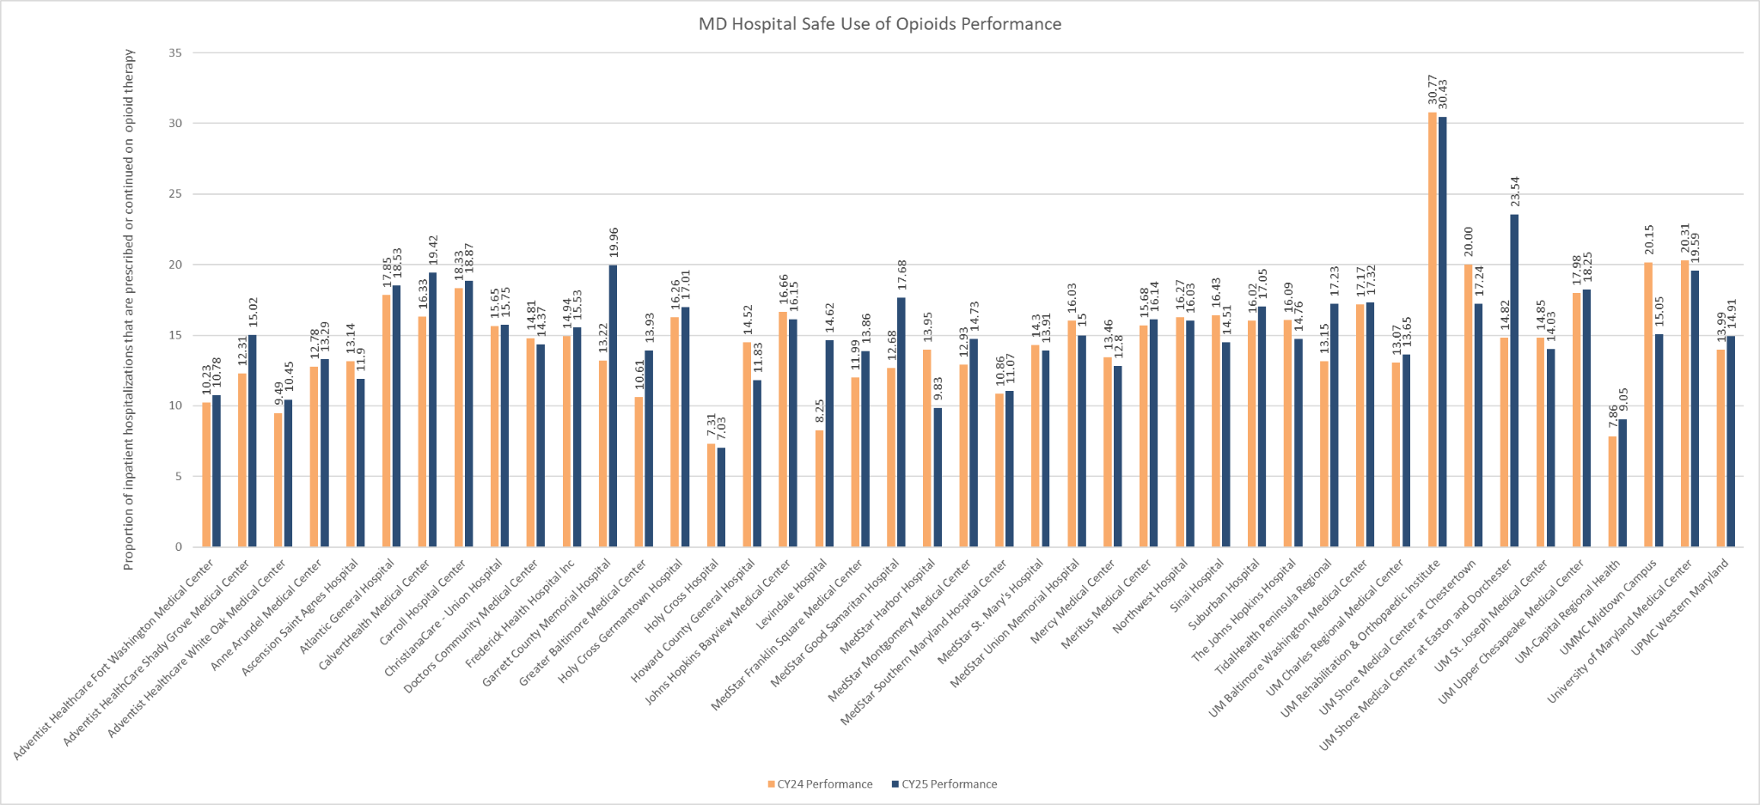
Safe Use of Opioids (CMS506)
Year | Measure | N | Mean | 10th Percentile | 25th Percentile | Median | 75th Percentile | 90th Percentile
CY 2024 | Safe Use of Opioids - Concurrent Prescribing | 43 | 14.73 | 10.31 | 12.86 | 14.81 | 16.30 | 18.26
CY 2025 | Safe Use of Opioids - Concurrent Prescribing | 43 | 15.40 | 10.84 | 13.76 | 15.00 | 17.24 | 19.31

Slide 85
CMS Performance Results
COND SPEC MORT, SEP 1

Slide 86
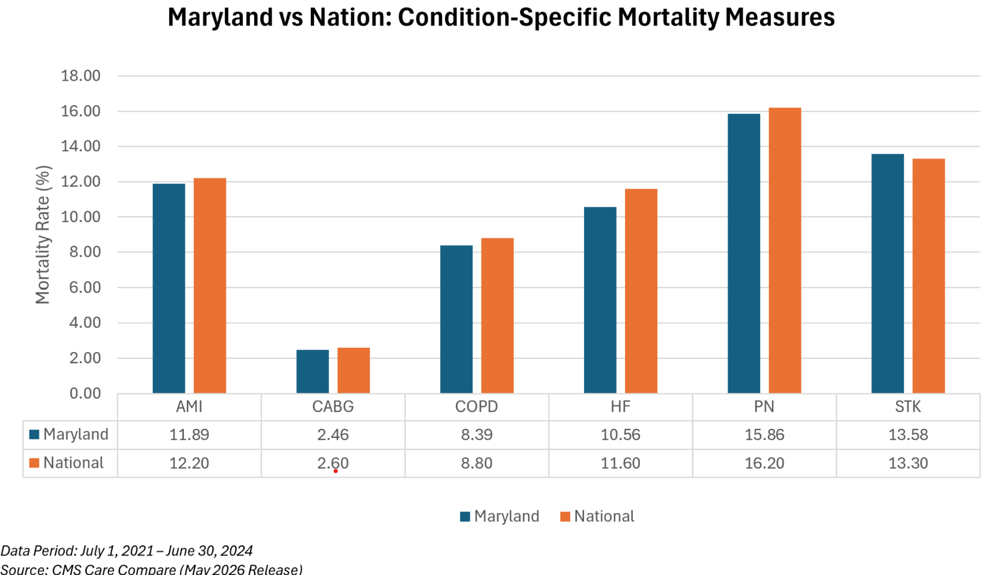
Maryland Performance is Slightly Better than the CMS 3-Day Condition Specific Mortality Measures with Exception of Stroke

Slide 87
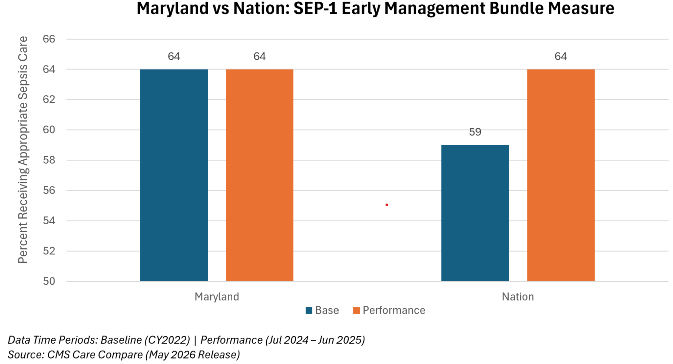
Maryland Performance on the Sep-1 Measure is Comparable to the Naiton

Slide 88
Sepsis Mortality Measure Comparison

Slide 89
Definition of Sepsis
Measure | Sepsis Definition
CDC Adult Community-Onset Standardized Sepsis Mortality Ratio (SMR) | Present on admission determination: Uses present on admission (POA) logic that identifies community onset sepsis as follows: diagnosis that is present on the day of admission to an inpatient location (calendar day 1), the 2 days before admission, or the calendar day after admission (POA time period). Inpatient mortality: Patients who die during the hospital stay or are discharged to hospice. Sepsis events are identified from electronic health records (EHR) using a combination of clinical indicators of presumed serious infection and evidence of organ dysfunction documented during hospitalization. Indicators of presumed infection include the collection of blood cultures and the initiation of new antimicrobial therapy. Evidence of organ dysfunction may include abnormalities in laboratory results, initiation of supportive therapies, or other indicators consistent with acute physiologic deterioration. Timing relationships between infection indicators and organ dysfunction indicators determine whether a qualifying sepsis event has occurred. Event identification is based on the temporal association of these elements as documented in the EHR.
HSCRC 30-day sepsis mortality | Present on admission determination: POA codes identify sepsis that was identified during the course of the stay and not found to be present on admission (healthcare-associated infection or HAI) . Both community acquired and HAI are included; the HAI indicator in HSCRC’s Sepsis Dashboard can be used to stratify unadjusted results. 30-day mortality: Patients who die within 30 days of being admitted to a hospital. Sepsis events are identified based on ICD-10 diagnoses codes indicating sepsis and confirmed by ICD-10 codes for organ dysfunction (Dombrowsky method). 30-day sepsis mortality rates are calculated for the following two service lines: surgical and non-surgical.

Slide 90
Overview of sepsis mortality measures
Measure | Data Source | Current use | Measure
CDC Adult Community-Onset Standardized Sepsis Mortality Ratio (SMR) | Claims and EHR | Measure being developed and could be used in CMS programs in future | Annual risk-adjusted standardized mortality ratio (SMR) of adult inpatients with community-onset sepsis. SMR is calculated as the observed-to-predicted ratio of adult community-onset sepsis in-hospital deaths or discharges to hospice.
HSCRC 30-day sepsis mortality rate | Casemix | HSCRC Sepsis Dashboard | Risk-adjusted 30-day mortality ratio calculated as the mean predicted probability over the mean expected probability of death within 30-days of being admitted to a hospital among patients with a diagnosis of sepsis. Two separate risk-adjusted mortality rates are calculated for the surgical service line and non-surgical service line.
Notes:
PCR, Hybrid HWR, RRIP, and the current contractual CMMI measure – compare to national

Slide 91
Overview of sepsis mortality measures
Measure | Initial Population | Numerator Exclusions | Denominator Exclusions
CDC Adult Community-Onset Standardized Sepsis Mortality Ratio (SMR) | All encounters for patients of any age in an ED, observation, or inpatient location | • Patients <18 years of age • Length of hospitalization >120 days • Patients with prior enrollment in hospice • Patients that transferred to another acute care hospital | None
HSCRC 30-day sepsis mortality rate | Patients ages 95 and younger residing in Maryland and treated in Maryland hospitals | None | • Patients enrolled in hospice before, during, or within 30 days after admission • Maternal, neonatal, and ungroupable admissions • Transfers, Left Against Medical Advice, Inconsistent vital status (death prior to admission or prior to discharge if discharged alive) • Any diagnosis of metastatic cancer or a principal diagnosis indicating low survival probability • After these exclusions are imposed, a random admission is selected for each patient with multiple stays and other admissions are excluded
Notes:
PCR, Hybrid HWR, RRIP, and the current contractual CMMI measure – compare to national

Slide 92
Overview of sepsis mortality measures
Measure | Numerator | Denominator
CDC Adult Community-Onset Standardized Sepsis Mortality Ratio (SMR) | Number of annually observed adults with community- onset sepsis who died during hospitalization or were discharged to hospice. | Number of annually predicted adults with community- onset sepsis who died during hospitalization or were discharged to hospice.
HSCRC 30-day sepsis mortality rate | Hospital-specific predicted probability of death within 30 days of being admitted to the hospital among patients with sepsis | Hospital-specific expected probability of death within 30 days of being admitted to the hospital among patients with sepsis
Notes:
PCR, Hybrid HWR, RRIP, and the current contractual CMMI measure – compare to national

Slide 93
Overview of risk adjustment
Measure | Risk Adjustment
CDC Adult Community-Onset Standardized Sepsis Mortality Ratio (SMR) | The regression-based risk adjustment model calculates the predicted number of adults with community-onset sepsis who died during hospitalization or were discharged to hospice. Risk adjustment model includes variables from EHR, claims and NHSN survey. From EHR: Sex; Age; admission from a facility or hospital transfer; patient-level physiology on admission; blood pressure; lactate; creatinine; platelets; white count; anion gap; hematocrit; ALT; bilirubin; sodium; albumin; hypothermia; vasopressors; BMI. From claims: comorbidities; present on admission codes for pulmonary, genitourinary, skin; procedure codes for mechanical ventilation. From NHSN survey: hospital size.
HSCRC 30-day sepsis mortality rate | Predicted probability is calculated as the probability of mortality projected from the model including the hospital’s intercept, while expected probability is projected without that intercept. The model includes age, sex, indication of palliative care and APR-DRG-ROM

Slide 94
Medisolv Digital Measures to Quality IQ Platform
on CRISP
(See Appendix for login tips)
Link to Webinar Demo on Using the Medisolv Digital Measures Quality IQ Platform (may be prompted to register):
https://event.on24.com/wcc/r/5257402/95F7D05A99E38B7DD00225E0BB0387FD

Slide 95
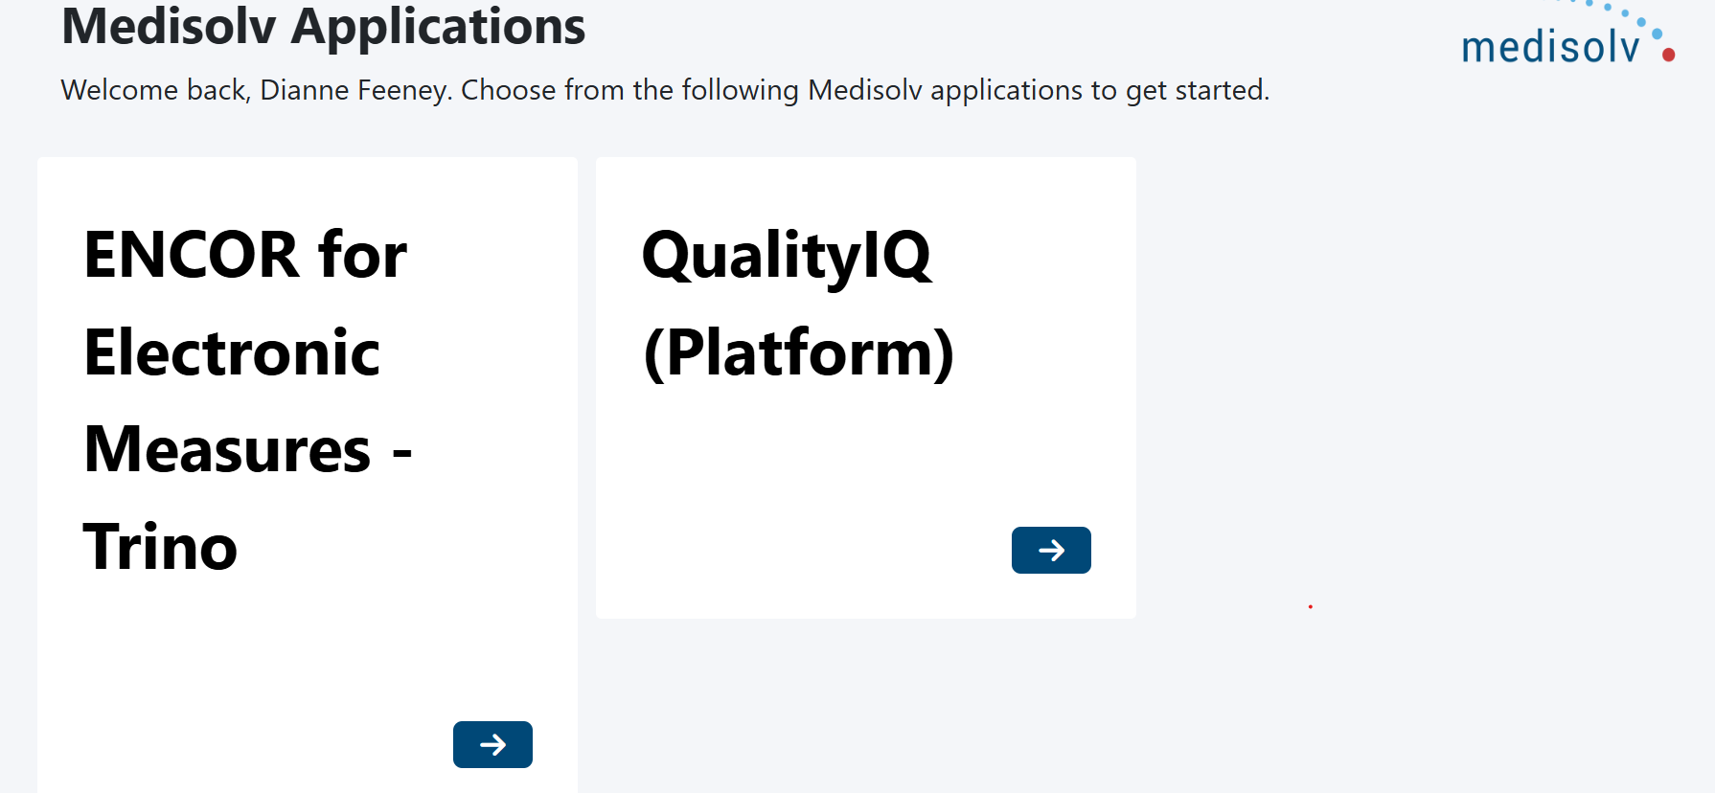
Quality IQ Plagform

Slide 96
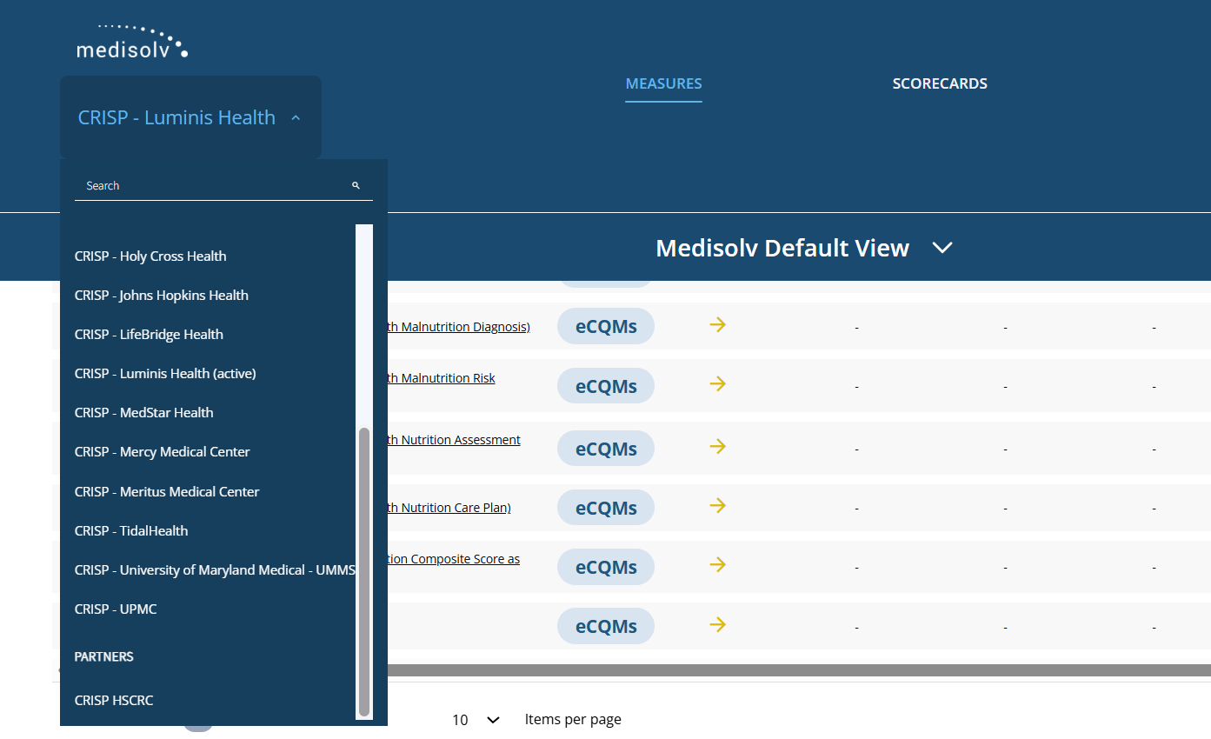
The Quality IQ URL is https://qualityiq.medisolvcloud.com/measures

