Slide 1
All-Payer Model Update
February 10, 2017

Slide 2
Maryland’s All-Payer Model
Goal:
Fundamentally transform the Maryland health care system
  Provide person-centered care
  Improve care delivery and outcomes
  Moderate the growth in costs

Slide 3
Maryland’s All-Payer Model
Background:
5-year Agreement with the Centers for Medicare & Medicaid Services (CMS), 2014 – 2018
  Under Affordable Care Act (ACA) provisions
  Care Redesign Amendment approved Sept. 2016
Proposal for second term filed in Dec 2016
Importance of the All-Payer Model

Slide 4
Maryland’s All-Payer Model
Status:
At start of the 4th year, Maryland is meeting the requirements of the agreement with CMS
  All hospitals on global revenue agreements since 2014
  Savings and quality requirements are on track
  Stakeholders organizing and changing delivery
  Generally positive feedback from CMS
    Basis for new model for rural hospitals in Pennsylvania

Slide 5
Care Redesign Amendment: Approved by CMS in September 2016
Providers called for alignment strategies
Care Redesign Amendment allows hospitals to participate in care redesign with physicians, nursing homes, and others:
  Access to Medicare data
  Approvals for hospitals to share resources and pay incentives based on savings to other providers
  Flexibility to create ongoing care redesign programs
  State working to align Amendment with MACRA requirements
Legal documents are still in progress

Slide 6
Care Redesign Amendment: Two Initial Programs
Two initial care redesign programs aim to align hospitals and other providers
Voluntary participation
Hospital Care Improvement Program (HCIP)
Designed for hospitals and providers practicing at hospitals Focus on efficient inpatient care and effective transitions of care Goal: Facilitate improvements in hospital care that result in care improvements and efficiency
Complex and Chronic Care Improvement Program (CCIP)
Designed for hospitals and community providers and practitioners Focus on complex and chronic patients Goal: Enhance care management

Slide 7
Proposal for Second Term Beginning in 2019: Overview, Timeline, Legislative Needs

Slide 8
Maryland’s Need to Address Aging Population Chronic Healthcare Needs
37% increase in Maryland’s population >65 years old between 2015 and 2025
Without coordinated comprehensive care, extraordinary expenses will occur
Profound impact on federal and state budgets and delivery systems
  E.g. the increase in utilization/spend in Medicare/Medicaid for dually eligible
  Need significant changes in delivery system
  Need improvements in care and supports for complex patients in facility setting/chronic care management in community settings

Slide 9


Payment and Care Delivery Alignment
Current
Planned
Hospitals on Global Budgets with quality targets
Providers on volume-based care without quality targets
Little coordination of care
Hospitals and Providers with aligned quality targets
Sharing information
Driving down costs
Improving the health of populations

Slide 10
Second Term Proposal: “Progression Plan” Highlights
Second term beginning in 2019
Build on global revenue model and continue transformation
Payment and delivery alignment beyond hospitals
Comprehensive Primary Care Model (begins 2018)
Dual Eligibles ACO
MACRA bonus-eligible programs

Slide 11
Progression Plan: Key Strategies
Foster accountability for care and health outcomes by supporting providers as they organize to take responsibility for groups of patients/a population in a geographic area.
Align measures and incentives for all providers to work together, along with payers and health care consumers, on achieving common goals.
Encourage and develop payment and delivery system transformation to drive coordinated efforts and system-wide goals.
Ensure availability of tools to support all types of providers in achieving transformation goals.
Devote resources to increasing consumer engagement for consumer-driven and person-centered approaches.

Slide 12
Potential Timeline
MACRA
Begin to implement MACRA bonus eligible models
MACRA bonus
available
2017
2018
2019
TBD
2020
Care Redesign Amendment
Negotiations with CMS for second term
Primary Care model
Geographic incentives in value based payments
Geographic partners and ACOs take on more responsibility
Dual Eligible ACOs
Post-acute
Behavioral health
Long-term care

Slide 13
Appendix

Slide 14
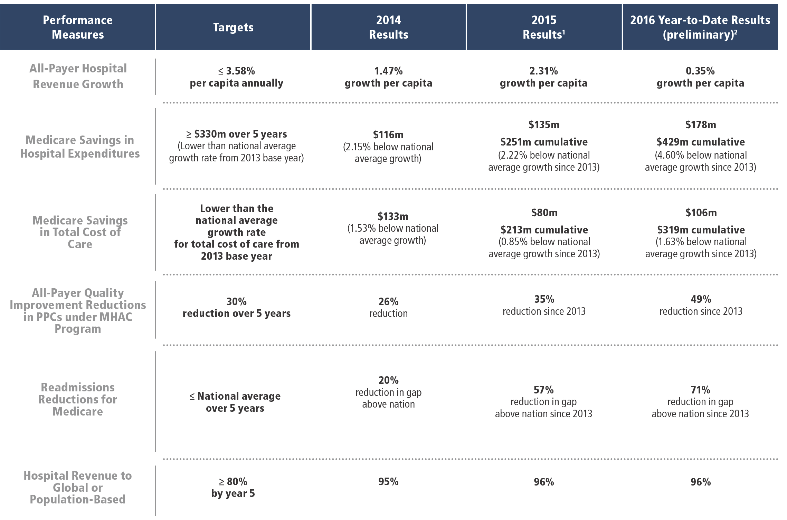
All-Payer Model: Performance to Date
Notes:
All Payer hospital revenue growth contained
Medicare hospital savings on track/non-hospital costs rising—need to accelerate reductions in unnecessary and preventable hospitalizations to offset “investments” in non-hospital costs
Quality measures on track
Delivery systems, payers, and regional partnerships organizing and transforming
Stakeholder participation contributing to success
Generally positive feedback from CMS

Slide 15
Major Impact of Federal Legislation Referred to as “MACRA” (Medicare Access and CHIP Reauthorization Act of 2015)
Bi-partisan federal legislation referred to as MACRA dramatically alters physician reimbursement for Medicare
  Focuses on moving from volume to value
  Physicians subject to potential payment reductions (or bonuses) up to 9% by 2022
  Creates 5% bonus for physicians in Advanced Alternative Payment Models (“Advanced APMs”)
Maryland will adapt its approaches to optimize opportunities for MACRA bonuses that can align performance goals under the All-Payer Model

Slide 16

Maryland Comprehensive Primary Care Program: Summary
CMS
Coordinating
Entity
Care Transformation
Organization
Care Transformation
Organization
Patient
Centered
Home
Patient
Centered
Home
Patient
Centered
Home
Patient
Centered
Home

Slide 17

Maryland Primary Care Model:
What does a transformed practice look like to a patient?
I am a Medicare beneficiary
Provider selection by my historical preference
I have a team caring for me led by my Doctor
My practice has expanded office hours
I can take advantage of open access and flexible scheduling:
  Telemedicine, group visits, home visits
My care team knows me and speaks my language
My records are available to all of my providers
I get alerts from care team for important issues
My Care Managers help smooth transitions of care
I get Medication support and as much information as I need
I can get community and social support linkages (e.g., transportation, safe housing)
Notes:
- Moving forward we envision patient selection of providers

