Slide 1
Complex and Chronic Care Improvement Program
All-Payer Model Amendment Webinar Series – Webinar 3
November 2, 2016

Slide 2
Welcome and Introduction Donna Kinzer, Executive Director, HSCRC
Donn

Slide 3
Chronic and Complex Care Improvement Program Deb Gracey (HMA) and Gail Miller (HMA)

Slide 4
Overview
Purpose
Basics of CCIP
How will CCIP work?
Funding and Incentive Payments
Email address for additional questions
Appendix
Frequently Asked Questions
Incentive Detail Slides

Slide 5
Purpose
Provide new and better care support to the aging population in Maryland
Create closer working relationships between hospitals and primary care physicians
Give physicians the tools they need to better care for patients - care managers, care technology, 24/7 care management phone access for patients
Reduce the hospitals avoidable admissions or lessen the days per stay of the chronically and complexly ill

Slide 6
The Basics of CCIP

Slide 7
What is the Maryland Complex and Chronic Care Improvement Program?
A complex and chronic care improvement program for the most seriously ill and those on the cusp of being the most seriously ill.
An opportunity for hospitals to provide care management staff and care resources to help community providers care for patients.
An innovative way to reduce medical expenses and improve health
A program aligned with CMS’s CCM fee requirements

Slide 8
Who is eligible to participate as a community provider or practitioner?
“Community physicians and practitioners” include all types of providers that are defined as eligible for the Chronic Care Management Fee (CCM).
Family practice, general or specialist physician, clinical nurse specialists and nurse practitioners
Must be designated by the patient as the primary provider of care
Must agree to manage all the patient’s care
Only one provider may be selected by the patient as the manager of that patient‘s care.
For purposes of this program, the eligible provider selected by the patient will be called the “Patient Designated Provider (PDP)”.

Slide 9
How Does the CCIP relate to the CCM fee?
Program requirements are designed to meet the billing requirements for CCM
Patient requirements - Two or more chronic conditions
Comprehensive care plan
Care plans established , implemented and revised
Continuous care management
Patient agreement
Structured reporting
Access to care
Hospital provided care management staff enables the process

Slide 10
How Will the CCIP Work?

Slide 11
Hospital Identifies the Patients
The program is open to all Medicare FFS and Dual Eligible patients who are classified as high risk or rising risk patients.
The hospital may use their own risk stratification tool of their choice.
Hospitals must include high risk and rising risk patients in the program.
A hospital may:
Use a standard definition of high risk which is patients with 3 or more admissions or observations within 12 months and two or more chronic conditions, one of which is one of the following conditions: Diabetes, COPD, Heart Failure or Hypertension. Rising risk is composed of at least 2 chronic conditions, with one of them being same conditions above and at least 2 admissions or observations and 2 ED visits in the last 12 months.
A hospital may also submit their own definition

Slide 12
Hospitals – Partner with PDPs
Hospitals will identify the PDP through patient selection in the hospital admission process, CRISP data, Medicare data or other methods.
Hospitals will invite the PDP to participate. PDPs will be required to sign a state approved Care Partner Agreement.
Hospitals will organize care management resources to assist the PDP’s execution of care management activities.

Slide 13
The Role of the Care Management Team
Hospitals will organize and fund care management staff to handle the care coordination functions to assist the PDP’s execution of care management activities. The team works under the direction of the PDP.
Follow directives of the PDP
Administering HRA and other assessment tools to identify gaps in care and deficits in ADLs and IADLs
Develop Care Plan for PDP review
Care plan updates including documentation needed for compliance purposes
Systematic assessment of the patient’s medical, functional, and psychosocial needs
Oversight of patient self-management of medications
Manage care transitions between and among health care providers and settings, including referrals to other providers
Follow-up after an emergency department visit, and after discharges from hospitals, skilled nursing facilities, or other health care facilities
Coordinate care with home and community based clinical service providers

Slide 14
The Role of the PDP
PDPs must agree to:
Provide direction to the care management team
Deploy processes to invite patient participation
Upload CCIP participating patient panels into CRISP including additions and deletions
Use certified electronic health record technology.
Agree to a structured recording of patient health information development and up keep of patient health care management plan.
Complete the care redesign activities. They include ensuring the care plan is completed, reviewing the care plan before each office visit, ensuring medication reconciliation occur as appropriate, and a physician visit occurs within 7 days after a hospitalization
PDPs may participate in the programs of multiple hospitals
PDPs may bill CCM fee when appropriate

Slide 15
Funding and Incentive Payments

Slide 16
Complex and Chronic Care Improvement Program
Flow of Funds
Hospital Global Budget
Hospitals invest in care coordination functions that are shared with Patient Designated Providers (PDPs)
Savings are realized through reduced potentially avoidable utilization
TCOC Guardrails must be met
Incentives are paid to PDPs who complete required activities known to reduce utilization.
Patient Designated Provider
Each PDP receives incentives for each
$ 700 > for high risk
$100 > per rising risk
CMS
Chronic Care Management Fee (CCM)
PDPs bill CMS @
$42/pppm = $500/year

Slide 17
CCIP Incentive Funding and Payouts
Hospitals may elect to provide financial incentives to PDPs beginning in 2018. Three interacting goals must be accomplished for financial incentives to be paid:
PDPs complete a set of activities known to reduce the need for hospitalizations for each patient in the CCIP:
Completion of a Care Plan- including a Health Risk Assessment (HRA)
Medication management
Post-discharge management – including visit to physician within 7 days of discharge
The incentive pool from which PDPs are paid is funded by actual reductions in avoidable utilization. The money comes from the hospital budget.
Total Cost of Care (TCOC) “Guardrails” are met in order for incentives to be paid.

Slide 18
PDPs Complete a Set of Activities Known to Reduce the need for hospitalizations. (Example)
80% of the enrolled patients must receive 80% of the care activities to qualify for a bonus, assume this is met
Patient Designated Provider Scoring Calculations
Metrics | Patient 1 | Patient 2 | Patient 3 | Patient 4
For Illustrative purposes only
Complete HRA | Yes | Yes | Yes | Yes
Care Plan Management | Yes | Yes | Yes | Yes
PDP visit w/in 7dys inpatient stay | Yes | No | Yes | N/A
Pneumonia Vaccine | Yes | Yes | Yes | N/A
Medication Reconciliation | Yes | No | No | Yes
Disease Specific Quality Metric | Yes | Yes | Yes | Yes
Totals | 6/6 = 100% | 4/6 = 67% | 5/6 = 83% | 4/4 = 100%
Do patient metrics meet incentive thresholds? | Yes | No | Yes | Yes
Risk Adjustment HCC score .6-1.25 =1, HCC score 1.26+ = 1.5 | 1*1=1 | 0*1.5=0 | 1*1.5=1.5 | 1*1.5=1.5
Quality Incentive >85% to 90% = 1.05 multiplier >90% to 95% = 1.10 multiplier >95% = 1.15 multiplier | 1.15 | N/A | N/A | 1.15
Total Points per Patient | 1.15 | 0 | 1.5 | 1.725
Total Score for Patient Designated Provider = 4.375
A patients score must exceed 80% to qualify for a bonus calculation
If the patient’s HCC score is 1.26 or higher , the score is increased by 50%.
Quality Incentive points are added for scores 85% and over.
All of the PDP scores are summed and then divided into the incentive pool to determine the incentive amount.
Example: PDP A Score + PDP B Score+ PDP C Score etc. = Total points.
Incentive Pool /Total Points =Point Value
Each PDP score is then multiplied by the point value to determine the PDP’s incentive.
*Note - the top limit on point value is $665

Slide 19
Example of Annual Incentive Opportunity: High-Risk Patients
Patient Designated Provider Scoring Calculations
Assume the incentive pool can fund the entire potential incentive. The PDP in this illustration would receive $665*4.375= $2,909.38 for these four patients.
Assume that three of the four patients qualify for CCM, the PDP will earn another (($42*12)*3) or $1,512 paid by CMS.
In this example the PDP annual total is $4,420.38 for the care of these four patients.
Metrics | Patient 1 | Patient 2 | Patient 3 | Patient 4
For Illustrative purposes only
Complete HRA | Yes | Yes | Yes | Yes
Care Plan Management | Yes | Yes | Yes | Yes
PDP visit w/in 7dys inpatient stay | Yes | No | Yes | N/A
Pneumonia Vaccine | Yes | Yes | Yes | N/A
Medication Reconciliation | Yes | No | No | Yes
Disease Specific Quality Metric | Yes | Yes | Yes | Yes
Totals | 6/6 = 100% | 4/6 = 67% | 5/6 = 83% | 4/4 = 100%
Do patient metrics meet incentive thresholds? | Yes | No | Yes | Yes
Risk Adjustment HCC score .6-1.25 =1, HCC score 1.26+ = 1.5 | 1*1=1 | 0*1.5=0 | 1*1.5=1.5 | 1*1.5=1.5
Quality Incentive >85% to 90% = 1.05 multiplier >90% to 95% = 1.10 multiplier >95% = 1.15 multiplier | 1.15 | N/A | N/A | 1.15
Total Points per Patient | 1.15 | 0 | 1.5 | 1.725
Total Score for Patient Designated Provider 4.375
*Note - the top limit on point value is $665

Slide 20
Example of Annual Incentive Opportunity: Rising-Risk Patients
Patient Designated Provider Scoring Calculations
Assume the incentive pool can fund the entire potential incentive. The PDP in the illustration would receive $100*4.375= 437.50 from the hospital for these four patients.
Assume that three of the four patients qualify for CCM, the PDP will earn another (($42*12)*3) or $1,512 paid by CMS.
In this example the PDP total is $1949.50 for the care of these four patients.
Metrics | Patient 1 | Patient 2 | Patient 3 | Patient 4
For Illustrative purposes only
Complete HRA | Yes | Yes | Yes | Yes
Care Plan Management | Yes | Yes | Yes | Yes
PDP visit w/in 7dys inpatient stay | Yes | No | Yes | N/A
Pneumonia Vaccine | Yes | Yes | Yes | N/A
Medication Reconciliation | Yes | No | No | Yes
Disease Specific Quality Metric | Yes | Yes | Yes | Yes
Totals | 6/6 = 100% | 4/6 = 67% | 5/6 = 83% | 4/4 = 100%
Do patient metrics meet incentive thresholds? | Yes | No | Yes | Yes
Risk Adjustment HCC score .6-1.25 =1, HCC score 1.26+ = 1.5 | 1*1=1 | 0*1.5=0 | 1*1.5=1.5 | 1*1.5=1.5
Quality Incentive >85% to 90% = 1.05 multiplier >90% to 95% = 1.10 multiplier >95% = 1.15 multiplier | 1.15 | N/A | N/A | 1.15
Total Points per Patient | 1.15 | 0 | 1.5 | 1.725
Total Score for Patient Designated Provider 4.375
*Note - the top limit on point value is $100

Slide 21
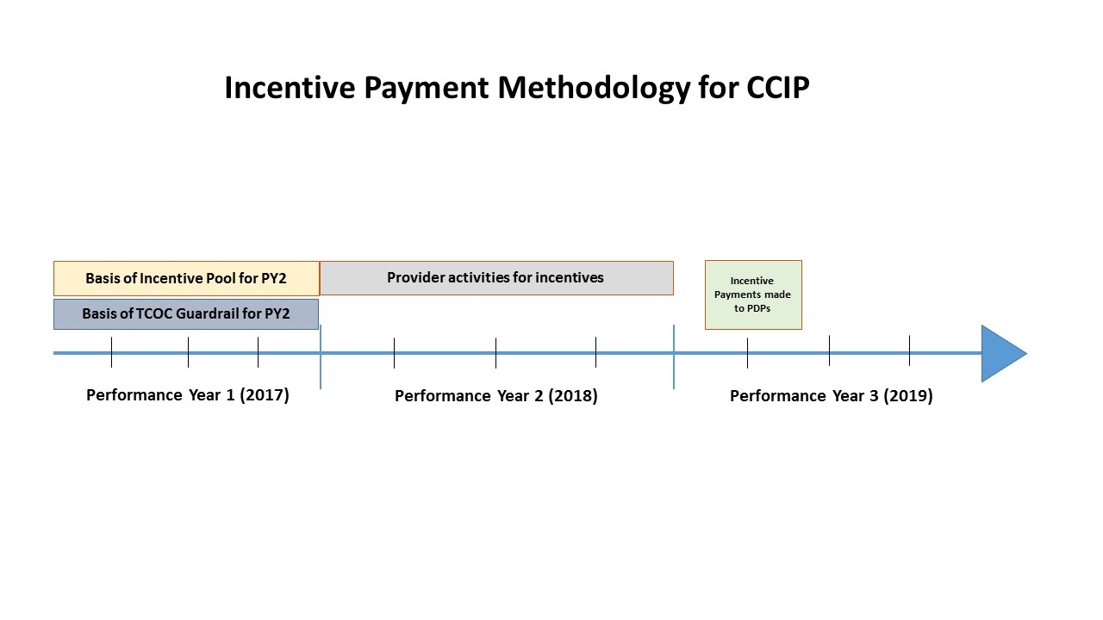
Calendar of Patient Designated Provider Incentive and Resources

Slide 22
The incentive pool from which PDPs are paid is funded by actual reductions in avoidable utilization
The CCIP Incentive Pool is derived from the savings driven by reduced avoidable utilization in a specified population.
The specified population includes all patients in the hospital geography that correspond to the cohort of patients in the CCIP. This creates a larger pool of patients as a basis for pool funding. The purpose is to acknowledge that savings attributable to a specific set of people takes time and to create a situation where money is available to incentivize providers while they are transforming their practices. The hospitals will only fund based on actual reductions in cost.
The incentive pool is funded by a dollar amount that is the difference between the standardized historical costs of included avoidable utilization in a base year less the standardized costs of actual avoidable costs in the current year, multiplied by a 50% variable cost savings factor, minus the intervention costs.
The intervention costs are the hospital provided resources such as care management technology and care management staff to enable the care management process.

Slide 23
Total Cost of Care “Guardrails” are met in order for incentives to be paid
Total Cost of Care
Total Cost of Care (TCOC) Guardrails are calculated at the hospital level
Hospitals will be limited or precluded from paying financial incentives to providers if the TCOC does not remain below a predetermined benchmark
Quality
Quality guardrails for the CCIP program are the completion of 80% of the metrics for 80% of the patients participating at the physician level.

Slide 24
Upcoming Webinars
Webinar 4: 9:00am EST, Friday, November 18
Hospital Care Improvement Program
Webinar 5: 9:00am EST, Wednesday, November 30
Comprehensive Medicare Data Process and Use
Webinar 6: 9:00am EST, Wednesday, December 7
Care Redesign Program Monitoring
Webinar 7: 9:00am EST, Friday, January 13
Care Partner Agreements

Slide 25
Questions?
For all information regarding the Care Redesign Programs please visit: http://www.hscrc.maryland.gov/care-redesign.cfm
Please send any questions to: hscrc.care-redesign@maryland.gov

Slide 26
Appendix

Slide 27
PDP Incentive Requirements
Payment is based on the performance of defined activities.
The measurement is done patient by patient – minimum requirement is 80% completion of the care activities for 80% of the patients.
A risk adjustment factor will be applied to each eligible patient’s score.
A quality incentive is then applied for activity-completion rates of over 85% for each patient.
The maximum annual payment per high risk patient is $665 before risk adjustment and quality incentive. The maximum with risk adjustment and full quality incentive is $1,146.55.
The maximum annual payment per rising risk patient is $100 before risk adjust and quality incentive. The maximum with risk adjustment and full quality incentive is $ 172.50.
Under some circumstances, a PDP may qualify for a monthly CCM fee ($42)

Slide 28
The incentive pool from which PDPs are paid is funded by actual reductions in avoidable utilization
The CCIP Incentive Pool is derived from the savings driven by reduced avoidable utilization in a specified population.
The specified population includes all patients in the hospital geography that correspond to the cohort of patients in the CCIP. This creates a larger pool of patients as a basis for pool funding. The purpose is to acknowledge that savings attributable to a specific set of people takes time and to create a situation where money is available to incentivize providers while they are transforming their practices. The hospitals will only fund based on actual reductions in cost.
The incentive pool is funded by a dollar amount that is the difference between the standardized historical costs of included avoidable utilization in a base year less the standardized costs of actual avoidable costs in the current year, multiplied by a 50% variable cost savings factor, minus the intervention costs.
The intervention costs are the hospital provided resources such as care management technology and care management staff to enable the care management process.

Slide 29
Total Cost of Care “Guardrails” are met in order for incentives to be paid
Total Cost of Care
Total Cost of Care (TCOC) Guardrails are calculated at the hospital level
Hospitals will be limited or precluded from paying financial incentives to providers if the TCOC for a set of hospital services and geographically determined non-hospital services does not remain below a predetermined benchmark
If a hospital’s care redesign programs increase the TCOC beyond the benchmark or do not meet the quality standards, incentive payments to providers will be limited or may not be allowed at all
Quality
Quality guardrails for the CCIP program are the completion of 80% of the metrics for 80% of the patients participating at the physician level. If a PDP does not meet the quality targets, the PDP may not receive an incentive. The entire group of participating physicians is not penalized for non productive PDPs as long as an incentive pool has been generated and the total cost of care guardrail has been met.

