Slide 1

Performance Measurement Workgroup Meeting
3/17/2014
New All-Payer Model Monitoring Measures

Slide 2
Contents of Presentation
New All-Payer Model Context, Purpose, Hypotheses
Theory of Action and Logic Model Overview
New Model Monitoring Commitments

Slide 3
The Recent Rise in Inpatient Hospital Cost Placed New Stresses on the Payment System
The previous waiver placed the emphasis on cost per admission
Not optimized to address overall health care spending or promote comprehensive and coordinated care across different settings
The tight constraint on per inpatient admission payments induced providers to increase the rate of inpatient admissions or inappropriately shift costs to outpatient settings

Slide 4
New Model Purpose and Hypotheses
Purpose
To test whether transformation efforts will produce greater results when implemented in the context of an all-payer rate setting system. Specifically, the model will test whether an all-payer system for hospital payment that is accountable for the total hospital cost of care on a per capita basis is an effective model for advancing better care, better health and reduced costs.
Hypotheses
An all-payer system for hospital payment that is accountable for the total hospital cost of care on a per capita basis is an effective model for advancing population health by raising the quality of health care delivery, improving population health, and reducing cost.
New payment and delivery system models implemented in the context of an all-payer rate setting system will have greater sustainability and impact when compared to payment and delivery system models in other states.

Slide 5
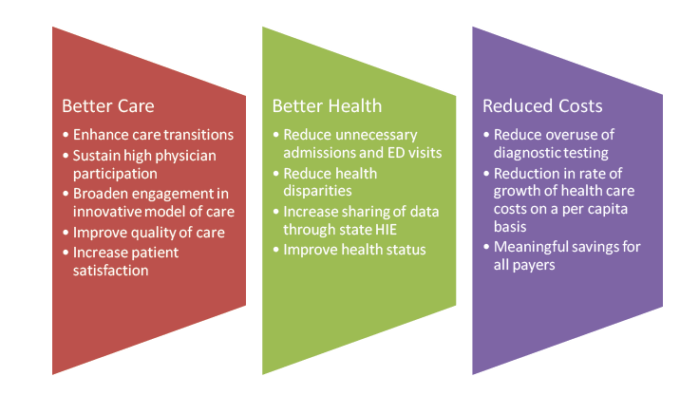
Three-Part Aim Construed Broadly in the Model Design

Slide 6
Theory of Action and Logic Model Illustrate the Major Moving Parts of the New Model at a High Level
Incorporates direct and indirect financial incentives
  Direct financial incentives- Include bonuses for improving performance on quality measures.
  Indirect financial incentives- Payment models that favor care integration that lowers inpatient volume and improves quality.
Incentives accelerate change and evolve over time, shifting focus from cost per admission to the cost per patient.
The model also facilitates delivery system transformation by encouraging hospitals to:
  Participate in local public health coalitions,
  Share savings with physicians and other providers,
  Participate in bundled payment arrangements, Accountable Care Organizations, and to work collaboratively with physicians in patient centered medical homes.
Logic models and driver diagrams are very useful tools for understanding and illustrating the relationships between outputs, inputs, methods, and outcomes.

Slide 7
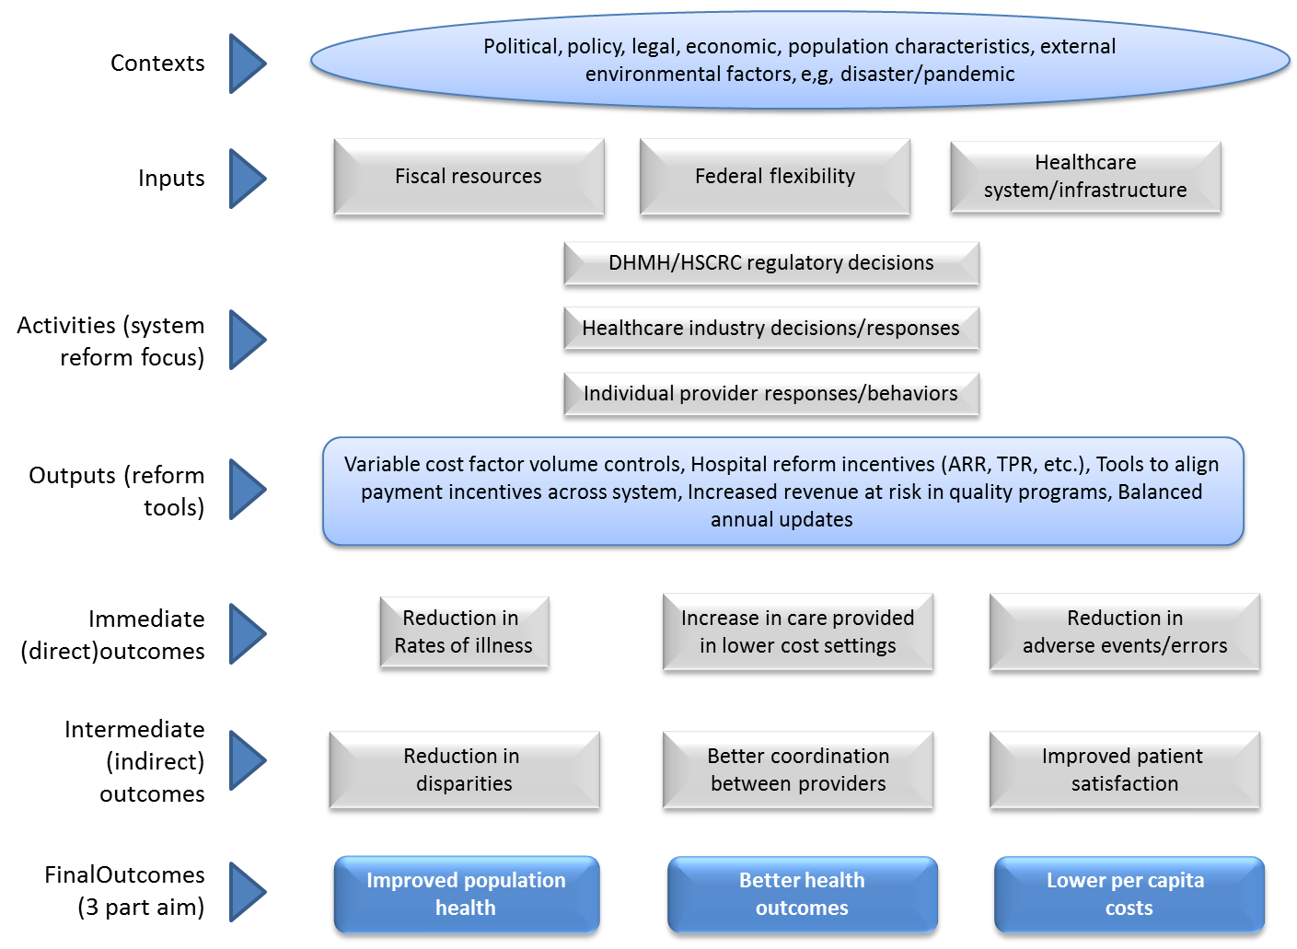
Logic Model

Slide 8
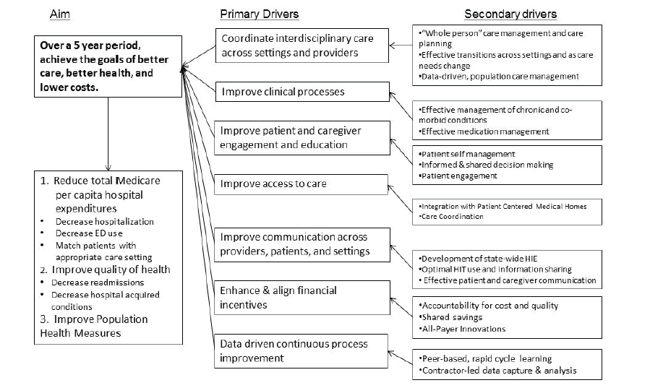
Driver Diagram

Slide 9
Monitoring Commitments and Data Sources Outlined in the CMS Contract: Main Areas
Performance Targets
Guardrails
Compliance Data
Monitoring Data
  Patient Experience of Care Measures
  Population Health Measures
  Hospital Cost Measures

