Slide 1
MACRA/TCOC Update

Slide 2
Accelerating Movement via MACRA
Medicare Access and CHIP Reauthorization Act of 2015
Signed into law in April 2015
MACRA Highlights
Repeals use of the Sustainable Growth Rate (SGR) Formula
Cut Medicare physician fees for all services if total physician spending exceeded a target, penalizing individuals who did control their costs
Was volume-based- did not reward improvements in quality
Replaces SGR with new quality-driven payment systems for providers

Slide 3
MACRA reform timeline (Medicare Access and CHIP Reauthorization Act of 2015)
2015
2016
2017
2018
2019
2020
2021
2022
2023
2024
2025
2026
Permanent repeal of SGR
Updates in physician payments
0.5% (7/2015-2019)
0% (2020-2025)
TRACK 1
PQRS pay for reporting
2018
4%
Meaningful Use Penalty (up to %)
Value-based Payment Modifier
± 1.0%
± 2.0%
2017
-3.0%
Merit-Based Incentive Payment System (MIPS) adjustments
Measurement period
+/-4%
+/- 5%
+/- 7%
+/- 9%
MIPS exceptional performance adjustment; ≤ 10% Medicare payment (2019-2024)
0.25% update
TRACK 2
Measurement period
Advanced APM participating providers exempt from MIPS; receive annual 5% bonus (2019-2024)
0.75% update
Source: MACRA Summit
Notes:
SGR repeal & annual updates
0.5% increase in physician payments for 5 yrs (beginning June 2015); Freeze through 2025
Beyond 2025: physicians in advanced payment models (APMs) receive 1% annual updates, all others receive 0.5% (these out years not pictured in graph)
Time to develop quality measures & clinical improvement activities
Value-Based Performance (VBP) Payment Program
2017, payments adjusted for physicians’ performance in prior period
2018: Consolidate PQRS, VBM & EHR MU into VBP
4% tied to performance in 2019; 5% in 2020; 7% in 2021; 9% in 2022 & beyond. Secretary can increase funding pool in 2021 and beyond to no more than 12%
Maximum upside and downside adjustment equal to funding pool % (e.g. +/- 4% in 2019)
Professionals will be measured on:
Quality
Resource use
Clinical practice improvement activities
EHR MU
Encouraging provider participation in APMs
APM participating providers exempt from VBP; receive annual 5% (2019-2024)
Significant share of revenues must be from APM with 2-sided risk and quality measurement
Reimbursed according to payment arrangements of model
Current Programs
Value Modifier:
2015: Groups of 100 or more +/- 1% payment; Performance year 2013
2016: Groups of 100 or more +/-2%; Groups 10-99 +2% (no negative adjustment); Performance year 2014
2017: Groups 10 or more +/-4%; 1-9 physicians +2% (no negative adjustment); Performance year 2015
2018: : Groups 10 or more +/-4%; 1-9 physicians +/-2%; Performance year 2017
2018 proposed: Non-physician EPs and groups of only non-physician EPs +2% (no negative adjustment)

Slide 4
Track 1: Merit-Based Incentive Payment System (MIPS)
MIPS is based on traditional Medicare FFS payments
Performance Areas
Streamlines 3 currently independent programs to work as one and to ease clinician burden.
Adds a fourth component to promote ongoing improvement and innovation to clinical activities.
Performance Area | Description | Previous Program
Quality | Preventive care, safety, etc | PQRS and Quality Portion of the VBM
Cost | Medicare spending per beneficiary, etc | Physician VBM
Advancing Care information | certified EHR technology | Meaningful Use
Improvement Activities | Shared decision making, APM participation, patient safety, coordinating care, increasing access, etc | None
Source: Summarized from https://www.cms.gov/Medicare/Quality-Initiatives-Patient-Assessment-Instruments/Value-Based-Programs/MACRA-MIPS-and-APMs/MACRA-Quality-Payment-Program-webinar-slides-10-26-16.pdf

Slide 5
Track 2: Advanced Alternative Payment Models (Advanced APMs)
Advanced Alternative Payment Models (Advanced APMs) enable clinicians and practices to earn greater rewards for taking on some risk (or working with an AAPM Entity that takes risk) related to their patients’ outcomes
Advanced APMs Entities Must:
Use certified EHR technology,
Pay based on MIPS comparable quality measures, and
Bear more than “nominal” financial risk for losses
8% of the average estimated total Medicare Parts A and B revenues of participating APM Entities; OR 3% of the expected expenditures for which an APM Entity is responsible under the APM.
Providers will receive +5% bonus incentive payment in 2019 for Advanced APM Participation in 2017 or 2018 if
They receive 25% of their Medicare Part B payments through an Advanced APM;
OR See 20% of their Medicare patients through an Advanced APM
Thresholds increase in later years
Source: Summarized from https://www.cms.gov/Medicare/Quality-Initiatives-Patient-Assessment-Instruments/Value-Based-Programs/MACRA-MIPS-and-APMs/MACRA-Quality-Payment-Program-webinar-slides-10-26-16.pdf

Slide 6
Track 2: Advanced Alternative Payment Models (AAPMs)
Eligible for 2017 Performance Year
CMMI anticipates the following models will be Advanced APMs in the future:
Comprehensive Primary Care Plus (CPC+)
Shared Savings Program Track 3
Next Generation ACO Model
Shared Savings Program Track 2
Oncology Care Model (Two-Sided Risk Arrangement)
Comprehensive End Stage Renal Disease Care Model (Two-Sided Risk Arrangements)
Advancing Care Coordination through Episode Payment Models Track 1 (CEHRT)
Comprehensive Care for Joint Replacement (CJR) Payment Model
New Voluntary Bundled Payment Model
ACO Track 1+
Vermont Medicare ACO Initiative (as part of the Vermont All-Payer ACO Model)
Source: Summarized from https://www.cms.gov/Medicare/Quality-Initiatives-Patient-Assessment-Instruments/Value-Based-Programs/MACRA-MIPS-and-APMs/MACRA-Quality-Payment-Program-webinar-slides-10-26-16.pdf

Slide 7
Language Referencing Maryland in the MACRA final rule
Final Rule on MACRA was released in October 2016
There was a specific clause in the final rule referencing the Maryland All-Payer Model and eligibility for MACRA in 2018:
“With new Advanced APMs expected to become available for participation in 2017 and 2018, including the Medicare ACO Track 1 Plus (1+), and anticipated amendments to reopen applications to modify current APMs, such as the Maryland All-Payer Model and Comprehensive Care for Joint Replacement (CJR) model, we anticipate higher numbers of QPs—approximately 70,000 to 120,000 in 2017 and 125,000 to 250,000 in 2018.”
Source: MACRA Final Rule p. 77013: https://www.gpo.gov/fdsys/pkg/FR-2016-11-04/pdf/2016-25240.pdf

Slide 8
MACRA-tizing the Maryland Model
Progression
Engaged physicians and other providers in aligned efforts
Key strategies to have the All-Payer Model qualify as Advanced APM:
CMS approved Care Redesign Programs (HCIP and CCIP) to link physicians to the All-Payer Model
However, CMS requires hospital global revenues incorporate non-hospital Part B costs through incentives
Concept Paper for a Value-Based Modifier (VBM) is being developed for CMS
Other key approaches to have Advanced APMs in Maryland:
ACOs with downside risk
New statewide Comprehensive Primary Care Model (CPC+ design)
New Dual Eligible ACOs

Slide 9
MACRA-tizing the Maryland Model for Care Redesign Amendment Programs
Qualifying APM Participant (QP)
Advanced APM Entities
MACRA Test: QP Threshold
Maryland All-Payer Model
Maryland Hospitals
Partnering Clinicians
Care Redesign Alignment
Non Qualifying APM Participant
Alternative Payment Model (APM)
Eligible clinicians for 2017 defined as physicians, nurse practitioners, physician assistants, certified nurse specialists, and CRNA

Slide 10
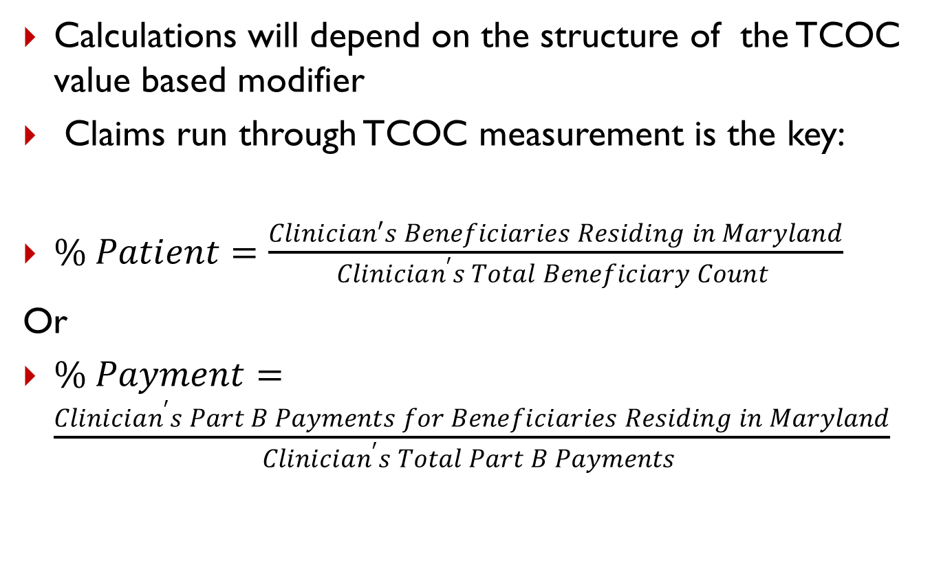
Determining individual physician’s eligibility
Calculations will depend on the structure of the TCOC value based modifier
Claims run through TCOC measurement is the key:
$\% Patient=\frac{Clinician′s Beneficiaries Residing in Maryland}{Clinician^{′}s Total Beneficiary Count }$
Or
$\% Payment=\frac{Clinician^{′}s Part B Payments for Beneficiaries Residing in Maryland}{Clinician^{′}s Total Part B Payments }$

Slide 11
Questions for TCOC Workgroup
How to attribute Total Cost of Care (TCOC) to each hospital? Options:
(1) Primary Service Area (PSA) – that is, based on the zip codes each hospital has declared as theirs
(2) 48 BPCI Episodes
(3) All Episodes Plus Geography

Slide 12
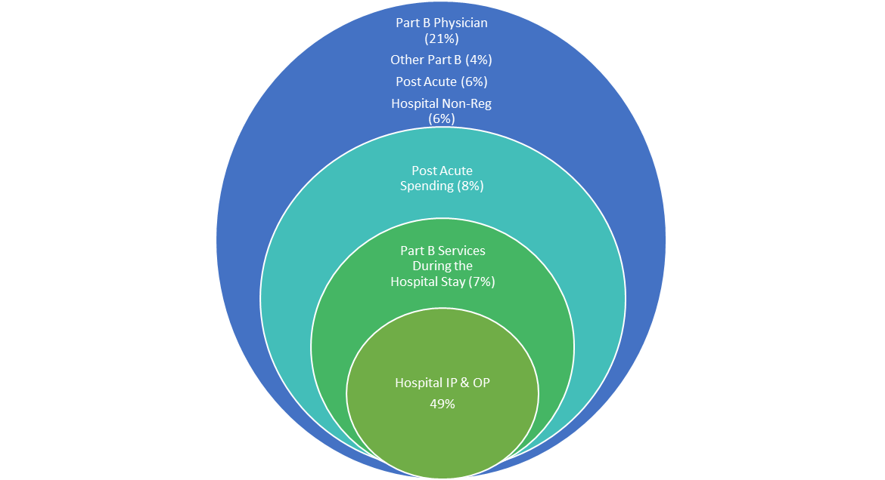
Distribution of TCOC Under All Episodes (inner three circles)

Slide 13
Questions for TCOC Workgroup: Structuring VBM for Possible Payments and Incentives
Once TCOC has been attributed to each hospital, what size of payment is appropriate?
Although the VBM is proposed to satisfy CMMI requirements for financial responsibility on TCOC, should it also permit positive financial payments to hospitals? If so, how structured?
Current goal is for VBM to be in place by January 2018

