Slide 1
Performance Measurement Workgroup
September 15, 2021
HSCRC Quality Team

Slide 2
Meeting Agenda
Total Cost of Care (TCOC) Model and SIHIS Updates
Focus on disparities - Federal (IPPS Final Rule), State and HSCRC Initiatives
Work Plan review for FY 2024 & beyond
RY 2024 QBR Redesign updates policy discussion
MHAC Discussion
COVID Updates

Slide 3
TCOC and SIHIS Updates:
Focus on Disparities

Slide 4
TCOC Model Year 1 Performance – Exceeded Targets
Performance Measures | 2019 Targets | 2019 Results | Met
Annual Medicare TCOC Savings | $120M in annual Maryland Medicare TCOC per Beneficiary of savings for MY1 (2019) | $364.85 million | ✔
TCOC Guardrail Test | Cannot exceed growth in National Medicare TCOC per beneficiary by more than 1 percent in a year and cannot exceed the National Medicare TCOC per beneficiary by any amount for 2 or more consecutive MYs | 0.6 percentage points below the National growth rate | ✔
All-Payer Revenue Limit | All-payer growth ≤ 3.58% per capita | 2.5% per capita | ✔
Improvement in All-Payer Potentially Preventable Conditions | Exceed the CY 2018 PPC rates for 14 Potentially Preventable Conditions (PPCs) that comprise Maryland’s Hospital Acquired Condition program (MHAC) | .13 percentage point reduction | ✔
Readmissions Reductions for Medicare | Maryland’s aggregate Medicare 30-day unadjusted all-cause, all-site readmission rate at regulated hospitals ≤ the National Readmission Rate for Medicare FFS beneficiaries | 14.94% Medicare readmission rate (below the national rate of 15.52%) | ✔
Hospital Population Based Payment | ≥ 95% of all Regulated Revenue for Maryland residents paid according to a Population-Based Payment methodology | 98% of Regulated Revenues are under Maryland’s ‘Rate Setting System’ | ✔
Notes:
Tequila/William

Slide 5
Statewide Integrated Healthcare Improvement Strategy (SIHIS):
Goals Across Three Domains
Total Cost of Care Model (2019-2028)
Hospital Quality
Reduce avoidable admissions (ambulatory sensitive conditions)
Improve Readmission Rates by Reducing Within-Hospital Disparities
1. Hospital Quality
Care Transformation Goals
Increase the amount of Medicare TCOC or number of Medicare beneficiaries under value-based care models*
Improve care coordination for patients with chronic conditions
3. Total Population Health
2. Care Transformation Across the System
Total Population Health Goals
Priority Area 1 (Diabetes): Reduce the mean BMI for adult Maryland residents
Priority Area 2 (Opioids): Improve overdose mortality
Priority Area 3 (Maternal and Child Health Priority Area):
  Reduce severe maternal morbidity rate
  Decrease pediatric asthma-related emergency department visit rates for ages 2-17
*Value-based models including the Care Redesign Program, Care Transformation Initiatives, and qualifying successor models.

Slide 6
IPPS Final Rule’s Focus on Disparities
Report disparities out to hospitals
  Currently stratifies by dual-eligibility status with plans to stratify by race and ethnicity
  Two disparity methods: Within-Hospital and Across-Hospital (1532)
  Requesting information for other risk factors to stratify by that would be valuable to stakeholders
Interest in improving the accuracy and reliability of Race Ethnicity and Language (REaL) data
Standardize and improve demographic data collection processes
Potential creation of a Hospital Equity Score to synthesize results across multiple social risk factors

Slide 7
Commitment to address health disparities in Maryland
The Shirley Nathan-Pulliam Health Equity Act of 2021
This bill establishes the Maryland Commission on Health Equity to (1) employ a “health equity framework” in specified examinations; (2) provide advice on issues of racial, ethnic, cultural, or socioeconomic health disparities; (3) facilitate coordination of expertise and experience in developing a comprehensive health equity plan addressing the social determinants of health; and (4) set goals for health equity and prepare a plan for the State to achieve health equity in alignment with other statewide planning activities. The commission must establish an advisory committee on data collection and submit an annual report by December 1 of each year.
MHA/AHA 1,2,3, Equity
All MD Hospitals have “Taken the Pledge” to take action to accelerate progress on the following areas:
  Increasing the collection and use of race, ethnicity, language preference and other socio-demographic data
  Increasing cultural competency training
  Increasing diversity in leadership and governance
  Improve and strengthen community partnerships

Slide 8
HSCRC Health Equity Initiatives
The HSCRC is committed to addressing disparities in all policies.
To accomplish this we are working to collect data, train staff, and collaborate with other State agencies to ensure Maryland eliminates long-standing health disparities and achieves a more equitable healthcare system.
Statewide Integrated Health Improvement Strategy (SIHIS)
Hospital Quality Programs
Special Program Funding
Data and Hospital Reporting
Internal Diversity Task Force
State Agency Collaboration

Slide 9
PMWG Work Plan and Deliverables
Detailed Work Plan in Separate Word Document

Slide 10
PMWG Timeline of Deliverables
October
    QBR RY 2024 draft policy
November
    QBR RY 2024 final policy
December
    MHAC RY 2024 draft policy
    SIHIS within-hospital readmission disparity reduction goal - proposal to CMS due December 31, 2021
January
    MHAC RY 2024 final policy
February
    RRIP draft policy
March
    RRIP final policy
May
    PAU Savings RY 2023 draft (in Draft Update Factor Recommendation)
June
    PAU Savings RY 2023 final (in Final Update Factor Recommendation)

Slide 11
QBR RY 2024
Redesign Subgroup Report and Discussion

Slide 12
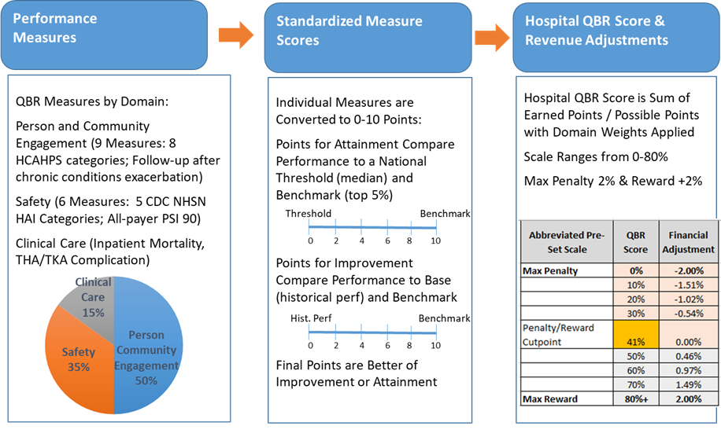
QBR Program RY 2023 Measures, Scoring and Revenue Adjustment Methodology

Slide 13
QBR Program Redesign, RY 2024 and Beyond
Person and Community Engagement
  HCAHPS
  ED Wait Times
  Timely Follow-up
Safety
  NHSN Measures
  PSI-90 Composite Measure
Clinical Care Domain
  Mortality measure
  THA-TKA Complications
This slide presentation outlines the QBR Subgroup report that was submitted to CMMI on Aug 16, 2021.

Slide 14
HCAHPS
What is it?
  Survey to capture patient experience in IP Hospitalization: 8 Composite Measures and Consistency Credit points
What we discussed?
Long-term challenges with low HCAHPS scores
Potential benefits to including Linear Scores, which recognizes greater gradation in performance across the range of responses of “Never”, “Sometimes”, “Usually”, and “Always”
  Linear scores more highly correlated with other quality outcomes (e.g. mortality)
Providing optional “upfront” investment dollars, to directly invest in HCAHPS Improvement
Sharing “best practices” or “lessons learned” across the industry
3. What we reported to CMMI/decided?
Add linear measures to incent incremental improvements
Offer upfront investment opportunity
Encourage sharing of best practices
Require hospitals to submit patient level data to MHCC to allow for additional analytics, in particular on disparities in patient experience

Slide 15
Linear Scores and Top Box Scores
HVBP and QBR use the Top Box Score for assessing performance (Always, Usually, Sometimes, Never)
  Only most positive response (“top box”) receive 100 pts, all other responses receive 0 pts
  Top-Box Scoring: Never = 0; Sometimes = 0; Usually = 0; Always = 100
CMS Star Ratings use Linear Scores that score all possible scores with equal intervals between each option (Always, Usually, Sometimes, and Never) in a 0-100 scale, weighted by discharge and response rate
  NOTE: Discharge information is YES/NO so only two potential scores

Slide 16
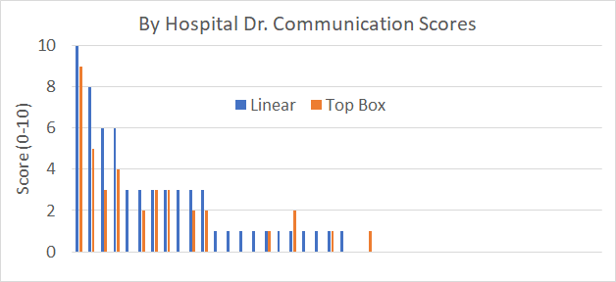
By Hospital Scores on Linear vs Top Box
Significant number of hospitals score zero on both top box and linear
Score higher on linear than top box
Score points only on linear
Score higher on top box than linear

Slide 17
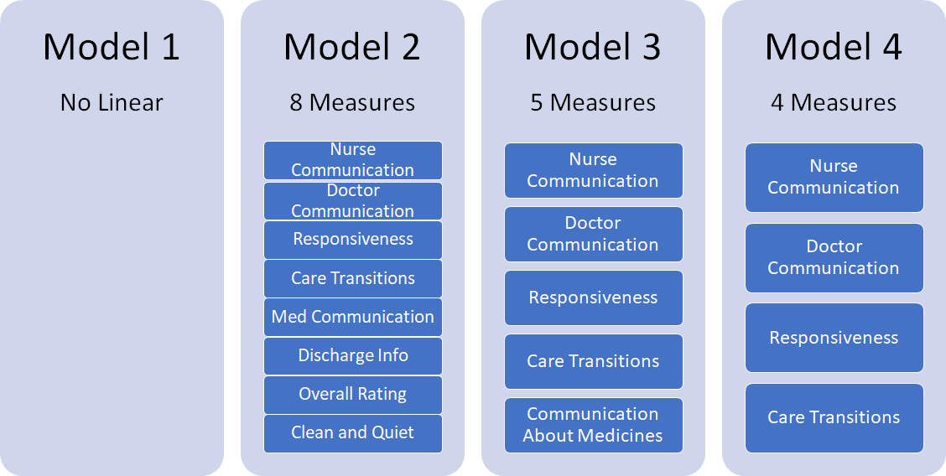
Measures Modeled at 10 Percent of total QBR Score
Subgroup recommended a more focused approach to linear measures
Considerations for Narrowing Down Measures
Patient-Centered
Leapfrog alignment
Correlations with other quality outcomes
Comprehensiveness
Importance to TCOC model

Slide 18
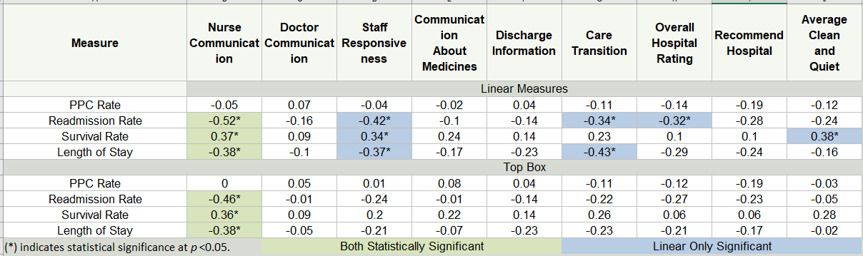
HCAHPS Linear Score Correlations
Previously, we shared that “top-box” scores were generally only weakly correlated with other quality of care measures.
We repeated this analysis with the Linear Scores, and found higher correlations between higher HCAHPS linear scores and other favorable quality outcomes (Lower mortality, lower readmissions etc).
Subgroup was supportive of model with four measures (2.5 percent each) but some stakeholders raised concerns about including the responsiveness measure:
  Staff strongly support the inclusion of the linear measure for responsiveness because it is patient centered and there is higher/statistically significant correlation with readmissions, survival, and LOS.

Slide 19
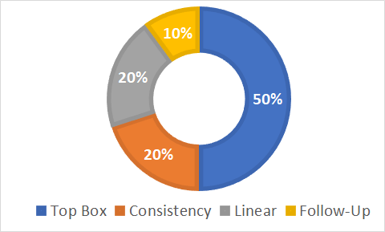
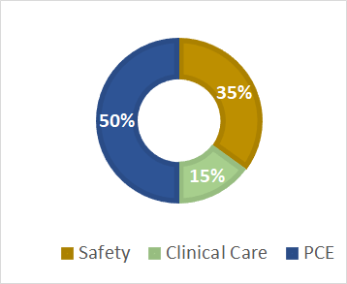
HCAHPS Linear Score Modeling
Modeled three different sets of HCAHPS measures
  All models weighted linear HCAHPS as 20 percent of PCE domain (10% of QBR), and specifically reduced the weight on the top box portion of the domain (i.e., consistency remained weighted at 20% of PCE Domain/10% of QBR score)
PCE
Domain
QBR

Slide 20
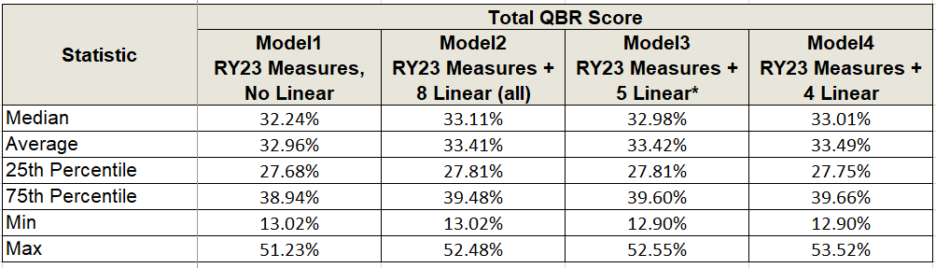
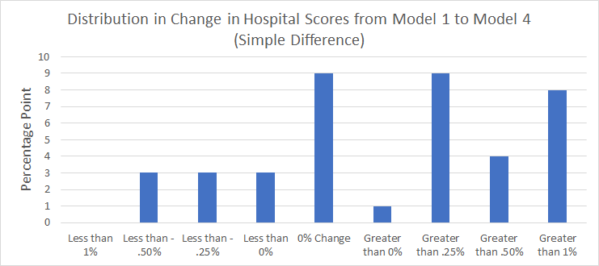
Descriptive Statistics of Hospital Scores

Slide 21



Upfront Investment
HSCRC quality team proposes a voluntary program where hospitals will receive upfront reward ahead of the performance year
  Currently no hospitals have expressed interest
  Upfront reward as currently construed will be paid back in subsequent year regardless of performance
  Idea is to provide upfront funding to drive HCAHPS improvements
Hospitals who are interested in participating should contact HSCRC quality team (hscrc.quality@maryland.gov) no later than 11/30/2021
  Interested hospitals should indicate anticipated 1-year improvement goal and/or ask HSCRC to calculate anticipated improvement goal on their behalf

Slide 22
ED Wait Times
1. What is it?
One measure of ED Throughput - ED-2b: Decision to Admit until IP Admission - designed to reduce “ED Boarding”
2. What we discussed?
Maryland’s continued poor performance on ED wait times
Belief that poor performance on HCAHPS could be improved if ED wait times improved
Discontinuation of ED wait time measures, including most recently the eCQM
3. What we reported to CMMI/decided?
Per Commission directive to include ED wait times, HSCRC will pursue eCQM data reporting capability

Slide 23
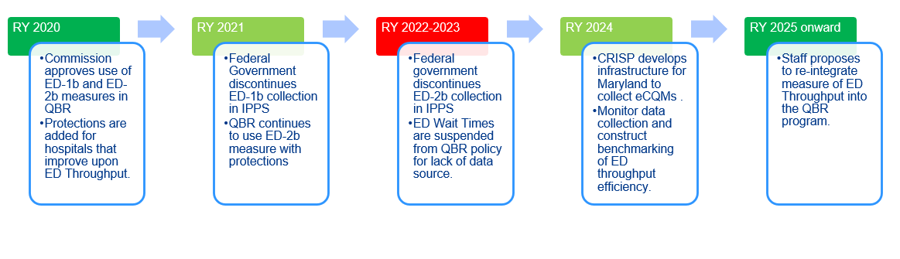
Timeline of ED Wait Times in QBR
Given ED Wait Times’ positive correlation with HCAHPS, Commissioners and Staff are interested in resuming inclusion of an ED Wait time measure for IP admissions
Notes:
In our timeline here we recap for you the history of the ED Throughput measure inclusion in the QBR program. As you can see (and as many of you remember) we had both inpatient ED measures included in RY 2020, one (ED-2b) measure included in RY 2021, and have removed these measures from the program in RYs 2022 and 2023 given data availability challenges. We are proposing to use an alternative data source RY 2024 and beyond, which we will discuss in the coming slides.

Slide 24
ED-2 and broader electronic Clinical Quality Measure (eCQM) Data Collection Efforts
HSCRC is working with CRISP/Medisolv to require submission of eCQM and hybrid data elements, as an additional tool to track quality performance under the Maryland Model.
Current work plan would require CY 2022 submission of eCQMs for ED-2 and the opioid measure
Hybrid data element reporting would be required in subsequent years
Phase-in approach with potentially additional required eCQMs in future years
More details, including reporting requirements and schedules, to come
CMS aims to move fully to digital quality measurement in CMS quality reporting and value based purchasing programs by 2025.

Slide 25
Timely Follow-Up After Discharge Measure
What is it?
  Measure of timely follow-up after an acute exacerbation of 6 specified chronic conditions
What we discussed?
  Measure expansion
    Expanding to include Medicaid beneficiaries
    Expanding to include behavioral health-related hospitalizations
What we reported to CMMI/decided?
  Work with PMWG to develop a monitoring report for Medicaid and/or Behavioral Health
  Potential inclusion of Medicaid and/or Behavioral Health in future payment policy

Slide 26
Status Update on Timely Follow-up for Medicare
Hospitals have identified issues with current code output
  CRISP is currently reviewing code and have made changes to ensure (1) proper patients are being flagged for denominator, and (2) IMPAQ measure specifications are being followed as closely as possible.
  We appreciate your patience as we ensure the Timely Follow-up measure is implemented as accurately as possible.
HSCRC is reviewing new telehealth codes to determine if any new codes should be added to the numerator definition
  HSCRC has confirmed that the IMPAQ-identified telehealth codes are being utilized
  Additional telehealth codes have come online during the COVID-19 PHE
Anticipate revised hospital results to be released in October
  Will include updated QBR performance standards for RY 2023
  May need to assess SIHIS goal in light of updated results

Slide 27
Safety Domain
What is it?
  5 NHSN Measures
  PSI-90 Composite
What we discussed?
Trend Analysis; Historical Analysis; Peer Group Analysis; CDC data analysis
Maintain focus on NHSN measures consistent with federal VBP
3. What we reported to CMMI/decided?
Maryland performs comparably or better than the national average on all but the SSI for hysterectomy measure
Consider for future adding more innovative and less burdensome “digital” measures to QBR (e.g., Hospital Onset Bacteremia (HOB) early adoption statewide) that can replace current chart-abstracted measures if allowed by CMS
  HSCRC has begun discussions with CDC on opportunities for collaboration, feasibility of early adoption of the HOB measure

Slide 28
Safety Domain: Maryland Performance on Par with Nation for NHSN Measures*
In 2019, for five out of six NHSN measures, the median hospital in Maryland performed better (had lower SIRs) than the national median hospital; SSI hysterectomy is the exception
Trend analysis from CY 2016-2019 shows most NHSN measures improved over time (except for SSI)
Peer group analysis done using the K-nearest neighbor approach (assign a peer group of 15 similar national hospitals to each MD facility):
  Maryland compared worse than its peers 50-60% of the time in CY 2016-2018,
  The State improved performance and compared better than its peers just over 50% in CY 2019.
The CDC 2019 National and State HAI Progress Report indicates:
  64-94 percent of Maryland hospitals have SIRs statistically similar to national rate
  No statistically significant change on any NHSN measure between 2018 and 2019 for Maryland.
*Analysis included unweighted means, weighted means (weighted based on hospital volume), and medians using CMS Hospital Compare data.

Slide 29
Hospital Onset Bacteremia Pilot *
A web-based, multiple-choice survey was administered via the SHEA Research Network to 133 hospitals.
Results: A total of 89 surveys were completed (67% response rate).
  60% of respondents defined HOB as a positive blood culture on or after hospital day 3.
  Central line-associated bloodstream infections and intra-abdominal infections were perceived as the most frequent etiologies.
  61% of participants thought that most HOB events are preventable,
  54% viewed HOB as a measure reflecting a hospital’s quality of care.
  29% of respondents’ hospitals already collect HOB data for internal purposes.
  Given a choice to publicly report central-line–associated bloodstream infections (CLABSIs) and/or HOB, 57% favored reporting either HOB alone (22%) or in addition to CLABSI (35%) and 34% favored CLABSI alone.
Conclusions: Among the majority of SHEA Research Network respondents, HOB is perceived as preventable, reflective of quality of care, and potentially acceptable as a publicly reported quality metric.
Further studies on HOB are needed, including validation as a quality measure, assessment of risk adjustment, and formation of evidence-based bundles and toolkits to facilitate measurement and improvement of HOB rates.
*For more information: https://pubmed.ncbi.nlm.nih.gov/30932802/

Slide 30
30-Day Mortality Measure
What is it?
  An all-payer measure that captures deaths that occur 30 days after a hospitalization
What we discussed?
  Concerns with current IP measure and desire to align with CMS 30-day mortality measures
  Risk-adjustment and other measure specifications that we cannot implement on an all-payer basis
What we reported to CMMI/decided?
  Additional analysis necessary
    Challenges:
      lack of correlation with current IP measure
      need to append hospice flag from CCLF
  Work with PMWG to determine whether measure can be included in RY 2024 for monitoring or payment
    In future with eCQM capabilities, move to hybrid version of mortality measure

Slide 31
30-Day Mortality Updates
Concept: Use draft CMS claims based, all condition, mortality measure methodology with similar IP mortality measure risk-adjustment
  Service lines and selection of random hospitalization are from CMS measure
  Risk adjustment variables from HSCRC IP measure
  Two-thirds of deaths occur in hospital; however, HSCRC staff believe the post hospitalization deaths are important indicator of quality
HSCRC working to match case-mix data with CCLF (medicare FFS) data to bring over hospice flag
  Due to 4 month data run out the flag for hospice determined from CCLF will be delayed
HSCRC working with MPR on additional validation results
  See handout with preliminary hospital specific results

Slide 32
Mortality - options for RY 2024 and moving forward
RY 2024:
Use IP mortality in QBR and monitor 30-day measure
  Adopt 30-day claims based measure for RY 2025
RY 2025 and beyond:
Use 30-day mortality measure for attainment and improvement
Comment letters from Medstar, Hopkins, and UMMS supported moving to a 30-day measure but to monitor for RY 2024
Note: As state develops infrastructure to collect hybrid data elements, HSCRC will consider transitioning to hybrid mortality measure

Slide 33
THA/TKA Complications Measure
What is it?
  Assesses occurrence of medical and/or surgical complications following hospitalization for THA/TKA
What we discussed?
  Measure expansion
    Expand Inpatient to All-Payers
    Expand to Medicare Outpatient
    Expand to both Medicare Outpatient and All-Payer Outcomes
What we reported to CMMI/decided?
  Strategy for inclusion of outpatient measure
  PMWG explore adapting CMS claims-based IP THA/TKA to all-payer
  Adaptation of provides eCQM measure to hospitals
    Measure is IP and OP and all-payer (18+)

Slide 34
Hip Knee Arthroplasty Measures
Measure | Program
1)Inpatient risk standardized complications measure based on Medicare claims data | CMS IQR, VBP, CMS Comprehensive Care Joint Replacement (CJR) Program
2)Inpatient patient reported outcome measure (PROM) based on claims and surveys | CJR PRogram
3)Inpatient and outpatient complications measure based on electronic health records | CMS Measuring Outcomes in Orthopedics Routinely (MOOR) Project*
4)Inpatient and outpatient PROM measure based on electronic health records and survey (MOOR project) | CMS MOOR Project
5)Outpatient/ambulatory PROM, a process measure based on chart abstraction and survey | Joint Commission Certification for Hip and Knee Replacement
*The MOOR project is measured at physician level and also includes
development of two drug measures of opioid use and adverse drug events.

Slide 35
Hip Knee Arthroplasty Complications: Measure Options
 | Inpatient | Inpatient and Outpatient
Medicare | CMS THA/TKA complications claims measure (IQR, VBP, CJR) CMS inpatient PROM measure (CJR) | Measures 1) and 2) (adapted for outpatient)
All- Payer | Measures 1) and 2) (adapted for all-payer) 5) Joint Commission Outpatient/ambulatory PROM, a process measure based on chart abstraction and survey; the outcome is administration of the PROM survey, not the results. | 3) CMS inpatient and outpatient complications measure based electronic health records (EHR) (adapted for hospital) 4) CMS’s inpatient and outpatient PROM measure based on EHR and survey (adapted for hospital)

Slide 36
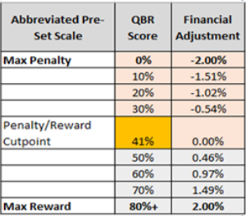
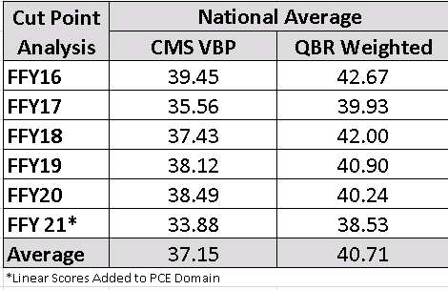
QBR Revenue Adjustment Scale
Revenue adjustment scale ranges from 0-80 percent, with rewards starting at scores >41 percent
Reward/penalty cut-point needs to ensure hospitals in Maryland are not rewarded for performance that is below the national average
Cut-point estimated by weighting national scores by QBR weights and calculating national average
Addition of linear scores increased the QBR weighted score by almost 2 percentage points; will be running same analysis adding linear scores for FFY2020
For now, staff are proposing to maintain the 41 percent cut-point
Notes:
FFY21
33.88
36.60 QBR weighted without linear

Slide 37
RY 2024 QBR Draft Recommendations (slide 1 of 2)
Continue Domain Weighting as follows for determining hospitals’ overall performance scores: Person and Community Engagement (PCE) - 50 percent, Safety (NHSN measures) - 35 percent, Clinical Care - 15 percent.
  Within the PCE domain, include four linear measures weighted at 10% of QBR score; remove associated revenue at risk from top box.
Provide optional upfront investment opportunity to hospitals for anticipated improvements in HCAHPS scores
Develop monitoring reports for measures that will be considered for adoption in RY 2025:
  30-day all-payer, all-cause mortality
  Follow-up for acute exacerbation of chronic conditions for Medicaid
  Follow-up after hospitalization for mental illness

Slide 38
RY 2024 QBR Draft Recommendations (slide 2 of 2)
Collaborate with CRISP to develop infrastructure for collection of hospital electronic clinical quality measures and core clinical data elements:
  Require hospitals to submit the CY 2022 ED-2 eCQM for re-adoption
  Explore development of hospital eCQM for inpatient/outpatient all-payer THA-TKA complications
Maintain the pre-set scale (0-80 percent with cut-point at 41 percent), and continue to hold 2 percent of inpatient revenue at-risk (rewards and penalties) for the QBR program.
Adjust retrospectively the RY 2024 QBR pay-for-performance program methodology as needed due to COVID-19 Public Health Emergency and report any changes to Commissioners.

Slide 39
Maryland Hospital Acquired Conditions (MHAC) Program

Slide 40
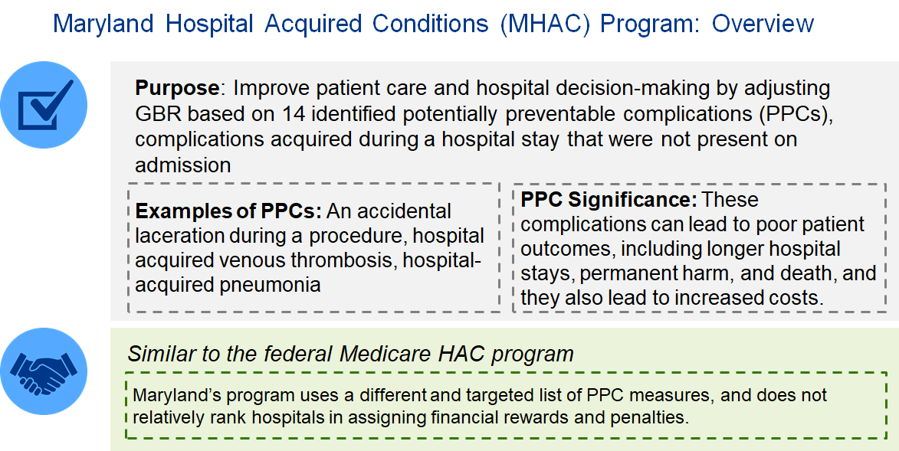

Slide 41
Maryland Hospital Acquired Conditions Program
Discussion Topics:
RY 2024 “base period” - proposal to generate normative values all underneath COVID timeframe (Jul 2020-Dec 2021)
  Pros:
    Comparable timeframe of generated PPC experience
    Removes concerns about pre-COVID normative values
  Cons:
    18 months < current 24 months
    Delayed generation of normative values
PPCs during COVID PHE; monitoring and payment PPCs (current data trends)
Updates to PPC Grouper and how hospitals can submit logic concerns
Palliative care diagnosis and present-on-admission status monitoring

Slide 42
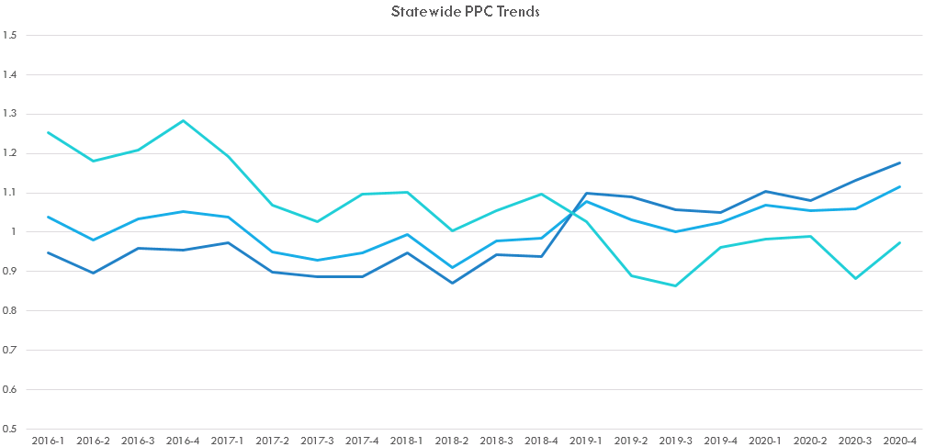
Statewide PPC Trends
 | All % Change | Monitoring % Change | Payment % Change
2019/2018 | 6.97% | 16.10% | -12.82%
2020/2018 | 11.26% | 21.57% | -10.26%
Note: Graph excludes COVID-19 patients

Slide 43
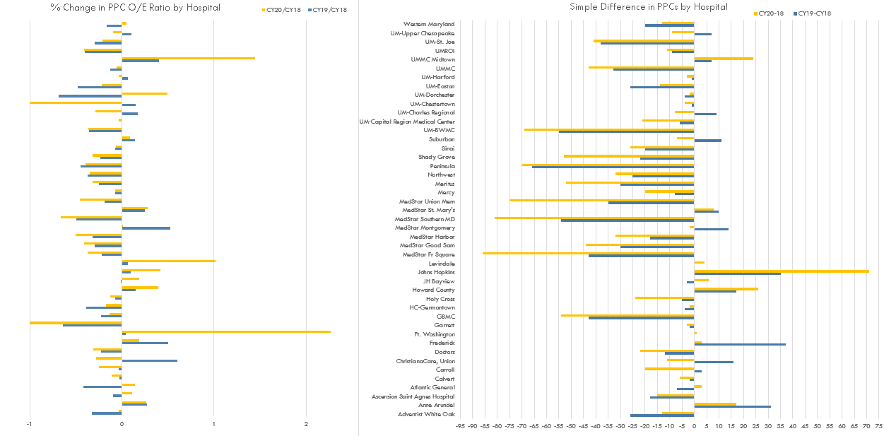
Note: This is a reflection of the 14 payment PPCs only.
Covid-19 patients are excluded.

Slide 44
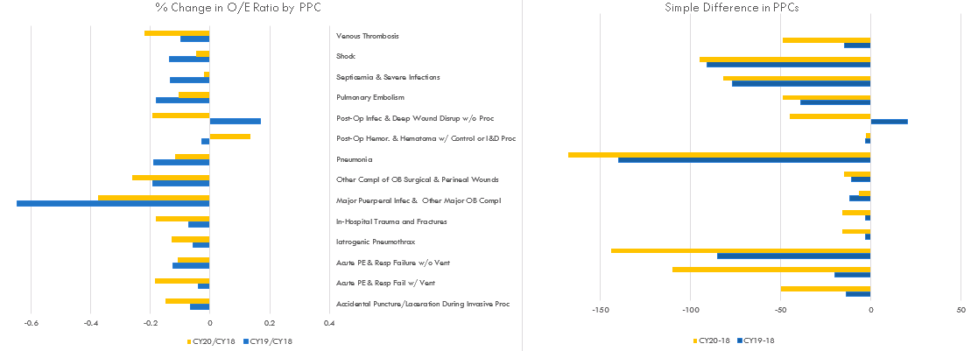
Note: This is a reflection of the 14 payment PPCs only.
Covid-19 patients are excluded.

Slide 45
PPC Updates v. 39
Changes for new 1/1/2021 DX/PROC codes
Nuss (and related) procedures to correct chest deformities added to exclusion groups used by PPC 49
Changes to capture more in-hospital falls and injuries
New PPC 28 assignment logic for codes with CPR exception
Respiratory arrest - global exclusion changed to PPC specific
New EKOS procedure exclusion for PPC 39 (ultrasound used to deliver very low doses of a clot-dissolving drug directly into the clot through a catheter for PE)
·
Removal of exclusion group 72- Hemolytic & Aplastic Anemia from PPCs 5 and 6
Removal of exclusion group 82- Poisoning of Medicinal Agents from PPC 29
O.R. procedures refresh from APR v39
Major surgical procedures refresh from APR v39
Updates to PPC assignments due to DX added to APR v39 Pre-Existing List

Slide 46
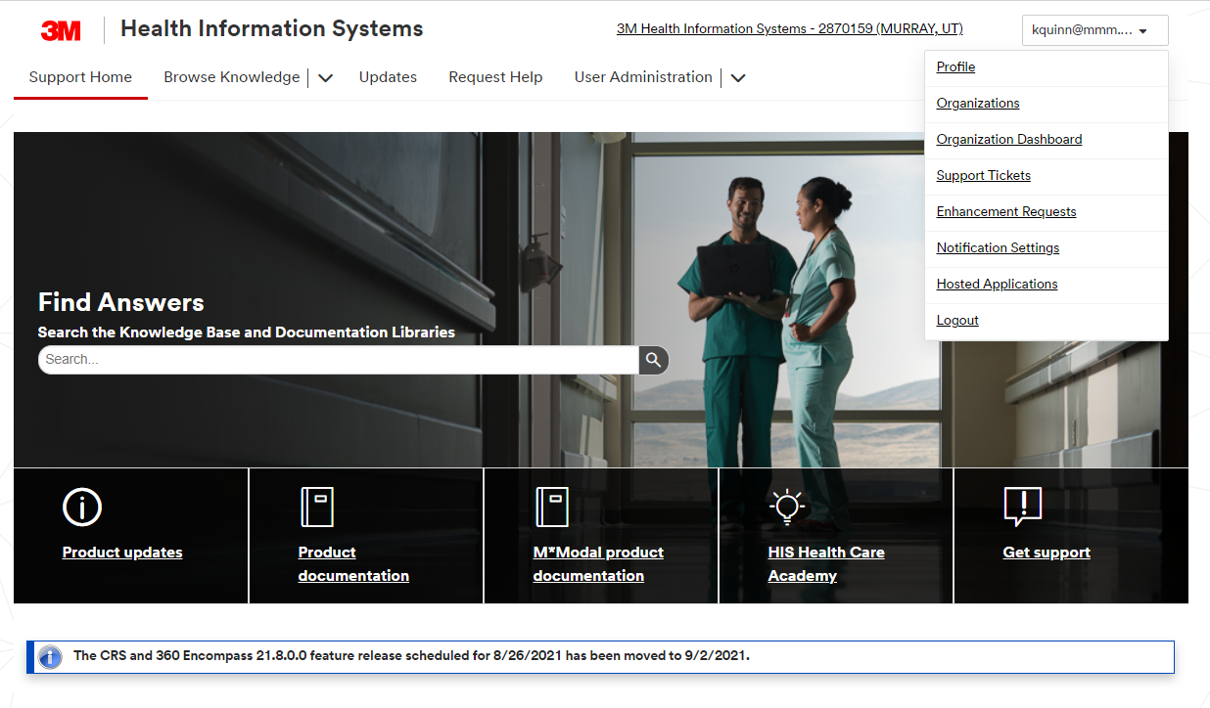
PPC Updates and Feedback
New login procedure for PPC documentation:
3M™ Web Portal - Login
At registration page, use the old user name of "MDHosp" as your authorization code, complete the fields with your personal information.
New PPC feedback submission procedure on 3M HIS support site:
https://support.3mhis.com/
After logging in, click on your login id in the upper right corner and click on “enhancement request”

Slide 47
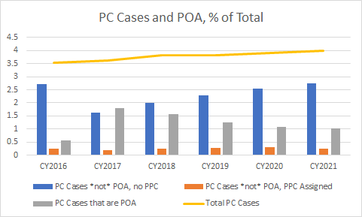
Palliative Care (Z515) in V38 of the PPC Grouper
Status: Beginning V38 of the PPC Grouper, palliative care status (Z515) is no longer on the global exclusion list, and palliative care cases may be assigned a PPC, unless palliative care is present on admission (POA).
Notes:
In the graph below, we are showing Palliative Care as a percentage of total IP discharges (% was used to align the 2021 YTD cases, which only include seven months of CY 2021 at this time).
To walk you through this graph, the yellow line at the top shows a steady and slight increase in percentage of palliative care cases, CY 2016 to present. Next, we would look to the

Slide 48
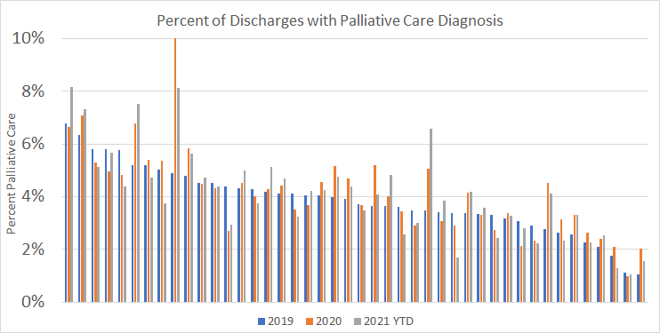
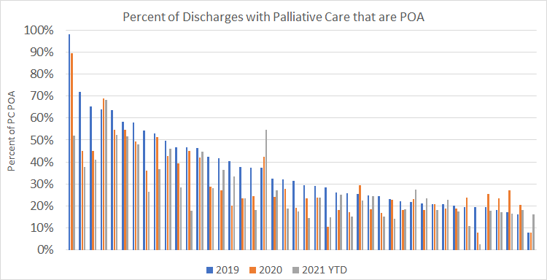
Monitoring Palliative Care
HSCRC will continue to include palliative care patients in RY 2024
Due to concerns in consistency of hospital reporting, HSCRC plans to monitor the following:
  Trends in palliative care coding statewide and by hospital
  Trends in palliative care that is present on admission statewide and by hospital

Slide 49
COVID Updates
RY 2022, RY 2023, RY 2024

Slide 50
RY 2022 COVID Updates
CMMI approved re-use of RY 2021 revenue adjustments for QBR, RRIP, and MHAC
While IPPS rule has made VBP revenue neutral for FFY 2022, Maryland will retain RY 2022 QBR revenue adjustments
  HSCRC negotiated re-use of RY 2021 revenue adjustments with CMMI for all programs
    Consistency across pay-for-performance programs necessary to achieve “least bad option” during CY 2020 performance
  HSCRC pay-for-performance programs, while informed by national programs, are unique, e.g. all programs include rewards
  Revenue adjustment in QBR signals our continued commitment to improve HCAHPS, reduce NHSN infections, and improve survival rates.

Slide 51
RY 2023 COVID Updates
HSCRC staff are exploring the following options for RY 2023:
  Removal of COVID patients vs. risk adjustment
  Use of concurrent data (CY 2021) for normative values and performance standards for PPCs, readmissions, and mortality
  Discussing with Mathematica other options for fairly assessing hospital performance during COVID PHE
  Considering CMS and other proposals for handling COVID, while acknowledging the unique aspects of our all-payer quality programs (e.g., not doing CMS pneumonia removal since we have all-cause measures)
PMWG will need to review staff proposals and provide input on any needed changes due to COVID for RY 2023 by March 2022
  PMWG members and other stakeholders can reach out to the quality team with any additional suggestions on things that should be explored
HSCRC staff will need to inform CMMI and the Commission of any proposed changes

Slide 52
RY 2024 COVID Updates
All quality policies will include the following recommendation for Commission approval:
  Adjust retrospectively the RY 2024 quality program methodology as needed due to COVID-19 Public Health Emergency and report any changes to Commissioners.
HSCRC staff will strongly consider inclusion of COVID patients in RY 2024 quality programs and/or develop monitoring reports on quality for COVID patients
HSCRC is interested in eliciting feedback from subject matter experts and hospital workers - if you have particular feedback to share in writing, please reach out the the Quality team at hscrc.quality@maryland.gov

Slide 53
THANK YOU!
Next Meeting: Wednesday, October 13, 2021

Slide 54
Appendix

Slide 55
