Slide 1
Performance Measurement Work Group Meeting
11/20/2019

Slide 2
Agenda
Welcome and introductions
Maryland Hospital Acquired Conditions (MHAC) Program
Readmissions Reduction Incentive Program (RRIP)
Quality Based Reimbursement (QBR) Program
Maximum Guardrail
Statewide Integrated Health Improvement Strategy (SIHIS)
Other topics

Slide 3
Maryland Hospital Acquired Conditions (MHAC)Program

Slide 4
MHAC Considerations for for RY 2022
Review 6-month PPC trends and revenue adjustments under revised RY 2021 policy
Update on palliative care status
RY 2022 performance standards using FY18 and FY19 to generate normative values
Revenue modeling for draft policy
Next steps

Slide 5
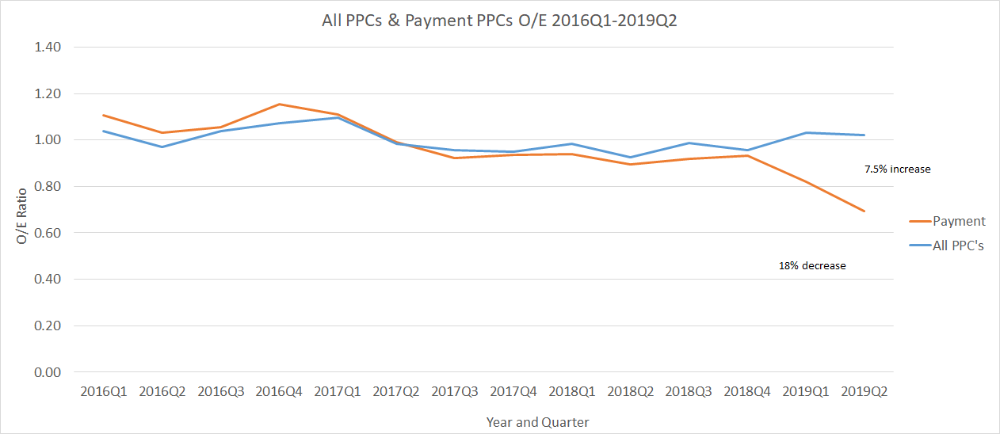
RY 2021 Performance through June
See handout for 14 payment program PPC trends

Slide 6
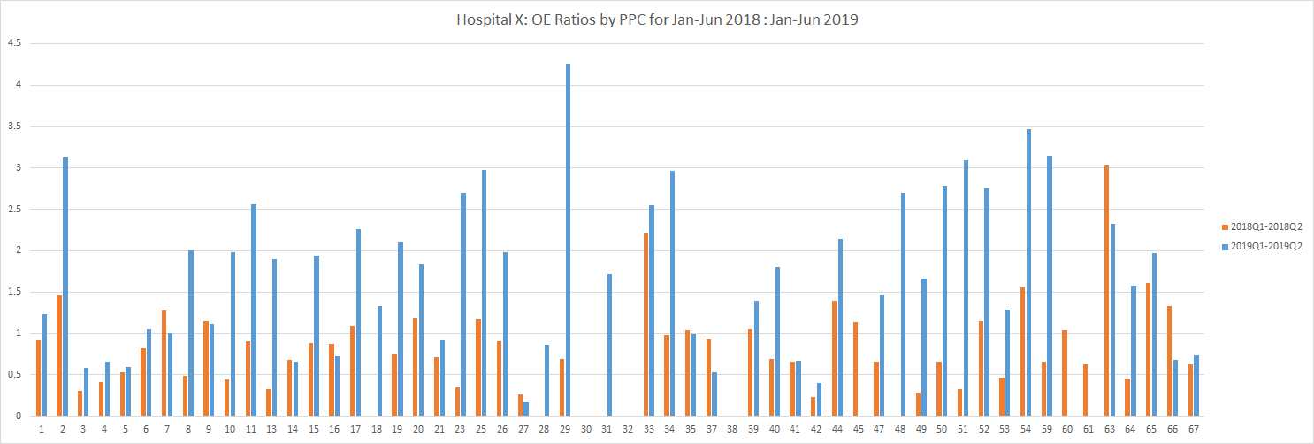
PPC Monitoring
HSCRC has excel reports to monitor all PPCs; will be developing in Tableau with CRISP
By PPC
By Hospital
By Status
(payment, monitoring, serious reportable event)
HSCRC reached out to 8 hospitals with larger increases on specific monitoring PPCs to get additional information

Slide 7
Monitoring PPCs with Larger Increases
PPC # | PPC Description | 2018 OE Ratio | 2019 OE Ratio
8 | Other Pulmonary Complications | 0.88 | 1.53
17 | Major Gastrointestinal Complications without Transfusion or Significant Bleeding | 1.11 | 1.89
18 | Major Gastrointestinal Complications with Transfusion or Significant Bleeding | 0.83 | 1.32
27 | Post-Hemorrhagic & Other Acute Anemia with Transfusion | 0.85 | 1.19
29 | Poisonings Except from Anesthesia | 0.76 | 1.79
31 | Decubitus Ulcer | 0.65 | 1.77
40 | Post-Operative Hemorrhage & Hematoma without Hemorrhage Control Procedure or I&D Proc | 0.96 | 1.23
52 | Inflammation & Other Complications of Devices, Implants or Grafts Except Vascular Infection | 0.84 | 1.51
PPCs 27 and 40 had modest OE increases; however these represented 48 and 61 additional observed PPCs (respectively) and were some of the final cuts in CAEM discussions.

Slide 8
Palliative Care Update
HSCRC has confirmed with 3M that the grouper logic already excludes cases with a palliative care diagnosis:
3M response: Z515- Encounter for Palliative Care is a global exclusion for PPC* (so only PPC 45 should be able to be assigned for these cases).
“*In the PPC v36 documentation this code is listed under DXs that are required to be POA, but this code is also on the APR pre-existing list. This should mean that regardless of the POA value on the record, when the record is processed by PPC we should see in the PPC flags that this code is processed as having the POA status set to ‘considered POA’.”
Staff propose to remove Palliative Care exclusion from MHAC program, as is duplicative of 3M PPC Grouper
This update will not substantively change the data (2 discharges statewide had PPC 45 assigned).

Slide 9
Modeling for Draft Policy
Performance standards (Base Period): FY 2018 and FY 2019
Performance period: FY 2019 for modeling; CY 2020 for RY 2022 policy
Maintain the 14 PPCs in payment program and attainment-only methodology
Maintain revenue adjustment scale
Need to discuss any potential cutpoint modifications but current modeling does not propose any change

Slide 10
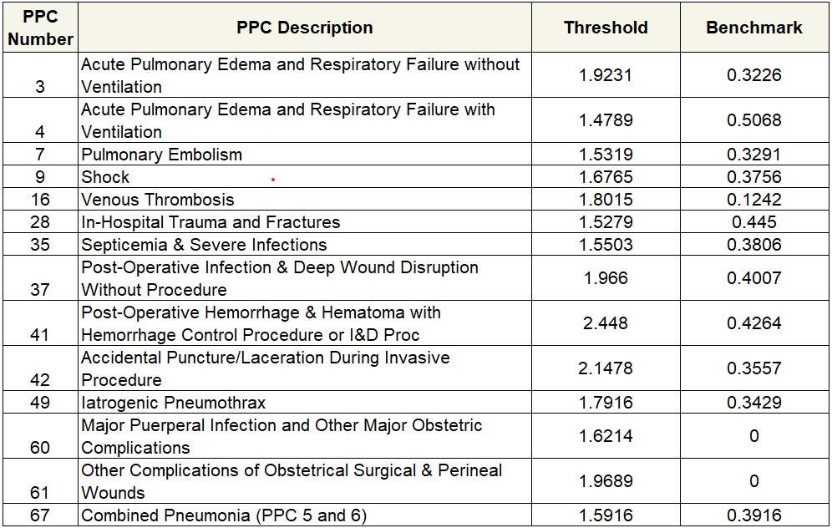
RY2022 Performance Standards

Slide 11
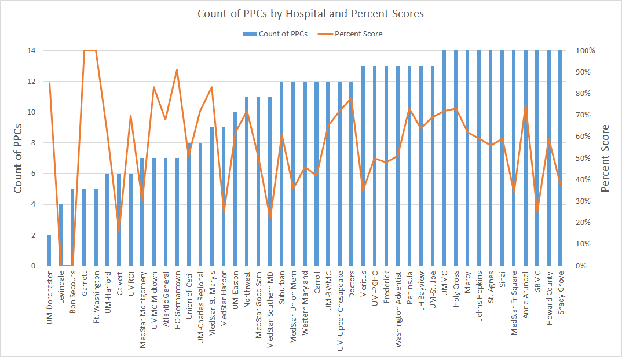
Should there be a minimum cutoff on number of PPCs for hospital inclusion?
UM Chestertown does not qualify for any of the 14 PPCs

Slide 12
Revenue Adjustments
Staff plan to also model FY 2019 performance (12 months) with RY 2021 performance standards (FY17-18).

Slide 13
Next Steps: Draft Policy December Commission Meeting
December PMWG Meeting:
Updates on hospitals’ insights regarding increases in monitoring PPCs
Updates on draft policy to commission
Ongoing:
Ongoing review of All PPCs, for purposes of considering inclusion in future years (not in RY 2022 policy)
Will bring final data for review by PMWG for input on this process

Slide 14
RRIP

Slide 15
Semi-final Readmission Measure - Update
AMA excluded - ~7,000 fewer cases in denominator
Oncology included* - ~2,500 additional cases in denominator
Ongoing Validation of logic
Readmission rates under this logic
Proposed Base Period: 2018
Normative Values
Proposed Improvement Target: -7.5% over 5 years
Ongoing Validation
Attainment Targets: TBD
Comparing Attainment and Improvement targets
Other tasks RE: Benchmarking and Out-of-State ratios
* Under specifications of oncology readmission measure, NQF 2884

Slide 16
Disparity Measure - Options for Discussion

Slide 17
Policy Considerations
Consistency with RRIP, other policies
Incentives sized appropriately to reflect importance of disparities issue, encourage movement
Pre-set target, scale
Difficult to scale, because we do not know the range of plausible improvements

Slide 18
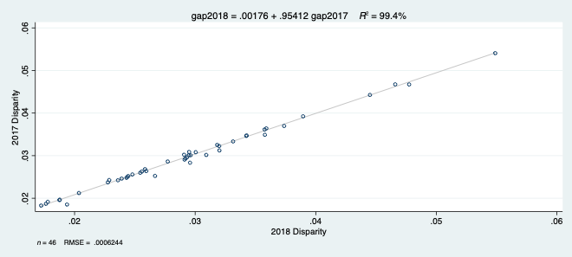
Year Over Year Disparity Score Correlation
Gap measure is currently extremely stable year over year, which suggests strong reliability

Slide 19
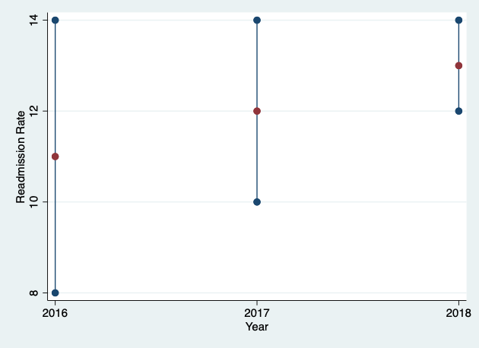
Gap Reduction vs. Improvement

Slide 20
Scoring approaches
Difference: Gap2019-Gap2018
Provides larger reward for larger absolute reduction in disparity risk
Hospitals with larger disparities potentially receive higher reward
Percent change: (Gap2019 -Gap2018)/Gap2018
Similar approach to RRIP
Rewards disparity improvement of different magnitude identically
Threshold: All hospitals with gap reduction>threshold receive reward of xx% revenue.
Provides all hospitals with incentive to improve, regardless of current level of disparity
May disincent hospitals from making investments required to move beyond minimal reduction

Slide 21
Quality Based Reimbursement (QBR) Program

Slide 22
QBR RY 2022 Draft Recommendations
Implement the following measure updates:
Remove the ED-2b measure commensurate with its removal from the CMS IQR program.
Consider adding OP-18b to the Person and Community Engagement domain.
Continue Domain Weighting as follows for determining hospitals’ overall performance scores: Person and Community Engagement - 50 percent, Safety (NHSN measures) - 35 percent, Clinical Care - 15 percent.
Maintain the pre-set scale (0-80 percent with cut-point at 41 percent), and continue to hold 2 percent of inpatient revenue at-risk (rewards and penalties) for the QBR program.

Slide 23
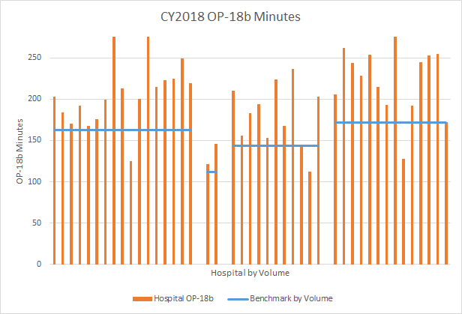
Option to Add OP-18b
Volume Categories (L-R) - HIGH; LOW; MEDIUM; VERY HIGH

Slide 24
QBR Redesign Sub-group: Among the Topics to be Considered
Strengthen the current incentives to improve patient experience, safety, and clinical outcomes.
Ensure that financial incentives under the population-based revenue system are aligned.
Evaluate additional data sources needed for performance measurement under the TCOC model.
Evaluate new opportunities for performance measurement as care is moved from the inpatient setting to other settings of care (e.g., outpatient hospital measures).
Explore potential new QBR measures:
Consider measures that foster accountability for broader care transformation and population health initiatives, specifically, measures that support goals developed for the State Integrated Health Improvement Strategy (SIHIS).
Identify or develop holistic and patient-centered measures.
30 day all payer mortality measure
Using measure catalogues such as the CMS’s Measure Inventory Tool and the National Quality Forum’s Quality Positioning System.
From those already in the CMS inpatient hospital reporting pipeline but not currently used in pay for performance, such as the Severe Sepsis and Septic Shock: Management Bundle measure (SEP-1).
Consider re-adoption of ED wait time measures

Slide 25
Max Guardrail Update

Slide 26
Maximum Revenue Quality Guardrail
The maximum penalty quality guardrail protects against unforeseen financial adjustments in Maryland pay-for-performance programs.
This years policy differs from previous iterations, in that staff is asking Commission approval to permanently adopt the previously used formula for calculating the guardrail until otherwise directed, and eliminate the need for an annual policy.
For reference, the RY 2020 max guardrail is 3.40 percent of total revenue; staff do not anticipate large shifts in this calculation year over year.
RY 2020: Maximum penalty for one hospital is estimated to be 2.00 percent of total hospital revenue (2.47 percent of IP revenue).
Policy recommends the maximum penalty one hospital could receive in RY 2021 and beyond across QBR, MHAC, RRIP, and net PAU savings.

Slide 27
Potentially Avoidable Utilization (PAU) Program

Slide 28
Future iterations of avoidable admissions
Risk Adjustment
AHRQ age and gender risk adjustment to calculate observed and expected values
Out-of-state Medicare PQIs
Workflows to MADE CCLF for MPA-attributed Marylanders

Slide 29
RY2021 Adjustment
% Reduction
Plan on using the inflation-based calculation developed last year to calculate the PAU Savings amount in the spring
Performance metric scaling
Over next few months will provide options for how to scale the Savings amount based on the PQI/PDI per capita and readmissions measures
Waiting for PQI/PDI risk adjustment to be complete

Slide 30
RY2022 and beyond
Staff plans to:
Refine Avoidable admissions per capita and readmissions
Explore Avoidable ED use
Explore how low value/overuse/utilization measures can be used for informational purposes

Slide 31
Measurement Report
Staff intends to present a RY21 and RY22 PAU Measurement Report to the Commission in early winter 2020.
Should help set up PAU Measurement to be determined earlier in the performance year

Slide 32
State Integrated Health Improvement Strategy (SIHIS) Maryland’s Quality and Population Health Strategy

Slide 33
Diverse Approaches for Statewide Integrated Health Improvement Strategy (SIHIS)
Shared Goals and Outcomes
1. Hospital Quality
3. Total Population Health
2. Care Transformation Across the System

Slide 34
Potential Examples of Shared Outcomes and Goals
Reduce within hospital readmission disparities
Reduce per capita PAU admissions
Reduce maternal morbidity
Increase value-based payment participation
Reduce diabetes burden
Improve on an SUD-related goal
Hospital
Hospital Quality & Pay-for-Performance
Health Sector
Total Population Health
Care Transformation Across the System
State/Local Gov’t
Communities

Slide 35
Guiding Principles for Maryland’s Integrated Health Improvement Strategy
Maryland’s strategy should fully maximize the population health improvement opportunities made possible by the Model
Goals, measures, and targets should:
Be specific to Maryland and established through a collaborative public process
Reflect an all-payer perspective
Target statewide improvements, including reducing disparities
Be synergistic and mutually reinforcing across the three domains
Focus on outcomes whenever possible; milestones, including process measures, may be used to signal progress toward the targets
Maryland’s strategy must promote public and private partnerships with shared resources and infrastructure

Slide 36
1. Hospital Quality & Pay-for-Performance under the TCOC Model
Refine existing hospital pay-for-performance programs and quality reporting
Develop paradigm for including population health metrics into pay-for-performance and monitoring as well as various HSCRC financial methodology applications
Maintain waivers from CMS
Maximize all-payer opportunity
Sustain and improve high quality care under capitated hospital model
Monitor additional types of performance metrics for holistic evaluation of hospital quality
Align with outcomes-based credit
Foster hospital accountability for population health
Utilize HSCRC hospital pay-for-performance expertise to support and align with other state value based initiatives to achieve statewide population health goals

Slide 37
2. Care Transformation Across the System
Objective: Create measure(s) of progress toward improved statewide outcomes and meaningful development of care transformation in Maryland
Examples:
Care coordination measures such as follow-up after hospitalization
Structural measure of share of Medicare beneficiaries in Category 3
Category 1 No change in practice of care | Category 2 Providers accept value-based payments for patients in their own setting of care | Category 3 Providers financially accountable for value and care quality for a population regardless of setting*
E.g., FFS payments for providers Some link to value and quality of care may be included (e.g., MIPS) but do not fundamentally change the incentives | E.g., Hospitals under global budgets accountable for services in the hospital Moves to value within own setting but little/no financial accountability for outcomes or what happens in other settings | E.g., ACO, ECIP This could be an attribution-based approach (e.g., ACO, ECIP, EQIP) or it could include self-defined populations (e.g., hospitals’ Care Transformation Initiatives)
* For approaches beyond the Traditional MPA, which captures 100% of Medicare beneficiaries

Slide 38
3. Total Population Health: Strategy for Starting with Diabetes
Leading cause of preventable death and disability
Increasing prevalence reflecting significant racial, ethnic and economic disparities
Evidence-based interventions (EBIs) can prevent or delay onset and improve outcomes
Maryland Medicaid launching Diabetes Prevention Program (DPP) this Fall
HSCRC Regional Partnership prioritizing diabetes
Diabetes/obesity cited as a priority by every jurisdiction’s Local Health Improvement Coalition (LHIC) and every hospital’s Community Health Needs Assessment (CHNA)
Strong private sector support for a sustained statewide initiative
Success provides credit in TCOC Agreement

Slide 39
What Has CMMI Said?
CMMI insists that for the TCOC Model to be “expanded” (made permanent) based on data through 2021:
Targets must be set and progress shown in the domains of hospital quality, care transformation, and population health
Although outcomes are preferred to show success, they are less likely to be obtained in 2021 data
CMMI requested the State to agree to amend the TCOC Contract, but instead accepted having an MOU that:
Establishes a framework and process that would be agreed on by the end of 2019
Requires the State to establish targets in all three domains as soon as possible in 2020
Each goal /measure could have, for example, a 2021 milestone, a 2023 interim target, and a 2026 target

Slide 40
Process for Establishing Targets and Being Successful
Set the Goals: Establish a collaborative process to select targets, measures and milestones (discussions beginning)
Hospital Quality and Pay-for-Performance (HSCRC Performance Measurement WG)
Care Transformation Across the System (HSCRC Performance Measurement WG)
Total Population Health (MDH, Diabetes Action Team)
Message the Goals: Develop communications/outreach strategy for statewide engagement
Resource the Goals: Develop multisector alignment of investments and accountability
Act on the Goals: Launch and support a statewide network of effective change
Monitor the Progress: Evaluate outcomes, reassess investments, adjust approaches accordingly

Slide 41
Structure of Statewide Integrated Health Improvement Strategy (SIHIS)
Domain | 2021 Milestone | 2023 Interim Target | 2026 Target
1. Hospital Quality
2. Care Transformation Across the System
3. Total Population Health
Need PMWG Input for Measures in Domain 1 and 2
MDH Lead on this Domain
As noted earlier, measures won’t always fit solely into one domain – which is good, showing the complementary nature of statewide efforts under the Maryland model

Slide 42
Next Steps for Measures Under Consideration
Domain 1:
Per capita avoidable admissions
Finalize risk-adjustment
Plan to bring data to upcoming PMWG meeting for establishing targets
Statewide disparities gap for readmissions
Finalize validation of measure and vetting with stakeholders as part of readmission redesign
Plan to bring data to upcoming PMWG meeting for establishing targets
Domain 2:
Gather stakeholder input on possible measures (see example of follow-up)
Assess data availability and feasibility
Select measures and targets

Slide 43
Follow Up After Discharge
PMWG concerns about the staff proposed 14 day follow up after discharge from regulated Maryland hospital (Medicare) as a part of MPA quality adjustment
Is 14 day follow up appropriate for all conditions?
Do all patients need a 14 day follow up?
Is this a meaningful measure?
In response to concerns, staff did not propose a new measure for the MPA quality adjustment for this year.
But staff did find a follow-up after discharge measure that may address PMWG concerns
Staff is considering follow-up measure for Statewide Integrated Healthcare Improvement Strategy and/or future MPA or other pay for performance programs
Notes:
2019
67.6%
49,367
Only paid through 201906
Notes: check on deaths,
one of two revenue center codes or one of 57 HCPCS codes
New Patient Visits,Established Patient Visits, Outpatient Consultations, nursing facility visits,Rest home visits,home visits,telephonic services,transitional care management
*rev codes;
%let REVCD= %str("0521","0522");

Slide 44
Timely follow-up after acute exacerbation of chronic conditions
NQF endorsed (NQF 3455)
Measure Definition
Percentage of patients with ED visits or hospitalization for one of the following: hypertension, asthma, heart failure, CAD, COPD, and diabetes
Follow-up received within recommended timeframe which vary by condition based on clinical practice guidelines (7, 14, or 30 day)
(see measure specifications handout)

Slide 45
Timely follow-up after acute exacerbation of chronic conditions (con’t)
Advantages:
NQF Endorsed (NQF 3455) with available measure specifications
Follows clinical practice guidelines, research demonstrating follow-up has a significant impact on patient outcomes
Aligns with PQI conditions and MDPCP follow-up after discharge
Addresses PMWG concerns that 14 day follow-up might not be appropriate for all conditions
Concerns:
Newly endorsed process measure, not widely used
Have not tested to see how Maryland compares to national or the variance in Maryland
Can only be calculated for Medicare with current data

Slide 46
Discussion
Should staff pursue modeling of follow-up measure for SIHIS goal?
Does this measure of follow-up address PMWG concerns raised recently?
What are other measures that stakeholders believe should be explored for care transformation across the system goal?
Please bring potential measures to the January PMWG

Slide 47
Next Work Group Meeting
Next PMWG meeting is scheduled for Wednesday, December 18

