Slide 1
Payment Model Work Group
January 23, 2024

Slide 2
Agenda
Introductions and Meeting Overview
Update Factor Model Review
Relevant Financial Data Review
Model Monitoring
Annual Filing Modernization
Important Dates Overview

Slide 3
Introduction and Meeting Overview

Slide 5
Update Factor Model Review

Slide 6
Policy Objective and Update Factor Components
The annual update factor is intended to provide hospitals with reasonable changes to rates in order to maintain operational readiness while also seeking to contain the growth of hospital costs in the State. In addition, the policy aims to be fair and reasonable for hospitals and payers.
One of the tenets of the update factor determination is to contain the growth of costs for all payers in the system and to ensure that the State meets its requirements under the Medicare Total Cost of Care Agreement.
Components Include:
Inflation
Care Coordination
Regional Partnerships
Population and Demographic Adjustments
Quality/ PAU
MHAC, QBR, RRIP
Other Adjustments
Unforeseen Adjustments
Complexity & Innovation
Capital Adjustments/FRA increases
Revenue Offsets with Neutral Impact of Financial Statements
Deficit Assessment
Uncompensated Care

Slide 7
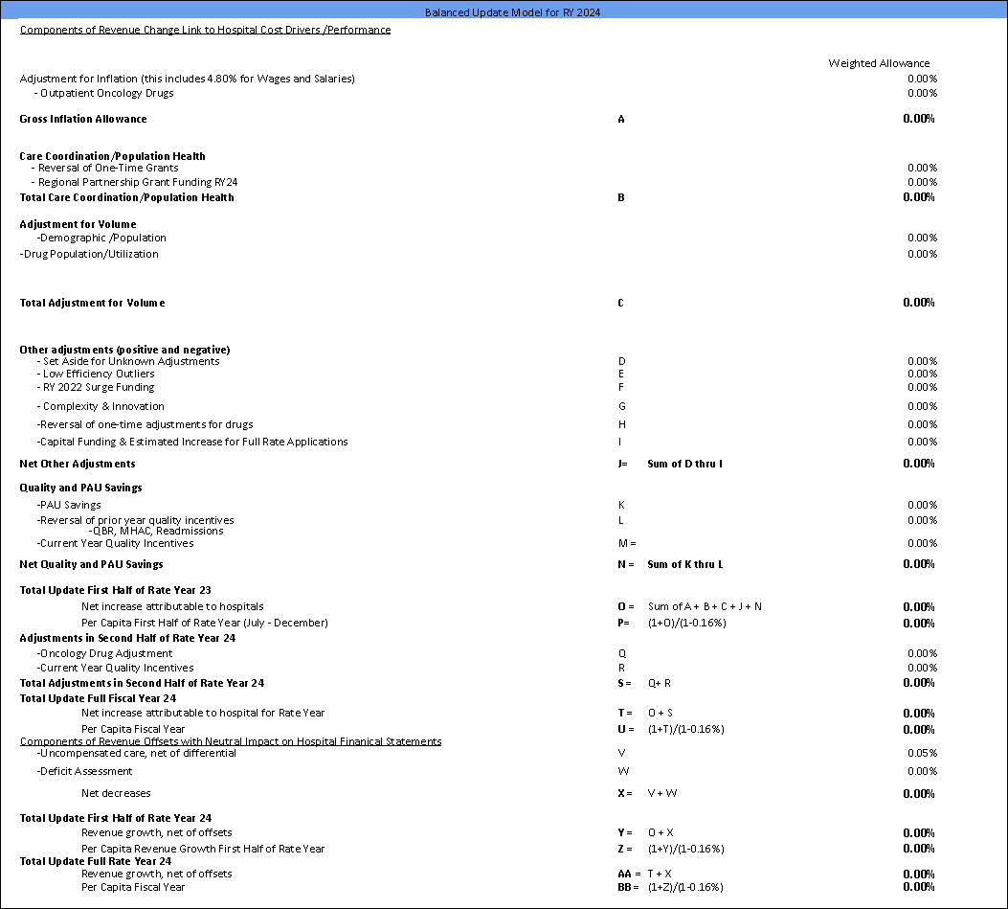

Slide 8
Guardrail Test & Saving Projections
Maryland’s performance on the Guardrail test and Savings are evaluated on a calendar year. HSCRC set rates on a fiscal year.
In effort to ensure we are balancing the calendar year and fiscal year relationship, staff must convert the recommended RY25 update (Hospital Part A) to a calendar year (CY24) growth estimate.
Staff model different scenarios to project the calendar year guardrail position for TCOC.
Estimates are divided into the following buckets: Hospital Part A, Hospital Part B, Non-Hospital Part A, and Non-Hospital Part B.
The only bucket we have control over is the revenue in Hospital Part A.
All other buckets utilize growth estimates are based on historical Medicare data.

Slide 9
Relevant Financial Data

Slide 10
January Update on Medicare FFS Data & Analysis
Data through September 2023, Claims paid through November 2024
Data contained in this presentation represent analyses prepared by HSCRC staff based on data summaries provided by the Federal Government.
The intent is to provide early indications of the spending trends in Maryland for Medicare FFS patients, relative to national trends.
HSCRC staff has added some projections to the summaries.
This data has not yet been audited or verified. Claims lag times may change, making the comparisons inaccurate. ICD-10 implementation and EMR conversion could have an impact on claims lags. These analyses should be used with caution and do not represent official guidance on performance or spending trends. These analyses may not be quoted until public release.

Slide 11
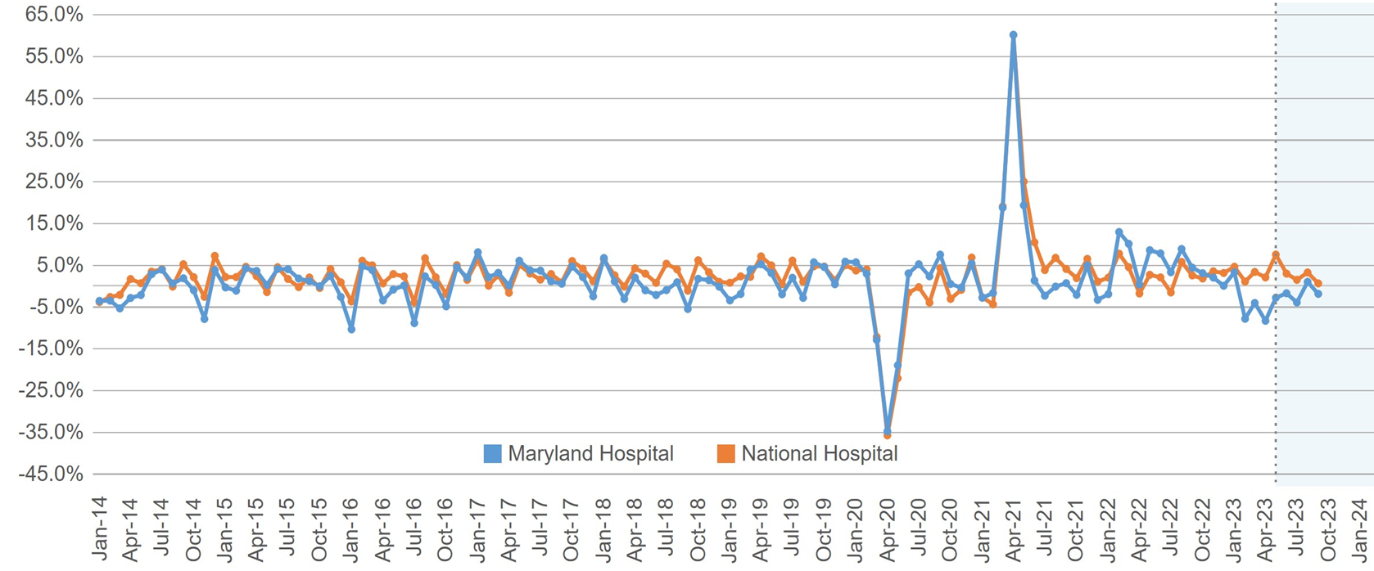
Medicare Hospital Spending per Capita Actual Growth Trend (CY month vs. Prior CY month)
CY16 has been adjusted for the undercharge.

Slide 12
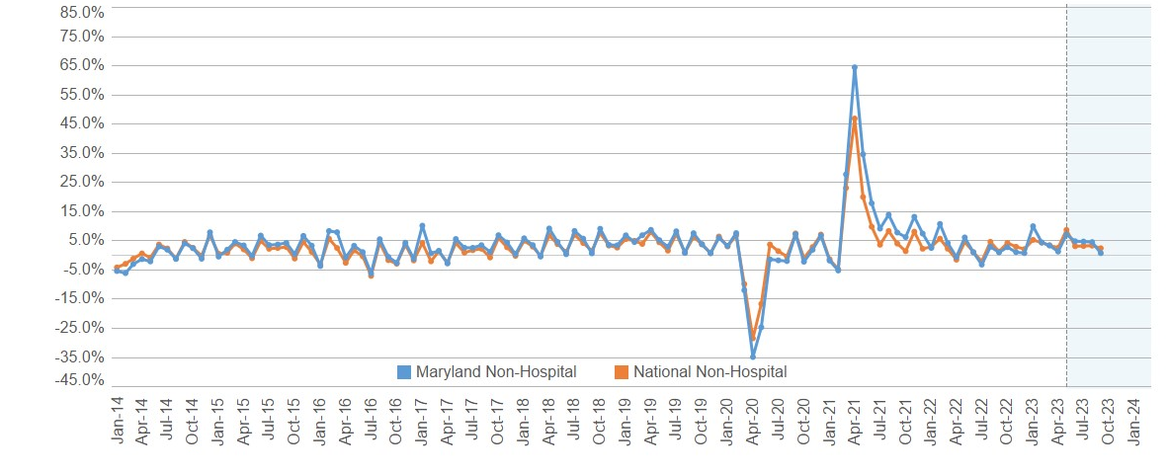
Medicare Non-Hospital Spending per Capita Actual Growth Trend (CY month vs. Prior CY month)

Slide 13
Medicare Hospital and Non-Hospital Payments per Capita

Slide 14
Medicare Total Cost of Care Spending per Capita Actual Growth Trend (CY month vs. Prior CY month)
CY16 has been adjusted for the undercharge

Slide 15
Medicare Total Cost of Care Payments per Capita
Guardrail

Slide 16
Medicare Projections CY24 and CY25
In future meetings Staff will present updated CY24 numbers and projections for CY25
YTD CY24 results shown on the prior slide (2.8% < guardrail) reflect the benefit of some one-time adjustments:
$64 M MPA saving component reduction that was reversed in December but is still reflected in YTD September data shown
1% increase in differential implemented in May 2023 that expires on June 30, 2024
0.20% All-Payer cut lapses ended on December 31
.

Slide 17
Annual Filing Modernization

Slide 18
Critical Elements of Annual Filing Modernization
3-year Annual Filing Modernization Project
A
Participation from Maryland hospitals and other stakeholders to provide critical input and advice.
B
Support from external consulting resources to assist, drive and focus:
i3 Healthcare Consulting LLC
Mathematica
SB & Company
Subgroup 1
Subgroup 2
Subgroup 3
Physician Cost
Overhead Cost Allocation
Cost Center
Annual Filing e-Tool
Accounting & Budget Manual Revision

Slide 19
Subgroup 1: Updates to Current Reporting
Modernize policies and data gathering in key areas of hospital operations
More discussion to come @ HFMA
Goal
Provider costs (physicians and extenders) and related revenues for which the hospital is responsible
Population Health operating costs and revenues
Administrative and overhead costs​
Update the overhead cost allocation framework
Goal
Ensure consistent allocation of overhead costs across all Maryland hospitals – Categories of cost & metrics used to determine allocation​

Slide 20
Subgroup 1: Updates to Current Reporting, Timeline
Hospital Surveys
More discussion to come @ HFMA
1.
First Survey - Beginning of February, 2 week response time
Subsequent survey(s) to follow
Annual Filing Modernization Workgroup
2.
Subcommittee of Payment Models Workgroup
First workgroup meeting – first 2 weeks of March
Second workgroup meeting – beginning of April
Test Supplemental Schedule on Physician Reporting
3.
Late Spring

Slide 21
Workgroup Meeting Work Plan

Slide 22
Important Spring Dates for Payment Model & Update Factor Season
• March 5 Workgroup Meeting
Update Factor Table with available draft inputs
• March 26 Workgroup Meeting
Update Factor Table with available draft inputs
Estimated Position on Medicare Target using FY GBR projections
GSP Estimated Impact
High Cost Drug Inflation
• April 30 Workgroup Meeting
Review of Draft Recommendation
Q1 Book for 2024 update inflation
Annual Filing Modernization
•May 8 Commission Meeting
Draft Recommendation Presentation to the Commission
•May 30 Workgroup Meeting
Review of Comment Letters and Final Recommendation
•June 12 Commission Meeting
Final Recommendation Presentation to the Commission

