Slide 1

Maryland Healthcare System Transformation
Consumer Standing Advisory Committee (CSAC)
Co-Chairs: Katie Wunderlich, HSCRC
Jennifer Barnhart, Public Health Services
December 19, 2016

Slide 2
Agenda
The Evolving Healthcare Landscape: National and State Perspective
All-Payer Model: Update and Future Plan
Public Health Primary Care Model
Consumer Engagement Work to Date
Consumer Standing Advisory Committee Proposed Charge and Work Plan
Notes:
The core three-part aim of the state’s healthcare system transformation work is better care, better health and lower cost. In Maryland, this includes: ongoing work of the Health Services Cost Review Commission (“HSCRC” or “Commission”) to modernize Maryland’s unique all-payer rate-setting system for hospital services—also known as the All-Payer Model (APM); and, the work of the Department of Health and Mental Hygiene (DHMH) in establishing a Comprehensive Primary Care Model—also known as Comprehensive Primary Care Plus (CPC+). To date, HSCRC and DHMH have worked with one another along with broad groups of public stakeholders to plan and implement each of their transformation initiatives.
Consumer engagement at all levels in planning and delivery of health care is essential to achieving the three-part aim. HSCRC working with DHMH is, therefore, establishing the Consumer Standing Advisory Committee (CSAC) that builds on the consumer engagement and involvement to date across the various HSCRC and DHMH work groups, reflects the gender, racial, ethnic and geographic diversity of the state, and in the course of conducting its work brings together a diverse cross-section of consumers, consumer advocates, relevant subject matter experts, and other stakeholders. See the Maryland Health Benefit Exchange (MHBE) http://www.marylandhbe.com/policy-legislation/committees/standing-advisory-committee/ and the Maryland Medicaid Advisory Committee (MMAC) https://mmcp.dhmh.maryland.gov/pages/maryland-medicaid-advisory-committee.aspx as examples.

Slide 3
The Evolving Healthcare Landscape

Slide 4
Centers for Medicare and Medicaid (CMS) and National System Transformation Strategy
Focus Areas
Description
Pay Providers
Deliver Care
Encourage integration and coordination of care
Improve population health
Promote patient engagement
Distribute Information
Create transparency on cost and quality information
Bring electronic health information to the point of care
Increase linkage of payments to value
Alternative payment models that move away from paying for only increasing use of services
Source: Summarized from Sylvia Burwell (US Secretary of Health & Human Services) presentation

Slide 5
Stakeholder-Driven Strategy for Maryland
Aligning common interests and transforming the delivery system are key to sustainability and to meeting Maryland’s goals
Focus Areas
Description
Provider Alignment
Line up payment incentives across providers
Care Delivery
Improve care delivery and care coordination across episodes of care
Promote consumer engagement and outreach
Health Information Exchange and Tools
Connect providers (physicians, long-term care, etc.) in addition to hospitals
Bring electronic health information to the point of care (for providers and consumers)
Develop shared tools (e.g. treatment summaries, care plans)
Harmonize outcome measures
Support enhancement of primary and chronic care models
Tailor care delivery to persons’ needs with care management interventions especially for patients with high needs and chronic conditions

Slide 6
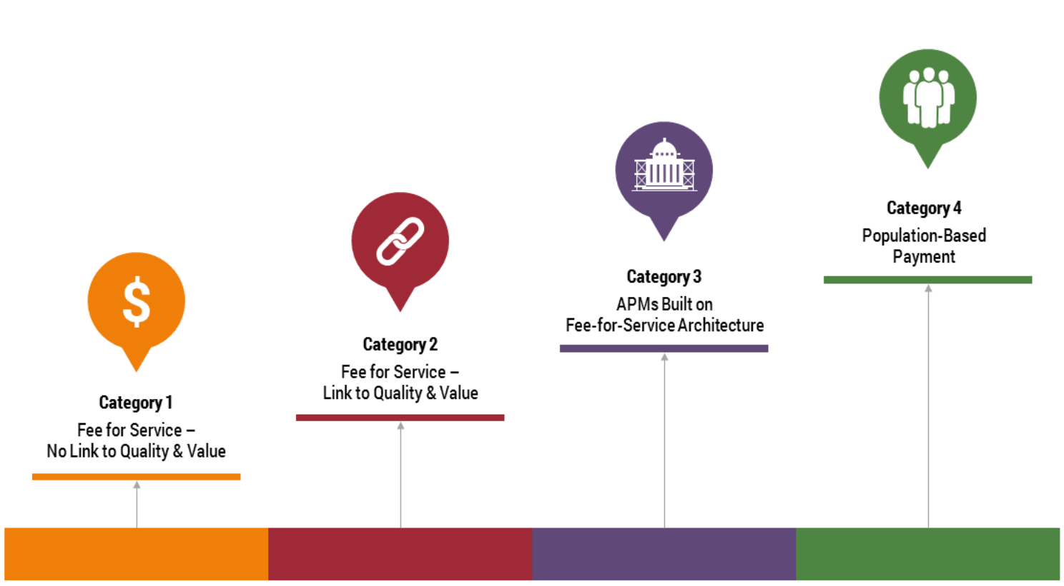
CMS is Focused on Progression to Alternative Payment Models (APMs)
MACRA is expected to have extensive fee schedule effects on physicians in 2019 based on participation in APMs
Source: Health Care Payment Learning & Action Network Alternative Payment Model (APM) Framework Final White Paper

Slide 7
DHMH Health Care Transformation Progression
2014 – 2015
2016 – 2018
2019 and Beyond
Hospital Global Budgets
Financial Alignment
Total Cost of Care
ALL-PAYER MODEL
POPULATION HEALTH
SHIP and LHICs
Formal Partnerships & Infrastructure
Sustainable Population Health Models
Dec 31, 2016
2017
2018
Submit designs of:
Primary Care Model
State Population Health Plan
All Payer Model Progression Plan
Duals ACO
All Payer Model Amendment, Population Health Plan – Design
Primary Care Model – infrastructure development
Primary Care Model – Year 1 Operation
Additional Population Health Plan and VBP - Planning
Notes:
While All Payer Model Progression is moving forward, Pop Health Planning is moving in lockstep
2014 - 2015: we are building on the success of SHIP and the LHICs – not replacing them. We want to take them to the next level.
2016 to 2018: Hospitals are entering into new financial relationships with physicians and other entities. There is a significant opportunity for local health departments and community organizations to enter into those financial relationships, share data, and coordinate services.

Slide 8
All-Payer Model: Update and Future Plan

Slide 9
Maryland’s All-Payer Model
  Oversees hospital rates for all payers
  Rate setting authority extends to all payers, Medicare waiver
    Granted in 1977 and renewed under a different approach in 2014
  Provides considerable value
    Limits cost shifting- all payers share in medical education, uncompensated care, etc.
Maryland is implementing an All-Payer Model for hospital payment
  Approved by Centers for Medicare & Medicaid Services (CMS) effective January 1, 2014 for 5 years
  Modernizes Maryland’s Medicare waiver and unique all-payer hospital rate system
  Health Services Cost Review Commission (HSCRC) is leading the effort
HSCRC back drop:
Old Waiver
Per inpatient admission hospital payment
  New Model
  All-payer, per capita, total hospital payment & quality
Notes:
Old System = Volume Driven
New System = Population and Value Driven
Uses updates for trend, population, and value.

Slide 10
What do Global Budgets Mean?
Hospitals:
  Incentive to reduce potentially avoidable utilization
    Readmissions
    Complications
    Ambulatory sensitive conditions
  Prevent new admissions:
    Spearhead prevention
    Collaborate with community providers
    Help to address social determinants
Payers
  Reduced unnecessary use
  Predictability in overall hospital costs
  Control on growth in hospital charges
  Consistent with Primary Care Medical Home (PCMH) and similar programs
Notes:
Total hospital revenue growth ceiling
Maximum 3.58% annual growth rate for first 3 years (Meeting)
Medicare payment savings
Minimum of $330 million in savings for Maryland beneficiaries (Meeting)
Patient and population centered-measures
Decrease the Medicare readmission levels to national average (Meeting)
Decrease potentially preventable complications over a 5 year period (2014-2018) by 30% as measured by the Maryland Hospital Acquired Conditions (MHAC)program Many other quality improvement targets (Met)

Slide 11
Opportunities for Patients—Tailoring Care Delivery to Persons’ Needs = Better Outcomes & Quality of Life, Fewer Hospitalizations
Utilizing EHRs, analytics, health information exchange, and care coordination resources to improve care and health.
A
Healthy
Chronically ill but under control
Care plans, support services, case management, new models, and other interventions for individuals with significant demands on health care resources
B
High need/
complex
Address modifiable risks and integrate and coordinate care, develop advanced patient-centered medical homes, primary care disease management, public health, and social service supports, and integrated specialty care
Chronically ill but at high risk to be high need
C
Promote and maintain health (e.g. via patient-centered medical homes)

Slide 12
Maryland’s Strategy Looking Forward—Care Coordination for High Needs Patients
Fully implement care coordination, first for complex and high needs chronically ill patients
  Organize and engage consumers, primary care, long-term care, and other providers in care coordination and chronic care management
  Intense focus on Medicare, where models do not exist or are immature in Maryland
  Build on growing Primary Care Medical Home (PCMH) and other organized care models, global budgets and geographic areas, and Medicare Chronic Care Management (CCM) fee
Develop financial alignment programs across hospitals and other providers, and get data and approvals needed for implementation (HCIP, CCIP, Comprehensive Primary Care program, Duals ACO)

Slide 13
Next Steps: All-Payer Model Extension
With stakeholder input, submit plan that expands focus on total cost of care (due December 31, 2016 for implementation in 2019 and beyond)
  Best approach is to focus on care redesign to reduce avoidable hospitalization costs
  Alignment of incentives across multiple settings
  Maryland will not propose rate-setting for other providers

Slide 14
DHMH Comprehensive Primary Care Model

Slide 15

Public Health Services
Maryland Primary Care Model
Medicare (Part B) moving
to all-payer
Care
Management
Payments
Advisory Board
Hospital Chronic
Care Initiative (CCIP)
High Risk Patients,
Rising Risk Patients
PQI Bonuses
Coordinating Entity
HIT Infrastructure/CRISP
xx% CM Funds
Care Transformation Organizations
Care Management Resources & Infrastructure
e.g., (ACO, CIN, LHIC, LHD, RP, Health Plan)
xx% CM Funds
xx% CM Funds
CM
PDP embeds CM resources
PDP requests unembedded CM resources
CM
Person-Centered
Home
(PCH)
Person-Centered
Home
(PCH)
Patient-Designated Provider (PDP)
PATIENT
Patient-Designated Provider (PDP)
15
Visit/Non-Visit-based Payments
MACRA Bonus Payments
Quality Payments at Risk
(MACRA qualifying)
Notes:
Over the next slides, we will break down this complex diagram into more digestible chunks of information

Slide 16
Primary Care Model: Patient Designated Providers
Patient Designated Providers (PDPs)
  The most appropriate provider to manage the care of each patient
  Provides preventive services
  Coordinates care across the care continuum
  Ensures enhanced access
  Most often this is a PCP but may also be a specialist, behavioral health provider, or other depending on patients health needs

Slide 17


Primary Care Model:
What does a transformed practice look like to a patient?
I am a Medicare beneficiary
Provider selection by my historical preference
I have a team caring for me led by my Doctor
My practice has expanded office hours
I can take advantage of open access and flexible scheduling:
  Telemedicine, group visits, home visits
My care team knows me and speaks my language
My records are available to all of my providers
I get alerts from care team for important issues
My Care Managers help smooth transitions of care
I get Medication support and as much information as I need
I can get community and social support linkages (e.g., transportation, safe housing)
Notes:
- Moving forward we envision patient selection of providers

Slide 18
Primary Care Model:
Care Transformation Organizations
Certification by external accrediting body
Apply through Coordinating Entity (CE)
  CE holds CTO accountable for requirements and outcomes
Ability to provide following services includes:
  Care management infrastructure
    Nurses, pharmacists, nutritionists, Community Health Workers, LCSWs, Health educators
  Technical assistance for 24/7 after-hours access
  Social support connections – Community Health Workers
  “Hot-spotting” areas with high and/or specific needs
  Pharmacist support for medication management and consultations
  Assisting practices in meeting Primary Care Model requirements
  Physician training resources
  CRISP connectivity
Notes:
Services may include up front investments or existing capacity consolidation to establish oneself as RCME; leveraging existing resources such as ACOs, CINs, LHICs and other regional healthcare programs
No regional requirement for RCMEs: Regional Care Coord recognizes the importance of local control and provision of care as well as distribution of resources to address need
Still having a lot of discussion around what CE looks like
Program payments from payers
ii. Distribution of CM payments to practices and Regional Entity
iii. Evaluation and analytics of program
iv. Identification and targeting
v. Coordinates functions with other models (e.g. Duals Model)
vi. CE hold regional RE and providers accountable
vii. Advisory Board – oversight of CE

Slide 19
Next Steps: Primary Care Model
Submit Concept Paper to CMS December 31, 2016
Negotiate terms and clearance of Contract January – May 2017 with CMS
Legislative approach to support Coordinating Entity function January through April 2017
If approved, Primary Care Model is effective January 2018

Slide 20
Opportunities for Consumers and Providers in Maryland
Get Connected
Utilize CRISP encounter alerts, common care histories, and other care management tools
Get Coordinated
Coordinate your patients’ care with other providers across clinical and community settings
Work with case managers to address the medical and social needs of complex patients
Participate
Join Accountable Care Organizations, medical homes, geographic initiatives, etc.
Get involved in outcomes-based payment programs, etc.
Be Proactive
Be a watchdog
Contribute to the redesign of the state’s healthcare delivery system
Address gaps in patients’ health
Use data and information to help improve outcomes and lower costs

Slide 21
Consumer Engagement Work To Date

Slide 22
What is Consumer Engagement?
CMS: states should ensure that the voices of older adults, persons with disabilities, and their caregivers are heard in the design, implementation, and oversight of the demonstrations.
Deloitte: relationship that helps individuals take action to improve their health, make informed decisions and enable them to engage effectively and efficiently with the health care system.

Slide 23
HSCRC: Engaging
Multiple Agencies and Stakeholders
“Successful consumer engagement requires proactive and committed leadership. It is imperative that the HSCRC embraces a continued leadership role to promote a coordinated, collaborative and person-centered health care system.”
HSCRC Advisory Council Representation
HSCRC Consumer Engagement Task Force
HSCRC Community Outreach Task Force
HSCRC Consumer – Standing Advisory Committee
Notes:
What we have laid out is really just the start ...
Your actions to date have set already set a high bar for the Commission's leadership role on consumer engagement and establishes Maryland as a model for other states
At we said at the outset, however, we recognize that the institutions and organizations represented on the Task Force and many others have key roles to play and while I can't speak for all of them I can say we are grateful for your commitment and we are prepared to do what we can to ensure that we achieve success not only with consumer engagement but with the New All-Payer Model.
It has been a real privilege to work with such a terrific team and thank you for the opportunity.

Slide 24
Consumer Engagement Task Force- March-September 2015
Task Force Roster:
Leni Preston, Chair – Maryland Women’s Coalition for Health Care Reform
Linda Aldoory, Herschel Horowitz Center for Health Literacy, University of Maryland
Barbara Brookmyer, Frederick County Health Officer
Kim Burton, Mental Health Association of Maryland
Tammy Bresnahan, AARP
Michelle Clark, Maryland Rural Health Association
Shannon Hines, Kaiser Permanente
Donna Jacobs, University of Maryland Medical System
Michelle LaRue, CASA DE MARYLAND
Karen Ann Lichtenstein, The Coordinating Center
Susan Markley, HealthCare Access Maryland
Suzanne Schlattman, Health Care for All!, MCHI
Novella Tascoe, Keswick Multi-Care
Hillery Tsumba Primary Care Coalition of Montgomery County
Gary Vogan, Holy Cross Hospital
Staff: Dianne Feeney & Steve Ports, HSCRC; Theressa Lee, MHCC; & Tiffany Tate, Consultant
Notes:
SLIDE (Leni) - Task Force Members
HSCRC commitment to process - Donna, Steve & Dianne
Members
diversity of expertise & organizations
commitment during 9-month process

Slide 25
HSCRC Consumer Engagement Task Force
January – September 2015
  Charge 1
  Provide rationale for health literacy and consumer engagement within the context of the New All-Payer Model (NAPM)
  Define audiences, identify messages, and propose engagement strategies as appropriate, including:
    Systemic adjustments
    Education and communication strategies
  Charge 2
  Advise decision-makers, regulators, etc. on the impact of system transformation on individual and community health issues
  Provide guidance for ensuring an appropriate and consumer-friendly communications process
  Make recommendations for enhanced ways for consumers to provide feedback and for hospitals to act on that input
Notes:
SLIDE (Leni) - Review Charges
Pleased to submit our report - this sets out the context and content for a consumer-focused communications plan w/ what we hope are clear goals and objectives and we have then broken those down into four categories - all stakeholders, policy makers, providers and hospitals and consumers - and have provided some specific strategies & tactics for each
emphasize that this is not a full blown communications plan - but we have done our best to provide a platform for that & we recognize that you can't do this alone
Need cooperation of other agencies and all stakeholders
that includes those of us on the Task Force, who are committed to ensuring that this doesn't sit on the shelf

Slide 26
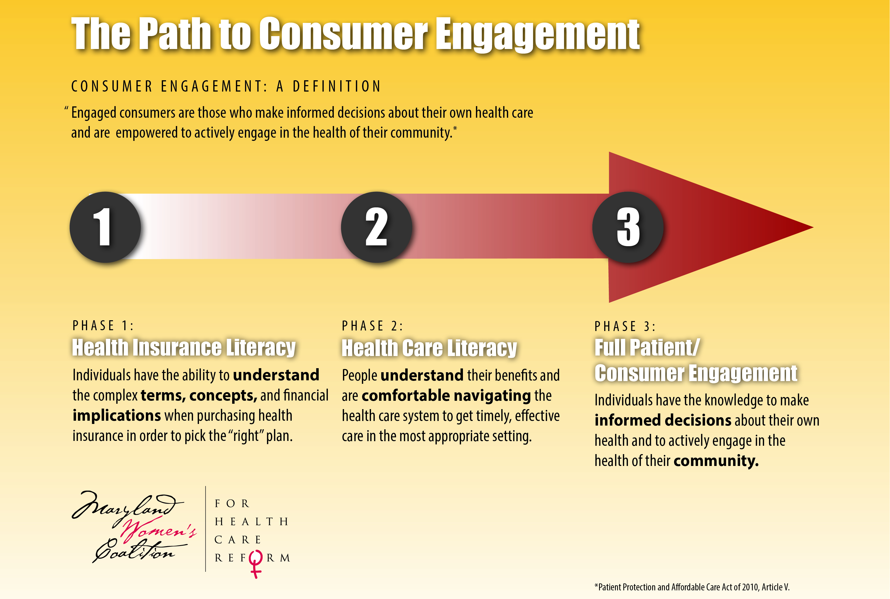
Consumer Engagement – Get It!
Notes:
SLIDE (Leni) - Path to Consumer Engagement
TF's path to create this report almost as challenging as moving consumers along the path to full engagement - still looking for that magic wand
As Hillery pointed out at your last meeting - you can't leap in at the end
Requires a continuum of information and reinforcement & it requires that collaboration that I just spoke of
step #1 - health insurance (and financial) literacy - MHBE & Connector Entities as well as organizations like the Coalition & PCC
step #2 - health care literacy - understanding not only how to use insurance coverage effectively, but how to traverse the system
step #3 - empowered w/ knowledge - consumers "own" their own health and, in best of all worlds, are engaged in improving health of their communities

Slide 27
Consumer Engagement: Who Benefits?
Consumers & the Community:
Increased knowledge of condition, treatments & access to services
Improved relationships providers
Sense of ownership with decision-making
Informed, responsive, & more efficient delivery system
Providers & Institutions:
Better outcomes & more efficient use of resources
Greater confidence that services are meeting patients’ needs
Better & more cooperative partnerships with individuals and communities they serve
Streamlined processes to receive information and insight from the community and apply these to inform policy decisions
Notes:
SLIDE (Leni) - CE Benefits to Consumers & the Community

Slide 28
Consumer Engagement: Themes/Factors
Engagement is dependent on individual’s input and perception that their actions have an impact
Individuals’ motives are different than institutions’ – must identify motivating factors for both groups
Consumers must trust the source of the health care information they receive
Sensitivity to diversity and the multitude of cultural differences are critical
Extraordinary commitment from health care leadership at all levels is critical
Ideally, consumers should be engaged, both prior to, and at the point of contact with the health care system
A more robust and consumer-friendly feedback process (i.e. concerns, complaints and commendations) is needed
Advanced directives planning is indicative of consumer engagement
Notes:
SLIDE (Leni) - CE Themes
In developing our construct and recommendations we looked at a set of overriding themes that emerged through our research phase
Literature review
presentations from Consumers Union, hospitals, and others working in Maryland
Themes
Call to action at the right time & from the right messenger (trusted source)

Slide 29
Consumer Engagement:
Strategic Communications Goals
Goal #1
Establish a person-centered health care delivery system with an ongoing role for consumers to participate in the design and implementation of policies and procedures at all levels.
Goal #2
Engage, educate, and activate people who use, or are potential users of, hospital services in their own health care in order to promote efficient and effective use of the health care system
Notes:
The Task Force established two strategic goals for the recommended consumer engagement activities.
These goals are informed by some of the themes Leni described earlier, most importantly the ideas that:
1) Consumers’ continued engagement depends on them being able to see the impact of their input and actions
And
2) Individuals motives for being engaged in their health and institutions motives for engaging consumers are different.
With these in mind it is clearly important to establish a person centered system with an ongoing and meaningful opportunities for consumers to participate.
Equally important is the need to educate and activate people in their own health and health care to promote efficient us of health services.

Slide 30
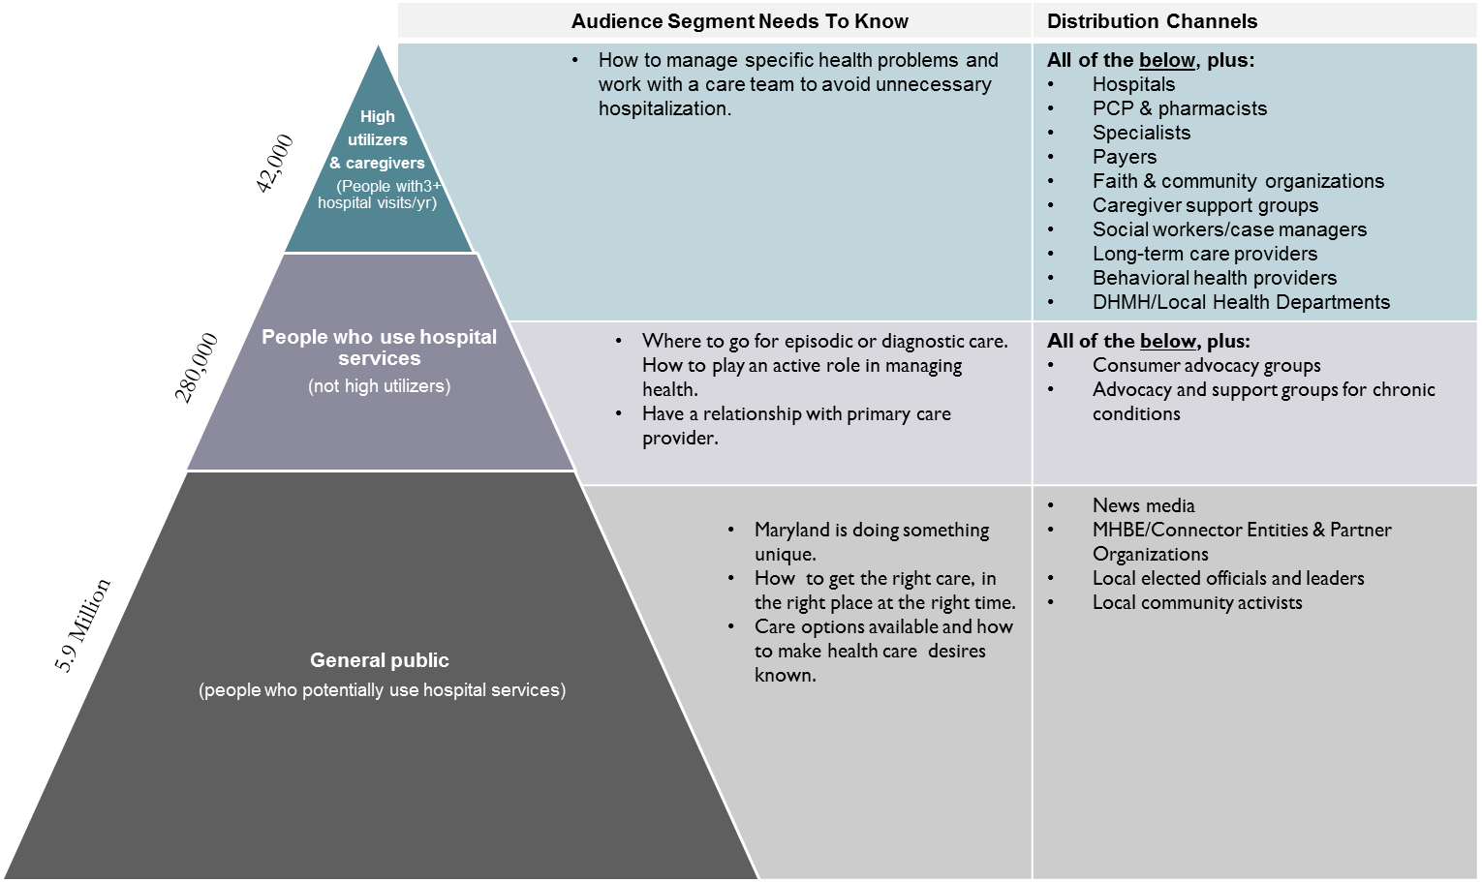
Audiences & Messengers
Notes:
We then turned to segmenting target audiences. Because everyone in Maryland could potentially use hospital services, our universe of audiences is all Marylanders. Within the broad audience we have identified sub-groups that require additional messages as shown in the right hand column.
While it may be tempting to focus heavily on individuals at the tip of the pyramid (those who frequently use hospital services), it is extremely important to diversify your investment in terms of consumer engagement for three important reasons:
First: In order for people to take a desired action they must already be aware of the issues, informed, and ready to make a wise decision. A good example of this is an advanced medical directive – this is something that should be in place before someone becomes so ill they are in the tip of the pyramid.
Second: People in the very tip of the pyramid are extremely ill and don’t stay in that category for very long. Either their health improves, in which case they move into the middle category, or it declines, in which case they pass on. While intensive interventions among high users show quality improvements, there is still some debate about cost savings for programs that are heavily focused on this group.
Finally: Thinking only about disease burden means losing sight of the big picture of consumer engagement and involving consumers in a meaningful way in the design of a person-centered health care system. Because of the severity of their health when in the tip of the pyramid, those individuals are unlikely to get involved in the policy and design piece.

Slide 31
Task Force Recommendations
Allow for meaningful, ongoing role for consumers at the HSCRC through continued representation of Commissioner(s) with primary consumer interest, and through a newly created standing advisory committee with diverse representation.
In collaboration with key stakeholders, develop a statewide public education campaign specific to the NAPM that is part of a broader campaign to promote health and wellness.
Convene an interagency task force, with consumer representation, to oversee the public education campaign including the development of related consumer-oriented information.

Slide 32
Task Force Recommendations
Provide options and opportunities that support regular, longitudinal and effective consumer engagement in the development of policies, procedures, and programs by hospitals, health care providers, health care payers, and government.
In coordination with the SAC, the MHCC and other key stakeholders, consider development of a Consumer Gold Star system for hospitals based upon consumer engagement standards.
Define Community Benefit dollars to include consumer engagement initiatives and promote these dollars for this use, particularly for those supporting vulnerable populations.

Slide 33
Task Force Recommendations
Continue to encourage and incentivize independent and collaborative approaches to support people who are at risk of becoming high utilizers.
Encourage hospitals to provide current, consistent, and transparent information on average procedure costs using the data made readily available by the Maryland Health Care Commission (www.marylandqmdc.org) and new pricing transparency tools being created, and make this available on NAPM and/or other appropriate website(s).
Include discussions about patient and family decision-making and preferences about advanced directives in the context of consumer engagement and educating consumers.

Slide 34
Consumer Engagement:
How Do We Measure It?
Currently few validated metrics or tools that could directly and comprehensively evaluate the impact of consumer engagement on health outcomes, patient experience or satisfaction, provider satisfaction, improved program design decision-making, access, or utilization.
Propose an initial non-exhaustive set of measures which could be adopted from currently available resources:
  Existing data sources (e.g., Hospital Consumer Assessment of Healthcare Providers and Systems (HCAHPS), Medicare claims, CRISP encounter information),
  Assess feasibility of collecting data on measures not currently collected (e.g., the Communication Climate Assessment Toolkit (C-CAT)).
Propose others where there are currently measurement gaps, through:
  HSCRC Standing Advisory Committee
  Patient Family Advisory Committees at hospitals
Notes:
While there are currently very few validated metrics or tools that could be used to evaluate the impact of these efforts the Taskforce has proposed an initial set of measures which could be adopted to evaluate these efforts. Consumer engagement is about behavior change, and is a long term proposition so while some of the recommendations will begin to demonstrate immediate changes, understand that behavior change takes time, but it is worth it to stick with it.

Slide 35
Questions for you
How can we work with consumer groups to ensure that our All Payer and Primary Care Models improve the patient experience with care?
What is the best way of integrating community-based services?
How can we avoid “under-care” even as we strive to reduce inappropriate care?
How can we ensure we are speaking the same language?

Slide 36
Consumer Standing Advisory Committee: Scope of Work and Work Plan

Slide 37
CSAC Charge
Builds on the consumer engagement and involvement to date
Reflects the gender, racial, ethnic and geographic diversity of the State
Brings together a diverse cross-section of consumers, consumer advocates, relevant subject matter experts, and other stakeholders
Members are appointed based upon their expertise, their potential contribution to the scope of work, and the need for input from important stakeholder perspectives
Notes:
The core three-part aim of the state’s healthcare system transformation work is better care, better health and lower cost.
In Maryland, this includes: ongoing work of the Health Services Cost Review Commission (“HSCRC” or “Commission”) to modernize Maryland’s unique all-payer rate-setting system for hospital services—also known as the All-Payer Model (APM); and, the work of the Department of Health and Mental Hygiene (DHMH) in establishing a Comprehensive Primary Care Model—also known as Comprehensive Primary Care Plus (CPC+). To date, HSCRC and DHMH have worked with one another along with broad groups of public stakeholders to plan and implement each of their transformation initiatives.
Builds on the consumer engagement and involvement to date across the various HSCRC and DHMH work groups

Slide 38
CSAC Goals
Ensure the consumer perspective is reflected in, and remains central to healthcare system modernization work;
Provide expertise in the area of consumer engagement to the Commission and DHMH;
Promote broad understanding about the APM and CPC+ and their impact on improving health and health care for consumers/patients;
Gather input from patients and consumers and represent their voices to ensure that the perspectives of patients / consumers are incorporated in health system transformation;
Advise on APM and CPC+ implementation, including evaluation of responsiveness to consumer feedback (e.g., concerns, complaints and commendations).

Slide 39
Proposed Work Plan Through 2017
CSAC will continue to provide critical feedback to the State as it develops and implements APM and CPC+
Meeting frequency is anticipated to be every two to three months.
Meeting dates for the following year will be set in advance.
Meeting participation options include in person or via conference call and webinar.

Slide 40
Thank you for the opportunity to work
together to improve care and health for people and communities that receive care in Maryland!

