Slide 1
Performance Measurement Work Group Meeting
12/19/2018

Slide 2
Guiding Principles For Performance-Based
Payment Programs
Program must improve care for all patients, regardless of payer
Program incentives should support achievement of all payer total cost of care model targets
Promote health equity while minimizing unintended consequences
Program should prioritize high volume, high cost, opportunity for improvement and areas of national focus
Predetermined performance targets and financial impact
Hospital ability to track progress
Encourage cooperation and sharing of best practices
Consider all settings of care

Slide 3
Agenda
1. Welcome and Introductions
2. RY 2021 RRIP Policy Draft
  Updated Targets
  Revenue adjustment scale
3. RY 2021 MHAC Policy Proposed Methodology Changes
  Targeted PPC list reliability analysis
  Revenue adjustment scale
  Revenue at risk
5. FY 2020 PAU Proposed Updates Modeling

Slide 4
Welcome and Introductions

Slide 5
RY 2021 RRIP Policy
Notes:
Andi- To add slides from Maddie and Judy (these are being re-vamped week of 9/4) Maddie will present

Slide 6
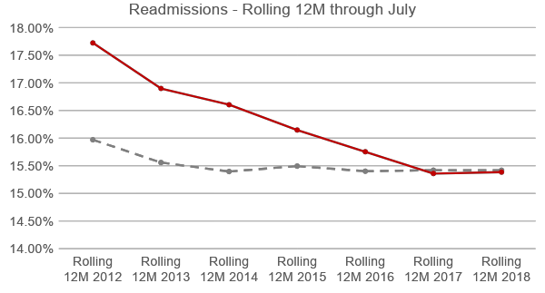
Medicare Waiver Test: At or below National Medicare Readmission Rate by CY 2018
With most recent Medicare Readmissions data, Maryland’s Medicare Readmission Rate (15.38%) is just below the National Medicare Readmission Rate (15.42%). Maryland will need to continue to reduce its readmissions, and match any additional reduction in the national rate.
Data are currently available through July 2018
Notes:
NOTE that YTD would suggest we are above the nation; however, trending over rolling twelve months is still in our favor.
Updated from 2018-12 Slides

Slide 7
HSCRC data aligns well with CMMI data

Slide 8
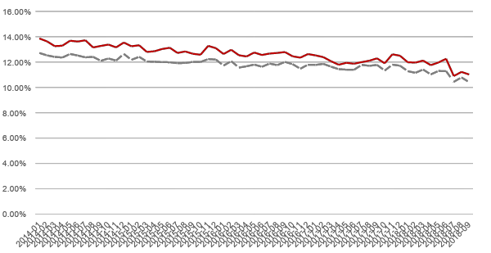
Monthly Case-Mix Adjusted Readmission Rates
ICD-10
Case-Mix Adjusted Readmissions | All-Payer | Medicare FFS
RY 2018 Improvement (CY13-CY16) | -10.79% | -9.92%
2016 Jan-September YTD | 11.79% | 12.67%
CY 2018 Jan-September YTD | 11.15% | 11.84%
RY 2020 YTD Improvement | -5.41% | -6.58%
RY 2020 Compounded Improvement | -15.61% | -15.85%
Note: Based on final data for Jan 2013 – Mar 2018; Preliminary data through September 2018. Statewide improvement to-date in RY 2020 is compounded with RY 2018 improvement.
Notes:
Updated from 2018-12 Slides – Thanks to Quanshay

Slide 9
Flowchart of Predicting Improvement Target
  Project CY 2019 National Medicare rates [15.34%]
Step 1
  Add a cushion to Medicare projections [15.24%, 15.14%; 15.04%]
Step 2
  Convert National (projected) rate to All-Payer Case-mix Adjusted Rate* [11.55%; 11.48%; 11.40%]
Step 3
  Calculate 2016-2019 Improvement Target (RY 2021) [-3.24%; -3.88%; -4.51%]
Step 4
HSCRC expects to have more recent data to improve predictions for final policy.
Notes:
Andi

Slide 10
Flowchart of Predicting Attainment Target
  Take Current All-Payer Case-mix Adjusted Readmission Rates (2018 YTD through Aug)
Step 1
  Increase these rates for Out-of-State Readmissions (Jul17-Jun18)
  Using CMMI data, the ratio is as follows:
Step 2
  Calculate the 35th and 5th percentiles for the statewide distribution of scores
  35th Percentile is threshold to receive attainment point rewards (11.19%)
  5th Percentile is benchmark to receive maximum attainment point rewards (8.76%)
Step 3
  Adjust benchmark and threshold downward 2.01%, per principles of continuous quality improvement
Threshold: 10.96%; Benchmark: 8.59%
Step 4
Notes:
ANDI
Questions:
Timeline to refresh these ratios? Currently I am refreshing every quarter, with rolling 12 months. Don’t seem to change too much, but there is some general variation for border hospitals. Laura is investigating.
Should we still decrease by 2.5%? Rationale was 2% + additional 3 months = 2.5%.

Slide 11
RY 2021 Proposed Revenue Adjustment Scales (Better of Attainment or Improvement
All Payer Readmission Rate Change CY16-CY19 |  | RRIP % Inpatient Revenue Payment Adjustment
 | A | B
Improving Readmission Rate |  | 1.0%
 | -15.01% | 1.00%
 | -9.76% | 0.50%
Target | -4.51% | 0.00%
 | 0.74% | -0.50%
 | 5.99% | -1.00%
 | 11.24% | -1.50%
 | 16.49% | -2.0%
Worsening Readmission Rate |  | -2.0%
All Payer Readmission Rate CY19 |  | RRIP % Inpatient Revenue Payment Adjustment
 | A | B
Lower Absolute Readmission Rate |  | 1.0%
Benchmark | 8.59% | 1.00%
 | 9.77% | 0.50%
Threshold | 10.96% | 0.00%
 | 12.15% | -0.50%
 | 13.34% | -1.00%
 | 14.52% | -1.50%
 | 15.71% | -2.0%
Higher Absolute Readmission Rate |  | -2.0%

Slide 12
Staff Draft Recommendations for RY 2021 RRIP Policy
Measure hospital performance as the better of attainment or improvement.
Set the all-payer case-mix adjusted readmission rate improvement target at 4.51 percent for CY 2016 to CY 2019.
Set the attainment performance standards for CY 2019 with an expanded benchmark and threshold range as follows:
  Use CY 2018 YTD hospital performance results with an improvement factor added.
  Increase the threshold where hospitals start to earn rewards from the 25th percentile to the 35th percentile, which is 10.96 percent.
  Decrease the benchmark where hospital receive the full 1 percent reward from the 10th percentile to the 5th percentile at 8.59 percent.
Include admissions to specialty hospitals in the calculation of acute care hospital readmission rates and monitor readmission rates of specialty hospitals.
Set the maximum reward hospitals can receive at 1 percent of inpatient revenue and the maximum penalty at 2 percent of inpatient revenue.

Slide 13
Proposals for 2019 Sub-Group
Staff will convene readmission subgroup in early 2019 to consider issues, such as:
  Attainment vs Improvement
  Socio-demographic risk-adjustment for attainment only program
  Shrinking denominator issue and per capita approaches
  By payer data sources for benchmarks
  Observation stays
Those interested in participating in subgroup should email hscrc.quality@maryland. gov and provide brief bio and reason for interest

Slide 14
RY 2021 MHAC Policy
Notes:
Andi- To add slides from Maddie and Judy (these are being re-vamped week of 9/4) Maddie will present

Slide 15
RY 2021 MHAC Program Updates Decision Points
Narrowed down, targeted measure list √
Cost-weights √
  Review of updated 3M Cost Weights- pending release
Attainment-only √
Reliability/Zero-Norm Concern
  Analysis of 80% exclusion--impact on RY2020
  Narrowed down PPC list
Expanded Scoring Methodology
Revenue At-Risk and Adjustment Scale
  Decision on revenue at-risk and adjustment scale

Slide 16
Review: Measure Selection
For payment program, proposing 14 PPCs with higher rates, variation, and clinical support
No national comparison, but 3M is developing national norms under v36 that should be available in early 2019
In future years, staff will assess AHRQ Patient Safety indicators or other new measures that have national comparability
Review histogram handout
Notes:
See if we have MPR handout

Slide 17
Zero-Norm Concerns and Clinical Alignment
Goals - Payment program should:
  Adjust measures to account for case-mix differences across hospitals
  Include measures that provide clinical opportunities for quality improvement
Concern:
  Case-mix adjustment calculates expected values using statewide averages by diagnosis and severity, high percentage of “zero-norms”
Approaches to address concern (RY 2020; interim suggestion):
  Measure performance on the diagnosis and PPC combos where at least 80% of complications occur
  Raise minimum at-risk number to focus on larger patient populations and require at least one expected PPC for hospital to be assessed
Approaches to address concern (RY 2021 and ongoing):
  Narrowed down PPC list to PPCs with higher rates and variation, and are clinically supported

Slide 18
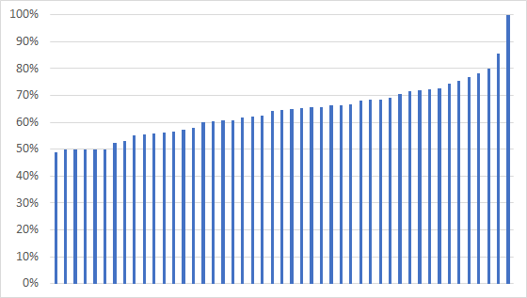
RY 2020 YTD Results: 80% Exclusion
RY 2020 YTD results (through June) show that only 65% of PPCs are included in the payment program, with only three hospitals having > 80% of PPCs included
HSCRC staff are concerned that the 80% methodology excludes high percent of PPCs in performance period
Staff believes that it is not necessary to restrict PPC measurement beyond the 3M clinical logic with the narrowed down PPC list

Slide 19
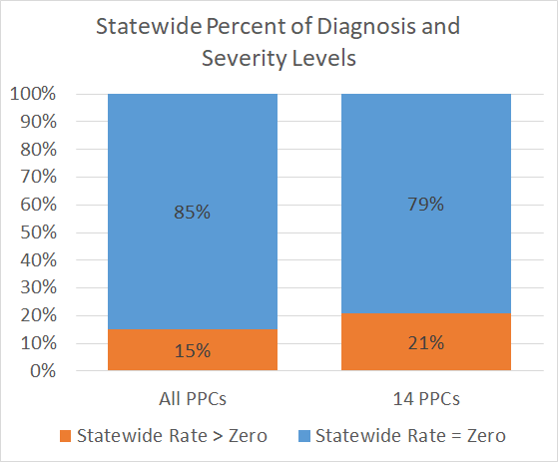
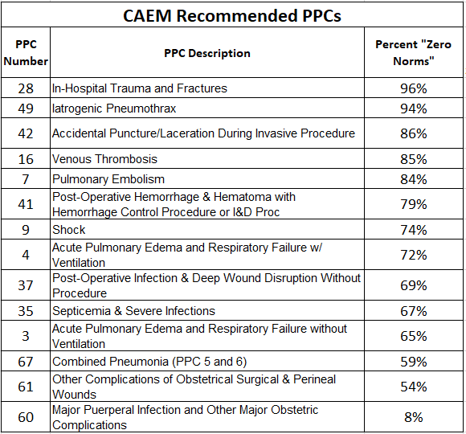
Narrowed PPC list reduces Zero Norm
Staff Recommendation: Remove temporary restriction to APR-DRG SOI and PPCs where 80% of PPCs occur.
Notes:
Handout with rationale
Change title or add text

Slide 20
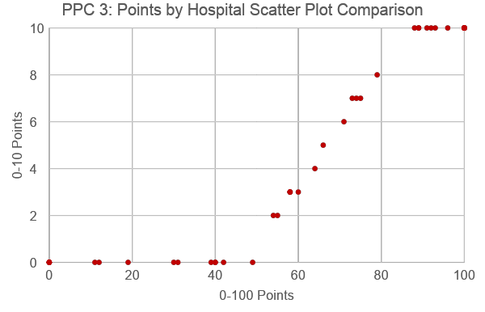
Attainment Only Program
Use wider range of performance standards and more granular points under attainment only approach:
  Proposed approach: Assign 0-100 points based on the 10th and 90th percentile of historical performance
The wider threshold and benchmark differentiates hospital performance at the lower and upper ends

Slide 21
Current RY 2021 Modeling
PPC Grouper v35
CY 2016 is used to calculate normative values and performance standards
Performance period: April 2017 to March 2018
Three models all using narrowed down PPC list and 3M cost weights:
  Model 1: Current threshold and benchmark, 0-10 points, improvement and attainment
  Model 2: Current threshold and benchmark, 0-10 points, attainment only
  Model 3: Expanded performance standards attainment only
Notes:
Actual RY 2021:
Update to v36 of PPC grouper
Base period FY 2018 (July 2017 - June 2018)
Performance period CY 2019

Slide 22
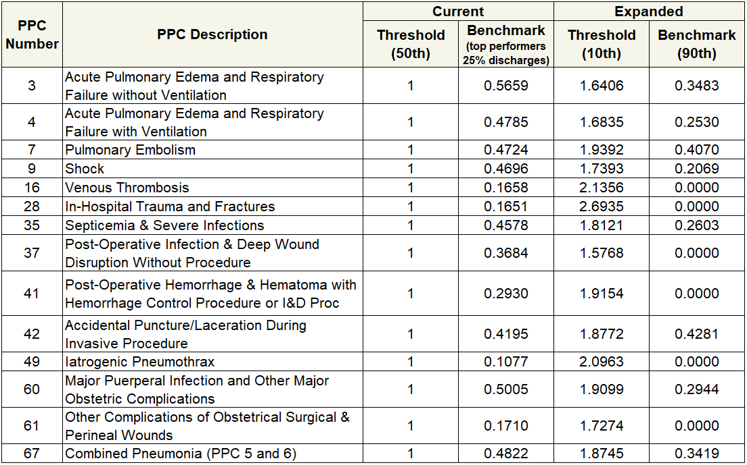
Thresholds and Benchmarks

Slide 23
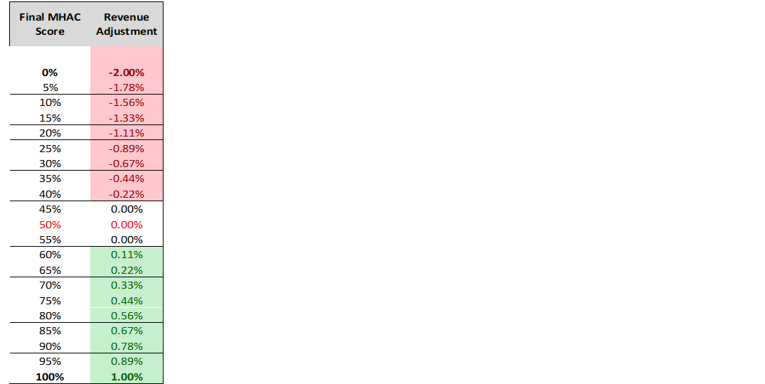
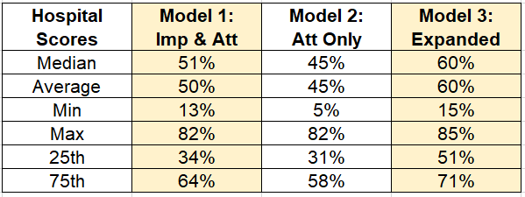
Hospital Scores &
Revenue Adjustments
Hospitals continue to want a prospective revenue adjustment scale that does not relatively rank hospitals
Current scale is based on mathematical range of scores from 0% to 100%, with a “hold harmless zone” between 45% and 55%
Linearly scales penalties and rewards, with a max penalty of 2% and max reward of 1% of inpatient revenue
How should revenue adjustment scale be modified to reflect higher scores under expanded scoring methodology?

Slide 24
Discussion: Where to move cut-point under 0-100 Scoring Methodology?
Cut-point must be greater than 50%; likely below 80%
Options:
  Apply change in average scores (base to perf) to determine cut-point
    20% incr. in average score would increase 50% cut-point to 60%
  Calculate attainment only scores using 2013 norms and performance standards, calculate with 30% improvement, average the attainment-only scores to generate cut-point
  Calculate O/E ratio for each PPC at selected percentile of statewide performance for rewards and calculate score
    50th percentile of base on all PPCs = 56% hospital score
    75th percentile of base on all PPCs = 79% hospital score

Slide 25
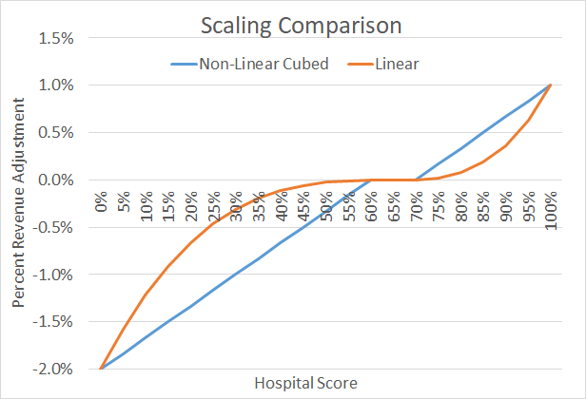
Policy Considerations
Continuous Incentives
Focus on Outliers
Non-Linear Scaling of Penalties and Rewards
Notes:
Put policy issues
Imprecision in measurement
Incentvies being continuous
Focus on outliers

Slide 26
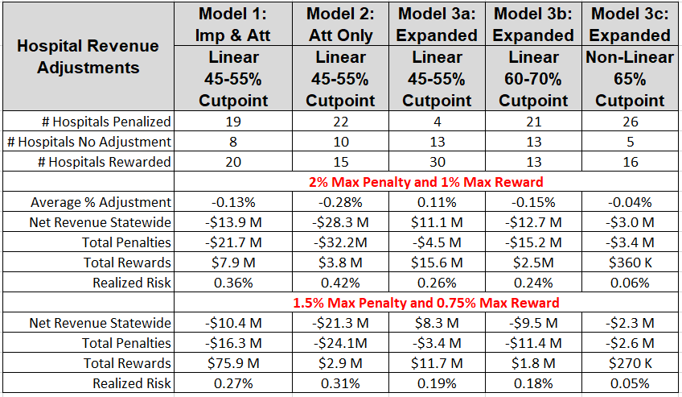
Revenue Adjustment Modeling

Slide 27
RY 2021 MHAC Draft Recommendations
Staff Recommendations:
Include 14 PPCs in payment program; monitor other PPCs
Move to attainment only measurement with more granular scoring methodology
Weight PPCs in payment program by 3M cost weights
PMWG Discussion to inform:
Set max penalty at 2% and max reward at 1% and use continuous non-linear scaling with a 65% cutpoint
Max Penalty | Max Reward | Cut Point or Hold Harmless Zone | Scaling Option
-2.0% | 1.0% | 60-70% | Linear
-1.5% | 0.75% | 60-70% | Linear
-2.0% | 1.0% | 65% or other calculated cut-point | Non-linear

Slide 28
Potentially Avoidable Utilization (PAU)

Slide 29
Timeline
PAU savings policy is approved by Commission at the same time as the update factor (June preceding rate year).
  Different from other quality policies that are approved before the performance period
In order for hospitals to monitor performance during the performance period, staff is building reporting to reflect potential staff recommendations for RY2020 and RY2021
  However, no decisions are final until approved by Commission.
PAU Savings Timeline | RY2020 | RY2021
Performance | Jan 2018-Dec 2018 | Jan 2019-Dec 2019
Commission Approval | June 2019 | June 2020

Slide 30
Potential changes for RY2020 Reporting
(CY 2018)
Keep RY19 measures but count readmission revenue for the sending hospital instead of the receiving hospital.
Staff plans to produce CY18 final reports with both old and new methodology

Slide 31
Potential changes for RY2021 Reporting (CY 2019)
Summary of reporting changes under consideration:
  Change to readmissions at the sending hospital
  Add pediatric avoidable admission measures
  Implement per capita approaches for PQIs and readmissions
Staff aiming to produce updated reporting in early 2019 so input in the next month or so is critical.
  Again, no RY2021 measure changes are final until approved by Commission

Slide 32
Review of per capita options
Geographic
  Attributes PQIs and population to one or more hospitals based on patient residence and hospital service areas, regardless of which hospital treated the PQI
Direct
  Attributes PQIs to hospital that treated the PQI, if the patient’s residence is in the hospital’s service area. Attributes population based on hospital service areas.
Provider/Geography (aka MPA)
  Attributes patients and corresponding PQIs to hospitals based on outside algorithm. Remaining PQIs attributed to hospitals based on geography

Slide 33
Provider/Geography Attribution Approach
Stakeholder interest in using patient-provider-hospital relationships to help attribute PQIs
Medicare Performance Adjustment (MPA) is the only HSCRC methodology currently linking patients to providers to hospitals
  MPA attributes Medicare beneficiaries to primary care providers based on primary care use, and then links providers with hospitals based on existing relationships
    Those not linked to a primary care provider are attributed based on geography (<15% of PQIs)
Could envision similar approaches for other payers, but do not currently have existing mechanisms/data

Slide 34
PQI Per Capita Reporting: Staff Assessment
For PQIs/PDIs, use Provider/Geography approach
Rationale
  May help align hospital efforts across programs
    Focus on the same population
  Reduces overlapping responsibility
  May be more actionable for hospitals
  Keeps geographic approach for pediatric patients
Data/Logistical Concerns
Different attribution for different payers Case-mix and CCLF data (MPA data source) may not tie together exactly Reliant on MPA attribution Any changes to MPA attribution would impact PAU Revised MPA attribution likely not finalized until after January

Slide 35
Adult PQI modeling
Modeling (table below) shows 2017 adult PQIs attributed under the Provider/Geography approach:
  Medicare FFS PQIs and population are attributed to hospitals using MPA
  Then non-Medicare FFS PQIs and population are attributed to hospitals using geographic approach
Total adult PQI per capita would be used as the performance measure, but additional per capitas are presented for reference
Over 50% of all 72,664 Maryland adult PQIs in 2017 could be attributed to a hospital through the RY2020 MPA.
2017 | PQIs | Adult Population | Per capita (per 100k)
1. Provider-based (MPA, adult) | 41,560 | 733,162 | 5,669
2. Geographic (adult) | 31,104 | 3,989,727 | 780
Total Adult PQIs | 72,664 | 4,722,889 | 1538

Slide 36
Pediatric modeling
Table below shows modeling for 2017 PQIs/PDIs for the pediatric population using the geographic approach
Using the geographic method, all hospitals would be partially accountable for pediatric patients.
  In contrast in 2017, seven hospitals received more than 50% of all low birthweight and PDI discharges.
 | PQIs/PDIs | Population | Per capita (per 100k)
Total Adult | 72,664 | 4,722,889 | 1538
Total Pediatric | 7,005 | 1,352,020 | 518
Total | 79,669 | 6,074,909 | 1,233

Slide 37
Readmit per Capita Reporting: Staff Assessment to date
If a discharge is both a PQI/PDI and a readmission, count it as a PQI (currently counted as a readmit)
  Statewide, 20% of readmissions were attributed as PQIs.
Attribute non-PQI/PDI readmission to sending hospital if the patient resides in the sending hospital’s PSAP
  Excludes 40% of readmissions that occur outside of the sending hospital’s PSAP
Rationale
Focuses PAU readmissions measure on discharge planning and follow-up within a hospital’s community Direct approach provides greater link to hospitals discharging patients compared to MPA Limited comprehensiveness may be an acceptable tradeoff, especially given all readmissions included in RRIP
2017 Readmit per capita Modeling | Readmits | Population | Per capita
Sending hospital’s PSAP | 33,954 | 6,064,173 | 560
Outside sending hospital’s PSAP | 23,917 | - | -

